Slide 1













EG-2: Divertor and SOL physics
E. Tsitrone, M. Wischmeier, P. Innocente and EG-2 group
13-15/12/2023 DTT-RP 3rd in-person
DTT Consortium (DTT S.C.a r.l. Via E. Fermi 45 I-00044 Frascati (Roma) Italy)

Slide 2
Status : Chapter 3 outline detailed under bullet format
  Waiting for output from Padova meeting for full text writing (note : already > 10 pages limit under bullet format)
  Draft chapter reviewed by EG2 group, comments/questions included here (purple text)
  Overall time sequence of the programme not defined yet

Slide 3
Chapter 3 : outline and general remarks
3.1 Introduction
3.2 Components and diagnostics relevant for divertor and SOL physics
3.3 Divertor and edge physics studies
3.3.1 Single Null optimization and physic in reference scenario
3.3.2 Single Null optimization and physic for ELM mitigation
3.3.3 Operation in Alternative Divertor Configurations
3.4 First wall load
3.5 Plasma Wall Interactions in a full tungsten environment
3.5.1 Plasma Wall Interaction for plasma performance and safety
3.5.2 PWI issues for operations
3.5.3 Future PFC and edge diagnostics enhancements
  Need to check consistency with description in Chap 1
  Needs more focus given ITER new baseline (but timing DTT vs ITER to be consolidated)
  3.5.3 : on EG6 ? Or dedicated sub-section ?

Slide 4
3.1 Introduction
    Power exhaust = major challenge for next step fusion devices
    Main target of DTT (= Divertor Test Tokamak)
  Explore reactor relevant plasma exhaust solutions + integrated core-edge scenario.
  Accompany ITER exploitation
  Set basis for DEMO design
    DTT specifically designed for
  Testing whether the alternative divertor solutions (eg ADC or liquid metals) can be technically integrated and are able to withstand the strong thermal loads in DEMO
  Improving the experimental knowledge in the scientific area of heat exhaust for parameter ranges that cannot be addressed by present devices

Slide 5
3.1 Introduction
  Comment : table to be commented/simplified to outline important parameters for exhaust (+ ref to other parameters overview tables) or suppressed (Chap 1) ?

Slide 6
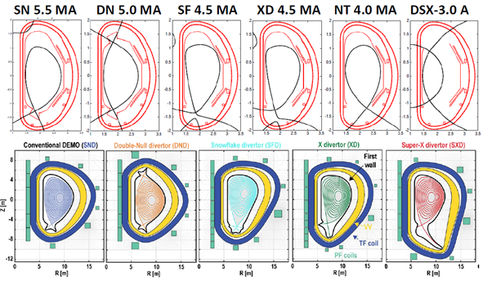
3.1 Introduction
  DTT : flexible configurations (already mentioned elsewhere ?)
Main message : DTT can test SN and most ADC configurations in collisional regimes, magnetic fields and normalized power crossing the separatrix close to those of ITER/DEMO

Slide 7
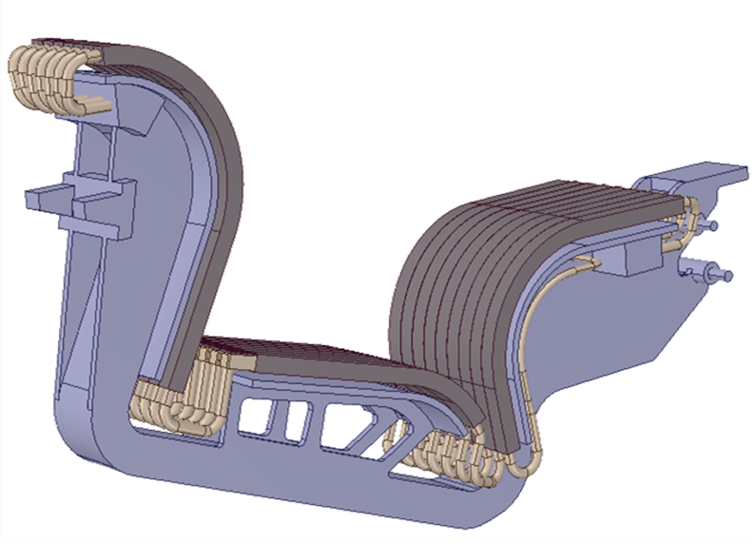
3.2 Components and diagnostics relevant for divertor and SOL physics
Flexible Wide Flat Divertor (WFD) : XD, SF and NT as well as the standard SN and long external leg variants
Angle of incidence (2°), monoblock shaping in both directions (NT)
4 modules as test sectors
Modelling : reasonable performance for seeded plasmas (Zeff~3)
  Ref needed for modelling + more explanation
First wall specs, start up on inner first wall
  Those 2 items deserve more focus with ITER new baseline
Conditioning = baking, GBC, boro, ICWC

Slide 8
3.2 Components and diagnostics relevant for divertor and SOL physics
Day 1
  IR : no view of OVT ?
  He enrichment : how is is assessed ?
  Divertor Zeff ?
  Visible spectroscopy on first wall (important for W erosion / core contamination) ?
  Figure to be added with location of diags + comments on which configuration is optimal or not for diag coverage
Day 2
  LID QMS (ITER ref) ?

Slide 9
3.3 Divertor and edge physics studies
Severity of parallel heat flux defined by PB/R → special role of DTT
Start with SN : current reference configuration for ITER/DEMO + most accessible in terms of control after commissioning
ADCs for parameter studies to assess the physics dependencies (L_ii , BT, Bp → related perpendicular transport))
Access regime in which role of ion vs electron heat channel might change (XCG1 vs Eich scaling) - SOL width at high Bt/Ip : relaxed compared to Eich scaling ?
Insights on enhanced transport at the H→ L threshold following αt
Detailed understanding of role of neutral-neutral collisions and pumping efficiency
He divertor enrichment and pumping - role of first wall intermediate storage of He (adsorption and release by particle erosion (fuel and seed impurities))
Divertor neutral opacity - neutral mfp versus divertor size as a unique feature before ITER/DEMO - to be compared to impact of divertor/dome geometry
Existence of natural baffling of neutrals at high ne (Open vs closed divertor)
Atomic and molecular processes with divertor neutral pressures similar to those expected in ITER/DEMO - comparison to findings from AUG/WEST/JET and TCV/MAST-U
Validate SOL numerical models
  Mention more clearly He/impurity enrichment/compression
  Mention highly radiating regimes (XPR)

Slide 10
3.3 Divertor and edge physics studies
3.3.1 Single Null optimization and physic in reference scenario
    Milestones:
  Establish SN operation with a low W level
  Establish reliable detached operation with impurity seeding in high performance / high radiative scenario positive triangularity H-mode (towards high current and field)
  Characterize divertor/pedestal/core parameters to compare with and validate integrated core-edge codes (TSVV11)
DTT will be as well the ideal test-bed for also GK studies with likely a low nu* at the top of the pedestal➔ physics understanding of the transport across the pedestal might be performed also informing TSVV1

Slide 11
3.3 Divertor and edge physics studies
3.3.1 Single Null optimization and physic in reference scenario
  Steps to achieve milestones:
  Test initially at low power and then at high power
  Start in L-mode to allow and easier characterization of SOL plasma and then move to H-mode
  Investigate heat flux mitigation techniques by strike point sweeping
  Assess to the detachment by density variations and impurity seeding
  Comparison between partial-detachment full detachment in terms of plasma performance
  Optimization of impurity mixing for the better core-edge plasma scenario
  Study the effect of gas fuelling and seeding location

Slide 12
3.3 Divertor and edge physics studies
3.3.1 Single Null optimization and physic in reference scenario
  Steps to achieve milestones
  Compare gas fuelling methods for various physics purposes (SMBI, pellets, regular gas valves)
  Study role of ratio of inner to outer diverter parallel connection length on inner versus outer target heat flux deposition
  Use the capability to locate strike point on dome to investigate role of total flux expansion (as a function of R)
  Development and testing of real time control methods for detachment control using available sensors/actuators to optimize performance of DTT
Ordering needed, either by scientific priorities or eventually by time (with the reasonable timeline of scenario development)
Better define what ref SN scenario is (connexion length …)
Move bullet on flux expansion to 3.3.3 (ADC) ?

Slide 13
3.3 Divertor and edge physics studies
3.3.2 Single Null optimization and physic for ELM mitigation
      Milestones:
  Development of no ELMs scenario and divertor characterization in these regimes (cf 3.3.1)
  Steps to achieve milestones:
  Study EDA, QCE and XPR
  Focus on QCE and XPR
  Use of RMPs (3D effects)
  Priority of no ELMs scenario to be discussed with EG.

Slide 14
3.3 Divertor and edge physics studies
3.3.2 Operation in Alternative Divertor Configurations
DTT specifically designed to study the capability of a large set of ADC
Most promising ADC can be accommodated + associated physics explored : flux flaring towards the target (XD), increasing of the outer target radius (Super-X), secondary x-point inside the vessel (X-point target), entire range of SnowFlake (SF), Double Null (DN) and NT (L mode of interest)
Not all configurations can be explored at full current / power

Slide 15
3.3 Divertor and edge physics studies
3.3.2 Operation in Alternative Divertor Configurations
Milestones:
  Establish reliable detached plasma operation in XD and its long leg variant with reasonable performance
  Realize integrated core-edge optimization for previous configurations
  Establish reliable detached plasma operation in negative triangularity SN configuration
  Study the possibility to achieve stable detached regime in the most interesting ADCs configuration
  Test Snowflake configuration
  Investigate particle exhaust (specifically He) in ADCs
Sequence = XD, NT, SF to be discussed with other EG

Slide 16
3.3 Divertor and edge physics studies
3.3.2 Operation in Alternative Divertor Configurations
Steps to achieve milestones:
  XD and long leg variants configurations will be studied initially at low power and then at high power.
  The XD access to the detachment studied for different positions of the second null as well for various distances between the first and secondary separatrix
  Study XD stability on respect the position of recombination front (at different flux expansion and seeding level)
  Study the possibility to directly build-up the XD configuration starting from the limiter one and combining it with detachment before L-H transition
  Characterize ELM behaviour and power spread on divertor for the XD configuration
Bullet 4 to be added also in SN

Slide 17
3.3 Divertor and edge physics studies
3.3.2 Operation in Alternative Divertor Configurations
Steps to achieve milestones:
  Characterize ELM behaviour and power spread on divertor for the XD configuration
  Perform particle exhaust studies to optimize He pumping in XD configuration
  Study negative triangularity configuration in terms of power exhaust and set-up detached condition compatible with good core performance
  Negative triangularity core experiments must be complemented by power exhaust ones to optimize plasma detachment in presence of probably lower separatrix density but higher edge transport
  Perform particle exhaust studies to optimize He pumping in neg. triang. configuration

Slide 18
3.3 Divertor and edge physics studies
3.3.2 Operation in Alternative Divertor Configurations
Steps to achieve milestones:
  Although at low priority, SF experiments should be done evaluating their detachment parameters together with their vertical stability
  Complete plasma scenario must be developed for each valuable ADC from ramp-up to ramp-down keeping fixed the strike points in the diverted phase
Bullet 12 to come earlier ?

Slide 19
3.4 First wall loads and far SOL physics
  Milestones:
  Ramp up optimization to avoid W influx / minimize heat loads
  Radiation, cx fluxes/energies on FW during ramp up/flat top / ramp down need to be assessed
  Far SOL plasma characterization / turbulent SOL transport of different scenarios (ELMy, mitigated ELMs, ELM-free) and different divertor configurations and their impact on FW loads
  Impact of SN vs ADC on first wall loads and erosion
  Disruption / ELMs heat loads on FW
  3D effects (RF systems, discrete limiters …)
  power and energy balance including first wall loads
First wall diag coverage to be checked to see what is achievable
Transient loads (ELMs/disrutions) to be also mentioned in chapter 3.3
NB : fast particle losses (ripple/NBI shine through not mentioned here as covered in Chap 6 on heating systems)

Slide 20
3.5 Plasma Wall Interactions in a full tungsten environment
Governing PWI : key for operating a future reactor successfully.
Impact on plasma performance (avoid plasma pollution and provide adequate wall conditioning), reactor maintenance (maximize PFC lifetime and ensure PFC protection) and safety (minimize fuel retention and dust production).
Tungsten = most promising material for DEMO and... and ITER (new baseline)
DTT = unique opportunity to study PWI in a full W environment with relevant heating power and ADCs.
In addition, DTT has test divertor modules with which advanced materials and cooling schemes can be tested
This section :
PWI for plasma performance and safety: W influxes, penetration, core transport, material migration, fuel retention and recovery, dust production.
PWI linked to operational issues : wall conditioning and PFC protection
Test of advanced materials and components for divertor and first wall
Definition of material migration vs impurity transport to be clarified
More focus on first wall technology (W coating vs W bulk …) + full W vs W limiters & recessed stainless steel

Slide 21
3.5 Plasma Wall Interactions in a full tungsten environment
3.5.1 Plasma Wall Interaction for plasma performance and safety
      Milestones:
  Assess W influxes, screening, core penetration ➔ impact on plasma performance
  Characterize material migration (net erosion/deposition pattern) ➔ impact on PFC lifetime
  Investigate D, He and neutrons induced W morphology changes ➔ impact on PFC lifetime and PWI
  Assess fuel retention/ recovery + dust production ➔ impact on safety for next step fusion devices
  Validation of PWI codes for extrapolation to next step devices : local W migration for erosion/redeposition (ERO) + global impurity transport, global material migration/ fuel retention codes (such as WALLDYN)
Check consistency with Chapter 4 on impurity transport (W)
Add operational aspect of deposited layers after long pulse/ high fluence hampering operation ?

Slide 22
3.5.1 Plasma Wall Interaction for plasma performance and safety
Steps to achieve milestones:
  W erosion
  Quantitative evaluation of W influxes from main chamber and divertor for different plasma scenarios and divertor configurations
  Comparison of W penetration/shielding/retention and relative weighting of divertor and main chamber for different plasma scenarios and divertor configurations
  Comparison of W transport in edge and core plasma for different plasma scenarios and divertor configurations
  Comparison of W migration pathways between SN and ADC, in particular in terms of W net erosion (PFC lifetime) and W core concentration (plasma performance).
  Start in L mode SN and ADC, then H mode with assessment of W erosion inter vs intra ELMs (diag capabilities to be checked. How well does visible spectro covers all configurations ?)

Slide 23
3.5.1 Plasma Wall Interaction for plasma performance and safety
Steps to achieve milestones:
  Fuel retention
  Assessment of fuel retention in a full W environment (long pulse required > 30s (to be checked) for particle balance accuracy)
  Comparison of fuel recovery efficiency of baking / GDC / ICWC / ECWC (feasibility to be checked)
  Diag : is LID QMS planned (ITER ref during plasma ops) ? LIBS from day 2 only (ITER : during shutdown only) ?
  Material morphology changes
  Assessment of material properties changes under D (blistering ...) and He operation (nanostructures, fuzz ...) and potential impact on PFC power handling performance.
  Impact of neutrons (if applicable, level of dpa to be checked)
+ impact of boronisation
For fuel retention, level of flux/fluence to be checked in addition to pulse length. Removable samples and components are of primary importance in addition to LID QMS/LIBS
Dpa level probably not significant compared to ITER/DEMO : to be suppressed ?
Dust production to be added

Slide 24
3.5.2 PWI issues for operations
  Wall conditioning = key for plasma performance in full W devices (most full high Z machine operate with regular low Z conditioning : Cmod, AUG, WEST, EAST with B and/or Li...)
  Wall protection : crucial when running with actively cooled components. Full W environment = reflections + emissivity changes, making IR interpretation challenging both for physics and machine protection
      Milestones:
  Develop wall conditioning methods in a full W environment
  Demonstrate efficient wall protection solutions

Slide 25
3.5.2 PWI issues for operations
  Steps to achieve milestones:
  Wall conditioning
  Try to start wo/w boronization (w/o boronization : for ref shots w/o B in the machine) ? To be discussed with other EG
  Monitoring of plasma recycling (main fuel), intrinsic impurities (O in particular) + seeded impurities as function of conditioning used (baking, boronization, overnight GDC, ICWC/ECWC) and configuration (SN vs ADC)?
  Optimize conditioning in view of reactor operation.
  Real time wall conditioning (boron dropper)?
Starting w/o boronization : not sure whether this is really meaningful .
This is a matter of cost (experimental time) / benefit (ITER seems to go for boronisation anyway)
Add also a word on management of deposited layers in long pulse device (cleaning by plasma or during shutdown …) ?

Slide 26
3.5.2 PWI issues for operations
  Steps to achieve milestones:
  Wall protection
  Dedicated experimental time for testing machine protection schemes in early phase
  Procedure needed for monitoring W emissivity changes
  Use of AI to handle a large number of camera views / ROI ?
W emissivity : 2 wall temperature possible (cf WEST method) ? Or other method (cf AUG sanded W) ?
Use of AI to be better defined

Slide 27
3.5.3 Future PFC and edge diagnostics enhancements
To be discussed with EG6 / Chap 9 technology development
      Milestones:
  Use of divertor test modules to test advanced W materials and components / PWI diagnostics
  Define optimized divertor towards a specific ADC solution
  Steps to achieve milestones:
  Dedicated programme with divertor test sectors implementing for instance :
  Markers for dedicated erosion/redeposition studies
  Dedicated components for D-retention measurements
  Diagnostics for detachment control and heat flux measurement : high risk of failure diagnostics (like Langmuir probes/QMBs ...) for a faster replacement
  Dedicated experiments/modeling for new optimized divertor
  Large scale test of advanced W materials and components (alloys ...) ?
  Divertor upgrade (optimized shaping, non MB technology …) ?
  Optimization of divertor geometry towards a specific ADC solution
  Installation of upper divertor consistent with the lower ADC
  Exploratory experiments on liquid metals
+ diag coverage
are the modular divertor test sectors suitable for such LM tests?

