Slide 1
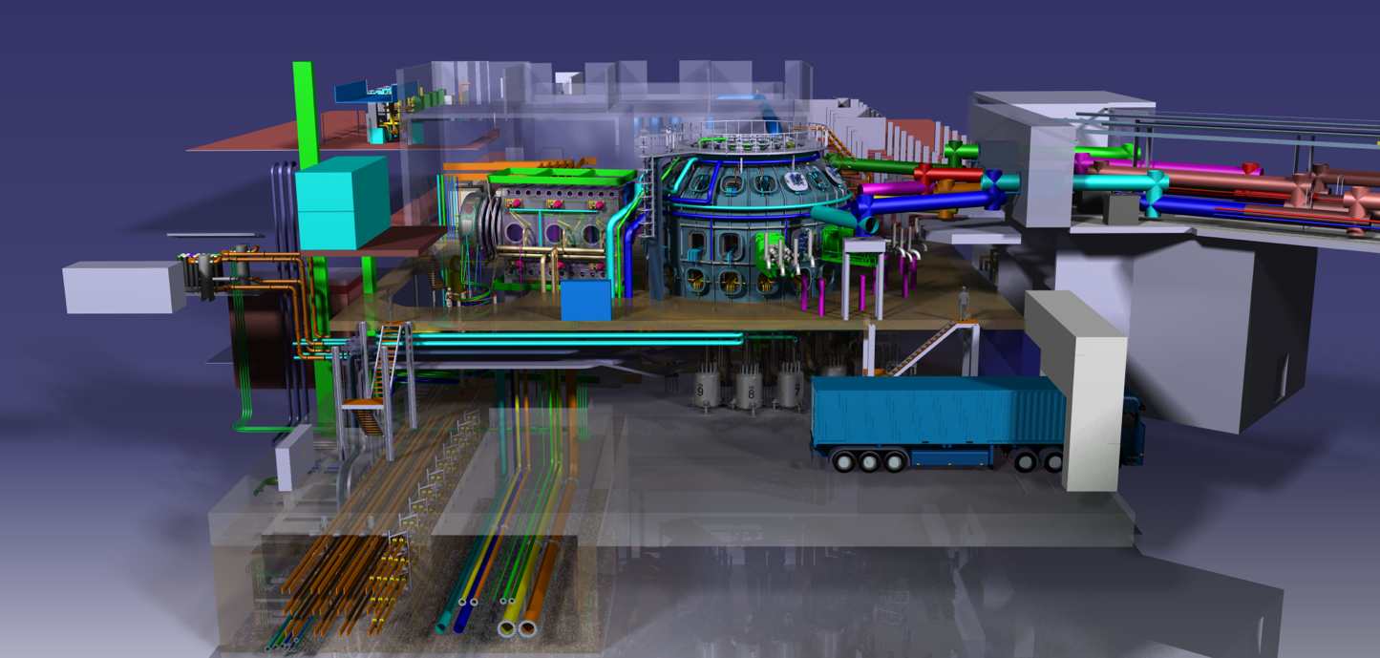
3rd DTT-RP Team meeting
DTT-RP Chapter 1
DTT Power Exhaust Strategy
F. Crisanti, G. Giruzzi, P. Martin

Slide 2
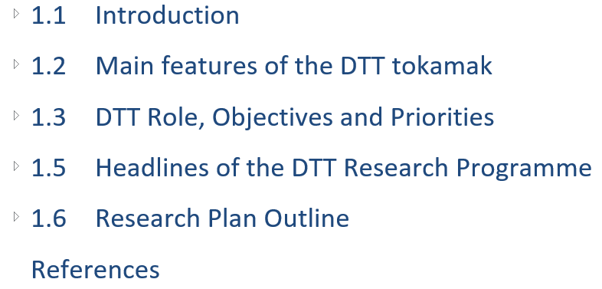
Chapter 1 contents

Slide 3
Chapter 1 : rationale
Starting point: the problem of plasma exhaust for fusion reactors
pointing out that it is not just an issue of PFC and materials, but also of core-edge integration
→ concepts used for DTT design, based on dimensionless scalings and ITER similarity
Short description of DTT features, main parameters and magnetic configurations, compared with ITER and EU-DEMO
What is possible to do with DTT (before, in parallel with and in support of ITER)
Among the possible objectives, which ones are considered as the main ones and in what priority order
How the objectives are pursued in a logical timeline, taking into account the sub-systems evolution (heating, PFC, diagnostics, etc.)
→ Description of DTT programme phases in connection with ITER and with DEMO design
Headlines of the DTT Research Programme → experiments adapted to the machine conditions during ~10 years (and beyond)

Slide 4
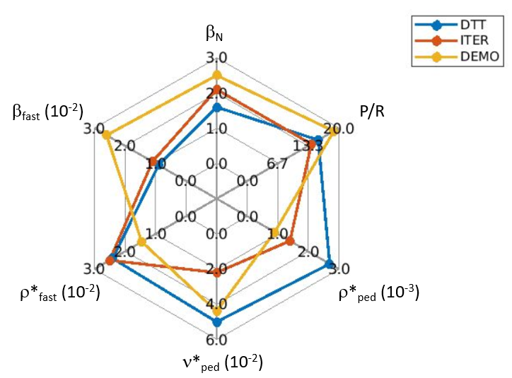
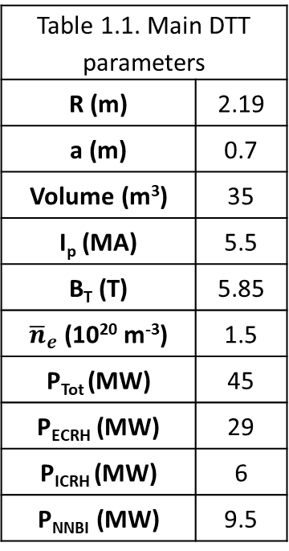
1.2 Main features of the DTT tokamak /1
issues of core-edge integration
concepts used for DTT design
DTT main parameters vs ITER & DEMO
Table 1.1. Main DTT parameters
R (m) | 2.19
a (m) | 0.7
Volume (m³) | 35
I_{p} (MA) | 5.5
B_{T} (T) | 5.85
${\overline{n}}_{e}$ (10²⁰ m⁻³) | 1.5
P_{Tot} (MW) | 45
P_{ECRH} (MW) | 29
P_{ICRH} (MW) | 6
P_{NNBI} (MW) | 9.5
Table 1.2. DTT important parameters versus the ITER and DEMO ones.
 | DTT | ITER | EU-DEMO 2018
Psep/R [MW/m] | 15 | 14 | 18.9
β_{N} [%] | 1.6 | 2.1 | 2.5
ρ* at mid-radius [10^{–3}] | 3.8 | 2.0 | 1.5
𝜈* at mid-radius [10^{–2}] | 1.2 | 0.3 | 0.3
ρ* at pedestal [10^{–3}] | 2.7 | 1.4 | 0.8
𝝂* at pedestal [10^{–2}] | 5 | 2.2 | 4.4
q₉₅ | 3.0 | 3.2 | 3.89
n_{GW} [10²⁰ m⁻³] | 3.6 | 1.2 | 0.66
Please check data in these tables and in the spider plot → coherence with the other chapters

Slide 5
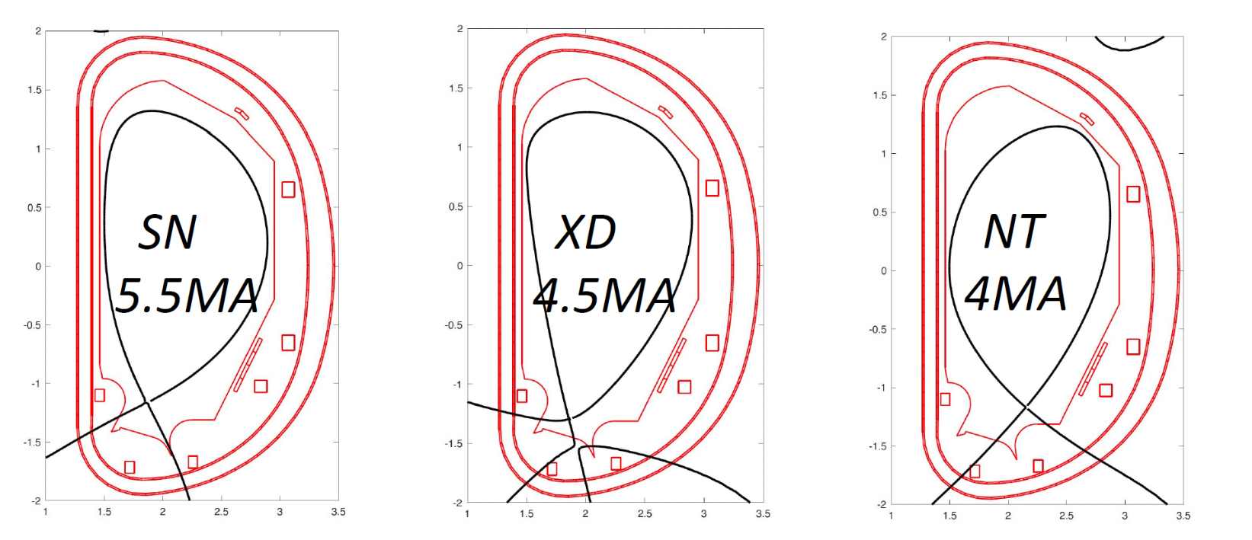
1.2 Main features of the DTT tokamak /2
Short description of heating systems
DTT features and possible magnetic configurations
Please check whether these configurations are the most recent ones → coherence with the other chapters

Slide 6
1.3 DTT Role, Objectives and Priorities
Test the role played by different magnetic configurations, combined with the local divertor radiation, to minimize the power flux to the divertor
Use of the test divertor modules to study divertor materials, shaping, cooling etc.
Propose a reliable, robust and experimentally validated divertor concept for DEMO
Enhanced connections with ITER programme because of the recent change of ITER first wall and increase of ECRH power →
Discussion of DTT role in support of ITER operation (disruption avoidance & mitigation etc.)
Discussion of DTT role complementary to JT-60SA, when operated at half field and current
Additional objectives, in particular, fast ion physics studies (essential for core-edge integration and ITER/DEMO similarity)
Review of DTT unique contributions (as in the Facility Review slides)
Review of DTT important contributions (as in the Facility Review slides)
Objectives associated with long term evolutions (second divertor, liquid metals)

Slide 7
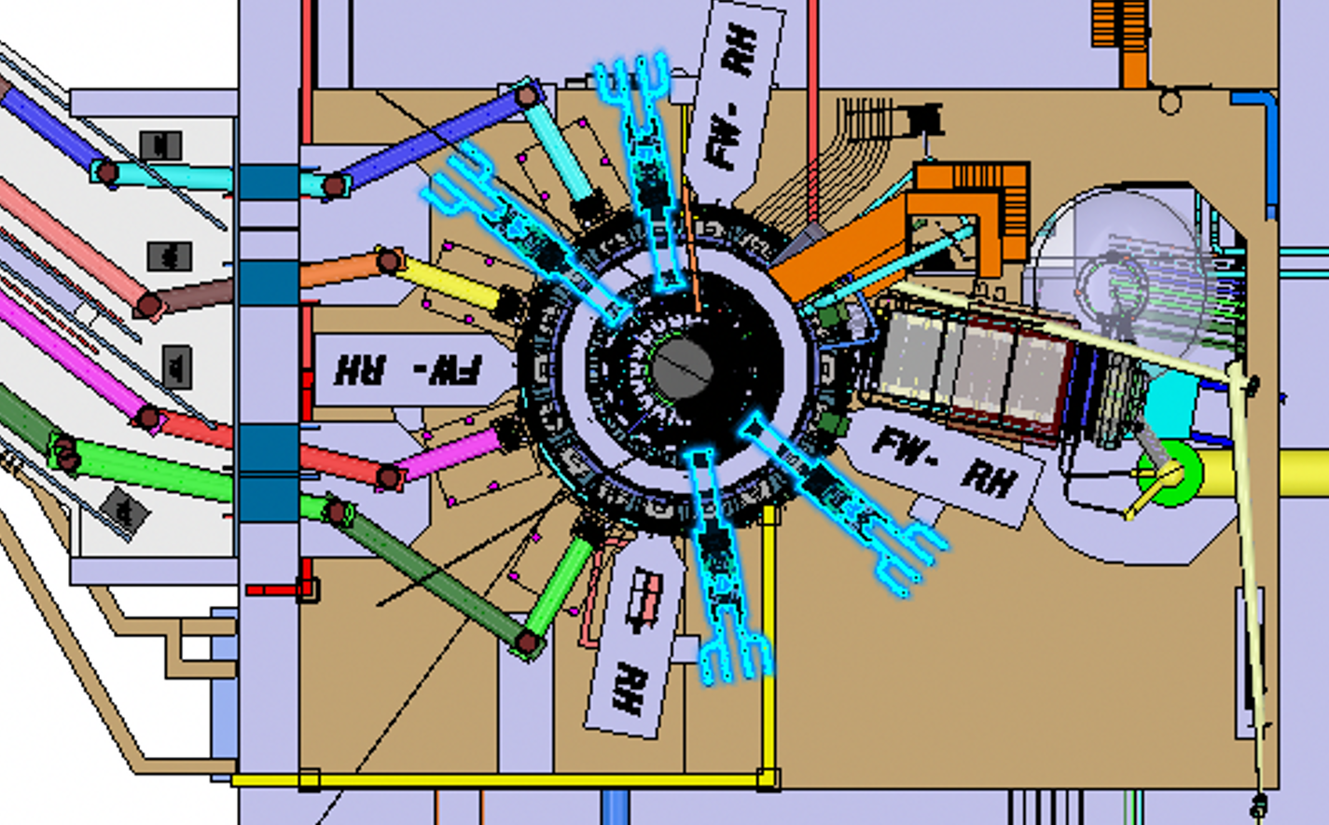
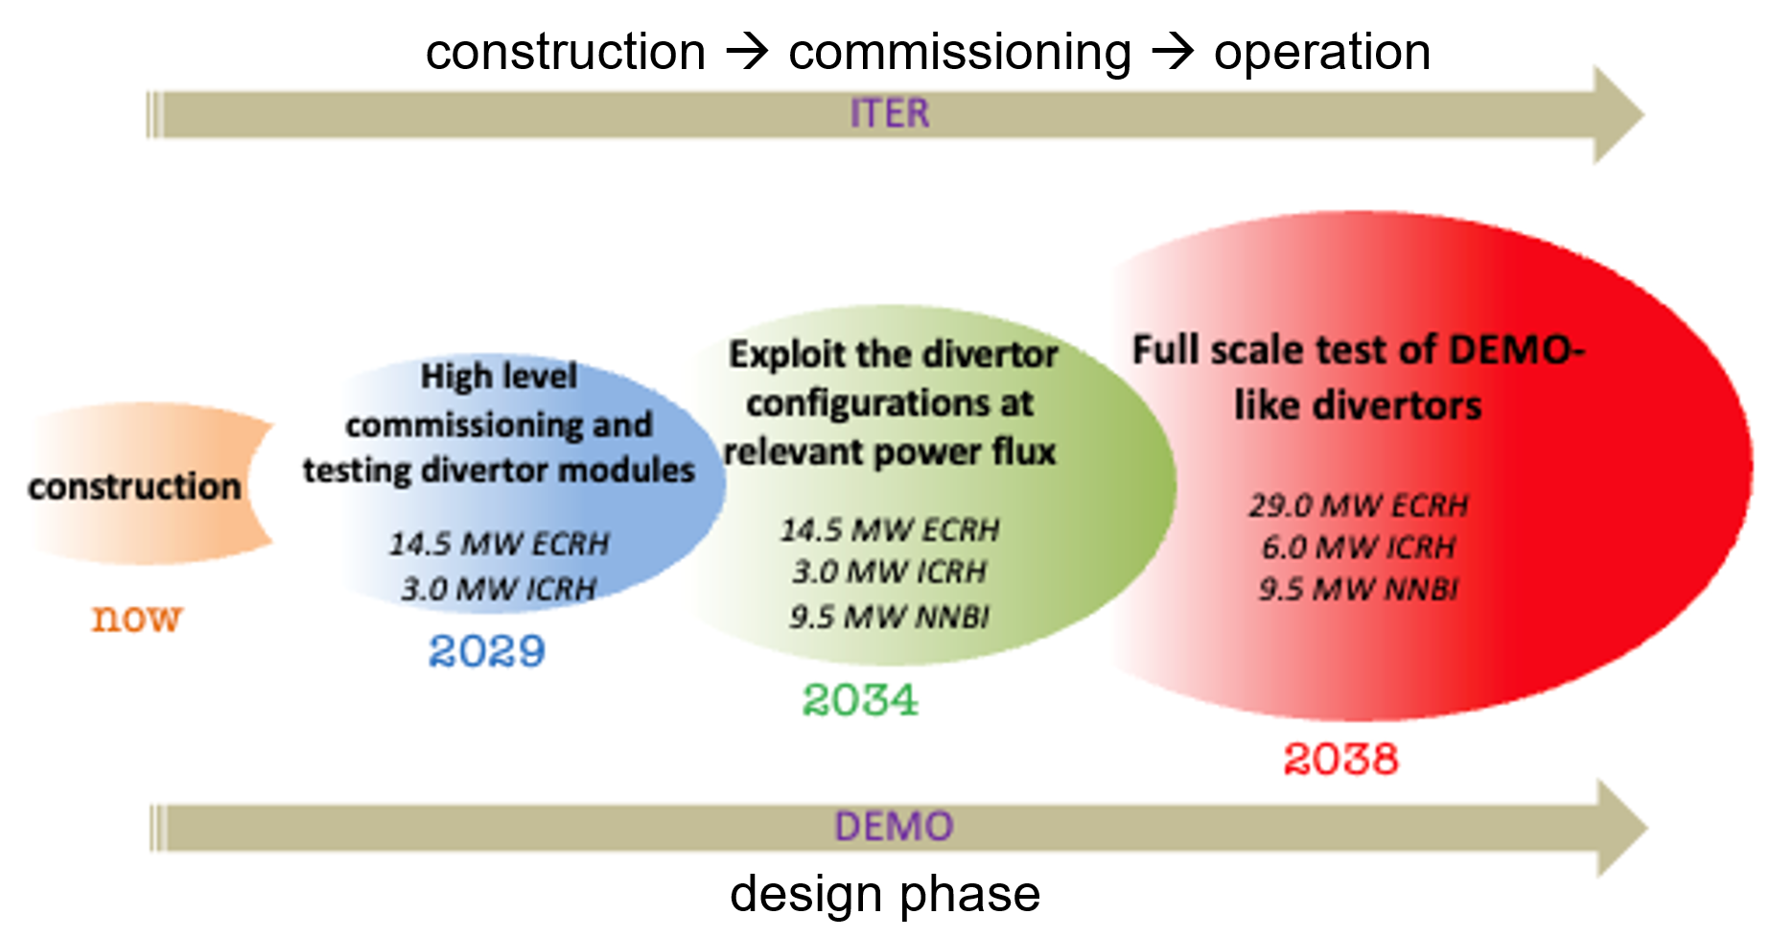
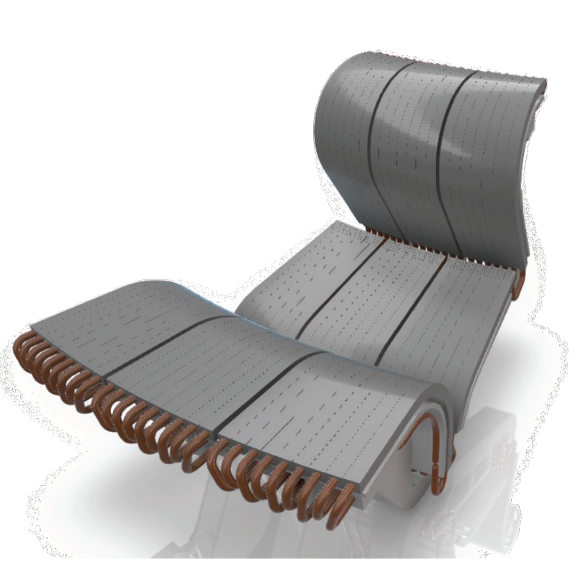
1.4 DTT Research Phases and evolutions
Construction phase → input from the DTT-RP to final design and definition of sub-systems (in particular diagnostics )
First phase (commissioning & beyond) → scientifically exploitable first plasma. Validating operation at the main technical parameters. First use of divertor test modules.
Second phase → power increase and test of actively cooled divertor under very large power flux, in SN, XD and NT configurations
Third phase → nominal power allows full scale test of a DEMO-like divertor solution (magnetic topology, divertor shape and material)

Slide 8
1.5 Headlines of the DTT Research Programme
Programme headlines = primary objectives, attainable with the machine characteristics
They depend on machine capabilities in the various phases → each phase can contribute !
Construction phase → contribution to analogous phases of ITER and DEMO. Possible common work with DEMO design team
First phase (commissioning & beyond) → identify the most critical components and the most robust tests to be performed, in support to ITER commissioning. Exploit programme at reduced field and current. Disruption studies.
Second phase → extensive test of magnetic configurations, with respect to performance, divertor compatibility and disruptions
Third phase → confirm selection of best configuration and scenarios at full power. Decide long term evolutions (liquid metals ?)
Note: various generations of test divertor modules will be used in all the phases

Slide 9
What is missing
This first draft of Chapter 1 is intentionally synthetic and shorter than 10-15 pages, in order to include input by all the ROs and connected to what is developed in all the chapters
The Headlines section is the one that will be re-written and significantly expanded after the discussions of this meeting
There should be a final table summarizing detailed Headlines (maybe with sub-Headlines) vs operation phases. How to conceive such a table ?
There could also be a table summarizing the experiments that will be useful for ITER and/or for DEMO
Example → next slide
Suggestions

Slide 10
Table format proposal (with examples)
Headlines number | Headlines contents | Priority (+, ++, +++) | Phases | Years | ITER | DEMO
C.1 | Central solenoid desired capabilities | +++ | Construction | now
C.2 | NBI system desired capabilities
C.3 | … (e.g. diagnostics) |  |  |  | * | *
1.1 | ECRH initial system commissioning | +++ | Phase 1 | 2029-2034 | *
1.2 | Magnetic diagnostics commissioning
1.3 | Plasma startup | ++ |  |  | * | *
1.4 | Disruption studies | + |  |  | *
1.5 | …
2.1 | High power level commissioning | +++ | Phase 2 | 2034-2038 | * | *
2.2 | Magnetic configuration comparison at high power |  |  |  |  | *
2.3 | ….
3.1 | Nominal power commission/use |  | Phase 3 | 2038-… |  | *

