Slide 1

Status of the machine design and construction
G.M. Polli ^{(1,2)} and G. Granucci ^{(1,3)} on behalf of DTT team
⁽¹⁾ DTT S.C.a r.l., ⁽²⁾ ENEA FSN Dept. ., ⁽³⁾ CNR ISTP Milan
DTT Technical and Scientific Committee
V meeting
21-22/11/23
Zoom conference
DTT Consortium (DTT S.C.a r.l. Via E. Fermi 45 I-00044 Frascati (Roma) Italy)

Slide 2
….BUT before starting let me thank all of you for the wonderful work you realized
Actually I am really surprised that we have been able to do what we have done.
And I was wondering how we could have been able!?
Eventually, yesterday evening, browsing in Venice I had an inspiration

Slide 3


Slide 4
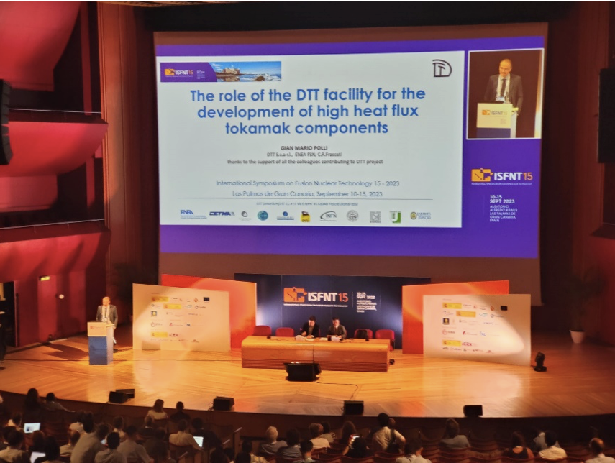
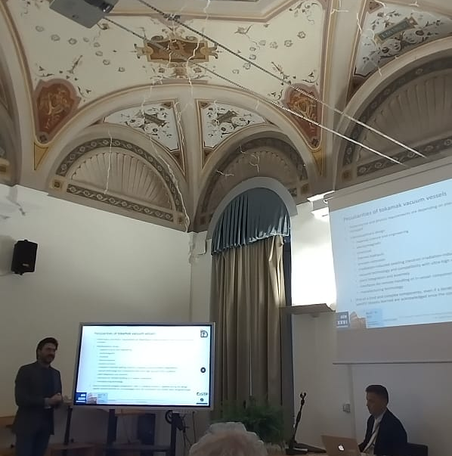
THM News
A large part of THM team participated in two conferences from July:
ISFNT in Las Palmas (10-15 September): a plenary lecture, three oral presentations and several posters
AIV conference in Rome (07-10 November): 6 orals
Newcomers from September:
1 physicist in Diagnostics integration team (S. Palomba)
2 engineers in In-vessel components team (G. De Sano, D. Paoletti)
1 engineer in the integration team (D. Regine)
Next meetings:
Between 4 and 6 of December there will be a technical meeting in Garching within Eurofusion WPDIV-IDTT (PL R. Neu) focused on several THM systems
On 13/12/23 -> EDRM on criogenic system (freezing of parameters, layout, interfaces, scope of supply)

Slide 5

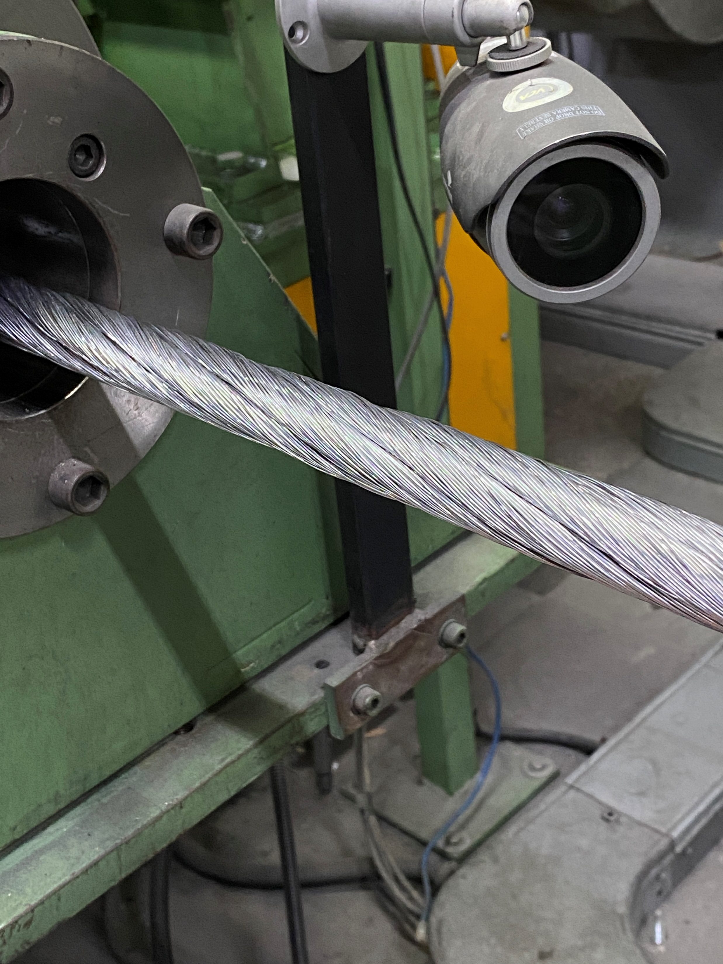
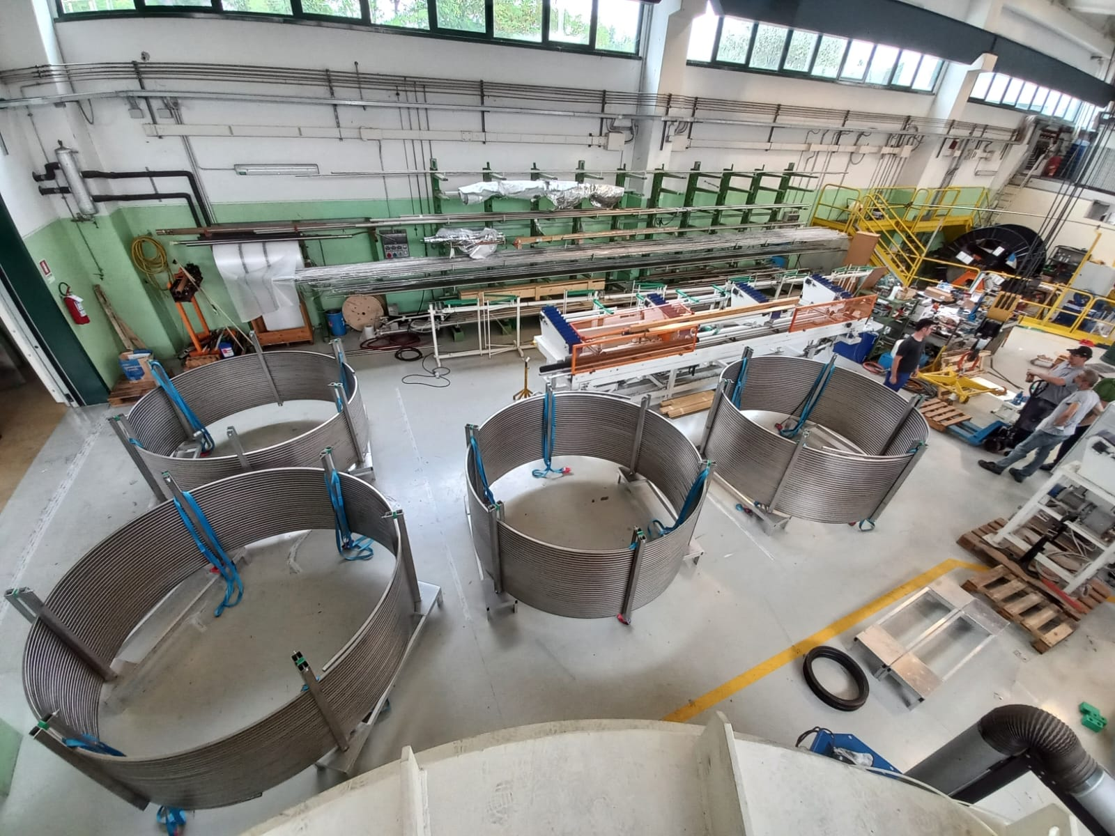
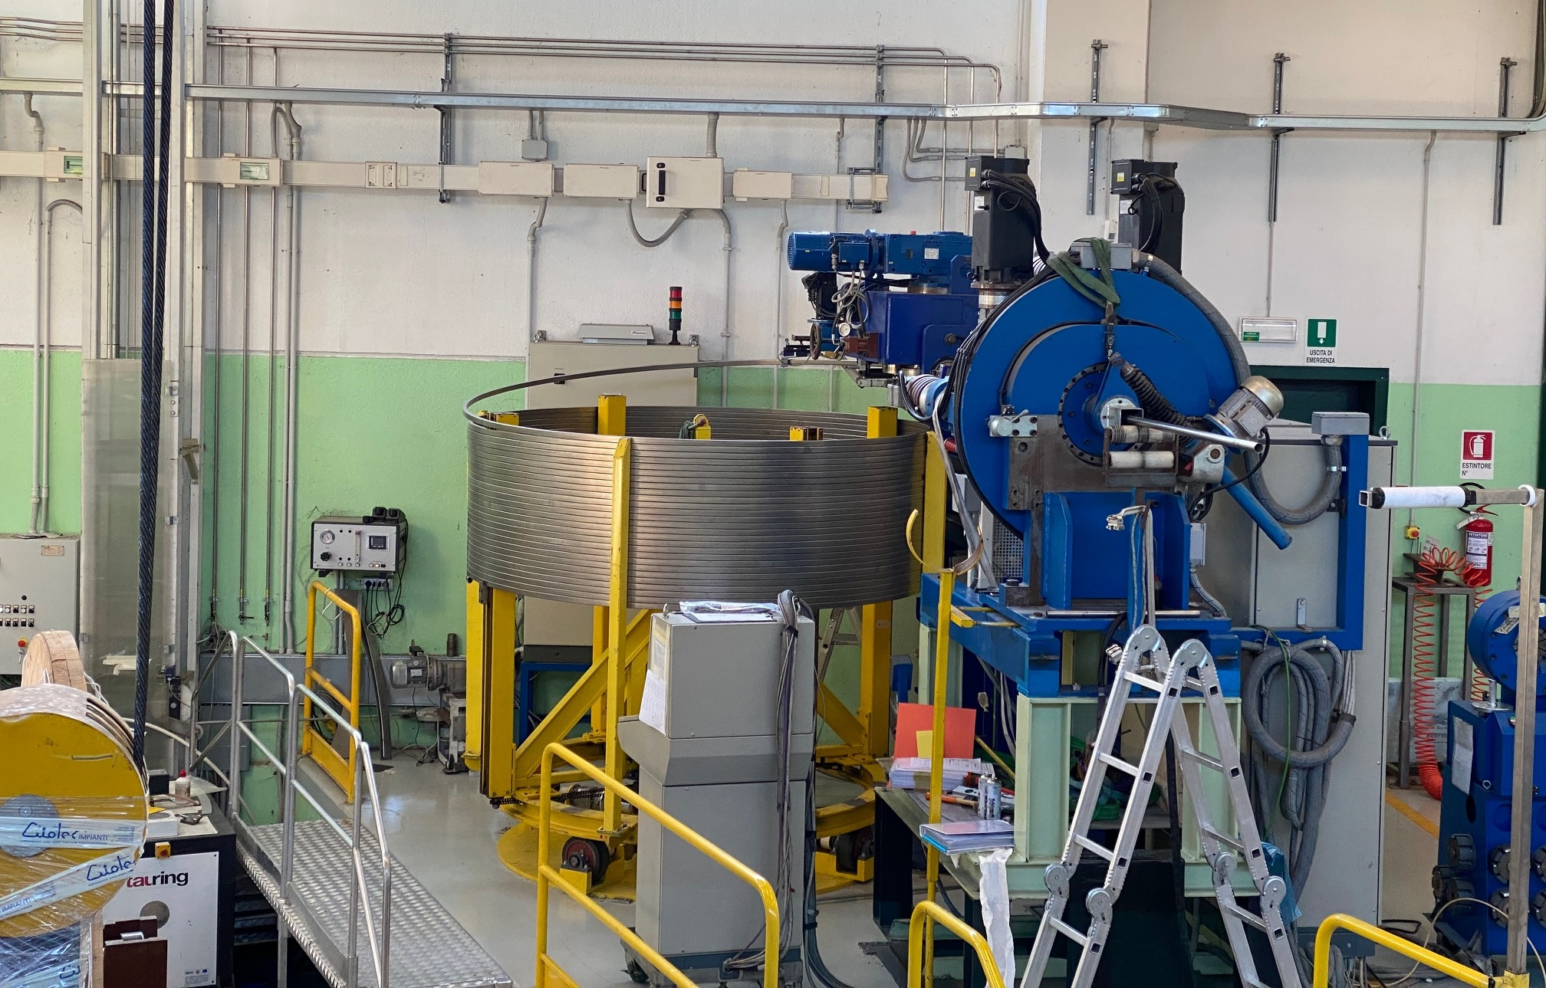
Conductors
WP 5 conductors delivered to ASG on 02/11/23
28 conductor Unit Lengths delivered TF (3 superdummy)
WP 6 conductors under testing (delivery within end of November)
WP 7 conductors in fabrication (delivery within end of December)

Slide 6
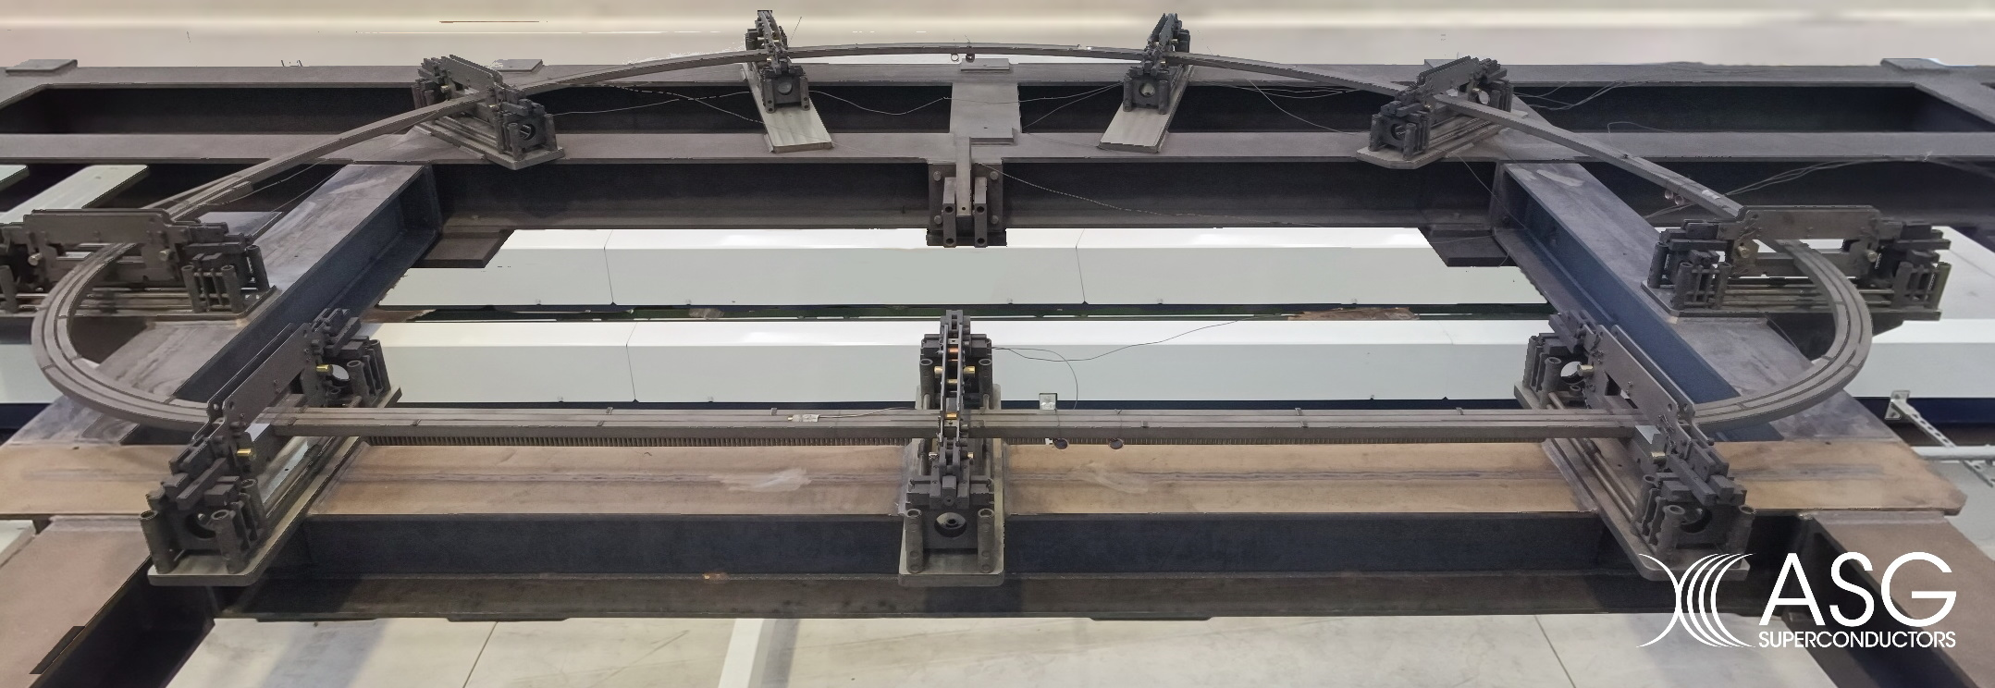
TF coil winding qualification: DP mock-up
A winding trial followed by heat treatment has been successfully completed in September.
Dummy DP under winding phase (qualification to be completed within February 2024) -> if successful the dummy DP shall be the first DP
Production to start at the beginning of 2024.
~4,6 m

Slide 7
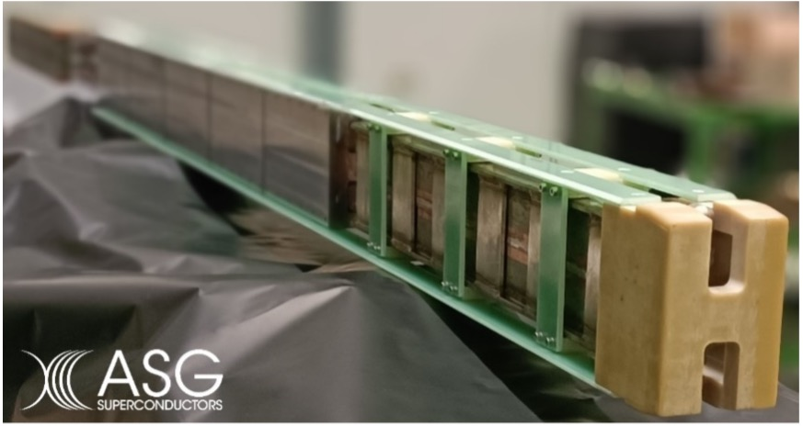
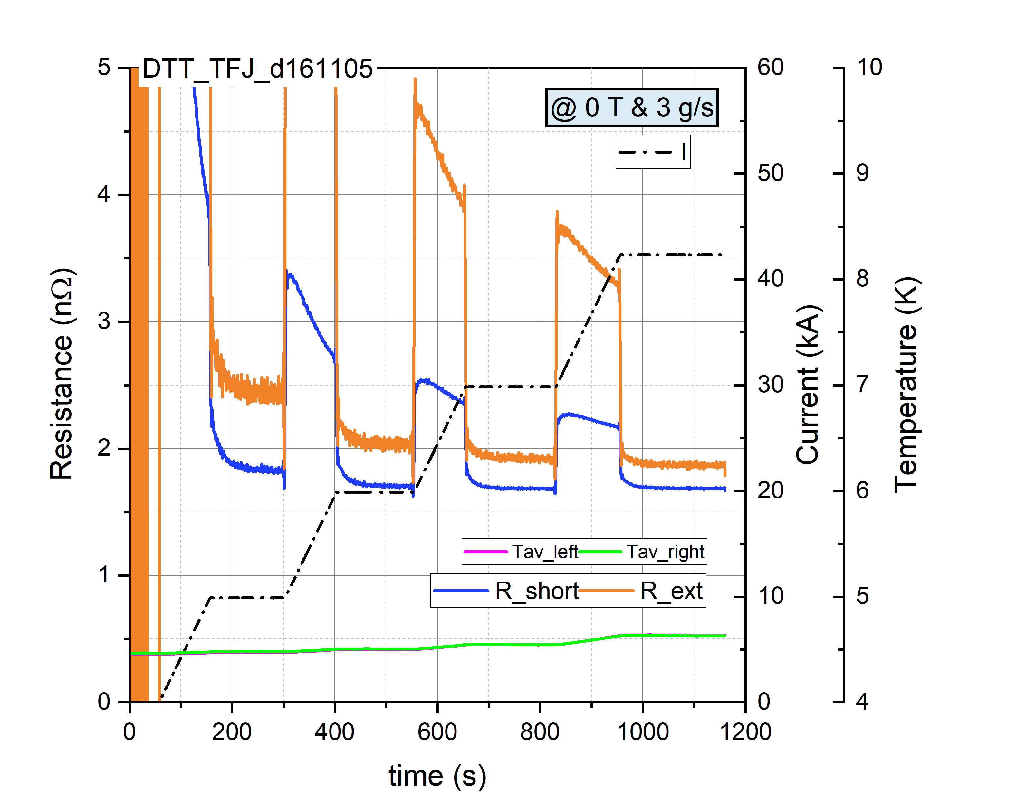
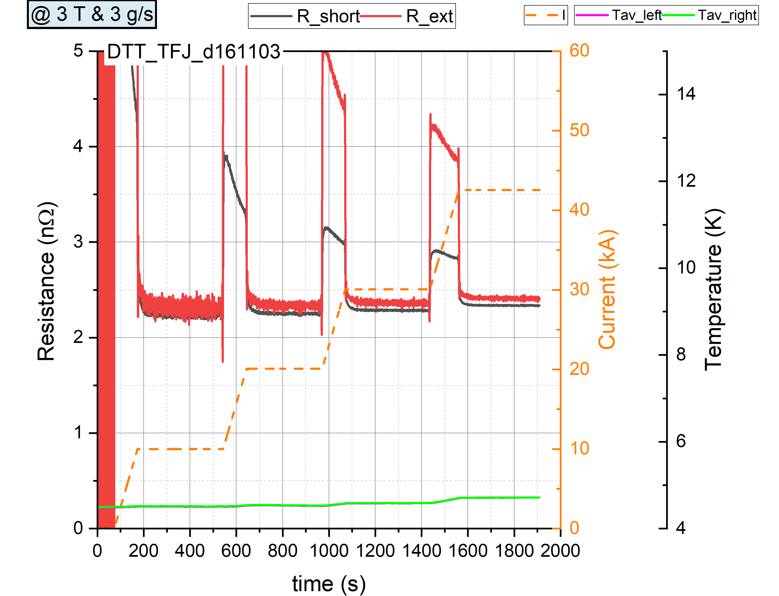
TF Joint sample tests @ SULTAN
Reference DC Tests before cycling, with "normal" polarity of the current
File | B Sultan | I Sample | dI/dt | T Left | T Right | dm/dt L | dm/dt R | dUh/dt | ACTIONS/NOTE
 | T | kA | A/s | K | K | g/s | g/s | V²/s
DTT_TFJ_d161101 | 4 | 0-42.5 | 100 | 4.5 | 4.5 | 3 | 3 |  | #3 R (I-steps): 0-10-20-30-42.5kA
DTT_TFJ_d161102 | 4 | 42.5 | 200 | 4.5 | 4.5 | 3 | 3 | 3 | #4 0-42.5kA directly, T-steps until quench Tq
DTT_TFJ_d161103 | 3 | 0-42.5 | 100 | 4.5 | 4.5 | 3 | 3 |  | #5 R (I-steps): 0-10-20-30-42.5kA
DTT_TFJ_d161104 | 2 | 0-42.5 | 100 | 4.5 | 4.5 | 3 | 3 |  | #6 R (I-steps): 0-10-20-30-42.5kA
DTT_TFJ_d161105 | 0 | 0-42.5 | 100 | 4.5 | 4.5 | 3 | 3 |  | R (I-steps): 0-10-20-30-42.5kA
Tests are on-going in SULTAN (starting from 15/11/23)
Field (T) | R_short (nOhm) | R_ext (nOhm)
4 | 2.54 | 2.65
3 | 2.33 | 2.41
2 | 2.09 | 2.15
0 | 1.68 | 1.87

Slide 8
TF casing: closing of contract
Due to the excessive increase in the cost of the base material (in particular forgings), complained by SIMIC, the contract, signed in December 2021, has been closed in an amicable way last week;
DTT in order to reduce the use of forgings in the manufacturing process, elaborated an alternative layout of the Outer-Intercoil-Structures (OIS) wrt the original one specified in 2020;
A new call for tender is now under preparation taking into account the following changes:
  Drawings updated wrt new layout;
  Implementation of ASG requests for extra-material and chamfer design;
  Reduction of 4.5 K tests
  Revision of the base price thanks to a market survey with steel manufacturers;
Additionally, withdrawal of bolts, nuts and PF support structures from the tender is under consideration in order to concentrate the production on the casing components needed for the TF module integration activities: a separate tender shall be launched
According to present estimate a new schedule would be:
  Publication of call for tender: end of December 2023;
  Contract signature: July 2024;
  Material procurements & manufacturing plan to be completed within 12 months;
  First casing set within 24 months from start of contract: July 2026;
  Taking into account lower delivery frequency at the beginning:
    Last casing in May 2028 -> last module in November 2028 -> Assembly in February 2029
  According to original delivery frequency:
    Last casing in December 2027 -> last module in May 2028 -> Assembly in July 2028

Slide 9
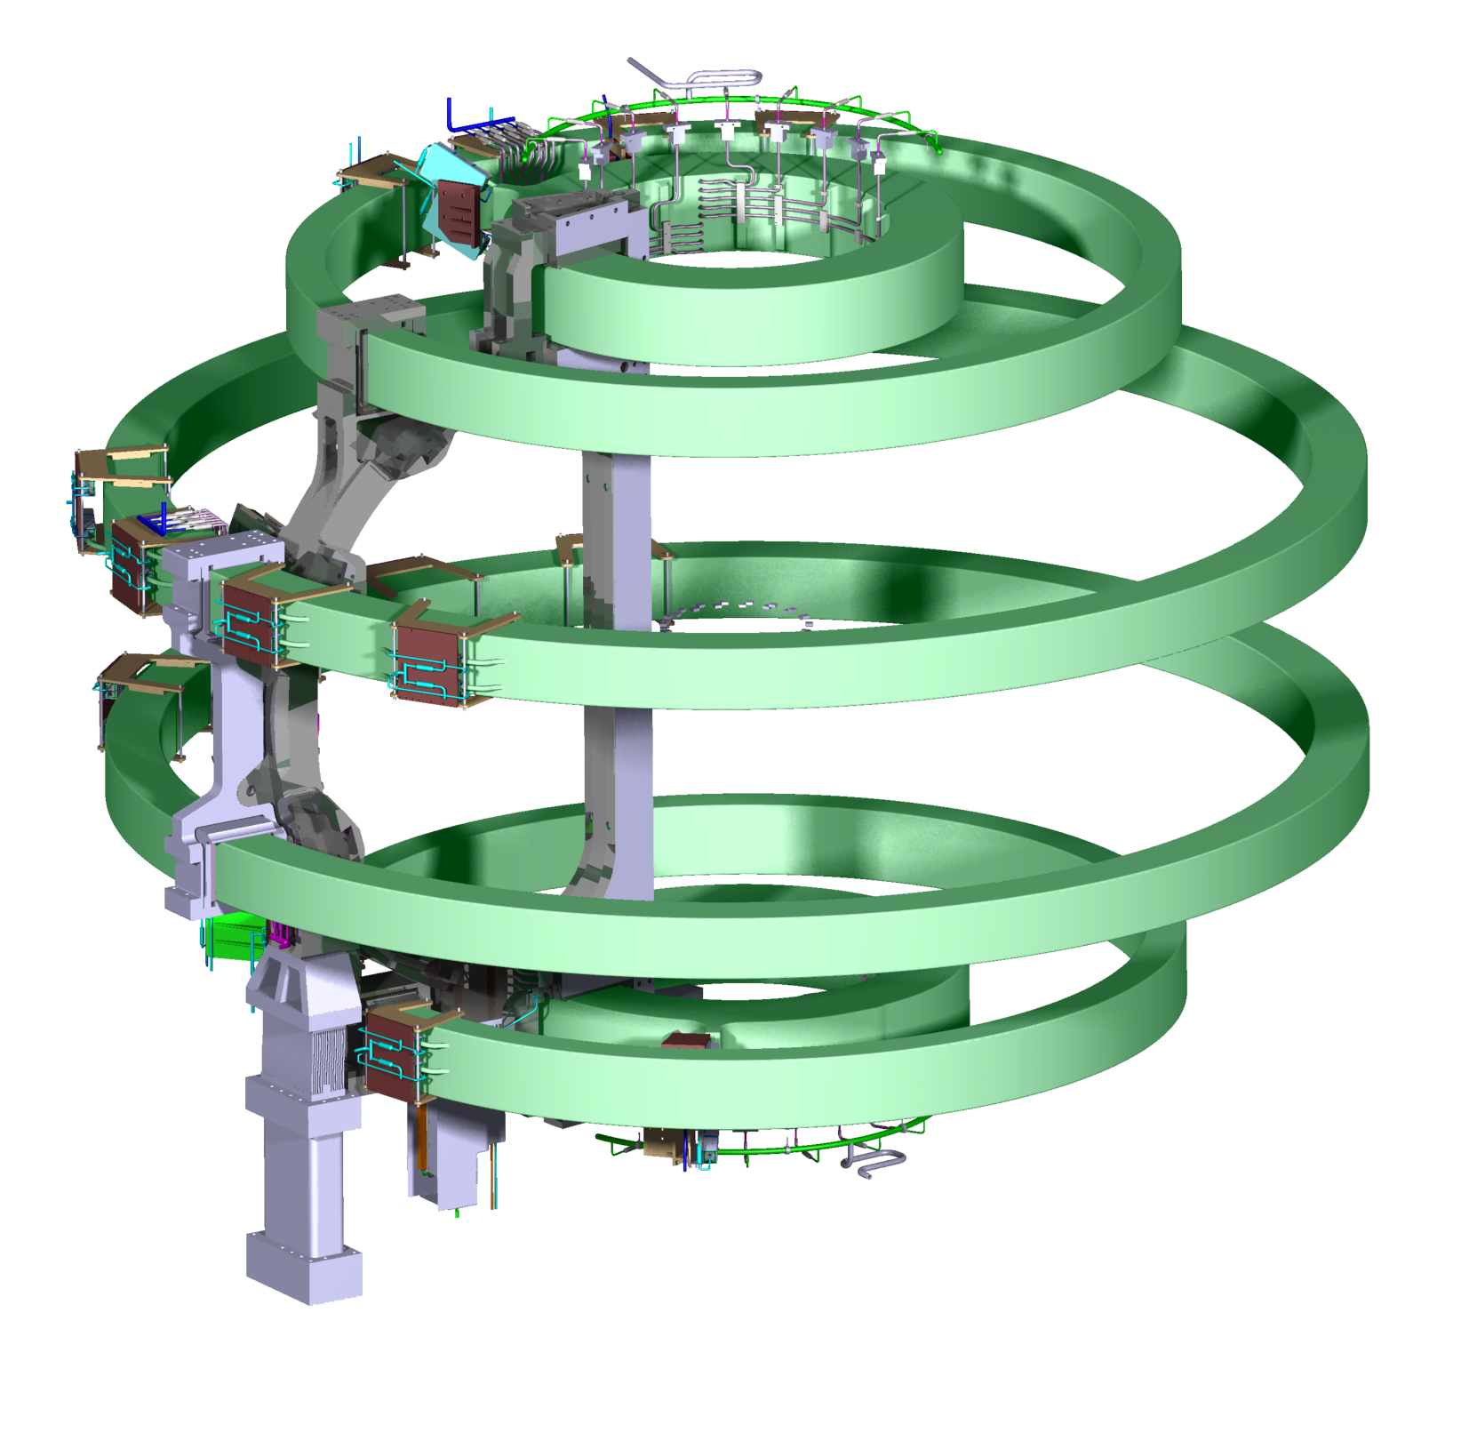
PF system
Final verification by third party on PF coil design has been completed.
The results of the level 1 submodels show failure only on the DP insulation of the PF03, while on the case the stresses are always well below the admissible limit of 600 MPa.
On the basis of this, it was agreed to proceed with more detailed analyzes with the level 2 submodels for PF03 (greater failure index on the DP insulation) and PF06 (greater stress in the coil), similarly to what was carried out for the 2022 EM scenarios.
It was possible to confirm that the updated EM scenarios are less critical than the EM reference scenarios analyzed in 2022; it is also verified that the critical part of the coil is the turn insulation, which also in these analyzes shows a failure index higher than one.
In particular, the failure index calculated by applying the “LHD” criterion is greater than one in correspondence with the ground insulation of the PF06 (preloading, FI = 1.12) and the DP Insulation of the PF03 (for scenario 2) with values slightly above of one and in very localized areas (FI = 1.03).
On the base of the results obtained, DTT is evaluating the risks associated with the design by an extensive review of the experimental data available on similar insulations
As soon as the assessment will be completed (also supported by the CS insulation mock-up) the Call for tender will be launched

Slide 10
CS system
In order to reduce compression forces during the most critical snapshots of plasma SN scenario (EOF, H-L transition and early phases of Ramp-Down), a new set of equilibria has been developed
Correspondingly the structural analysis on the 2D model is under repetition by a third party
Benchmark on previous results (both in terms of EM loads and resulting stresses) has been carried out
CS insulation mock-ups technical specification has been approved. Tender is on the way of the administrative steps and shall be launched soon;
Testing will be carried out in ENEA Brasimone facility at the beginning of 2024;
With the confirmation of mock-ups’ testing results and the 2D calculation, the 3D engineering design activity shall start by mid 2024 in order to prepare the call for tender by the end of 2024

Slide 11
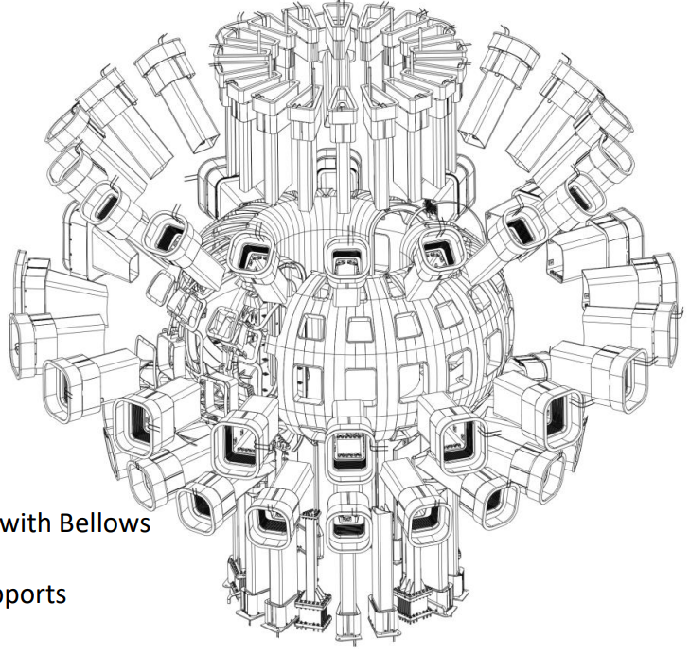
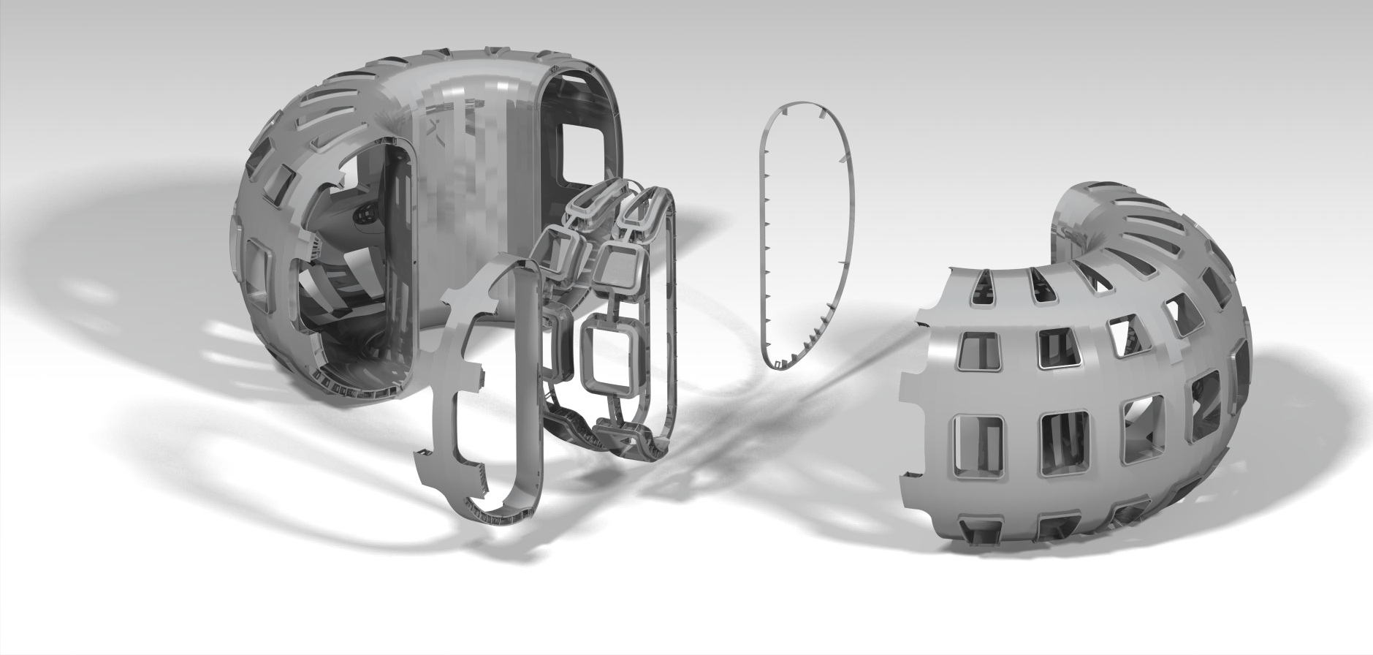
Vacuum vessel and ports
Call for tender launched on June the 28th
Deadline with no offer 16/10/2023
New call to be launched soon
Tender ID | Fornitura della camera da vuoto di DTT costituita di 3 multisettori e relativi accessori
Type of tender | Open
Award criteria | Most economically advantageous offer
Base price | 25 M€ of which 125k€ for on-site assistance
Duration of contract | 52 months: 40+12 (assistance)
Pubblication on GUE | 28/06/2023
Deadline for Offer | 14/09/2023
New deadline (published on 10/08/23) | 16/10/2023
A1.

Slide 12
VVP tender review
Note that:
19 requests of clarifications where submitted in the tender portal (corresponding to about 60 questions);
Last request arrived on the 06/10/23 at 11:52 (deadline for submission was at 12:00)
Request for extension of deadline submitted by two suppliers
Starting from October the 16 a deep review analysis has been carried out focused on the following items:
Technical documentation;
Base price and cost breakdown;
Market of steel manufacturers
Additionally, discussions, with the potential bidders that did not present an offer, have been done in the two weeks after the tender closure.

Slide 13
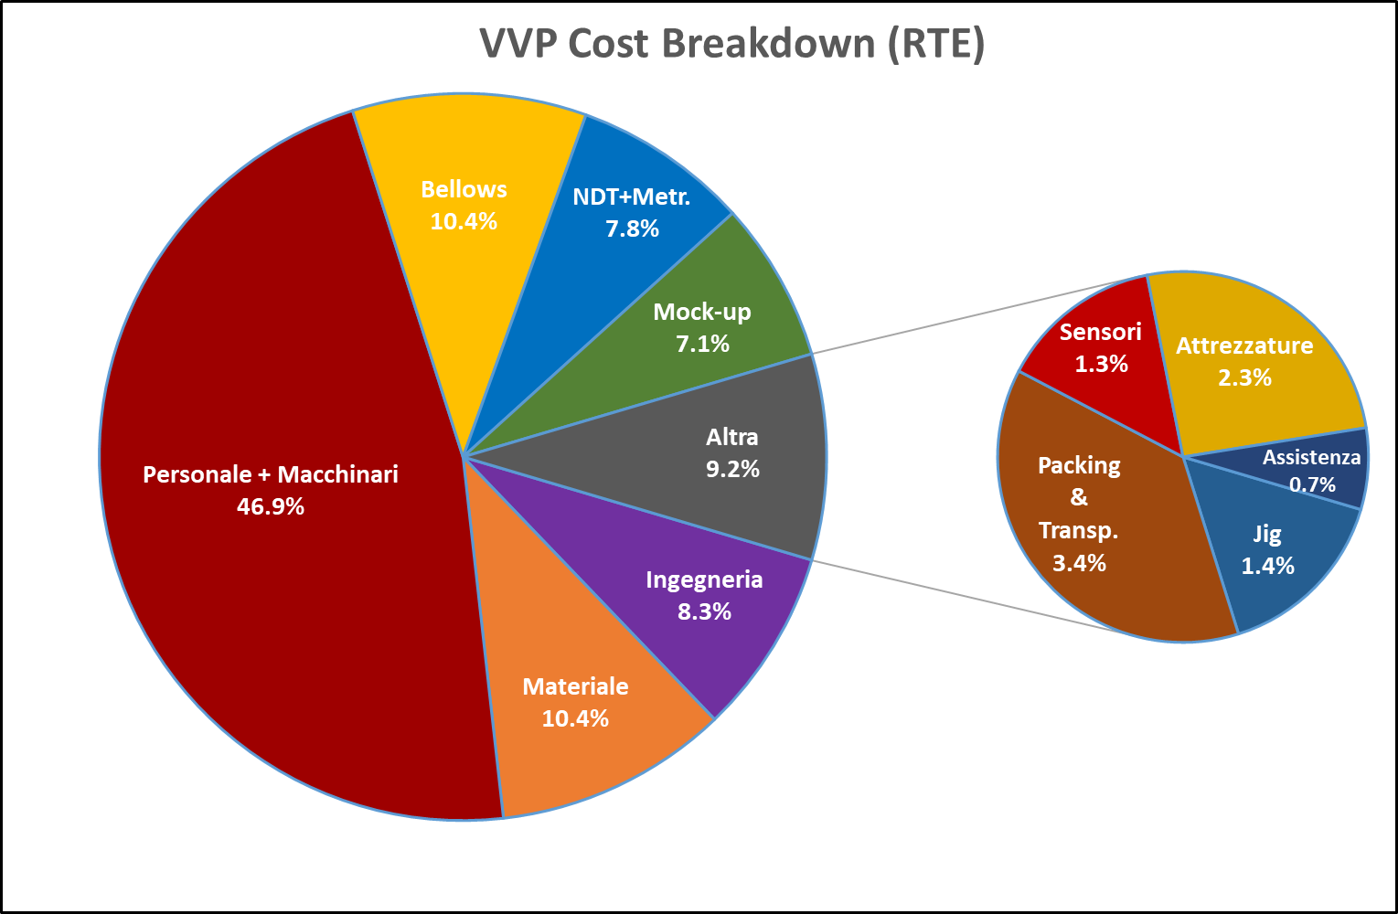
VVP tender: analysis of issues
In the discussions had, the following technical issues have been highlighted:
Uncertainties on PED certification process;
Tolerances too tight for in-vessel components interfaces in comparison to base price and/or contract duration;
Sensors not well specified;
Material requirements (impurities) too tight for price;
Bellows too expensive and with limited number of suppliers on the market
The cost of the material has been underestimated in the tender preparation for:
Base price (present market condition 30% larger than original estimate)
Scrape material too low (between 100% and 200% of final mass to be considered)

Slide 14
VVP tender: actions of revision
A new call for tender is now under preparation taking into account the following changes:
  Drawings updated with enlarged tolerance (risks moved to assembly process);
  Sensors number reduced taking inspiration by KSTAR and not by ITER;
  Sensors specifications revised and simplified (withdrawal of calibration request at -200°C);
  Preparation of PED certification with Italian certifying authority (INAIL);
  Revision of bellows specifications;
  Revision of the base price thanks to a market survey with steel manufacturers;
Additionally, a new type of tender is under consideration including a lump-sum and a framework contract part: a price list will be requested

Slide 15
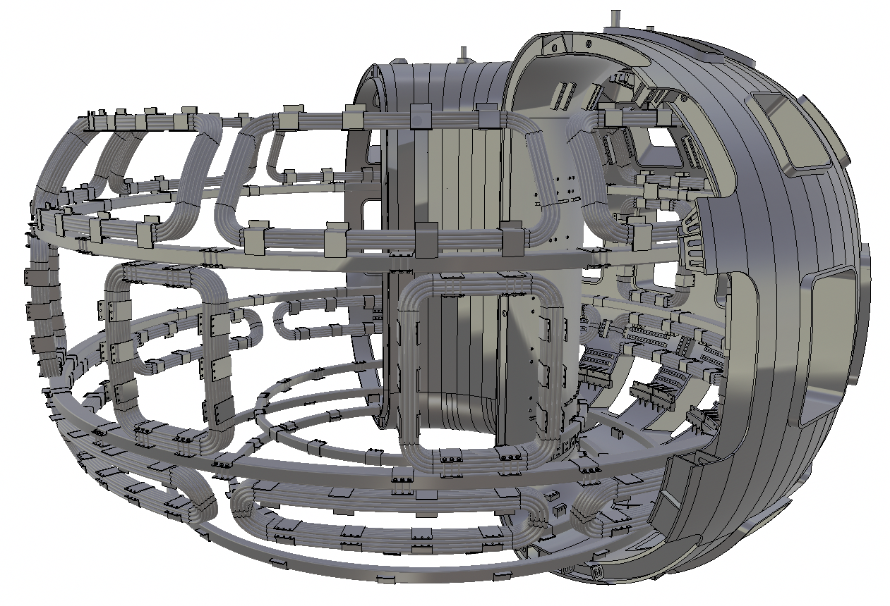
In-vessel coils and related power supplies
Through a NextGenerationEU funding scheme the power supplies for the three sets of in-vessel coils are about to be procured;
SDRM for not axis-symmetric coils power supply (NAS) carried out on 29/05/23
SDRM for axis-symmetric coils power supply (VSS and DIS) carried out on 12/10/23
Technical and management specifications for the three lots authorized on 30/10/23
Tender documentation approved by ENEA on 17/11/23
Tender to be published this week
Deadline for offer presentation before 25/12/23
Base prices:
  Lot 1 (VSS): 8 M€
  Lot 2 (DIS): 2,6 M€
  Lot 3 (NAS): 4,4 M€
A1.

Slide 16
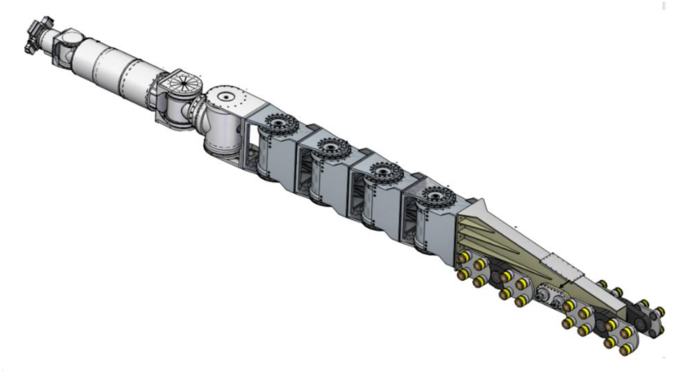
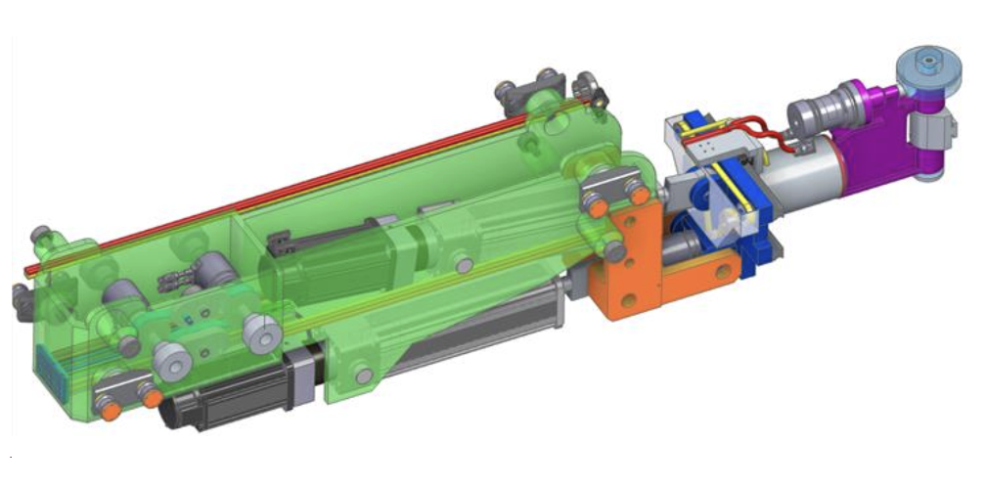
Tender for Remote Manipulation Systems published
Through a NextGenerationEU funding scheme, DTT, through ENEA, is setting up a RH training facility. In it the two Remote Manipulation Systems (HYMAN and CMM) will be tested.
Technical and management specifications for the two lots authorized on 09/10/23
Tender documentation approved by ENEA on 27/10/23
Tender published on 10/11/23 (link)
Deadline for offer presentation before 15/12/23
Base prices:
  Lot 1 (2 HYRMANs): 5,4 M€
  Lot 2 (3 CMM): 4,2 M€
HYRMAN
CMM
A1.

Slide 17
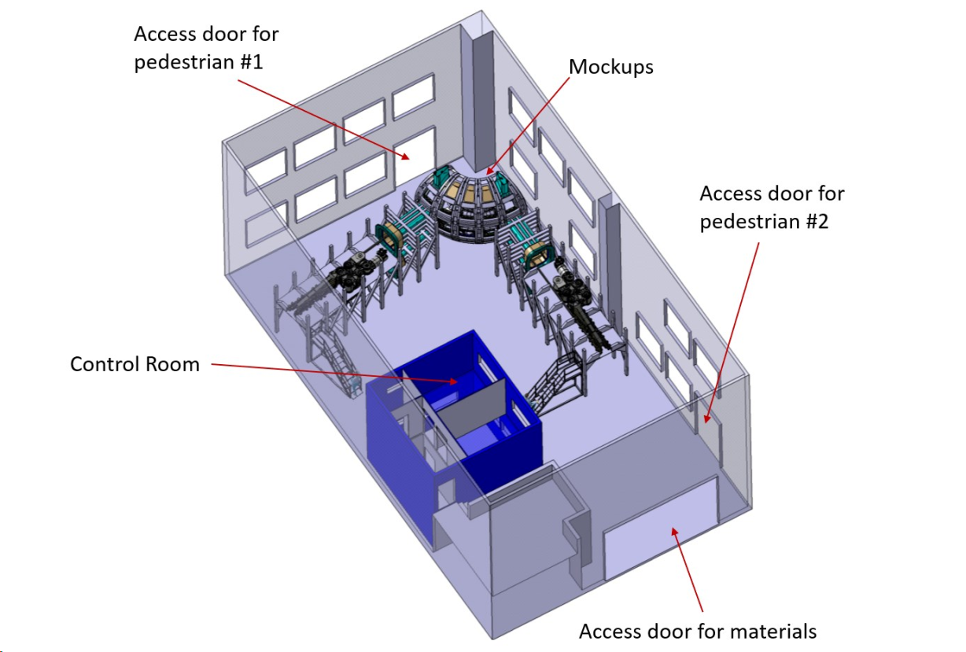
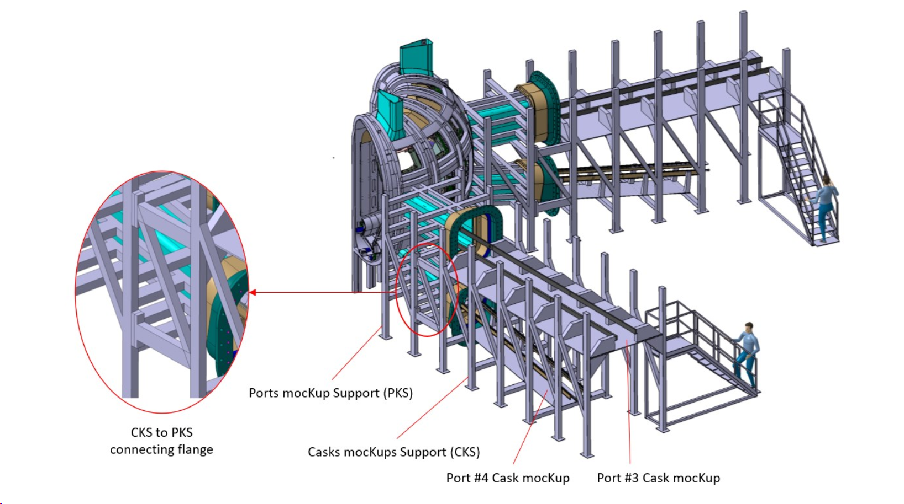
ENEA-DTT RH Training facility
In addition to the previous:
  the mock-up of the VV and in-vessel components, and;
  The control room of facility;
is about to be procured with specific tenders
Technical and management specifications authorized on 17/11/23
Tender documentation to be approved by ENEA
Tender to be published
Deadline for offer presentation before 25/12/23
Base prices:
  Mock-ups: 1,5 M€
  Control room: 0,5 M€

Slide 18
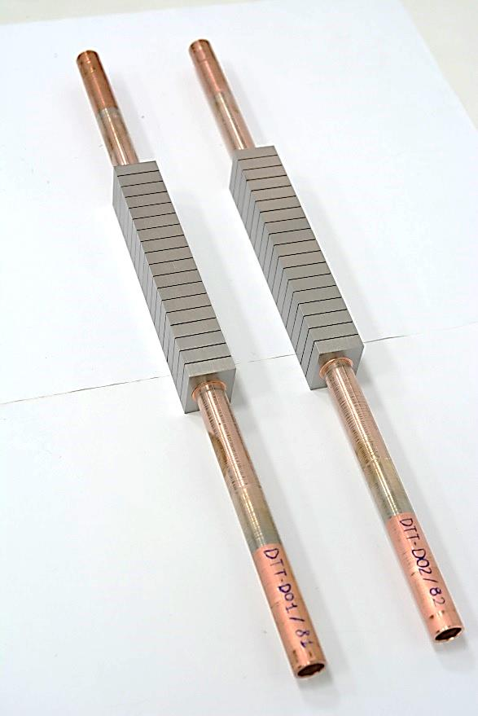
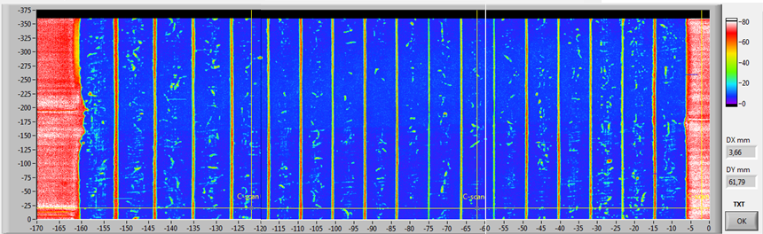
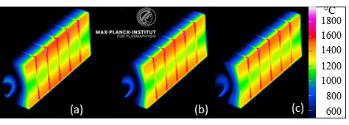
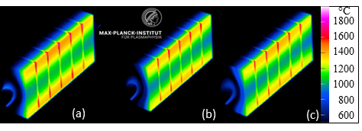
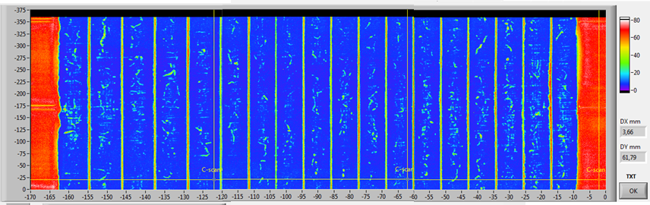
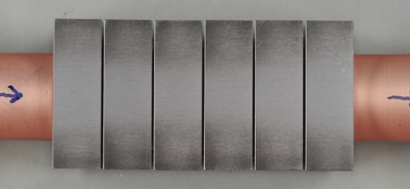
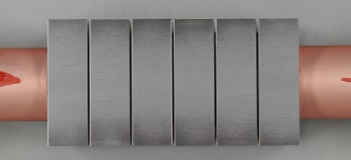

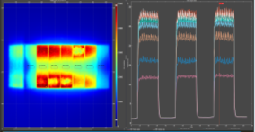
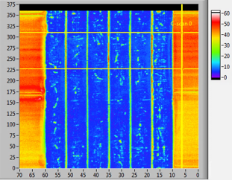
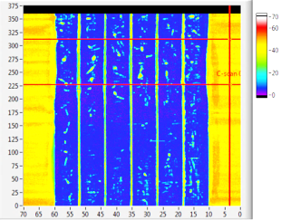
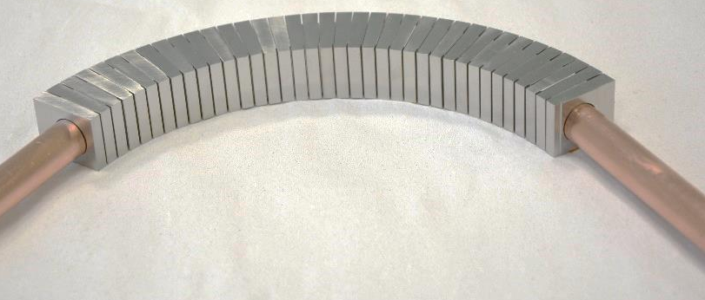
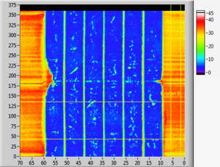
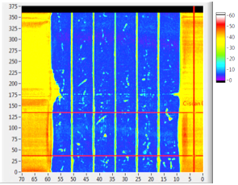
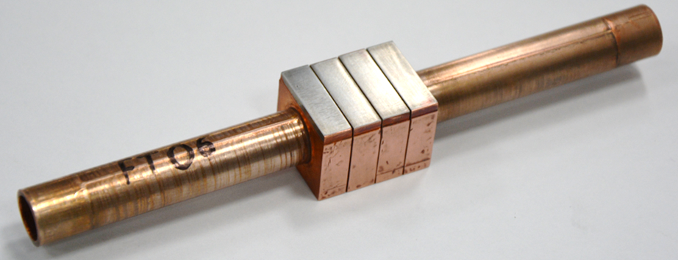
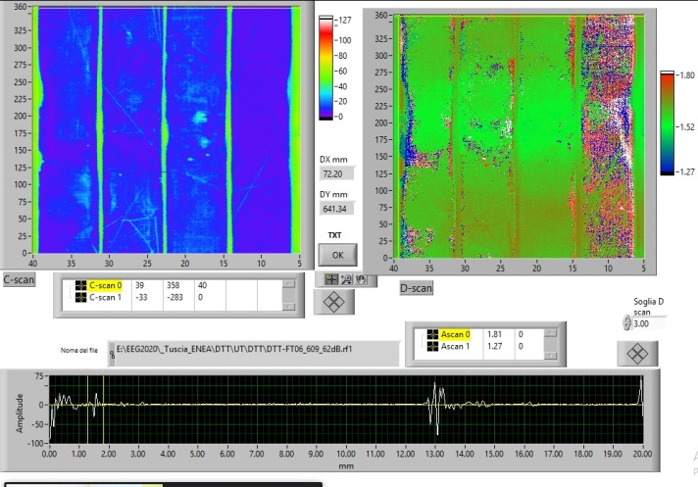
Progresses on Divertor qualification activities
HHF tests in GLADIS (July-September 2023)
CHF tests in HADES (August – September 2023)
Without Twisted Tape
DTT-T02 (4mm di armour)
DTT-T03 (3 mm di armour)
IR Camera: 1st pulse (a), 500th pulse (b), 1000th pulse at 20 MW/m2 (c).
IR Camera: 1st pulse (a), 500th pulse (b), 1000th pulse at 20 MW/m² (c).
With Twisted Tape
Plasma facing surface after 1000th pulse
Plasma facing surface after 1000th pulse
1000 cyclic tests passed w/o at the surface or the junction damages @ 20 MW/m² (130 °C, 40 bar, 14 m/s)
DTT-D01: Tungsten melting
@33 MW/m²; No CHF
Curved mock-up qualification
after fabrication
after 1000th pulse
Flat-tile mock-up qualification
UT results after manufacturing showed excellent joining at the HRP interface by validating the process parameters and equipment
after fabrication
after 1000th pulse

Slide 19
Concluding remarks
Issues on two large contracts (casing components and vacuum vessel) distracted from the regular execution of the activities
Qualification activities are ongoing on most challenging components
Many large tenders have been prepared and in publication (more than 1000 pages of technical specification written in the last 3 months)
New resources (4) have been hired to sustain analyses and verifications in faster and more controllable way

Slide 20











CTS#5 –
Progress in WP-HCD Activities
DTT Consortium (DTT S.C.a r.l. Via E. Fermi 45 I-00044 Frascati (Roma) Italy)

Slide 21
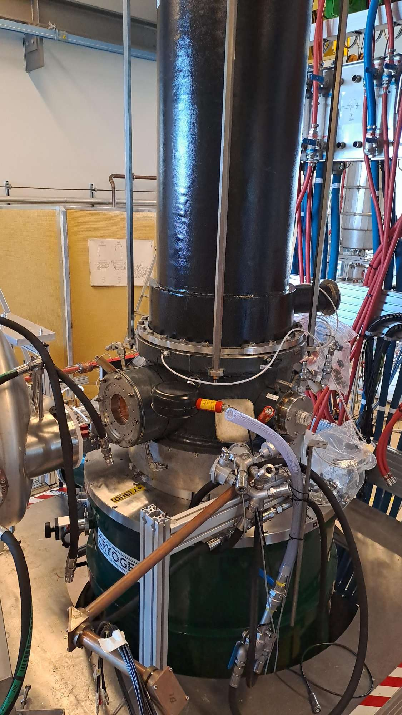
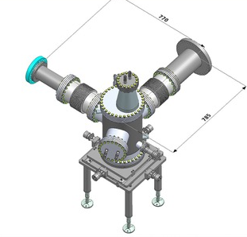
ECH Progress
GYROTRON: pre-serie gyrotron in under conditioning at FALCON facility ( 880 kW for 10s). Delays due to production of Super Conducting Magnet (SCM).
Interim FAT to demonstrate gyrotron performance, using prototype magnet, are foreseen before end of the 2023.
Contract for 15 series gyrotrons ready to be signed in 2023. First serie gyrotron delivered to DTT in 2025.
RF LOAD: tender awarded, contract to be signed in 2023. SAT of the first unit in 2024 at FALCON using the pre-serie gyrotron.
First single mirror unit will be procured in 2024, mirror already printed (to be tested).

Slide 22
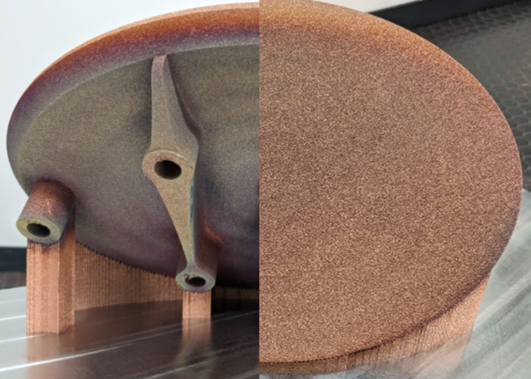
ECH Progress
HVPS for gyrotron: Technical Specification will be completed in 2023. Collaboration with F4E on ITER PS tests and FALCON operation ready to start.
Transmission Line: Preliminary engineering activity (L4 contract with ANN) started to define: containment vessel, alignment solution and combiner/splitter mirrors unit. PhD on universal polarizer started in 2023.
Launcher: Engineering activity (L4 contract with ANN) to define mechanical plug-in structure and mirrors/drivers support has been started. Prototype M1 mirrors under preparation for test.
Control System and Diagnostics: Initial hardware will be procured under Next Generation EU for development of first control system (Test Bed)
Support activity at FALCON to share solutions implemented by F4E and SPC.
M1

Slide 23



ICH progress
ANTENNA
TRANSMITTERS
30/06/23 issue of the call for tender for the first two solid state transmitters.
11/09/23 call deadline - 4 bidders:
offers under assessment
Start of contract activities likely in Jan. 2023.
1st transmitter presumably by summer 2025.
Conceptual design ongoing. A semi-plug design is the current favourite option:
straps, coax, backwall, septa, and top limiter preassembled and plugged;
Faraday screen, part of limiter and box remotely handled.
Pros: no special RF contacts,
reliable coax & strap cooling,
weight compatible with
Hyrman dexterous arm.
Cons: two cooling circuits,
assembling of FS bars with
higher demands on RH
kinematics.
In case of additive manufacturing of straps, CuCrZr would be used.
TRANSMISSION LINE & MATCHING
Call for tender of the 1st batch of RF components (test-bed + initial part of TL)
issue on 22/11/23
Expression of interest to UKAEA for some RF components of JET
27/09/23
Ongoing purchase of measurement instrumentation
OTHER ICH WBS
Update of system CAD waiting for transmitter layout after contractor selection. Feedthrough: ongoing conceptual RF design. Diagnostics in pre-conceptual phase. ICH control system waiting for human resources.

Slide 24
Answer to CTS on RH studies for ICH Antenna
Antenna assembling and disassembling through the Hyrman is a critical aspect of its design that is being intensively studied by Prof. Di Gironimo’s group. Prof. Di Gironimo, from the mechanical engineering dept. of “Federico II” University of Naples (CREATE), is a reference person in Italy on remote-handling systems (RHS) for tokamaks and his expertise is internationally appreciated too.
Among the major problems of the remote-handled antenna fronted, there are the connection of the coaxial feeders to the vacuum transmission line and the weight of the remote-handled part (i.e. the payload). To overcome them, a mixed (plug-in/remote-handling) design is being pursued, where the straps and antenna backwall are plugged, while the very front of the antenna (approx. Faraday screen, limiters, and part of the box) is assembled via RHS. This solution
requires no development of special RF contacts for the coaxial lines,
makes the payload weight compliant with dexterous arm specifications of the Hyrman,
improves the reliability of the strap cooling circuit that would be pre-assembled outside the tokamak. Welding of other cooling pipes are ordinary tasks for Hyrman that
have been already developed for first
wall modules and divertor cassettes.
Several proposals for this mixed design are
under assessment primarily from the RF point
of view to identify the optimal one.
According to preliminary considerations,
the design of such proposals is undoubtedly
difficult, but feasible.

Slide 25
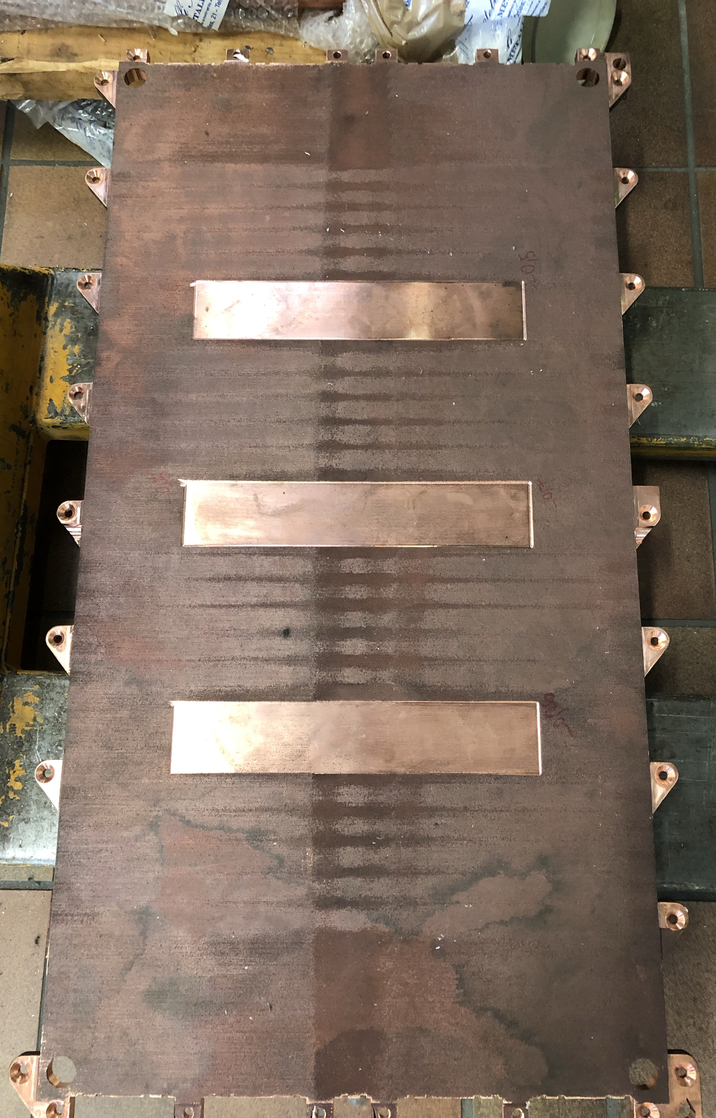

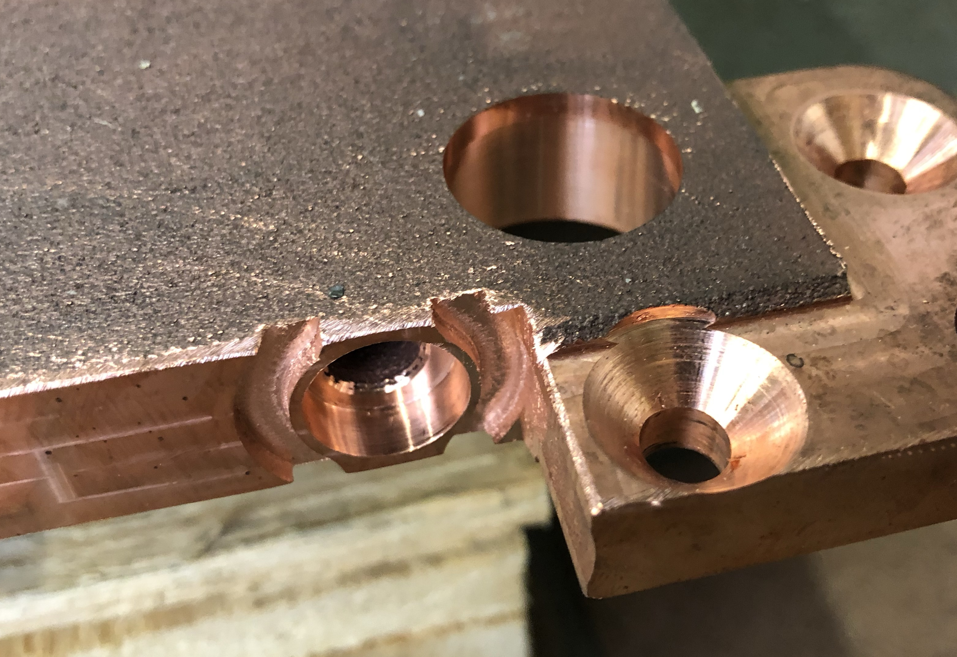
NBI Progress
Power Supplies the realization of the High Voltage Test Bed is foreseen for the next year. Final report on MMC solution (alternative to MITICA PS) will be analyzed and considered to take a decision.
167 kV stage
333 kV stage
500 kV stage
>8 m
34 m
>14 m
Preliminary Layout
Accelerator: Full size grid printed and machined to prepare welding (EBW) and qualification tests. In 2024 the engineering phase will be started.

Slide 26
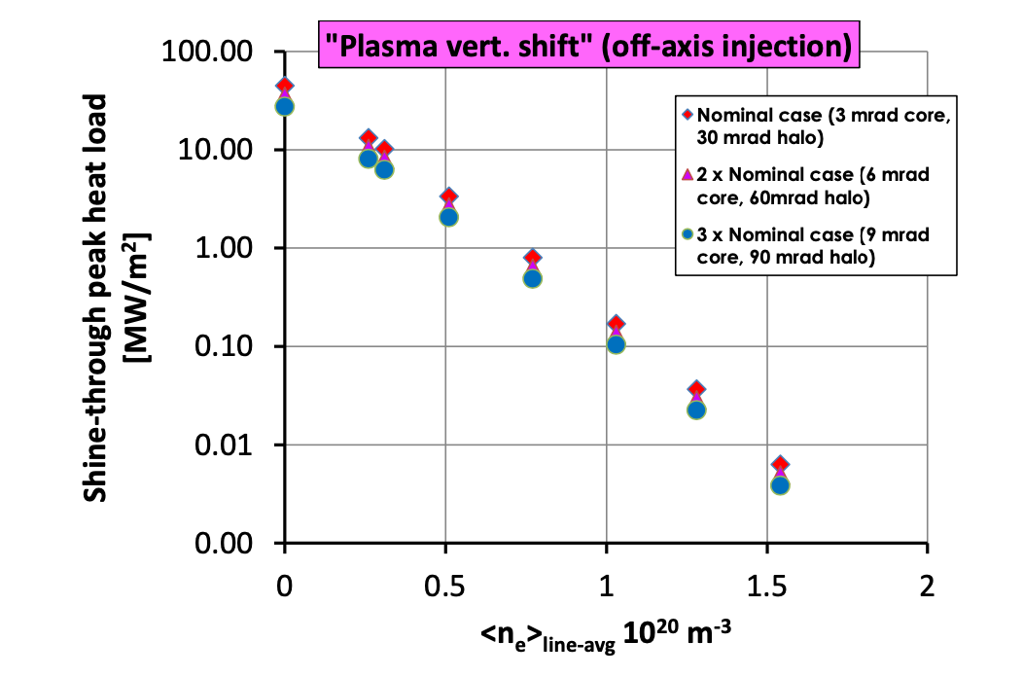
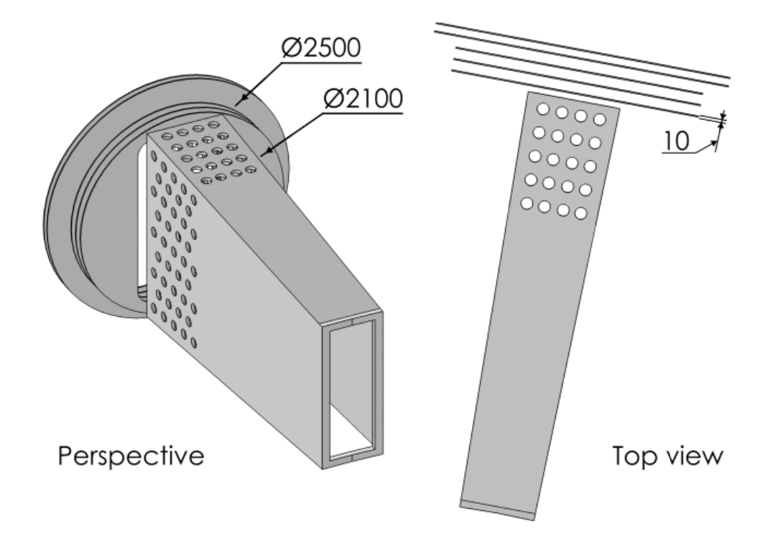
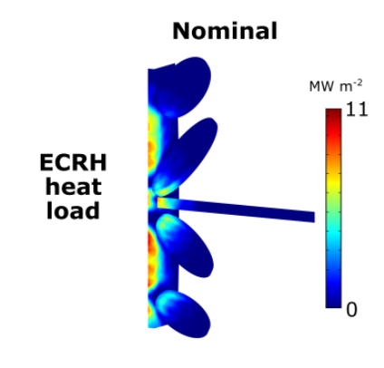
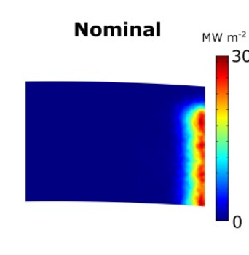
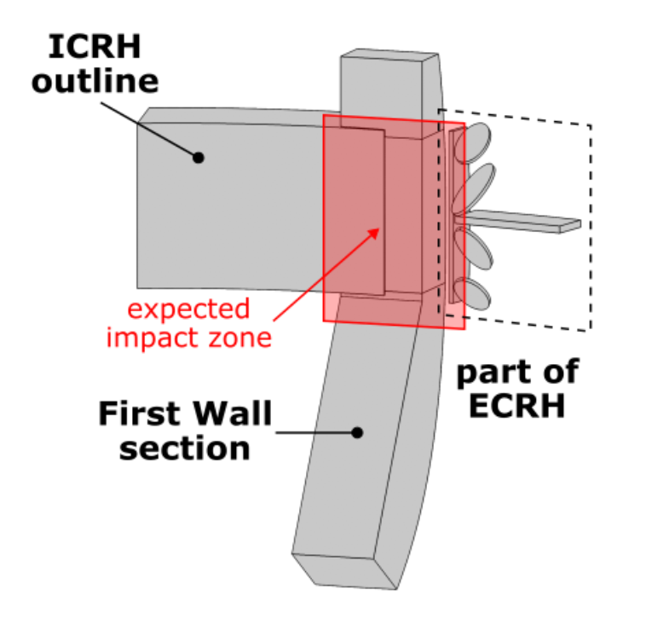
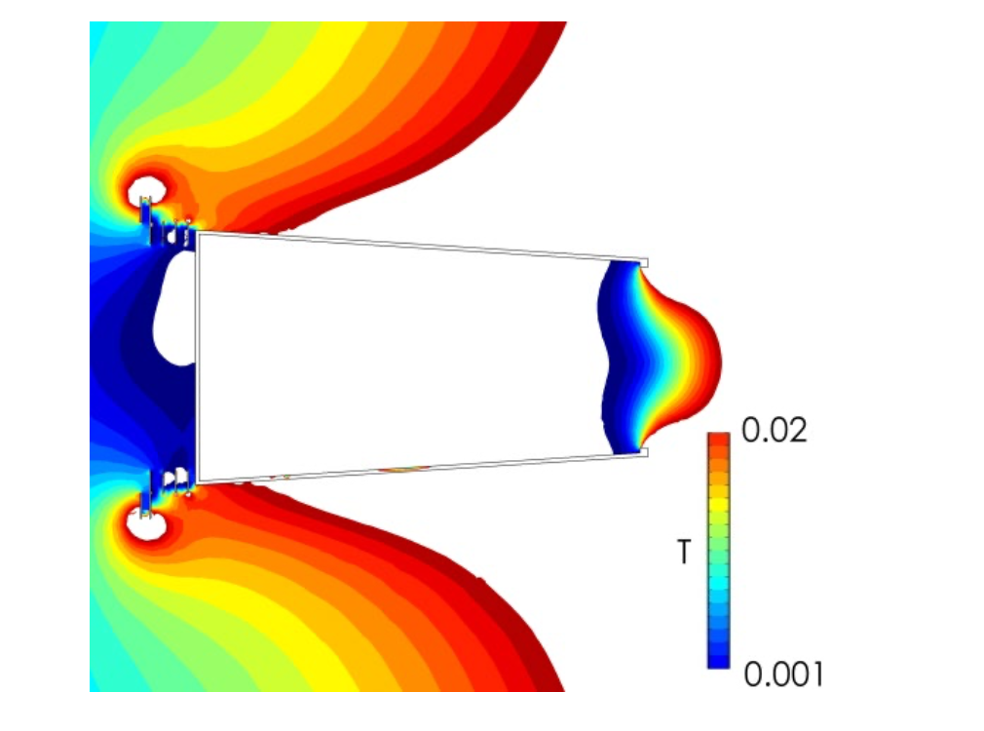
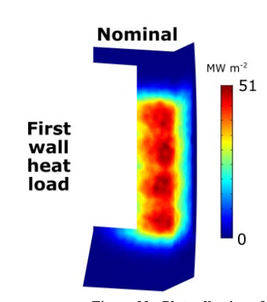
Injector: next objectives are the C-DRMs for the Beal Line Components, the Vacuum Vessel, the magnetic shielding of the injector and of the vacuum system.
MAGNETIC SHIELDNG
Beam Load at Wall

Slide 27
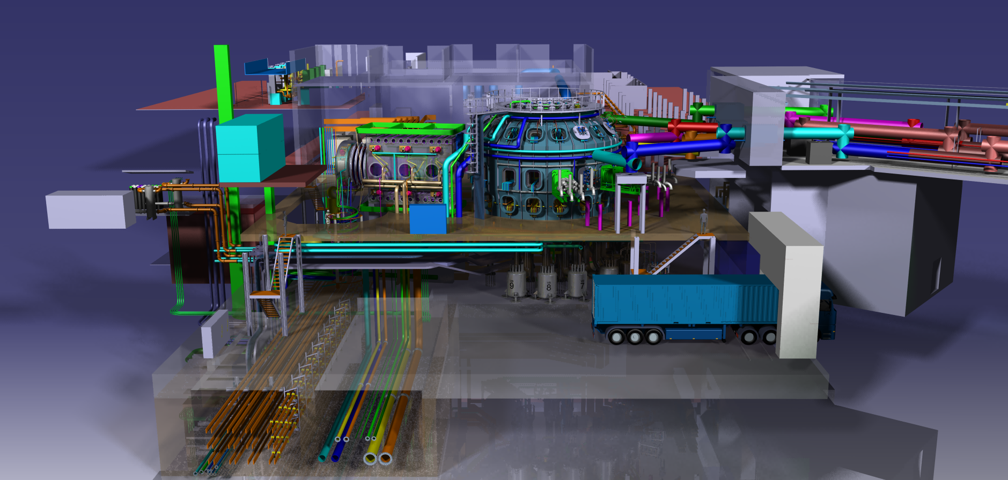
Thank you for attention
DTT Consortium (DTT S.C.a r.l. Via E. Fermi 45 I-00044 Frascati (Roma) Italy)

