Slide 1
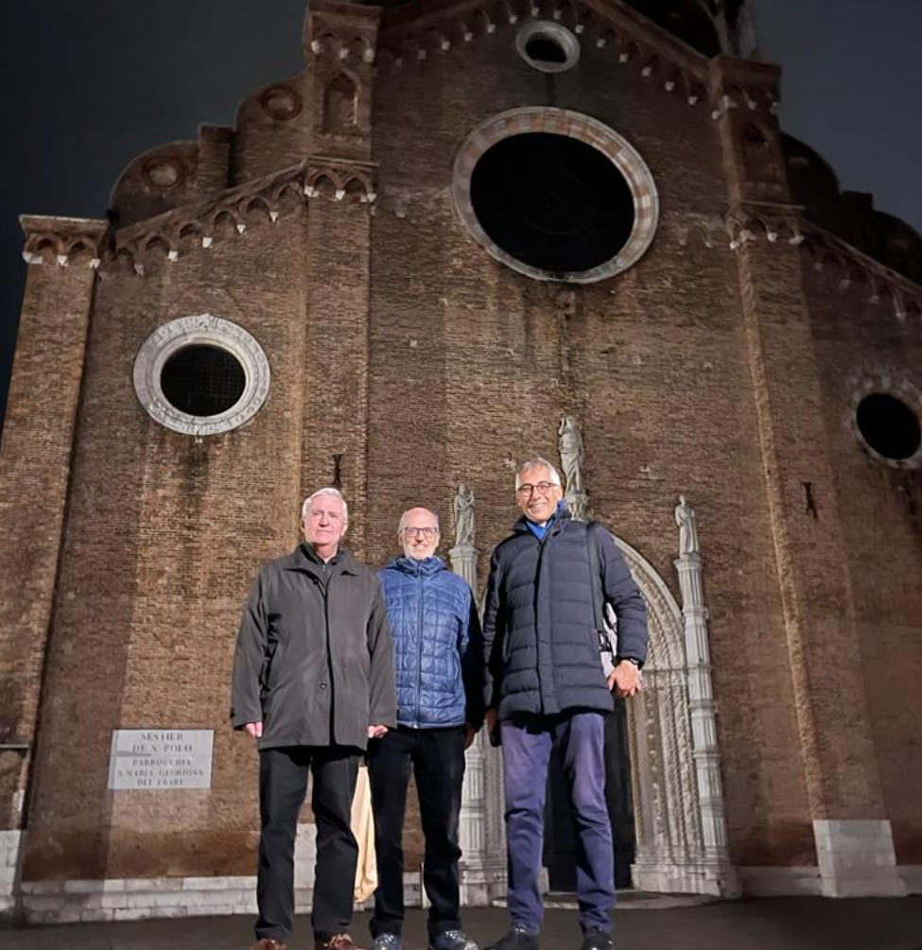













DTT Research Plan
3rd DTT-RP Team meeting
Scope of the meeting
G. Giruzzi, F. Crisanti, P. Martin

Slide 2
Comments/Recommendations from CTS
The CTS welcomes the successful establishment of the Research Plan Expert Group and the large-scale participation though at this stage limited to Europe. Consideration could be given to extending it globally.
The CTS welcomes the focus on the two priorities: preparation for the different phases of ITER operation and DEMO, energy and particle exhaust, and we encourage their use as priority lines.
The phasing of the Research Plan implementation is a very important issue so as to guide the prioritizations especially as far as diagnostics are concerned.
In that respect, the intended creation of a Diagnostic Expert group is welcome: it should be tranversal and address a wide scope.
The CTS strongly recommends that, building on the strong interest already shown by the European (and possibly international in the future) tokamak physics community, efforts to involve more laboratories to the various diagnostics projects, that cannot be all implemented in due time with the ones involved up to now

Slide 3
DTT Research Plan activity timeline /1
DTT Research Plan workshop July 2022
Call for participation July-Sept. 2022
Selection of DTT-RP participants (~90) and ROs of the 6 Expert groups: Sept. 2022
EG-1: DTT scientific exploitation strategy - EG-4: Heating, current drive and fuelling
EG-2: Divertor and SOL physics - EG-5: MHD and fast particles, theory
EG-3: Plasma scenarios and associated modelling - EG-6: Fusion technology developments
1st meeting (Kick-off) of the DTT-RP Team (in person, at ENEA/Frascati) Nov. 2022
2nd meeting of the DTT-RP Team (in person, at ENEA/Frascati) 26-28 Apr. 2023
Production of document on the Central Solenoid options May 2023
Production of slides for the EU facility review June 2023
Production of synopses of the DTT-RP chapters end July 2023
Production of drafts of the DTT-RP chapters (under completetion) Nov. 2023
3rd meeting of the DTT-RP Team (in person, at Padova University) 13-15 Dec. 2023

Slide 4
DTT Research Plan activity timeline /2
3rd meeting of the DTT-RP Team (in person, at Padova University) 13-15 Dec. 2023
First draft of the DTT-RP (chapters completed by ROs) end Jan. 2024
Draft reviewed by coordinators and sent to CTS for comments (not for approval) mid Feb. 2024
Comments by CTS expected end Feb. 2024
4th meeting of the DTT-RP Team (in person ?) mid March 2024
DTT-RP version 1 issued end March 2024
Call for new DTT-RP Team (to elaborate version 2) June-July 2024
1st meeting of the new DTT-RP Team autumn 2024
DTT-RP 2nd version issued autumn 2026

Slide 5
Status of DTT Research Plan activity
Chapter drafts received, except:
  Chapter 3 : Divertor and SOL physics
Most drafts to be completed/adjusted → it's normal
Some drafts too long → to be shortened
List of authors, contributors, DTT community → to be discussed here
Significant pressure by F. Romanelli to complete the DTT-RP on time (March 2024)
The present document (~120 pages) looks already impressive
An effort is necessary by all the ROs to read and comment the full document
The ROs should ask the same effort from the members of their groups
About the style (my personal opinion):
  readability is a must: please try to streamline your text, split in paragraphs etc.
  all the chapters should be understandable by an average fusion physicist: not for specialists
At some point, close to the final version, should we ask other people (not involved so far) to read the document ? Who ?

Slide 6
Scope of the meeting
Presentation by the EG-ROs of slides summarising the contents of each chapter (Please allow time for discussion) → in particular, doubts and questions that are still open
First objective: find a general agreement on the contents
Second objective: establish a coherence among the various chapters
Friday morning: final discussion, with the following objectives:
  agree on main changes and improvements of the draft
  agree on general format, lists of authors, contributors etc.
  agree on next steps and timeline from now to DTT-RP completion
  define date and scope of next meeting(s)

Slide 7
Meeting agenda /1
13 December 14:15 – 18:15
Scope of the meeting, general information 14:15
DTT project and machine design status 14:30
3) Chapter 1: DTT power exhaust strategy 15:00
Coffe break 16:00
4) Chapter 2: Plasma scenarios 16:15
5) Chapter 3: Divertor and SOL physics 17:15
Meeting adjourns 18:00
Dinner at Ristorante Pino 20:00

Slide 8
Meeting agenda /2
14 December 9:00 – 17:30
Chapter 4: Transport physics and integrated modelling of plasma scenarios 9:00
Chapter 5: MHD, disruptions and control 10:00
Coffe break 11:00
8) Chapter 6: Physics of heating, current drive and fuelling 11:30
Lunch break 12:30
9) Chapter 7: Fast particle physics 14:00
Coffe break 15:00
10) Chapter 8: Theory and simulation for preparation of experiments 15:30
11) Chapter 9: Fusion technology developments 16:30
Meeting adjourns 17:30

Slide 9
Meeting agenda /3
15 December 9:00 – 13:00
General discussion 1: 9:00
- main changes and improvements of the draft
- general format, lists of authors, contributors etc.
Coffe break 10:30
General discussion 2: 11:00
- next steps to the final version
- date and scope of next meeting(s)
End of the meeting 12:00
Meeting room closes 13:00

