Slide 1












DTT Central Solenoid design status
L . Muzzi
ENEA FSN-COND
DTT CTS Meeting ; 24/25-07-2023
DTT Consortium (DTT S.C.a r.l. Via E. Fermi 45 I-00044 Frascati (Roma) Italy)

Slide 2
Features of the DTT CS coil
RECAP:
Due to geometrical constraints and physics requirements:
«non-standard» layer-wound coil necessary, to provide:
Winding pack current density: J_{ENG}: 30 – 40 A/mm²
L. Muzzi – ENEA FSN COND – 24/07/2023

Slide 3
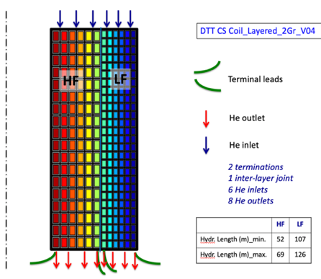
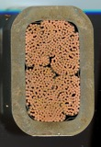
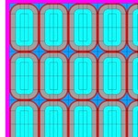
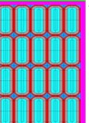

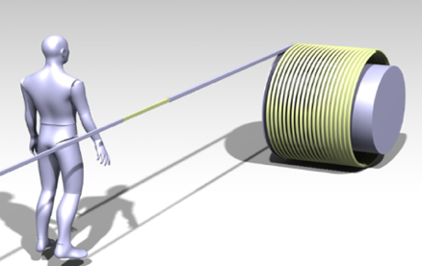
Central Solenoid Coils design status
Presently, a 2-grades, layer-wound coil solution is the reference.
44.5 x 28.3 mm
HF
LF
30.9 x 15.6 mm
 | Layer – 2 Grades_V04_R00
Winding pack layout | 6 layers x 18 turns (HF section) 6 layers x 27 turns (LF section)
CICC operating current | 34 kA
# s.c. / Cu strands in CICC | 768 / 0 (HF); 168 / 228 (LF)
CICC dimensions (non-insulated) | 42.0 mm x 27.7 mm (HF) 27.3 mm x 19.3 mm (LF)
Jacket thickness | 4.55 mm (HF) / 2.56 mm (LF)
Turn insulation | 1 mm
CICC length per CS module | 361 m (HF) + 699 m (LF)
Winding pack dimensions | 315 mm x 800 mm
Coil inner radius | 441 mm
Module self-inductance | 66 mH
Inter-module axial spacer | 64 mm
Winding features | 1 inter-module external joint + 2 terminations; 6 He inlets and 8 He outlets
Hydraulic length | between 52 m and 69 m (HF) between 107 m and 126 m (LF)
Max. Volt. @ breakdown | 2.8 kV
Max. inter-turn volt. | 640 V (between layers 11 and 12)
Ideal / Real Magnetic Flux | 17.0 / 16.2 Weber
L. Muzzi – ENEA FSN COND – 24/07/2023

Slide 4
Central Solenoid Coils design: open issues
Issue 1: we have to rely on heat-treatment tolerant insulation (glass+VPI) only, and the insulation is highly loaded mechanically;
Issue 2: Thermo-hydraulic configuration is not optimal (cold He does not directly enter at the coil high-field region);
Issue 3: the procurement of the Nb₃Sn strand has to be launched again, and the performance brought back to the “original request”:
Ic(4.2K-12T) > 260 A (about 8% lower)
Hyst. Loss < 400 mJ/cm³
Issue 4: Distribution of the pre-compression load on the two sub-coils with different stiffness could be “tricky”. To be still studied and assessed.
Issue 5: Same comment as above concerning quench detection strategy.
L. Muzzi – ENEA FSN COND – 24/07/2023

Slide 5
Central Solenoid Coils design: open issues
Issue 1: we have to rely on heat-treatment tolerant insulation (glass+VPI) only, and the insulation is highly loaded mechanically;
L. Muzzi – ENEA FSN COND – 24/07/2023

Slide 6
Central Solenoid Coils design: open issues
Issue 1: we have to rely on heat-treatment tolerant insulation (glass+VPI) only, and the insulation is highly loaded mechanically;
«Standard» mechanical criteria for insulation components are not satisfied
L. Muzzi – ENEA FSN COND – 24/07/2023

Slide 7
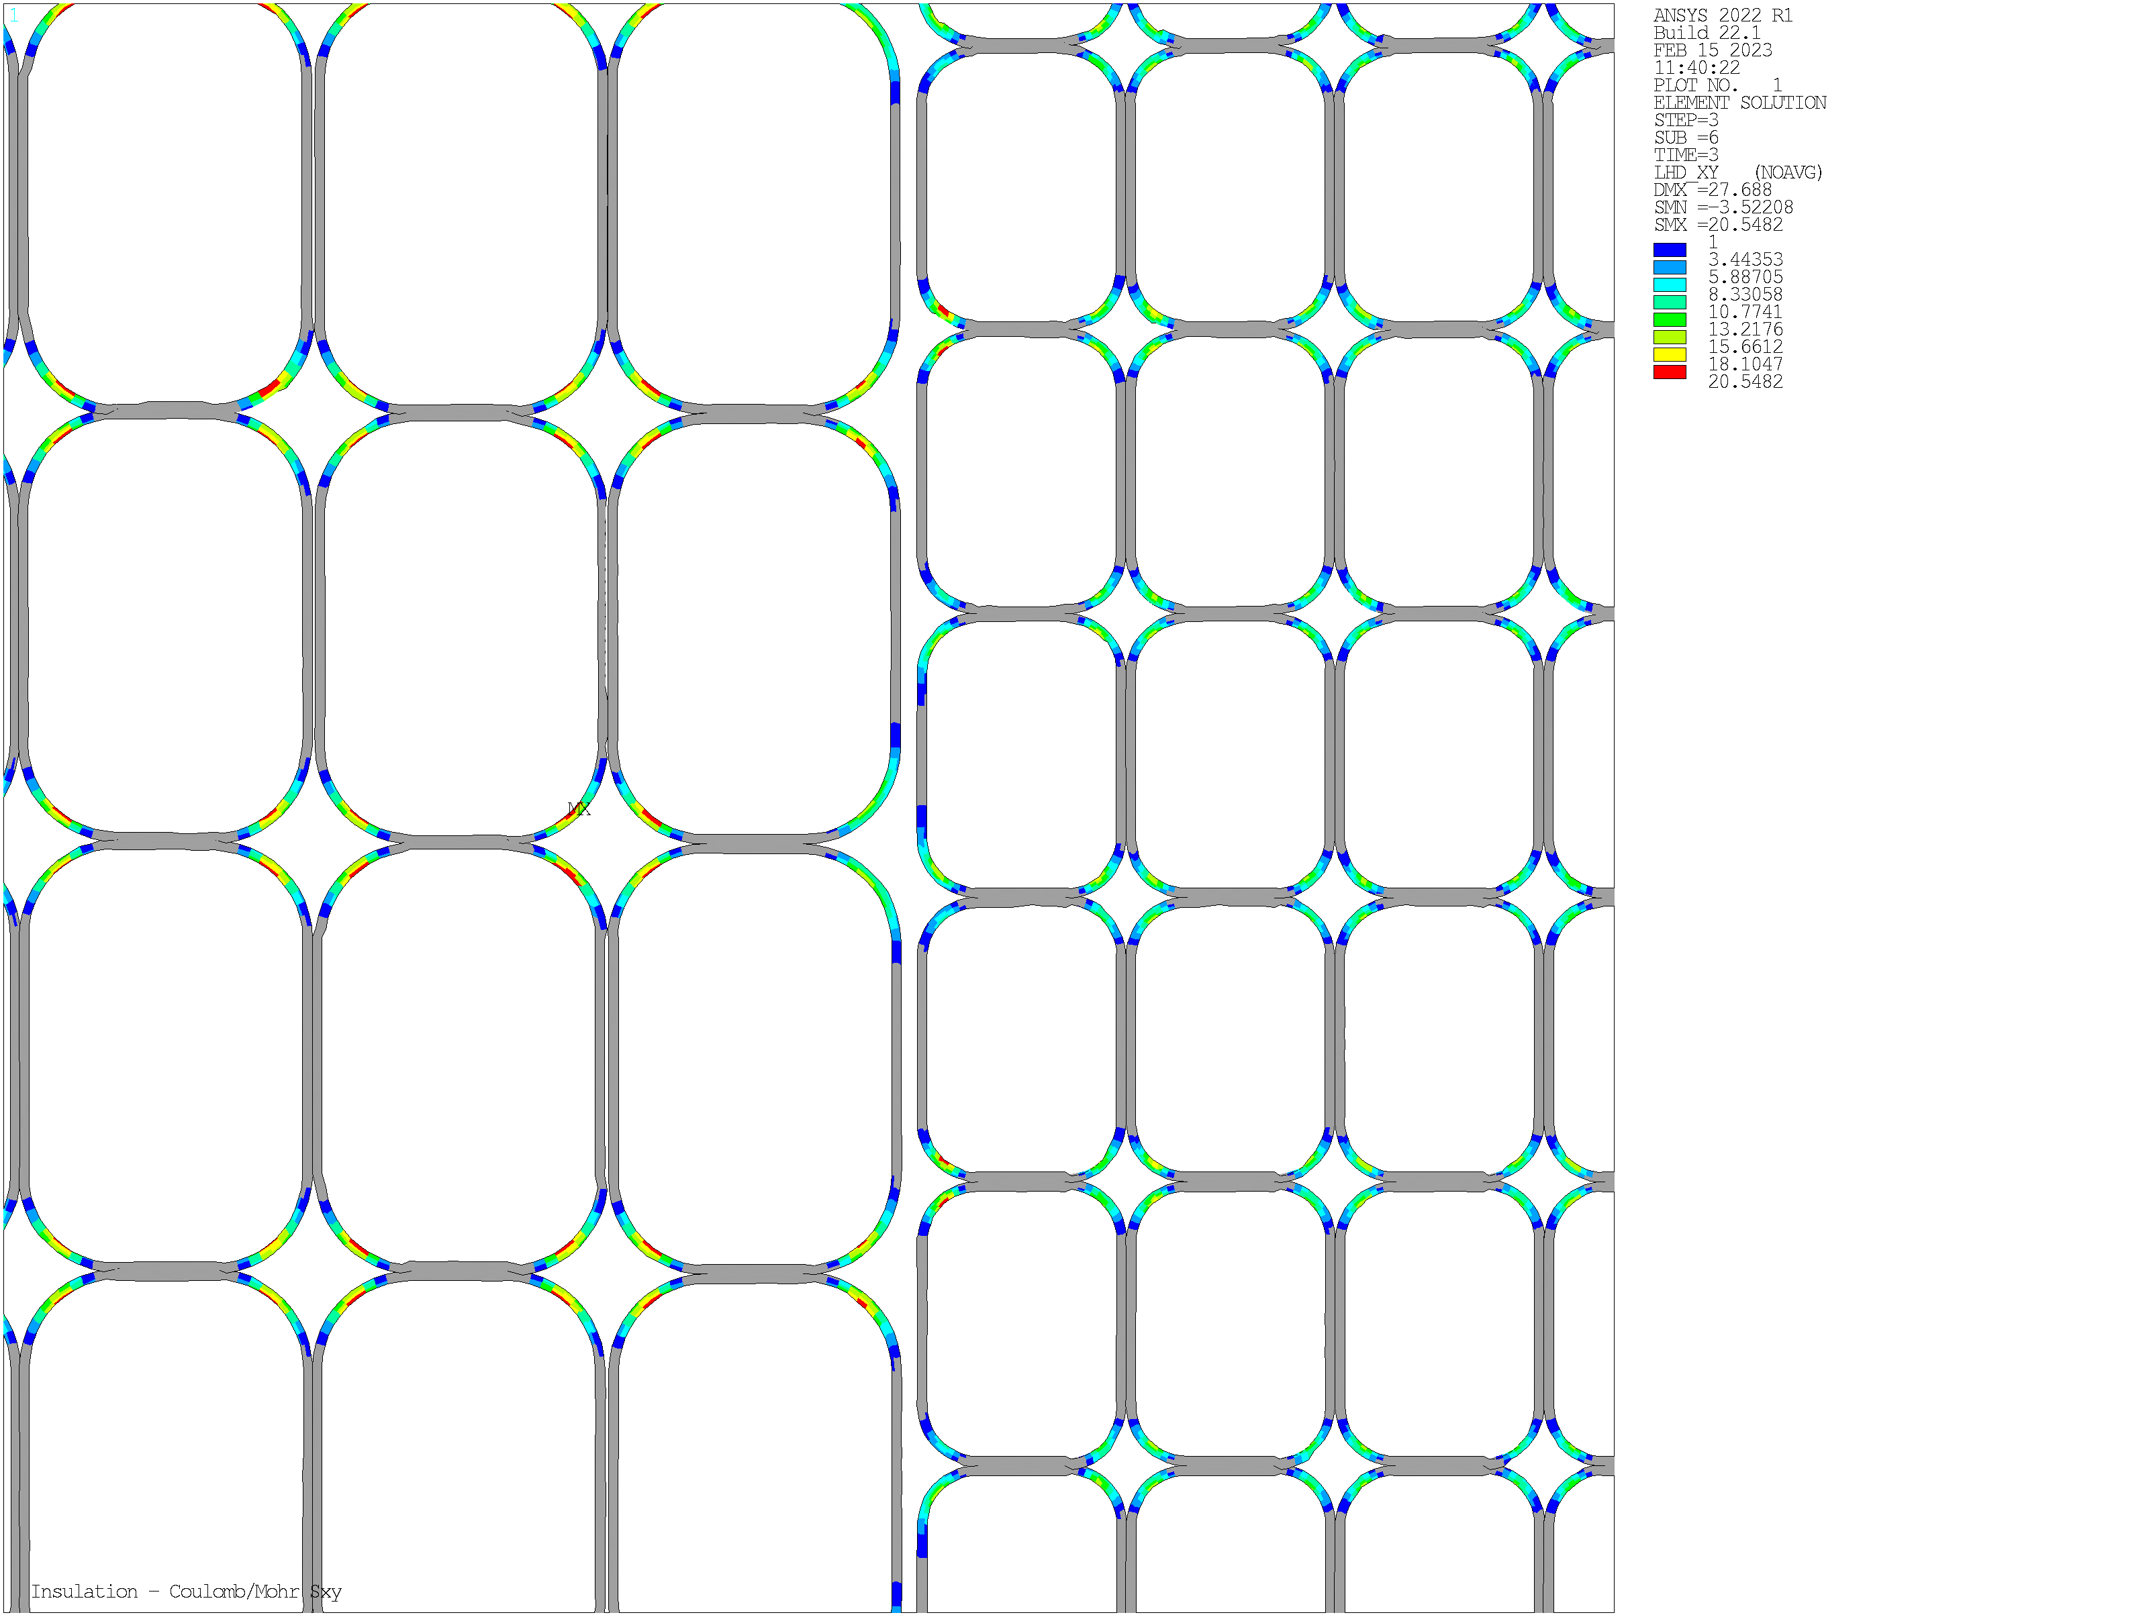
Central Solenoid Coils design: open issues
Issue 1: we have to rely on heat-treatment tolerant insulation (glass+VPI) only, and the insulation is highly loaded mechanically;
«Standard» mechanical criteria for insulation components are not satisfied
CS1U turn insulation. Regions exceeding the LHD criterion
L. Muzzi – ENEA FSN COND – 24/07/2023

Slide 8
Central Solenoid Coils design: open issues
Issue 1: we have to rely on heat-treatment tolerant insulation (glass+VPI) only, and the insulation is highly loaded mechanically;
«Standard» mechanical criteria for insulation components are not satisfied
CS1U turn insulation. Regions exceeding the LHD criterion
So, what happens during machine lifetime?
L. Muzzi – ENEA FSN COND – 24/07/2023

Slide 9
Central Solenoid Coils design: open issues
Issue 1: we have to rely on heat-treatment tolerant insulation (glass+VPI) only, and the insulation is highly loaded mechanically;
«Standard» mechanical criteria for insulation components are not satisfied
CS1U turn insulation. Regions exceeding the LHD criterion
So, what happens during machine lifetime?
Can we guarantee the capability to maintain:
Max. terminal-to-terminal voltage (at breakdown): 2.8 kV
Max. inter-turn voltage (at breakdown): 640 V
(between two outermost LF layers, 11 and 12; 360 V between outermost HF layers, 5 and 6)
L. Muzzi – ENEA FSN COND – 24/07/2023

Slide 10
Central Solenoid Coils design: open issues
Issue 1: we have to rely on heat-treatment tolerant insulation (glass+VPI) only, and the insulation is highly loaded mechanically;
«Standard» mechanical criteria for insulation components are not satisfied
Terminal-to-terminal voltage to be treated with «common practice»; but for the inter-turn insulation:
risk mitigation strategy, based on two main points:
further optimization of scenarios, aimed at a reduction of mechanical loads
Manufacture and integrated electro-mechanical test of an insulation mock-up
L. Muzzi – ENEA FSN COND – 24/07/2023

Slide 11
Central Solenoid Coils design: open issues
Issue 1: we have to rely on heat-treatment tolerant insulation (glass+VPI) only, and the insulation is highly loaded mechanically;
«Standard» mechanical criteria for insulation components are not satisfied
Terminal-to-terminal voltage to be treated with «common practice»; but for the inter-turn insulation:
risk mitigation strategy, based on two main points:
further optimization of scenarios, aimed at a reduction of mechanical loads
Manufacture and integrated electro-mechanical test of an insulation mock-up
L. Muzzi – ENEA FSN COND – 24/07/2023

Slide 12
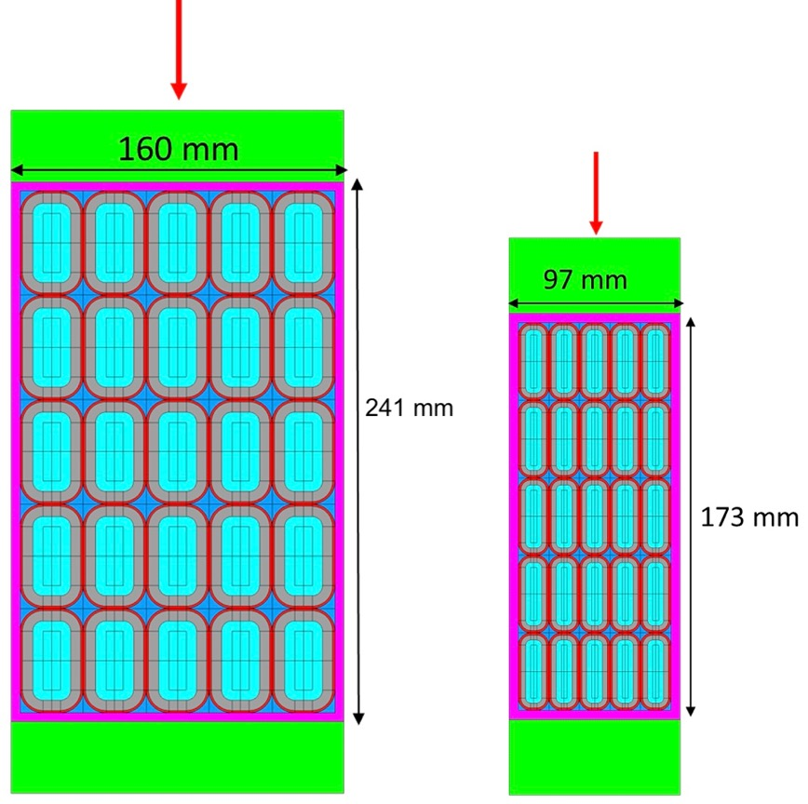
Winding Pack Electrical Insulation
Manufacture of two 5 x 5 mock-ups (a HF- and a LF-relevant one), about 0.5 m long, employing the full process (sand-blasting; glass wrapping; assembly; heat treatment; VPI; 4 mm ground insulation application);
Application at 77 K of a mechanical compression load
Electrical tests layout (see later)
L. Muzzi – ENEA FSN COND – 24/07/2023
DTT CS Design Update Meeting

Slide 13
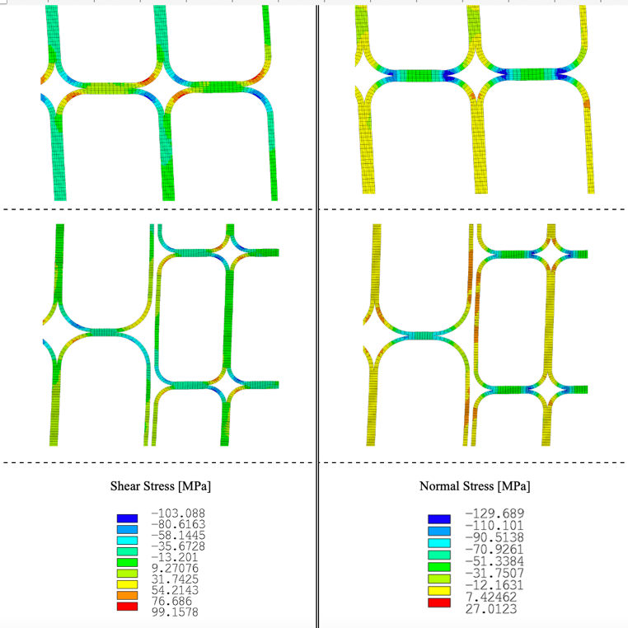
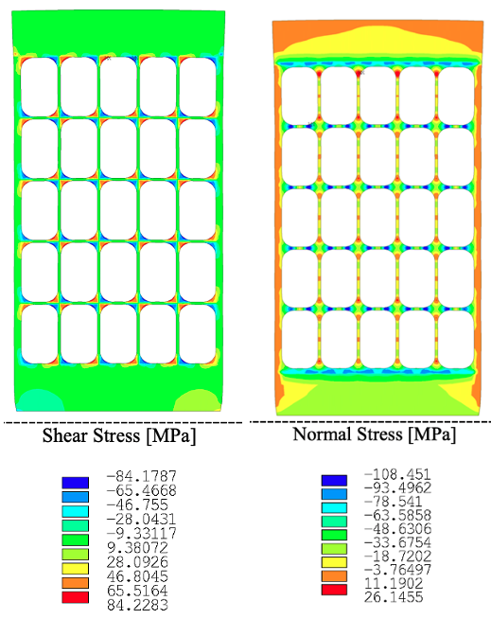
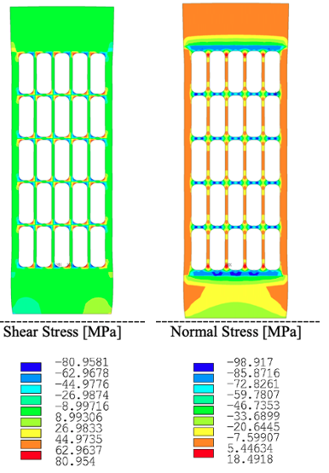
Winding Pack Electrical Insulation
Manufacture of two 5 x 5 mock-ups (a HF- and a LF-relevant one), about 0.5 m long, employing the full process (sand-blasting; glass wrapping; assembly; heat treatment; VPI; 4 mm ground insulation application);
Application at 77 K of a mechanical compression load that provides a stress equivalent to the one computed in operation;
Computed stress in operation
Effect of 640 tons compressive load on HF
Effect of 390 tons compressive load on LF
L. Muzzi – ENEA FSN COND – 24/07/2023
DTT CS Design Update Meeting

Slide 14
Winding Pack Electrical Insulation
Manufacture of two 5 x 5 mock-ups (a HF- and a LF-relevant one), about 0.5 m long, employing the full process (sand-blasting; glass wrapping; assembly; heat treatment; VPI; 4 mm ground insulation application);
Application at 77 K of a mechanical compression load that provides a stress equivalent to the one computed in operation;
Measurement of the inter-turn electrical insulation, before and after the cyclic (up to 25000?) application of load.
Max. inter-turn voltage computations:
- 640 V for LF CICC (between L12 ed L11);
- 360 V for HF CICC (between L5 and L6).
Acceptance criteria:
Electrical insulation maintained for an applied voltage level (between central turn and any of the adjacent ones):
  → 1500 V / 850 V, in LF / HF mock-up, respectively
L. Muzzi – ENEA FSN COND – 24/07/2023
DTT CS Design Update Meeting

Slide 15
Winding Pack Electrical Insulation
Manufacture of two 5 x 5 mock-ups (a HF- and a LF-relevant one), about 0.5 m long, employing the full process (sand-blasting; glass wrapping; assembly; heat treatment; VPI; 4 mm ground insulation application);
Application at 77 K of a mechanical compression load that provides a stress equivalent to the one computed in operation;
Measurement of the inter-turn electrical insulation, before and after the cyclic (up to 25000?) application of load.
Max. inter-turn voltage computations:
- 640 V for LF CICC (between L12 ed L11);
- 360 V for HF CICC (between L5 and L6).
Acceptance criteria:
Electrical insulation maintained for an applied voltage level (between central turn and any of the adjacent ones):
  → 1500 V / 850 V, in LF / HF mock-up, respectively
Discussion is also on-going, to verify the possibility of manufacturing and testing an additional mock-up made with Mica, instead of glass tape
L. Muzzi – ENEA FSN COND – 24/07/2023
DTT CS Design Update Meeting

Slide 16
Central Solenoid Coils design: open issues
Issue 2: Thermo-hydraulic configuration is not optimal (cold He does not directly enter at the coil high-field region);
Issue 3: the procurement of the Nb₃Sn strand has to be launched again, and the performance downgraded back to the “original request”:
Ic(4.2K-12T) > 260 A (about 8% lower)
Hyst. Loss < 400 mJ/cm³
L. Muzzi – ENEA FSN COND – 24/07/2023

Slide 17


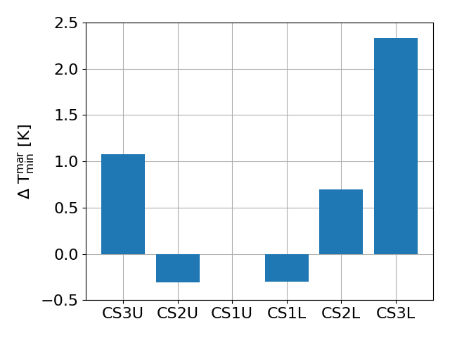
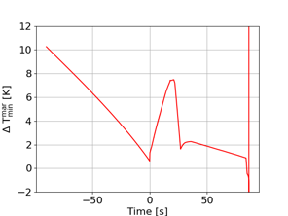
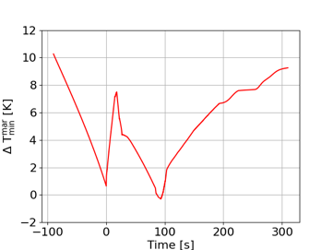

CS Coil Thermal-hydraulics
Temperature margin (min. ΔT_{margin}) verified for the layer-wound CS coil, with original strand properties: Ic (@ ref. conditions) > 260 A; Hyst. Losses (+/- 3 T) < 400 mJ/cm³
At EoF – Scenario v14i1 (scaled with max curr, e.g., 34 kA for layer-wound)
L. Muzzi – ENEA FSN COND – 24/07/2023

Slide 18
CS Coil Thermal-hydraulics
Temperature margin (min. ΔT_{margin}) verified for the layer-wound CS coil, with original strand properties: Ic (@ ref. conditions) > 260 A; Hyst. Losses (+/- 3 T) < 400 mJ/cm³
At EoF – Scenario v14i1 (scaled with max curr, e.g., 34 kA for layer-wound)
Options to «recover» temperature margin?
Further coil design review, adapted to the original strand performance → most likely leading to a magnetic flux decrease (maybe a few tenths of Vs?)
Sub-cooling of supercritical helium, to 4.2 K (0.3 K less than currently considered as a reference);
Increase of CS current ramp-up time; introduction of a current plateau after reaching Initial Magnetization, to get rid of the heat accumulated during the current ramp
L. Muzzi – ENEA FSN COND – 24/07/2023

Slide 19
CS Coil Thermal-hydraulics
Temperature margin (min. ΔT_{margin}) verified for the layer-wound CS coil, with original strand properties: Ic (@ ref. conditions) > 260 A; Hyst. Losses (+/- 3 T) < 400 mJ/cm³
At EoF – Scenario v14i1 (scaled with max curr, e.g., 34 kA for layer-wound)
Options to «recover» temperature margin?
Further coil design review, adapted to the original strand performance → most likely leading to a magnetic flux decrease;
Sub-cooling of supercritical helium, to 4.2 K (0.3 K less than currently considered as a reference);
Increase of CS current ramp-up time; introduction of a current plateau after reaching Initial Magnetization, to get rid of the heat accumulated during the current ramp
L. Muzzi – ENEA FSN COND – 24/07/2023

Slide 20
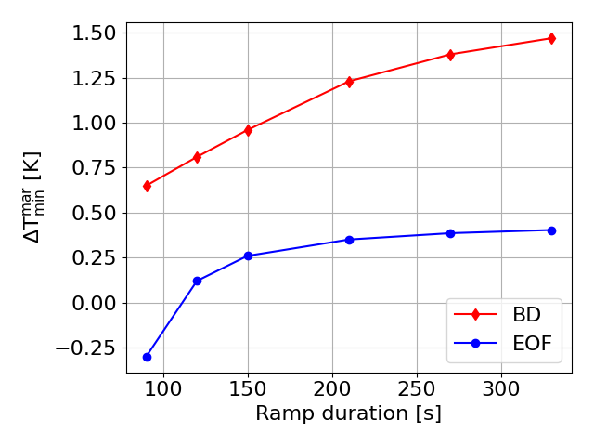
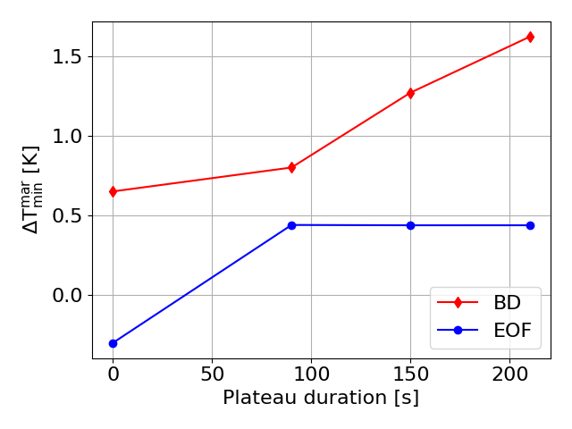
CS Coil Thermal-hydraulics
Temperature margin (min. ΔT_{margin}) verified for the layer-wound CS coil, with original strand properties: Ic (@ ref. conditions) > 260 A; Hyst. Losses (+/- 3 T) < 400 mJ/cm³
At EoF – Scenario v14i1 (scaled with max curr, e.g., 34 kA for layer-wound)
Options to «recover» temperature margin?
NOTE: He transit time through the 52 m of innermost HF turn = 210 s
L. Muzzi – ENEA FSN COND – 24/07/2023

Slide 21
CS Coil Thermal-hydraulics
Temperature margin (min. ΔT_{margin}) verified for the layer-wound CS coil, with original strand properties: Ic (@ ref. conditions) > 260 A; Hyst. Losses (+/- 3 T) < 400 mJ/cm³
At EoF – Scenario v14i1 (scaled with max curr, e.g., 34 kA for layer-wound)
Options to «recover» temperature margin?
Further coil design review, adapted to the original strand performance → most likely leading to a magnetic flux decrease;
Sub-cooling of supercritical helium, to 4.2 K (0.3 K less than currently considered as a reference);
Increase of CS current ramp-up time; introduction of a current plateau after reaching Initial Magnetization, to get rid of the heat accumulated during the current ramp
Different cooling layout: He inlet at the center of the innermost layer, thus halving the hydraulic path of the most loaded, highest field, innermost layer.
L. Muzzi – ENEA FSN COND – 24/07/2023

Slide 22
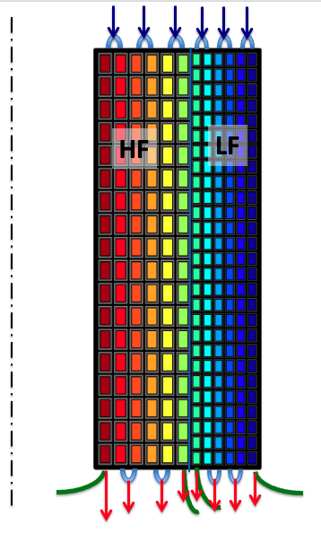
CS Coil Thermal-hydraulics
Currently assumed cooling layout for layer-wound coil (6 + 6 layers)
Cold He inlet
«Hot» He outlet
Conductor Termination
Hydraulic length of innermost HF layer = 52 m
L. Muzzi – ENEA FSN COND – 24/07/2023

Slide 23
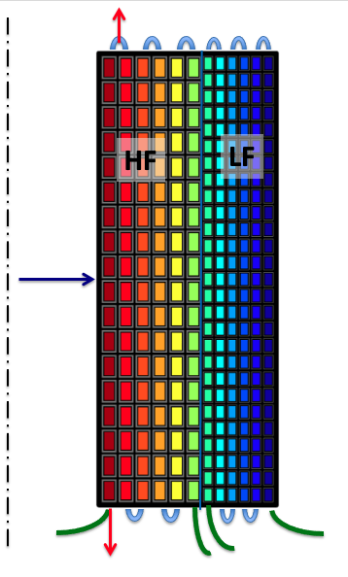
CS Coil Thermal-hydraulics
Currently assumed cooling layout for layer-wound coil (6 + 6 layers)
Alternative cooling He inlet and outlets
Hydraulic length of innermost HF layer = 52 m
Hydraulic length of innermost HF layer = 26 m
L. Muzzi – ENEA FSN COND – 24/07/2023

Slide 24
CS Coil Thermal-hydraulics
Currently assumed cooling layout for layer-wound coil (6 + 6 layers)
Alternative cooling He inlet and outlets
... BUT:
Hydraulic length of innermost HF layer = 52 m
Hydraulic length of innermost HF layer = 26 m
L. Muzzi – ENEA FSN COND – 24/07/2023

Slide 25
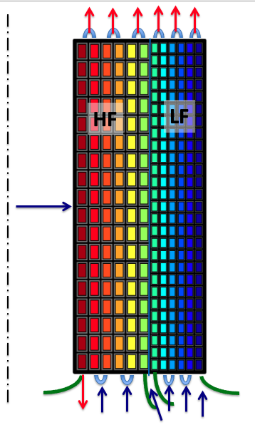
CS Coil Thermal-hydraulics
Currently assumed cooling layout for layer-wound coil (6 + 6 layers)
Alternative cooling He inlet and outlets
... BUT:
Hydraulic length of innermost HF layer = 52 m
Hydraulic length of innermost HF layer = 26 m
He inlet at inter-layer joint to be avoided!
L. Muzzi – ENEA FSN COND – 24/07/2023

Slide 26
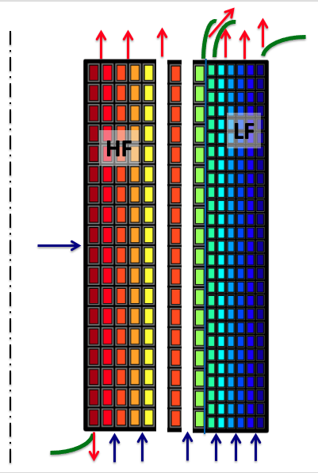
CS Coil Thermal-hydraulics
Coil Winding should be changed, to accomodate an odd number of layers.
The layout would thus schematically appear as:
1st HF termination exiting on one coil side; 2nd HF termination and both LF terminations on the other side
L. Muzzi – ENEA FSN COND – 24/07/2023

Slide 27
CS Coil Thermal-hydraulics
Temperature margin (min. ΔT_{margin}) verified for the layer-wound CS coil, with original strand properties: Ic (@ ref. conditions) > 260 A; Hyst. Losses (+/- 3 T) < 400 mJ/cm³
At EoF – Scenario v14i1 (scaled with max curr, e.g., 34 kA for layer-wound)
Options to «recover» temperature margin?
Further coil design review, adapted to the original strand performance → most likely leading to a magnetic flux decrease;
Sub-cooling of supercritical helium, to 4.2 K (0.3 K less than currently considered as a reference);
Increase of CS current ramp-up time; introduction of a current plateau after reaching Initial Magnetization, to get rid of the heat accumulated during the current ramp
Different cooling layout: He inlet at the center of the innermost layer, thus halving the hydraulic path of the most loaded, highest field, innermost layer.
NOTE: a +/- 30% uncertainty should be considered on computed AC Losses
L. Muzzi – ENEA FSN COND – 24/07/2023

Slide 28
Central Solenoid Coils design: open issues
Issue 4: Distribution of the pre-compression load on the two sub-coils with different stiffness could be “tricky”. Still to be studied and assessed.
Issue 5: Same comment as above, concerning quench detection strategy. Still to be studied and assessed.
L. Muzzi – ENEA FSN COND – 24/07/2023

Slide 29
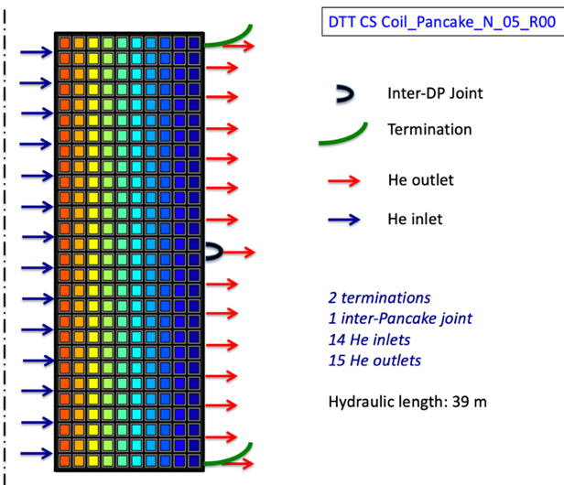
Alternative pancake-wound solution
An alternative pancake-wound option is being considered as well, but not satisfying the physics requirements.
Peak inter-turn insulation is smaller than in the layer-wound;
Axial mechanical loads better distributed on this geometry.
BUT some risks identified in the handling of the innermost turn after Nb₃Sn H.T.
1 inter-pancake joint ; I_{op} = 31.0 kA;
T_{op} = 4.8 K (Top = 6.2 K in layer-wound coil)
 | Pancake –N_05_R00
Winding pack layout | 28 pancakes, with 10 turns each
CICC operating current | 31 kA
# s.c. / Cu strands in CICC | 300 / 129
CICC dimensions (non-insulated) | 27.4 mm x 25.3 mm
Jacket thickness | 3.75 mm
Turn insulation | 1 mm
CICC length per CS module | 2 x 545 m
Winding pack dimensions | 281 mm x 830 mm
Coil inner radius | 479 mm
Module self-inductance | 69 mH
Inter-module axial spacer | 10 mm
Winding features | 1 inter-pancake joint + 2 terminations; 14 He inlets and 15 outlets
Hydraulic length | 39 m
Max. Volt. @ breakdown | 2.7 kV
Max. inter-turn volt. | 195 V (between pancakes 14 and 15)
Ideal / Real Magnetic Flux | 15.9 / 15.6 Weber
L. Muzzi – ENEA FSN COND – 24/07/2023

Slide 30
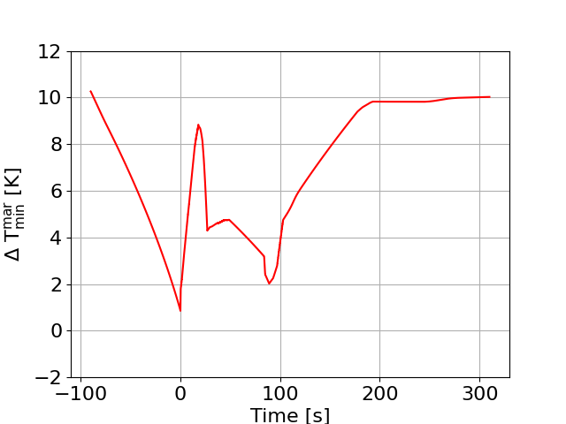
Alternative pancake-wound solution
An alternative pancake-wound option is being considered as well, but not satisfying the physics requirements.
Peak inter-turn insulation is smaller than in the layer-wound;
Axial mechanical loads better distributed on this geometry.
BUT some risks identified in the handling of the innermost turn after Nb₃Sn H.T.
1 inter-pancake joint ; I_{op} = 31.0 kA;
T_{op} = 4.8 K (Top = 6.2 K in layer-wound coil)
Min. ΔT_{margin} not influenced by current scenario
To be re-computed with downgraded wire performance
L. Muzzi – ENEA FSN COND – 24/07/2023

Slide 31
Concluding remarks
The design of the DTT Central Solenoid (CS) coil has proven to be challenging.
Concerns on the integrity of the electrical insulation throughout the machine lifetime. Beside the “normally-adopted” criteria for insulation assessment, a relevant mock-up test will be used for design assessment and acceptance.
A layer-wound, 2-grades coil solution, operating at 34 kA, and providing an (ideal) 17.0 Weber flux still represents the baseline, but a pancake-wound one has been designed as well, providing (ideal) 15.9 Weber.
But “downgraded” wire performance call for a re-assessment of all numbers. A re-design activity will be necessary, to “recover” the minimum required temperature margin.
Some analyses (mechanical and thermo-hydraulic) need still be carried out, and no systematic fault analysis has been undertaken.
Quench detection and coil protection strategy is still to be developed. Quench detection is more difficult in layer-wound coil solutions.
Some optimization on the current scenarios is being attempted to reduce loads.
L. Muzzi – ENEA FSN COND – 24/07/2023

