Slide 1
DTT diagnostic equipment: design progress status
A.Murari ^{2,4} , L.Gabellieri ^{1,3} and M.A.Caponero³, D.Fiorucci³, O.Tudisco^{1,3}
DTT S.c.a r.l Frascati (Italy)^{1,} Consorzio RFX Padova (Italy)², ENEA Fusion and Nuclear Safety Department, Frascati (Italy)³, Istituto per la Scienza e la Tecnologia dei Plasmi, CNR, Padova, Italy⁴
WPDIV-IDTT 2023 Midterm meeting - 17–19 July 2023 ENEA Frascati

Slide 2
OUTLINE
WPDIV-IDTT Diagnostic Area design activities
DTT Diagnostic Equipment: strategy for diagnostic implementation
Design Activities goals
Planning priorities
DAY-0 equipment: requirements and next steps
Diagnostic suites for specific and transversal studies
Issues
S6 session agenda

Slide 3
2023 WPDIV IDTT Divertor Diagnostics Area design activities
DIV-IDTT.S.06 | Proposal Title / Task Title | Project Leader (THM-DIA) | Deliverable Owner | DTT Shareholders | EU Institutions | DTT Funct. Budg. (PM) | WPDIV (PM)
T021 | Bolometry and SXR Tomography, SXR imaging | DTI - G.M.Apruzzese (ENEA) | G.M.Apruzzese (ENEA), F.Bombarda (ENEA), D.Pacella (ENEA) | ENEA,I NFN, RFX,ISTP-CNR, UNIMIB, UNITOV |  | 1,0 | 18,8
T022 | Interferometers and Polarimeters | DIP - D.Fiorucci (ENEA) | D.Fiorucci (ENEA), F.Filippi (ENEA), A.Fassina (ENEA), P.Gaudio (UNITOV), M.Alonzo (ENEA) | ENEA, RFX, UNITOV |  | 2,0 | 12,0
T023 | Active and Passive Spectroscopy | DSP - F.Bombarda (ENEA) | F.Bombarda (ENEA) | ENEA, RFX, POLITO, UNIMIB |  | 2,0 | 15,5
T024 | Neutrons and Gammas | DGN - D.Marocco (ENEA) | D.Marocco (ENEA) | ENEA,I STP-CNR, POLITO, UNIMIB |  | 3,0 | 23,4
T025 | Magnetics Sensors | DMA - G.Artaserse (DTT), M.Baruzzo (ENEA) | G.Artaserse (DTT), M.Brombin (RFX), G.Sias (UNICA), A.Pironti (CREATE), I.Duran (IPP-Prague) | ENEA, CREATE, RFX, UNITUS, CETMA | IPP-Prague | 2,0 | 66,0
T026 | Embedded, IR/VIS cameras and PWI Diagnostics | DWI - M.Iafrati (ENEA) | M.Iafrati (ENEA), M.Alonzo (ENEA), M.Agostini (RFX), M.Spolaore (RFX), S.Almaviva (ENEA), L.Laguardia (ISTP-CNR), M.Caponero (ENEA), M.Houry (CEA-Cadarache) | ENEA, RFX,I STP-CNR | CEA-France | 1,25 | 33,3
T027 | ECE Diagnostics | DEE - S.Schmuck (ISTP-CNR) until 31/05/23 | S.Schmuck (ISTP-CNR), W.Bin (ISTP-CNR) | RFX, ISTP-CNR |  | 4,00 | 11,0
T028 | Reflectometry | DRE - G.De Masi (RFX) | G.De Masi (RFX) | ENEA, INFN,RFX |  | 1,00 | 9,0
T029 | Thomson Scattering Systems | DTS - L.Giudicotti (RFX) | L.Giudicotti (RFX) | ENEA, RFX |  | 2,00 | 5,0
T030 | Run Aways Diagnostics | DRA - B.Esposito (ENEA) | B.Esposito (ENEA), M.Hoppe (VR-KHT) | ENEA, CREATE, UNITOV | VR-KHT-Sweden | 2,50 | 5,9
T031 | Fast Particles Diagnostics | DFP - M.Nocente (UNIMIB) | M.Nocente (UNIMIB), M.G.Munoz (Univ. de Sevilla) | ISTP-CNR, UNIMIB | Univ. de Sevilla | 1,00 | 8,0

Slide 4
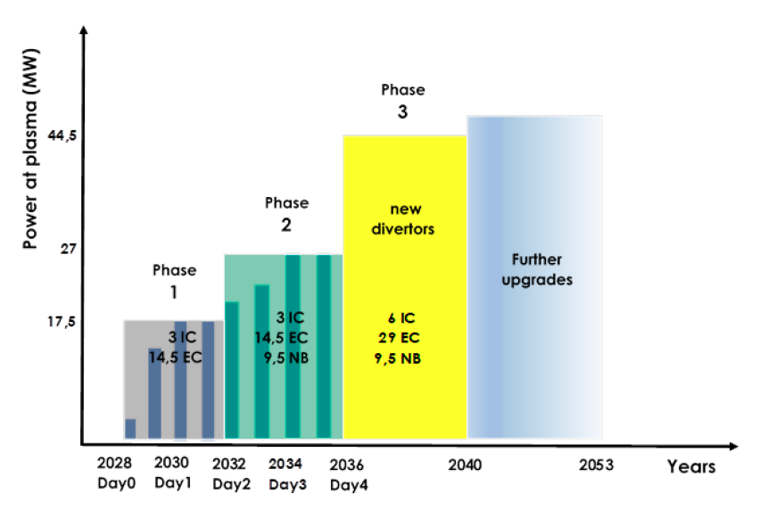
DTT Diagnostic Equipment: Strategy for diagnostic implementation
Good diagnostics coverage in relation to the DTT experiment mission ➔ guess an optimizable as well as complete, diagnostic equipment
In addition to DAY0 equipment, a number of advanced diagnostic systems is anyway being conceived until now to assess interface and integration issues
DTT DIAGNOSTIC EQUIPMENT : ABOUT #80 DIAGNOSTIC TECHNIQUES
DAY-0 ➔PHASE 1 | Machine and divertor protection & plasma control | ~30
 | Science program (Phase 1) ➔ TBD | 0
DAY-2 ➔ PHASE 2 | Science program (Phase 2) ➔ TBD | ~50
The design activities of the DTT equipment, as currently planned, were only started this year 2023 and currently in progress as stated in the 11 DTT Diagnostic Proposals
Day-0 Day-2 Day-4

Slide 5
THM-DIA 2023 Design Activities goals
DAY-0 diagnostic equipment and DAY-2 diagnostic equipment (parts linked to the assembly planning) :
  Finalise Conceptual design (final assessment of interface and integration, remote handling, cooling, vacuum etc …)
  Preliminary estimation of costs (to assess DAY-0 equipment)
  Activity Planning definition (scheduling of Procurement, Assembling and Commissioning phases) (to define dagnostic planning)
DAY-2 diagnostic equipment
Progress on Preliminary Conceptual Design (finalizing allocation, interface and integration, remote handling, cooling, vacuum issues & requirements etc…)

Slide 6
THM-DIA 2023 activities planning priorities
PRIORITIES of the activities have to be aligned to:
machine assembly planning and critical lines of the project
Diagnostic positioning ➔ link conditioning, impact on Assembly planning | Diagnostic positioning / planning link conditioning | Diagnostic Assembly Activities
1 | External Vacuum Vessel | 2026
2 | Internal Vacuum Vessel | 2027
3 | DIVERTOR instrumentation | 2026 - 2027 (tbc)
4 | Outer/Inner First Wall | 2027 (tbc)
5 | Others DAY-0 Diagnostics | 2028
… WHAT IS MORE URGENT TO BE FINALIZED FOR THE PROGRESS of Diagnostic design activities ?
Alignment of the main machine CAD design to the current state of progress of Divertor Cassette, First Wall Outer/Inner design etc...
Completion of Port plug design (RH rails design assessment etc …)
Vacuum Allowed Materials, Baking etc… requirements assessment

Slide 7
DAY-0 equipment requirements and next steps
THM-DIA DataBase | Port, Sector | Inside- Cryostat |  |  |  | Vacuum | Outside - Cryostat | Remote Handling activities | Cabling & Routing | Phase1 (Day-0) / Phase2 (Day-2)
 |  | Ex /In VV | Out/In FW | IVT/CT/OVT Divertor | Port Plug | Window - Feed Trough
 |  |  |  |  |  |  |  |  |  | Protection (machine & divertor) | Essential for operation | Science program
LINK DTT2023 _04165 | Allocation | Descriptions & Requirements |  |  |  |  |  |  |  | Measurement descriptions and classification
This document is updated continuously day after day
… NEXT STEPS to finalize the DAY-0 equipment strategy:
 | WHAT | WHO | WHEN
1 | Validation of DAY-0 equipment adopted strategy | DTT-TCM activities | … discussion in progress …
2 | Cost estimate | 2023-THM-DIA Proposal | End 2023
3 | Definition of Phase 1 Science Program | Research Plan activities | …waiting for …

Slide 8
Diagnostic suites for specific and transversal studies
Diagnostic Equipment for detachment studies and control
Divertor instrumentation: protection and studies
Runaways protection and studies Equipment (including SPI)
Diagnostics for neutral particle profiles
Stray radiation…

Slide 9
Critical points
Dramatic lack of resources: teams very thin on the ground and heavy bureaucratic and organisational burden.
One PL resigning in May and two retiring very soon (both in autumn): strategy to be defined.
Three ROs not available next year: strategy to be defined.
Planning DTT: some diagnostic activities with very tight schedule.
Research plan: priorities to be defined.
Laboratories: availability required soon
Matrix organisation of the diagnostics: required coordinators for diagnostics essential for protection and scientific priorities

Slide 10
WPDIV-IDTT Midterm Meeting 2023
S6 - Diagnostics Tuesday 18th July 13:30-17:00
Duration | Speaker | Title
00:15 | Andrea Murari | DTT diagnostic equipment: design progress status
00:10 | Questions
00:25 | Giovanni Artaserse | DTT Magnetic Sensors equipment: design progress status and planning
00:10 | Questions
00:25 | Matteo Iafrati | DTT InfraRed and Visible cameras, Langmuir Probes and Thermocouples equipment: design progress status
00:10 | Questions
00:30 | Break
00:25 | Francesca Bombarda | DTT spectroscopy equipment essential for machine operation and detachment studies: design progress status
00:10 | Questions
00:25 | Donatella Fiorucci | Interferometers/Polarimeters equipment essential for machine operation and detachment studies: design progress status
00:10 | Questions
00:15 | Discussion & Conclusion

Slide 11
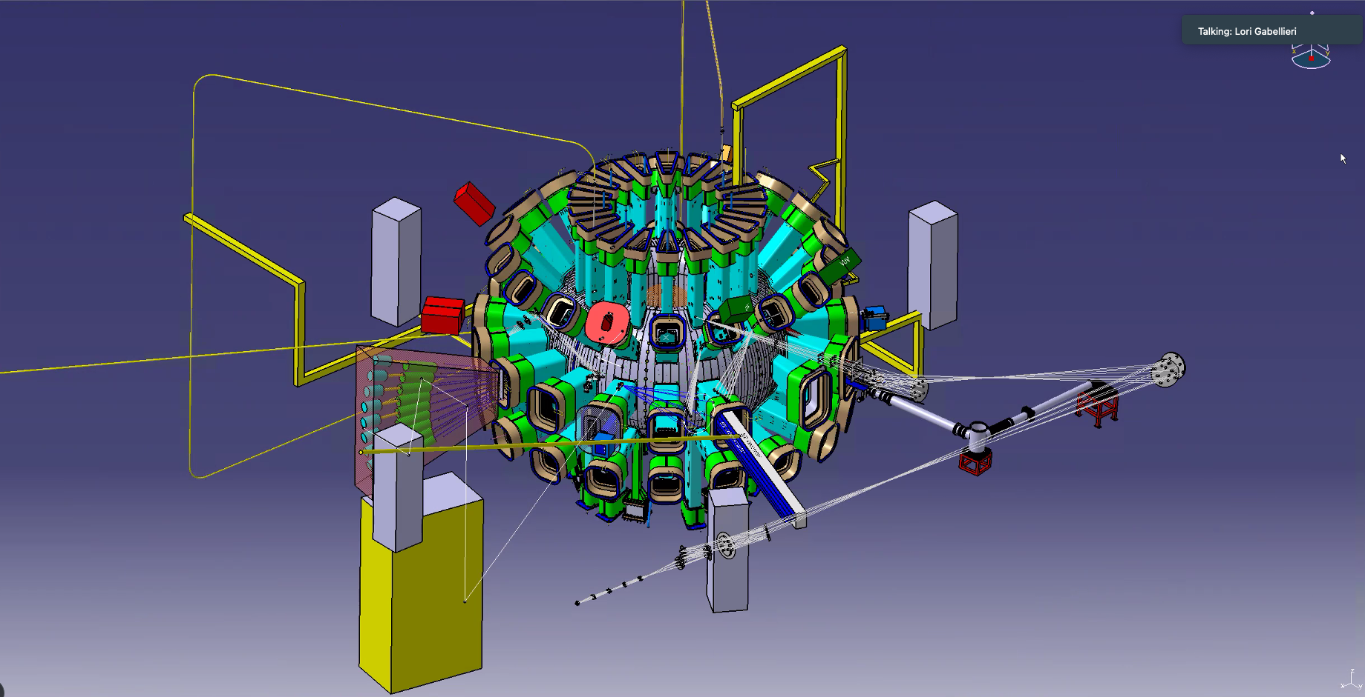
DTT diagnostic equipment: design progress status
A.Murari ^{2,4} , L.Gabellieri ^{1,3} and M.A.Caponero ³, D.Fiorucci ³, O.Tudisco ^{1,3}
DTT S.c.a r.l Frascati (Italy)¹, Consorzio RFX Padova (Italy)², ENEA Fusion and Nuclear Safety Department, Frascati (Italy)³, Istituto per la Scienza e la Tecnologia dei Plasmi, CNR, Padova, Italy⁴
WPDIV-IDTT 2023 Midterm meeting - 17–19 July 2023 ENEA Frascati

