Slide 1











WPDIV-IDTT Project Monitoring Meeting July 2023
AWP 2023
Task title: Project Leader and PSO budget 2023
Deliverable title: PSO Budget 2023
IMS task ID: DIV-P.01.01-T003
DO: Oliver Schneider
TC: Oliver Schneider

Slide 2
Outline
Deliverables 2022
TS 2023 and Budget
TS Approval Procedure

Slide 3
Meeting IDM Link
Please upload presentations to:
  https://idm.euro-fusion.org/default.aspx?uid=2QYC67&newcontentuid=2QYC67

Slide 4
IMS Deliverable 2022 Handling
All DIV IDTT deliverables will eventually be located in one specific IDM folder: https://idm.euro-fusion.org/default.aspx?uid=2PNRWB
Placeholders for all deliverables have been made, and templates have been distributed to DOs
Again, the entire reviewing and approval process will first be done outside of IDM, by email
When sending me a deliverable, please tell me whether the version is agreed with the technical reviewer.
Deliverable Owner and co-authors
Technical Reviewer
PSO Reviewer
R. Neu
IDM

Slide 5
IMS Deliverable 2022 Status
DIV IDTT: 104 Deliverables (2022)
Approved: 42
On IDM uploaded / signed: 3
On PSO desk: 3 (late 2021 deliverables)
Delayed / withdrawn: 3
Received and fully reviewed: 34
Apart from IMS deliverables, there are also 4 open PEP deliverables
  Specification for DTT divertor manufacturing and control feasibility
  Report of interim design definition of DTT divertor prototype
  Detailed drawings and procurement specs on power supplies for in-vessel coils
  Report of final design definition of divertor prototype and interfaces
No Grant Deliverable in 2022, but one grant deliverable in 2023
7 PEP deliverables in 2023, one of them a GRANT deliverable: “Detailed drawings and procurement specs for divertor PFCs”
All 2022 reports not received until ~July 21 might miss the first deadline for payment, which is end of August

Slide 6
Deliverable Owners
Please check your final document for consistency
  Numbering of tables and figures
  Correct cross references
  Style of captions
  Preferred: Use the automatic numbering system in Word and cross references, to minimize errors by manual work
  Preferred: you can use chapter number in Figure number, but please only level 1. Figure 2.1 is okay, but to have Figure 2.1.3 and in the same document Figure 2.2.3.4 is confusing.
Stick with one font for the main text
Please use the templates that I distribute. Do not use FP8 templates.

Slide 7
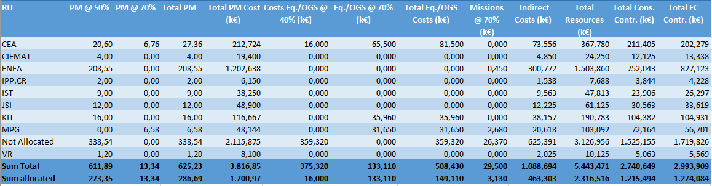
Task Specifications and Budget 2023
All TS entered (62 Deliverables)
Significant deviations from original plan
Approach until further information on use of resources becomes available:
  Enter TS with budget provided by Section leaders
  Convert the remaining 2023 budget originally allocated into PM@50% not allocated and OGS40% not allocated to keep total costs (direct costs + indirect cost; determines EU contribution) and consortium contribution constant.

Slide 8


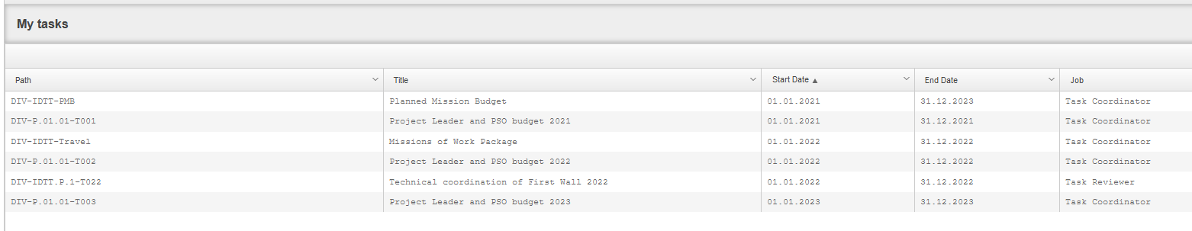
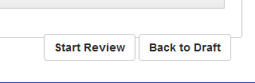

Task Specifications Approval Procedure
PSO
Task Coordinator
Task Reviewer

Slide 9
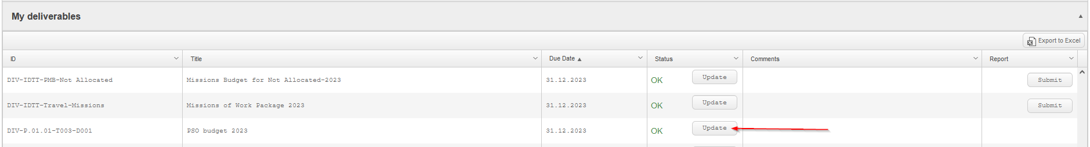
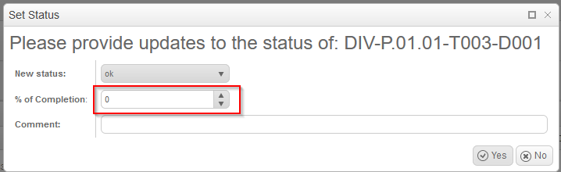
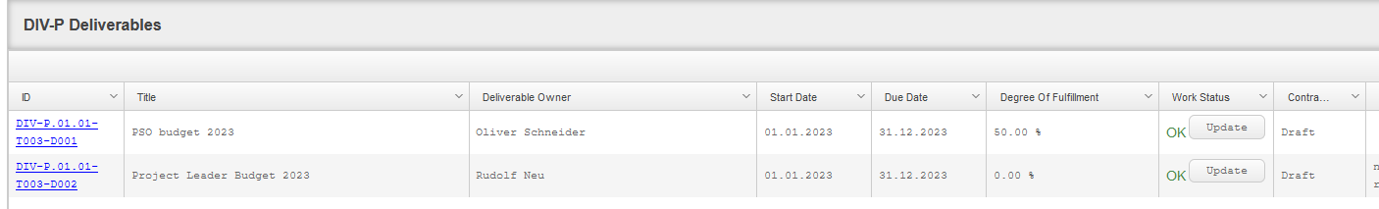
Deliverable Monitoring
PMU would like to have an early warning system for unspent budget
Request to all DOs: enter an information on degree of deliverable fulfilment in IMS, so that budget shifts can be done early:
Here you can enter „delayed“ or „blocked“

Slide 10
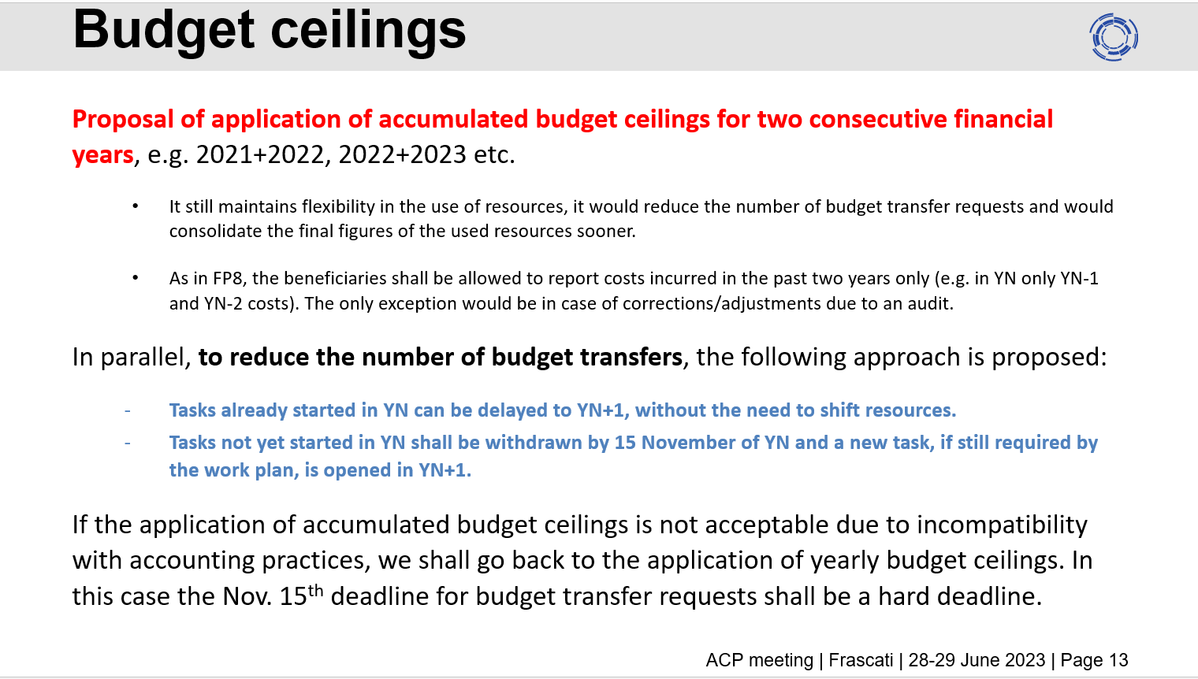
Proposal by PMU to reduce budget transfer needs

Slide 11
Thank you for your attention

