Slide 1

KOM WPDIV-IDTT
2023
Rudolf Neu

Slide 2
IDTT internal organisation
WPDIV
IDTT
R. Neu (IPP)
WPDIV PSO
O. Schneider (IPP)
Div PFC & Cass
S. Roccella
(ENEA)
Div. Pump. Sys.
Ch. Day
(KIT)
Cooling System
A. Cucchiaro
(RFX)
In-Vessel Coils
M. Dalla Palma
(ENEA-RFX)
Codac
G. Manduchi
(ENEA/RFX)
Vessel
M. Dalla Palma
(ENEA-RFX)
Global Model
G. Ramogida
(ENEA)
RH Div
A. Reale
(ENEA)
Diag
M. Valisa
(RFX)
IV Coils PS
A. Lampasi
(ENEA/DTT)
First Wall
S. Roccella
(ENEA)

Slide 3
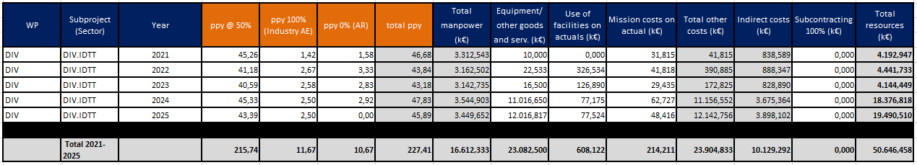
WPDIV-IDTT Resources
Total

Slide 4
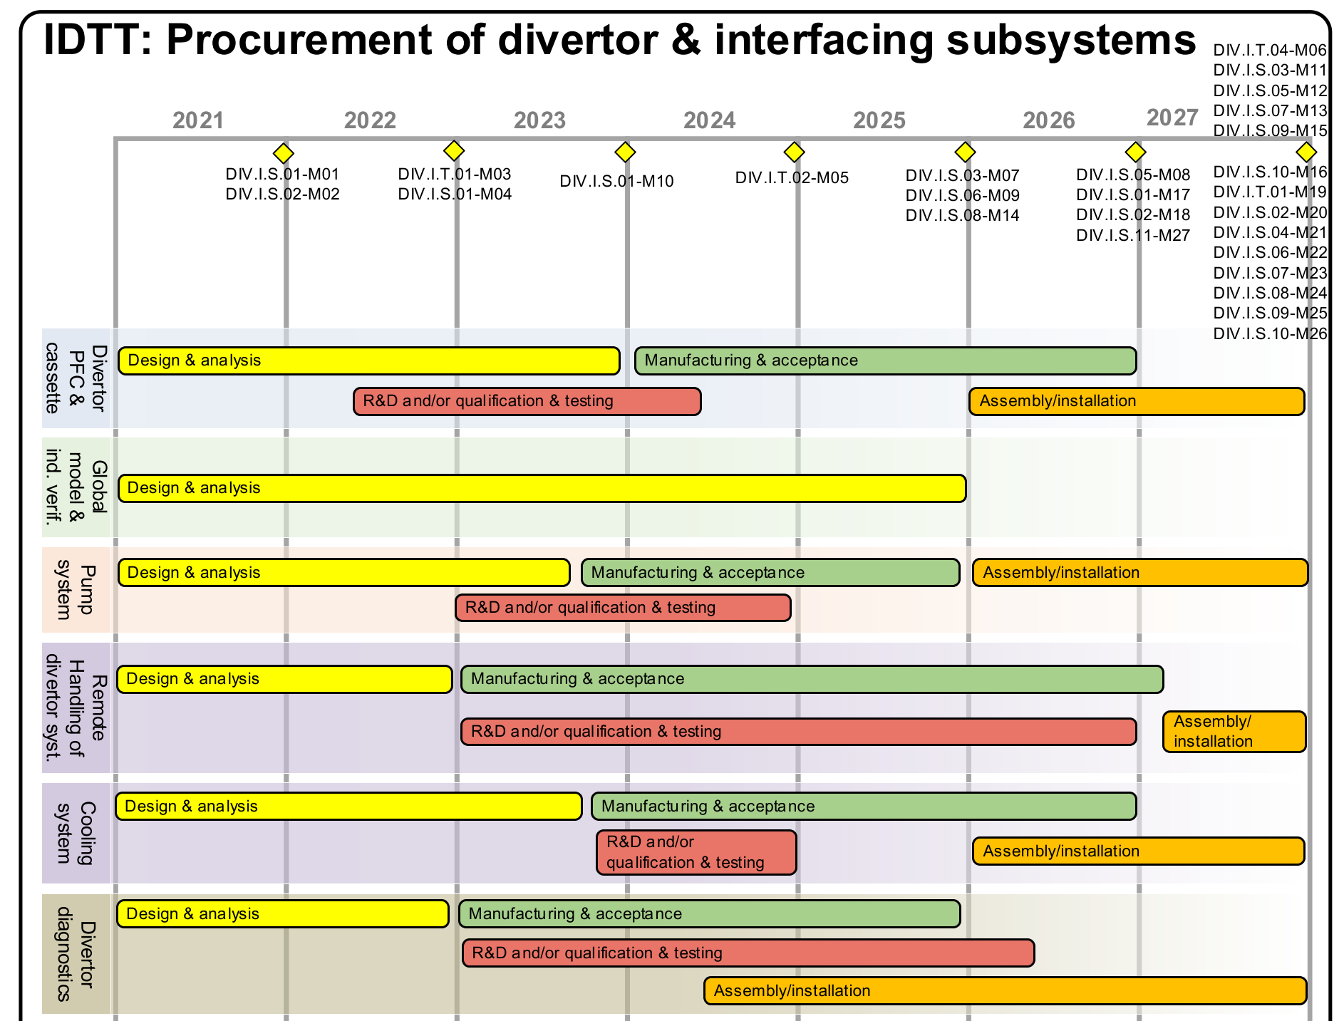
Actual IDTT Gantt Chart
IDTT.M0

Slide 5
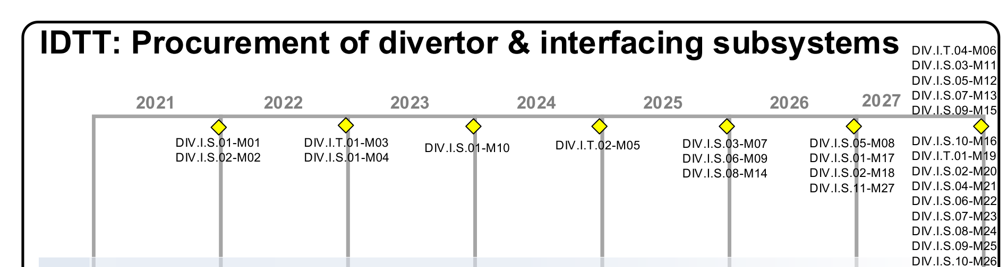
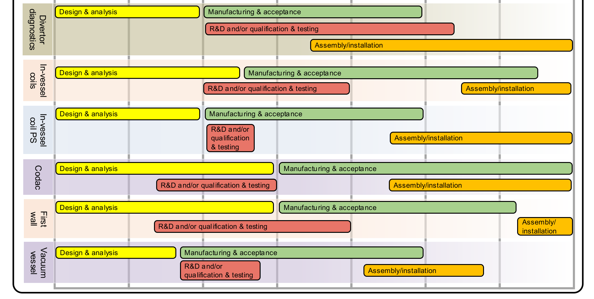
Actual IDTT Gantt Chart
IDTT.M0

Slide 6
Timeline DTT / IDTT
parts of originally foreseen timeline (strongly) delayed
alignment of PEP with updated timeline necessary (after next GA)
change of assembly sequence (delayed Tokamak building) requires renegotiation of IDTT.M0 milestone (DTT ↔ EF GA)
possible reallocation of resources for a timely spending profile:
  facilitate complete and compliant use of allocated resources with FP9
  adhere to frame for consortium contribution
  avoid complications due to depreciation process
LE to check timeliness of milestones and deliverables
(intentional delay/advancing of deliverables and milestones)
⇒ LE to provide input to PL for next update of the PEP

Slide 7
IDTT Milestones until 2025
Milestone ID | Title (short description) | Grant Milestone | Date
DIV.I.S.01-M01 | DTT-Divertor PFC concept complete |  | 2021
DIV.I.S.02-M02 | DTT-Divertor cassette design complete |  | 2021
DIV.I.T.01-M03 | DTT-Divertor PFC R&D and testing complete |  | 2022
DIV.I.S.01-M04 | DTT-Divertor design review 1 completed | DIV.M01 | 2022
DIV.I.T.02-M05 | DTT-Divertor cassette R&D and testing complete |  | 2024
DIV.I.S.03-M07 | DTT-Divertor pumping system procurement complete |  | 2025
DIV.I.S.06-M09 | DTT-Divertor divertor diagnostic procurement complete |  | 2025
DIV.I.S.01-M10 | DTT-Divertor design review 2 completed | DIV.M03 | 2023
DIV.I.S.08-M14 | DTT-Divertor in-vessel-coils power supply procurement complete |  | 2025

Slide 8
IDTT Deliverables until 2023
Deliverable ID | Title (short description) | Grant Deliv. | Date
DIV.I.S.01-D01 | Specification for divertor manufacturing and control feasibility |  | 2022
DIV.I.S.01-D02 | Report of interim design definition of DTT divertor prototype |  | 2022
DIV.I.S.11-D03 | Report of design definition of DTT divertor - VV interfaces |  | 2021
DIV.I.S.03-D04 | Detailed drawings procurement specs for divertor pumps |  | 2023
DIV.I.S.05-D05 | Detailed drawings & procurement specs for cooling system |  | 2023
DIV.I.S.06-D06 | Detailed drawings & procurement specs divertor diag. systems |  | 2023
DIV.I.S.01-D07 | Detailed drawings & procurement specs for divertor PFCs | DIV.D02 | 2023
DIV.I.S.02-D08 | Detailed drawings & procurement specs for divertor cassette |  | 2023
DIV.I.S.07-D09 | Detailed drawings & procurement specs for in-vessel coils |  | 2023
DIV.I.S.08-D10 | Detailed drawings & procurement specs power supplies for IVC |  | 2022
DIV.I.S.09-D11 | Detailed procurement specs for CODAC |  | 2023
DIV.I.S.10-D12 | Detailed drawings & procurement specs for first wall components |  | 2023
DIV.I.S.02-D13 | Report of final design definition of div. prototype and interfaces |  | 2022

Slide 9
DTT Proposal for Remodulation of Resources (GMP)
DTT budget is composed of two area: i) construction; ii) functioning
Design activities are included in functioning budget and are shared among DTT shareholders.
Construction budget is own solely by ENEA and includes different forms of financing.
One of them is the Eurofusion contribution which is divided in:
i) costs for divertor prototype reimbursed at 100%;
ii) support in design activities;
iii) contribution in other expenditure.
reallocation of the resources for design activities is proposed in order to meet the DTT budget distribution.
use EF resources preferentially fur construction activities
Transfer budget from manpower to OGS (other goods and services)
Keep non-Italian manpower at planned level
Keep activities inside S06 (divertor diagnostic) at planned level
In order to guaranty execution of WPDIV-IDTT project execution plan (PEP):
Keep structure (segments) of IDTT, perform monitoring meetings (midterm/end-of-year)
Allocate 1 pm for LEs for reporting

Slide 10
Tasks allocated in 2023
LE tasks (11 Sectors)
Name | Title | Task Coordinator
DIV-IDTT.P.1-T024 | Coordination and management of the Sector Divertor Pumping 2023 | Christian Day (KIT)
DIV-IDTT.P.1-T025 | Diagnostics Coordination Activities 2023 | Andrea Murari (01-RFX)
DIV-IDTT.P.1-T026 | 2023 Divertor Coordination Activities | Selanna Roccella (ENEA)
DIV-IDTT.P.1-T027 | 2023 Global model analyses Coordination activities | Giuseppe Ramogida (ENEA)
DIV-IDTT.P.1-T028 | 2023 RHS Coordination activities | Andrea Reale (20-DTT)
DIV-IDTT.P.1-T029 | 2023 In-vessel coils Coordination activities | Mauro Dalla Palma (01-RFX)
DIV-IDTT.P.1-T030 | 2023 In-vessel coils power supply Coordination activities | Alessandro Lampasi (ENEA)
DIV-IDTT.P.1-T031 | 2023 CODAS Coordination activities | Gabriele Manduchi (ENEA)
DIV-IDTT.P.1-T032 | 2023 First Wall Coordination activities | Selanna Roccella (ENEA)
DIV-IDTT.P.1-T033 | 2023 VV Coordination activities | Mauro Dalla Palma (01-RFX)
DIV-IDTT.P.1-T034 | 2023 Divertor cooling Coordination activities | Marco Utili (ENEA)

Slide 11
Tasks allocated in 2023
Miscellaneous tasks (from 2022 / with non-Italian contributions)
Name | Title | Task Coordinator
DIV-IDTT.S.01b-T003 | Analysis of PFUs in different plasma scenarios 2023 | Emanuela Martelli (ENEA)
DIV-IDTT.S.01b-T004 | Heat Loads and Erosion 2023 | Paolo Innocente (ENEA)
DIV-IDTT.S.02b-T003 | Database of magnetic and thermal field distribution inside vessel and ports - 2022 | Giuseppe Ramogida (ENEA)
DIV-IDTT.S.02b-T004 | Non linear MHD codes disruption modelling for validation of engineering simulations - 2022 | Giuseppe Ramogida (ENEA)
DIV-IDTT.S.03-T006 | Finalisation of the DTT divertor pumping system design | Christian Day (KIT)
DIV-IDTT.S.03-T007 | Neutral gas modelling of the DTT divertor area | Paolo Innocente (ENEA)
DIV-IDTT.S.04-T013 | Risk and critical analysis of the RHS | Andrea Reale (20-DTT)
DIV-IDTT.S.04-T014 | Out-vessel equipment conceptual design including interface & requirement definition (Hot room manipulation, casks, etc) | Andrea Reale (20-DTT)
DIV-IDTT.S.04-T016 | C&W risks analysis 2023 | Andrea Reale (20-DTT)
DIV-IDTT.S.04-T017 | Inner first wall Lifting risks analysis 2023 | Andrea Reale (20-DTT)
DIV-IDTT.S.04-T018 | Conceptual design of RH_Hot_room_manipulation and related interface and requirements management | Andrea Reale (20-DTT)
DIV-IDTT.S.04-T019 | Conceptual design of Port plug cask , interface and requirements management | Andrea Reale (20-DTT)
DIV-IDTT.S.11-T003 | 2023 Simulations to assess activated corrosion products | Mauro Dalla Palma (01-RFX)

Slide 12
Tasks allocated in 2023
Diagnostic development tasks
Name | Title | Task Coordinator
DIV-IDTT.S.06-T021 | Bolometer and SXR tomographies and SXR imaging Diagnostics | Andrea Murari (01-RFX)
DIV-IDTT.S.06-T022 | Interferometers and Polarimeters Diagnostics | Andrea Murari (01-RFX)
DIV-IDTT.S.06-T023 | Passive and Active Spectroscopy Diagnostics | Andrea Murari (01-RFX)
DIV-IDTT.S.06-T024 | Neutron and Gammas Diagnostics | Andrea Murari (01-RFX)
DIV-IDTT.S.06-T025 | Magnetic Sensor Diagnostics | Andrea Murari (01-RFX)
DIV-IDTT.S.06-T026 | IR and VIS cameras, Embedded and other PWI Diagnostics | Andrea Murari (01-RFX)
DIV-IDTT.S.06-T027 | Electron Cyclotron Emission Diagnostics | Andrea Murari (01-RFX)
DIV-IDTT.S.06-T028 | Microwave Reflectometry Diagnostics | Andrea Murari (01-RFX)
DIV-IDTT.S.06-T029 | Thomson Scattering Diagnostics | Andrea Murari (01-RFX)
DIV-IDTT.S.06-T030 | Runaways Diagnostics | Andrea Murari (01-RFX)
DIV-IDTT.S.06-T031 | Fast Particles Diagnostics | Andrea Murari (01-RFX)

Slide 13
Tasks allocated in 2023
PFC development testing tasks
Name | Title | Task Coordinator
DIV-IDTT.T.01-T002 | Manufacturing and experimental activities | Francesco Giorgetti (ENEA)
DIV-IDTT.T.01-T003 | HHF testing 2023 on divertor PFU mock-ups | Selanna Roccella (ENEA)
DIV-IDTT.T.10-T003 | DIV IDTT HHF testing of FW mock-ups | Selanna Roccella (ENEA)

Slide 14
Preliminary Budget Table 2023
Benefi- ciary ID | PM @ 50% | PM @ 70% | Total PM | Total PM Cost [k€] | OGS @ 40% [k€] | OGS @ 70% [k€] | OGS [k€] | Missions @ 70% [k€] | Total Indirect Costs [k€] | Total Resources [k€] | Total Cons. Contr. [k€] | Total Commission Contr. [k€]
IPP.CR | 2 | 0 | 2 | 6,15 | 0 | 0 | 0 | 0 | 1,5375 | 7,6875 | 3,84 | 4,23
CEA | 20,6 | 6,76 | 27,36 | 212,72 | 16 | 65,5 | 81,5 | 0 | 73,556 | 367,78 | 211,40 | 202,28
KIT | 16 | 0 | 16 | 116,67 | 0 | 35,96 | 35,96 | 0 | 38,16 | 190,78 | 104,38 | 104,93
MPG | 0 | 6,58 | 6,58 | 48,14 | 0 | 31,65 | 31,65 | 0 | 19,95 | 99,74 | 69,82 | 54,86
ENEA | 205,65 | 0 | 205,65 | 1185,92 | 0 | 0 | 0 | 0 | 296,48 | 1482,39 | 741,20 | 815,32
JSI | 12 | 0 | 12 | 48,9 | 0 | 0 | 0 | 0 | 12,23 | 61,13 | 30,56 | 33,62
CIEMAT | 4 | 0 | 4 | 19,4 | 0 | 0 | 0 | 0 | 4,85 | 24,25 | 12,13 | 13,34
VR | 1,2 | 0 | 1,2 | 8,1 | 0 | 0 | 0 | 0 | 2,03 | 10,13 | 5,06 | 5,57
IST | 9 | 0 | 9 | 38,25 | 0 | 0 | 0 | 0 | 9,56 | 47,81 | 23,91 | 26,23
Not Allocated | 341,22 | 0 | 341,22 | 2132,63 | 359,32 | 0 | 359,32 | 29,4995 | 630,36 | 3151,81 | 1538,36 | 1733,49
Total 2023 | 611,67 | 13,34 | 625,01 | 3816,87 | 375,32 | 133,11 | 508,43 | 29,50 | 1088,70 | 5443,51 | 2740,67 | 2993,93

Slide 15
Summary & Tasks for LEs
Complete 2023 Task Specifications
Perform Kick-Off Meetings in near future (for Sectors 1,2,3,4,6,10,11;
please put me in the line)
Check PEP milestones and deliverables 2021 – 2025:
- Report delays (for due dates ≤ 2022)
- Discuss necessary shifts (for due dates > 2022)
Review 2022 task specifications
Prepare/oversee preparation of 2022 IMS deliverables
Prepare presentation for midterm monitoring meeting in view of PEP 2023 milestones and deliverables (Frascati, July 17-19, 2023)
Prepare presentation for end-of-year monitoring meeting in view of PEP 2023 milestones and deliverables (Garching, December 4-6, 2023)

