Slide 1











EG-6
Fusion technology developments
S. Brezinsek⁽¹⁾, C. Day⁽²⁾, G. Dose⁽³⁾ on behalf of the Expert Group-6 of the DTT Research Plan
⁽¹⁾Forschungszentrum Jülich GmbH, Institut für Energie- und Klimaforschung-Plasmaphysik, Jülich, D-52425, Germany
⁽²⁾ Karlsruhe Institute of Technology, Karlsruhe (KIT), Germany,
⁽³⁾ University of Rome “Tor Vergata”, Industrial Engineering Department, Via del Politecnico 1, 00133 Rome, Italy
2nd meeting
26-27-28 April 2023
DTT Consortium (DTT S.C.a r.l. Via E. Fermi 45 I-00044 Frascati (Roma) Italy)

Slide 2
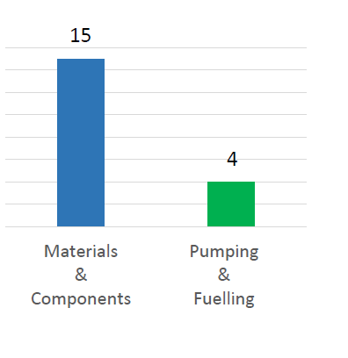
Where we stand
Meetings with the expert group held in January and received 19 proposals
Discussion in February, and following re-work of some of them.
This will be the basis of the chapter 9 content.
Characterisation of materials:
  Coatings, alloys, composites, printed [PWI characterisation measurements]
Characterisation of well-defined pre-damaged materials:
  Artificial defects, cracks,
Testing of new components:
  2nd divertor, FW module
Validation of DEMO technology (pumping, pellet injection)

Slide 3
Outline Structure of chapter 9
Introduction
  Technology aspects have to be in line with DTT mission – trade-off between relevance of technology investigations and associated risk to plasma operation – scientific relevance vs reactor support
Technology Area Materials
Technology Area Components
Technology Area Fuelling and Pumping
References
All proposals discussed/grouped by relevancy (to the fusion timeline in general, not only the EU roadmap) – timeline fit – added effort -

Slide 4
Pumping&Fuelling Topics
Adding additional components to test:
Final validation of new reactor scale DEMO technologies (not tested in existing tokamaks yet):
→ Characterisation of a metal foil pump under real scale external gradient magnetic fields
→ Characterisation of a DEMO type pellet injector (or just not)
→ Integration of matter injection for detachment control
Pellets
Core Fuelling
SOL losses
Gas
Gas
Operating existing technology in a R&D way rather than only as service unit
Exhaust

Slide 5
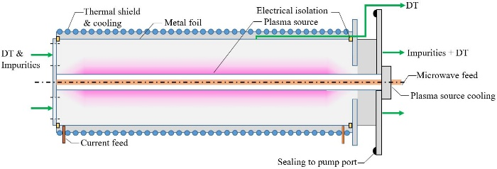

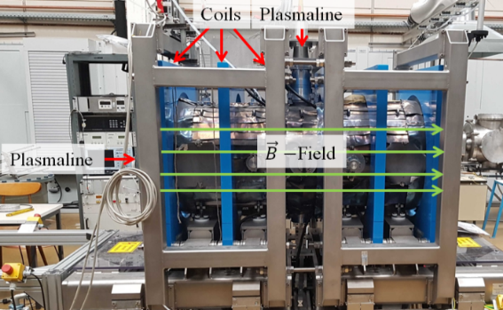
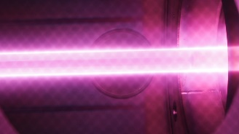
Pumping&Fuelling Topics – The metal foil pump
To characterize a test metal foil pump under reactor magnetic fields (non-uniform, transient)
Pump development completed in 2028 (except for fully representative magnetic field influence)
10 Pa
3 kW, no B
3 kW,
B=250 mT ll

Slide 6
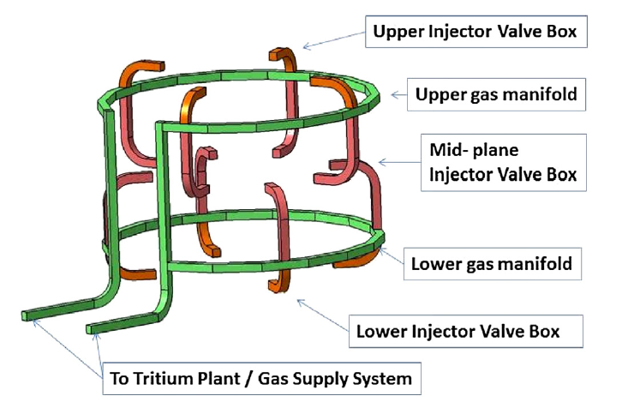
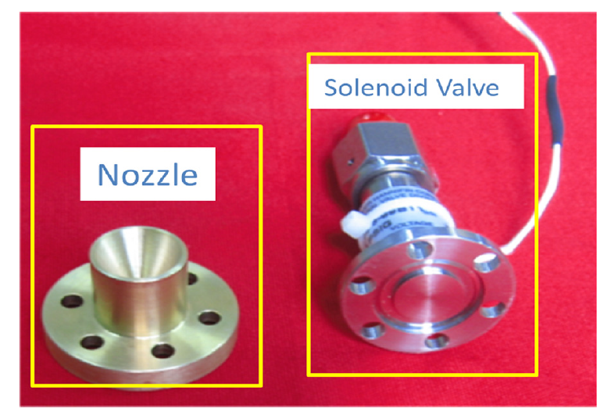
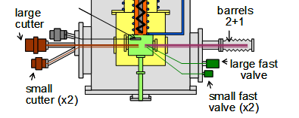
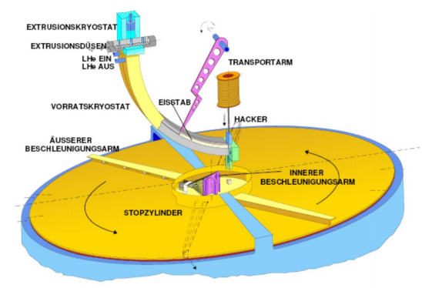
Pumping&Fuelling Topics – Core fuelling
Gas Injection
Pellet Injection
Supersonic molecular beam injection (SMBI)=
pipe + valve + nozzle
Extruder
+ Gas gun
+ straight tube
Extruder
+ Centrifuge
+ curved guide tube
Pipe + valve
Current DEMO route,
Technology available by 2026?
- Understood - - known from EAST - - both unknown for reactor scale -

Slide 7
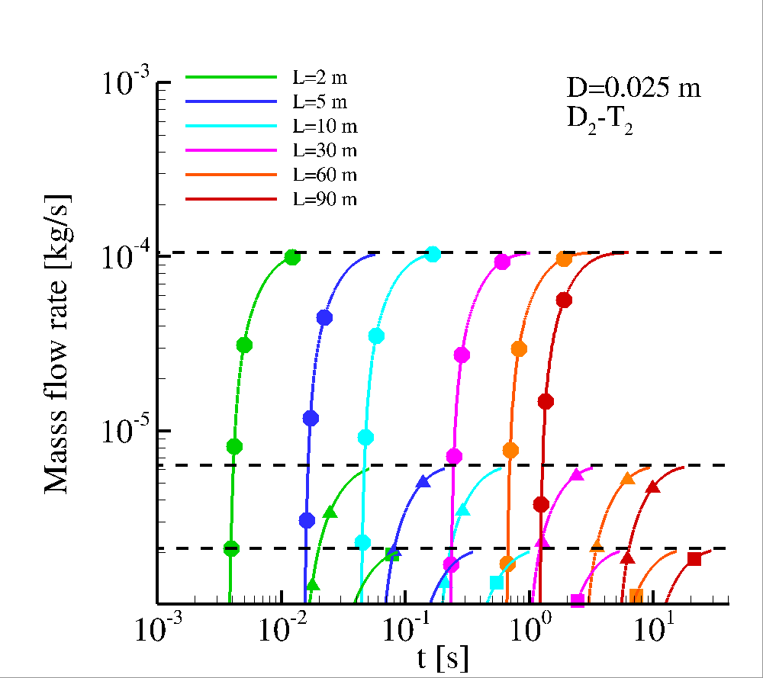
Pumping&Fuelling Topics – Detachment control
To control detachment in the divertor, it is required to introduce matter as actuator in a control loop at very small reaction times
At DEMO scale, simple gas injection will not work.
DEMO needs another technology, which is not defined yet:
  SMBI achieves higher flowrates, but suffers from strongly directed flows (beam rather than cloud) and strong demixing in case of mixture flows.
  Injection of micro shattered pellets (but coupling with low temperature environment is unknown)
Also included in EG-2 list of items
Unique?

Slide 8
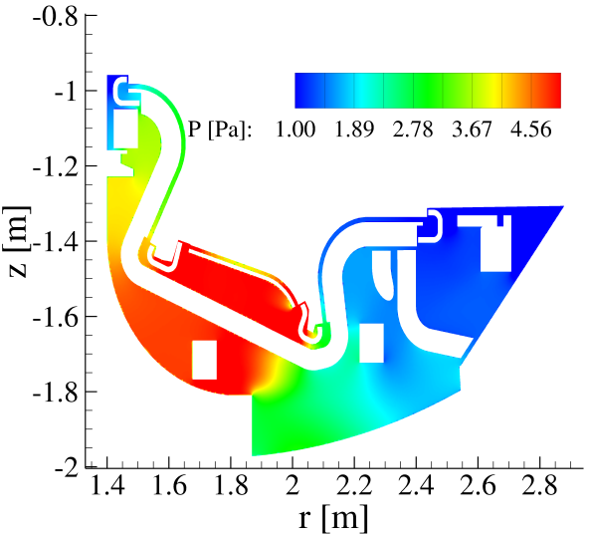
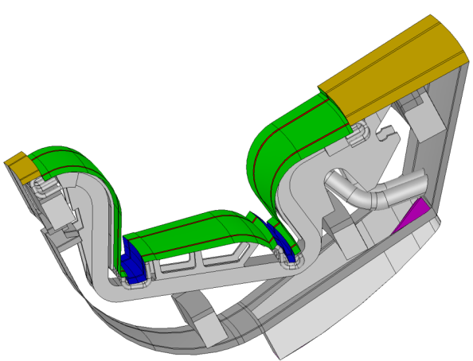
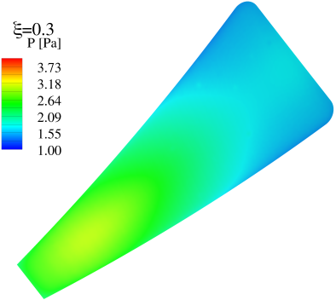
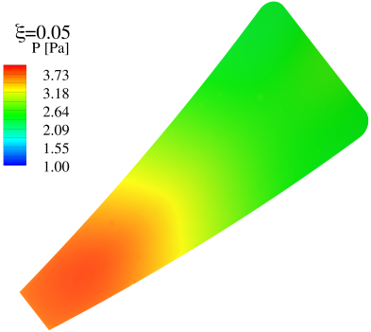
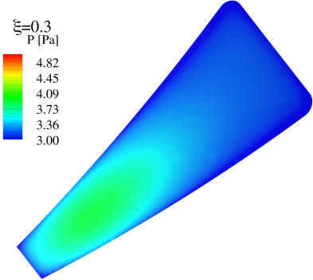
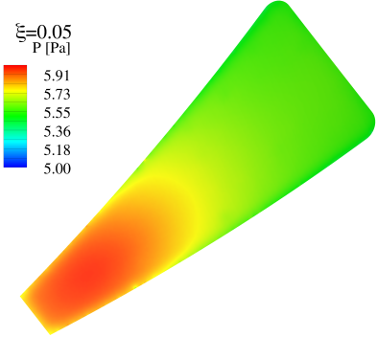
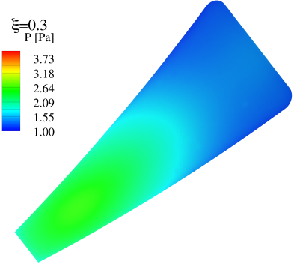
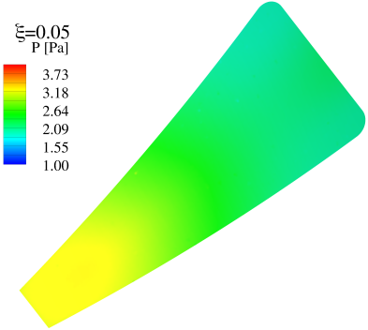


Pumping&Fuelling Topics – Operation to learn
Also included in EG-2
list of items
DIVGAS Code
The existing divertor pumping system has 9 pumps, which can be individually switched off – which allows to study the effect on particle exhaust (as compression in the divertor is not separated from the attached pumping speed) irrespective of chosen pump technology
..and allows for validation of codes (if rich diagnostics are there)
$ξ$=0.3
$ξ$=0.05
Case: basic scenario
Case: Toroidal gaps are closed
Case: Widened poloidal gaps

Slide 9
Materials and Components
A total of 19 Proposal have been submitted
7
15
3
3
4
2
DTT Research Plan – 27 April 2023
1

Slide 10
Materials and Components
Testing of new materials
  W alloys; Composites (WfW, WfCu, FGMs); Thick W coatings; 3D printed W; liquid metal (Tin); insulating materials
  PWI mesurements (LIDS, LIBS)
Pre-damaged components
  Artifical defects; misalignements; cracks on edges; recrystallized; ELM-loads; ion beam; He damage
Testing of new components
  DTT 2nd divertor (optimized); testing of DEMO FW modules; testing of ITER 2nd/DEMO 1st divertor
Other
  Thermohydraulic model for DTT PFC
  Toroidal shaping testing
7
3
3
2
DTT Research Plan – 27 April 2023
1

Slide 11
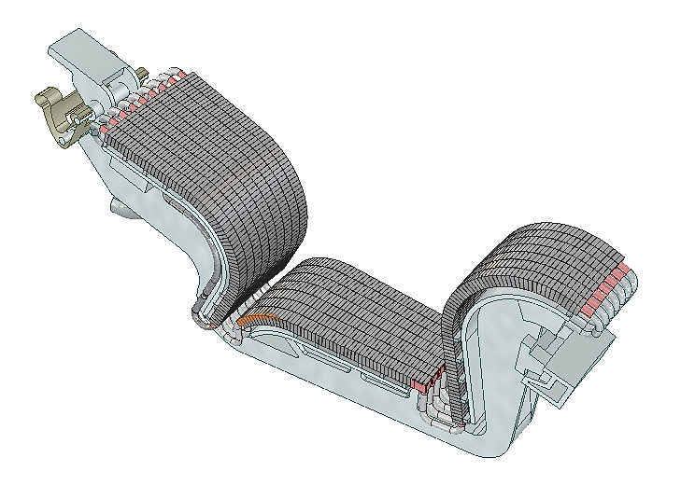
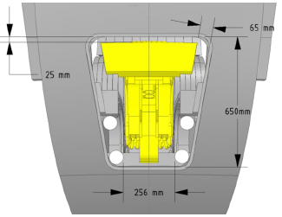
Divertor Test Module
The Divertor Test Modules will be the main tool to test:
Novel materials
Novel components
DTT will provide a testbed where a large area dedicated to material/component studies in tokamaks at reactor relevant particle/heat fluxes
(currently missing in EU)
  Toroidal length of OVT
  ~216 mm
  Toroidal length of IVT
  ~168 mm
DTT Research Plan – 27 April 2023

Slide 12
Status and next steps
Status:
Internal meetings:
- 30th Nov 22: Responsible Officers' coordination meeting
- 25th Jan 23: First meeting with experts
- 30th Jan 23: Responsible Officers' coordination meeting
- 10th Feb 23: Second meeting with experts
Proposal have been collected and evaluated
Next Steps:
Risk and Impact analysis of the proposals on DTT operation/schedule
Start writing so that the experts can have a template to work on
DTT Research Plan – 27 April 2023

Slide 13
Unique contributions to the Fusion Roadmap (max. 5 slides)
Integrated demonstration of technological solutions for the heat and particle exhaust under the whole plethora of extreme conditions (steady state/slow transient/fast transients/PWI) expected in a fusion reactor, in EU or worldwide.
  Innovative Plasma-Facing Components
  Improved Materials for heat exhaust
  Reactor-relevant solution for particle exhaust

Slide 14
Important contributions to the Fusion Roadmap (max. 5 slides)
Improving the understanding of the impact of material damage on the operations
Testing potential engineering solutions which needs validation (composite materials, liquid metals, etc..)
Detachment control – reattachments studies
Model validation for divertor pumping

