Slide 1
Theory Chapter⁺
Chapter 8: Theory and simulation for preparation of experiments
M.V. Falessi*, E. Nardon¹, G. Vlad²
*Center for Nonlinear Plasma Science and ENEA C.R. Frascati
¹CEA, Cadarache
²ENEA C.R. Frascati
⁺Acknowledgment: G. Falchetto, Y. Kominis, M. Gobbin, G. Spizzo, F. Porcelli, F. Zonca*, M. Zuin
CNPS: https://www.afs.enea.it/zonca/CNPS/

Slide 2
Status of the theory Chapter
We defined chapter structure in March meeting;
we have now identified preliminary chapter contents;
we aim to leverage international collaborations within CNPS and EUROfusion to enhance the quality and impact of our work;
further iterations within the group are required before starting the writing process;

Slide 3
Chapter’s outline
8.0 Introduction: DTT uniqueness and mission;
8.1 Weak similarity scaling & DTT;
8.2 Plasma as a complex system: nonlinear equilibria and self organization;
8.3 Gyrokinetic transport theory: general approach & reduced models;
8.4 Integration of theory, simulation and experiments;
8.5 Novel approaches and open problems

Slide 4
Introduction: DTT scientific mission
From ICPP 2022 FZ&DTT Team

Slide 5
8.1 Weak similarity scaling & DTT
From ICPP 2022 FZ&DTT Team

Slide 6
8.1 Weak similarity scaling & DTT
From ICPP 2022 FZ&DTT Team

Slide 7
8.1 Weak similarity scaling & DTT
Different scope compared to chapter 1. Focus on fundamental
physics processes.
From ICPP 2022 FZ&DTT Team

Slide 8
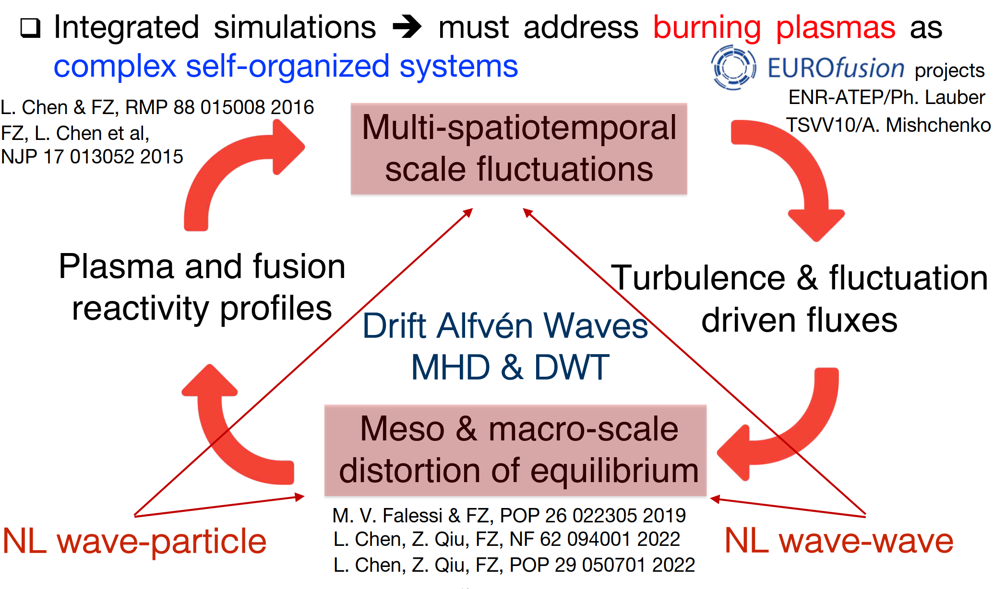
8.2 Plasma as a complex system: nonlinear equilibria and self-organization
From ICPP 2022 FZ&DTT Team

Slide 9
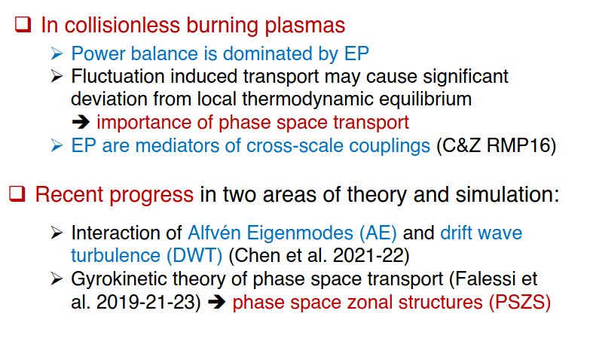
8.2 Plasma as a complex system: nonlinear equilibria and self-organization
From ICPP 2022 FZ&DTT Team

Slide 10
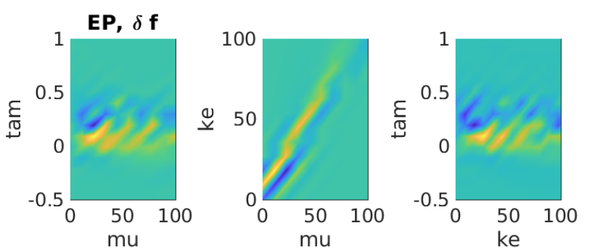
8.2 Plasma as a complex system: nonlinear equilibria and self-organization
From ICPP 2022 FZ&DTT Team

Slide 11
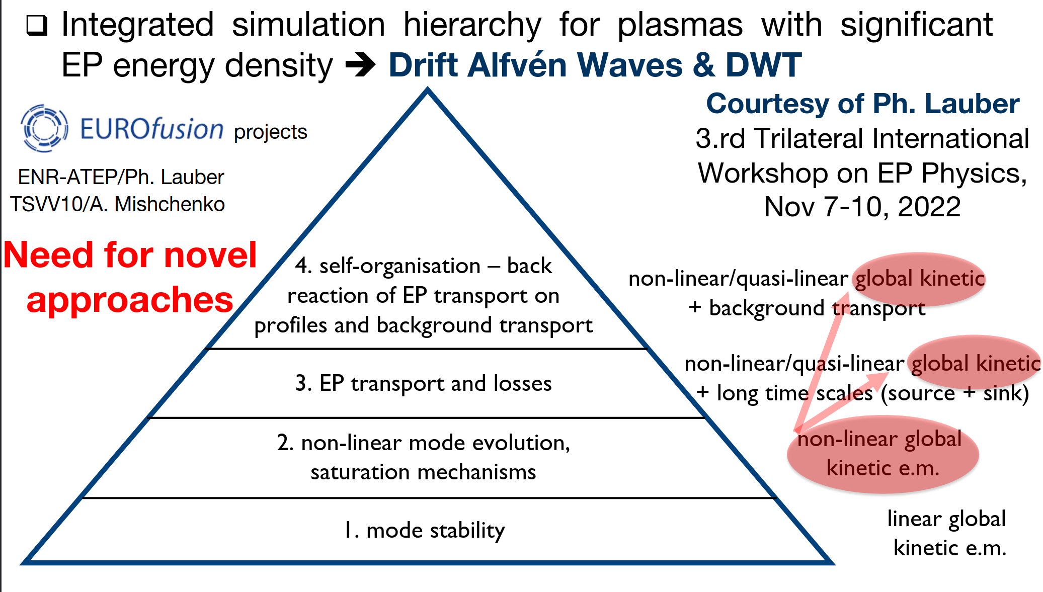
8.3 Gyrokinetic transport theory: general approach & reduced models

Slide 12
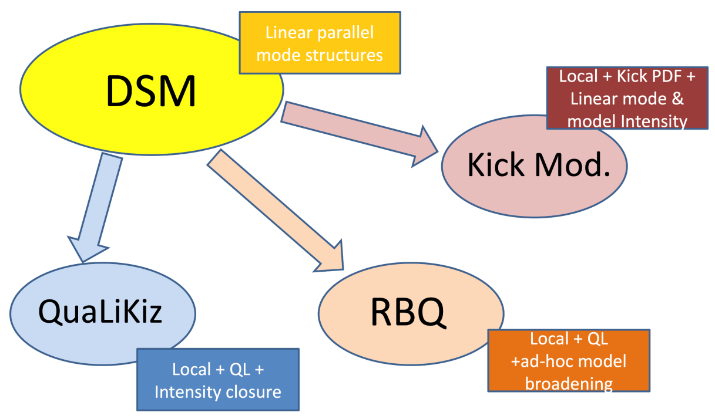
8.3 Gyrokinetic transport theory: general approach & reduced models

Slide 13
8.3 Gyrokinetic transport theory: general approach & reduced models
limitation of present transport approaches.
need of truly global, electromagnetic, Gyrokinetic analyses;
break down of nonlinear Gyrokinetics near plasma edge;
fully nonlinear Gyrokinetic collision operators;

Slide 14
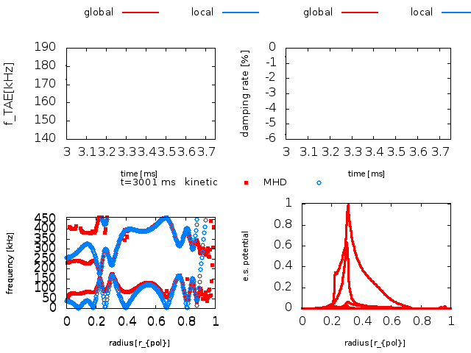
8.4 Integration of theory, simulation and experiments
Importance of building an infrastructure to verify and validate reduced models on DTT;
role of IMAS infrastructure;
Ligka Hagis workflow, synthetic diagnostics;

Slide 15
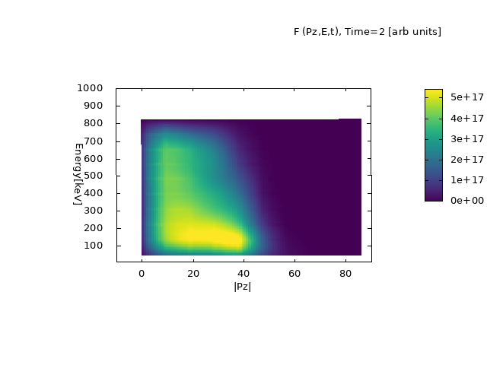
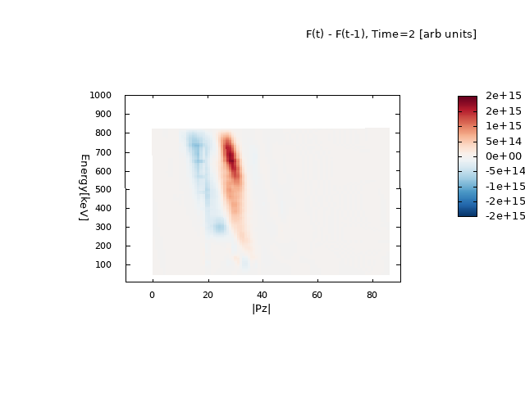
8.4 Integration of theory, simulation and experiments

Slide 16
8.5 Novel approaches and open problems
Limit of present analyses and codes for edge physics
Moment based hybrid/kinetic models
more inputs required by the theory RP group and interaction with other groups e.g., edge related physics

Slide 17
Thank you for your attention!

