Slide 1
Expert Group 4 (EG-4)
Heating, current drive and fuelling
ROs: C. Sozzi, D. Van Eester, P. Vincenzi

Slide 2
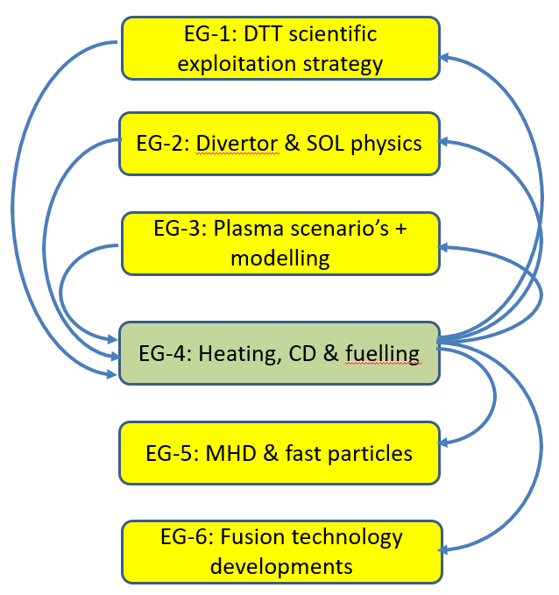
Introduction
4 group meetings held between 1st and 2nd in-person meetings including:
  Meeting with H&CD RO (G.Granucci)
  Talk on fuelling strategies (B.Baiocchi)
  Discussion of the bullet’s list delivere on 1st March
  List of question for other EGs
Aim:
  selection of the main topics to be reported in the first RP edition
  status of the analysis/preparation (before cutting iron) and/or issuing the RP
  indication of important missing points
Please reserve questions/discussion at the end for more coherent view

Slide 3
ECRH topics
Assess (control) capabilities for essential tasks:
  plasma start-up (Assisted breakdown, Burnthrough and assisted current ramp – flux consumption/savings)
  X2M operations (at ½ magnetic field in commissioning)
  electron heating (general evaluation of the deposition/absorption)
  current drive
  mhd control (NTMs, STs)
Assess control capabilities for high priority tasks:
  tailoring of the kinetic profiles
  tailoring of q profile
  Impurity accumulation control (core heating but possibly including edge ECRH absorption? See DEMO modelling)
  H-mode access and exit (ramp-up and down of Ip)
  Transport studies
  Scenario with dominant electron heating, energy transfer e-i
  Operation at high density (with pellet fuelling – pellet notching?)
Other tasks
  ECWC
  ELM triggering/control with ECRH
  Effect of turbulence on power absorption (also relevant for ITER and DEMO)
Exploration of the integrated control capabilities (power sharing to allow parallel/competitive tasks) made possible by the three heating systems

Slide 4
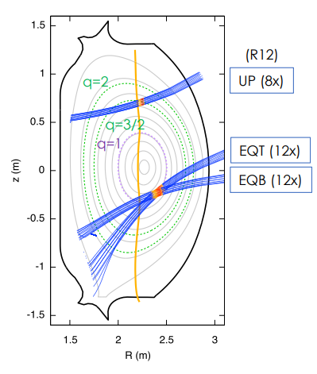
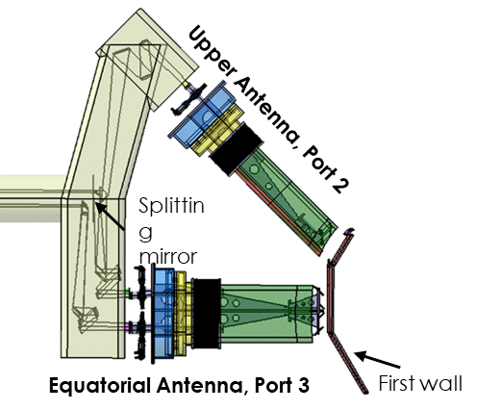
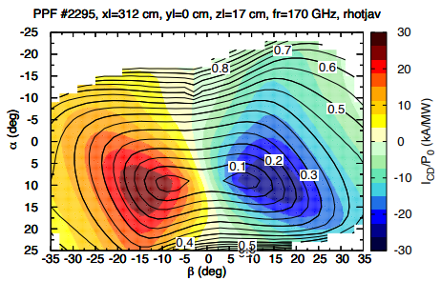
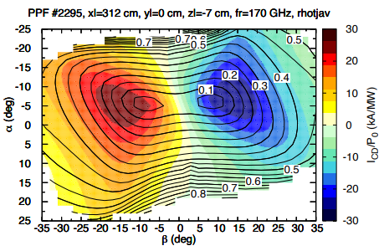
Essential ECRH tasks: core e-h&cd
32 x 1 MW, 170 GHz (Bres = 6.07 T) beams, 28.8 MW at the plasma
4 Upper launchers x 2 mirrors => MHD control
4 Equatorial launchers x 6 mirrors (two rows) => core heating
Baiocchi et al., https://doi.org/10.1051/epjconf/202327701006
DTT Single Null full power scenario (32+8+10), Bt=5.85 T, Ip=5.5 MA, R=2.19 m, a=0.7 m,
Top and Bottom EL driven current per unit power
poloidal
toroidal steering angle

Slide 5
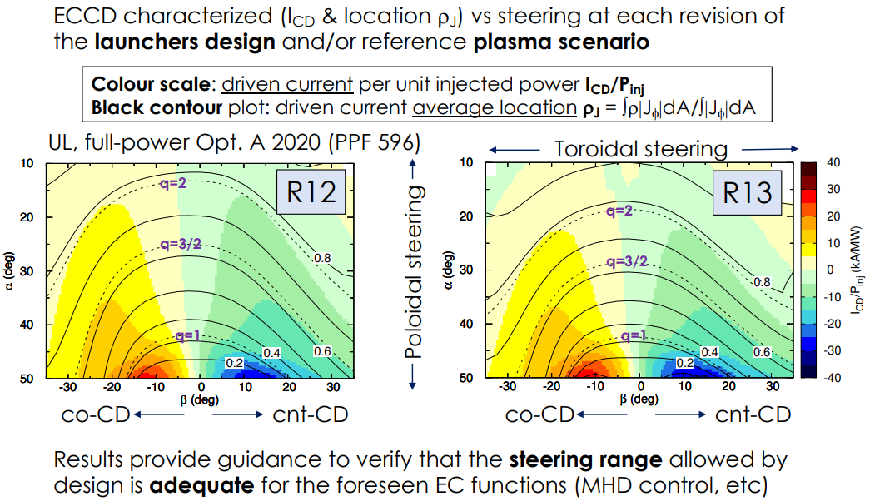
Essential ECRH tasks: rational surfaces access
Figini_DTT_Phys2021_8_3_FM_DTT2022_00751.pdf https://www.dtt-dms.enea.it/share/page/site/dtt/document-details?nodeRef=workspace://SpacesStore/c2bc5363-9fe5-4ccf-a1bc-b477236ff474

Slide 6
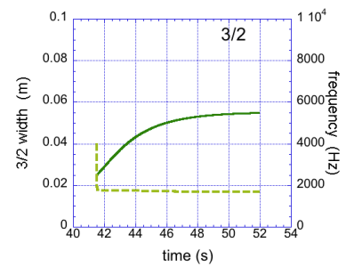
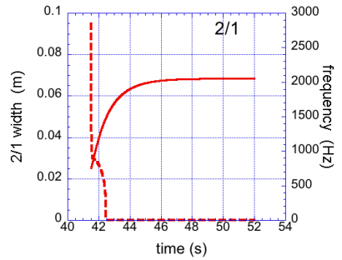
MHD control (NTM)
Predictions of the evolution of the frequency of low order tearing modes (poloidal mode number m=2,3 and toroidal mode number n=1,2) and their locking for reference full power scenarios 5.5 MA and 5.8 T
Braking effect of electromagnetic, inertial and viscous torque included
Stabilization via ECCD not yet investigated
S. Nowak et al., DTT-PHY-MHD - Execution Tasks 2022 - MHD- MSS-05

Slide 7
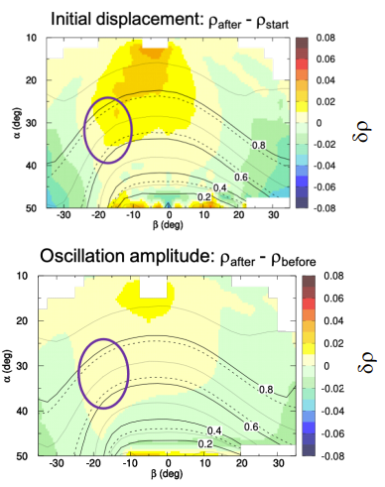
EC analysis in presence of density fluctuations due to pellets injection
Estimation of maximum allowed density perturbation for ECH operation
High density perturbations reduce the accessibility and/or require large angle adjustment (unreliable control of the deposition)
Variation between consecutive pellets <10% (16 Hz) considered
Radial displacement of the absorption for pellet radius <1mm does not require adjustments
For pellet size>1mm δρ~0.04 comparable with the ECCD profile width => adjustment required (2°) to reach the rational surface
Displacement δρ of the ECCD location due to pellets ne modifications by varying toroidal and poloidal angles for reference pellets (1 mm)
B. Baiocchi et al., EPJ Web of Conferences 277, 01006 (2023) – EC21 conf.
https://doi.org/10.1051/epjconf/202327701006

Slide 8
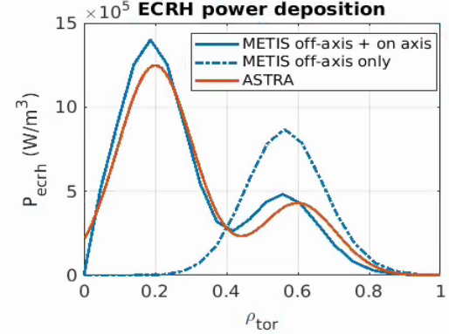
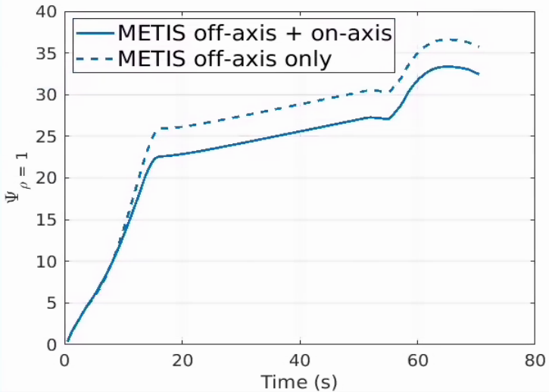
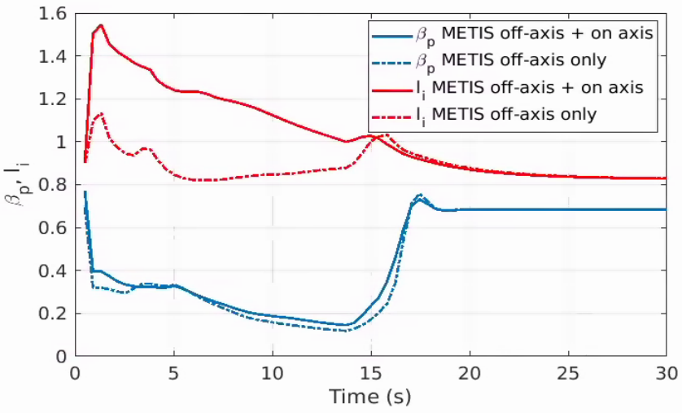
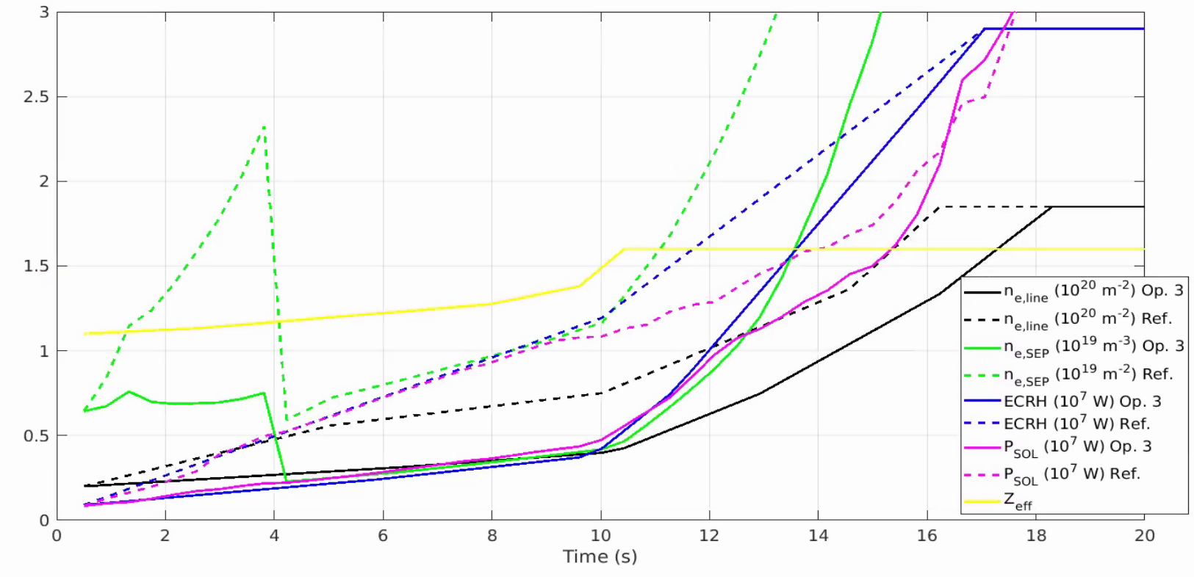
Essential ECRH tasks: start-up, burnthrough and Ip ramp
Heating profile acts on flux consumption (≈+10%)
Strong effect on li during ramp-up
Strong effect of the heating ramp-up on flux consumption
  Impact on li (controllability)
  Impact on Ne_sep
  Impact on P_sol
Work in progress (G. Rubino, https://www.dtt-dms.enea.it/share/page/site/dtt/document-details?nodeRef=workspace://SpacesStore/8c1b1793-5630-4652-9a6d-7cdf3c8f4527

Slide 9
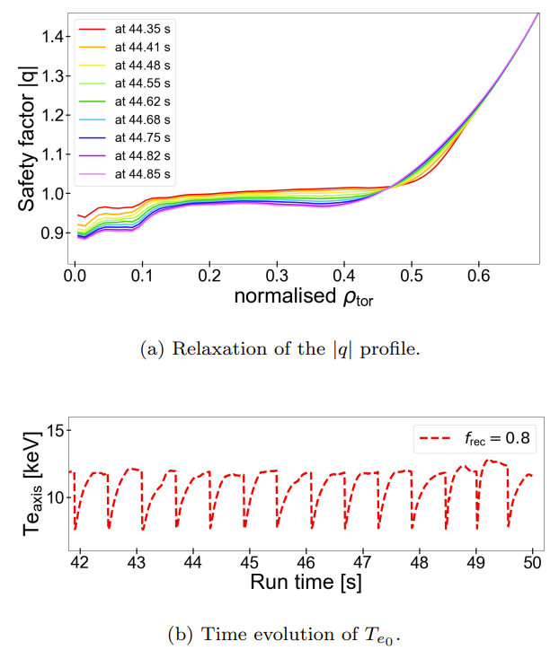
MHD control (ST)
Scenario E1, full power, Porcelli’s model
sawtooth period of 0.59 s (i.e. f_{ST} ≈ 1.7 Hz) and a crash amplitude of 4.2 keV.
Central temperature drop of 35% and large mixing radius (~ρ_{tor}=0.5)
Potential effect of ECRH/ECCD control not yet evaluated
Impact on NTM triggering not yet evaluated
I Casiraghi et al 2023 Plasma Phys. Control. Fusion 65 035017

Slide 10
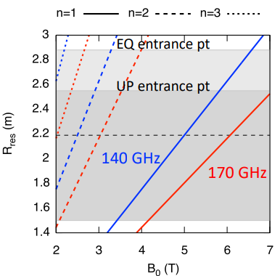
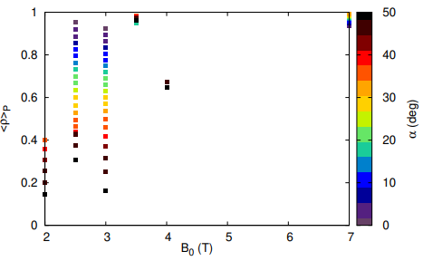
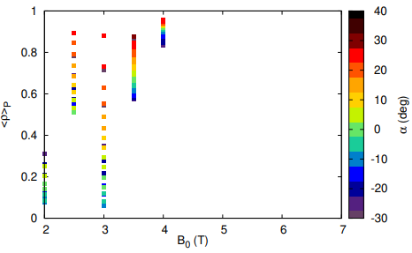
Operation of ECRH at low magnetic field
Magnetic field B scaling at constant q₉₅ and <n_{e}>/n_{GW}
Scaling: B’/B = Ip’/Ip = ne’/ne = Te’/Te
n=2 harmonic (X-mode cut-off at n_{c}=1.8 10²⁰ m⁻³) •
2.1 T < B₀ < 4 T
n=3 in plasma for B₀ < 2.7 T (parasitic absorption)
Operation extended at higher <n>/n_{GW} only for O-mode
Operation at 2.5 T ≤ B0 ≤ 3 T (X-mode), low density is possible, with radial access and I_{CD} performance similar to the nominal scenario
β= -15º, <n>/n_{GW} = 0.4
XM, UP
Figini, DRM July 2020 https://www.dtt-dms.enea.it/share/proxy/alfresco/slingshot/node/content/workspace/SpacesStore/ec558269-2e5a-45ed-abce-81e94c52dc3a/DTT2020_02970_P-DRM-11_07_Figini.pdf?a=true
XM, EQB

Slide 11
Experimental topics (ideas to be discussed)
Physics application of ECRH/ECCD require experimental assessment for optimal development, in particular
  ECRH/ECCD in ramp-up (absorption, scenario access, flux consumption…)
  ECRH/ECCD at high plasma density; operations with pellet fuelling
  MHD control with the various techniques: pre-emptive, seek and suppress etc
  Disruption avoidance (depending on the disruption path: impurities-dominated, density limit, …)
  ECRH & Runaway electrons (start-up re triggering, control, suppression…)
Additional topics
electron heating with significant energetic particle population? Synergetic effects?

Slide 12
Relevance to ITER and DEMO (ECRH)
Technology
  ECRH system RAMI (system reliability, availability, maintainability, inspectability)
  Commissioning time and needs
  Transmission line technology (evacuated multibeam TL)
Physics
  ECRH at high plasma density
  e-i transfer and ion heating in dominant electron heating scenarios
  ECRH broadening due to edge fluctuations

Slide 13
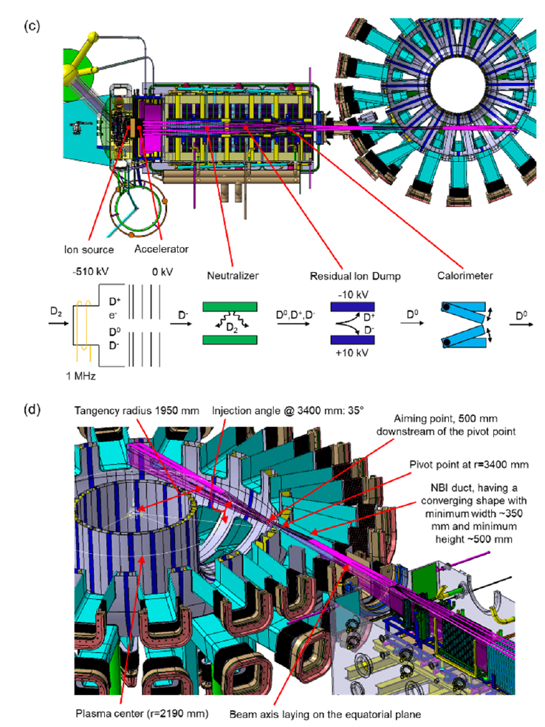
NBI system
Physics-relevant NBI system characteristics:
NBI energy (100 ≤ E_{NBI} [keV] ≤ 510)
NBI power (linear in E_{NBI} from E_{NBI} ~ 250 keV, up to 10 MW)
Modulation times (10s of ms; 0—100% of V_{acc} in 20 to 80 ms)
NBI geometry (on-axis, co-current, beam shape: focus on the port)
H and D NBI operations
NBI system availability:
not available in the short-term phase, but from phase-2. NBI system will need ~2 years for installation from ~2032
DTT Plant Integration Document Version number 3.2 Last update 07/07/2022
Agostinetti et al., IEEE Transactions on Plasma Science ( Volume: 50, Issue: 11, November 2022)

Slide 14
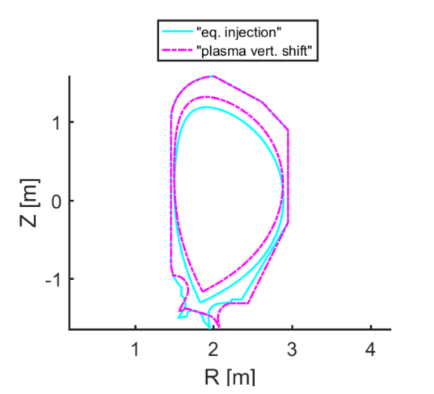
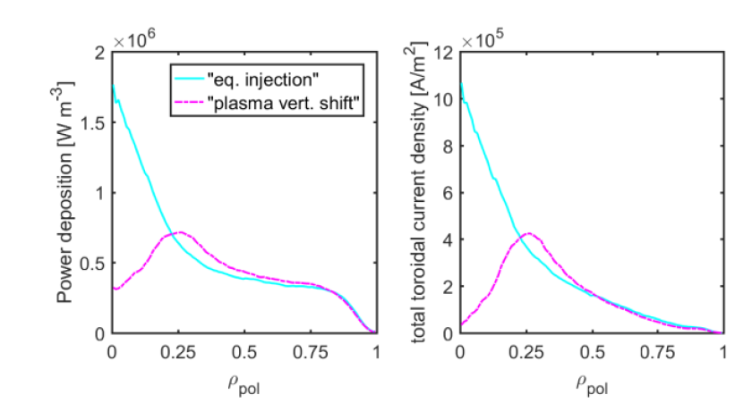
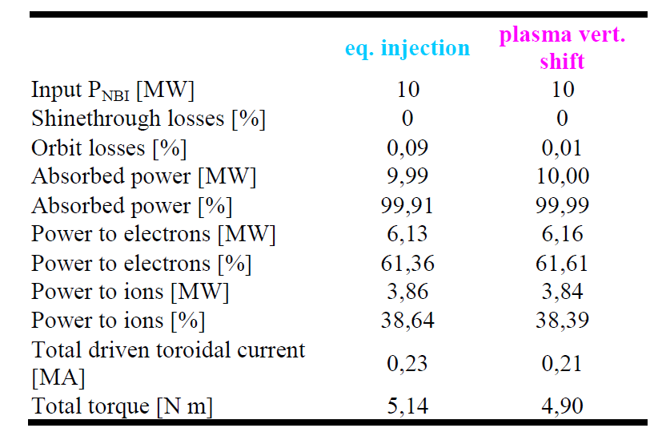
DTT NBI-plasma interaction
DTT NBI capabilities:
Electron/ion heating, current-drive, energy/particle flux, torque injection – limited at high energy, EP population generation)
In the reference, full power scenario (E SN):
The beam is well coupled to the plasma and provide core power deposition (depending on plasma vertical position)
eq. injection: CREATE v13 EM scenario
plasma vert shift (~15 cm): CREATE v14 EM scenario
currently: CREATE v15 EM scenario (~12 cm)
Vincenzi et al., Fusion Eng. Design (2023), 189, 113436

Slide 15
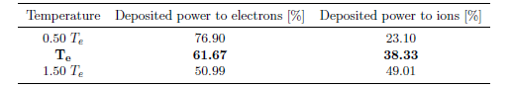

DTT NBI-plasma interaction
DTT NBI capabilities:
Electron/ion heating, current-drive, energy/particle flux, torque injection – limited at high energy, EP population generation)
In the reference, full power scenario (E SN):
Majority of power going to plasma electrons (~60%)
Low current drive in the order of 0.2 MA and torque ~5 N m for ref. E SN plasma
C. De Piccoli, «DTT NBI fast particle modelling with Monte Carlo ASCOT code», 2022, Mater thesis in Physics, Università degli Studi di Padova

Slide 16
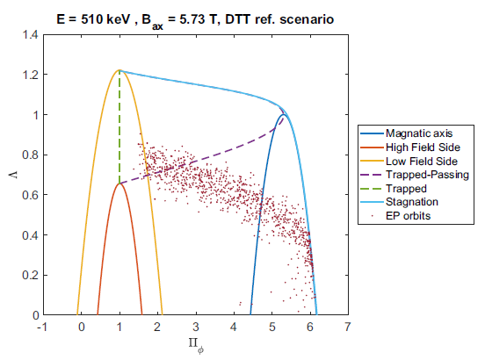
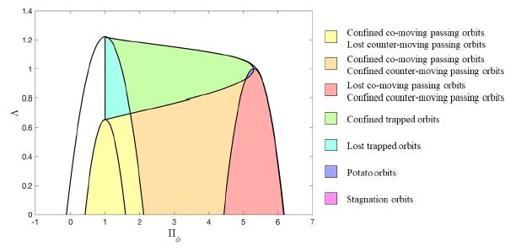
DTT NBI-plasma interaction
Beam EP population generation
In the reference, full power scenario (E SN):
Typical slowing down time for E1 scenario ~0.1 s
Expected “standard” beam EP orbits (passing, banana-trapped) after ionization with limited losses due to co-current injection, while “non-standard” orbits (e.g. stagnation, potato…) are not likely to be seen (but for ICRH…)
NBI+ICRH synergy has not yet been studied
Confinement and losses of beam EPs is reported also in EG5, regarding e.g. ripple losses (see work of G. Spizzo and M. Gobbin)
C. De Piccoli, «DTT NBI fast particle modelling with Monte Carlo ASCOT code», 2022, Mater thesis in Physics, Università degli Studi di Padova

Slide 17
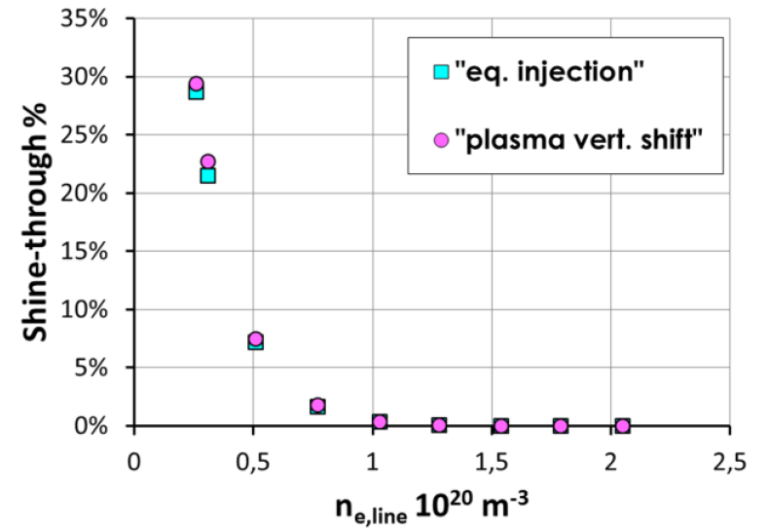
DTT NBI-plasma interaction
Shine-through (ST) limits:
Depending on plasma density, NBI energy/power and FW heat load tolerance, NBI operation may be restricted
Currently, the beam footprint is likely to intercept FW ports of ICRH and ECRH: a discussion is ongoing to investigate this issue and possible solutions
It will be crucial to understand the NBI operational windows in density
Low-density scenarios/plasma-phases may be affected, while flat-top of ref. scenario E should be well above ST limits
REF E SN scenario
Vincenzi et al., Fusion Eng. Design (2023), 189, 113436

Slide 18
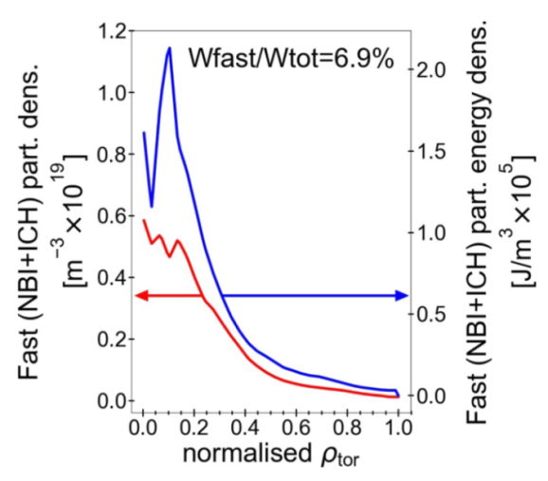
Use of NBI to reach DTT goals
Use of NBI: Modelling is required to assess NBI contribution to different plasma configurations, scenarios, regimes. NBI will be used in: (from draft of “Guidelines_RP_Chap2.docx”, EG-2)
  Main scenarios:
    Phase-2: D (SN), D XD, D NT, D low
    Phase-3: E (SN, ref. full power), E XD, E NT, E low
  Regimes:
    NT L-mode, H-mode, Hybrid, I-mode (NBI counter-current but likely not needed), high β AT scenario, EDA, QCE, QH, WPQH
  Transients:
    Possibility to assist plasma operations in different phases (e.g. transients, end-of-ramp-up, start-of-ramp-down in terms of heating and CD for Vloop saving)
…anyway depending on NBI operability in density
Currently integrated modelling of DTT plasma scenarios with NBI and stand-alone NBI modelling have carried out for ref. scenario E
Integrated modelling is described in DTT RP Ch.2
Casiraghi et al., Nucl. Fusion 61 (2021) 116068
I Casiraghi et al 2023 Plasma Phys. Control. Fusion 65 035017
Integrated modelling of scenario E

Slide 19
Useful experiments to be planned
Useful experiments to be planned:
Regarding NBI system performance:
SPIDER and MITICA experimental campaigns to improve/validate DTT NBI system design (important information on DTT PNBI/ENBI modulation, beam shape, NBI pulse length…):
DTT ion source is similar (but improved) with respect to SPIDER and MITICA source
Plasma grid and extraction grid are similar too
Other DTT NBI system components (accelerator, neutralizator, RID, calorimeter...) are based on MITICA solutions
SPIDER will use NEG vacuum pumps (as foreseen for DTT NBI too), and results are expected on the usage of this technology for large devices
Collaboration with high-NBI energy devices (LHD, JT60-SA) for EP physics and contributions to different plasma regimes

Slide 20
ITER/DEMO relevance
NBI is currently the main heating system of ITER, while for DEMO (or FUTURE) it is being discussed
Only high-energy NBI in high-field device with metallic wall
DTT NBI and ITER NBI system availability timescales are currently similar: possible areas of contributions e.g. ITER PFPO phase, D plasmas
EP population similarities: high B_{t}, high-energy, co-current, low input torque NBI
NBI dominant electron heating similar to ITER/DEMO (NBI and α-particle heating)
Identification of ITER needs/priorities where DTT NBI operation can contribute to, e.g.:
  NBI dominant electron heating
  NBI ionization cross section validation
  NBI-ICRH synergy
  High-energy particle effects on plasma (CD etc)
  …
ITER Research Plan, IO, ITR-18-003, 2018

Slide 21
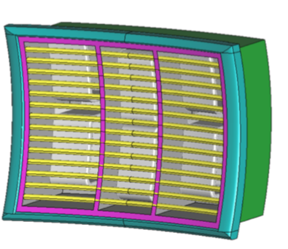
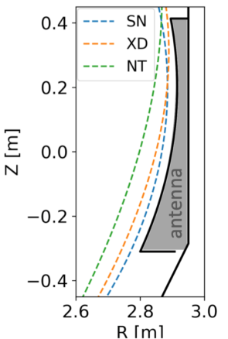
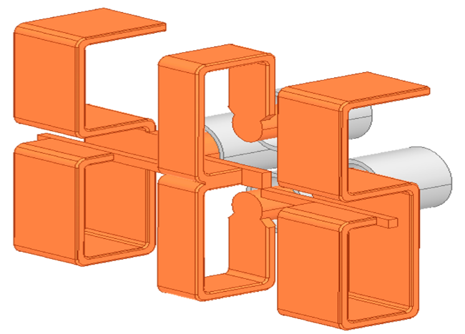
Ion Cyclotron Resonance Heating
B_{o}, I_{p}
ramp-down
lowering T and N
(“landing” = dropping out of H-mode)
plasma start-up
ramp-up
-> low T and N
Intershot:
ICWC
Flat top
RF heating & CD
Synergy
RF pacing
MHD (NTM/ST) control
time

Slide 22
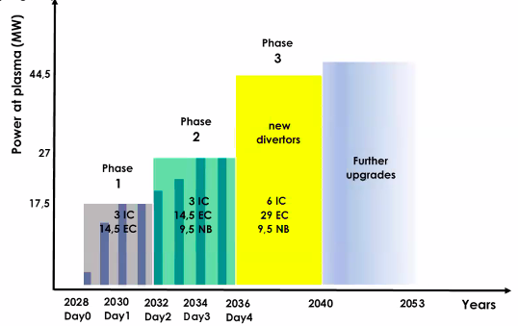
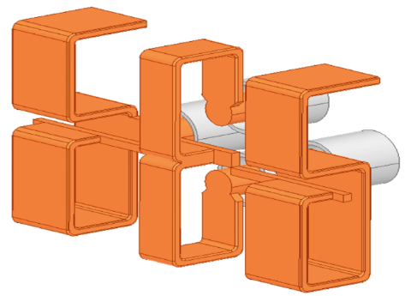
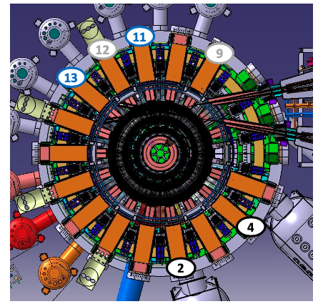
ICRH system characteristics
ICRH available in all stages of the experiment
  DTT Phases I & II: 2 antenna’s @1.5MW/antenna=3MW coupled
  DTT Phase III: 4 antenna’s @1.5MW/antenna =6MW coupled but ≠ mix ICRH/ECRH might be decided
(desired) power/module ~ 4MW
multistage amplifiers end stage
  broadband solid-state amplifiers
  tuning motors allowing intershot f change
transmission lines 9 3/16” EIA standard or RL 100-230 Spinner
transmission lines @50Ohm impedance; close to straps: 30Ohm
VSWR~1.5
frequency range 60-90MHz
TWA option looked into but discarded (broad f-range cannot be covered)
3dB couplers (preferred to external conjugate T for cost and to internal conjugate T for access/risk reasons)
E-field limits inside antenna box set at |E|<2.5MV/m and |E//|<1.5MV/m; stand-off voltage: 35kV (limits based on operational limits on other machines)
further optimization to reduce e.g. RF sheaths (and hence RF induced impurity release) through optimisation amplitudes & phases straps
3D view final design option:
Designated ports:
DTT sectors with ICRF ports in case of 2 (black), 4 (black & blue) or 6 (black+blue+grey) antennas

Slide 23
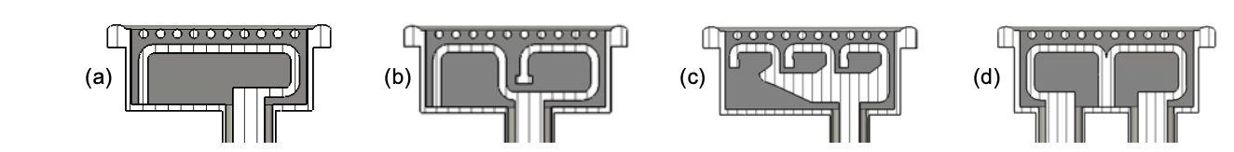
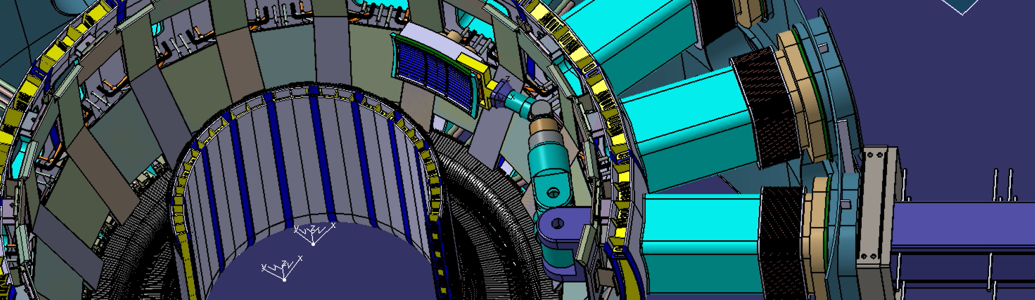
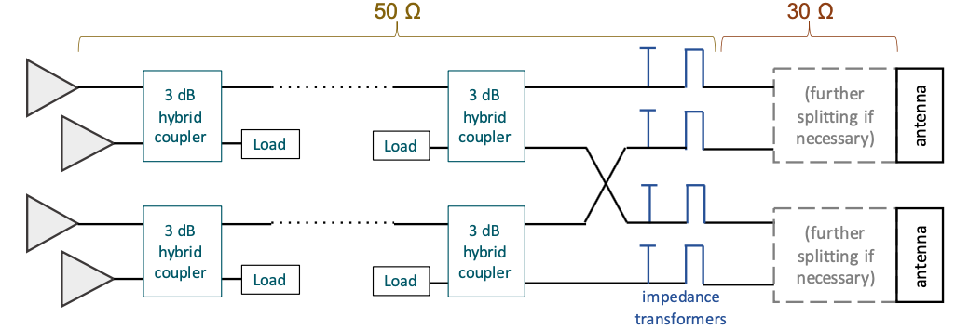
DTT antenna design & matching system
S. Ceccuzzi et al., The ICRF Antenna of DTT: Design Status and Perspectives, RF Power in Plasmas (Annapolis) 2022
Various considered antenna options (final decision : 3-strap antenna with shapes d (central) and b (lateral) straps):
Assembly with remote handling system:
Matching scheme:

Slide 24
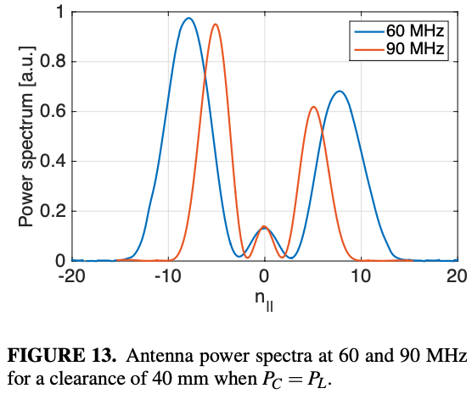
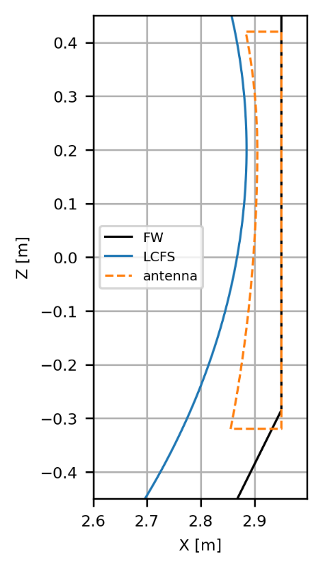
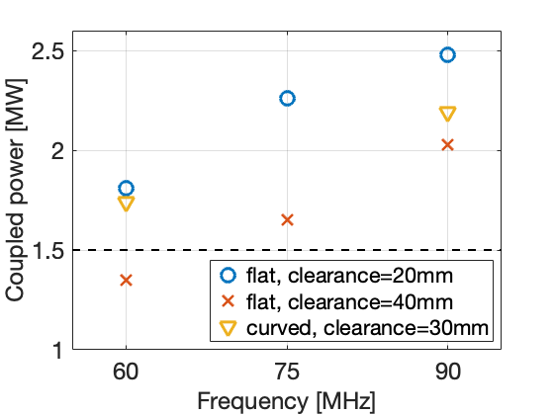
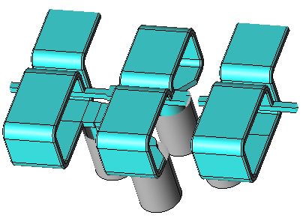
DTT antenna design: coupling studies
S. Ceccuzzi et al., The ICRF Antenna of DTT: Design Status and Perspectives, RF Power in Plasmas (Annapolis) 2022
Antenna spectrum (for balanced strap power)
clearance: 40mm
60 MHz
90 MHz
Coupled power (for balanced strap power)
Antenna shape not tailored to a specific configuration but mostly determined by geometrical constraints.
Shape optimisation in progress.
SN
Response differs depending on antenna design preferred

Slide 25
Available ICRH scenarios: overview & roles
ICRH very flexible:
  steerability damping location: B_{o} and/or f
  ≠ scenarios (minority or “3-ion” small minority, majority, beam) scenarios in foreseen frequency range (60-90MHz)
  full and half-field options
Synergy options ≠ heating mechanisms
Transport study options: power modulation and localized damping
MHD study options: EP creation, pacing
N=1 OK at low T: ramp-up & “landing” after high-performance
Phasing options for core damping & avoidance RF induced edge sputtering

Slide 26
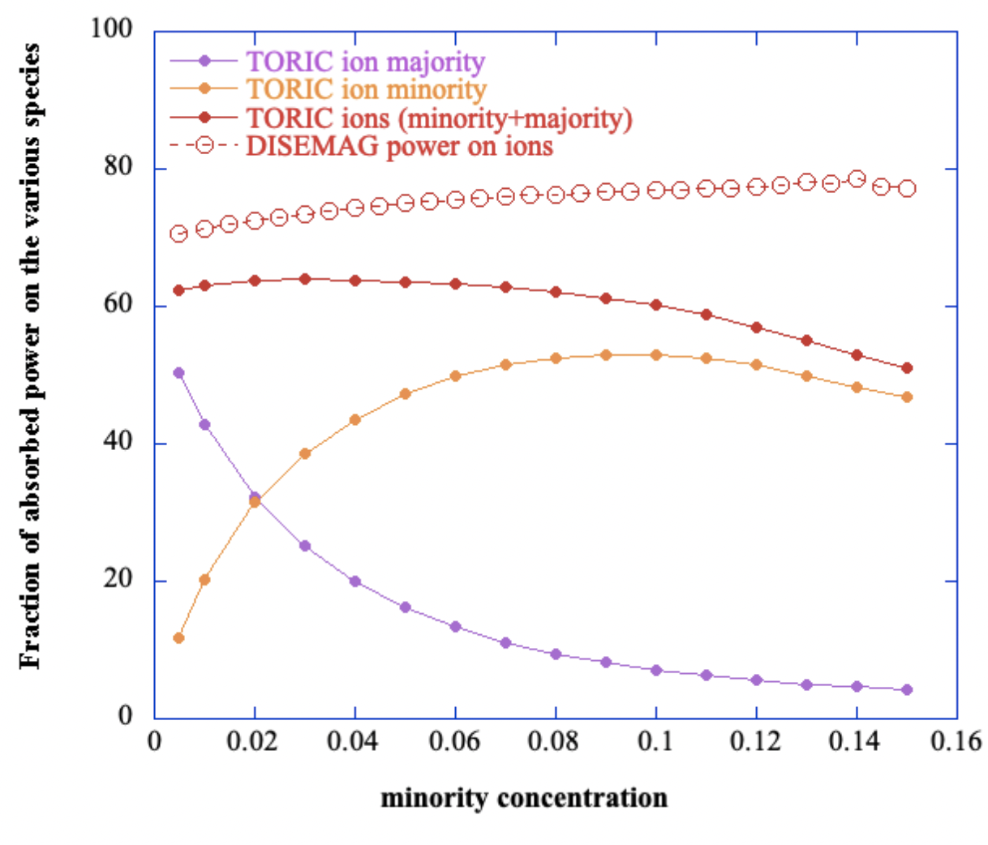
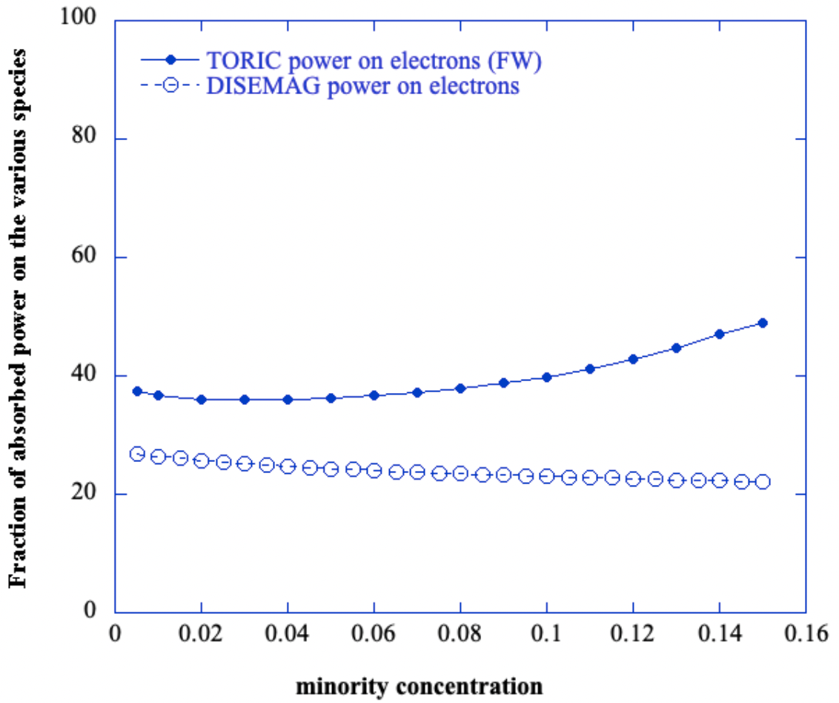
ICRH core heating & tail formation
A. Cardinali et al (2020) Study of ion cyclotron heating scenarios & fast particles generation in the DTT facility, PPCF 62 044001 ]
A. Cardinali et al (2022) Numerical investigation of Ion Cyclotron Resonance Heating (ICRH) Physics in DTT, J. Phys.: Conf. Ser. 2397 012017]
Direct wave absorption: (N=1 H)+ N=2 D heating
f=85MHz
n_{tor}=25
n//=4.8
H+D
H minority
D majority
electrons

Slide 27
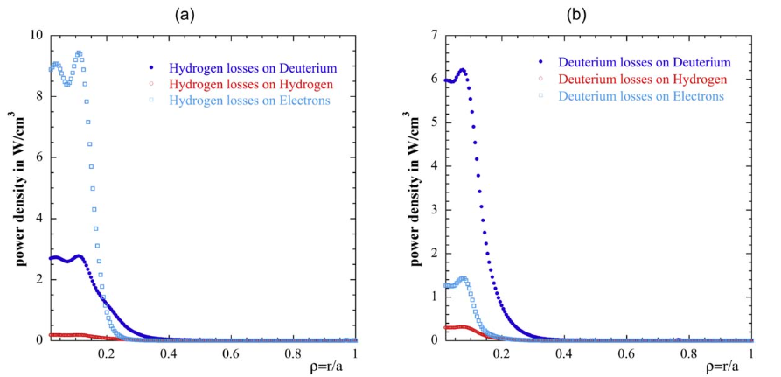
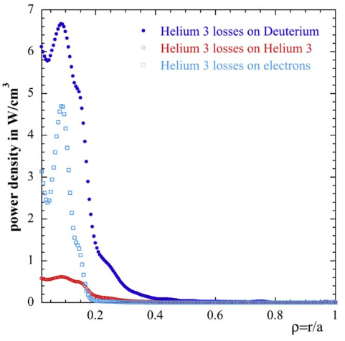
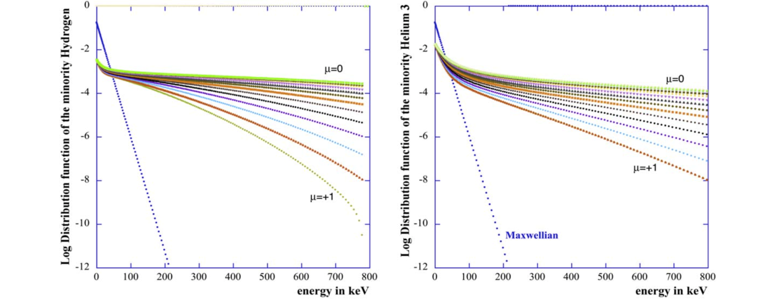
ICRH core heating & tail formation
A. Cardinali et al (2020) Study of ion cyclotron heating scenarios & fast particles generation in the DTT facility, PPCF 62 044001 ]
A. Cardinali et al (2022) Numerical investigation of Ion Cyclotron Resonance Heating (ICRH) Physics in DTT, J. Phys.: Conf. Ser. 2397 012017]
Indirect (Coulomb collisional) wave absorption
Tail formation
H minority
³He minority

Slide 28
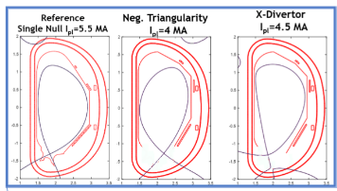
Relevance DTT (& its systems) for ITER/DEMO + define possible tasks to prepare for ITER/DEMO
  DTT aims at exploiting ≠ plasma configurations: allows understanding
    impact overall plasma shape on performance
    performance of heating systems challenging circumstances
  DTT will study high vs low B_{o} operation:
    ITER e.g. has 1/3, 1/2 and full field phase; DEMO foresees similar systems “testing” phase
    requires ≠ scenarios; ICRH is flexible to assist in many types of plasmas
  ICRH earmarked experiments for ≠ configurations tested; study
    impact (non-negligible) distance plasma-antenna on coupling
    impact mitigating actions to improve coupling: gas (impact on plasma-edge interaction, recycling, …)
    ICRH wall conditioning
    role ICRH ramp-up and “landing”
    role synergy ≠ heating methods
    impurity mitigation (relative phasing & amplitude ≠ straps)

Slide 29

Fuelling
Not clear if this should not be part of EG-2 or EG-3. Why dedicated effort inside EG-4?
Present set of slides is only attempt by “non-specialists” …
David Terranova providing input: Thanks!

Slide 30
Relevance fueling for DTT objectives
  Reaching desired density requires fuelling via gas and/or pellets
  Impact fuelling on performance
    ≠ gas/pellet injection position yields
      ≠ pumping
      ≠ penetration in main plasma
      ≠ confinement
      ≠ ELMs
      …
  In view of DTT mission to explore ≠ plasma shapes to assess impact on divertor, fuelling will play a key role in ensuring as “identical as possible” plasmas when comparing ≠ configurations + help improving overall performance through optimisation

Slide 31
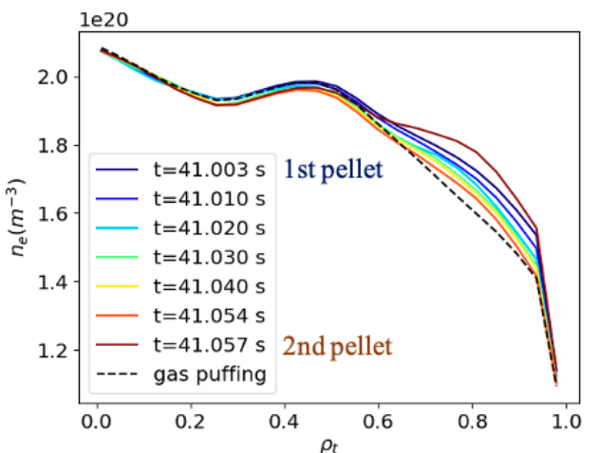
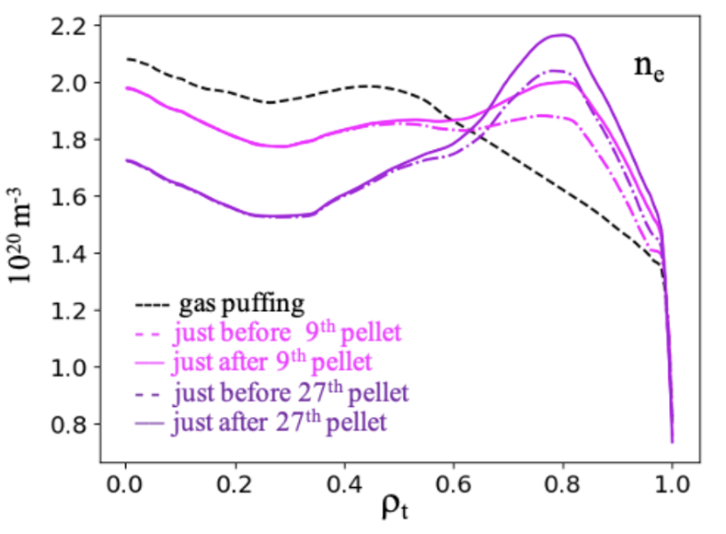
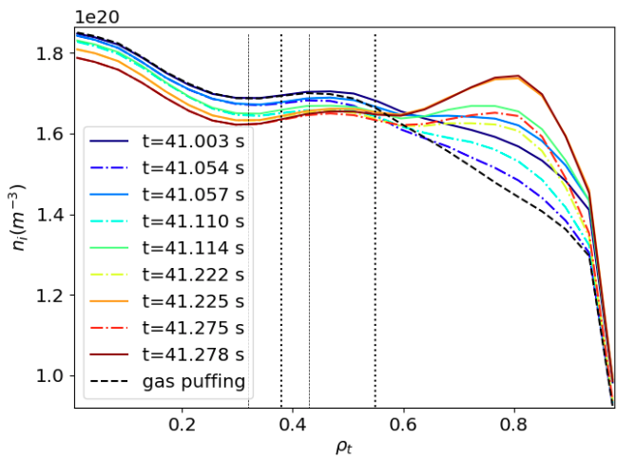
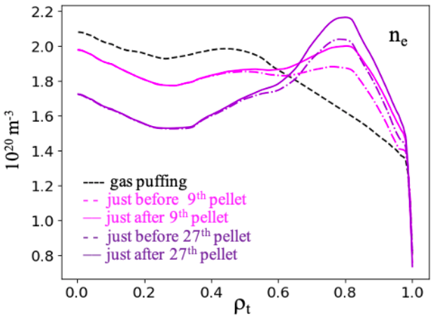
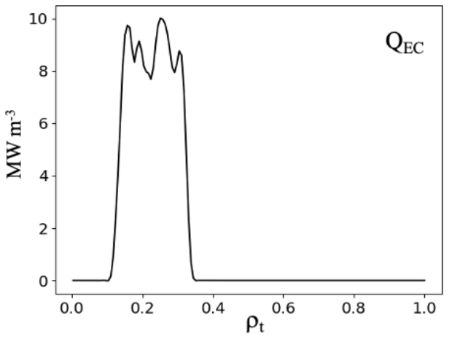



Example modelling: gas vs pellet fuelling
B. Pégourié et al., EXTRA - Common milestones PEX/DTT, Topic 4: - CEA-01 Neutrals and impurities model and pumping, PPPT IDM reference EFDA_D_2M4P9J (WPPMI; deliverable PMI-2.3-T011-D001)
[B. Baiocchi et al (2023) Core transport modeling of the DTT full power scenario using different fueling strategies, in preparation for submission]
Simulation of density profile evolution for DTT full power scenario E1 calculated using QuaLiKiz using gas puff (black) or pellets (color). Computations performed with narrow or broad deposition, the latter avoiding TEM dominance.
Ne seeding
ECRH power deposition
Ar seeding
Ne seeding
ECRH power deposition
Ar seeding

Slide 32
Relevance for ITER/DEMO & define possible tasks to prepare for ITER/DEMO
  For each of the ≠ divertor configurations tested:
    Study experimentally impact gas/pellets (proposing dedicated experiments - - TORT); first assess by modelling as guidance
    Study impact on other aspects of the physics
  Role of fueling & pellets still not fully clear (e.g. ELM triggering) --> DTT provides info for wide range of scenarios & shapes.

Slide 33
Fuelling/edge physics
  Specific physics fuelling:
    gas and pellet injection as local source
      neutral density and pressure
      ionisation
      plasma-wall interaction (physical and chemical sputtering, …)
    influence on other aspects
      pedestal / H-mode (ELMs,…)
      heating efficiency (e.g. indirectly via RF coupling)
    transient vs steady state effects

Slide 34

Fuelling technology
  describe foreseen gas inlets
  describe pellet injector
  detailed info to be gathered to write Chapter 6
The only viable for HFS injection (required for fuelling) due to injection line curvature

Slide 35


ELM-pacing injection location
Need fast code with simplified analysis: NGS model
Possibly good to assess the injection location for ELM pacing.
Need info on injection frequency.
Pellet radius about 0.5mm
Pellet speed around 100 m/s

Slide 36
Diagnostics needs
Physics parameter | Diagnostics | ECRH | ICRH | NBI | Fueling
Core density | interferometer | X | X | X
Electron temperature | ECE fast radiometer | X | X | X
 | ECE interferometer (Michelson) | X | X | X
 | Thomson scattering | X | X | X
 | ECE for MHD control | X
Ion temperature | CXS |  | X | X
Magnetics |  | X | X | X | X
Impurities | Spectroscopy (VUV) |  | X
Isotope ratio | Spectroscopy (Vis) |  | X
EC stray | Stray detectors and sniffers | X
Fast particles | NPA |  | X | X
 | neutrons |  | X | X
 | Lost particles (FILD, FIDA, Faraday cups…) |  | X | X
Edge density | Li beam |  | X |  | X
 | Langmuir (near ICRH antenna) |  | X |  | X
 | reflectometer |  | X |  | X
Edge composition | Light and mass spectroscopy
Beams characterization | Shape, attenuation, shine-through |  |  | X
Ablation & pellet trajectory | Fast cameras |  |  |  | X

Slide 37
(Required) Simulation tools [ICRH]
  Need for integrated simulation: core/edge; transport/heating; …
  Need to (attempt to) predict impact on various scenarios in ≠ configurations : higher realism = higher reliability
  Need to have close contact with ≠ other EG’s (NOT part of chapter 6 but chapter 6 result from interaction with EG’s):
    Core description: optimisation scenarios (EG-3)
    Edge description: impact mitigating tools (EG-2)
  Adopted tools
  so far:
  *) antenna design: CST, HFSS, COMSOL, COMSOL-Matlab, TOPICA
  *) core heating:
  - TORIC (2D FLR2 wave equation solver)
  - FELICE (1D FLR2 wave equation solver)
  - DISEMAG (all-FLR dispersion solver)
  - SSQLFP bounce averaged Fokker-Planck code
  exploit IMAS/ETS? -> for discussion
  ICRH induced plasma-wall interaction: No explicit DTT info is available; assemble broader info for Chapter 6.

Slide 38
(Required) Simulation tools [Fuelling]
  Need for integrated simulation
  Need to (attempt to) predict impact on various scenarios: higher realism = higher reliability
  Need to have close contact with ≠ other EG’s, in particular
      Edge description: impact mitigating tools (EG-2)
  Adopted tools for dedicated edge study
    EMC3-EIRENE?
    EDGE2D-EIRENE?
    SOLPS4.3?
    Use IMAS?
  Describe plasma-wall interaction

Slide 39
Required simulation tools [ECRH]
Adopted so far: ECRH/ECCD modelling with GRAY code
  Consider Real Time version for operational use (already ongoing?)
  Consider coupling with RT-GRE for MHD control (already ongoing – e.g. RAPTOR suite?)
  Consider ECH deposition broadening due to edge turbulence (see e.g. J.H. Slief et al 2023 Nucl. Fusion 63 026029)

Slide 40
Tentative conclusions + discussion
Discussion:
  Interaction with ≠ EG’s : How and needed up to which point?
  More integrated modelling when modelling scenarios: IMAS?
ICRH
  Work progressing well
    Impressive amount of work on antenna design – final design decision awaited
    Key heating schemes explored
    Basis for writing Chapter 6 for ICRH available but …
  Extra info on ≠ various points needed/welcome
    Performance under ≠ circumstances (ramp-up, landing, …) not yet widely studied
    More integrated modelling: actual shapes etc. accounted for (DTT’s main mission is study of ≠ shapes and its impact on performance, divertor in particular …)
Fuelling
  Only crude general notions so far
  No proper expertise among present RO’s …: to be integrated in description scenarios and/or SOL or appoint dedicated RO?

Slide 41
Modelling (to be done or to be expanded)-NBI
It could be worth to be ITER-relevant also in modelling by using IMAS from the beginning
List of topics (prioritized)
Definition of NBI operational window for different plasmas
NBI in different plasma scenarios, configurations, regimes
NBI energy/power modulation effect on plasmas
NBI/ICRH synergies
Maximization of ion heating
CD in low density/half Bt/half Ip to access advanced plasma scenarios
Heating/CD in ramp-up/down
NBI in reversed Ip configuration (I-mode)

Slide 42
Further assessment needed (ECRH)
Working points (tbd before writing ch.6):
  Implementation of the requirements in the launcher design (within the practical constraints, e.g. interaction with the sides of the ports)
  q=2 access
  Evaluation of the control capabilities (comparison with GRE computations for NTM stabilization)
  Sawtooth control
  Effect of heating & density ramp rate and waveforms
  Sensitivity studies
  Other scenarios
  +combination of heating sys. (e.g. in scenario modeling)
  NBI+ICRH synergy, ECRH
  Fast particles effect (eq., MHD,…)
  NBI fuelling

