Slide 1
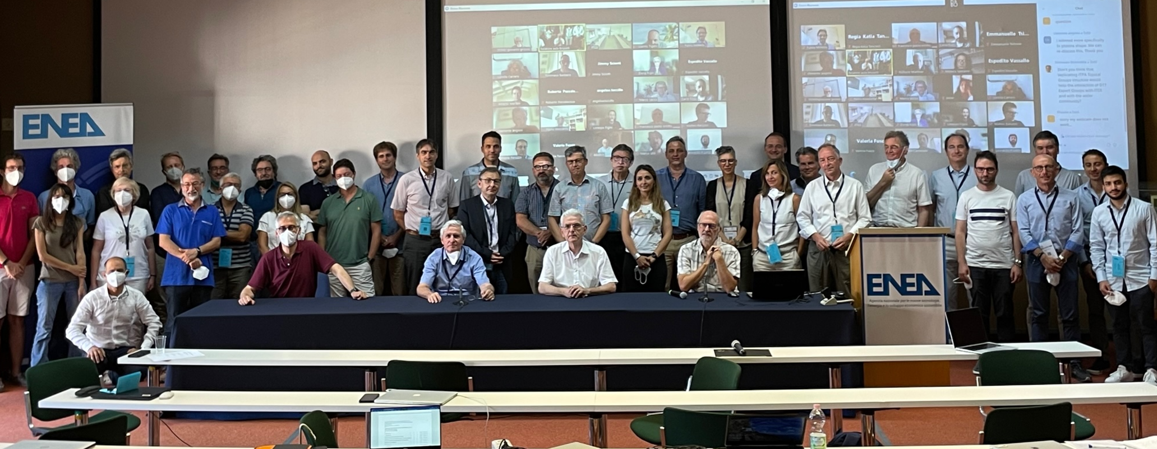
DTT Research Plan 2nd DTT-RP Team meeting
Scope of the meeting and general information
DTT Consortium (DTT S.C.a r.l. Via E. Fermi 45 I-00044 Frascati (Roma) Italy)

Slide 2
Scope of the meeting
Presentation by the EG-ROs of slides summarising conclusions of the present phase of their work (Please allow time for discussion)
First objective: establish a coherence among the conclusions of the various EGs
Second objective: discuss the input we should provide to the EU Facilities Review (unique & important points of DTT).
At the end of the second day, a 2-hour slot for separate discussions, in order to prepare the final version of the slides.
Friday morning: final discussions of the slides elaborated by each group and of the inputs for the Facilities Review.

Slide 3
Preparation of EU facilities review: timescale

Slide 4
Facilities Review - Terms of Reference
Motivation: identify the facilities needed in Europe to carry out fusion R&D
Time scale: covering the next two European Framework Periods (until 2034)
Perimeter: the full European Fusion landscape, not only the facilities supported by EUROfusion
Facilities, existing or under construction, including proposed or considered upgrades
Input: updated Fusion Roadmap (published in September 2018) + implementation plan of EUROfusion for the period 2021-2025/27 (December 2021).
Goal: keep the date of first fusion electricity generation as early as possible.
The Panel should seek the view of EUROfusion on the integration of facilities into a coordinated programme and the views of the Beneficiaries (individually or preferably through clusters), as well as input from other stakeholders.
The Panel will deliver a SWOT analysis (strengths, weaknesses, opportunities, threats)
Identify areas of research that cannot be addressed by existing facilities (or under construction), and the types of facilities that could fill these gaps.
The required facilities should be incorporated into a “facility development” roadmap, and prioritised according to benefits, costs and risks.

Slide 5
Facilities Review – Panel members
EU non-fusion people
Rolf-Dieter Heuer – CERN retired, CH (chair)
Thomas Mull – Framatome, DE
Vincent Boudry - LLP, FR
Caterina Biscari – ALBA-synchrotron, ES
Christa Hooijer – TNO, NL
Non-EU fusion people
Jiangang Li – ASIPP, CN
Chuck Greenfield – GA, US
David Campbell – ITER retired
Indranil Bandyopadhyay – IPR,IN
Sehila Gonzalez – Clean Air Task Force, US
Dan Brunner – CFS, US
Secretary to the panel
Duarte Borba - EUROfusion

Slide 6
Preparation of EU facilities review: our task
DTT-RP Team should elaborate (deadline July 21):
5 slides (max.): Unique contributions to the EU fusion Roadmap
5 slides (max.): Important contributions to the EU fusion Roadmap
"Indicate for the relevant roadmap missions which unique / important contributions will be given (see Chapter 5 of the Roadmap) – in other words how does the present (or future/upgraded) facility addresses the eight R&D Missions of the fusion roadmap and gives unique / important contributions to the development of basic understanding in support of the Missions (for relevant Missions only)
5-year perspective
10-year perspective (if applicable)
Longer term perspective (if applicable) "

Slide 7
Meeting with DEMO physics group
Organised on April 4 at our request (analogous initiative with ITER, not finalised)
Participants:
DEMO: M. Siccinio, H. Zohm, S. Wiesen, C. Bourdelle, M. Coleman, F. Maviglia
DTT: F. Crisanti, P. Martin, G. Giruzzi, P. Mantica, P. Innocente, G. Vlad, …
Informal discussion on possible contributions of DTT to the European DEMO, in view of the DTT Research Plan elaboration.
DEMO physics group provided us with a list of "High priority research topics":
no ELM regimes (QCE*/EDA**, RMP suppressed ELMs, QH-mode***)
exhaust (code validation, impurity, edge, pedestal transport, integrated modelling & control)
reattachment (basic physics, operational aspects)
transient phases (from breakdown to high confinement access to end of burn & ramp-down)
3-D effects (error fields, locked tearing modes, edge rotation, first wall loads, ripple impact)
hybrid scenario (current profile, core transport and radiation, disruptivity, exhaust)
Suggestion to consult PEX AHG report
Suggestion to have a similar meeting with DEMO technology group
Next meeting on May 23
*Quasi-continuous exhaust; **Enhanced D-alpha; ***Quiescent H-mode

Slide 8
Meeting agenda /1
26 April 13:45 – 17:00
Scope of the meeting, general information 13:45
DTT project and machine design status 14:00
EG-1: DTT scientific exploitation strategy 14:30
Coffe break 15:30
EG-2: Divertor and SOL physics 16:00
Meeting adjourns 17:00
27 April 9:00 – 17:30
5) EG-3: Plasma scenarios and associated modelling 9:00
EG-4: Heating, current drive and fuelling 10:00
Coffe break 11:00
EG-5: MHD and fast particles, theory 11:30
Lunch break 12:30
EG-6: Fusion technology developments 14:00
Coffe break 15:00
Separate groups work session 15:30
Meeting adjourns 17:30
Dinner at Ristorante Pasquino (Frascati) 20:00

Slide 9
Meeting agenda /2
28 April 9:00 – 13:00
10) EG-6: discussion of final set of slides 9:00
11) EG-5: discussion of final set of slides 9:30
EG-4: discussion of final set of slides 10:00
Coffe break 10:30
EG-3: discussion of final set of slides 11:00
EG-2: discussion of final set of slides 11:30
EG-1: discussion of final set of slides 12:00
General discussion. Next steps 12:30
End of the meeting 13:00

