Slide 1
Experts Group 5: MHD and fast particles, theory
E. Nardon, G. Vlad, DTT-RP KoM, 16-17/11/22
Terms of Reference
Connecting with the objectives and main scenarios described by EG-1 (‘DTT scientific exploitation strategy’),
  Elaborate simulations of MHD stability
  Elaborate predictions of DTT scenarios disruptivity, runaway generation and suppression.
Define specific experiments on disruptions and runaways and their implementation in the DTT programme
For the various DTT scenarios, elaborate simulations of fast ion distributions and the associated Alfvénic MHD instabilities
Describe the plasma theory elements that can be validated by the DTT scientific programme
Write Chapter 5: MHD, disruptions and control
Write Chapter 7: Fast particle physics
Write Chapter 8: Theory and simulation for preparation of experiments
→ Terms to clarify: ‘elaborate’, ‘disruptivity’?

Slide 2
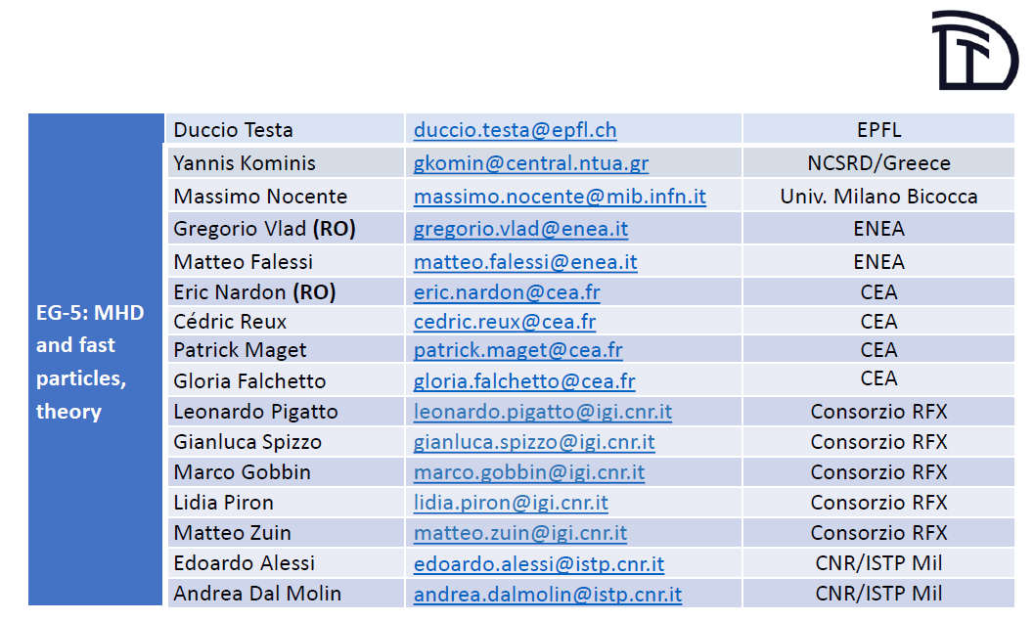
Members of EG-5

Slide 3
Organization
We envisage forming sub-groups:
  MHD, disruptions and control ↔ Chapter 5, coordinated by Eric Nardon
  Fast particle physics ↔ Chapter 7, coordinated by Gregorio Vlad
  Theory and simulation for preparation of experiments ↔ Chapter 8, coordinated by Matteo Falessi
Interaction with other groups:
  EG-1 (scientific exploitation) and EG-3 (scenarios) for plasma scenarios
  EG-4 (heating & CD) for actuators to control MHD (e.g. NTM, sawtooth, etc.)
  For Chapter 8 (theory), we’ll also need to interact with EG-2 (divertor & SOL)

Slide 4
Ideas about Chapter 5: MHD, disruptions and control
Disruption mitigation
Will get in touch with DTT project team to see what has been done so far
Beyond machine protection, DTT may be a good platform for disruption mitigation research
  Could be a good companion to ITER if a Shattered Pellet Injection (SPI) system is implemented
  JT-60SA presently only plans a Massive Gas Injection (MGI) system for machine protection
DTT may be used to validate disruption (mitigation) models such as JOREK
  Needs good diagnostics → Work on a list
Runaway Electrons (REs) are the most serious issue for ITER and DEMO
  When the machine is activated, unavoidable RE seeds x enormous avalanche gain due to large I_{p}
  → Multi-MA RE beam formation predicted to be unavoidable in ITER (and probably DEMO too) → Critical topic!
  Before the activated phase in ITER, RE avoidance might be possible with SPI
A promising idea to avoid REs is the ‘RE killer passive helical coil’
  Will be tested at DIII-D and SPARC
  Too late to install in ITER…
  → Think whether DTT could/should join the club
    Note: REs may probably be avoided simply by MGI/SPI in DTT, although not certain because of large I_{p} and B_{t}
    → Needs modelling – Will discuss with TSVV 9 colleagues (DREAM, later perhaps JOREK)

Slide 5
Disruption mitigation (continued)
Best hope regarding REs for the activated phase in ITER: mitigation by H₂ SPI into the beam, leading to a benign termination
  Promising results from DIII-D, JET, ASDEX Upgrade, TCV
  DTT can probably contribute (if not with SPI, at least with MGI) – Need to assess required characteristics
Also some hopes of RE avoidance using waves / kinetic instabilities but still very uncertain
  Need to assess interest and feasibility. Will discuss with experts, e.g. Carlos Paz-Soldan, who coordinates this topic within the ITPA MDC group.

Slide 6
Disruption prediction and avoidance
Tools are being developed for both disruption prediction and avoidance but no selected tools for ITER yet
DTT may be used as a companion to ITER to deploy and test tools
  → Discuss with ITER on a strategy/partnership?

Slide 7
Ideal and Resistive MHD (DTT Physics tasks for 2021)
Tight interaction with EG-3 “Plasma scenarios and associated modelling“ is envisaged here
Ideal and classical resistive MHD studies to check MHD stability for low-n modes of the foreseen scenarios of DTT (already carried out on the full power reference scenario E1: SN with q=3, B_{T}=6T, I_{p}=5.5MA, ECRH=32MW, ICRH=8MW, NNBI=10MW):
  Check ideal internal and external modes, infernal modes (parametric scans on q-profile, pressure profile, etc…);
  Classical (tearing) resistive modes;
  It would be important to check the whole discharge phases, i.e., ramp-up, flat-top, ramp-down, …;
  Numerical tools available: CHEASE (high resolution equilibria), MARS (ideal & resistive linear MHD) – both codes already fully IMAS compliant
  Stability analysis of Resistive Wall Mode (RWM) in specific, high β_{N} scenarios (MARS-F, lower priority)
Study of medium-to-high-n ideal stability properties of edge peeling-ballooning modes (JALPHA workflow, thanks to R. Coelho, acquired and tested by ENEA Frascati group)
Neoclassical Tearing Modes (NTMs) and their control using plasma actuators (European Transport Solver (ETS) and the NTM module, and ECRH)
  NTM unlocking using non axisymmetric coils
Functional specification for Sawtooth control using EC and IC waves

Slide 8
Ideal and Resistive MHD (further topics)
ELMs and their control with Resonant Magnetic Perturbations (RMPs)
  Linear MHD stability for assessment of plasma response to RMPs in DTT scenarios (MARS-F)
  Explore ELM-free regimes?
Error Fields (EFs)
  Statistical study of EFs in DTT
  Investigation of physics relevant to EF control (e.g. compass scan experiments)
→ Overall, quite a large list of topics for Chapter 5. Envisage distributing the work among EG-5 experts.

Slide 9
Ideas about Chapter 7: Fast particle physics
Energetic fast ions (as generated by NNBI and ICRH) are expected to mutually interact with Alfvén waves (TAE, EPM, etc.)
In the past years, some activities in the field of Fast particle Physics have been carried out within the DTT Physics Theory tasks (F. Zonca); part of these activities should be continued for the different plasma scenarios developed within the RP:
  Stability of Drift Alfvén Waves (a series of semi-analytical tools have been developed in order to study the linear physics of the Energetic Particles: FALCON code, EQUIPE (equilibrium post processing), DAEPS (Drift Alfvén Energetic Particle Stability code));
  Optimization of NNBI energy and geometry (with important fall-out on machine and scenario design): resonance structures by NNBI ions in DTT; strong dependence of ripple losses of NNBI energy and angle of injection;
  Test particle transport: prompt and ripple losses and Resonant Magnetic Perturbation coils effect.
Preliminary studies of Energetic Particle driven Alfvénic modes using HMGC and HYMAGYC have been performed showing the evidence of excitation of Alfvénic type modes
Phase space fluxes from DAEPS: using the Phase Space Zonal Structures (PSZS) theory and linear results allow to compute the non-linear fluxes in the phase space ↔ implications on transport
Should work on developing synthetic diagnostics to understand how much this interesting physics can be "seen" in practice, and possibly suggest new diagnostics in consequence
We should benefit from the EUROfusion theory and simulation initiatives (TSVVs, ENRs):
  CfP-FSD-AWP21-ENR-03 (ATEP: Advanced Energetic Particle transport models): propose DTT reference scenarios available for benchmarking and testing;
  TSVV Task 10: Physics of Burning Plasmas;
  TSVV Task 2: Physics Properties of Strongly Shaped Configurations (NT).
Energetic Particles and their effects on bulk plasma transport (→ EG-3 “Plasma scenarios and associated modelling“)
Should benefit from other EUROfusion initiatives (e.g., WPs (WPTE, WPSA, WPPrIO, etc.) and International Collaborations, e.g., China...).

Slide 10
Chapter 8: Theory and simulation for preparation of experiments
→ Work in progress (Matteo Falessi)

