Slide 1

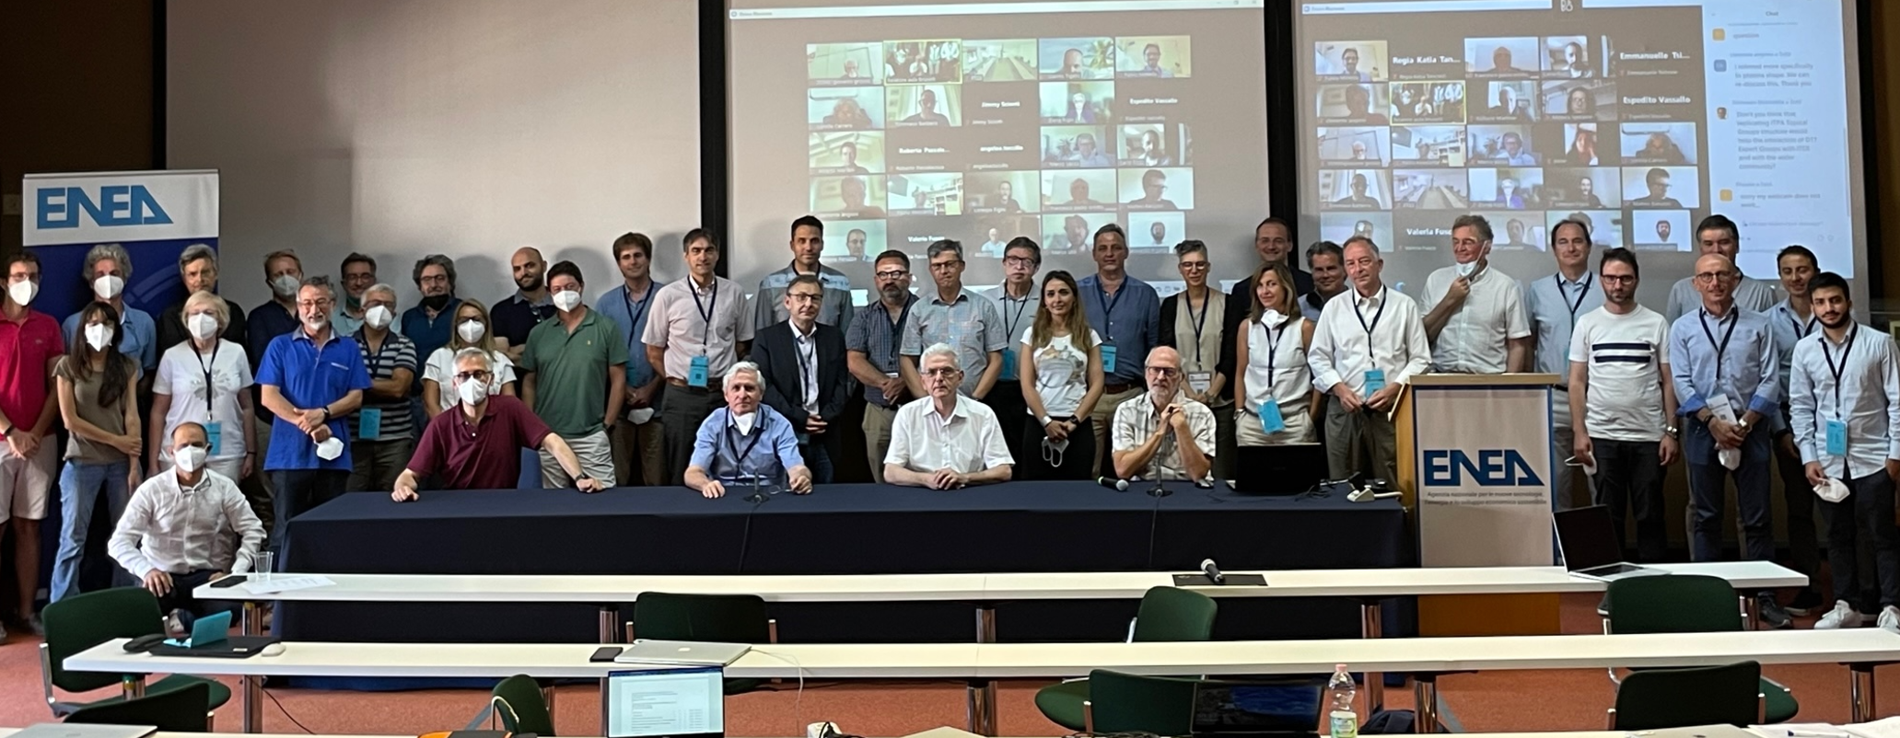









DTT Research Plan RO
1st in person meeting
F. Crisanti ^{(1,2)} and
G. Giruzzi³, P. Martin^{(1,4)}
⁽¹⁾ DTT S.C.a r.l., ⁽²⁾ Tuscia Univ., ⁽³⁾ CEA/Cadarache, ⁽⁴⁾ RFX/Padua
DTT Consortium (DTT S.C.a r.l. Via E. Fermi 45 I-00044 Frascati (Roma) Italy)

Slide 2
EG-1: DTT scientific exploitation strategy
Ensure integration and coherence of the outputs of the ensemble of the EGs
  Consider the power exhaust as an integrated edge-bulk plasma problem
  stronger focussing of the scientific programme on the divertor and plasma wall interactions studies, from which possible prioritization of the diagnostics
Perform a critical analysis of Chap. 1 (Executive summary) and Chap. 2 (Role and objectives) of the so-called "Green Book", considering recent evolutions of the international fusion programme. This can be used as a starting point for the elaboration of the overall machine and scientific programme evolution.
The main focus should be on Phase 1 (2028-2032) and Phase 2 (2032-2036), with the ultimate goal of sketching the programme for the full DTT lifetime (~25 years).

Slide 3
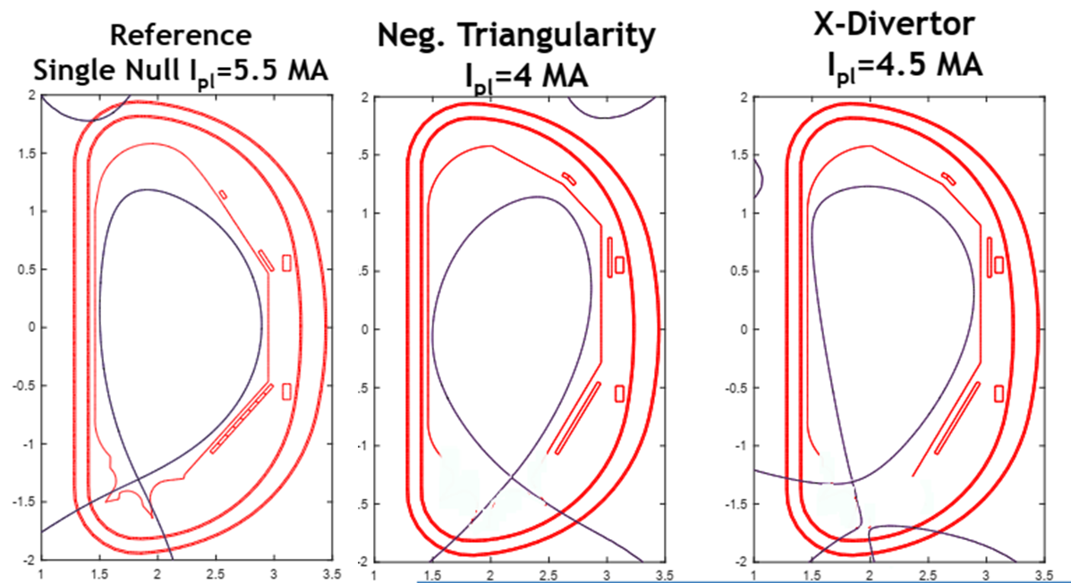
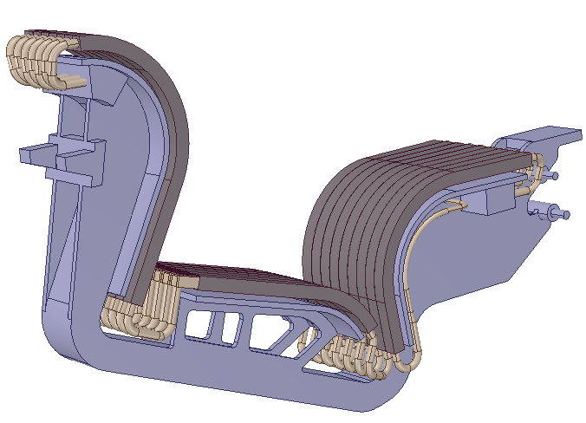
DTT experimental program
1) In the first phase all the possible plasma scenarios will be tested to identify the most promising following divertors – Day0: I_{p}= 2 MA - B_{T}= 3 T ; Day1: I_{p}= 5.5 MA - B_{T}= 6 T
The amount of additional heating power to be installed in three steps
Phase
3
Power at plasma (MW)
First divertor in operation
Phase
2
new
divertors
Phase
1
Further
upgrades
3 IC
14,5 EC
3 IC
14,5 EC
9,5 NB
2028
Day0
2030
Day1
2032
Day2
2036
Day4
2040
2053
Years

Slide 4
DTT experimental program
In the first phase all the possible plasma scenarios will be tested to identify the most promising following divertors – Day0: I_{p}= 2 MA - B_{T}= 3 T ; Day1: I_{p}= 5.5 MA - B_{T}= 6 T
Detachment studies (test divertors)
Phase
3
Strong Coperation with DEMO divertor program
Plus divertor test modules ?
Power at plasma (MW)
Phase
2
new
divertors
Phase
1
Further
upgrades
3 IC
14,5 EC
9,5 NB
3 IC
14,5 EC
2028
Day0
2030
Day1
2032
Day2
2036
Day4
2040
2053
Years

Slide 5
DTT experimental program
In the first phase all the possible plasma scenarios will be tested to identify the most promising following divertors – Day0: I_{p}= 2 MA - B_{T}= 3 T ; Day1: I_{p}= 5.5 MA - B_{T}= 6 T
Detachment studies (test divertors?)
Total Heating
Phase
3
Power at plasma (MW)
Phase
2
new
divertors
Final choice of the last heating systems
Decision to be taken within DEMO divertor program
Phase
1
Further
upgrades
3 IC
14,5 EC
9,5 NB
3 IC
14,5 EC
2028
Day0
2030
Day1
2032
Day2
2036
Day4
2040
2053
Years

Slide 6
DTT experimental program
In the first phase all the possible plasma scenarios will be tested to identify the most promising following divertors – Day0: I_{p}= 2 MA - B_{T}= 3 T ; Day1: I_{p}= 5.5 MA - B_{T}= 6 T
Detachment studies (test divertors?)
Total Heating
New divertor
Phase
3
Power at plasma (MW)
New divertor?
Shape?
Double null?
Negative triangulariry
Liquid metals
…..
Phase
2
new
divertors
Phase
1
Further
upgrades
3 IC
14,5 EC
9,5 NB
3 IC
14,5 EC
2028
Day0
2030
Day1
2032
Day2
2036
Day4
2040
2053
Years

Slide 7
DTT experimental program
In the first phase all the possible plasma scenarios will be tested to identify the most promising following divertors – Day0: I_{p}= 2 MA - B_{T}= 3 T ; Day1: I_{p}= 5.5 MA - B_{T}= 6 T
Detachment studies (test divertors?)
Total Heating
New divertor
Phase
3
Power at plasma (MW)
The full experimental program will run in parallel to ITER and JT60SA, consequently a strong cooperation will be mandatory among these three facilities.
In particular for DTT it will be mandatory to assist DEMO in the design of its divertor
Phase
2
new
divertors
Phase
1
Further
upgrades
3 IC
14,5 EC
9,5 NB
3 IC
14,5 EC
2028
Day0
2030
Day1
2032
Day2
2036
Day4
2040
2053
Years

Slide 8
EG-1: DTT scientific exploitation strategy
Give full consideration to the comments and recommendations made by the DTT Scientific-Technical committee (DTT CTS), focussed on core-edge integration. (Excerpts of the CTS report have been sent to the EG-1 members).
Consider how the DTT programme can integrate the evolving international fusion programme
Consider, critically analyse and possibly revisit the three DTT main scenarios (described in the DTT-RP workshop summary (sent to the EG-1 members).
Assess the requirements for experiments finalised to plasma core and edge integration

Slide 9
EG-1: DTT scientific exploitation strategy
Define the scientific and technical objectives of Phase 1 and Phase 2
Evaluate the coherence of the planned H&CD, fuelling, diagnostic and other machine sub-systems with the defined programme and objectives.
Give the group opinion about the possible technical choices during the DTT construction
  For instance what are the implication of a reduction of the total plasma current and/or the flat top duration?
Write Chapter 1: DTT power exhaust strategy

Slide 10
Green Book Extract…
The strategy to face with the problem of thermal loads on the divertor in DEMO and, in general, in future reactors, relies upon several factors:
development of plasma facing components able to cope with very large power fluxes (>5 MW/m²) based on materials of reactor interest;
selection of the divertor geometry and of the magnetic flux map able to reduce the normal heat flux on the target, and therefore able to distribute the heat over a larger surface;
removal of plasma energy before it reaches the target, via impurity radiation; this goal is pursued by increasing edge plasma density and injecting impurities (other substances than products and reagents) in the SOL region, so the fraction of the heating power impinging on the divertor is reduced up to a level compatible with the present available technology (about 10 MW/m²);
recycling of the particles released by the wall and increase of the density close to the plates, resulting in a "detachment" from the wall of the plasma (the temperature drops below the ionization threshold, the particles become neutral and are not any more constrained by the magnetic field; consequently, no direct energy flow affects the divertor plates

Slide 11
Green Book Extract …
Any proposed strategy for the solution of thermal loads problem must take into account that:
present experiments where "detached" plasma conditions are obtained, are characterized by conditions of the SOL region very different from those expected in the ITER and DEMO reactors;
simulations with the available physics models for the study of SOL are presently not sufficiently reliable;
stability of the detachment front has yet to be experimentally assessed for ITER and DEMO conditions;
various problems might arise related to integration of this solution with the plasma core and the other reactor subsystems, e.g.:
  impurity contamination of the core with consequent reduction in the confinement efficiency and in the general performance of the reactor;
  compatibility of bulk plasma with the very high requested radiation fraction (> 90%);
  compatibility with pumping of the particles;
  monitoring of erosion, temperature, etc.
Moreover, a number of nuclear aspects must be taken into account, restricting the use of certain materials

Slide 12
Green Book Extract …
The main objectives of DTT, as reported in a number of official European documents, can be summarized as follows:
demonstrate that the heat exhaust system proposed for DEMO is able to withstand the strong thermal load acting if the fraction of radiated power turns out to be lower than expected;
improve the experimental knowledge in the heat exhaust scientific area that cannot be addressed by present devices;
demonstrate that the possible (alternative or complementary) divertor solutions (e.g., advanced divertor configurations or liquid metals) can be integrated in the DEMO device.

Slide 13
Green Book Extract …
In particular, it will be possible to assess whether:
the alternative divertor magnetic configurations are viable in terms of the exhaust problems as well as of the plasma bulk performances;
the alternative divertor magnetic configurations are viable in terms of poloidal coils constraints (i.e., currents, forces, …);
the various possible divertor concepts are compatible with the technological constraints of DEMO;
the divertors based on the use of liquid metals are compatible with the characteristics of the edge of a thermonuclear plasma;
liquid metals are applicable to DEMO.

Slide 14
Timeline
DTT-RP team (Coordinators and ROs) kick-off meeting | Nov. 2022
1st draft of the Appendices (written by DTT project team) | Dec. 2022
EG-ROs organise Expert Groups, first EG meetings agree on guidelines of activities define work plans | Nov.-Dec. 2022
First reports of Expert Groups | March 2023
2nd meeting of the DTT-RP team Discussion of the EG reports Coherence of the ensemble | April 2023
Executive summary of the DTT-RP produced Document available for the EUROfusion Facility Review | June 2023
Drafts of DTT-RP chapters | Oct. 2023
3rd meeting of the DTT-RP team Discussion on the drafts of DTT-RP chapters Discussion on the coherence of the ensemble | Nov. 2023
1st draft of the DTT-RP produced | End 2023
4th meeting of the DTT-RP team Analysis of the Facility Review panel recommendations (if any) Impact on DTT-RP → revisions if necessary Consolidation of the 1st draft → agreement on version to be issued | Feb. 2024
DTT-RP version 1 issued | March 2024
Subsequently: regular meetings and updated versions, to prepare DTT start | 2024-2028

