Slide 1

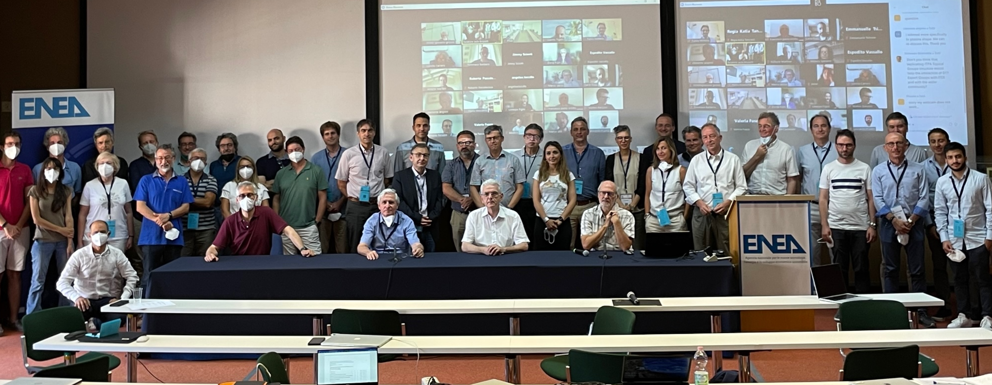









DTT Research Plan
Kick-off meeting
Scope of the meeting and general information
DTT Consortium (DTT S.C.a r.l. Via E. Fermi 45 I-00044 Frascati (Roma) Italy)

Slide 2
About the DTT-RP: reminder /1
DTT Research Plan (RP) has to be a “living” document that will evolve along the years to prepare the first DTT operations and to design an experimental strategy on the long time scale.
The DTT-RP will evolve also along the DTT life in order to design the progress of the experimental campaigns
The DTT main scientific targets will be eventually decided by the DTT stakeholders (DTT-Scarl, EUROfusion). However, →
The DTT-RP Team will play an essential role in guiding those decisions
Our overall terms of reference are to prepare:
  a first short document for the EU Facility Review, by June 2023
  Prepare a first draft of the RP document by the end of 2023

Slide 3
About the DTT-RP: reminder /2
To fulfil these goals we should:
  consider what are the actual DTT capabilities
  on this basis, work out a scientific / experimental programme
  propose the best possible diagnostic set for the experiment
  propose the best simulation tools to prepare, analyse and interpret the experiments
  propose experiments on the existing machines to validate our ideas
  propose “Modelling Campaigns” to check/confirm our hypotheses and plans.
  ……

Slide 4
DTT-RP KoM – Scope of the meeting
first exchange of ideas on the contents of the chapters
find an agreement about the role and perimeter of the EG activities (e.g.: limits between suggestions and actual work)
discuss organisation aspects of the activity → elaborate a common working method
agree on lists of subjects that will be discussed in the EGs and included in the chapters, as well as on their priorities
identify the elements of interaction between the EGs
discuss how to elaborate on diagnostic needs and on the accompanying modelling necessary to execute the proposed scientific programme

Slide 5
DTT-RP – Chapters (as discussed so far)
Foreword
History, status and prospects of the DTT project
Chapter 1: DTT power exhaust strategy
DTT objectives, programme headlines, research phases
Chapter 2: Plasma scenarios
Reference scenarios in the various research phases
Chapter 3: Divertor and SOL physics
Divertor configurations, heat and particle exhaust
Chapter 4: Transport physics & integrated modelling of plasma scenarios
Plasma profiles and transport properties in the reference scenarios
Chapter 5: MHD, disruptions and control
Stability of reference scenarios, disruption studies
Chapter 6: Physics of heating, current drive and fuelling
Heating, current drive and fuelling scenarios
Chapter 7: Fast particle physics
Fast particle population and MHD in the reference scenarios
Chapter 8: Theory and simulation for preparation of experiments
Contribution of DTT to plasma theory for fusion research development
Chapter 9: Fusion technology developments
Opportunities for testing of fusion relevant components in DTT

Slide 6
DTT-RP – Appendices
Synthetic descriptions of machine and subsystems:
  a useful update on the status of the design and components
  summary of the Plant Integration Document, written by DTT staff
  very short: what is indispensable to understand the chapters.
Appendix A: DTT parameters
Appendix B: DTT machine description
Appendix C: Plasma facing components
Appendix D: Heating and current drive systems
Appendix E: Diagnostic systems
Appendix F: Control systems
Appendix G: Fuelling and pumping systems
Appendix H: Data system and numerical codes
Appendix I: Project structure, timeline and evolutions

Slide 7
DTT-RP expert groups & chapters
EG-1: DTT scientific exploitation strategy → Chap. 1
EG-2: Divertor and SOL physics → Chap. 3
EG-3: Plasma scenarios and associated modelling → Chap. 2,4
EG-4: Heating, current drive and fuelling → Chap. 6
EG-5: MHD and fast particles, theory → Chap. 5,7,8
EG-6: Fusion technology developments → Chap. 9
Organization:
ROs in charge of coordinating the EG activities, meetings, reporting, DTT-RP chapters writing
Activity supported, but at present not funded by EUROfusion → voluntary participation
Overall DTT-RP coordinators, responsible for the final versions:
F. Crisanti (DTT), P. Martin (University of Padova), G. Giruzzi (CEA)

Slide 8
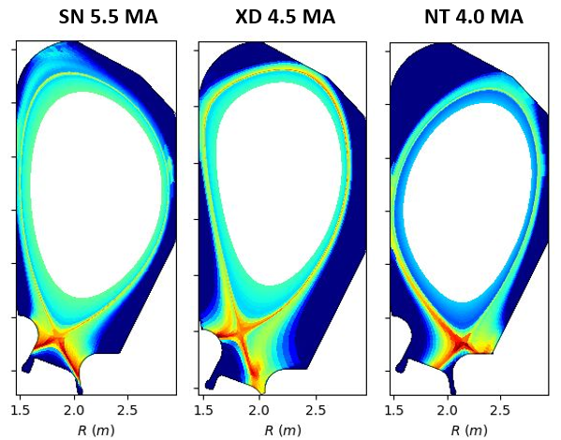
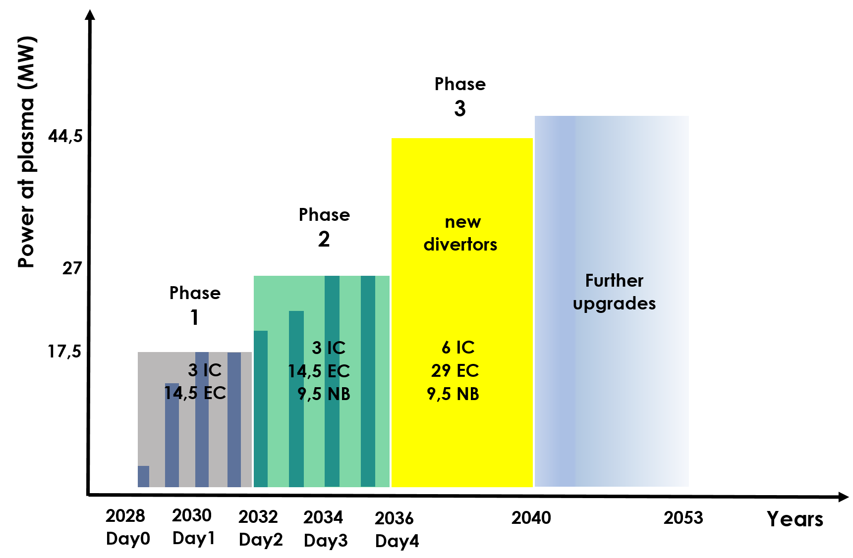
Plasma scenarios & Research phases

Slide 9
Timeline of the DTT-RP activity
DTT-RP team (Coordinators and ROs) kick-off meeting | Nov. 2022
1st draft of the Appendices (written by DTT project team) | Dec. 2022
EG-ROs organise Expert Groups, first EG meetings agree on guidelines of activities. Define workplans | Nov.-Dec. 2022
First reports of Expert Groups | March 2023
2nd meeting of the DTT-RP team Discussion of the EG reports. Coherence of the ensemble | April 2023
Executive summary of the DTT-RP produced Document available for the EUROfusion Facility Review | June 2023
Drafts of DTT-RP chapters | Oct. 2023
3rd meeting of the DTT-RP team Discussion on the drafts of DTT-RP chapters. Coherence of the ensemble | Nov. 2023
1st draft of the DTT-RP produced | End 2023
4th meeting of the DTT-RP team Analysis of the Facility Review panel recommendations (if any) Impact on DTT-RP → revisions if necessary Consolidation of the 1st draft → agreement on version to be issued | Feb. 2024
DTT-RP version 1 issued | March 2024
Subsequently: regular meetings / updated versions, in preparation of DTT start | 2024-2028

Slide 10
Meeting agenda
16 November 13:30 – 18:00
1) Scope of the meeting, general information 13:45 15 min
2) DTT project and machine design status 14:00 30 min
3) EG-1: DTT scientific exploitation strategy 14:30 1h00 min
Coffe break 15:30 30 min
4) EG-2: Divertor and SOL physics 16:00 1h00 min
5) EG-3: Plasma scenarios and associated modelling 17:00 1h00 min
Meeting adjourns 18:00
Dinner at Ristorante Pasquino (Frascati) 20:00
17 November 8:30 – 13:00
6) EG-4: Heating, current drive and fuelling 8:30 1h00 min
7) EG-5: MHD and fast particles, theory 9:30 1h00 min
Coffe break 10:30 30 min
8) EG-6: Fusion technology developments 11:00 1h00 min
9) General discussion. Workplan 12:00 1h00 min
End of the meeting 13:00

