Slide 1
Third Trilateral International Workshop
on Energetic Particle Physics
November 7 - Discussion
Online event: November 7 – 10, 2022
November 10th 2022

Slide 2
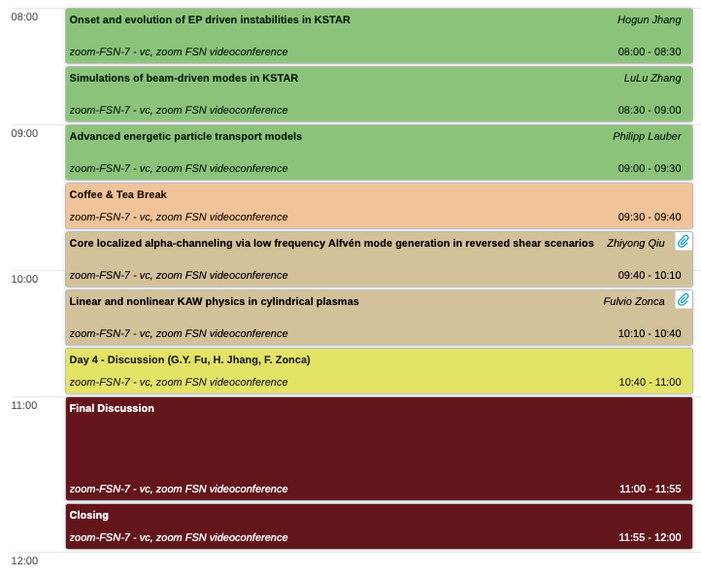
November 10 - Discussion
November 10th 2022

Slide 3
November 10 - Discussion
Observations of energetic circulating particle-driven fishbones/EPMs
Experiments in KSTAR
Numerical simulations by M3D-K
Advanced energetic particle transport models
Multi-level approach to long-time scale EP transport (Ph. Lauber/EUROfusion)
Nonlinear route to Alfvénic fluctuations
GK theory of wave-wave couplings
NL AE couplings in tokamak: impact on transport
NL KAW couplings in cylinder: paradigm case for VVUQ
November 10th 2022

