Slide 1
Third Trilateral International Workshop
on Energetic Particle Physics
November 7 - Discussion
Online event: November 7 – 10, 2022
November 7th 2022

Slide 2
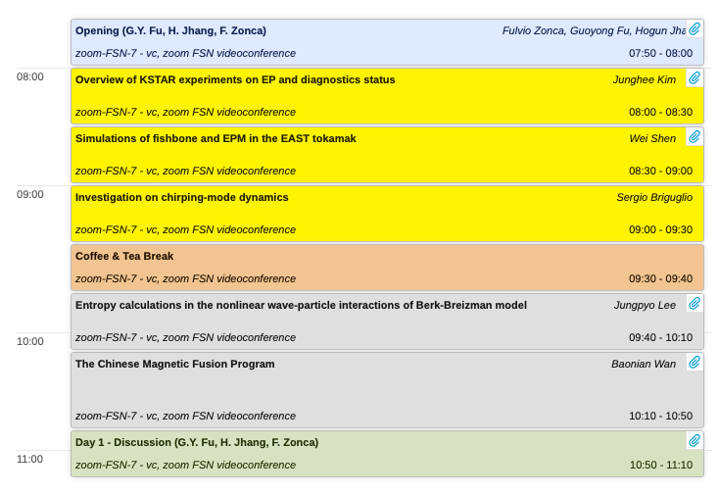
November 7 - Discussion
November 7th 2022

Slide 3
November 7 - Discussion
Overview of rich EP physics in KSTAR and EAST
Progress in diagnostics, impressive results
Simulation of fishbones/EPM/TAE in realistic conditions
Role of synthetic diagnostics in comparison of Th&Sim with Exp?
Detailed analysis of chirping dynamics
Maximization of wave-particle power transfer
Chirping linear scaling with A: consistent with theory (space&lab)
Entropy production in B&B model: implications on long time scale dynamics ➔ connection with maximization of w-p power transf.?
Chinese fusion program
Challenging physics issues: motivation for international collaborations
Problems of common interest with KSTAR/DTT
November 7th 2022

