Slide 1
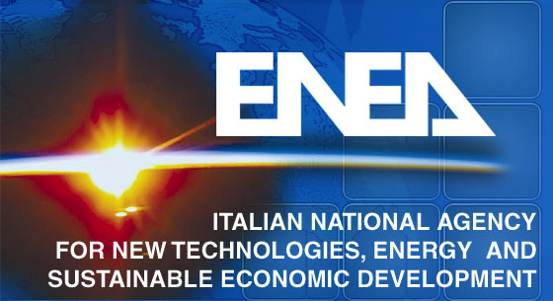
3rd Trilateral EP Workshop – Nov. 7-10, 2022
Linear and nonlinear kinetic Alfvén wave
physics in cylindrical plasmas*
F. Zonca1,2, L. De Fabrizio3, L. Chen2,4,1, M. V. Falessi1 and Z. Qiu2,1
1Center for Nonlinear Plasma Science and ENEA C.R. Frascati, 00044 Frascati, Italy
2IFTS and Dept. Physics, Zhejiang University, Hangzhou, 310027 P.R. China
3Dept. Mathematics and Physics, Roma Tre University, Rome, Italy
4Dept. Physics and Astronomy, University of California Irvine, Irvine, CA, USA
*Livio De Fabrizio: PhD Thesis, Roma Tre University, 2022-23
Also presented at the AAPPS-DPP 2022 Conference
November 10th 2022

Slide 2
Motivation I
Kinetic Alfvén Waves (KAW) [Hasegawa&Chen 75,76, Chen etal 21] are ubiquitously generated in magnetized space and laboratory plasmas due to the existence of the continuous spectrum of shear Alfvén waves (SAW), with the corresponding phase mixing and resonant absorption.
Unlike SAW, KAW are characterized by microscale perpendicular structures of the order of the thermal ion Larmor radius, which are responsible of the transverse propagation of wave packets as well as the finite parallel electric field.
November 10th 2022

Slide 3
Motivation II
These features have important consequences on heating, acceleration and transport processes connected with KAW.
Here, we demonstrate that large amplitude KAW can be generated in the core of a cylindrical magnetized plasma by means of a mode converted SAW launched by an external antenna.
This KAW, in turn, then generates convective cells (CC) inside the plasma core, which can be controlled in phase, amplitude and associated parallel electric field by means of the external antenna.
November 10th 2022

Slide 4
Motivation III
Convective cells (CC) are, generally, the counterpart of Zonal Field Structures (ZFS) in fusion plasmas [M.V. Falessi presentation on Tues.]
Analytical theory and numerical results demonstrate the crucial role of plasma nonuniformity because of the subtle interplay between nonlinearity and nonuniformity itself.
Geometry is also a key player:
This has important implications for wave-wave couplings in fusion plasmas.
radial dependence of k|| (sheared slab)
radial dependence of k_{θ} (cylinder)
cylindrical geometry is minimum requirement
November 10th 2022

Slide 5
Background
Historically, KAW generation by mode conversion of SAW in laboratory plasmas and their absorption has been investigated with emphasis on plasma heating [H&C75,76; Itoh’s82,83].
The mode converted KAW are typically strongly damped/absorbed by thermal electrons right after SAW mode conversion, and spatially localized near the SAW resonant absorption layer. This also has strong impact on the corresponding nonlinear processes [2].
November 10th 2022

Slide 6
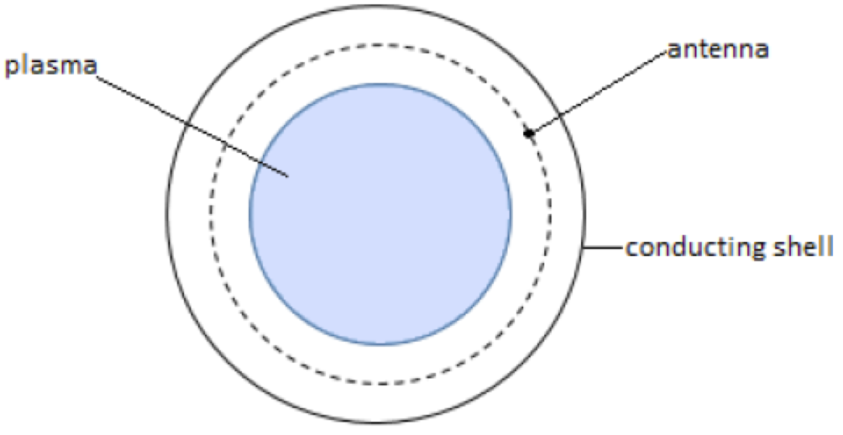
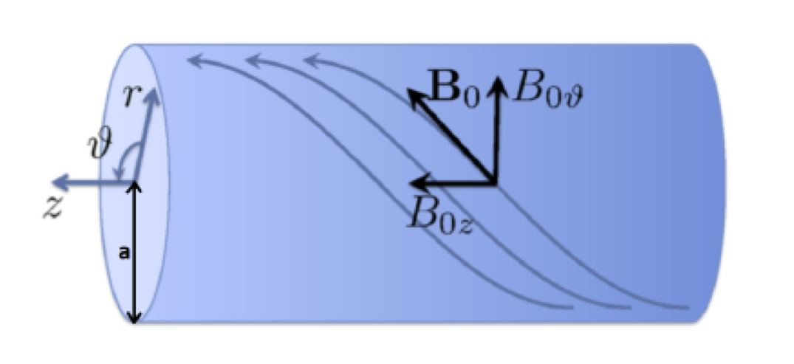
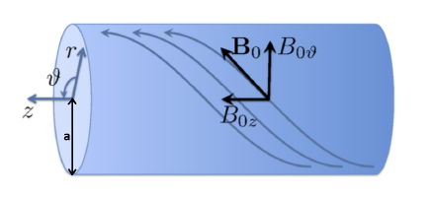
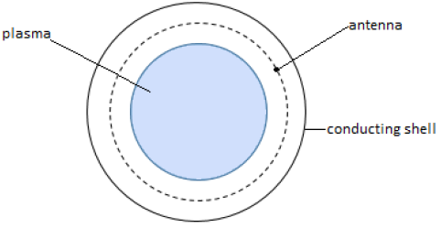
A classical problem revisited
Mode conversion to KAW [H&C75,76]
In this work [LDF PhD Thesis], we focus on the opposite limit; i.e., when the mode converted KAW are weakly absorbed in a periodic magnetized plasma cylinder.
antenna
plasma
November 10th 2022

Slide 7
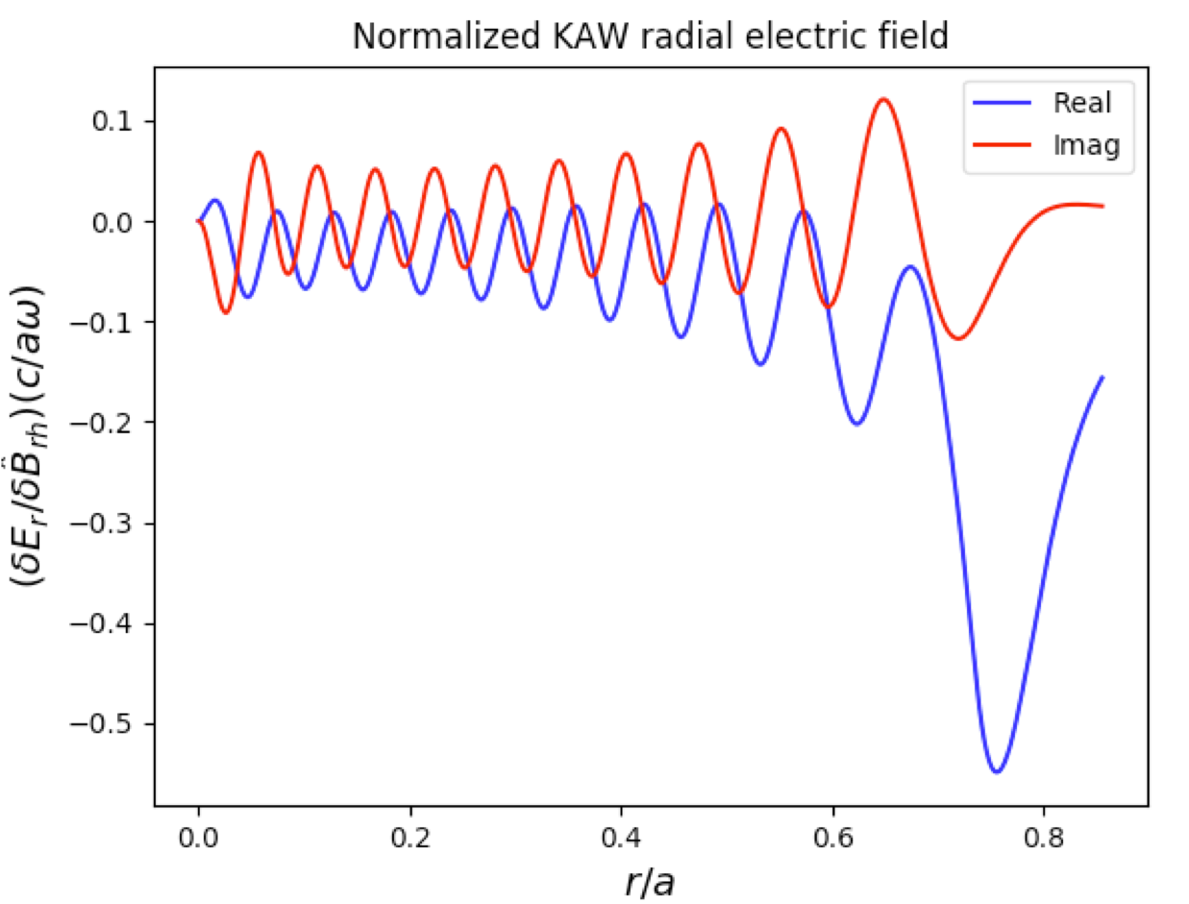
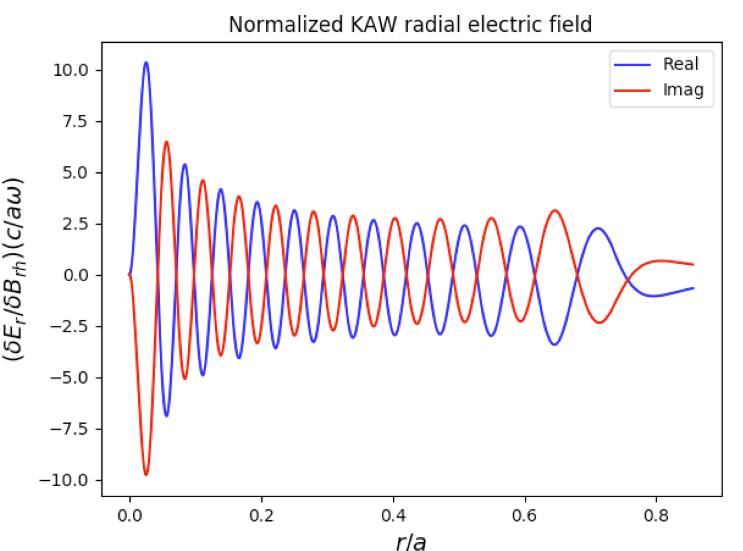
A classical problem revisited
We show that KAW can be excited as resonant cavity modes in the region between the magnetic axis and the resonant absorption layer of SAW
Analogous to [Buchsbaum&Hasegawa 66] for mode converted electron Bernstein waves.
strong damping: absorption
weak damping: cavity modes
November 10th 2022
strong damping: absorption
weak damping: cavity modes

Slide 8
Linear wave packet analysis
(no diamagnetic effects)
Vorticity equation (short wavelength)
Quasineutrality condition (short wavelength)
dominant e-Landau damping [H&C76]
WP Amplitude equation -
November 10th 2022
strong damping: absorption
weak damping: cavity modes

Slide 9
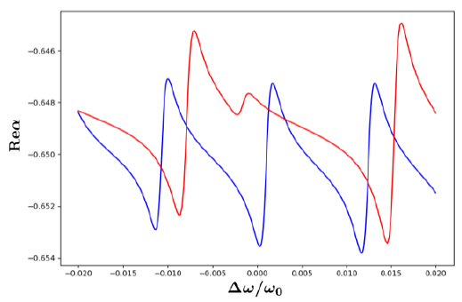
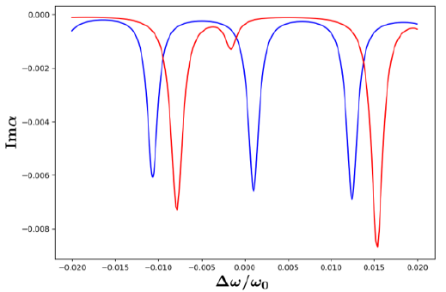
WKB vs. wave packet solution
Strong damping: H&C76 results recovered ➔ plasma impedance same as in MHD
Weak damping: WKB solutions for α vs wave packet solutions for α
antenna
plasma
November 10th 2022
strong damping: absorption
weak damping: cavity modes

Slide 10
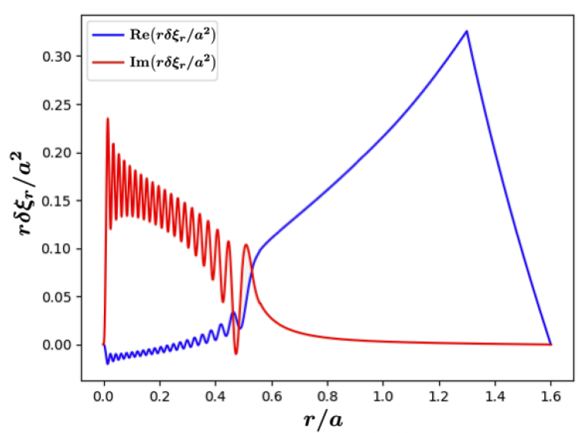
Implications
Large amplitude KAW may be generated time asymptotically even with small coupled antenna power.
Little relevance for plasma heating, but this large amplitude KAW has interesting nonlinear implications ➔ Control self-consistent CC radial structures by fine tuning of antenna fluctuation phase and amplitude.
November 10th 2022
strong damping: absorption
weak damping: cavity modes

Slide 11
Nonuniform cylindrical plasma
Mode converted KAW acts as pump wave and generates CC and KAW sidebands by modulational instability.
Diamagnetic effects are negligible for the KAW pump, dominated by fast radial scales, but are crucial for both CC and KAW sidebands ➔ Symmetry breaking [Kaw&Chen83, Chen etal22, LDF Phd Thesis 2022]
November 10th 2022
strong damping: absorption
weak damping: cavity modes

Slide 12
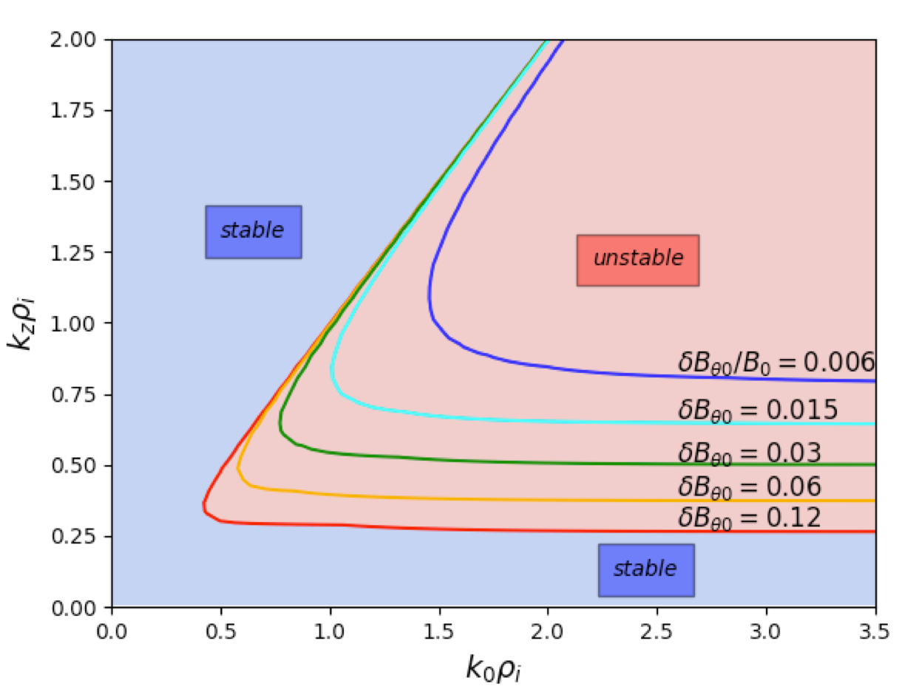
Nonuniform cylindrical plasma
Recover uniform plasma limit [Zonca,Lin,Chen EPL15]
NL coupling
Maximization of NL coupling: Theta pinch ➔ k|| = 0 condition on CC allows finite m_{z}
November 10th 2022
strong damping: absorption
weak damping: cavity modes

Slide 13
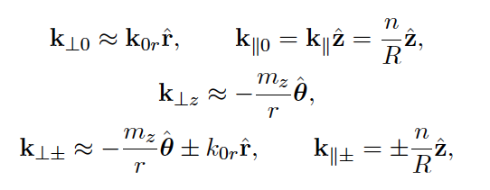
Nonuniform cylindrical plasma
Mode converted KAW acts as pump wave and generates CC and KAW sidebands by modulational instability.
Model equations are obtained from coupled GK vorticity and quasineutrality conditions for CC and KAW
sideband @ fixed pump KAW
November 10th 2022
strong damping: absorption
weak damping: cavity modes

Slide 14
Model equations
Gyrokinetic vorticity equation
Quasineutrality condition
NL gyrokinetic equation [Frieman & Chen 82]
November 10th 2022
strong damping: absorption
weak damping: cavity modes

Slide 15
Four-wave coupling
Underlying physics process is four-wave coupling [L. Chen presentation on Wed.; C&Z RMP16; Chen etal 22]
November 10th 2022
strong damping: absorption
weak damping: cavity modes

Slide 16
Modulational instability
Normalized field variables: $δ\hat{φ}=e δ\text{φ}$/T_{0i}, $δ\hat{ψ}=e\text{ (}\text{w}\text{0}\text{/}k\text{‖}c) δ$A‖/T_{0i}. KAW sideband response $±\tilde{ε}$_{A1}- $\tilde{ε}$_{A2}. Finite ion Larmor radius effect: Γ₊=Γ₋ . Frequency mismatch: Δ₊=Δ₋ . Other quantities describe NL couplings $∝\left|δ\hat{φ}0\right|$²
November 10th 2022
strong damping: absorption
weak damping: cavity modes

Slide 17
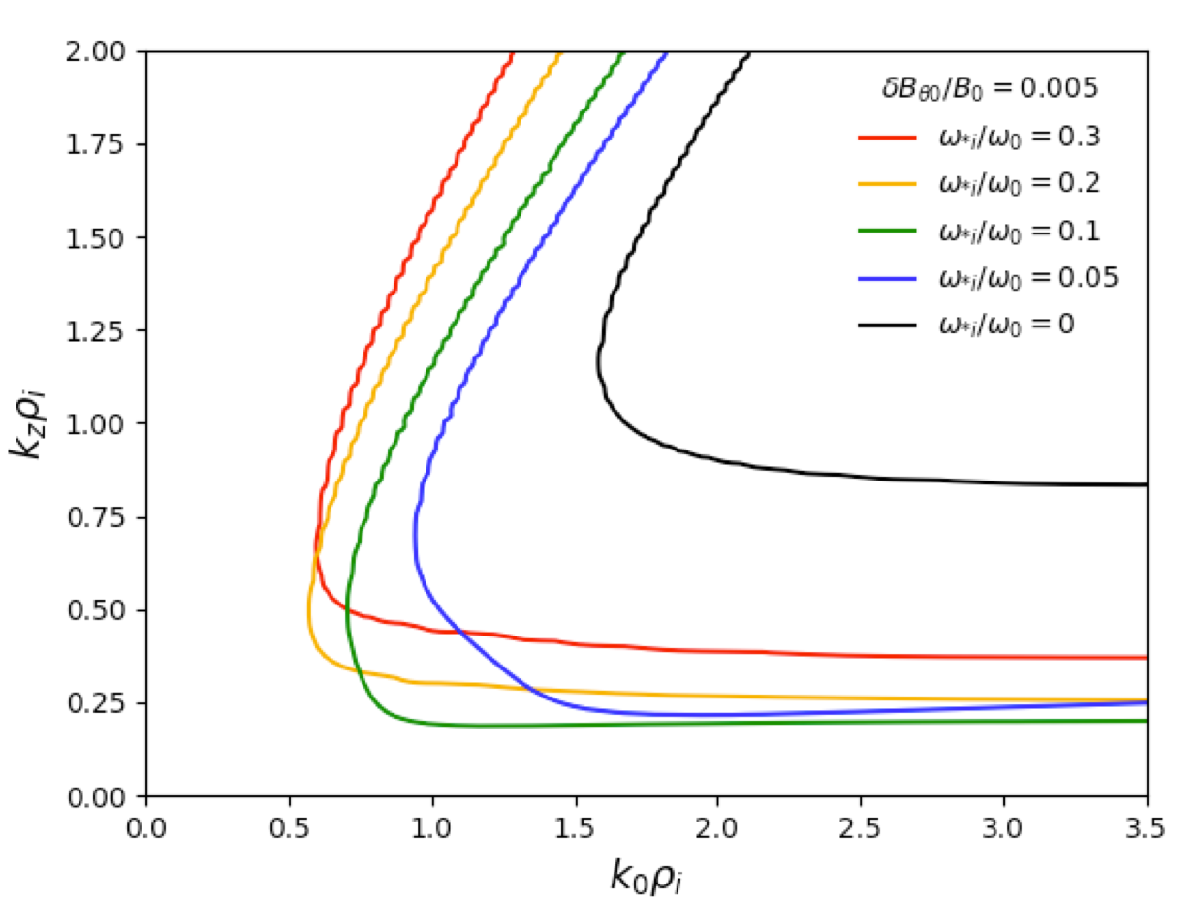
Impact of diamagnetic effects
Parameters: B₀ = 1.6T, a/d/b/R = 0.5/0.65/0.8/2m, T_{i}/T_{e}= 1.5/3.5keV, n₀ = 5x10²⁰m⁻³, n_{e} = n_{i} = n₀(1-r²/a²), pure D, ω₀ = 1.53MHz, n=m=2.
November 10th 2022
strong damping: absorption
weak damping: cavity modes

Slide 18
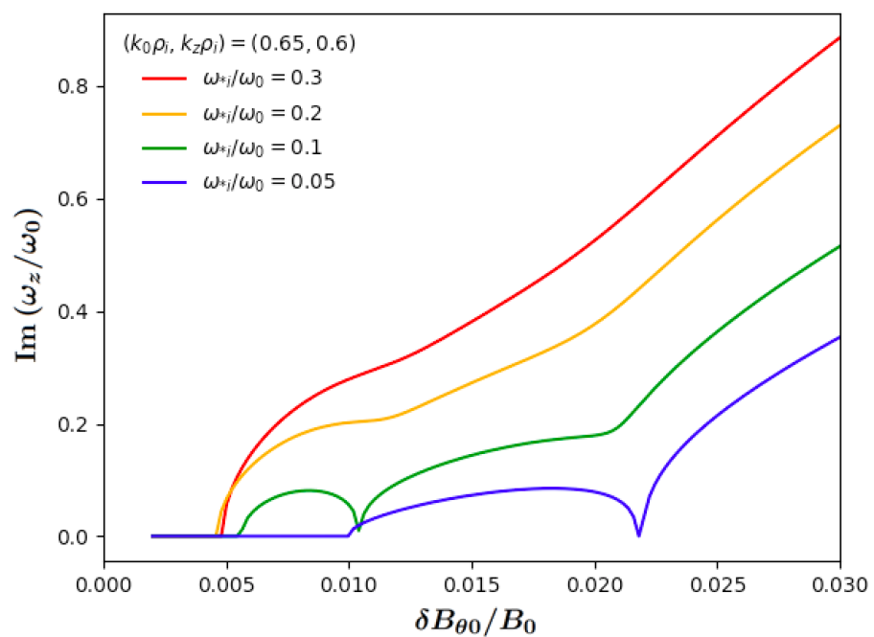
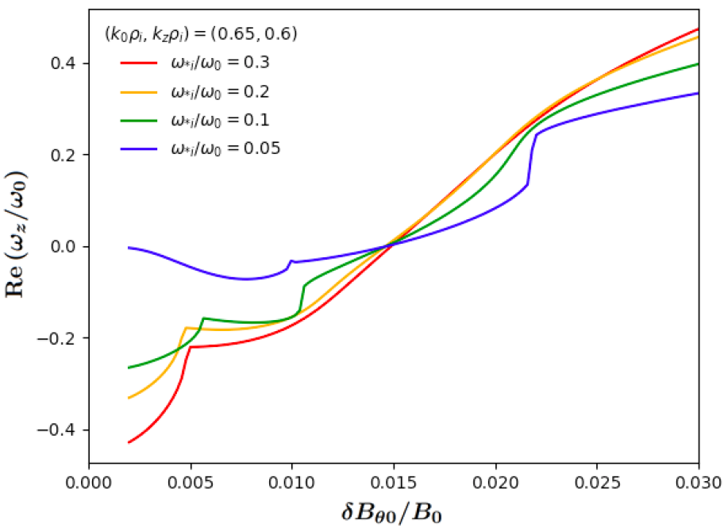
Impact of diamagnetic effects
Diamagnetic effects are qualitatively and quantitatively important: they show significant broadening of the CC modulational instability domain
Results illuminate subtle coupling of nonuniformity and nonlinearity [LDF Phd Thesis 22]. Consistent with magnetostatic CC analysis [Kaw&Chen83]
ion diam.
electron diam.
strong damping: absorption
weak damping: cavity modes

Slide 19
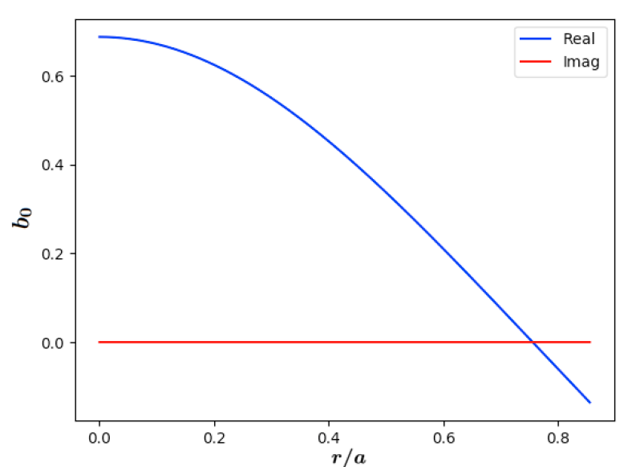
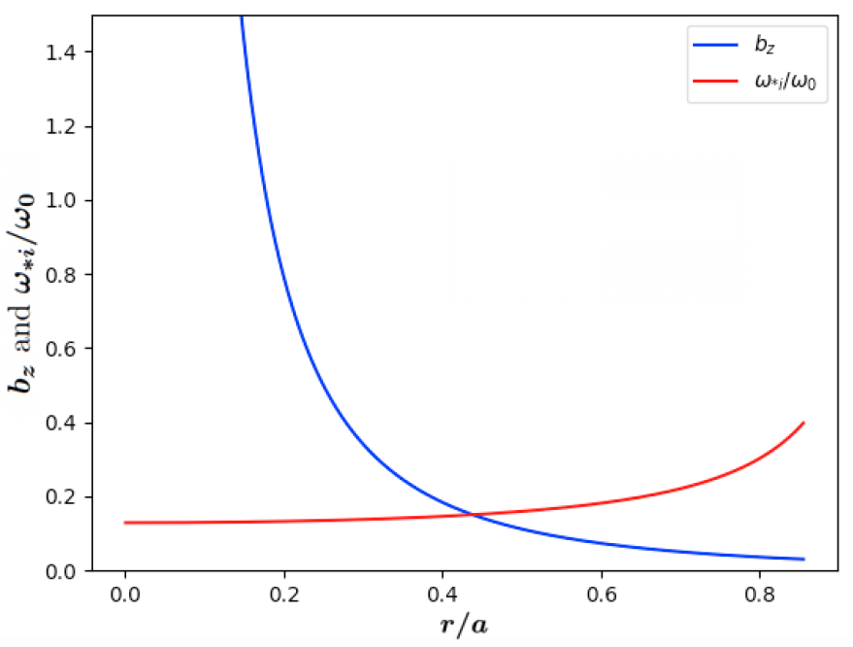
Geometry effects
As anticipated, geometry enters in the radial depencences of wave-number spectrum
November 10th 2022
strong damping: absorption
weak damping: cavity modes

Slide 20
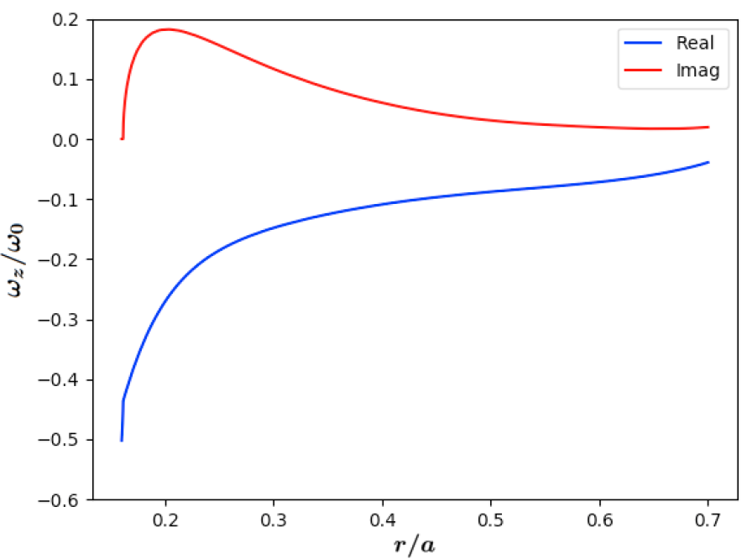
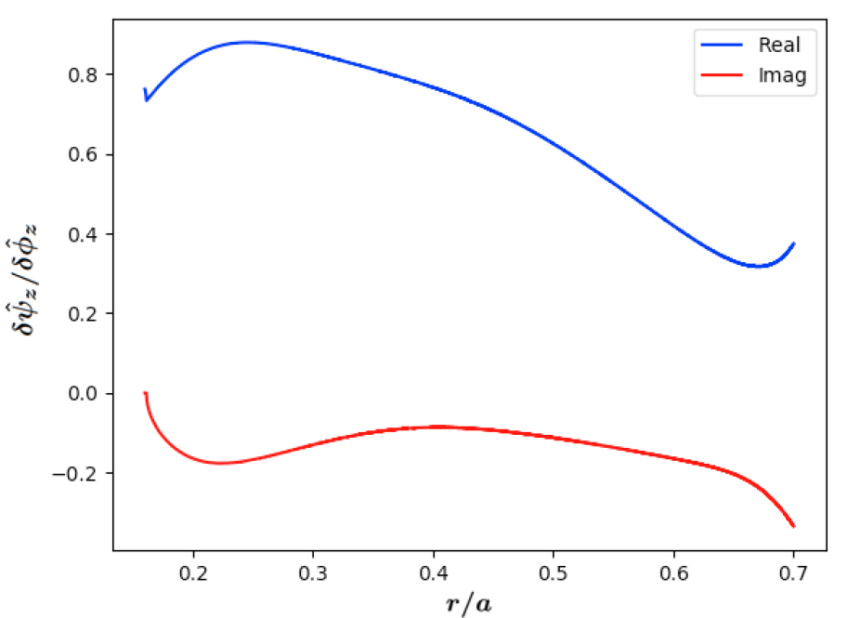
CC spatial structures
This is reflected in the radial dependence of CC growth, rotation and polarization (generally mixed)
November 10th 2022
strong damping: absorption
weak damping: cavity modes

Slide 21
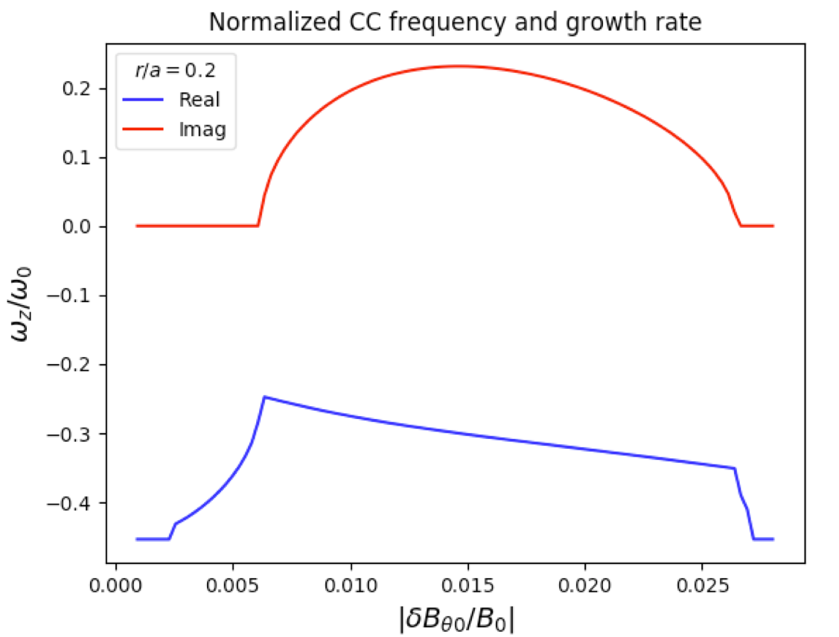
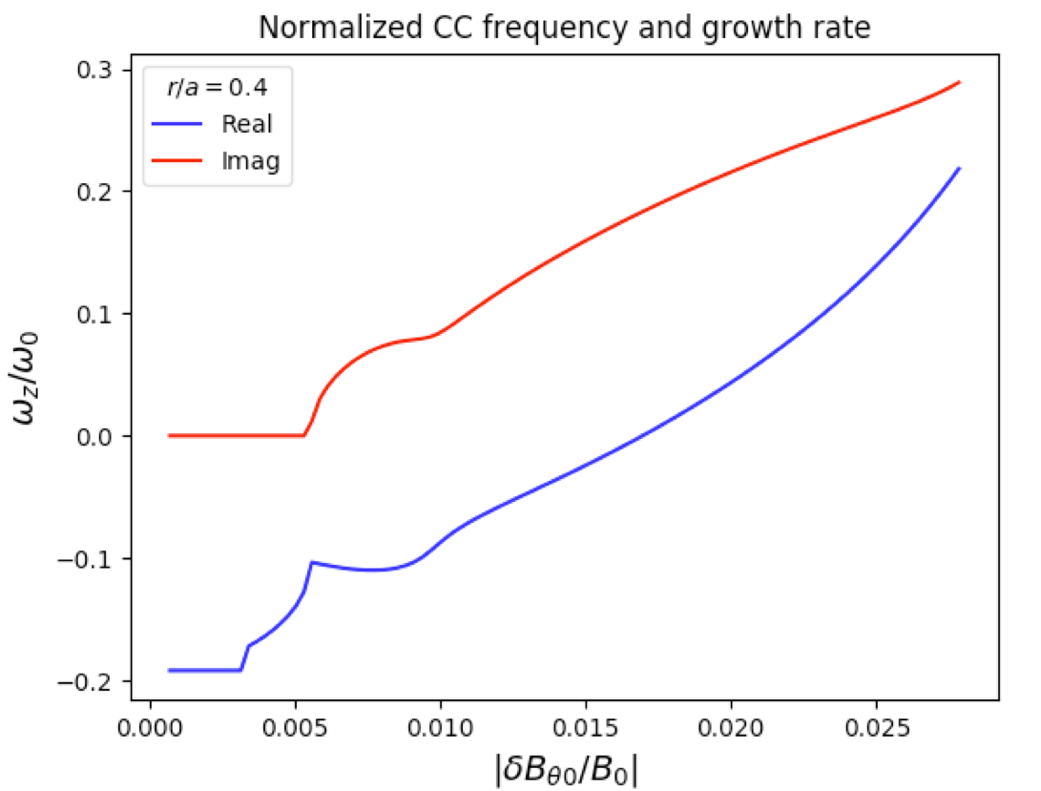
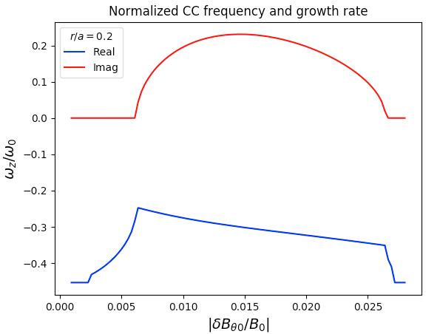
CC spatial structures
Antenna amplitude, in addition to frequency, can be used to control self-consistent radial structures of CC and inductive parallel electric field in the plasma core
m_{z}=20
m_{z}=20
November 10th 2022
strong damping: absorption
weak damping: cavity modes

Slide 22
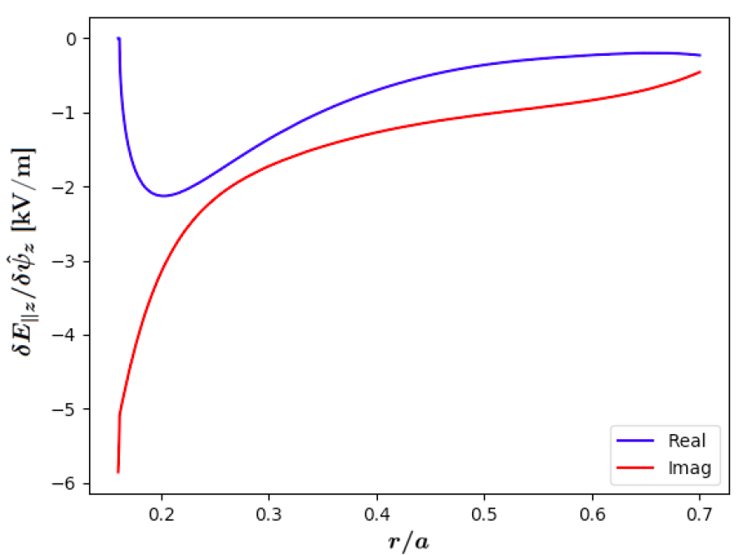
CC parallel electric field
CC and inductive parallel electric field
November 10th 2022
strong damping: absorption
weak damping: cavity modes

Slide 23
Conclusions
Revisited a classical problem with new (unexpected) twists
Important consequences for Alfvénic wave-wave couplings in burning plasmas ➔ generation of ZFS
Symmetry breaking (convective/momentum transport)
Interplay of nonuniformity and nonlineariry (nonlocality)
Breaking of the Alfvénic state (saturation of global e.m…)
Analytical predictions suggest precise test cases for numerical applications
Open problem: investigating self-organization of the plasma core in the presence of KAW & CC
Small table-top experiment for VVUQ?
November 10th 2022

