Slide 1
Global Alfvénic modes excitation in Ohmic Tokamak plasmas following magnetic reconnection events
${\text{Artur} \text{Kryzhanovskyy}}^{1}$,
${D.Bonfiglio}^{1,2}$, ${\text{S}\text{. }\text{Cappello}}^{1,2}$, ${\text{M}\text{. }\text{Veranda}}^{2}$ and the RFX-mod team
¹ Consorzio RFX, Padova, Italy
² Consiglio Nazionale delle Ricerche – CNR – ISTP, Italy
8 November 2022
3rd Trilateral International Workshop on Energetic Particle Physics, 7-10 November 2022

Slide 2
Introduction
Motivations
Tools
Uniform case
RFP
Tokamak
Conclusions
Subject of this talk
Characterization of AWs in RFP and Tokamak configuration
Alfvén waves (AWs) in ideal MHD model in cylindrical geometry
Uniform cases: analytic solutions used for MHD numerical code verification
Modelling of AWs in RFP and Tokamak configurations in single wave cases
Triggering mechanism in Ohmic (i.e. absence of fast particles) plasmas
RFP: Systematic repetition of QSH states in a 3D “sawtoothing” dynamics [Kryzhanovskyy et al, 2022]
- Comparison with experimental observations in particular with RFX-mod device
Tokamak: Sawtooth dynamics in fully 3D nonlinear configuration
(Paper under revision)
Possible contribution to explain the experimental observation of AWs in Ohmic discharges in RFP devices, like RFX-mod and MST, and several present day Tokamak experiments
Artur Kryzhanovskyy et al.
Introduction

Slide 3
Introduction
Motivations
Tools
Uniform case
RFP
Tokamak
Conclusions
Outline of the talk
Experimental motivations: AWs in RFX-mod and Tokamak Ohmic discharges
Tools: SpeCyl code
Nonlinear 3D MHD modelling of Alfvén waves:
Conclusions and future perspectives
Verification with analytical solutions for uniform case
RFP configuration (Recall)
Tokamak configuration (New)
Self-consistent AWs excitation in fully 3D dynamic configuration
Artur Kryzhanovskyy et al.
Outline

Slide 4
Introduction
Motivations
Tools
Uniform case
RFP
Tokamak
Conclusions
Outline of the talk
Experimental motivations: AWs in RFX-mod and Tokamak Ohmic discharges
Tools: SpeCyl code
Nonlinear 3D MHD modelling of Alfvén waves:
Conclusions and future perspectives
Verification with analytical solutions for uniform case
RFP configuration (Recall)
Tokamak configuration (New)
Self-consistent AWs excitation in fully 3D dynamic configuration
Artur Kryzhanovskyy et al.
Outline

Slide 5
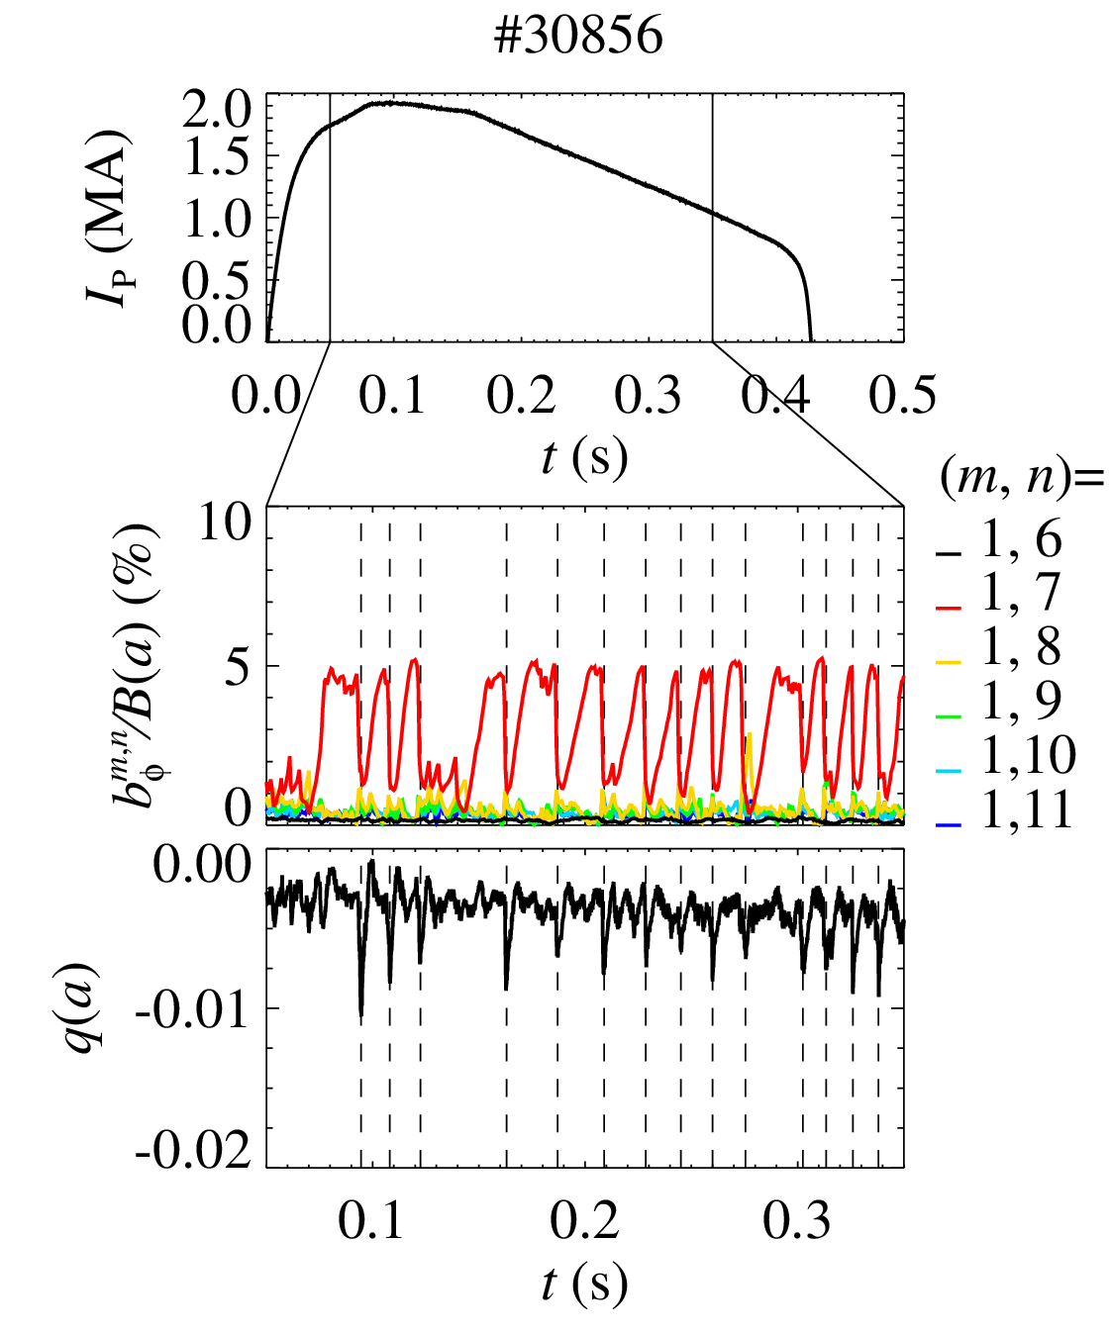
Introduction
Motivations
Tools
Uniform case
RFP
Tokamak
Conclusions
RFX-mod plasmas at high IP: spontaneous helical RFP states
At high IP (>1 MA), RFX-mod show spontaneous quasi-helical RFP states with m=1, n=7 dominant mode
QSH periodically interrupted by bursts of MHD activity associated with magnetic reconnection events
(magnetic → kinetic energy)
[M. Zuin et al., PPCF 2009]
Artur Kryzhanovskyy et al.
RFX-mod

Slide 6
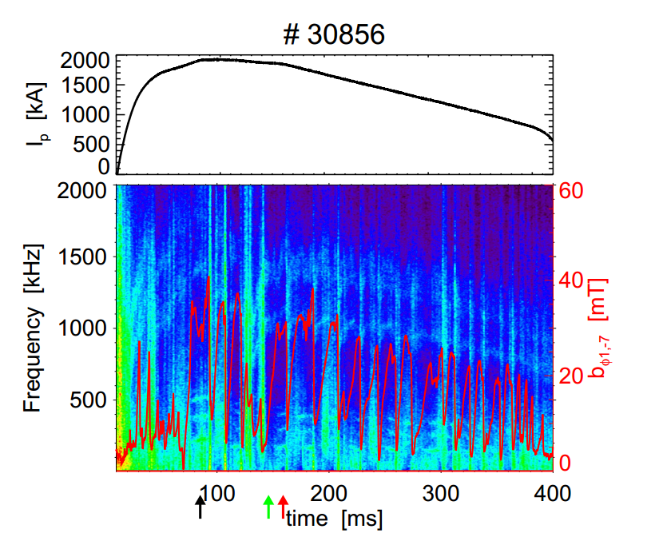
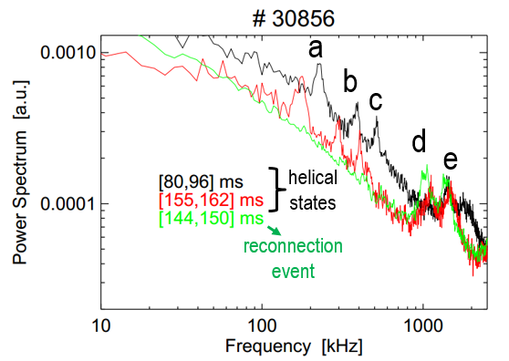
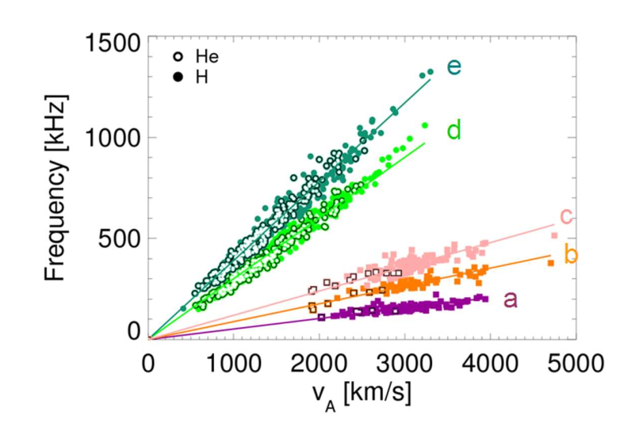
Introduction
Motivations
Tools
Uniform case
RFP
Tokamak
Conclusions
RFX-mod Ohmic plasmas: Alfvén eigenmodes
5 AEs (coherent frequency peaks that scale with $v_{A}$)
a-b-c: only during helical states
d-e: whole discharge, triggered by reconnection
all modes with m=1, n=0 and no NBI
[Spagnolo, Zuin et al, NF 2011]
AWs in Ohmic RFP discharges also in Extrap-T2R
[G. Regnoli et al, Phys. Plasmas 2005]
Artur Kryzhanovskyy et al.
RFX-mod

Slide 7
Introduction
Motivations
Tools
Uniform case
RFP
Tokamak
Conclusions
AWs in Tokamak Ohmic plasmas
Experimental observations of AWs in Ohmic Tokamak discharges (no injected fast particles):
After sawtooth crashes (Globus-M2, TUNAM-3M)
Following a forced n=2 magnetic reconnection by a static MPs (EAST)
Following minor disruptions (SUNIST)
In the presence of large 2/1 tearing modes or strong resonant MPs
(HL-2A, FTU, TEXTOR and JET)
Following impulsive MHD events (IREs or ELM) observed in COMPASS, MAST, ASDEX Upgrade and TFTR
[Balachenkov et al., NF 2021]
[S.V. Lebedev et al., 43th EPS 2016]
[N. Chu et al., NF 2018]
[Y. Liu et al., $Phys. Plasmas$ 2016]
[W. Chen et al., NF 2011]
[P. Buratti et al., NF 2005]
[O. Zimmermann et al., 34th EPS 2007]
[T. Markovi$\check{c}$ et al., ${44}^{th}$ EPS 2017]
[A. Sykes, PPCF 2001]
[M. Maraschek et al., PRL 1997]
[Z. Chang et al., NF 1995]
Numerical modelling of the correlation between AWs excitation and low-frequency MHD activity investigated by McClements et al., NF 2002.
AWs excitation by 3D MHD perturbations of toroidal equilibrium addressed theoretically by Biancalani et al. (2010a, 2010b, 2011) and Cook and Hegna (2015, 2016).
Artur Kryzhanovskyy et al.
Experimental observations

Slide 8
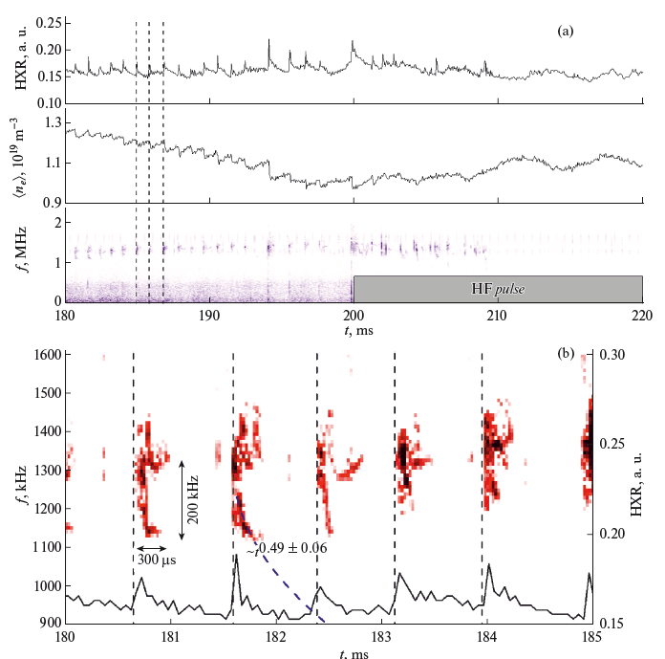
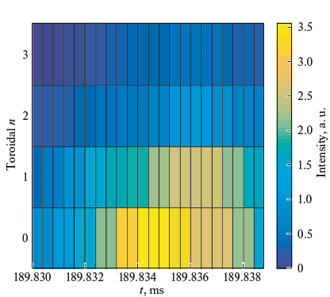
Introduction
Motivations
Tools
Uniform case
RFP
Tokamak
Conclusions
Tokamak Ohmic plasmas: sawtooth & Alfvén eigenmodes
[Balachenkov et al., NF 2021]
Discharge in Spherical tokamak Globus-M2
Bursts of Alfven oscillations
arise after sawtooth crashes
n=0 dominant toroidal mode number
Artur Kryzhanovskyy et al.
Globus-M2 Tokamak

Slide 9
Introduction
Motivations
Tools
Uniform case
RFP
Tokamak
Conclusions
Outline of the talk
Experimental motivations: AWs in RFX-mod and Tokamak Ohmic discharges
Tools: SpeCyl code
Nonlinear 3D MHD modelling of Alfvén waves:
Conclusions and future perspectives
Verification with analytical solutions for uniform case
RFP configuration (Recall)
Tokamak configuration (New)
Self-consistent AWs excitation in fully 3D dynamic configuration
Artur Kryzhanovskyy et al.
Outline

Slide 10
Introduction
Motivations
Tools
Uniform case
RFP
Tokamak
Conclusions
The SpeCyl code
The numerical simulations were carried out with SpeCyl [Cappello and Biskamp, 1996],
a non-linear visco-resistive 3D MHD code.
SpeCyl solves the visco-resistive MHD model in a straight periodical cylinder, in dimensionless units, in the negligible pressure and fixed density (time independent).
⦁ $ρ\left[\frac{∂v}{∂t}+\left(v∙∇\right)v\right]=J×B+ρν∇^{2}v$
Lundquist
⦁ $ρ\left[\frac{∂v}{∂t}+\left(v∙∇\right)v\right]=J×B+ρν∇^{2}v$
⦁ $J=∇×B$
$$S=η^{−1}$$
⦁ $J=∇×B$
$$M=ν^{−1}$$
visc. Lundquist
⦁ $\frac{∂B}{∂t}=∇×\left(v ×B−ηJ\right)$
⦁ $\frac{∂B}{∂t}=∇×\left(v ×B−ηJ\right)$
⦁ $∇∙B=0$
$$P=\frac{S}{M}$$
⦁ $∇∙B=0$
Prandtl
SpeCyl is a fully spectral code, in which a generic quantity $f(r,θ,z,t)$ can be written as:
$$f\left(r,θ,z,t\right)=\sum_{m}{ \sum_{n}{f_{m,n}\left(r,t\right) exp\left[i\left(mθ+\frac{n}{R_{0}}z\right)\right]}}$$
In this presentation: $R_{0}/a$=4, a time step of ${10}^{−4}τ_{A}$, a radial step of 256 points and semi-implicit term. The plasma boundary conditions at $r=a were$ chosen to represent an ideal, i.e. perfectly conducting, shell.
Artur Kryzhanovskyy et al.
The SpeCyl code

Slide 11
Introduction
Motivations
Tools
Uniform case
RFP
Tokamak
Conclusions
Outline of the talk
Experimental motivations: AWs in RFX-mod and Tokamak Ohmic discharges
Tools: SpeCyl code
Nonlinear 3D MHD modelling of Alfvén waves:
Conclusions and future perspectives
Verification with analytical solutions for uniform case
RFP configuration (Recall)
Tokamak configuration (New)
Self-consistent AWs excitation in fully 3D dynamic configuration
Artur Kryzhanovskyy et al.
Outline

Slide 12
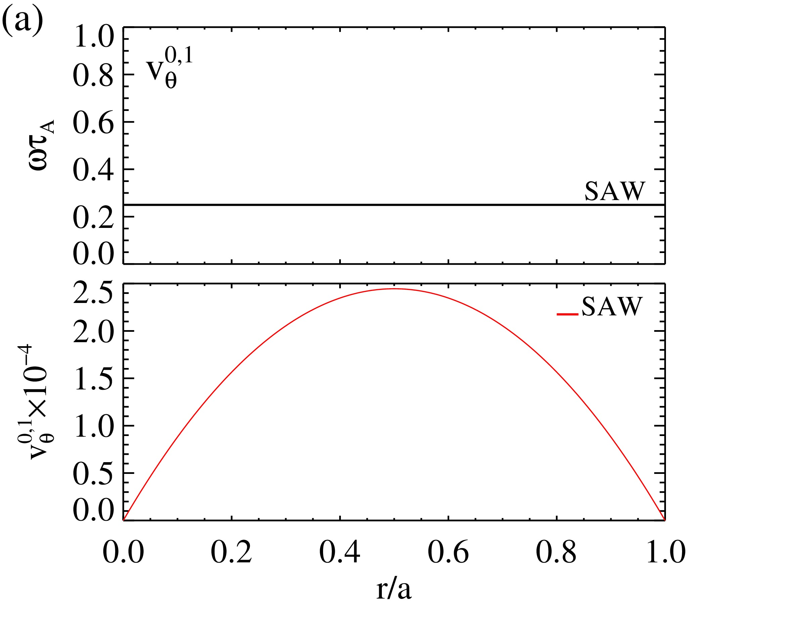
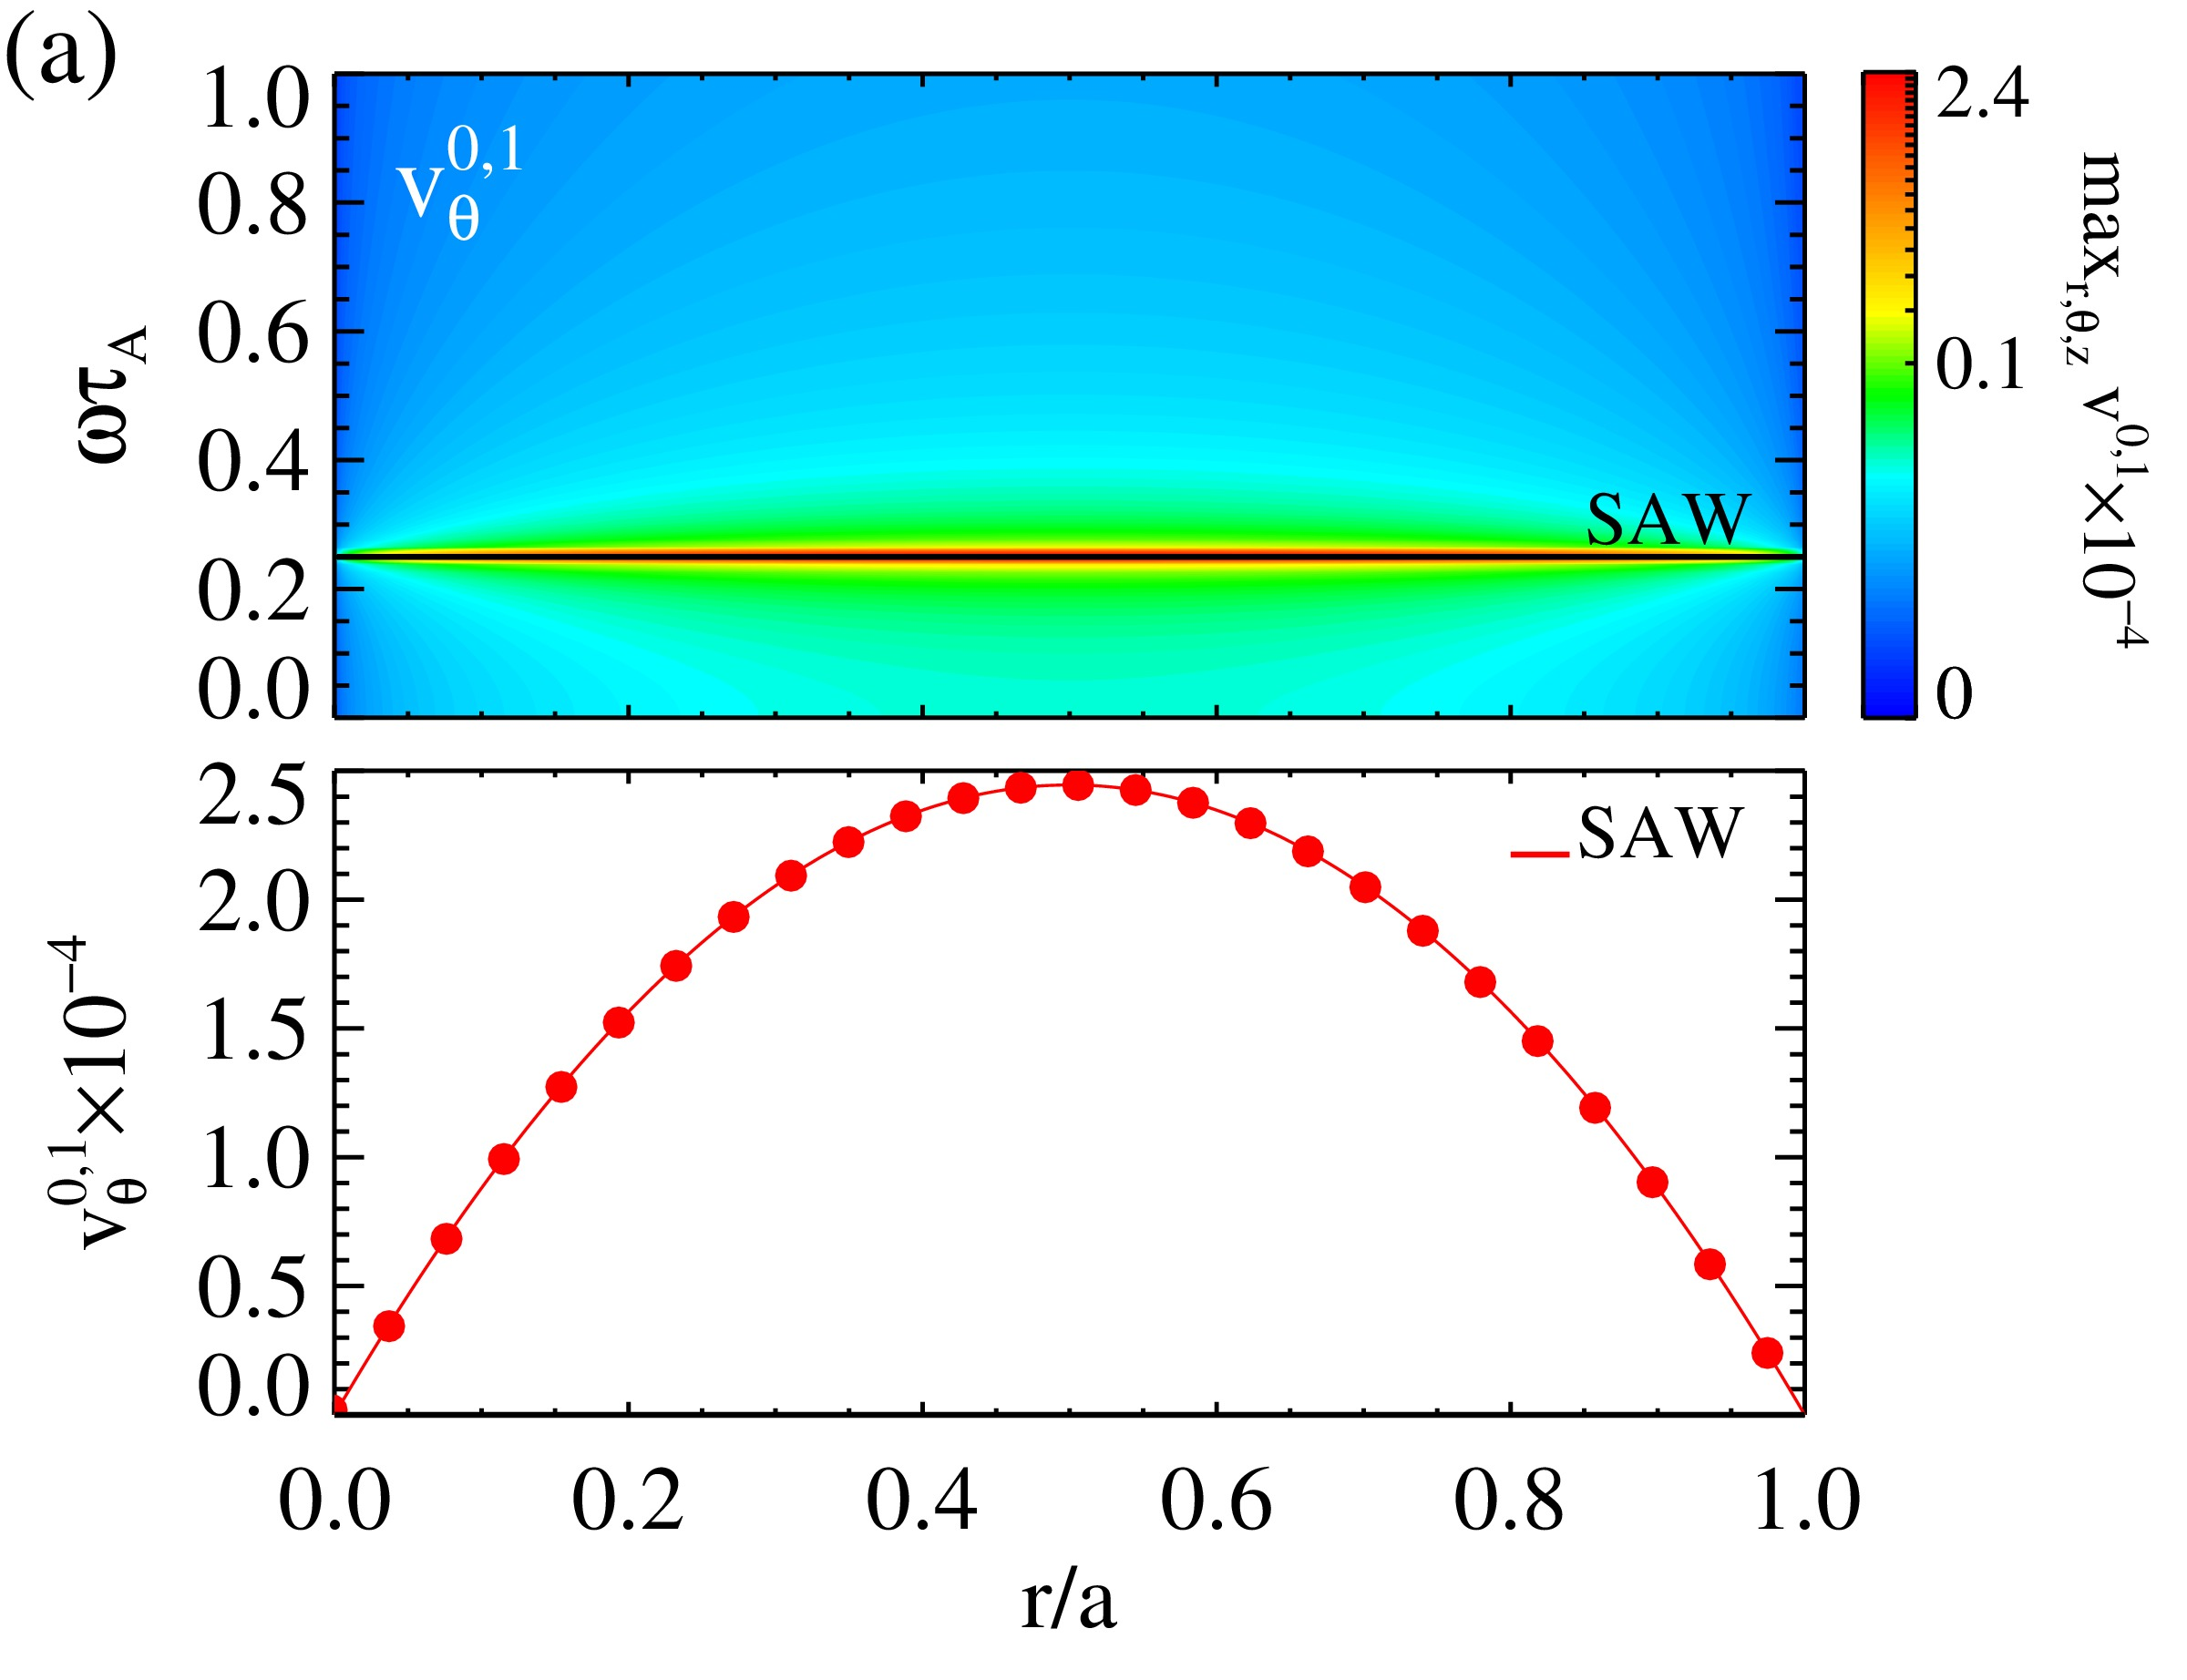
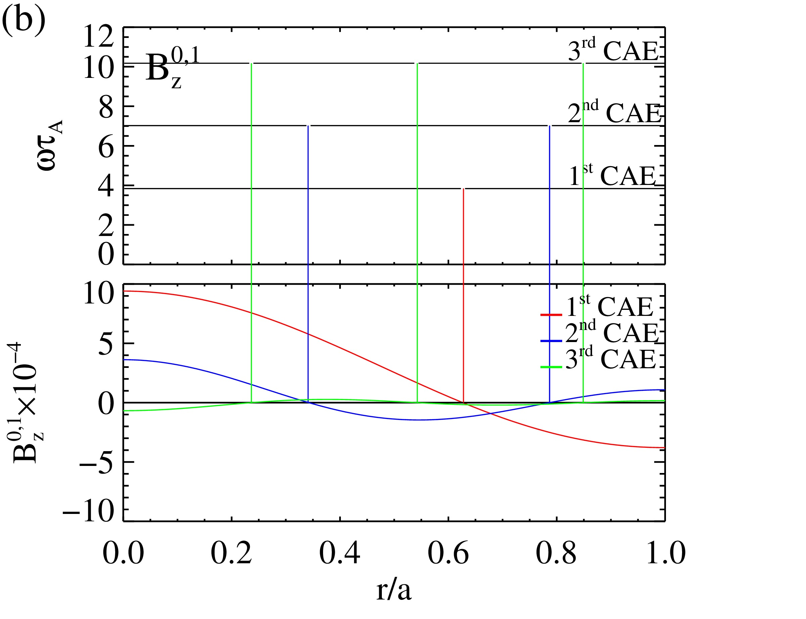
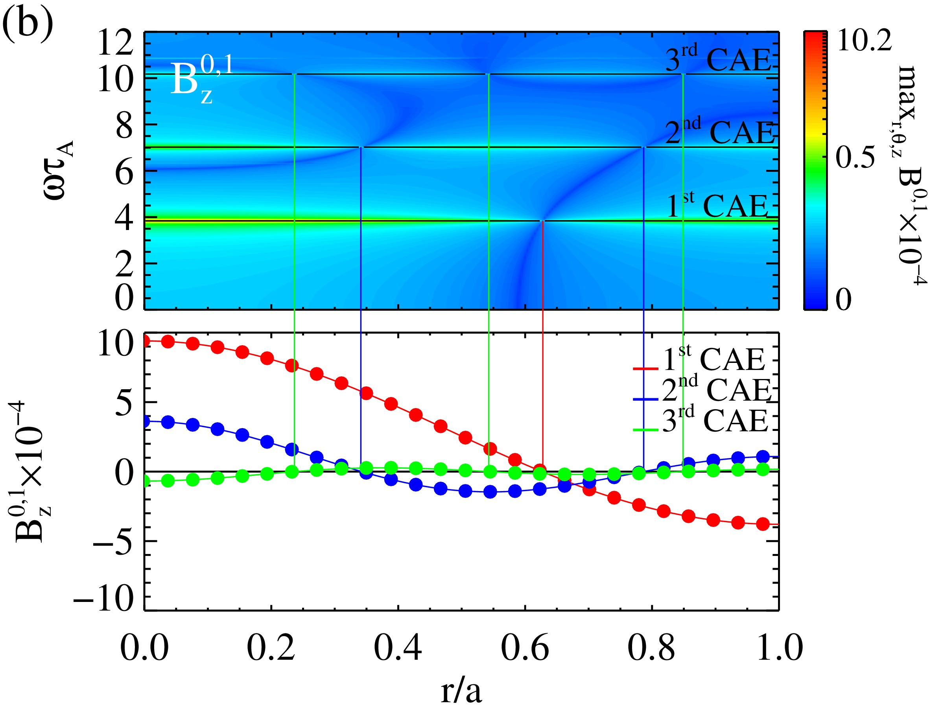
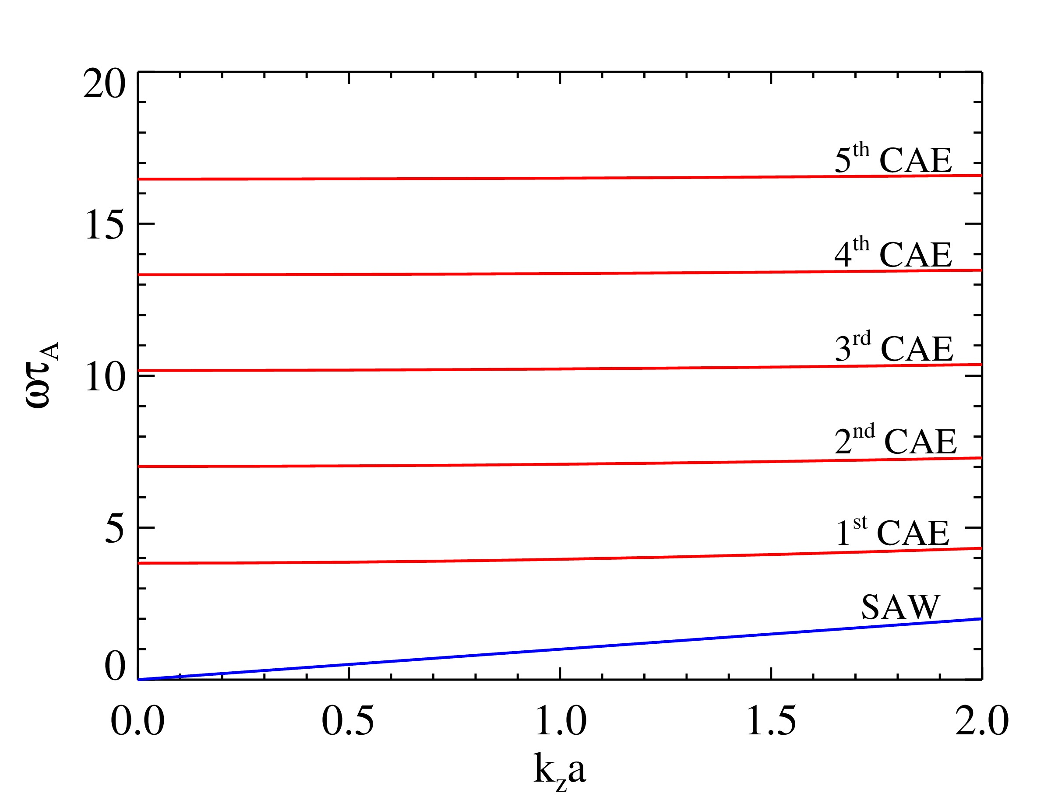
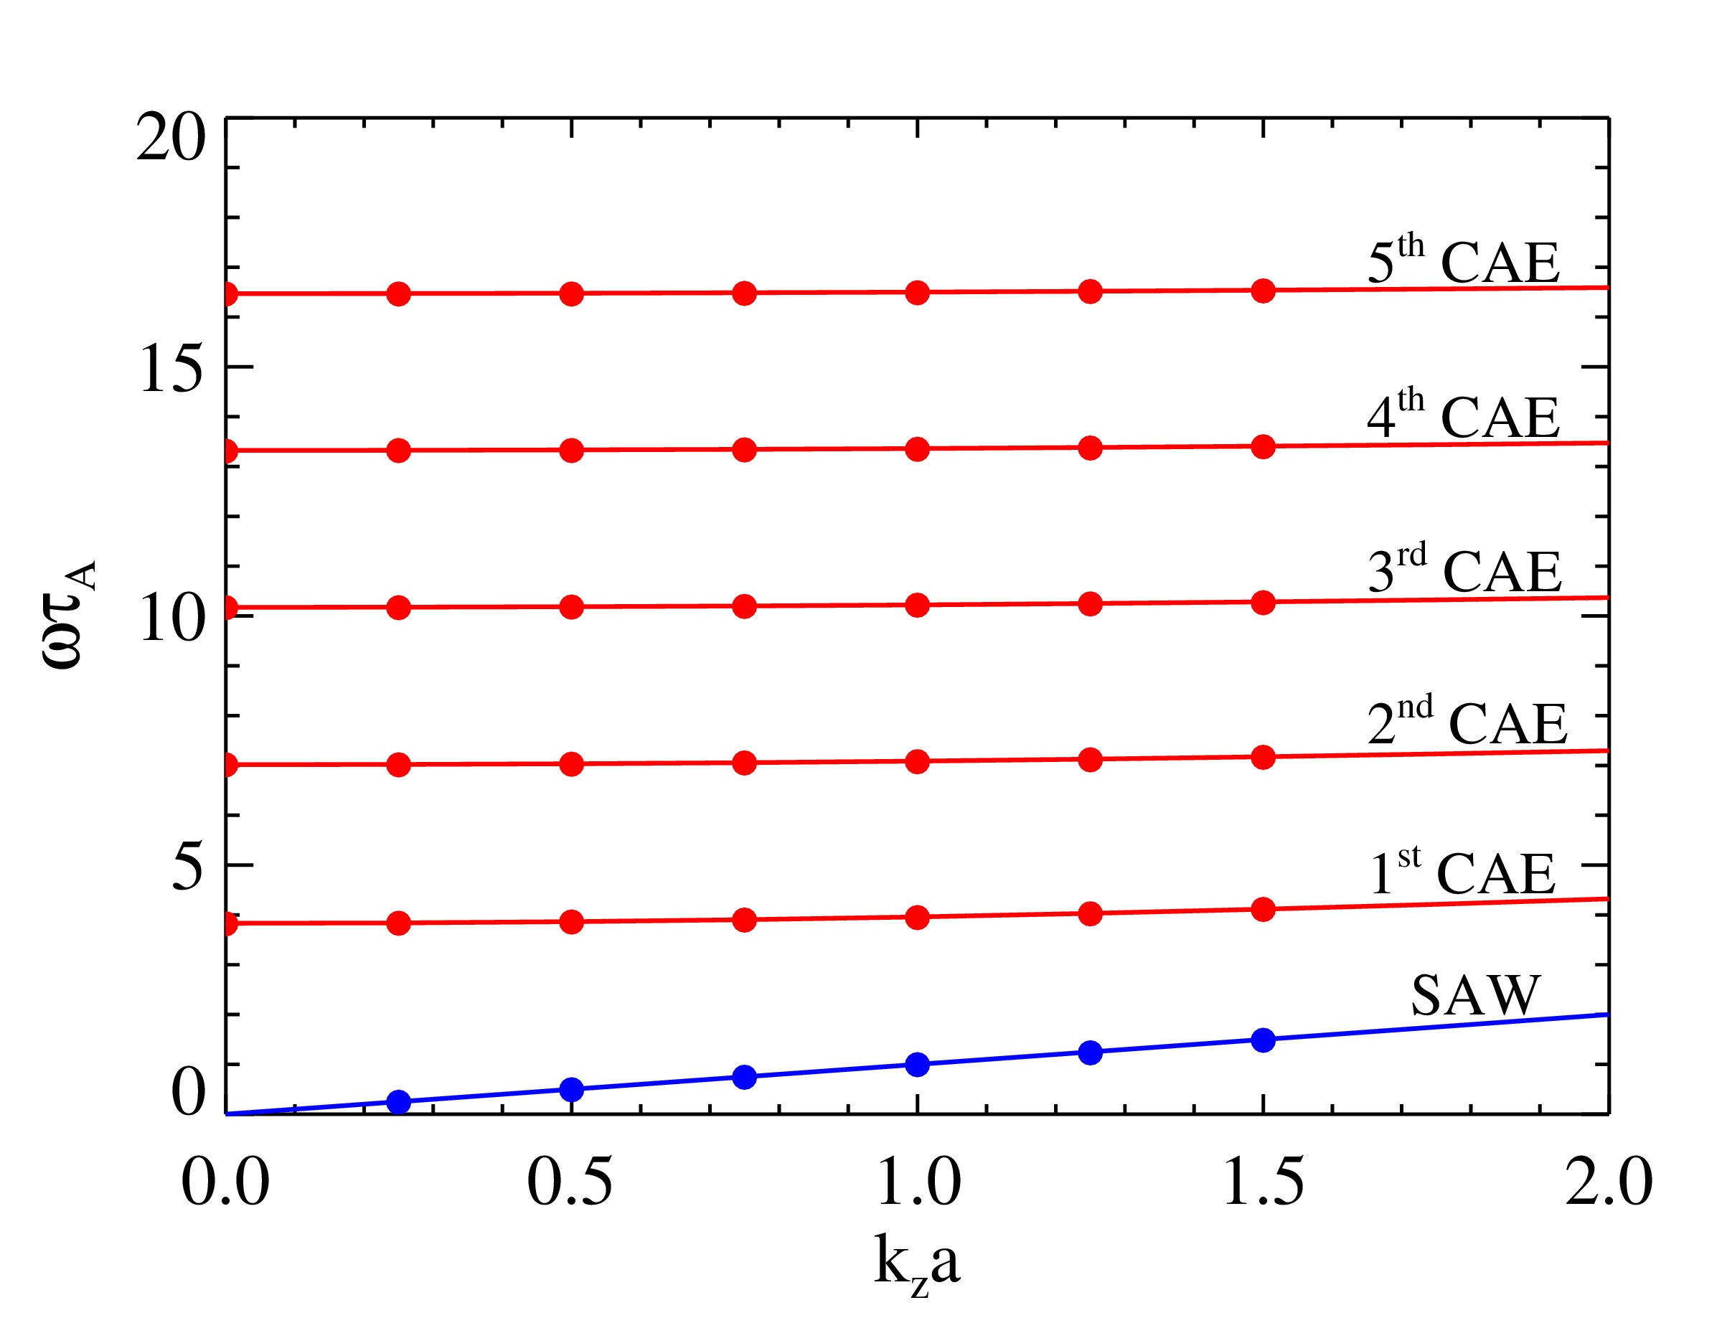
Introduction
Motivations
Tools
Uniform case
RFP
Tokamak
Conclusions
Uniform B and 𝜌: code verification
On the left: comparison between numerical and analytical spectra and eigenfunctions for 𝑚=0, 𝑛=1
Perturbed
$v_{θ}$
Bottom: comparison between numerical (dots) and analytical (solid curves) spectra for 𝑚=0 and toroidal periodicity from 𝑛=0 to 𝑛=6
(b)
Perturbed
$$v_{r}$$
Artur Kryzhanovskyy et al.
Uniform case

Slide 13
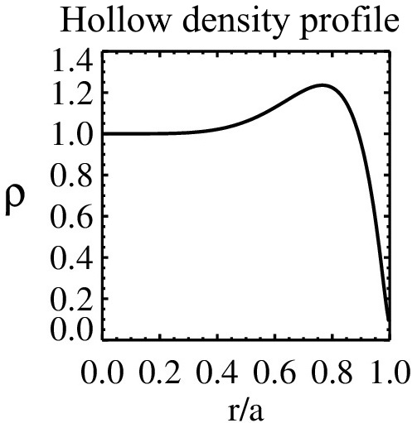
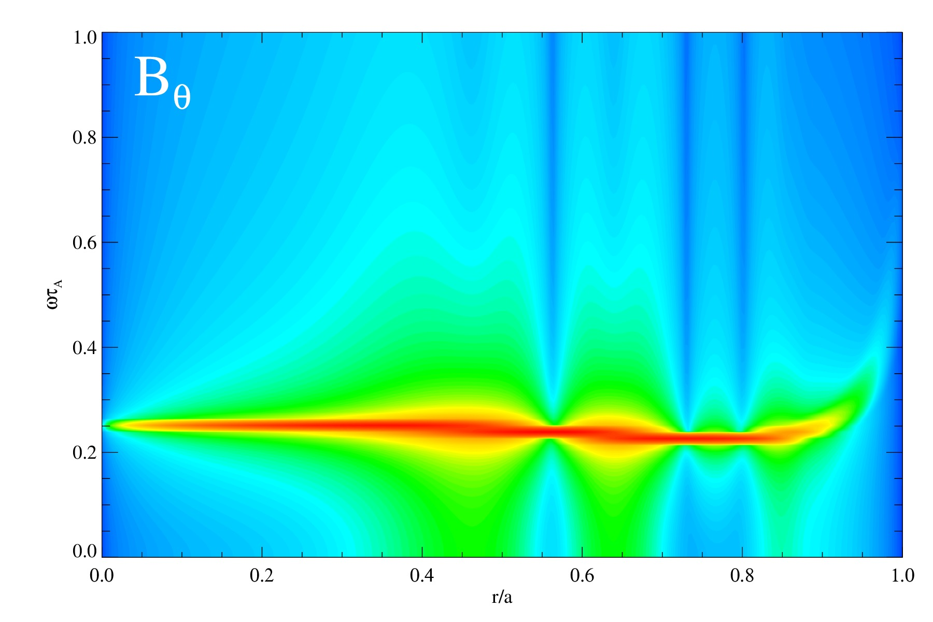
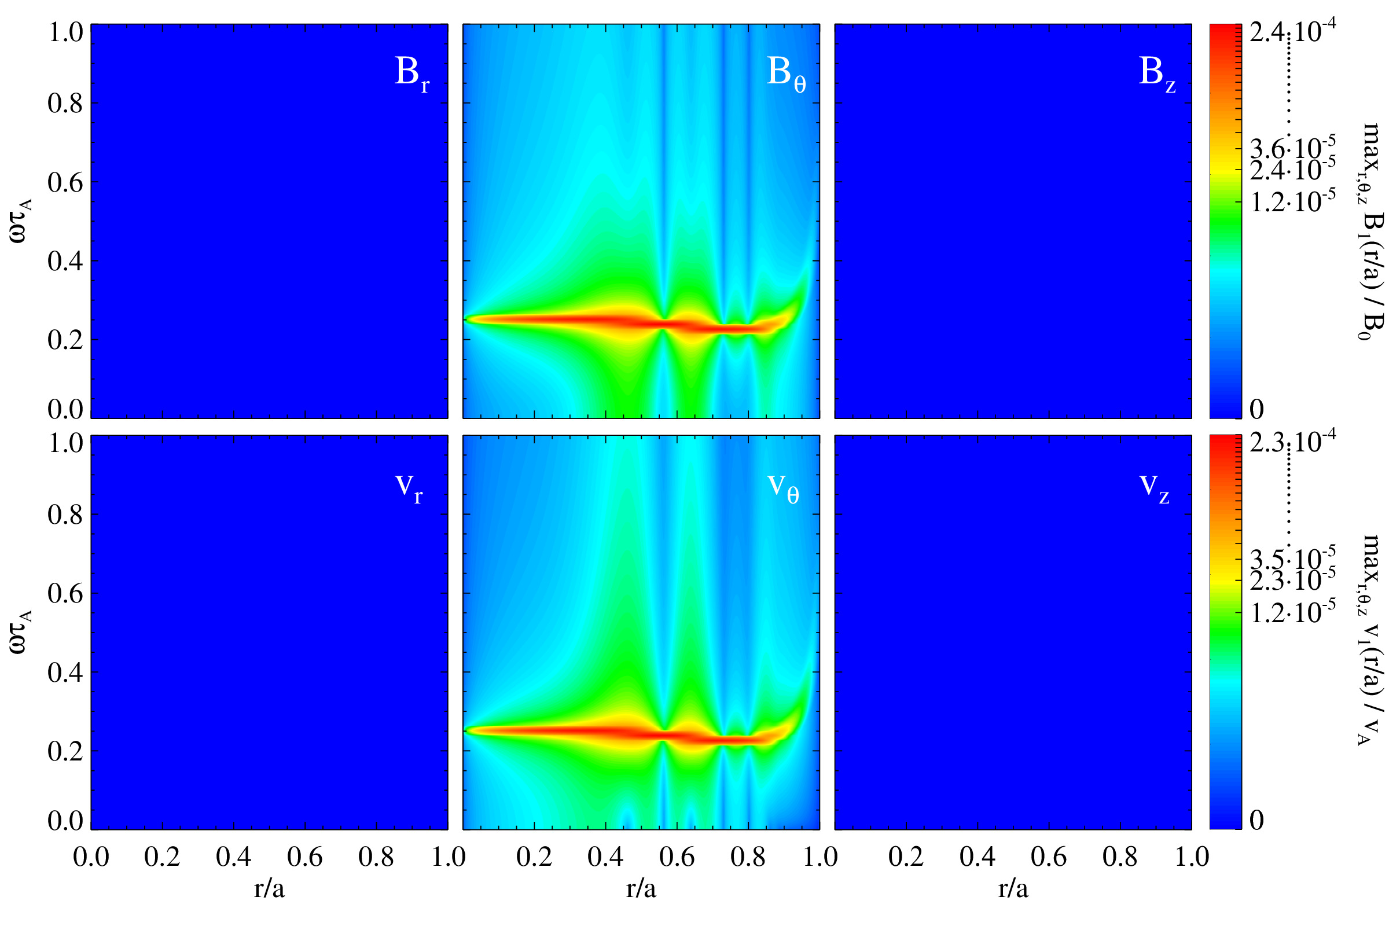
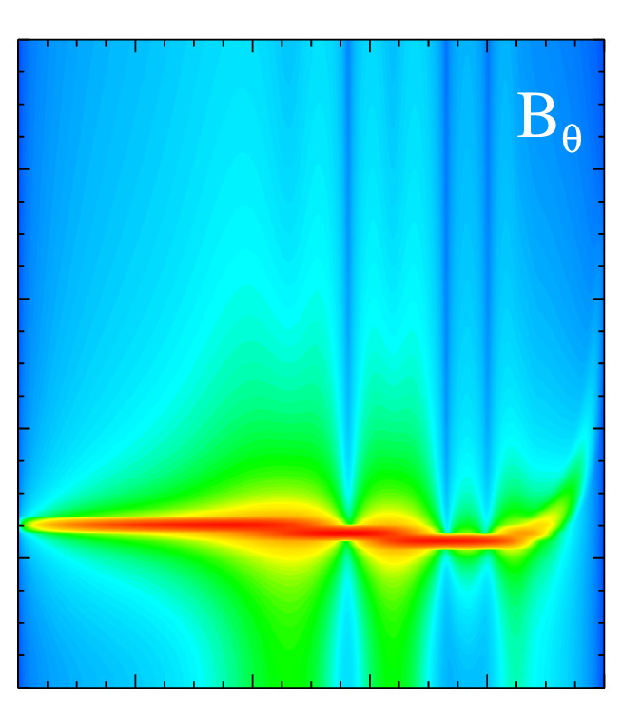
Introduction
Motivations
Tools
Uniform case
RFP
Tokamak
Conclusions
Uniform B and hollow density $ρ$: Phase mixing
FFT of (m,n)=(0,1) mode with perturbed component $v_{θ}$.
FFT of (m,n)=(0,1) mode with perturbed component $v_{θ}$. Verification with the theoretical model (MHD).
Artur Kryzhanovskyy et al.
Phase mixing
9 / 19

Slide 14
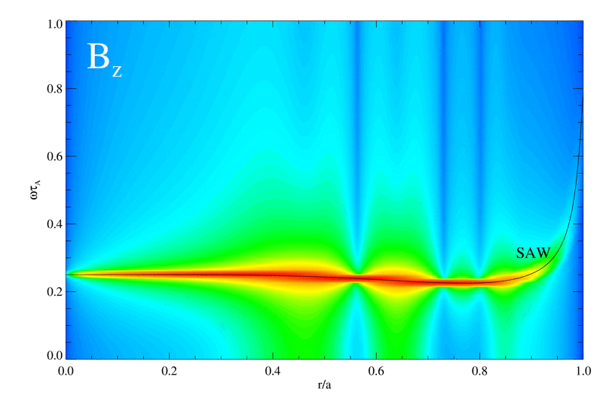
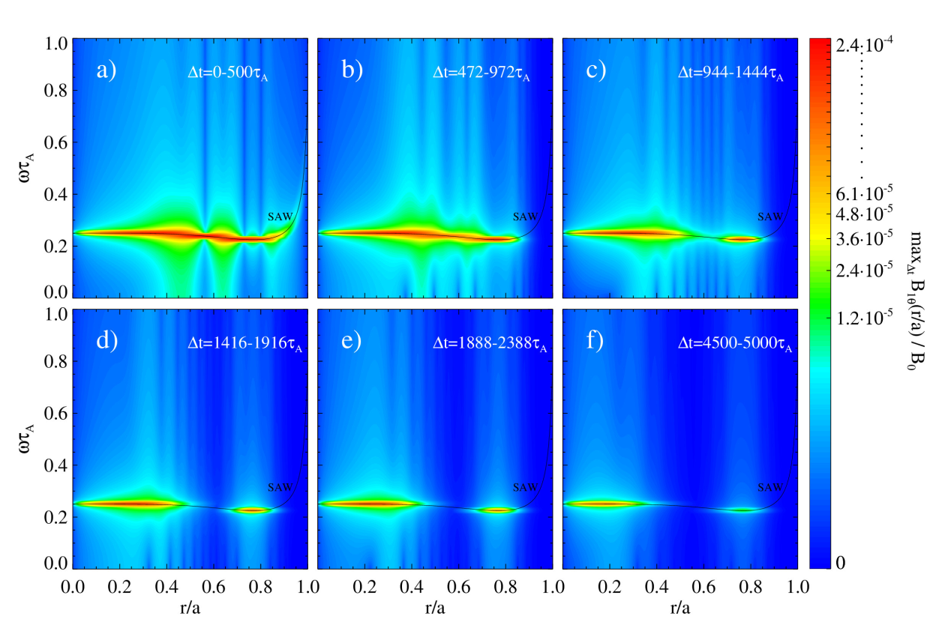
Introduction
Motivations
Tools
Uniform case
RFP
Tokamak
Conclusions
Uniform B and hollow density $ρ$: Phase mixing
FFT of (m,n)=(0,1) mode with perturbed component $v_{θ}$.
FFT of (m,n)=(0,1) mode with perturbed component $v_{θ}$. Verification with the theoretical model (MHD).
FFT of (m,n)=(0,1) mode with perturbed component $v_{θ}$. Verification with the theoretical model (MHD). Time evolution of Alfvén continuum and Phase mixing.
Phase mixing: Alfvén continuum amplitude is damped very quickly where $\left|\frac{dω_{A}}{dr}\right|$ is large.
[Cramer, 2001]
Condition: non uniform B or 𝜌.
$$B_{θ}$$
Artur Kryzhanovskyy et al.
Phase mixing
9 / 19

Slide 15
Introduction
Motivations
Tools
Uniform case
RFP
Tokamak
Conclusions
Outline of the talk
Experimental motivations: AWs in RFX-mod and Tokamak Ohmic discharges
Tools: SpeCyl code
Nonlinear 3D MHD modelling of Alfvén waves:
Conclusions and future perspectives
Verification with analytical solutions for uniform case
RFP configuration (Recall)
Tokamak configuration (New)
Self-consistent AWs excitation in fully 3D dynamic configuration
Artur Kryzhanovskyy et al.
Outline

Slide 16
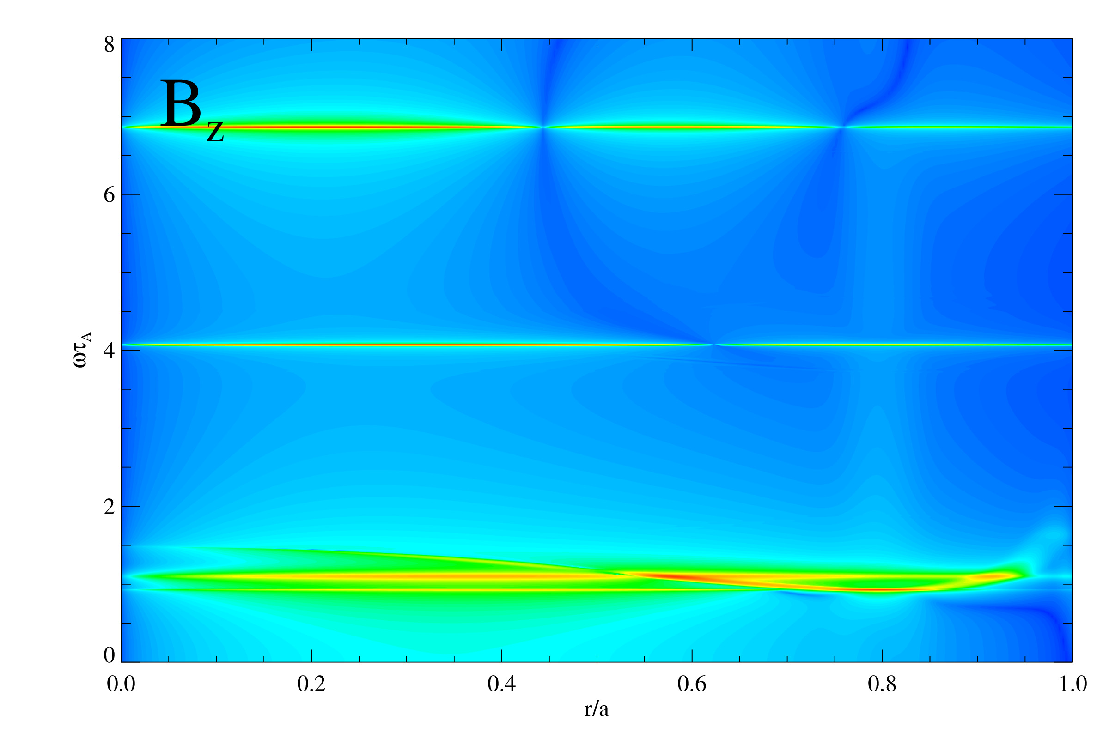
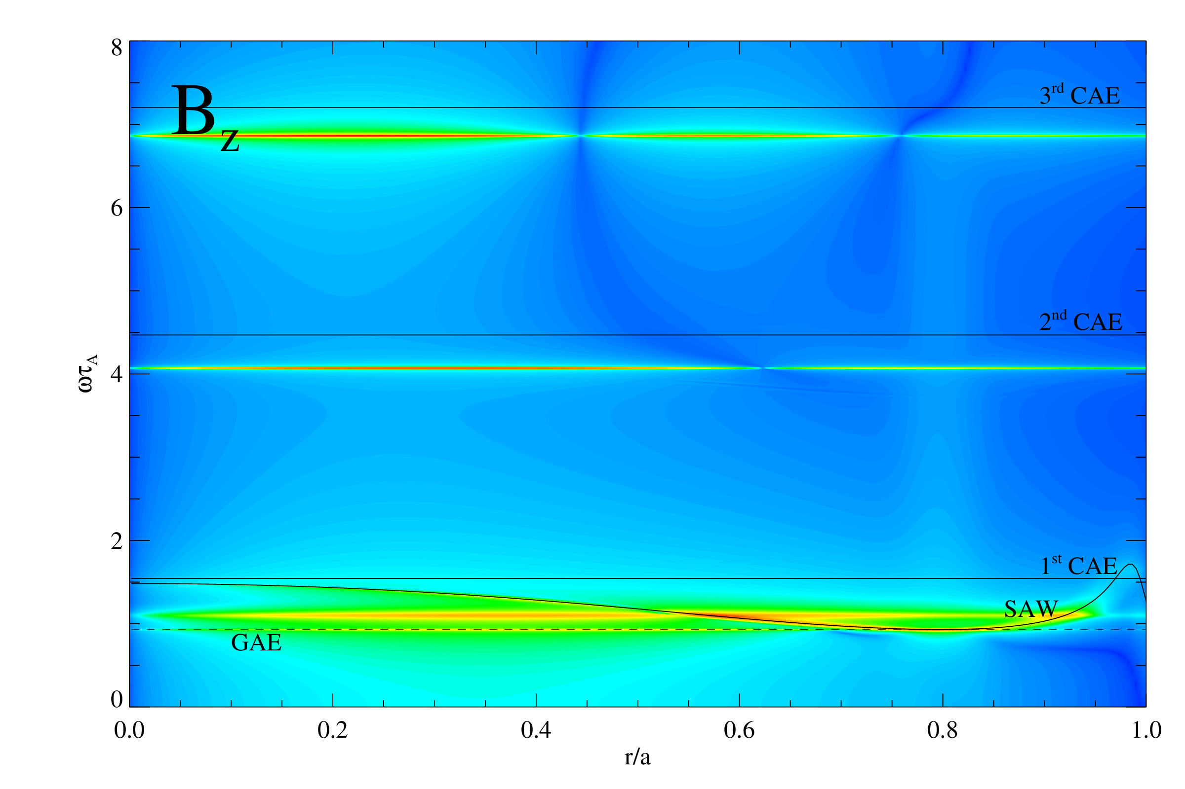
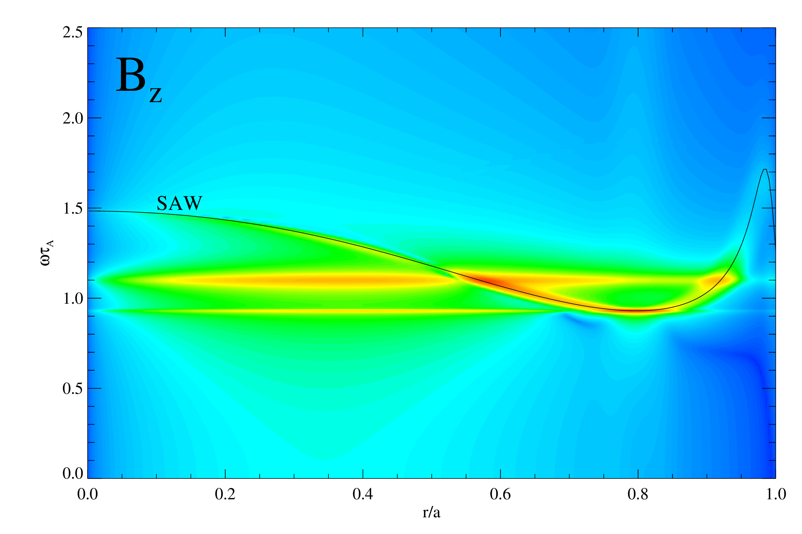
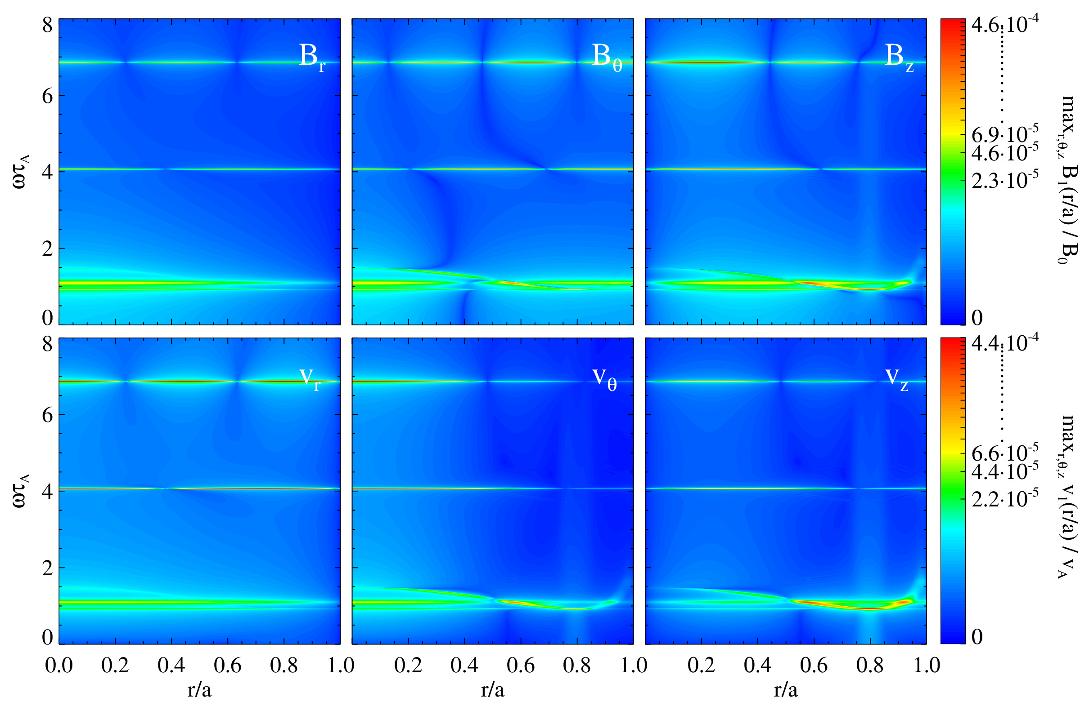
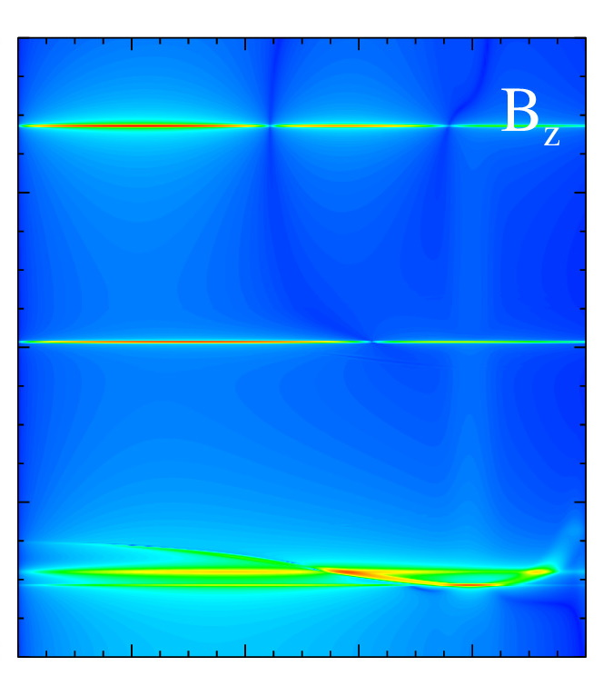
Introduction
Motivations
Tools
Uniform case
RFP
Tokamak
Conclusions
RFP B and hollow density $ρ$: Resonance absorption & GAE
FFT of (m,n)=(1,0) mode.
FFT of (m,n)=(0,1) mode Verification with the theoretical model (MHD).
GAE
Artur Kryzhanovskyy et al.
Resonance absorption & GAE
10 / 19

Slide 17
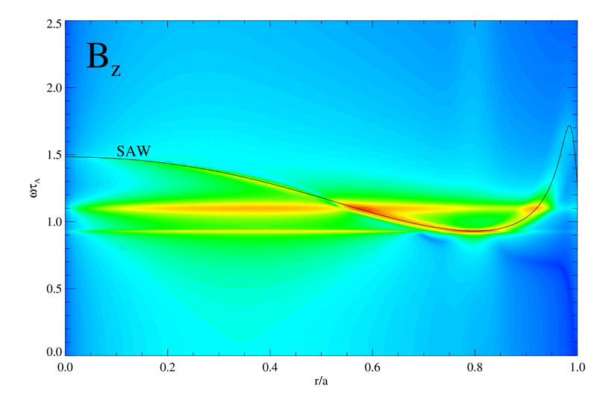
Introduction
Motivations
Tools
Uniform case
RFP
Tokamak
Conclusions
RFP B and hollow density $ρ$: Resonance absorption & GAE
FFT of (m,n)=(1,0) mode. Verification with the theoretical model (MHD). Time evolution of the spectrum and Resonance absorption.
FFT of (m,n)=(1,0) mode.
FFT of (m,n)=(0,1) mode Verification with the theoretical model (MHD).
Resonance absorption: waves with frequency falling inside the Alfvén continuum get damped.
[Hasegawa and Chen, 1976]
Condition: non uniform B.
GAE excitation below SAW local minimum.
GAE
Artur Kryzhanovskyy et al.
Resonance absorption & GAE
10 / 19

Slide 18
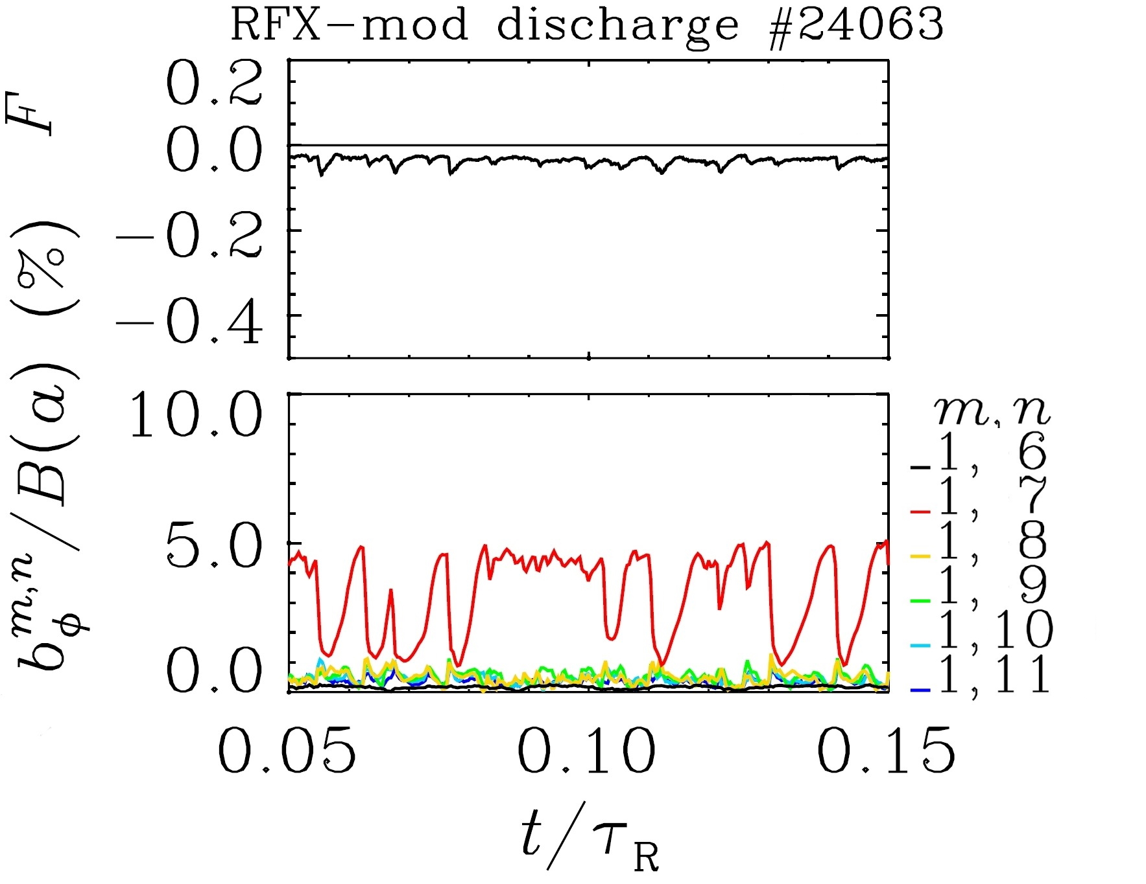
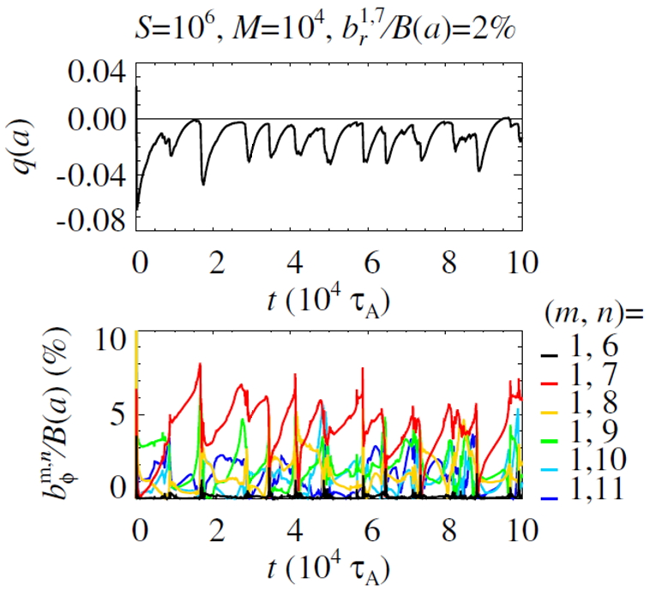
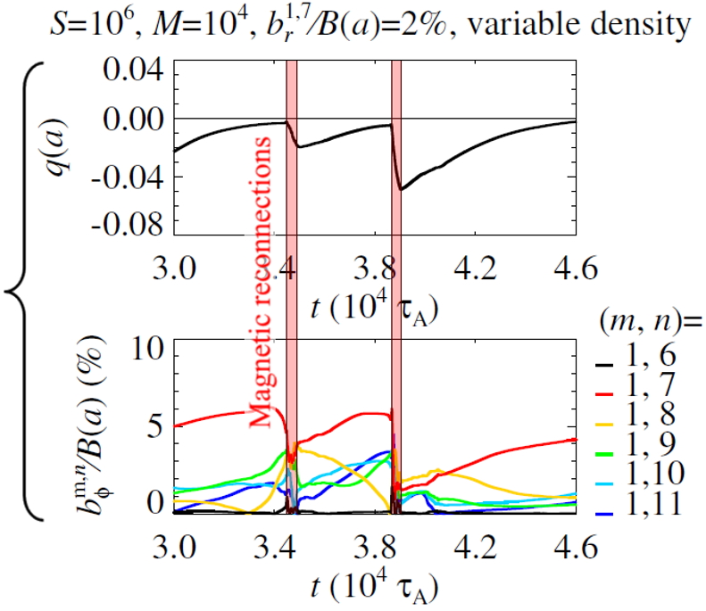
Introduction
Motivations
Tools
Uniform case
RFP
Tokamak
Conclusions
RFP setup in fully 3D configuration
Experimental data
-0.04
Typical RFX-mod discharge characterized by the systematic repetition of Quasi-Single-Helicity (QSH) states
q(a)
-0.00
-0.04
-0.08
10
05
$$b_{φ}^{m,n}/B(a)(\%)$$
00
0.05
0.10
0.15
Numerical modelling
t/$τ_{R}$
We set S=${10}^{6}$, M=${10}^{4}$ and a fully 3D spectrum of MHD modes (225 harmonics with $0≤m≤4$) with magnetic perturbation on $b_{r}^{1,7}\left(a\right)$
As shown in [D. Bonfiglio et al., PRL 2013], this gives the systematic repetition of QSH states with chosen helicity in between magnetic reconnection events, as routinely observed in RFX-mod
Artur Kryzhanovskyy et al.
3D RFP setup
11 / 19

Slide 19
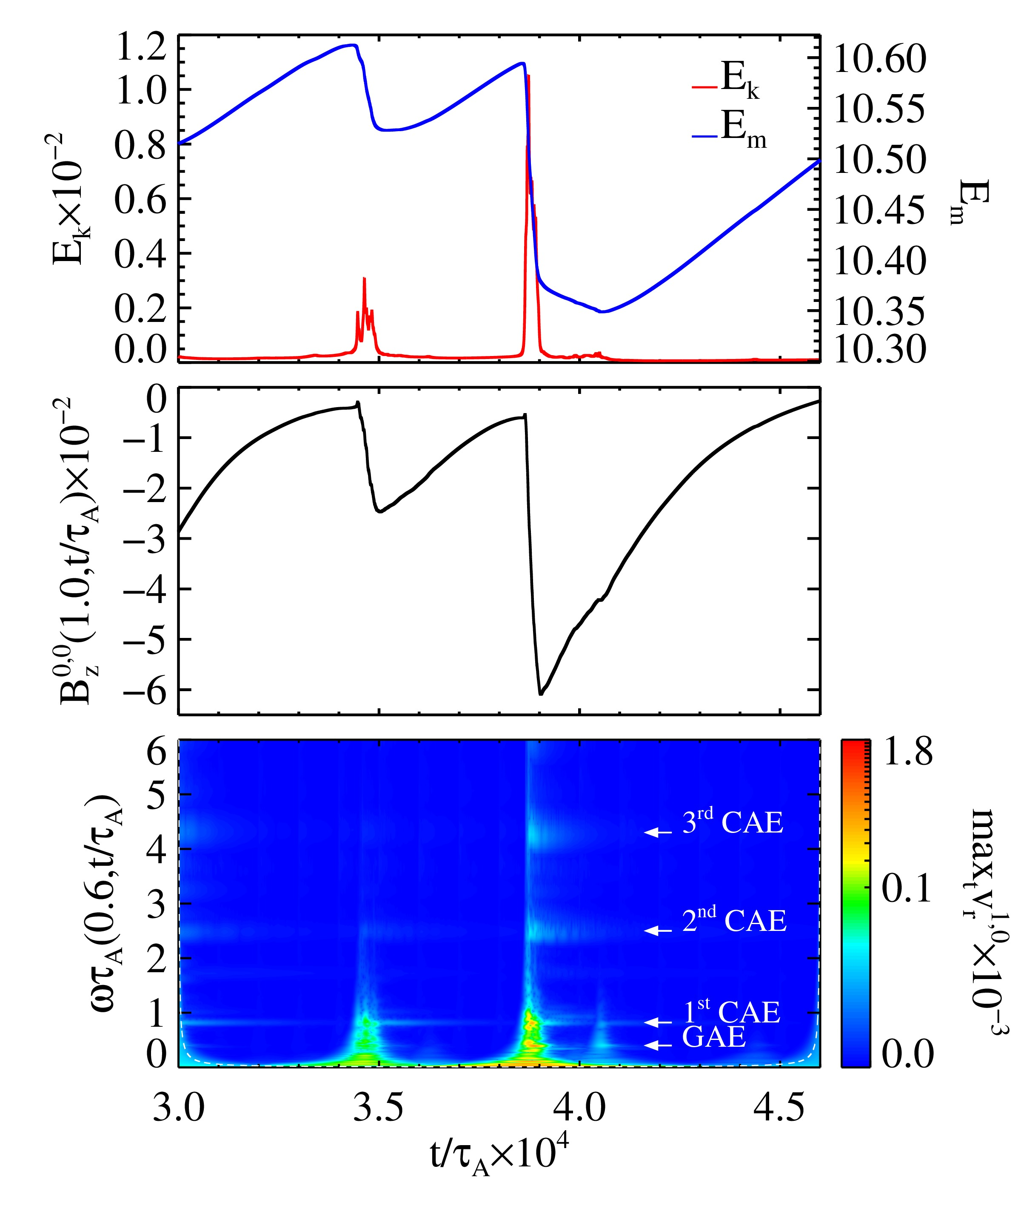
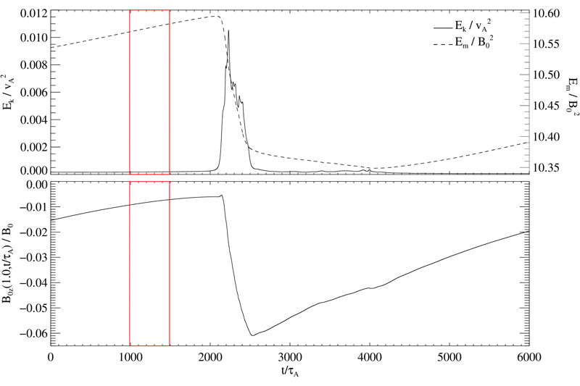
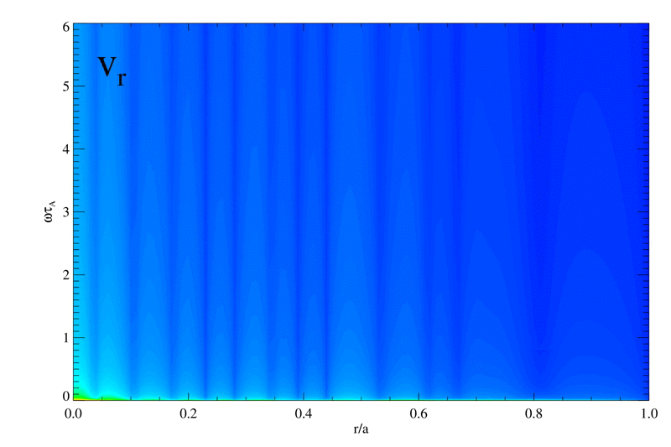
Introduction
Motivations
Tools
Uniform case
RFP
Tokamak
Conclusions
Excitation of AWs by magnetic reconnection in RFP
We look at (m,n)=(1,0) mode spectrum during the fully 3D RFP simulation.
Clear excitation of Alfvénic activity by magnetic reconnection.
$$1.2$$
$$10.60$$
$$1.0$$
$$E_{k}$$
$$0.8$$
$$E_{m}$$
$$10.55$$
$$E_{k}×{10}^{−2}$$
$$10.50$$
$$0.6$$
$$E_{m}$$
$$0.4$$
$$10.45$$
$$0.2$$
$$10.40$$
$$0.0$$
$$10.35$$
$$−0$$
$$10.30$$
$$−1$$
$$−2$$
$$−3$$
$$B_{z}^{0,0}(1.0,t/τ_{A})×{10}^{−2}$$
$$−4$$
$$−5$$
$$−6$$
3.6
3.7
3.8
3.9
4.0
4.1
4.2
t/$τ_{A}×{10}^{4}$
FFT
6
CWT
5
r/a=0.6
4
$$ωτ_{A}$$
3
2
1
0
0.0
0.2
0.4
0.6
0.8
1.0
r/a
Artur Kryzhanovskyy et al.
3D RFP simulation
12 / 19

Slide 20
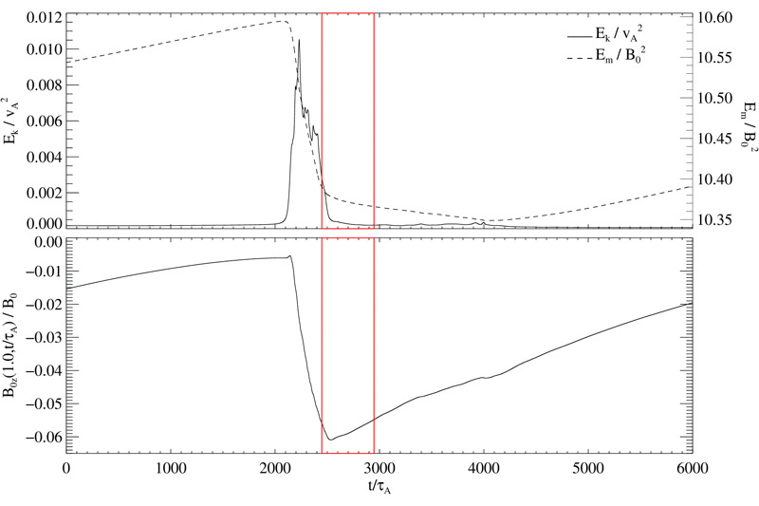
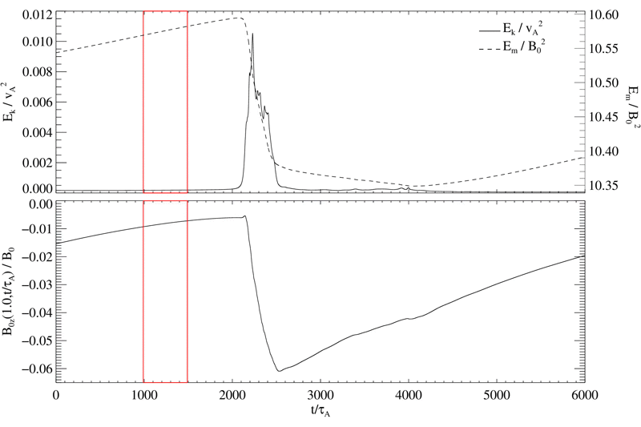
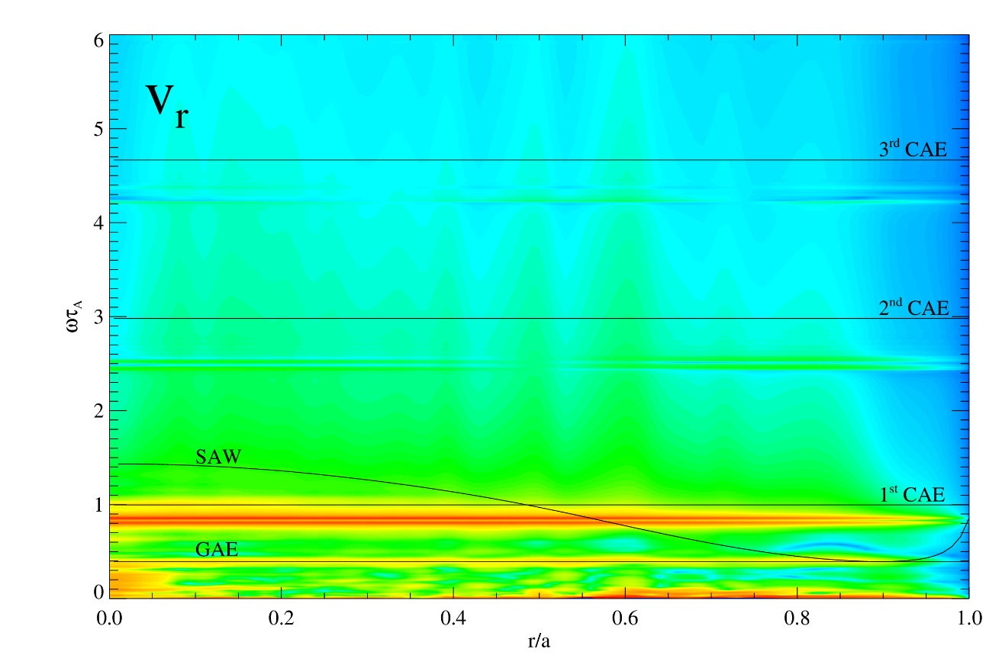
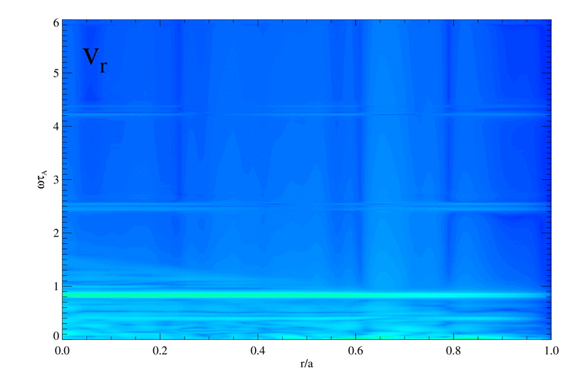
Introduction
Motivations
Tools
Uniform case
RFP
Tokamak
Conclusions
Excitation of AWs by magnetic reconnection in RFP
We look at (m,n)=(1,0) mode spectrum during the fully 3D RFP simulation.
Clear excitation of Alfvénic activity by magnetic reconnection.
$$1.2$$
$$1.2$$
$$10.60$$
$$10.60$$
FFT on a time window just after the magnetic reconnection event
$$E_{k}$$
FFT on a time window just after the magnetic reconnection event:
Alfvén Eigenmodes (in particular the GAE and $1^{st}$ CAE) are excited by magnetic reconnection
$$1.0$$
$$E_{k}$$
$$1.0$$
$$10.55$$
$$E_{m}$$
$$10.55$$
$$0.8$$
$$E_{m}$$
$$0.8$$
$$10.50$$
$$E_{k}×{10}^{−2}$$
$$10.50$$
$$E_{k}×{10}^{−2}$$
$$0.6$$
$$0.6$$
$$E_{m}$$
$$E_{m}$$
$$10.45$$
$$0.4$$
$$10.45$$
$$0.4$$
$$10.40$$
$$0.2$$
$$10.40$$
$$0.2$$
$$10.35$$
$$0.0$$
$$10.35$$
$$0.0$$
$$10.30$$
$$−0$$
$$10.30$$
$$−0$$
$$−1$$
$$−1$$
$$−2$$
$$−2$$
$$−3$$
$$−3$$
$$B_{z}^{0,0}(1.0,t/τ_{A})×{10}^{−2}$$
$$B_{z}^{0,0}(1.0,t/τ_{A})×{10}^{−2}$$
$$−4$$
$$−4$$
$$−5$$
$$−5$$
$$−6$$
$$−6$$
3.6
3.7
3.8
3.9
4.0
4.1
4.2
3.6
3.7
3.8
3.9
4.0
4.1
4.2
t/$τ_{A}×{10}^{4}$
t/$τ_{A}×{10}^{4}$
FFT
6
6
6
6
5
5
5
CWT
5
4
r/a=0.6
4
4
4
$$ωτ_{A}$$
$$ωτ_{A}$$
3
$$ωτ_{A}$$
3
$$ωτ_{A}$$
3
3
2
2
2
2
1
1
1
1
0
0
0
0
0.0
0.2
0.4
0.6
0.8
1.0
0.0
0.2
0.4
0.6
0.8
1.0
0.0
0.2
0.4
0.6
0.8
1.0
0.0
0.2
0.4
0.6
0.8
1.0
r/a
r/a
r/a
r/a
Artur Kryzhanovskyy et al.
3D RFP simulation
12 / 19

Slide 21
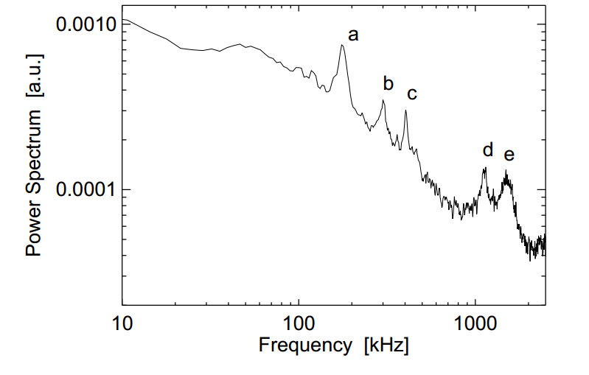
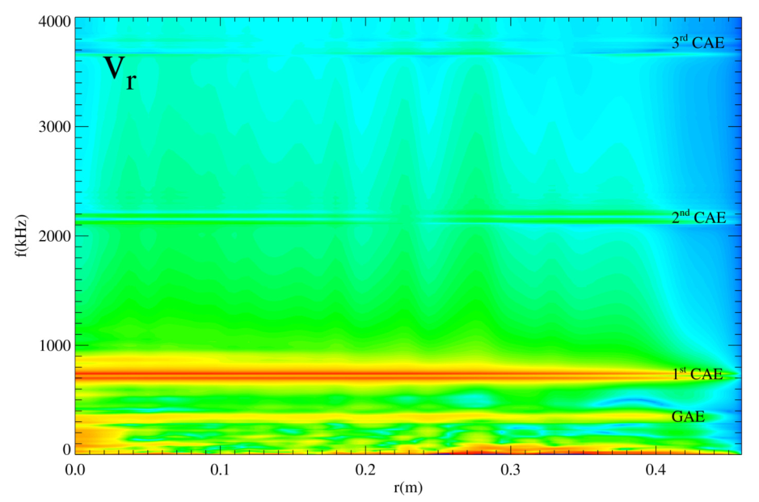
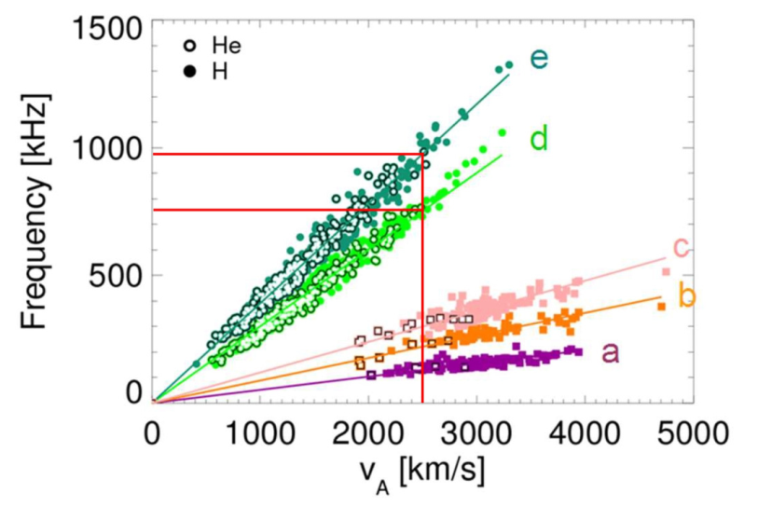
Introduction
Motivations
Tools
Uniform case
RFP
Tokamak
Conclusions
Comparison with experimental observations in RFX-mod
The previous figure is converted to physical units by assuming $v_{A}$=2500 km/s and a=0.459m (typical of RFX-mod)
The GAE and $1^{st}$CAE frequencies are in good quantitative agreement with (d) and (e) peaks of the RFX-mod spectrum (the dominant $m=1$, $n=0$ periodicity also agrees)
Numerical spectra
Experimental observations
Power spectrum of a ${\dot{b}}_{p}$ (r/a=1) signal evaluated during a helical state characterized by an improved confinement.
d and e peaks are present during almost the full discharge duration.
4000
3000
f(kHz)
2000
1000
Power spectrum Linear relation between peaks frequency and the Alfvén velocity for a large database of H and He plasmas.
0000
0.0
0.1
0.2
0.3
0.4
r(m)
Artur Kryzhanovskyy et al.
3D RFP simulation
13 / 19

Slide 22
Introduction
Motivations
Tools
Uniform case
RFP
Tokamak
Conclusions
Outline of the talk
Experimental motivations: AWs in RFX-mod and Tokamak Ohmic discharges
Tools: SpeCyl code
Nonlinear 3D MHD modelling of Alfvén waves:
Conclusions and future perspectives
Verification with analytical solutions for uniform case
RFP configuration (Recall)
Tokamak configuration (New)
Self-consistent AWs excitation in fully 3D dynamic configuration
Artur Kryzhanovskyy et al.
Outline

Slide 23
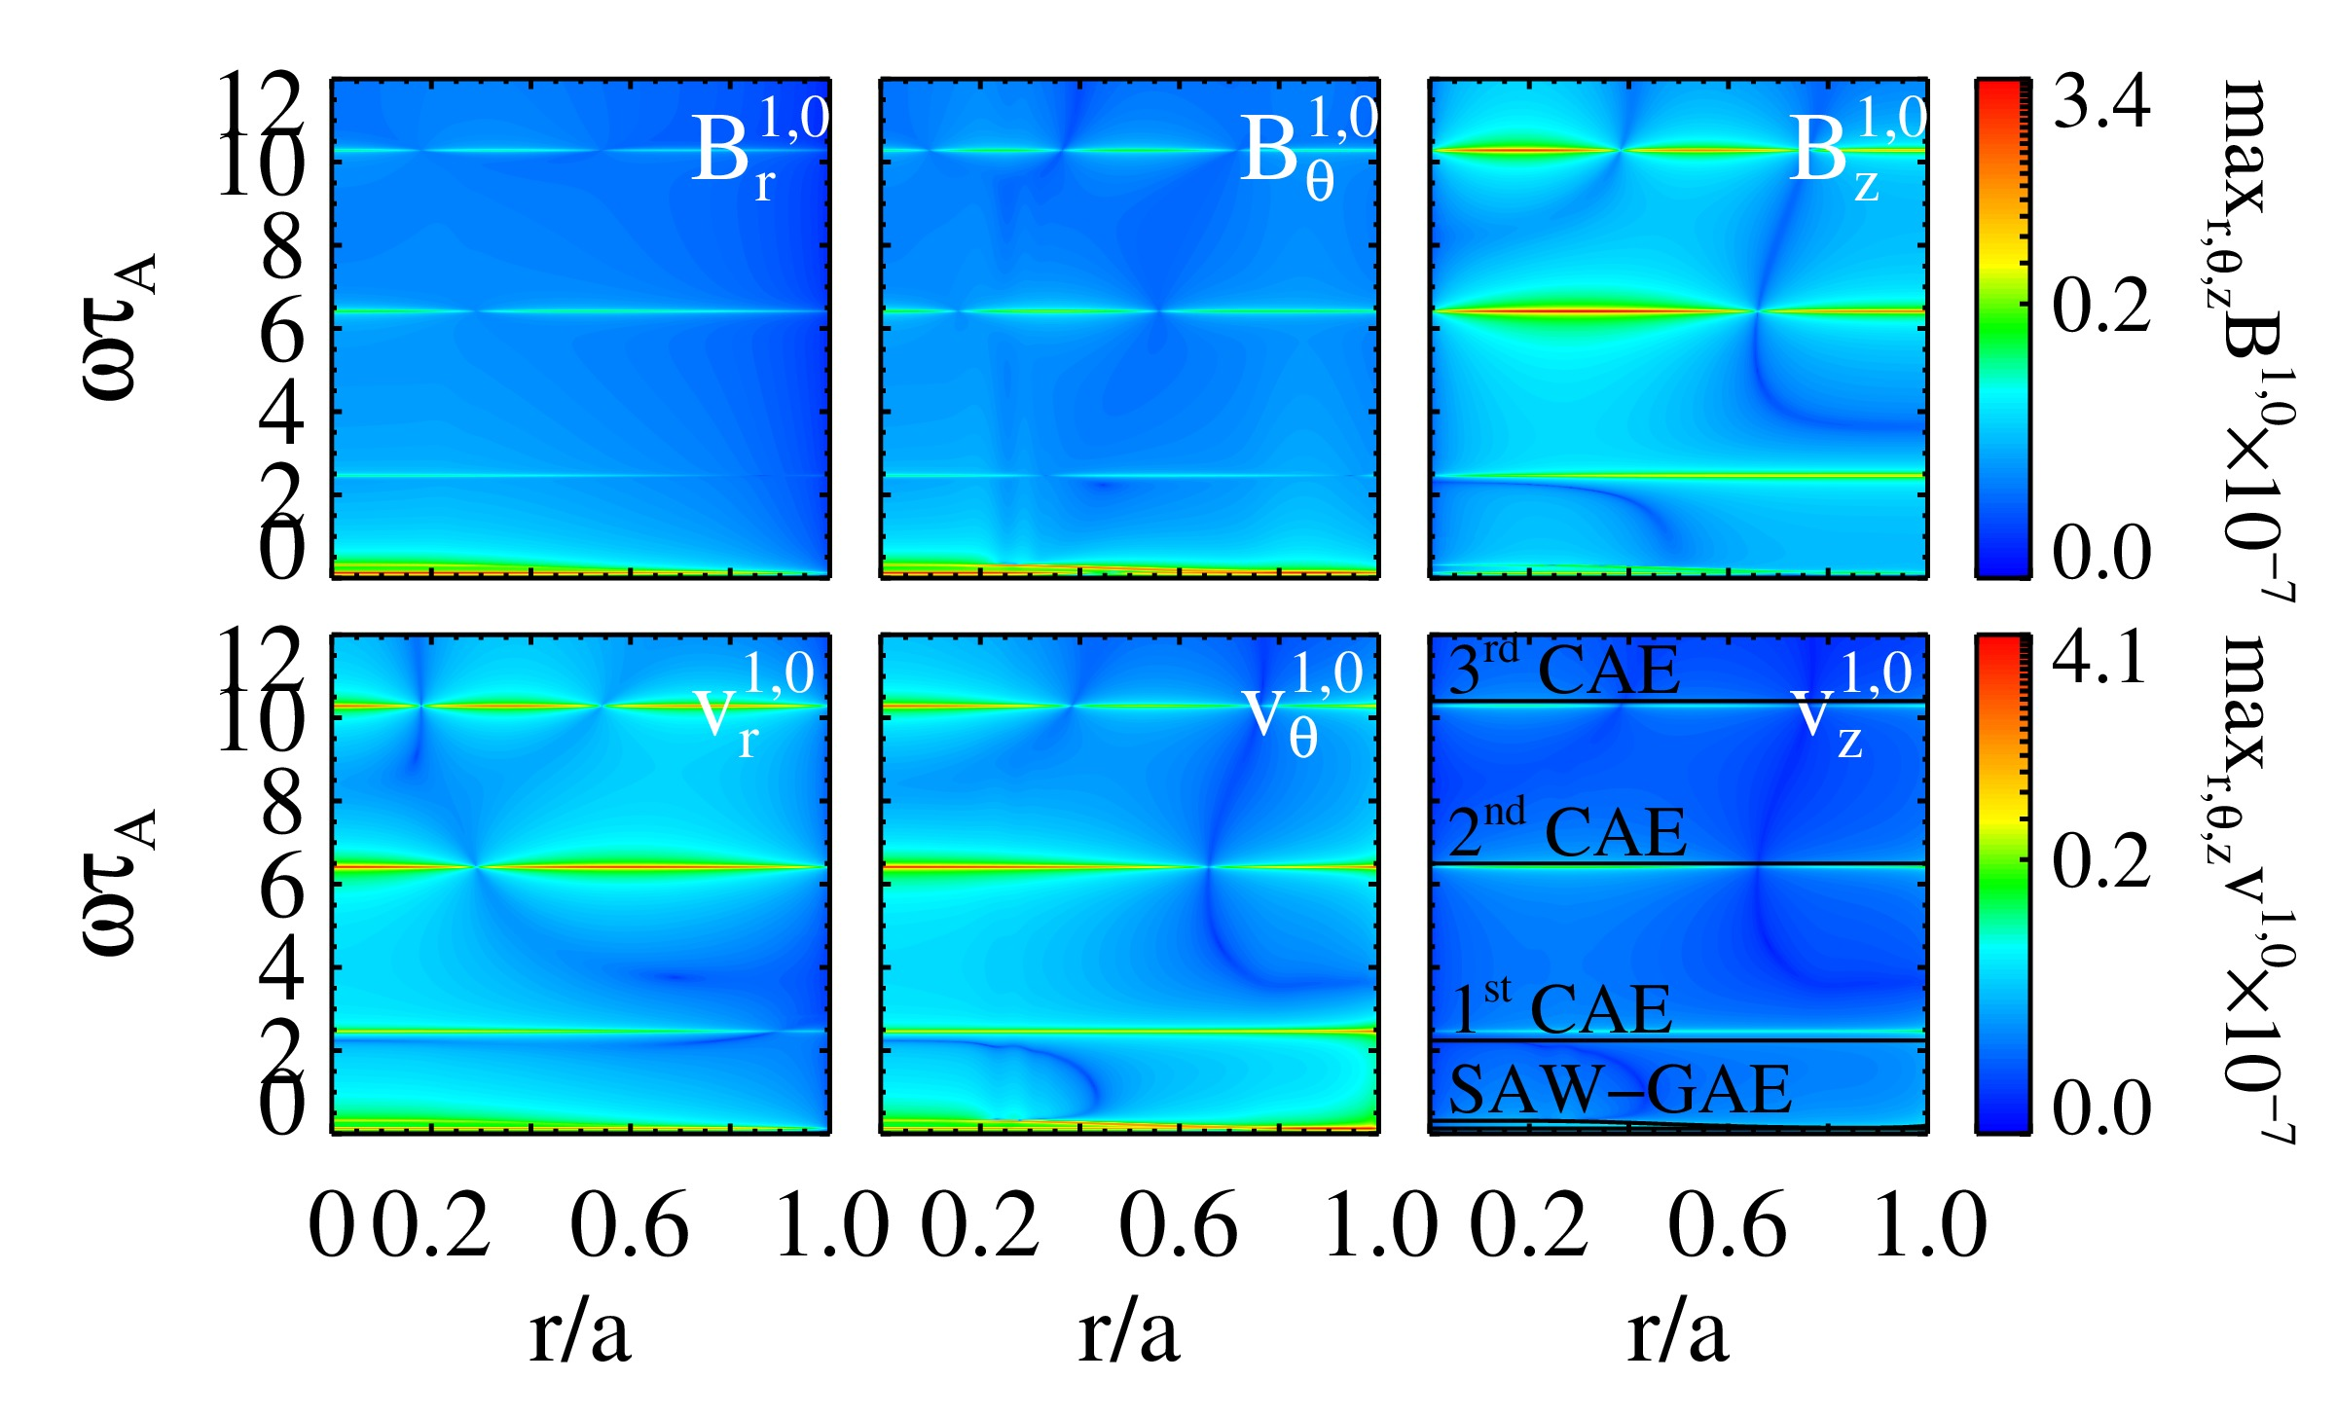
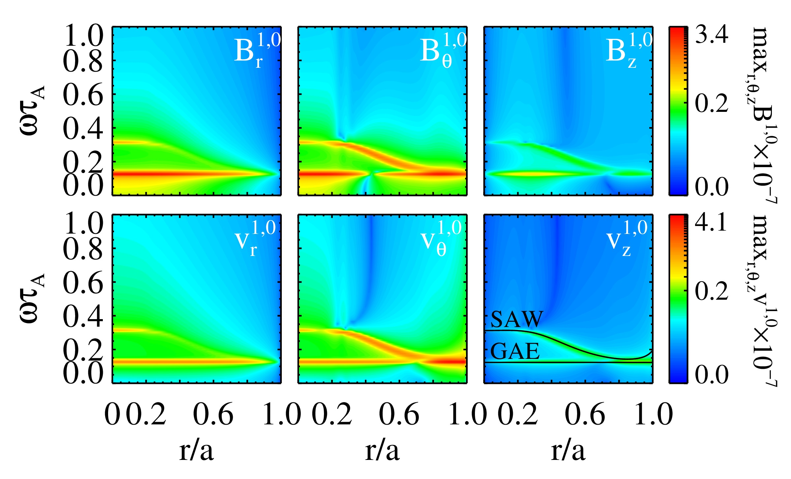
Introduction
Motivations
Tools
Uniform case
RFP
Tokamak
Conclusions
Tokamak B and bell-shaped density 𝜌
FFT of (m,n)=(1,0) mode. Focus on low frequency AWs: continuum SAW and GAE.
FFT of (m,n)=(1,0) mode.
Snapshots in time
Artur Kryzhanovskyy et al.
Tokamak single wave
14 / 19

Slide 24
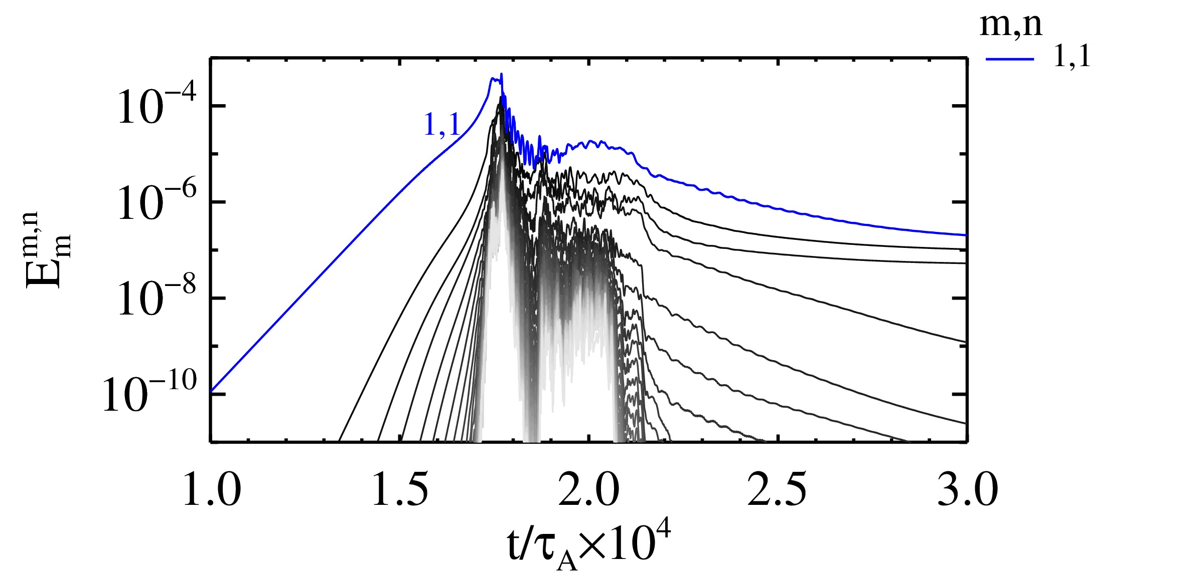
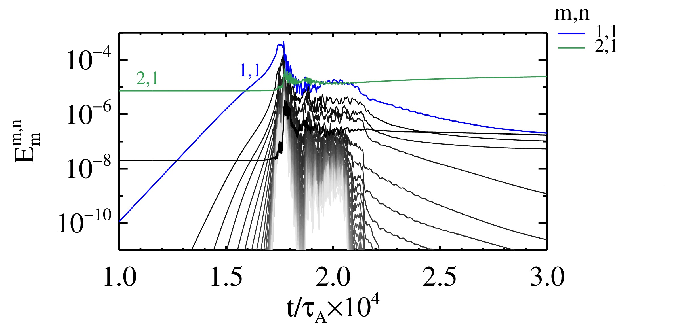
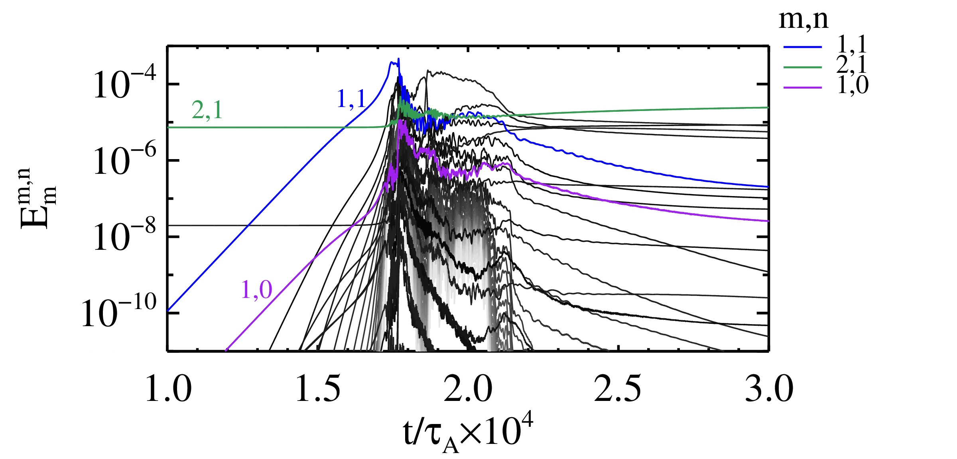
Introduction
Motivations
Tools
Uniform case
RFP
Tokamak
Conclusions
Tokamak setup in fully 3D configuration
We start from an axisymmetric static Ohmic equilibrium with central safety factor $q_{0}=0.8$ and bell-shaped density profile
We set S=${10}^{8}$, M=${10}^{6}$ and consider 32 harmonics of the 1,1 internal kink mode in the computation, with initial up-down asymmetric perturbations
Fully 3D sawtoothing dynamics initialized by three-wave coupling approach between 1,1 and 2,1 modes
The 2,1 tearing mode is marginally stable for this tokamak configuration
The 2,1 mode will couple the internal kink to other harmonics, e.g. 1,0
[Mcclements et al, 2002]
Artur Kryzhanovskyy et al.
3D Tokamak setup
15 / 19

Slide 25
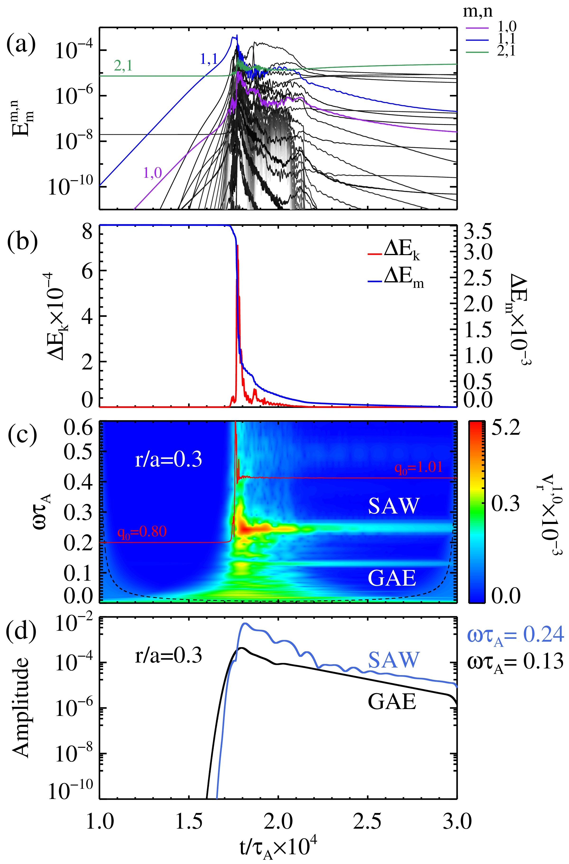
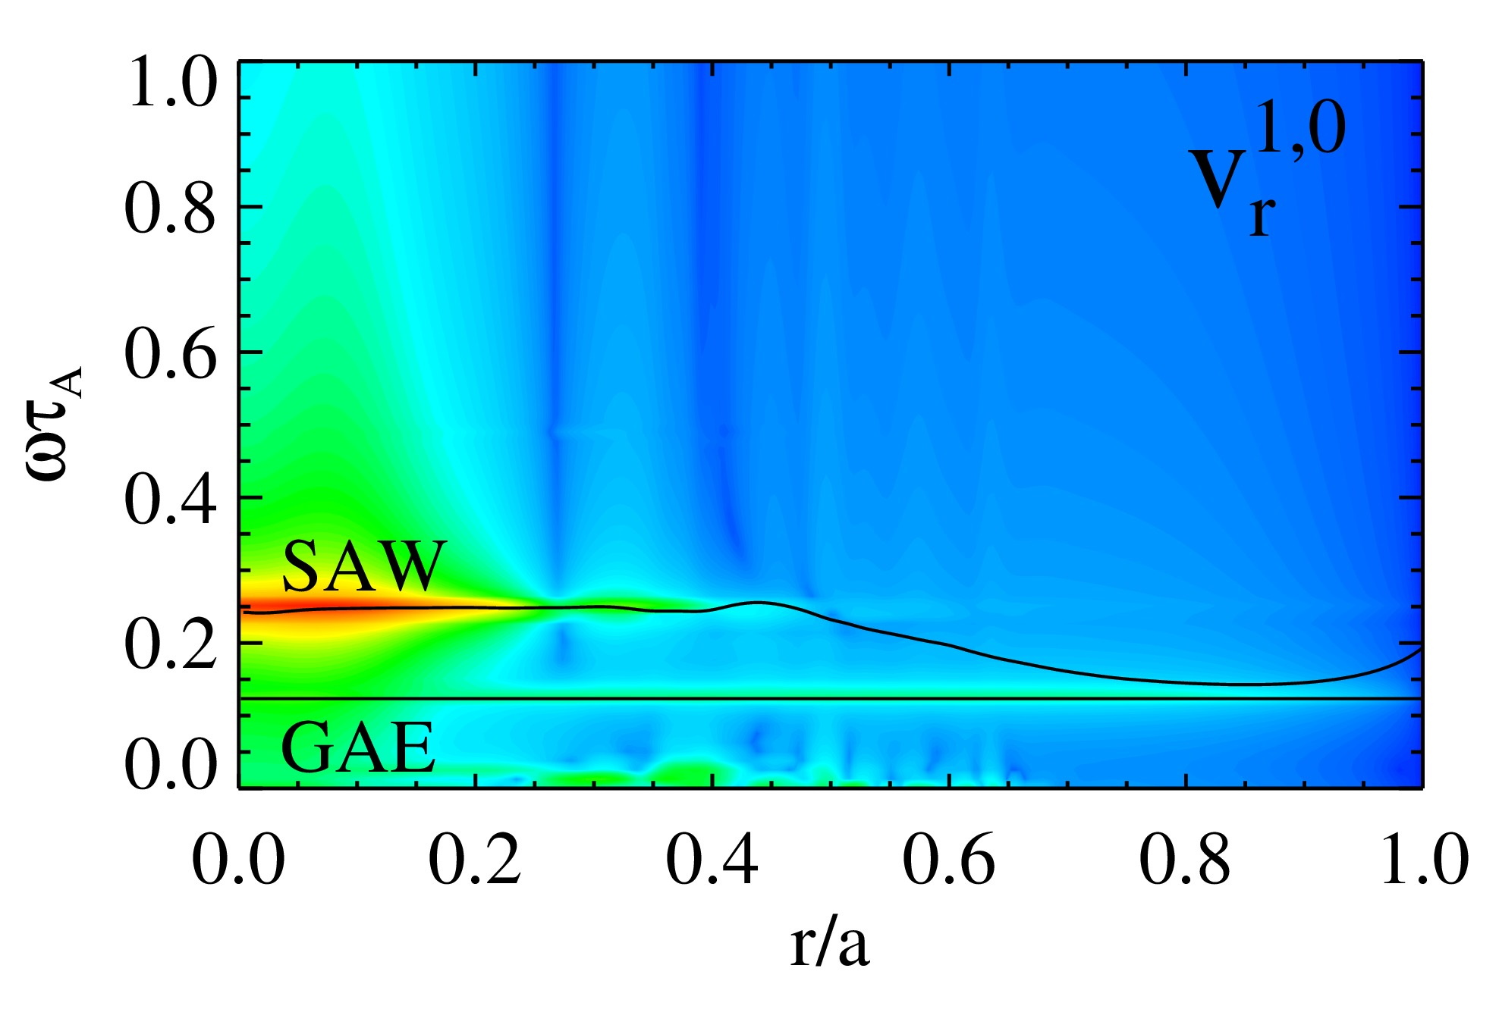
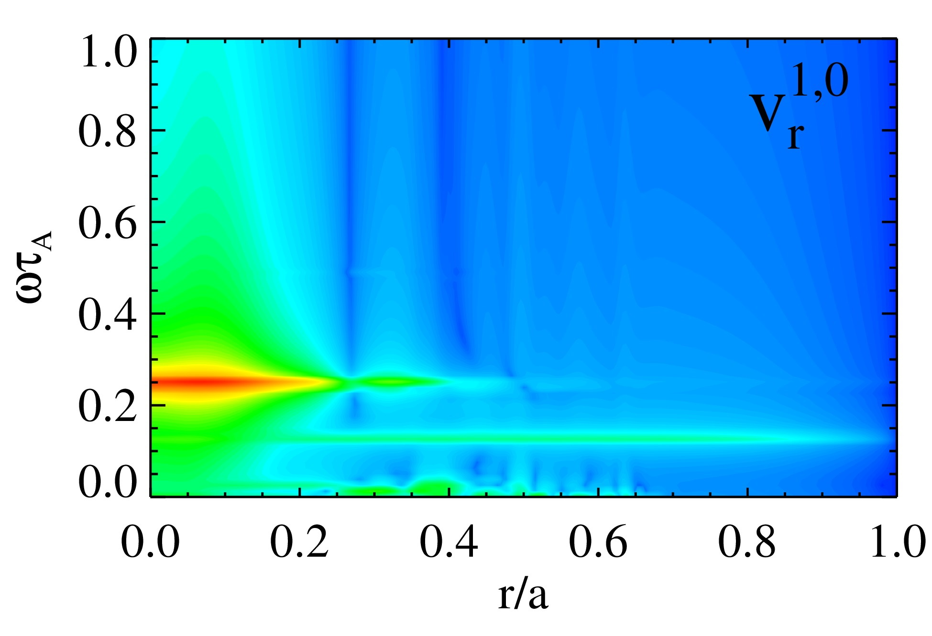
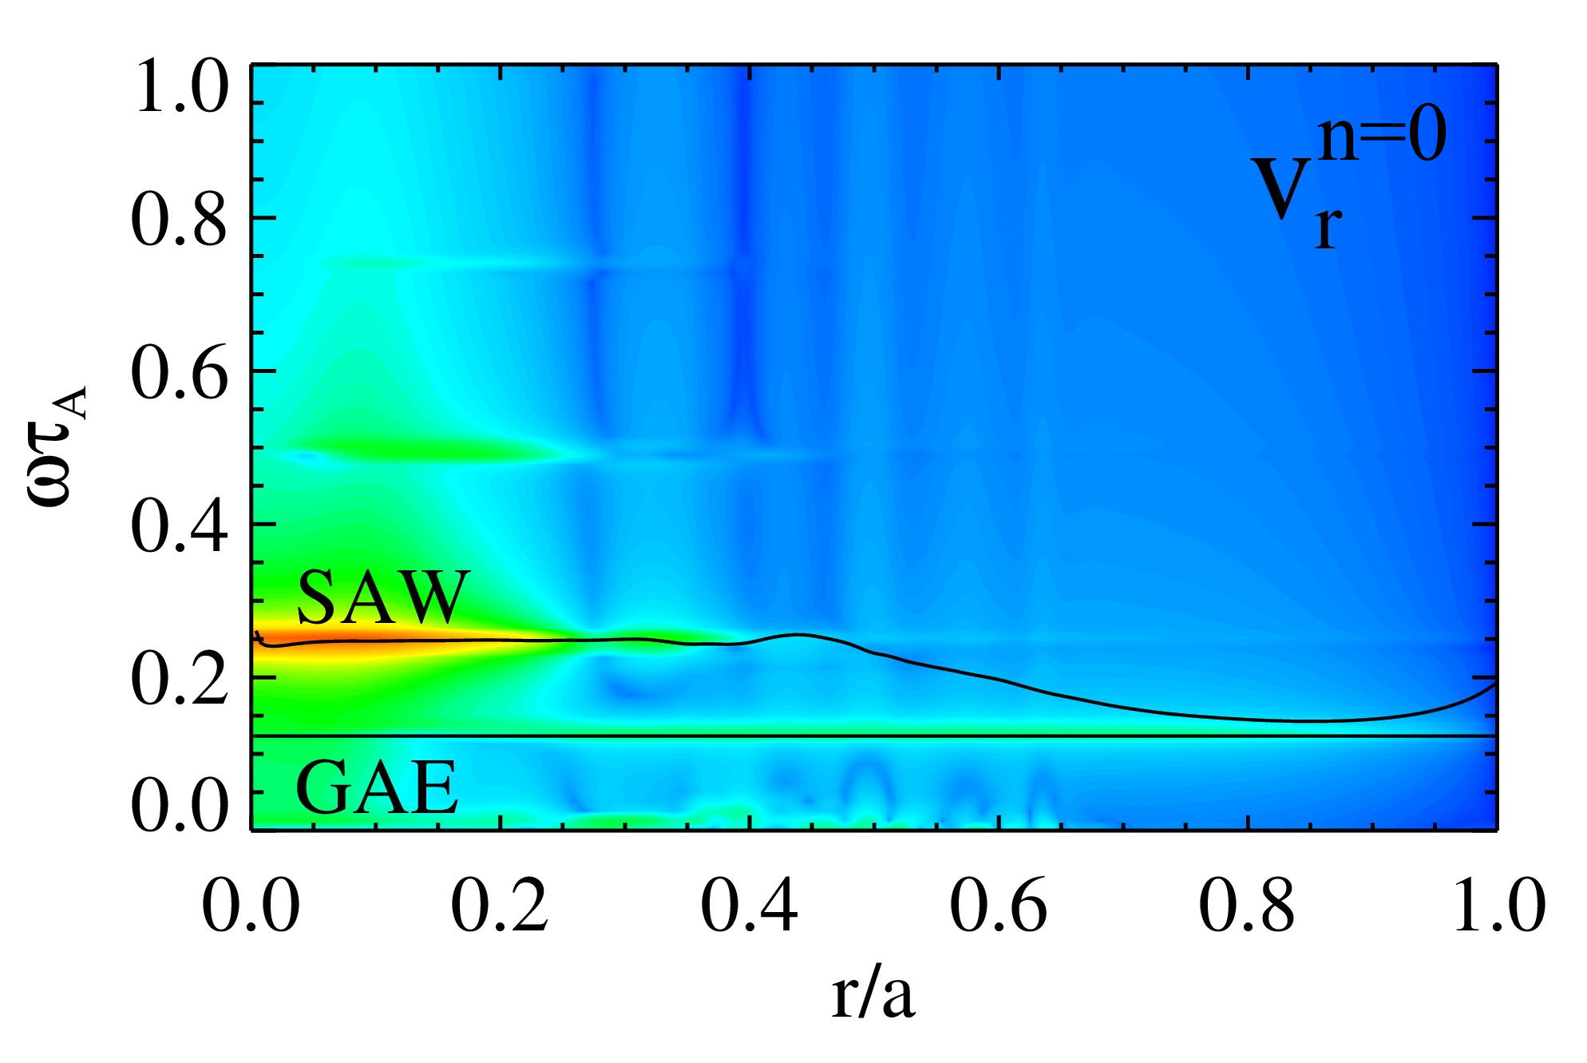
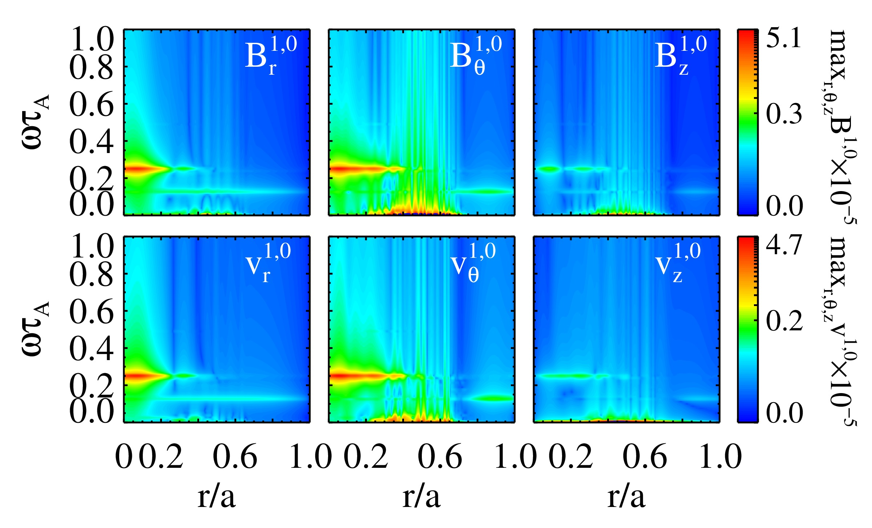
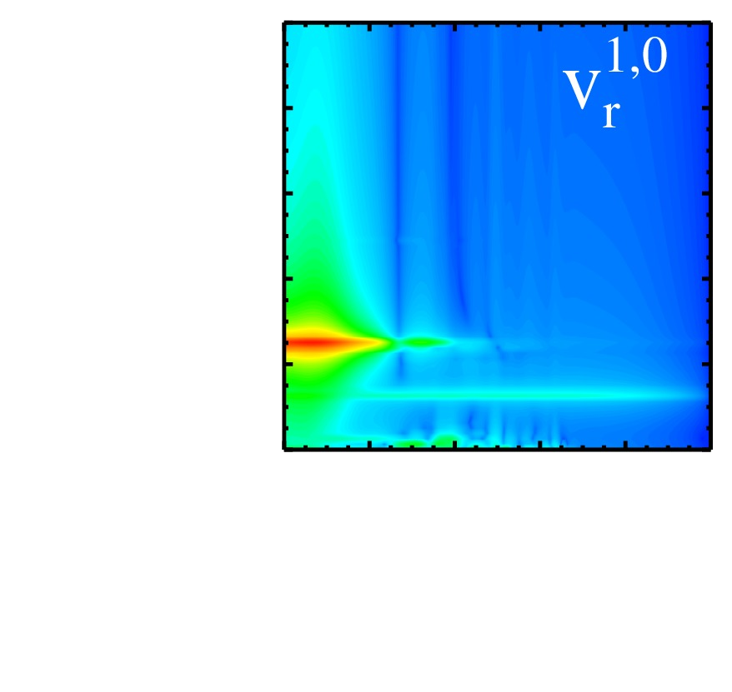
Introduction
Motivations
Tools
Uniform case
RFP
Tokamak
Conclusions
Excitation of AWs by magnetic reconnection in Tokamak
FFT of the (m,n)=(1,0) for the last 500$τ_{A}$of the simulation.
FFT of the (m,n)=(1,0) for the last 500$τ_{A}$of the simulation. Verification with the theoretical model (MHD).
Weaker frequencies correspond to SAW with 2,0 and 3,0 periodicities.
Analogous results by using 2,1 island amplitude from 10% to 1% and 3,2 instead.
CWT
FFT
Artur Kryzhanovskyy et al.
3D Tokamak simulation
16 / 19

Slide 26
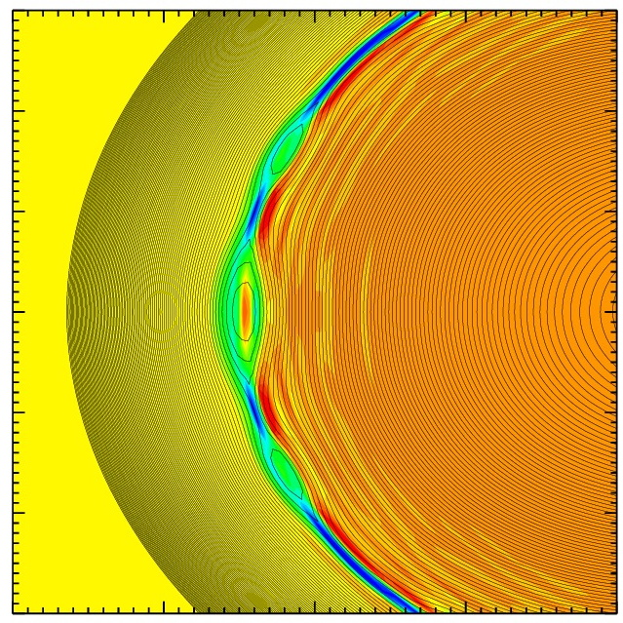
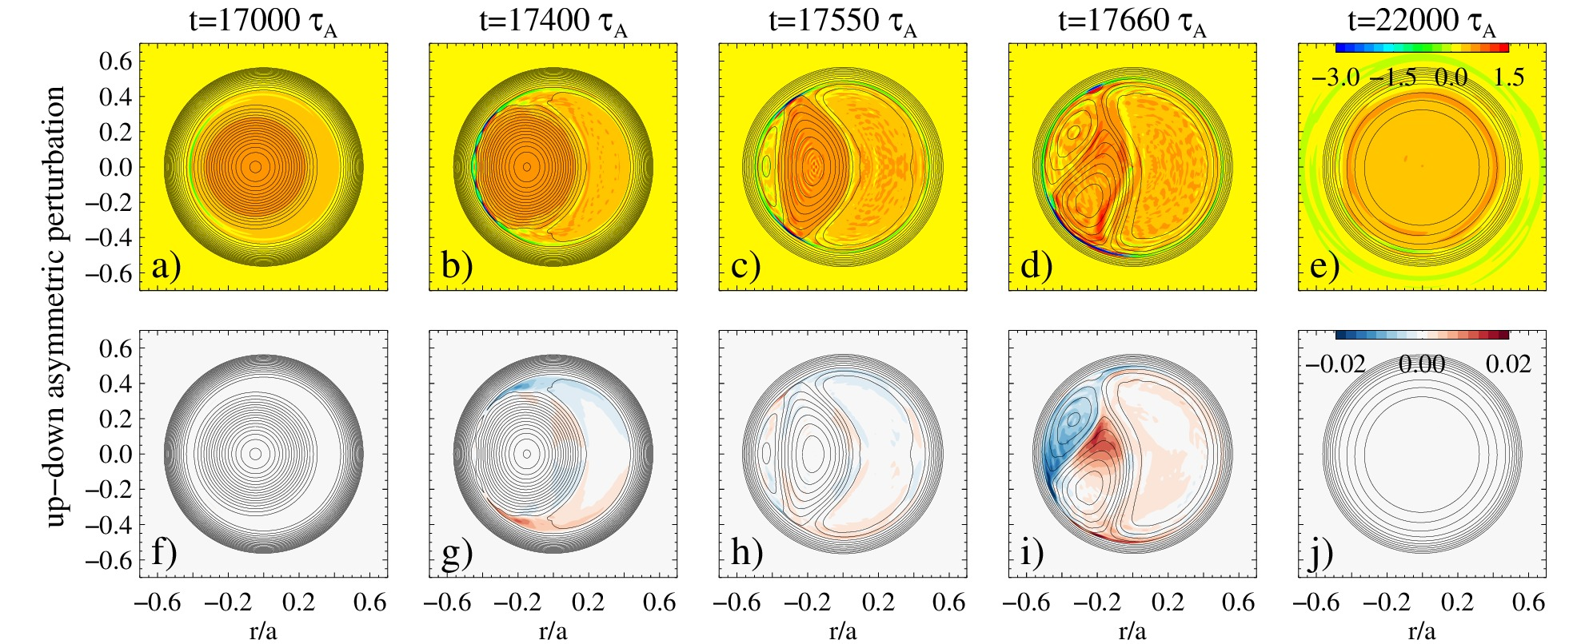
Introduction
Motivations
Tools
Uniform case
RFP
Tokamak
Conclusions
What is the origin of AWs? $→$ J and v local perturbations
Plasmoids formation along the elongated current sheet (expected for S ≥ ${10}^{7}$)
Asymmetric up-down initial perturbation leads to complete reconnection for high-S dynamics
(S ≥ ${10}^{7}$)
For example
[Q. Yu et al., NF 2014]
z = 0
r
.
.
$$j_{z}$$
$$←j_{z}$$
x
o
Y
$$v_{θ}$$
$$←v_{θ}$$
Artur Kryzhanovskyy et al.
3D Tokamak simulation
17 / 19

Slide 27
Introduction
Motivations
Tools
Uniform case
RFP
Tokamak
Conclusions
Outline of the talk
Experimental motivations: AWs in RFX-mod and Tokamak Ohmic discharges
Tools: SpeCyl code
Nonlinear 3D MHD modelling of Alfvén waves:
Conclusions and future perspectives
Verification with analytical solutions for uniform case
RFP configuration (Recall)
Tokamak configuration (New)
Self-consistent AWs excitation in fully 3D dynamic configuration
Artur Kryzhanovskyy et al.
Outline

Slide 28
Introduction
Motivations
Tools
Uniform case
RFP
Tokamak
Conclusions
Summary
Characterization of AWs in RFP and Tokamak configuration in the framework of nonlinear viscoresistive MHD.
In ours simulations magnetic reconnection events involves current density and velocity perturbations, which in turn excite Alfvénic fluctuations that persist beyond the relaxation event itself.
RFP: clear excitation of (m,n)=(1,0) CAEs and GAE globally in between QSH states in a fully 3D configuration $⟹$ good agreement with RFX-mod experimental observations
Tokamak: clear excitation of (m,n)=(1,0) SAW in the core and GAE globally following sawtooth crash in a fully 3D configuration $⟹$ possible mechanism for AWs observations in Ohmic Tokamak plasmas
Despite simplified model (cylindrical geometry, no pressure) relatively rich phenomenology.
Artur Kryzhanovskyy et al.
Conclusions
18 / 19

Slide 29
Introduction
Motivations
Tools
Uniform case
RFP
Tokamak
Conclusions
Future perspectives
Open questions (future work):
Short term:
Long term
Additional analysis on the physics of AWs excitation within same model (SpeCyl code):
- How is energy being transferred MHD modes and Alfvén waves?
- What is the role of dimensionless parameters for the excitation and damping of the AWs?
Extension of results in more realistic and complete modelling with wider variety of Alfvén waves:
- Inclusion of toroidal geometry (no need for 2,1 coupling), finite beta, two-fluids and
kinetic effects (coupling with fast particles)
Possible heating effect in a wave-particle interaction in inhomogeneous fields
(collaboration with colleague at RFX)
Artur Kryzhanovskyy et al.
Conclusions
19 / 19

Slide 30
Thank you for your attention

Slide 31
Introduction
Tools and models
Uniform case
RFP
Tokamak
Conclusions
Alfvén Waves in cylindrical geometry
Shear Alfvén Wave (SAW), Compressional Alfvén Eigenmode (CAE) and Global Alfvén Eigenmode (GAE)
The linear dispersion relations for Alfvén waves in the ideal MHD model, in a cold plasma and with conducting wall boundaries are:
$BCs: {\left.E_{θ}\right|}_{r=a}=0$
$k_{θ}=\frac{m}{r}$
$k_{z}=\frac{n}{R_{0}}$
Analitic
$$ω^{2}−v_{A}^{2}k_{z}^{2}=0$$
Uniform
B and $ρ$
SAW
CAE
Analitic
$$ν_{n}a=χ_{j}→ω_{j}^{2}=v_{A}^{2}\left(k_{z}^{2}+\frac{χ_{j}^{2}}{a^{2}}\right)$$
$$B_{0}$$
$$B_{0}$$
SAW
$$ω(r) =\left|k∙v_{A}\right|= \frac{\left|k_{θ}B_{θ}+k_{z}B_{z}\right|}{\sqrt{μ_{0}ρ}}$$
Analitic
$$\int_{0}^{a}{ν_{n}(r)} dr=χ_{j}→ω_{j}$$
Non-uniform
B and/or $ρ$
WKB
CAE
WKB
$$\int_{0}^{a}{k_{r}(r) dr}=lπ→ω_{l}$$
GAE
Artur Kryzhanovskyy
AWs in cylindrical geometry

Slide 32
Introduction
Tools and models
Uniform case
RFP
Tokamak
Conclusions
Uniform B and 𝜌: SAW and CAEs
The $(m,n)=(0,1)$SAW is obtained by applying initial perturbation on $v_{θ}^{01}$, with radial profile $v_{θ}^{01}=εr\left(1−r\right)$, where $ε≪1$
The $(m,n)=(0,1)$CAEs are obtained by applying initial perturbation on $v_{r}^{01}$
Monochromatic spectrum corresponding to the SAW
Many discrete modes, corresponding to the CAEs with increasing number of nodes
Frequency spectra of B e v components for ∆𝑇= 500 $τ_{A}$
B and v fields components at r/a = 0.5
Frequency spectra of B e v components for ∆𝑇= 500 $τ_{A}$
B and v fields components at r/a = 0.5
FFT
FFT
SAW
$1^{st}$CAE
Artur Kryzhanovskyy
Uniform case

Slide 33
Extra
Uniform magnetic field B and uniform density $ρ_{0}$(𝑟)=1.
Mode (m,n)=(0,1). Example of an entire simulation.
Perturbed component $v_{θ}$
Perturbed component $v_{r}$
Artur Kryzhanovskyy
Extra
1

Slide 34
Extra
RFP like configuration with RFX-mod like density $ρ_{0}$(𝑟) profile
Mode (m,n)=(0,2)
Mode (m,n)=(4,4)
Artur Kryzhanovskyy
Extra
2

Slide 35
Extra
Full 3D RFP configuration, equilibrium profiles.
Artur Kryzhanovskyy
Extra
3

Slide 36
Extra
Full 3D RFP configuration. Helical flux function with $J_{∥}$.
Magnetic separatrix
Plasmoid like structure
Original topology regained with a new helical axis
Artur Kryzhanovskyy
Extra
4

Slide 37
Extra
Artur Kryzhanovskyy
Extra
5

Slide 38
Extra
Variation of the amplitude of $1^{a}$ CAE, when varying mode (m,n):
Artur Kryzhanovskyy
Extra
6

Slide 39
Extra
Helically-symmetric Tokamak configurations. (m,n)=(1,1) mode analysis.
S= ${10}^{6}$, M=${10}^{6}$
S= ${10}^{8}$, M=${10}^{6}$
Increase in S
No excitation for higher viscosity
(lower M)
Artur Kryzhanovskyy
Extra
6

Slide 40
AWs in Ohmic discharges
[S.V. Lebedev et al., 43th EPS 2016]
Discharge in Spherical tokamak Globus-M2
Bursts of Alfven oscillations arise after sawtooth crushes
Alfvénic scaling
Artur Kryzhanovskyy
Extra
7

Slide 41
AWs in Ohmic discharges
[Balachenkov et al., NF 2021]
Discharge in Tunam-3M tokamak
Bursts of Alfven oscillations
arise after sawtooth crushes
n=0 dominant toroidal mode number
Artur Kryzhanovskyy
Extra
7

Slide 42
AWs in Ohmic discharges
Discharge in Compass tokamak
[T. Markovi$\check{c}$ et al., ${44}^{th}$ EPS 2017]
Inboard side of the torus:
quasi-coherent band correlated with the edge MHD events such as ELMs.
Outboard side of the torus:
a series of short frequency bursts correlated with periodic MHD events in core
plasma, such as internal reconnection events during sawtooth crashes
Artur Kryzhanovskyy
Extra
7

Slide 43
AWs in Ohmic discharges
Discharge in SUNIST spherical tokamak in ohmic plasmas.
[Yangqing Liu et al., $Phys. Plasmas$ 2016]
AWs following minor disruptions.
Alfvénic scaling
n=-1 and -4$≤$m$≤$-3
Artur Kryzhanovskyy
Extra
7

Slide 44
AWs in Ohmic discharges
Discharges in EAST tokamak
[N. Chu et al., NF 2018]
TAE excitation following a forced n=2 magnetic reconnection by a static MPs.
TAE frequency scaling $f_{A}/2$=$\frac{V_{A}}{4πq_{95}R_{0}}$
Artur Kryzhanovskyy
Extra
7

Slide 45
Excitation of AWs by Large Resonant Magnetic Perturbations in Ohmic Discharges
FTU, TEXTOR and JET tokamaks
[O. Zimmermann et al., 34th EPS 2007]
AWs appear in the presence of large 2/1 tearing modes or strong resonant magnetic perturbations
Alfvénic scaling
Artur Kryzhanovskyy
Extra
7

