Slide 1
Investigation on chirping-mode dynamics
S. Briguglio, X. Wang
in collaboration with C. Di Troia, M. Falessi, G. Fogaccia, V. Fusco, G. Vlad, F. Zonca

Slide 2
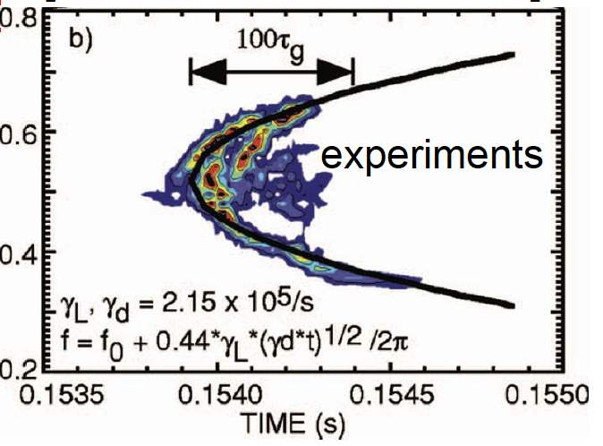
Chirping Alfvén modes
Alfvén modes in Tokamak equilibria often exhibit frequency variation ("chirping") in the nonlinear phase: it allows maximising power extraction from fast particles
ω

Slide 3
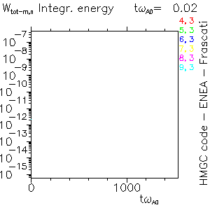
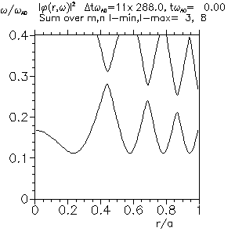
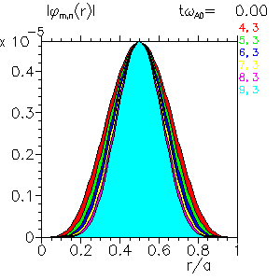
Investigation of a chirping mode with HMGC
Let us investigate a n=3 EPM, exhibiting frequency chirping in the nonlinear phase
Frequency chirping is apparent in the nonlinear phase

Slide 4
Analysis of the most relevant phase-space slices
Let us identify the most relevant phase-space structures (that is, those that resonate more effectively with the mode)
We cut the phase space into slices characterised by two constants of motion (in our case, M and U_{eq0}); such slices do not exchange particles
Once identified the most relevant slices, we can investigate their dynamics by Hamiltonian-mapping techniques: sampling each slice with test particles
Let us start from the slice yielding the largest contribution to the drive during the linear stage ("linear resonance")

Slide 5
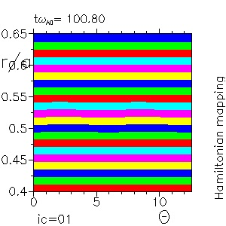
"Linear resonance"
Markers are colored according to their initial value of the equatorial r

Slide 6
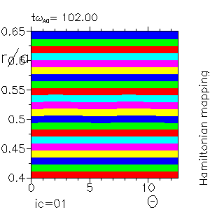
"Linear resonance"
Markers are colored according to their initial value of the equatorial r
An island-like structure is formed around the resonance radius, drifting inwards as the frequency chirps downwards

Slide 7
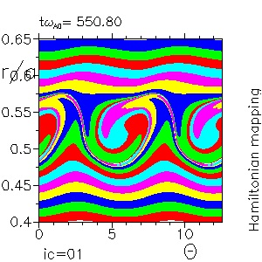
"Linear resonance"
Markers are colored according to their initial value of the equatorial r
An island-like structure is formed around the resonance radius, drifting inwards as the frequency chirps downwards
It corresponds to a density flattening region, delimited by two large density gradients

Slide 8
"Linear resonance"
The large negative density gradients move inwards and outwards

Slide 9
"Linear resonance"
The large negative density gradients move inwards and outwards
As frequency decreases, the resonance region moves inwards (ω_{res}'(r)>0)

Slide 10
"Linear resonance"
The large negative density gradients move inwards and outwards
As frequency decreases, the resonance region moves inwards (ω_{res}'(r)>0)
Until the inner large density gradient remains within the resonance region, it is able to drive the mode

Slide 11
"Linear resonance"
The large negative density gradients move inwards and outwards
As frequency decreases, the resonance region moves inwards (ω_{res}'(r)>0)
Until the inner large density gradient remains within the resonance region, it is able to drive the mode
The island grows around at a faster rate

Slide 12
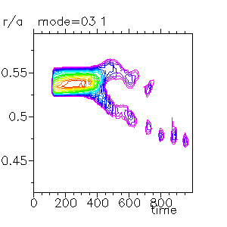
"Linear resonance"
The large negative density gradients move inwards and outwards
As frequency decreases, the resonance region moves inwards (ω_{res}'(r)>0)
Until the inner large density gradient remains within the resonance region, it is able to drive the mode
The island grows around at a faster rate
When the frequency chirping is no longer able to accommodate the large gradient in the resonance region, in spite of a nonlinear broadening of such region, the gradient is no longer effective in driving the mode

Slide 13
"Linear resonance"
The large negative density gradients move inwards and outwards
As frequency decreases, the resonance region moves inwards (ω_{res}'(r)>0)
Until the inner large density gradient remains within the resonance region, it is able to drive the mode
The island grows around at a faster rate
When the frequency chirping is no longer able to accommodate the large gradient in the resonance region, in spite of a nonlinear broadening of such region, the gradient is no longer effective in driving the mode
Drive falls down

Slide 14
Chirping rate and saturation amplitude
In the constant-frequency low-growth-rate limit, a certain phase-space resonance ceases to contribute to the drive when the flattening region covers the resonance region; that is, when the gradient drift is
(Δr_{grad})_{sat} ≈ γ / (ω_{res}')

Slide 15
Chirping rate and saturation amplitude
In the constant-frequency low-growth-rate limit, a certain phase-space resonance ceases to contribute to the drive when the flattening region covers the resonance region; that is, when the gradient drift is
(Δr_{grad})_{sat} ≈ γ / (ω_{res}')
In the chirping case, the resonance region moves along with the resonance radius

Slide 16
Chirping rate and saturation amplitude
In the constant-frequency low-growth-rate limit, a certain phase-space resonance ceases to contribute to the drive when the flattening region covers the resonance region:
(Δr_{grad})_{sat} ≈ γ / (ω_{res}')
In the chirping case, the resonance region moves along with the resonance radius
This requires a larger gradient drift

Slide 17
Chirping rate and saturation amplitude
In the constant-frequency low-growth-rate limit, a certain phase-space resonance ceases to contribute to the drive when the flattening region covers the resonance region:
(Δr_{grad})_{sat} ≈ γ / (ω_{res}')
In the chirping case, the resonance region moves along with the resonance radius
This requires a larger gradient drift (Δr_{grad})_{sat} ≈ (Δω)_{sat} / (ω_{res}')

Slide 18
Chirping rate and saturation amplitude
In the constant-frequency low-growth-rate limit, a certain phase-space resonance ceases to contribute to the drive when the flattening region covers the resonance region:
(Δr_{grad})_{sat} ≈ γ / (ω_{res}')
In the chirping case, the resonance region moves along with the resonance radius
This requires a larger gradient drift (Δr_{grad})_{sat} ≈ (Δω)_{sat} / (ω_{res}')
The chirping rate can then be estimated as
(Δω/Δt)_{sat} ≈ (ω_{res}') (Δr_{grad}/Δt)_{sat}

Slide 19
Chirping rate and saturation amplitude
In the constant-frequency low-growth-rate limit, a certain phase-space resonance ceases to contribute to the drive when the flattening region covers the resonance region:
(Δr_{grad})_{sat} ≈ γ / (ω_{res}')
In the chirping case, the resonance region moves along with the resonance radius
This requires a larger gradient drift (Δr_{grad})_{sat} ≈ (Δω)_{sat} / (ω_{res}')
The chirping rate can then be estimated as
(Δω/Δt)_{sat} ≈ (ω_{res}') (Δr_{grad}/Δt)_{sat}
Moreover, Δr_{grad}/Δt ~ A(t)

Slide 20
Chirping rate and saturation amplitude
In the constant-frequency low-growth-rate limit, a certain phase-space resonance ceases to contribute to the drive when the flattening region covers the resonance region:
(Δr_{grad})_{sat} ≈ γ / (ω_{res}')
In the chirping case, the resonance region moves along with the resonance radius
This requires a larger gradient drift (Δr_{grad})_{sat} ≈ (Δω)_{sat} / (ω_{res}')
The chirping rate can then be estimated as
(Δω/Δt)_{sat} ≈ (ω_{res}') (Δr_{grad}/Δt)_{sat}
Moreover, Δr_{grad}/Δt ~ A(t)
Then (Δω/Δt)_{sat} ~ (ω_{res}') A_{sat}

Slide 21
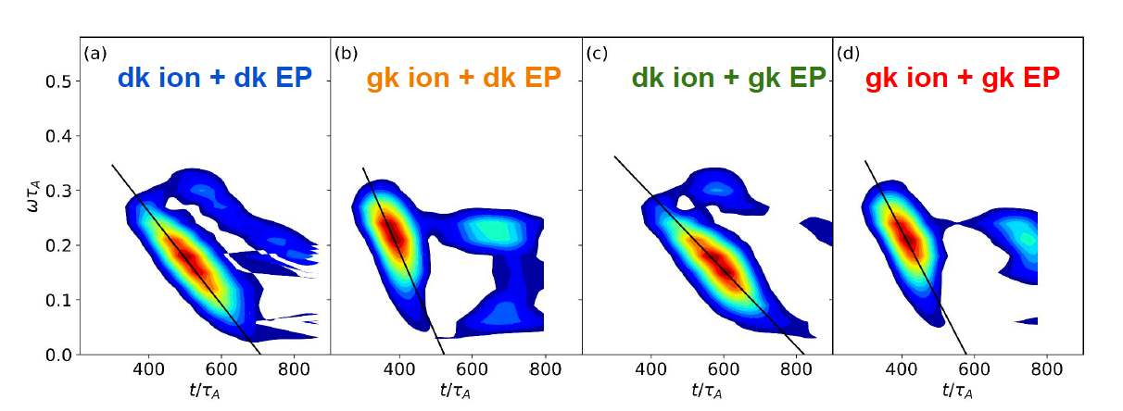
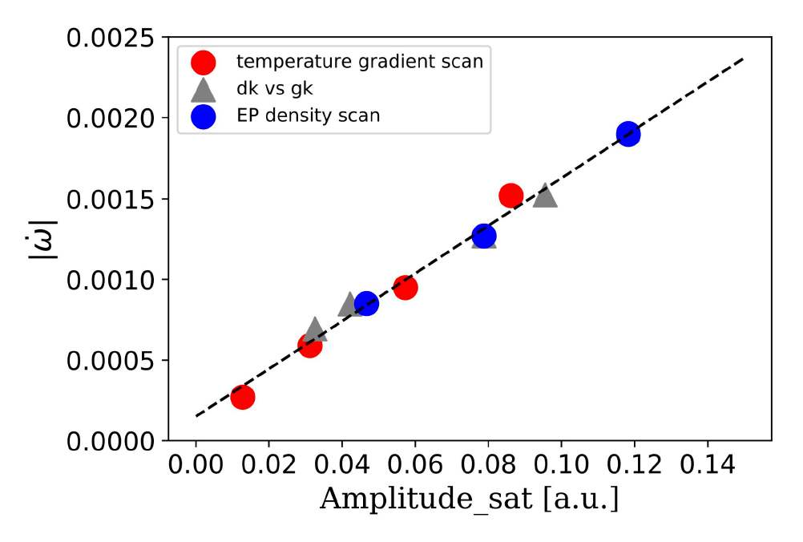
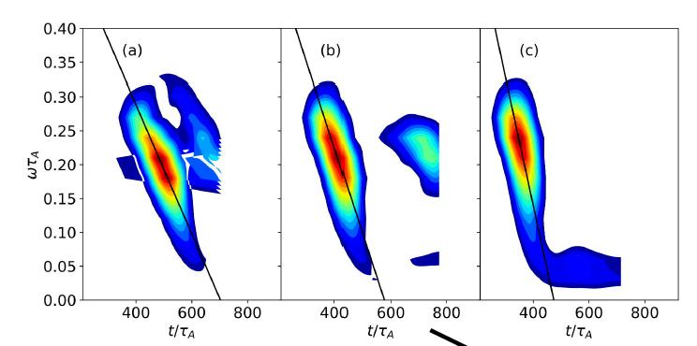
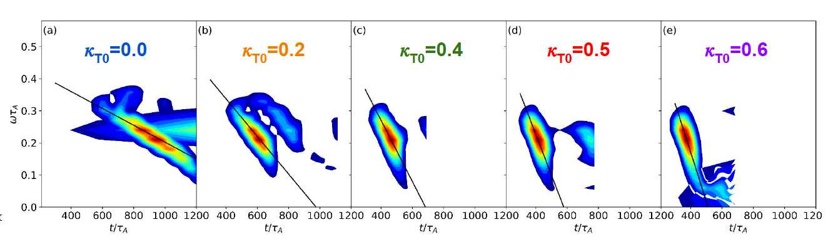
Chirping rate and saturation amplitude
This scaling is well satisfied by ORB5 simulations, performed with/wihout FLR effects, different energetic-particle density, different bulk-plasma temperature gradient
n_{EP}/n_{i}=0.0075
n_{EP}/n_{i}=0.0080
n_{EP}/n_{i}=0.0085

Slide 22
Richer non linear dynamics
This agreement does not mean that power exchange between particles and the mode can be described just in terms of the dynamics of the "linear resonance" (that is, the relevant one in the linear stage)
The figure reports the label U_{eq0} for the dominant phase-space slices at each time (the other label is M=0 at each time)
A succession of different slices contributes to the growth of the mode

Slide 23
Richer non linear dynamics
After considering the "linear resonance", let us consider one of the resonances that dominate during the non linear stage ("non linear resonance")
This non linear resonance yields a little drive during the linear stage; why does such drive strongly grow in the non linear stage?

Slide 24
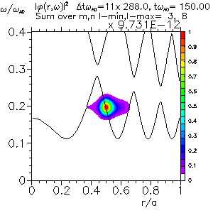
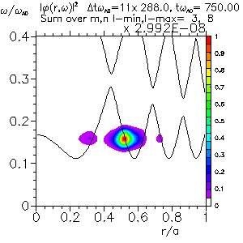
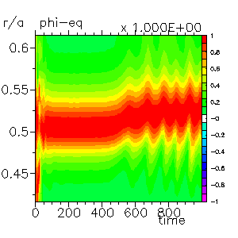
"Non linear" resonance
The reason is that the resonance region and the mode peak, originally separated, move toward each other
While the resonance region moves inwards, the mode peak drifts outwards, due to the radial slope of the continuum

Slide 25
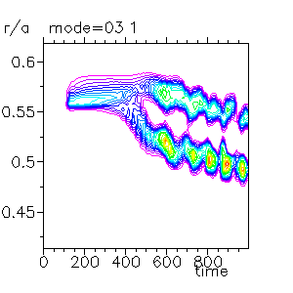
"Non linear" resonance
The reason is that the resonance region and the mode peak, originally separated, move toward each other
While the resonance region moves inwards, the mode peak drifts outwards, due to the radial slope of the continuum
As the resonance region meets mode peak, the drive yielded by this slice increases

Slide 26
"Non linear" resonance
The reason is that the resonance region and the mode peak, originally separated, move toward each other
While the resonance region moves inwards, the mode peak drifts outwards, due to the radial slope of the continuum
As the resonance region meets mode peak, the drive yielded by this slice increases
It becomes the dominant contribution at a certain time; then, another slice will take over

Slide 27
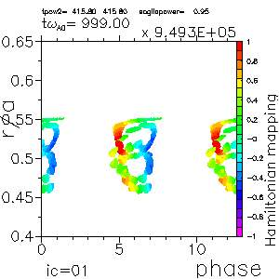
Some other aspects...
Let us follow a certain bunch of particles, coloring them according to the instantaneous power-transfer level
Θ

Slide 28
Non adiabatic dynamics
Let us follow a certain bunch of particles, coloring them according to the instantaneous power-transfer level
The radial displacement of the orbit in a bounce time is of same order of its width

Slide 29
Non adiabatic dynamics
Let us follow a certain bunch of particles, coloring them according to the instantaneous power-transfer level
The radial displacement of the orbit in a bounce time is of same order of its width
➔ non-adiabatic dynamics

Slide 30
Continuous trapping/detrapping
The non adiabatic character of the dynamics emerges from the continuous trapping/detrapping phenomenon

Slide 31
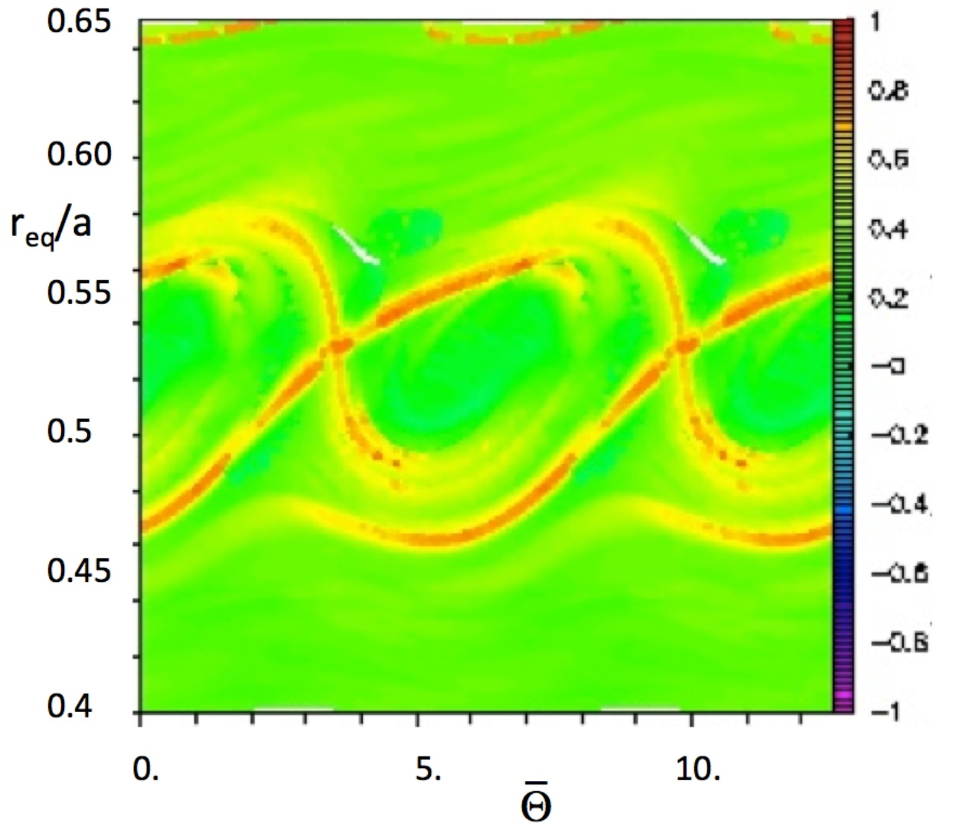
Continuous trapping/detrapping
The non adiabatic character of the dynamics emerges in the continuous trapping/detrapping phenomenon
Let us resort to Lagrangian Coherent Structures

Slide 32
Continuous trapping/detrapping
The non adiabatic character of the dynamics emerges in the continuous trapping/detrapping phenomenon
Let us resort to Lagrangian Coherent Structures
Superposition of repulsive and attractive lines would correspond, for constant frequency and mode amplitude, to the separatrix between trapped and unbounded trajectories
repulsive
attractive

Slide 33
Continuous trapping/detrapping
The non adiabatic character of the dynamics emerges in the continuous trapping/detrapping phenomenon
Let us resort to Lagrangian Coherent Structures
Superposition of repulsive and attractive lines would correspond, for constant frequency and mode amplitude, to the separatrix between trapped and unbounded trajectories
The channels left open between attractive and repulsive lines allow for an incoming particle flow from the lower edge (trapping) and an outgoing flow from the upper edge (detrapping)
repulsive
attractive

Slide 34
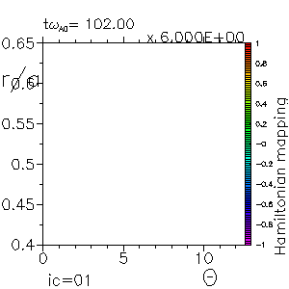
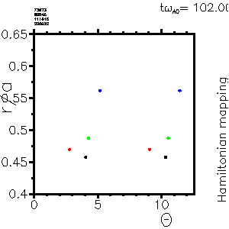
Continuous trapping/detrapping
4 initially untrapped particles (for the sake of clarity, we plot a twin marker in the interval [2π,4π])
- black remains untrapped
- blue and green become and remain trapped in the wave
- red gets trapped and, then, detrapped

Slide 35
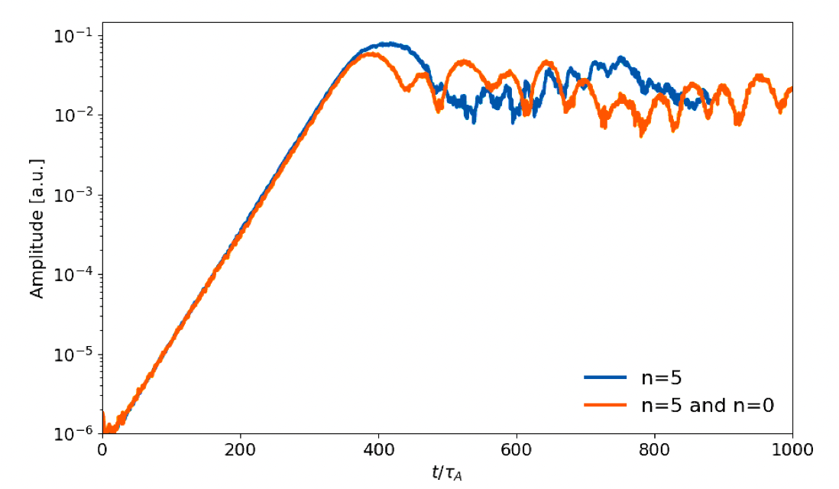
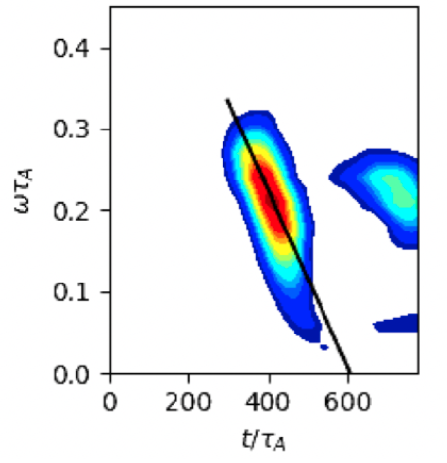
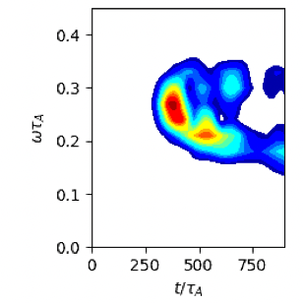
Zonal-flow and multi-n effects
Preliminary results: is chirping modified by the inclusion of zonal flows and/or co-presence of more toroidal modes?
ORB5:
  n=5, without zonal flows
  n=5, with n=0 zonal flows
without
with

Slide 36
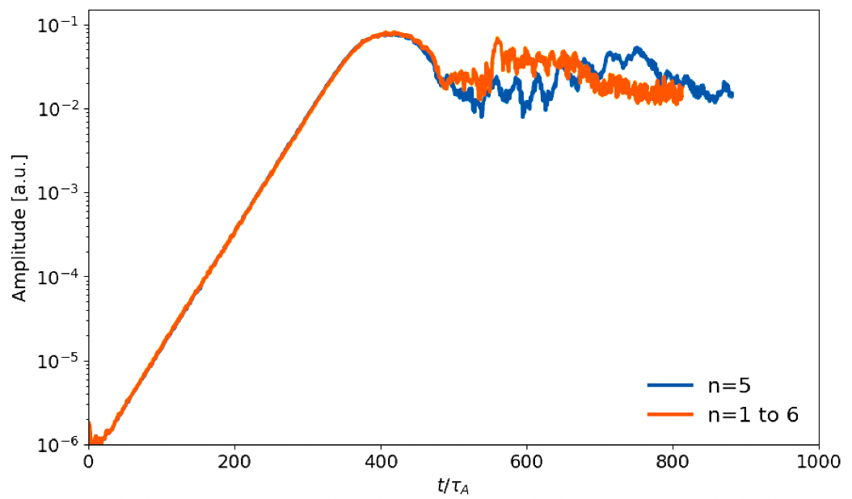
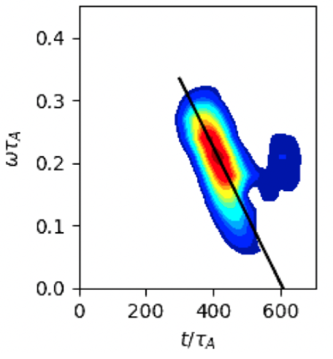
Zonal-flow and multi-n effects
ORB5:
  n=5
  n=1-6
n=5
n=1-6

Slide 37
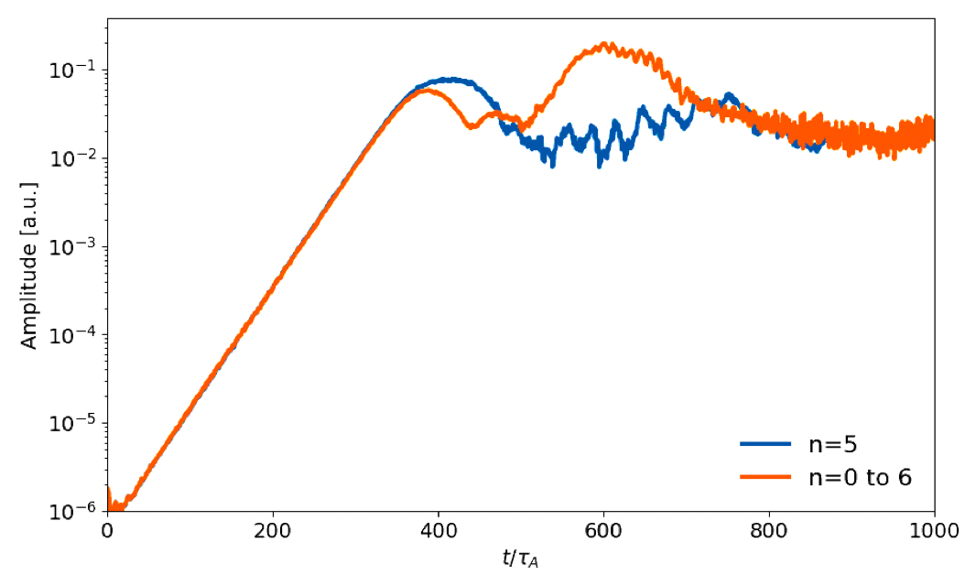
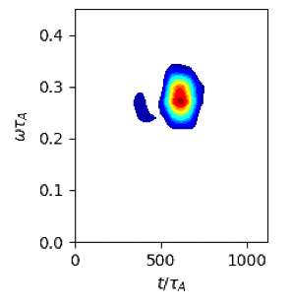
Zonal-flow and multi-n effects
ORB5:
  n=5
  n=0-6
n=5
n=0-6

Slide 38
Multi-n effects
HMGC:
  n=4
  n=2-4

Slide 39
Summary
Chirping Alfvén mode dynamics has been investigated by HMGC and ORB5 simulations
The possibility of modifying its frequency allows for a prolonged power transfer from particles to the mode
Different resonances become relevant once that dominating the linear stage exhausts its drive capability. Their resonance region and mode peak move towards each other; as they meet, the drive yielded by the resonance is strongly enhanced
The non adiabatic character of the dynamics, leading to a continuous trapping/detrapping of particles, has been shown
Preliminary results of simulations including zonal flows and/or multi-n dynamics show that frequency chirping can be affected

Slide 40
"Linear" resonance
Let us plot the maximum (negative) density gradients, along with the boundaries of flattening and resonance region

Slide 41
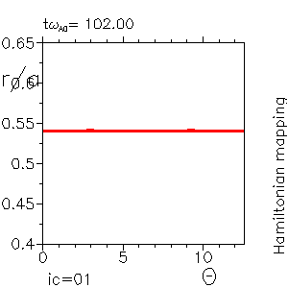
Continuous trapping/detrapping
The non adiabatic character of the dynamics emerges in the continuous trapping/detrapping phenomenon
Here, only markers that get trapped are coloured (red)
If they get detrapped, they are coloured blue

