Slide 1
ENEA contribution to the R&D of HTS conductors
Hybrid HTS/LTS CS within F9-WPMAG
Zoom Meeting, 2021/05/11

Slide 2
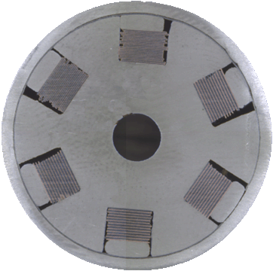
HTS slotted-core for CS DEMO insert coil
ENEA → study an alternative conceptual design of an HTS + LTS hybrid CS DEMO system based on:
- REBCO tapes, with Al-slotted core conductor technology.
- BiSCCO. At least in the first stage, we will consider an alternative based on it.

Slide 3
HTS slotted-core for CS DEMO insert coil
Al slotted-core conductor (basic technological features: Al core extrusion + HTS tape stack)
Where we are:
A lot of practical / handling issues already experienced;
many experimental evidences accumulated;
What we need to do:
performance verification in a fully equipped sample and under relevant electromagnetic load conditions still to be assessed.
Issues to be addressed…
slots:
  are useful for direct cooling?;
  filled with thermal/mechanical effective fillers?;
HTS stack:
  Additional mechanical support to sustain em loads is necessary?;
  Soldered? A reliable W&R process must be developed to take advantage from the more mechanical tolerant “slipping-tape” configuration during manufacturing and winding;
Jacket:
  Aluminum (high strength Al-alloy) preferable for thermal property matching with core;
  SS preferable in a perspective of long length cable production (can be welded, for Al welding is an issue)
  Round / Cicle-in-square?
We expect some of these concerns could be clarified by the results of quench conductor test

Slide 4
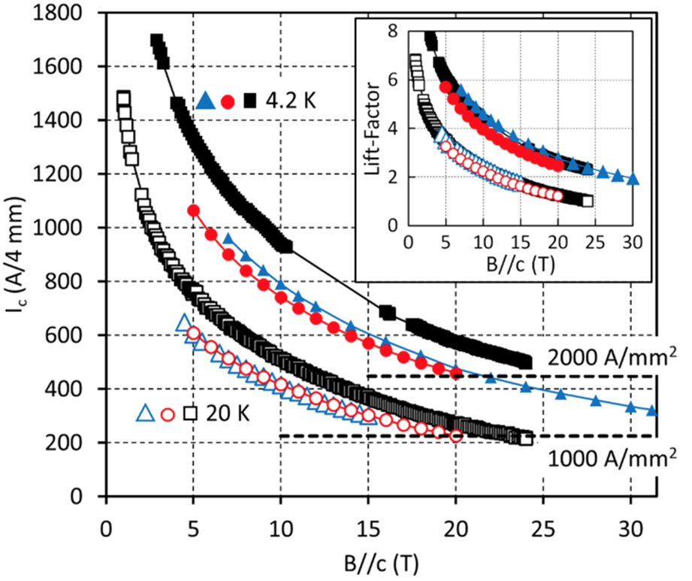
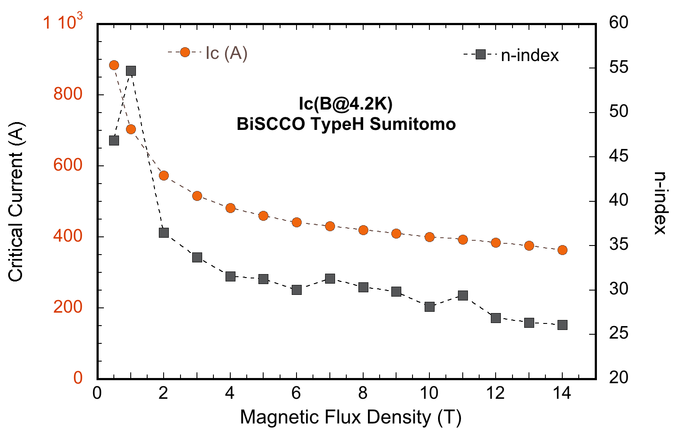
HTS slotted-core for CS DEMO insert coil
P. Bruzzone ” Boundaries for R&D of HTS-CS Conductor 2021-2024” Meeting WPMAG 13/04/2021
Target range of operation
Inlet Temperature = 4.5 K,
Peak field = 18 T,
Operating current = 60 kA,
Bending radius = 1.5 m
Based on typical performances → about 300+ YBCO HTS tapes
commercial production grade
Similar for Bi-2223 → about 300+
A. Molodyk, et al., Sci. Rep. (2021) 11:2084

Slide 5
HTS slotted-core for CS DEMO insert coil
Al slotted-core with 10 Slots
10 HTS stacks x 30 tapes
Pros
- Assessed manufacturing process
- High Je
Contras
- Manufacturing complexity due to huge number of tapes/stacks
- Concerns on minimum bending radius (?)

Slide 6
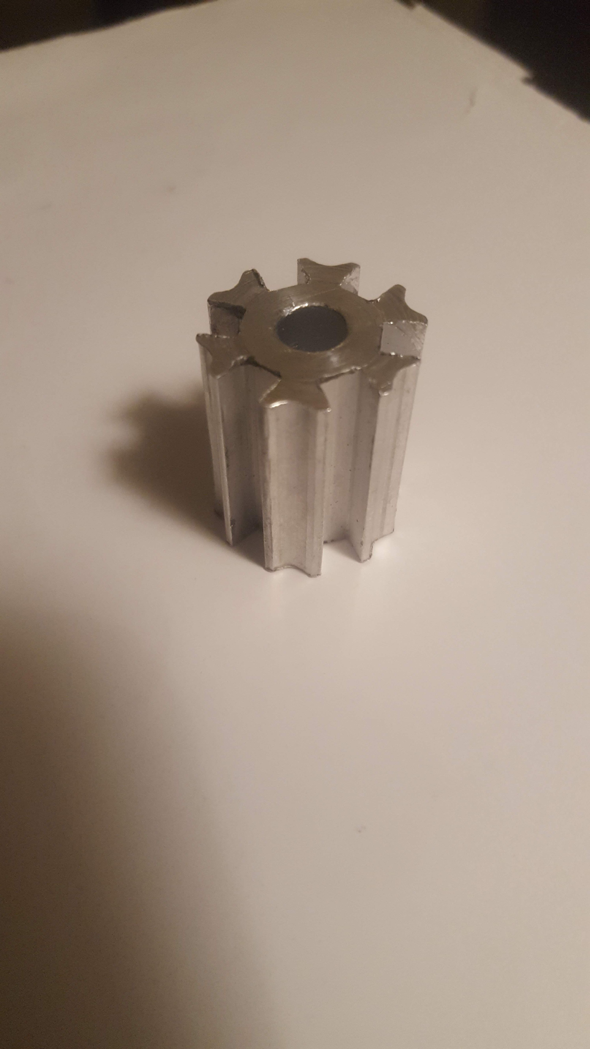
HTS slotted-core for CS DEMO insert coil
Al slotted-core with 10 Slots
10 HTS stacks x 30 tapes
Advanced cooling layout
Developed for the 6 slots core. To be tested in the next quench experiment @ SULTAN
Core cooling dual path
Core Center (channel);
Core Periphery (6 grooves);
→ More uniform cooling mechanism
If successful, it will be adopted to the 10 slot layout

Slide 7
Alternative layout of a HTS slotted-core
Flat cable
(Untwisted) Al slotted-core with 6 Slots
6 x 30 HTS tapes
Δr = 10 mm → 6 cm of max tape extra length (R_{coil} = 1.5 m)
Cooling channel
Δr
H
Pros
Reduced number of HTS tapes (a factor 2+ with respect to twisted)
higher aspect ratio cable can be envisaged (thinner & more # stacks)
More tolerant configuration against bending loads
Appealing for Bi-2223 tapes
Contras
Tolerable Δr to be defined
New cabling concept to be fully developed and assessed

Slide 8

Alternative layout of a HTS slotted-core
Main drivers:
easier manufacturing;
more friendly handling;
Investigation of new cable concept/layout
Tentative conductor layout for a 60 kA, high field operation
5 strands x 60 HTS = 300 tapes
fillers
31.5 mm
Round Dual Stack Macro-strand
Al slotted-core with 2 Slots
2 x 30 HTS tapes
Cooling channel
Jacketed/wrapped strands
Pros
- Macro-strand easier to manufacture/handle
Contras
- New cabling concept to be fully developed and assessed
- Very similar to other already proposed approaches based on round strands by SPC and KIT

Slide 9
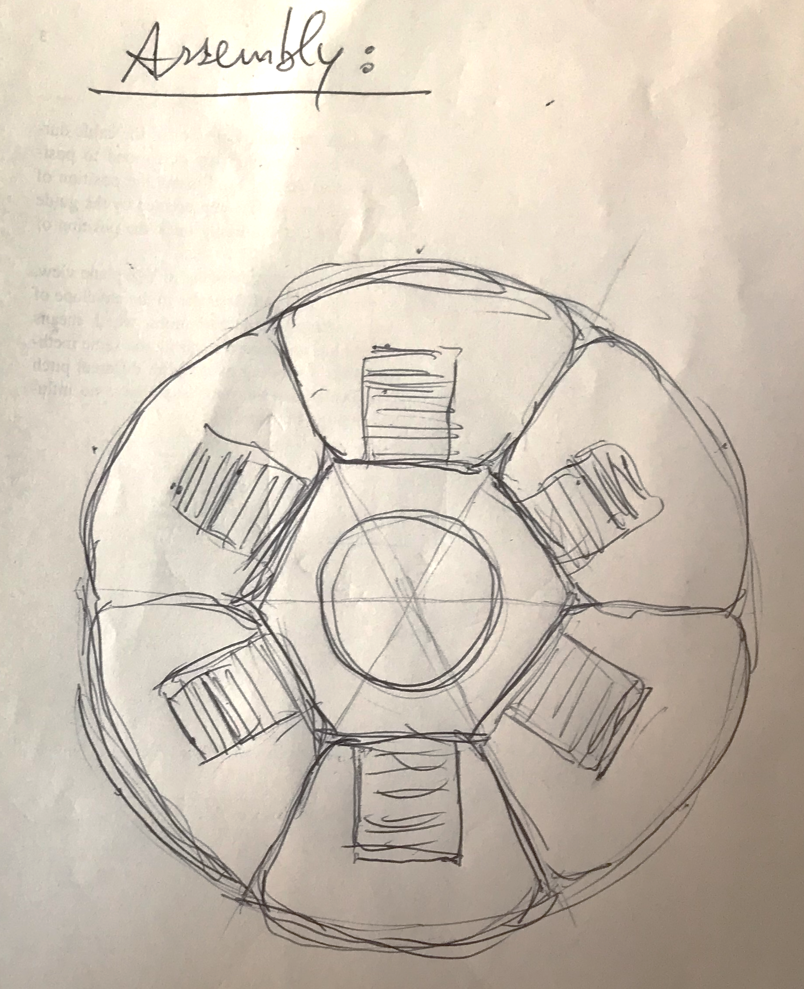
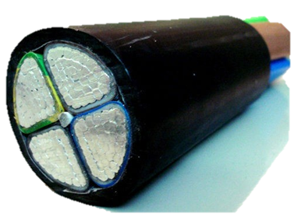
Alternative layout of a HTS slotted-core
Main drivers:
easier manufacturing;
more friendly handling;
Investigation of new cable concept/layout
Single stack Macro-Strand for HTS sector cable
Al slotted-core for one HTS stack
1 x 40/50 HTS tapes
Inspired by sector conductor approach aimed at minimizing the cable diameter
Two base elements →
Macro-Strand
+
Central support
taken from Google…

Slide 10
Time schedule
Sept./Oct. 2021
Dec. 2021
Mar./Apr. 2022
Sept./Oct. 2022
- Definition of a proper conductor layout
- Material procurements
- Investigation and assessment of manufacturing / layout details: experimental campaign on short/sub-size samples
- SULTAN sample manufacturing
Dec. 2022 (?)
- Performance tests @ SULTAN

Slide 11
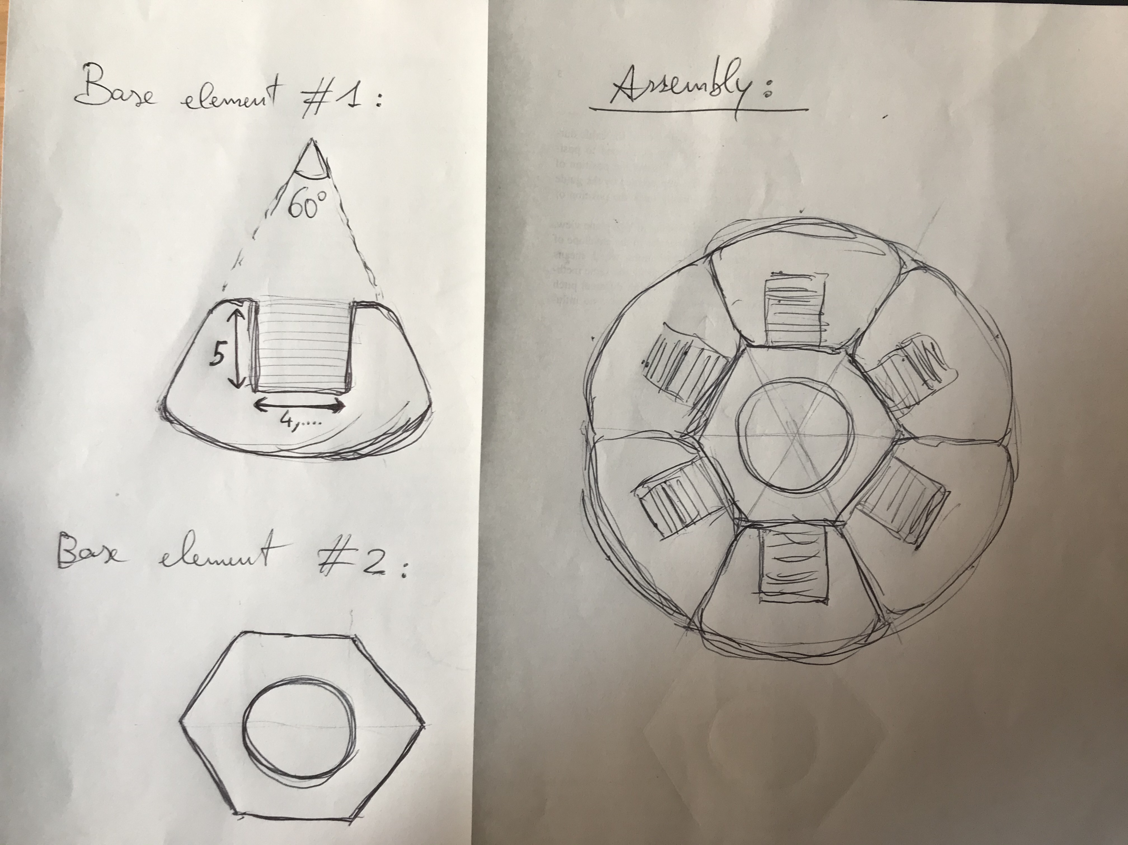
Alternative layout of a HTS slotted-core
Main drivers:
easier manufacturing;
more friendly handling;
Investigation of new cable concept/layout
Single stack Macro-Strand for sectorial cable approach
Al slotted-core with 1 Slots
1 x 40/50 HTS tapes

