Slide 1
ASTRA conductor for DEMO CS
N. Bykovskiy
D. Uglietti
P. Bruzzone
R. Wesche
X. Sarasola
K. Sedlak
13 April 2021

Slide 2
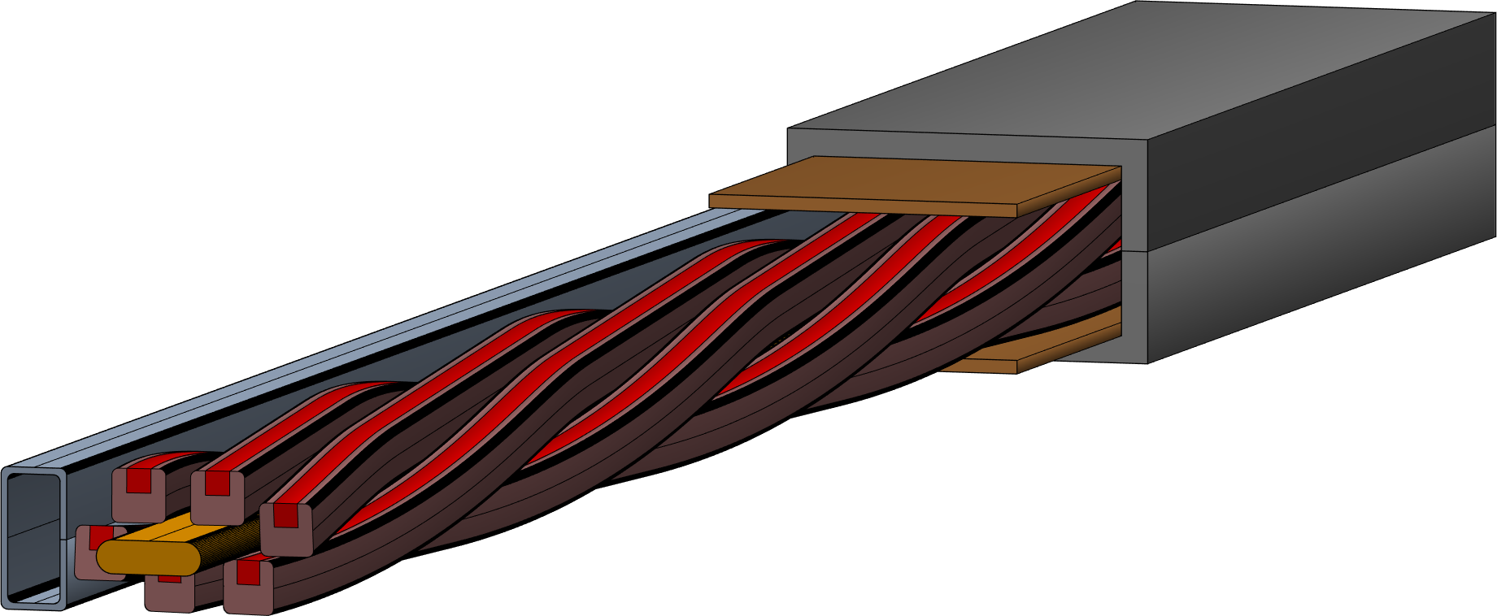
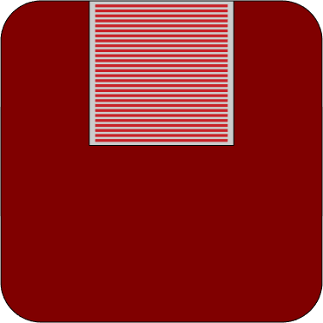
Design considerations
Mechanical issue with unsupported strand section…
Field
Force
Strand design:
Rectangular profile, rounded corners
Open soldering channel
Non-twisted soldered tapes
Cable design:
Roebel cabling
Jacket pre-compression
Separate cooling channel
Current
ASTRA (Aligned Stacks Transposed in Roebel Arrangement) conductor features:
Simplified and well controlled strand soldering
Favorable direction of transverse load (compression along c-axis)
Aligned stacks, thus less tapes needed (~50% in central modules, for details see last slide)
Reduced AC losses (less strands needed)
Conduction cooling conditions to address fatigue issues of DEMO CS
Likely, the key aspects to avoid cyclic load degradation

Slide 3
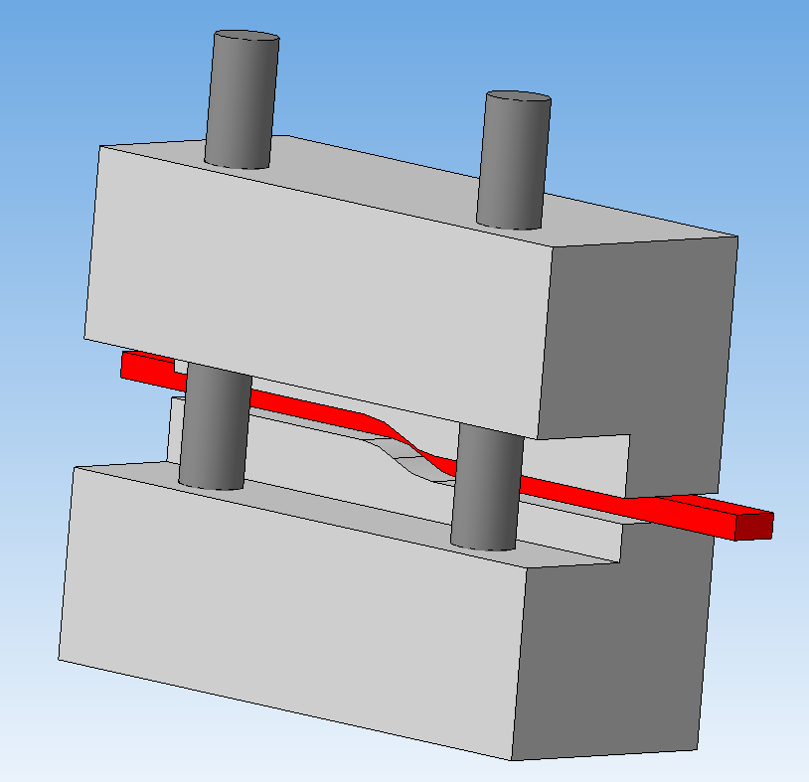
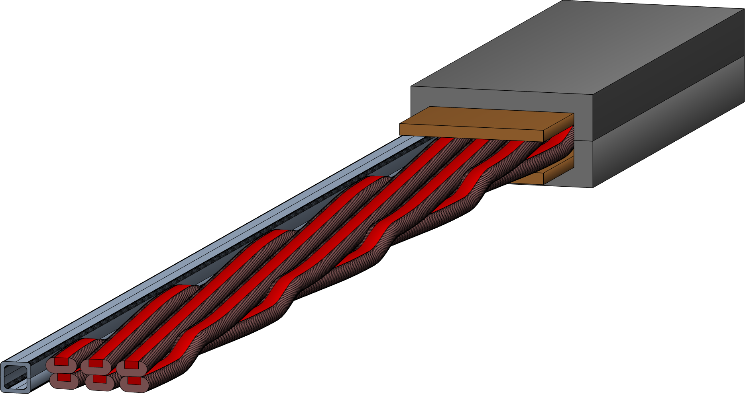
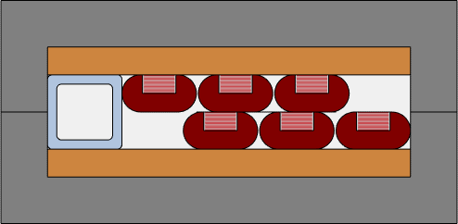
Proposed design solutions
Short transition of strands between the cable layers
Impregnation of the cable space
reduced cable thickness (no core), min bending radius <1.5 m
Profile annealing
Strand pre-shape (easy bending)
Strand soldering
Strand cabling (hard bending)
* Tape packing before or after 2.

Slide 4
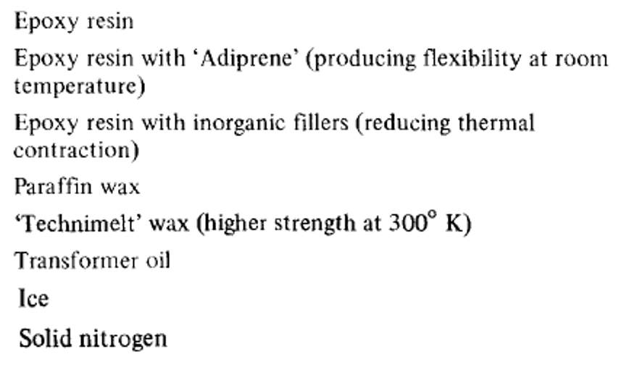
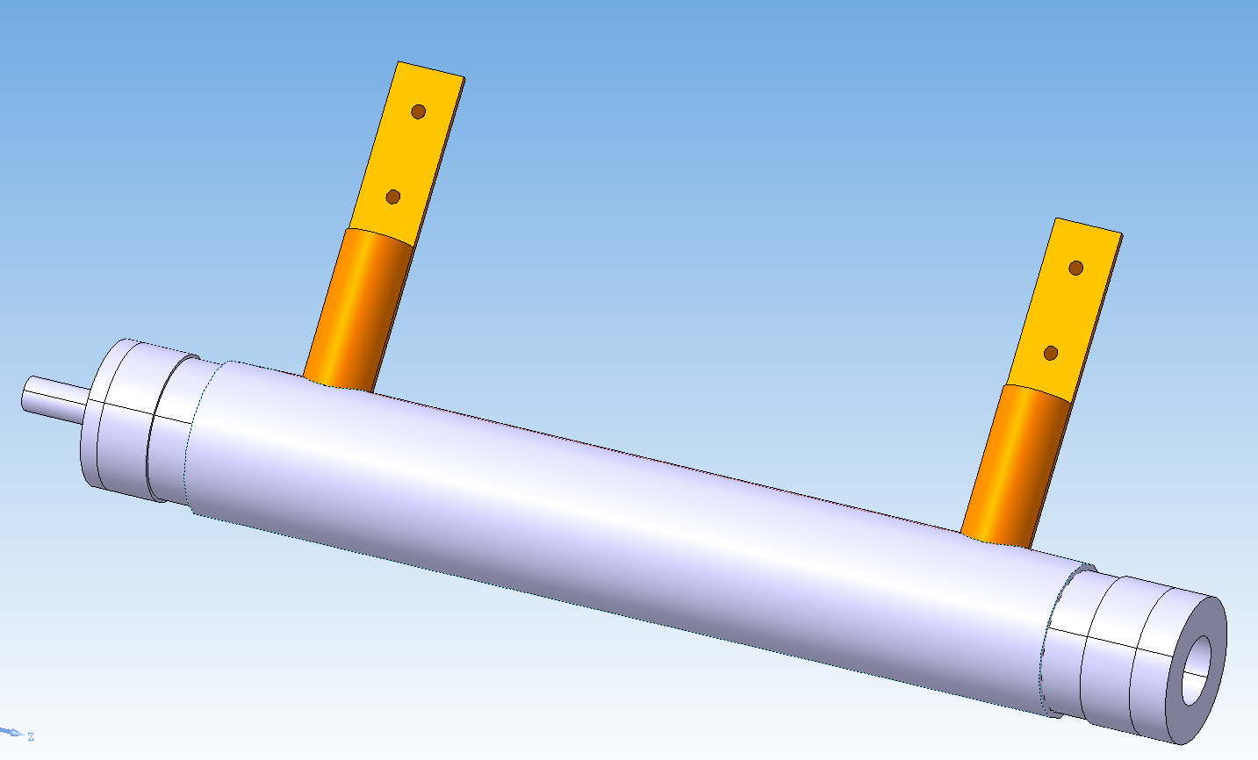
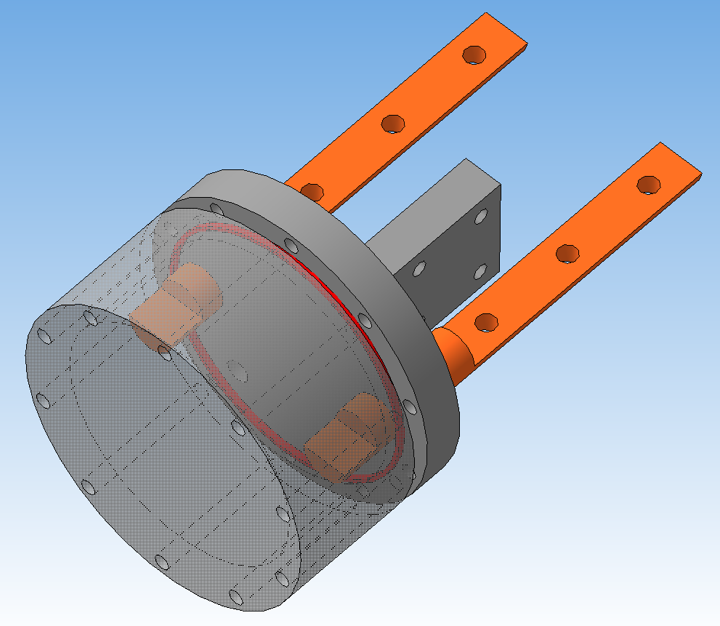
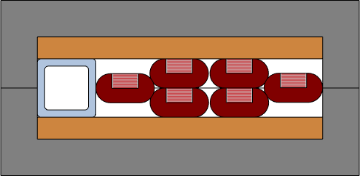
Proposed design solutions
Short transition of strands between the cable layers
Impregnation of the cable space
reduced cable thickness (no core), min bending radius <1.5 m
→ Related study from 1975…
Various filling options to be investigated (only the mechanical reason):
Glycerin + water (aiming at reduced thermal expansion)
Paraffin wax (melting point ~50ºC)
… Nitrogen?
https://doi.org/10.1016/0011-2275(75)90034-X
Forced flow helium
Liquid impregnation
LN2 first trials
In-field test

Slide 5
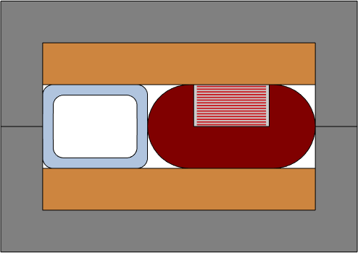
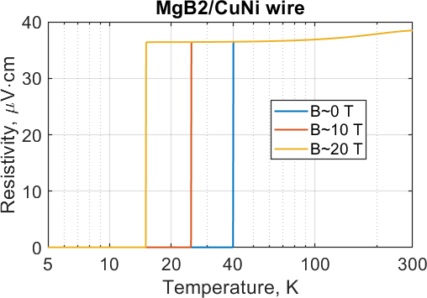
Sub-scale ASTRA sample for quench experiment
QE sample features:
Operation in parallel DC field
Conduction cooling
Electrically insulated and thermally coupled MgB₂ wire in highly resistive matrix for early quench detection
Co-wound SC wire vs fiber optics:
Cheaper, simplified and more robust instrumentation
Location of hot-spot can not be identified
Co-wound SC wire vs voltage taps:
Increased sensitivity of voltage detection (~100 times at low T)
Reparability is the main issue (similar to co-wound voltage taps)

Slide 6
Action items towards performance demonstration
Time and amount of tape needed
Short transition of strands
~2 months ~20 m
Liquid impregnation
~4 months ~10 m
Material procurement
SST 3.3 mm tapes: completed
Copper profiles: small (required) amount ordered
Cooling channel: follow-up QE sample
Protection copper: TBD
Steel and copper components: TBD
~10 months ~300 m
Test SULTAN sample
Long-length strand soldering
Cabling
Conduction cooling
Conductor terminations
Integration and instrumentation
New QE sample
~6 months ~80 m
SST tapes characterization
Conductor performance assessment
Discussion

Slide 7
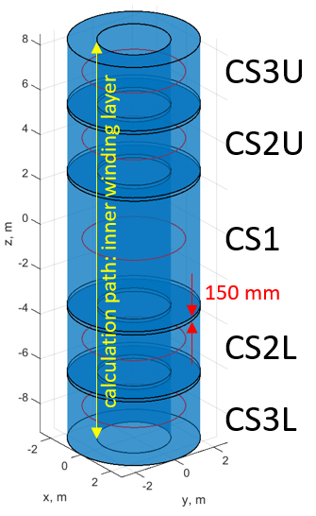
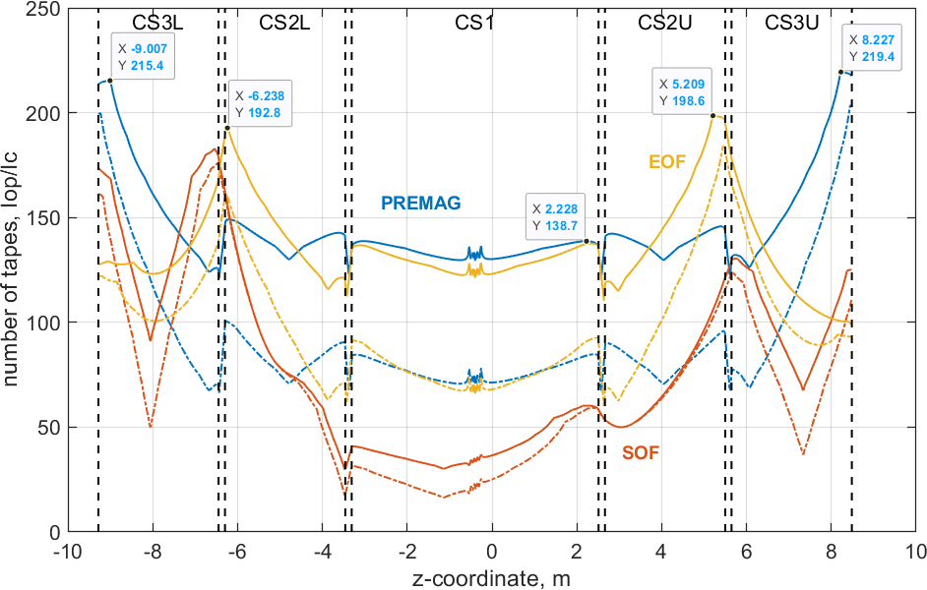
DEMO CS coils: tapes needed for ASTRA conductor
3.3 mm SST tapes
Dashed lines: tapes aligned along z-axis
Solid lines: ± 5 deg mismatch with z-axis
~330 tapes (SST 3.3 mm) needed for the operation in perpendicular peak field
CS module | CS3L | CS2L | CS1 | CS2U | CS3U
Most demanding operating conditions | PREMAG: 14.66 T / 70.1º | EOF: 12.59 T / 70.1º | PREMAG: 18.14 T / 83.7º | EOF: 13.16 T / 70.3º | PREMAG: 15.03 T / 70.2º

