Slide 1
HTS conductor development
Valentina Corato - ENEA

Slide 2
Meeting 23rd March 2021

Slide 3
Premises
The HTS/LTS hybrid CS has a strategic importance in the FP9 R&D work-plan.
However presently none of the proposed options for HTS conductors has operated at full performances without degradation under mechanical and thermal cycles
It’s worth joining all forces to achieve the goal, because we have 3-4 years maximum to demonstrate that the HTS concept can work before the down-selection.
NOW or NEVER
(at least within EU-DEMO programme, assuming that the requested budget will be given)

Slide 4
Possible routes/synergies
Verify the possibility to integrate the CroCo strands in the SPC design or in an alternative common design for the CS HTS cable. This would allow to exploit the equipment realized at KIT for manufacturing long strands.
ENEA could also contribute on the manufacture of the conductor through its industrial contacts.
ENEA could develop an alternative design of the hybrid CS coil based on its conductor, which has a completely different layout.

Slide 5
Potential budget
Assuming that the requested budget will be approved….
KIT (Total budget 21-25: Equip. 210k€+ Facility use 400k€)
Equipment for HTS samples:210 k€
Use of KIT facilities for conductor development: 200 k€
(other 200k€ for HV tests on samples to study insulation)
ENEA (Total budget 21-25: Equip. 515k€+ Facility use 85k€)
Equipment for HTS samples:215 k€
Use of ENEA facilities for conductor development: 85 k€
(other 300k€ for manufacturing samples to study insulation)
SPC (only budget for HTS 21-25):
Equipment for HTS samples: 2 015 k€
1 CS sample (100 k€) + 50 m HTS conductor (1 915 k€)
Sultan tests for HTS conductors: 280k€ (4 tests)
This industrial activity starts in 2022. If no suitable conductors will be available, it could be partially converted into short-length conductor development
+ 2500 k€ in 2026 for manufacture and test of HTS insert

Slide 6
Meeting 13th April 2021

Slide 7
Budget 2021-2025: Approved by GA
SULTAN tests
Year | Beneficiary | ppm @ 50% | ppm PL-TFL-PSO (70%) | Total ppm (Labs) | Total Manpower (k€) | Equipmt./ oth. goods & services: Other | Equipment/other goods and serv. (k€) | Eq./ OGS type | Use of facilities: ppm | Use of facilities: Manpower | Use of facilities: Other | Use of facilities on actuals (k€) | fac. type | Total other costs (k€) | Indirect costs (k€) | Subcon-tracting 100% (k€) | Total Mobility + Subcon (k€) | Total Resources (k€) | Cons. Contr. (CC)
2021 | EPFL | 20.00 |  | 20.00 | 200 | 700 | 700 | D | 11.00 | 110 | 430 | 540 | T | 1 240 | 360 | 200 | 200 | 1 999 | 1 147
2022 | EPFL | 33.00 |  | 33.00 | 334 | 2 350 | 2 350 | D | 9.90 | 100 | 300 | 400 | T | 2 750 | 771 | 1 600 | 1 600 | 5 456 | 3 334
2023 | EPFL | 33.00 |  | 33.00 | 340 | 2 600 | 2 600 | D | 6.00 | 62 | 128 | 190 | T | 2 790 | 782 | 1 600 | 1 600 | 5 512 | 3 278
2024 | EPFL | 24.00 |  | 24.00 | 251 | 1 850 | 1 850 | D | 9.60 | 100 | 300 | 400 | T | 2 250 | 625 | 150 | 150 | 3 276 | 1 582
2025 | EPFL | 24.00 |  | 24.00 | 254 | 810 | 810 | D | 6.00 | 64 | 126 | 190 | T | 1 000 | 314 | 50 | 50 | 1 618 | 780
2021 | KIT | 9.00 |  | 9.00 | 64 | 85 | 85 | D | 4.20 | 30 | 50 | 80 | D | 165 | 57 |  | 0 | 285 | 122
2022 | KIT | 9.00 |  | 9.00 | 65 | 50 | 50 | D | 4.20 | 30 | 50 | 80 | D | 130 | 49 |  | 0 | 244 | 105
2023 | KIT | 9.00 |  | 9.00 | 66 | 25 | 25 | D | 4.10 | 30 | 50 | 80 | D | 105 | 43 |  | 0 | 213 | 93
2024 | KIT | 9.00 |  | 9.00 | 67 | 25 | 25 | D | 4.10 | 30 | 50 | 80 | D | 105 | 43 |  | 0 | 215 | 94
2025 | KIT | 8.00 |  | 8.00 | 60 | 25 | 25 | D | 4.00 | 30 | 50 | 80 | D | 105 | 41 |  | 0 | 207 | 90
2021 | DIFFER | 6.00 |  | 6.00 | 44 |  | 0 | D | 2.40 | 18 | 12 | 30 | D | 30 | 19 |  | 0 | 93 | 43
2022 | DIFFER | 6.00 |  | 6.00 | 45 |  | 0 | D | 2.40 | 18 | 12 | 30 | D | 30 | 19 |  | 0 | 94 | 43
2023 | DIFFER | 6.00 |  | 6.00 | 46 |  | 0 | D | 2.40 | 18 | 12 | 30 | D | 30 | 19 |  | 0 | 95 | 44
2024 | DIFFER | 6.00 |  | 6.00 | 46 |  | 0 | D | 2.30 | 18 | 12 | 30 | D | 30 | 19 |  | 0 | 95 | 44
2025 | DIFFER | 6.00 |  | 6.00 | 47 |  | 0 | D | 2.30 | 18 | 12 | 30 | D | 30 | 19 |  | 0 | 97 | 45
2021 | ENEA | 39.00 | 10.8 | 49.80 | 278 | 100 | 100 | D | 1.30 | 7 | 10 | 17 | D | 117 | 99 | 50 | 50 | 545 | 298
2022 | ENEA | 39.00 | 10.8 | 49.80 | 283 | 125 | 125 | D | 1.30 | 7 | 10 | 17 | D | 142 | 106 | 100 | 100 | 632 | 363
2023 | ENEA | 39.00 | 10.8 | 49.80 | 287 | 125 | 125 | D | 1.30 | 7 | 10 | 17 | D | 142 | 107 | 50 | 50 | 587 | 316
2024 | ENEA | 39.00 | 10.8 | 49.80 | 291 | 85 | 85 | D | 1.20 | 7 | 10 | 17 | D | 102 | 98 |  | 0 | 492 | 249
2025 | ENEA | 38.00 | 10.8 | 48.80 | 290 | 80 | 80 | D | 1.20 | 7 | 10 | 17 | D | 97 | 97 | 50 | 50 | 534 | 296

Slide 8
Available budget for HTS conductor development
KIT (Total budget 21-25: Equip. 210k€+ Facility use 400k€)
Equipment for HTS samples:210 k€
Use of KIT facilities for conductor development: 200 k€
(other 200k€ for HV tests on samples to study insulation)
ENEA (Total budget 21-25: Equip. 515k€+ Facility use 85k€)
Equipment for HTS samples:215 k€
Use of ENEA facilities for conductor development: 85 k€
(other 300k€ for manufacturing samples to study insulation)
SPC (only budget for HTS 21-25):
Equipment for HTS samples: 2 015 k€
1 CS sample (100 k€) + 50 m HTS conductor (1 915 k€)
Sultan tests for HTS conductors: 280k€ (4 tests)
2022: 500k€
2023: 600k€
2024: 815 k€
If no suitable conductors will be available, it could be partially converted into short-length conductor development.
+ 2500 k€ in 2026 for manufacture and test of HTS insert

Slide 9
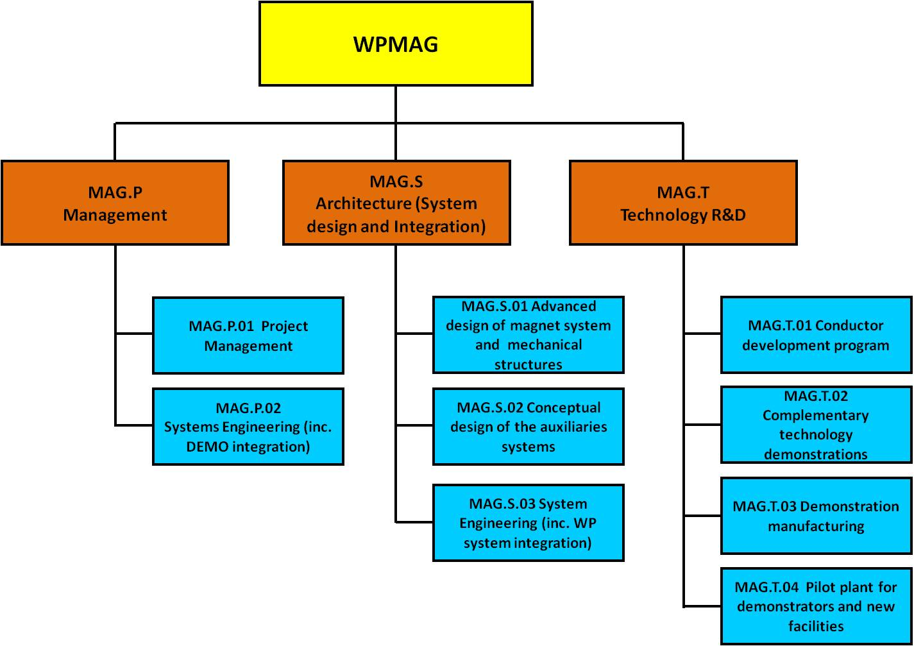
Reference persons
Reference persons
Project Leader (PL)
PL
Member of Central Unit/PL
P. Bruzzone

Slide 10
Updates
P. Bruzzone will coordinate the Technological R&D branch of WPMAG, including the HTS conductor development.
The design will be coordinated by a Member of the Central Unit (not yet selected) in compliance with the PL.
PoliTo will be involved in the TH analysis of all configurations for a comparative purpose. SPC, KIT and ENEA can do their independent analyses if they wish.
DIFFER will develop models of HTS conductors with Jackpot and measure AC losses.
New designs with high-current conductors will be studied in 2021, for reducing the allowable Voltage across the coil. Therefore it’s possible that the target current of the HTS conductors could increase in the future.

Slide 11
Updates
EU-CN collaboration: 2021 resources for completing the quench experiment are NOT included in the budget approved by the GA. The possibility to have them is still under debate. I will discuss with EUROfusion this point on thursday, as well as the possibility to extend the collaboration of magnets with China on other topics in the future.
RUs should clarify as soon as possible:
if they intend to contribute with their own conductor layout or support the design of another RU.
How many samples they intend to provide between 2021-2023 and the estimated budget for manufacturing. Also the time schedule is important because the resources are assigned each year.
In absence of EU-CN funds, if they intend to use 2021 budget to complete the quench experiment.

