Slide 1
Eﬀects of the non-perturbative mode structure on energetic particle transport*
G. Meng
Collaborating with: Ph. Lauber, Z.X. Lu, X. Wang
Acknowledgement: F. Zonca, S.D. Pinches, B. Scott and T. Hayward-Schneider
Max Planck Institut für Plasmaphysik, Garching, Germany;
MID TERM MET Worskop 2020
Mar. 23-25, 2020
*Accepted: 2020 Nucl. Fusion https://doi.org/10.1088/1741-4326/ab7e01

Slide 2
Outline
Motivation
Test particle studies
$δf$ studies
growth rate and saturation level
$u_{∥}$ reversal
Summary and next step work

Slide 3
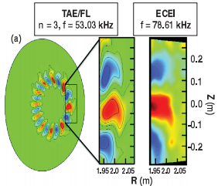
Motivation
The mode structure distortion can be induced by EP non-perturbative effects [1].
The non-perturbative EP effects can change the wave-particle interaction, the mode growth rate, the saturation level, in turn, the EP transport changes [2, 3].
The non-perturbative mode structure can be represented by the “symmetry breaking” in parallel and radial directions [4]. Up-down asymmetry of the 2D mode structure.
While “symmetry breaking” has been intensively studied in micro-turbulence transport (w/o EPs) due to its effects on intrinsic toroidal rotation, its effects on EP transport are less well understood.
[1] Tobias PRL 2011
[2] F. Zonca, NF 2005
[3] L. Chen RMP 2016
[4] Z. Lu, et al., NF 2018
Notes:
the \non-perturbative" effects cause a \distortion" of the mode which has been generally observed by Electron Cyclotron Emission Imaging (ECEI) in various experiments

Slide 4
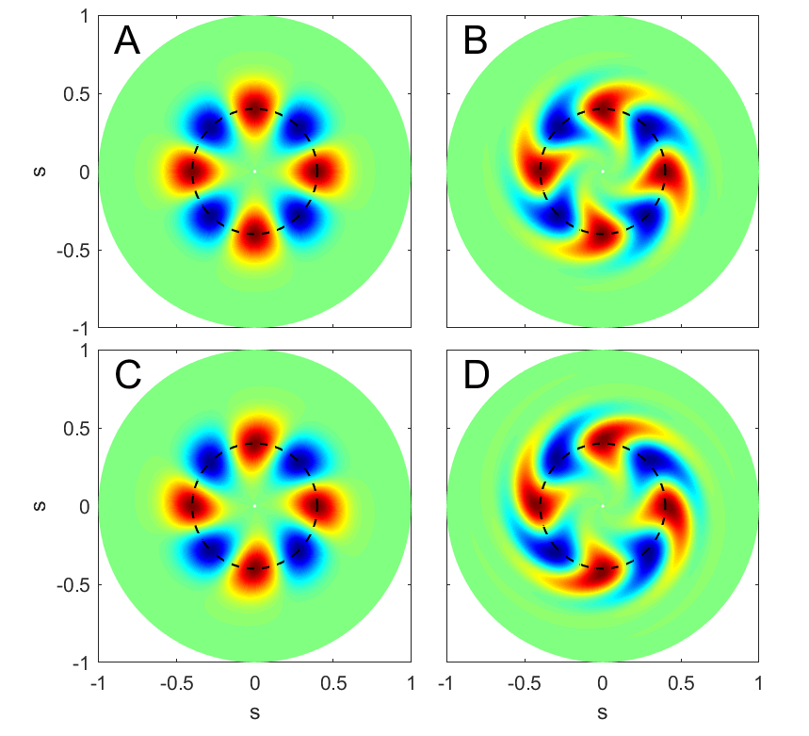
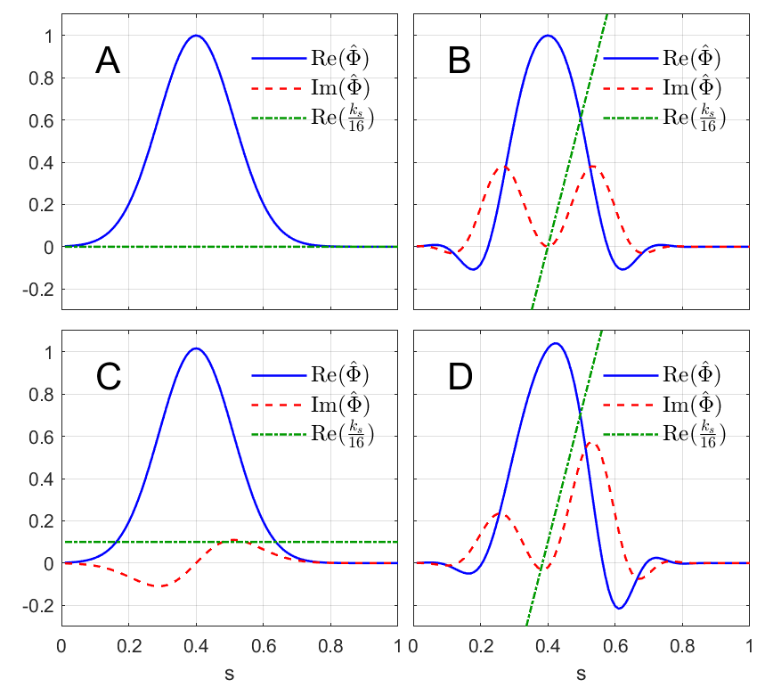
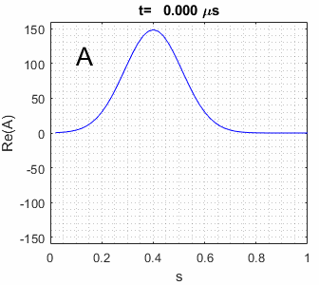
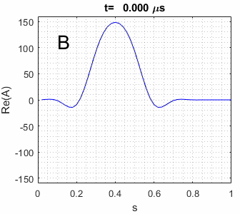
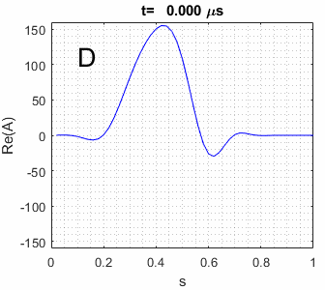
Mode structure with Symm. Breaking
EPs induce radial & up-down mode structure symmetry breaking.
The radial mode structure $Φ\left(s\right)=\exp\left\{−σ{\left(s−s_{0}\right)}^{2}\right\}$ with complex parameters σ and $s_{0}$[1].
Define the complex radial wave vector as $k_{s}≡−id\left(lnΦ\right)ds=i2σ(s−s_{0})$
$s=\sqrt{ψ}$ : radial coordinate.
 | A | B
$$σ$$ | 40 | 40-50i
$$s_{0}$$ | 0.4 | 0.4
 | C | D
$$σ$$ | 40 | 40-50i
$$s_{0}$$ | 0.4+0.02i | 0.4+0.02i
RSAE mode for AUG #31213, f=133 𝑘𝐻𝑧, 𝑛=2, m=4 (LIGKA[2] results).
σ and $s_{0}$of Case A is by fitting the LIGKA results.
Cases B, C, D mimic experiment and HMGC simulation results [3].
Base case A, without symmetry breaking.
[1] Lu NF 2018 [2] Lauber JCP 2007
[3] Briguglio POP 1995

Slide 5
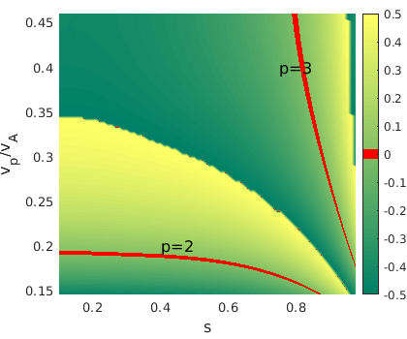
Linear resonance
HAGIS result: linear resonances ($n〈ω_{ζ}〉−p〈ω_{θ}〉=ω,$red lines, p= 2, 3) in phase space for a $133 kHz n=2$mode in the circular equilibrium matched to AUG #31213. Color bar represents [$n〈ω_{ζ}〉−ω]/〈ω_{θ}〉−p$.
$v_{∥}$is parallel velocity; $v_{A}$ is Alfvén velocity. Particle initial$v_{⊥}$=0, $v_{∥}/v=1$, initial $θ=0, ζ=0$.
${|v}_{∥}/v_{A}|$=0.15 corresponds to E=16 keV.
$|v_{∥}/v_{A}|$=0.2 corresponds to E=28 keV.
NBI birth energy: 93 keV.
In this range, for co-passing particles p=2 resonance dominates.
$$v_{∥}/v_{A}$$
Notes:
E from 15kev-150

Slide 6
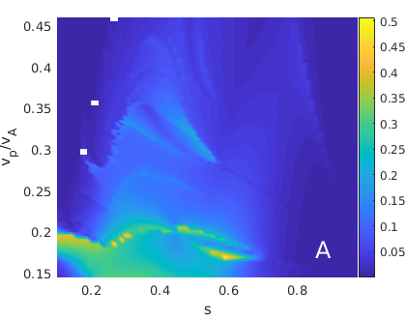
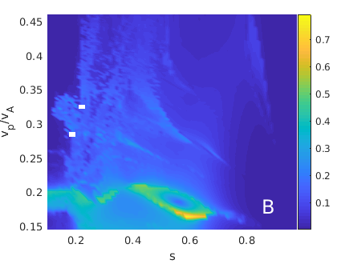
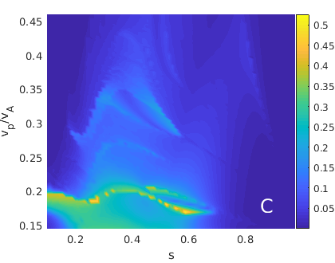
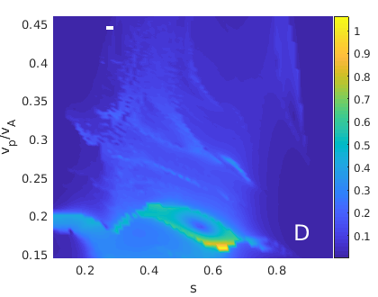
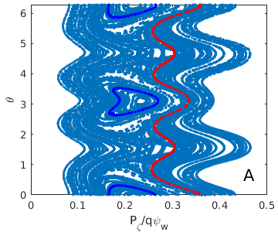
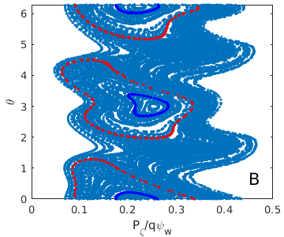
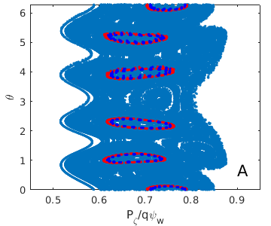
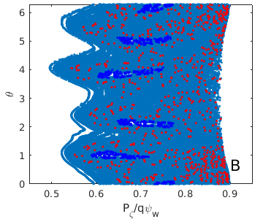
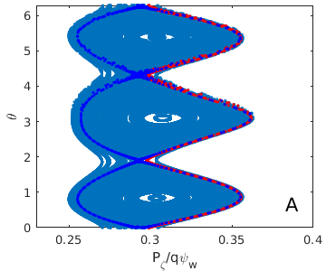
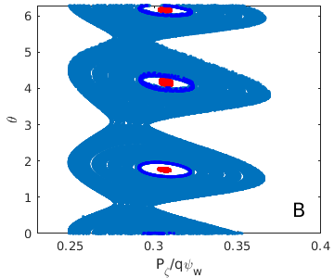
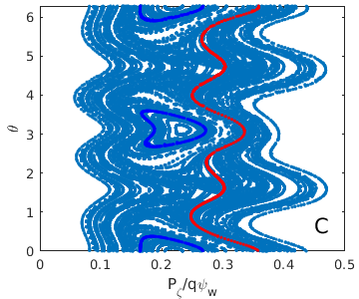
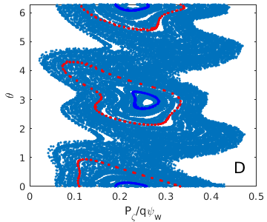
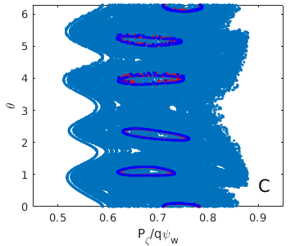
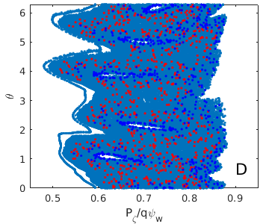
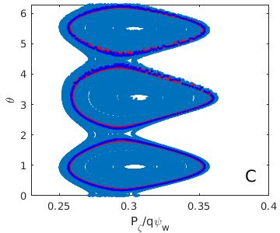
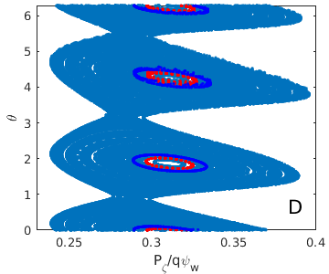
Test particle studies: wave-particle resonance
Particle energy change $|ΔE/E_{0}|$ during 20 poloidal circles with a fixed mode amplitude $δB/B={10}^{−3}$ ($≈$ HAGIS saturation value).
Particle energy changes significantly at p=2 resonance and s around 0.4.
Resonance lines are visible in A,B,C,D but can be distorted due to different mode structures.
A and C are similar; B and D are similar (also see saturation level analyses following).
B and D, featured with the significant radial propagation in mode structures, are distorted compared with A.
$$v_{∥}/v_{A}$$
$$v_{∥}/v_{A}$$
p=2 | p=2.5 | p=3
For this case, the p=2.5 nonlinear resonance is also observed. At the p=2.5, the resonance structure is due to the coupling of the two primary resonance p=2 and p=3.
Resonance islands are narrow at p=3.

Slide 7
$δf$ studies: EP Initial distribution
Radial distribution
$f\left(ψ\right)=1/[1+exp\left(\frac{{ψ−ψ}_{0}}{δψ}\right)],$ with $ψ_{0}=0.16, δψ=0.2$.
EP density at magnetic axis n(0) = 9.163E+17 [1/m^3]
Energy slowing down distribution
with $E_{0}=93 keV, E_{c}=37.21 keV, ΔE=149.9 keV$
Pitch angle isotropic distribution. The beta of EP population is $β_{f}$ = 0.1%.
Notes:
E cut off

Slide 8
Mode saturation and linear growth rate
Linear growth rate $γ_{L}$ is fitted during the first 1000 steps; averaged saturation level $A_{sat}$and frequency change $δω/ω$ during 10000-15000 steps (t=3.77-5.65 ms)
Base case A: $γ_{L}/ω=1.00 \%$, $A_{sat}$is 3.61$×{10}^{−3}$ and $δω/ω=−1.64×{10}^{−2}$.
Compare B with A: the $γ_{L}$ and $A_{sat}$ of B decrease by ~10% & 20% respectively. Due to opposite radial $k_{s}$.
Case C: $γ_{L}$ and $A_{sat}$ slightly change.
Case D: $A_{sat}$ and $γ_{L}$ decrease compared with Case A, which shows the similar trend as Case B. Synergistic effect of $Im\{σ\}$ & $Im\{s_{0}\}$.
Amplitude
Notes:
$γ_{L}/ω=1.00 \%$, $A_{sat}$is 3.61$×{10}^{−3}$ and $δω/ω=−1.64×{10}^{−2}$.

Slide 9
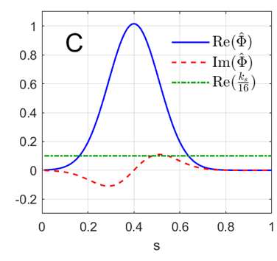
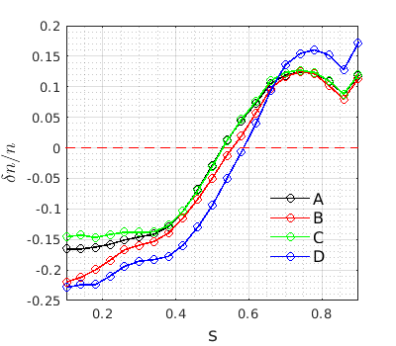
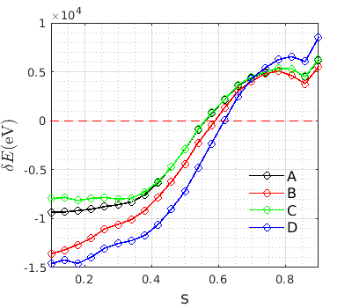
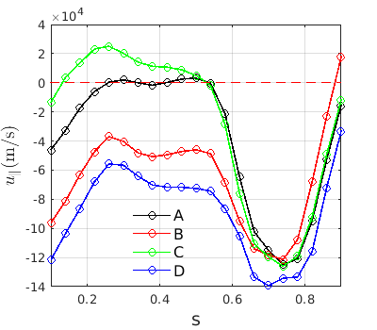
$δf$and particle redistribution
EP density radial distribution: $δn/n$ (left); Energy change profile: $δE=\frac{∫δf⋅E dv^{3}}{∫f dv^{3}}$ (middle);
Parallel velocity radial distribution: $u_{∥}=\frac{∫δf⋅v_{∥} dv^{3}}{∫f dv^{3}}$ significantly different
$$δn/n$$
$u_{∥}$[m/s]
$$δE[eV]$$
Case C (with $σ=40$, $s_{0}=0.4+0.02i.$ → constant $k_{s}$= 1.6, corresponding $k_{r}=k_{s} \frac{ds}{dr}≈ \text{0.032 /}\text{cm}$).
Alfvén mode leads to the flattening of density and energy profiles ($δn, δE<0$ for $s<0$.5; $δn$,$δE>0$ for $s>0$.5).
Perturbative mode structures (B,C,D) lead to changes in particle and energy transport with $δn, δE$ deviating by $\sim 10\%$.
Parallel velocity profile changes significantly due to the non-perturbative mode structure symmetry breaking. In the inner region ($s<0.5$), $u_{∥}$ can change its direction (rotation reversal).
All figures are averaged over t=3.77-5.65 ms.

Slide 10
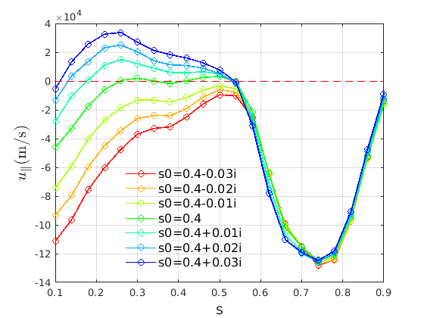
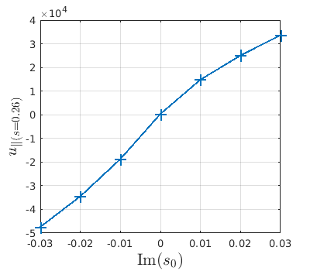
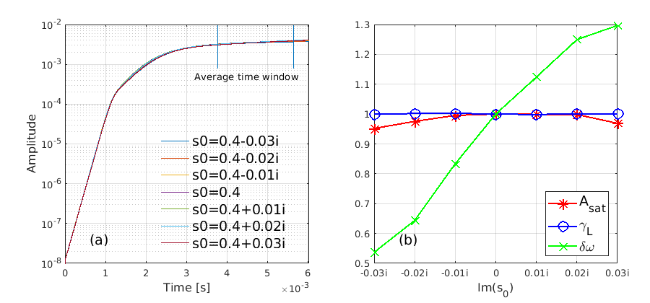
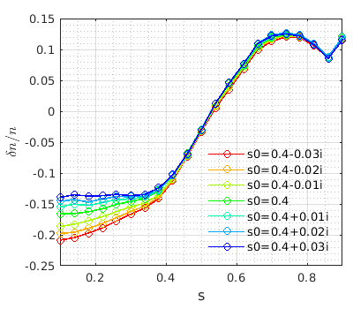
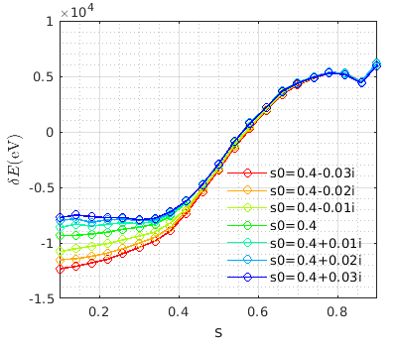
$u_{∥}$ reversal
Vary Im$(s_{0})$, with $σ=40$. $k_{s}=80 \text{Im}(s_{0})$.
Case A
$u_{∥}$[m/s]
+
$u_{∥}$reversal
x5 Int.
When varying the mode structures, EP parallel velocity $u_{∥}$ changes significantly. $u_{∥}$ reversal in the inner region is observed.
This large effect (∼100%) on the $u_{∥}$ could have implications for EP current drive and the transport in the burning plasmas.
Mode structure symmetry breaking is important to EP momentum transport.
Next step: comparison with ORB5.
AUG experiment proposed².
G. Meng , et al., NF 2020 ;
2. Ph. Lauber, et al., AUG experiment proposal 2020
Notes:
uk of EPs at s = 0:26 can be produced with a magnitude of ∼ 10 km=s.
The mode linear growth rate, saturation level, frequency change at saturation, compared with case A. The frequency change of the mode at saturation $δω/ω_{n}$ varies from $−0.88×{10}^{−2}$ to $−2.13×{10}^{−2}$ for Im($s_{0}$) varying from -0.03i to 0.03i

Slide 11
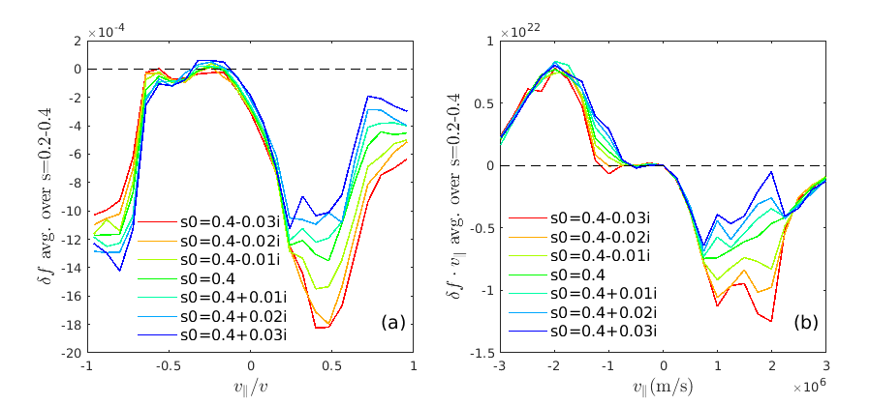
Particle response $δf(v_{∥}/v, s)$
The change of the δf value is more visible for the co-moving particles in the s < 0.4 region.
$δf$ distribution of $λ$ averaged over s=0.2-0.4, where $λ=v_{∥}/v$.
Particle response are different according to their pitch angles.
$δf$of co-moving particles are more sensitive to the $Im(s_{0})$. The response region $λ=[0.3, 1].$
$δf$of counter-moving particles response region is much narrower. $λ=[−1,−0.6].$
Co- and counter moving particles response differently to the asymmetric wave
Co-moving particles response more significantly
$\text{Asymmetric} \text{wave}\text{−}\text{particle} \text{interaction} \text{leads} \text{to} u_{∥} \text{generation}$

Slide 12
Toroidal momentum transport
Toroidal momentum evolution equation in conservative form $∂_{t}P_{φ}+∂_{t}g_{φ}+∇⋅Π_{φ}=0$
HAGIS conserves the total energy and toroidal momentum of the wave-particle system.
$\vec{g}$ Electromagnetic field momentum
$$\vec{g}=ε_{0}δ\vec{E}×δ\vec{B}=\vec{B}/(2B)\{\left(k_{∥}/ω\right)\left(k_{rR}^{2}+k_{rI}^{2}+k_{θ}^{2}\right){\left|{\hat{Φ}}_{nm}\right|}^{2}\}$$
Comparing mode with positive and negative values of Im($s_{0}$): the wave momentum $\vec{g}$ is the same but the $u_{∥}$ in the inner region is opposite.
Toroidal momentum transport equation needs to be derived using the gyrokinetic theory [1,2].
EP physics and EM field perturbations to be considered.
[1] Scott B, Smirnov J, 2010 POP 17 112302
[2] Abiteboul J, Garbet X, et al.,2011 POP 18 082503

Slide 13
Summary
The effects of the non-perturbative mode structure on the energetic particle transport have been analyzed.
Particle-wave resonance changes due to the mode structure symmetry breaking
Mode structure symmetry breaking leads to distortion of wave-particle resonance island structures; the mode radial wave vector $k_{s}$ plays an important role.
With mode symmetry breaking effects considered:
Mode linear growth rate can change by 10% and saturation level can change by 20%.
EP density and energy transport can change by of order 10%.
EP parallel velocity $u_{∥}$ in the inner region s = 0.2-0.5 can change its sign for different mode structures, demonstrating the importance of the mode structure symmetry breaking on EP toroidal velocity reversal. This large effect (∼100%) on the mean parallel flow could have implications for EP current drive and the transport in the burning plasmas.
Next: more self-consistent simulation, full f HAGIS simulation, $α$ particles transport
Notes:
with mode symmetry breaking effects considered, the mode linear growth rate can change by 10% and the saturation level can change by 20%. While the EP density and energy transport can change by of order 10%, the EP parallel velocity distribution can change significantly, with the magnitude of ∼ 10 km=s.

Slide 14
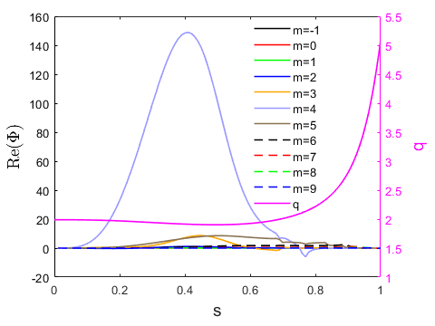
Φ = A $\exp\left\{−σ{\left(s−s_{0}\right)}^{2}\right\}$using the least-squares method. The fitting results are shown in the right frame of figure 1 with σ = 39.25+1.14i and s0 = 0.40+0.0015i. The LIGKA mode structure is almost symmetric. The fitting parameter A = 148.66 – 18.17i = 149.77$e^{−0.1216i}$ is related to the mode amplitude and initial phase.

Slide 15
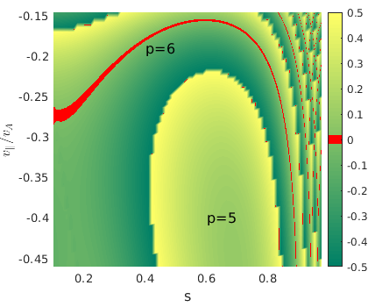
Linear resonance
HAGIS result: linear resonances ($n〈ω_{ζ}〉−p〈ω_{θ}〉=ω,$red lines, p= 2, 3) in phase space for a $133 kHz n=2$mode in the circular equilibrium matched to AUG #31213. Color bar represents [$n〈ω_{ζ}〉−ω]/〈ω_{θ}〉−p$.
s is $\sqrt{ψ}.{ v}_{∥}$is parallel velocity; $v_{A}$ is Alfvén velocity. Particle initial$v_{⊥}$=0, $v_{∥}/v=1$, initial $θ=0, ζ=0$.
$$v_{∥}/v_{A}$$
${|v}_{∥}/v_{A}|$=0.15 corresponds to E=16 keV.
$|v_{∥}/v_{A}|$=0.2 corresponds to E=28 keV.
NBI birth energy: 93 keV.
In this range, for co-passing particles p=2 resonance dominates.
$$v_{∥}/v_{A}$$

