Slide 1
Benchmark for HMGC, HYMAGYC and MEGA Large aspect ratio equilibrium
X. Wang, S. Briguglio, G. Vlad, G. Fogaccia, V. Fusco

Slide 2
Benchmark set-up
HMGC, HYMAGYC and MEGA are hybrid MHD-kinetic codes
In the present benchmark they all adopt drift-kinetic limit (FLR effects neglected; FOW ones retained)
Shifted circular magnetic surface equilibrium
Large aspect ratio: R₀/a=10
q(0)=1.1 q(a)=1.9
Bulk-ion (D) density profile such to yield alined gaps: n_{i}/n_{i}(0)=[q(0)/q]²
Maxwellian energetic particle (D) population (flat temperature)
Single toroidal number n=2
Alfvén
continuum
EP density

Slide 3
Two types of EPMs
Their relative stability depends, ceteris paribus, on n_{H}
At low values of n_{H} the high-frequency mode dominates; at large values of n_{H}, the low-frequency one
High frquency mode
Low frquency mode

Slide 4
Two types of EPMs
Lower n_{H} case
Larger n_{H} case

Slide 5
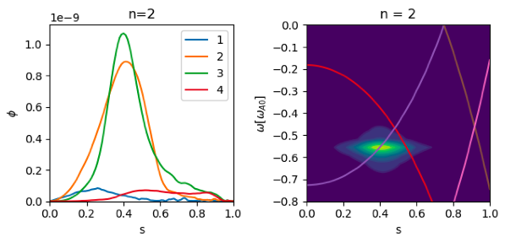
Benchmark results
Low n_{H} case
MEGA eigenfunctions less peaked
Note that different frequency spaces are used
HMGC
HYMAGYC
MEGA

Slide 6
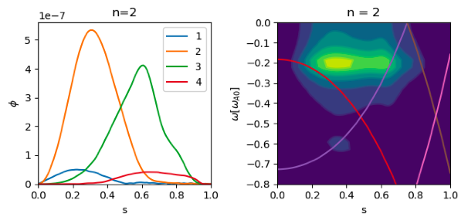
Benchmark results
Large n_{H} case
Relatively fair agreement
HMGC
HYMAGYC
MEGA

Slide 7
Benchmark results
Frequency and growth rate values
MEGA does not observe a strong dependence of the growth rate on n_{H}/n_{i} for the low frequency mode

Slide 8
Benchmark results
Are MEGA and HMGC/HYMAGYC looking at a different dynamics for large n_{H}/n_{i}?
It would be worth investigating the involved resonances and their relative weight

Slide 9
Conclusions
Positive results:
two types of EPM exist
the high-frequency one dominates at low drive; the low-frequency one, at large drive
real frequency of the two modes in fair agreement
low-frequency mode structure similar
Negative results:
the low-frequency mode growth rate, for MEGA, does not increase fast with increasing n_{H}/n_{i}
the high-frequency mode structure for MEGA is less peaked than that found by HMGC and HYMAGYC
Deeper resonance investigation required

