Slide 1
Review of WP Code Development activities in 2019
Michele Romanelli
WPCD Annual Planning Meeting – Frascati, 24-28 February 2020

Slide 2
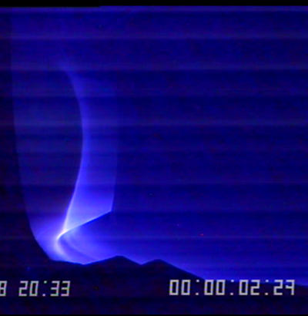
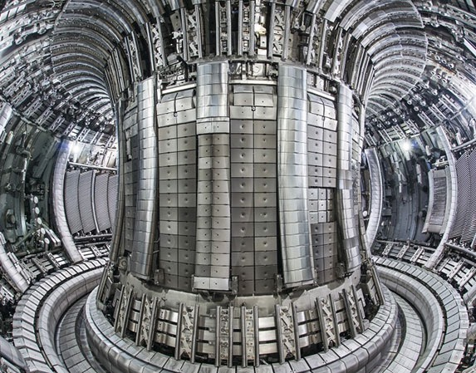
WEST
MAST
AUG
Goals of WPCD in 2019:
Make data-structure (IMAS / IDS*) and workflows developed by WPCD available to USERS in EUROfusion for routine analysis and modelling across EUROfusion programs / laboratories
Demonstrate the added value of using the Integrated Modeling (WPCD) tools by supporting their use in JET /MST for delivering new scientific results
WPCD workflows as tools for USERS and not exclusively for developers
* IMAS (ITER Modelling and Analysis System) / IDS (Interface Data Structure)

Slide 3
WPCD Contractual Deliverables
Deliverables from approved EUROfusion Workplan 2019 – 2020 :
CD.D12 | Scientific support and contribution to the publication of ETS* physics results on JET analysis (2019) - Achieved
CD.D13 | Tutorial and documentation on ETS* and training for MST1 and WPPFC users (2019) - Achieved
CD.D15 | Release of turbulence workflow, documentation and contribution to a publication on physics applications (MST1/JET) (2020)
CD.D16 | Tutorial, training, documentation on and release of the core-edge transport simulator ETS-6 in IMAS (2020)
* ETS (European Transport Simulator)

Slide 4
WEST
MAST
AUG
Remarkable achievements of WPCD in 2019:
For first time experimental data of JET / TCV / AUG / MAST are routinely available in IMAS format
WPCD workflows have been verified & validated and embedded in the JET / MST programs for routine use
ETS is now ready to replace TRANSP and other non-EU transport codes used routinely in European laboratories
The number of ETS users has increased substantially within EUROfusion and amongst ITER / ITER partners (USA, Korea), attracting the interest of students and experienced researchers – an ETS TRO has been appointed
Documentation is now accessible on https://wpcd-workflows.github.io

Slide 5
2019 WPCD Project Structure
20 ppy
100 contributors
1.62 Meuro EUROfusion
contribution
PMU Responsible Officer for WPCD
Hyun-Tae Kim
Adaptation of Workflow in IMAS
Workflow Development
Enabling Workflow Exploitation

Slide 6
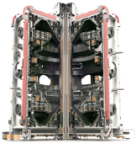
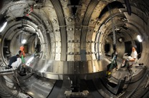
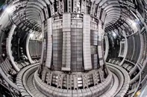
Mapping of JET / MST data in IMAS / IDS
UDA* is used to map existing experimental and machine description data from different Tokamaks into IMAS data format.
EUROfusion Gateway
The mappings are machine specific and use different technologies: XML, Matlab, etc.
IMAS
UDA
WEST mappings
JET mappings
ASDEX mappings
MAST mappings
AUG
AUG
WEST
JET
AUG
MAST
*Universal Data Access: Data access and transformation tool originally created for the MAST data systems
J. Hollocombe and D. Muir, 2019

Slide 7
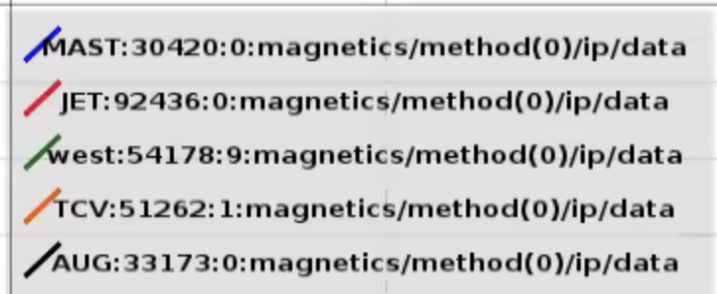
Magnetic IDS data fetched with UDA and plotted with IMASviz
Plotting IMAS data: IMASviz

Slide 8
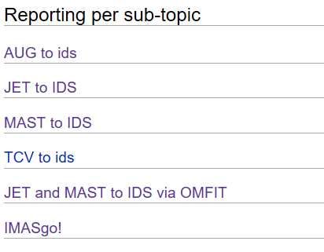
Mapping of JET / MST data in IMAS / IDS
Some data such as kinetic profiles vs rho_tor_norm are not readily available in the tokamak databases. Tools to process native data and map them in IMAS/IDS (e.g. core_profile) had to be developed for each device
https://users.euro-fusion.org/iterphysicswiki/index.php/EWE-1_Data_access,_interfaces_and_data_preparation_routines_for_the_initialization_of_WPCD_workflows_to_enable_MST/JET/WPs_exploitation
G. Tardini
J. Hollocombe
J. Hollocombe, S. Henderson
O. Sauter, A. Merle
S. Henderson, M. Romanelli, J. Ferreira
M.Romanelli, O. Meneghini, J. Ferreira

Slide 9
IMASgo!
IMASgo! builds upon the OMFITprofiles, EFIT++, KineticEFIT and TRANSP modules. Any tokamak for which the above modules have been configured can use IMASgo! to map its data into IMAS
M. Romanelli et al (2019), submitted to FST
After importing the equilibrium the TS / CX data are fitted and profiles generated
and stored in IDSs together with the machine description (JET / MAST)
O. Meneghini, S. Smith, M. Romanellii, J. Ferreira
You tube channel

Slide 10
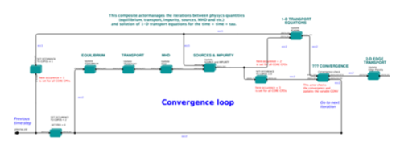
The European Transport Simulator
ETS-5 (CPO) / ETS-6 (IDS) different Internal data structure same input data
Fully Tokamak independent: only IMAS data used as input to the workflow
Synthetic diagnostics
JET/MST data in IDS
Neutron rate / Transport coefficients / profiles evolution
JET/MST Machine Description
Same functionality as TRANSP available
Statistical benchmark with TRANSP carried out on more than 100 JET discharges
INPUT data / interfaces for MST prepared in EWE tasks
Heating and Current Drive modules - Sources
Transport models
Qualikiz, TGLF
G. Falchetto et al, EPS 2019

Slide 11
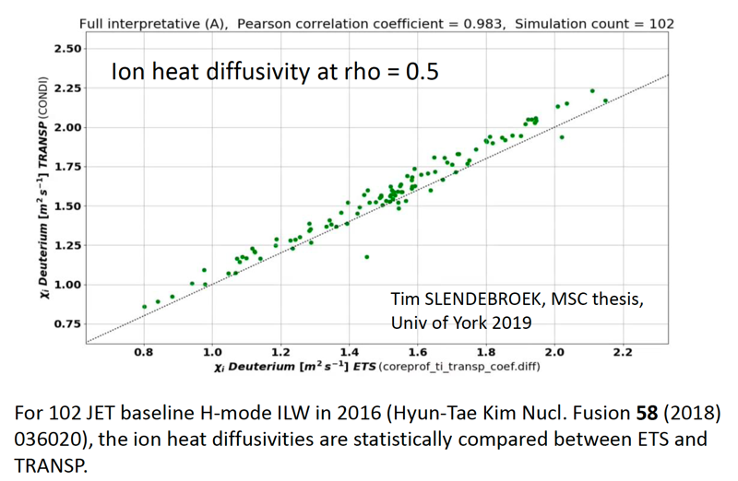
Statistical benchmark of ETS vs TRANSP
JET/MST data in IDS
T. Slendebroek, MSC thesis, 2019

Slide 12
NBI Heating in ETS – geometry via NBI IDS
JET/MST data in IDS

Slide 13
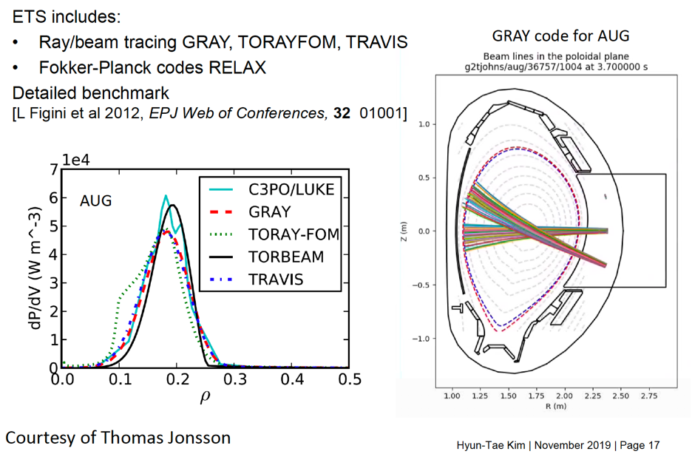
ECRH Heating in ETS – geometry via EC_antenna
also with other codes outside ETS
JET/MST data in IDS

Slide 14
ICRH heating in ETS – geometry via IC_antenna
JET/MST data in IDS
D. Van Eester, Invited Talk, EFTC 2019

Slide 15
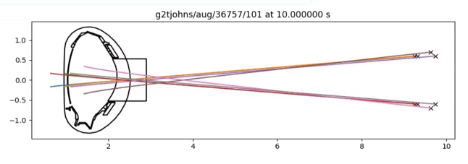
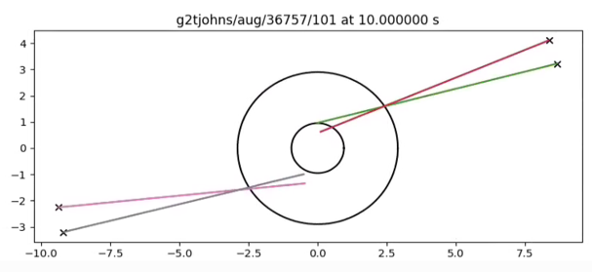
Visualising the NBI system - AUG
The settings of the NBI system are stored in the NBI IDS
Visualization of the beams is essential for checking settings is correctly mapped
New visualization tools work for any Tokamak

Slide 16
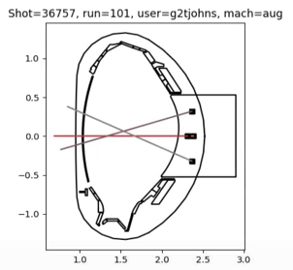
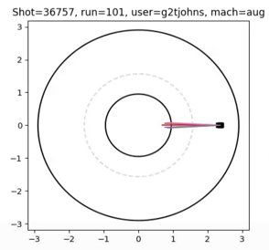
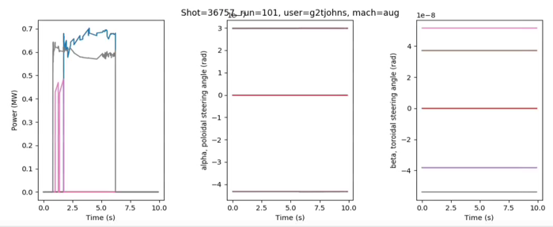
Visualising the ECRH system - AUG
The settings of the ECRH system are stored in the EC_antenna IDS

Slide 17
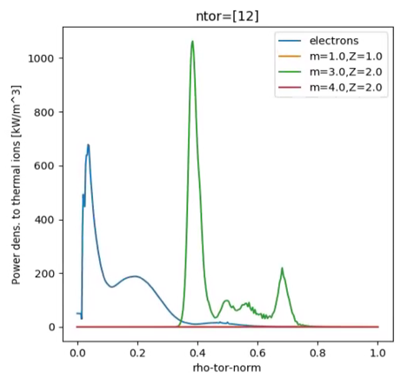
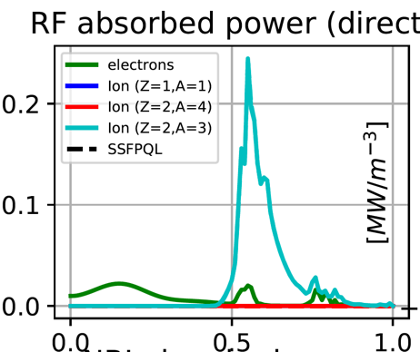
Comparison: CYRANO vs TORIC
ETS / TORIC simulations by Y. Kazakov done at the MST1 ETS training (AUG three ion ICRH heating scenario)
Qualitative similarities TORIC /CYRANO
TORIC reference
CYRANO

Slide 18
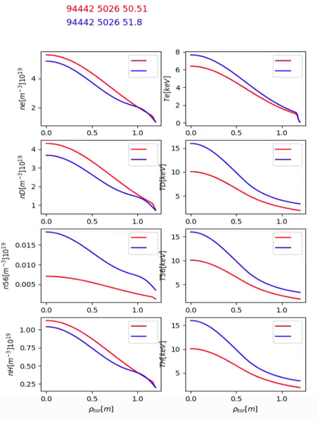
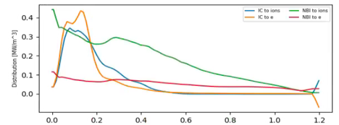
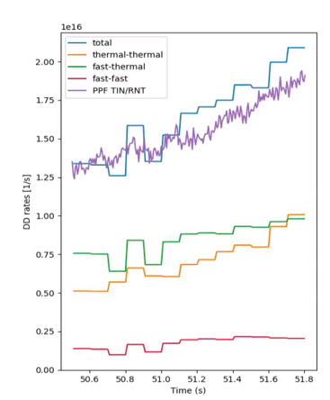
JET 94442 Neutron rate ETS vs RNT
ETS (ASCOT/CYRANO) with Ni, H minority, T_{D} from validated CX data, and Zeff(t)

Slide 19
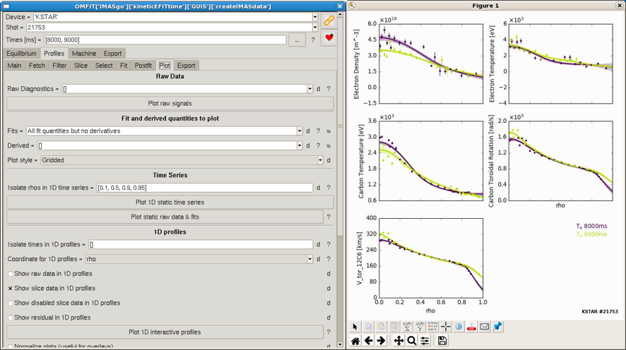
IMASgo! data of KSTAR
IMASgo now runs on the NFRI computers and allows to write IMAS data on the EUROfusion Gateway (requires an NFRI computer account)
L. Terzolo, M.W. Lee, J.S. Kang (NFRI), C.Y. Lee, S.K. Kim, S.J. Park, M.S. Park, Y.S. Na (SNU)

Slide 20
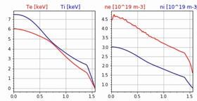
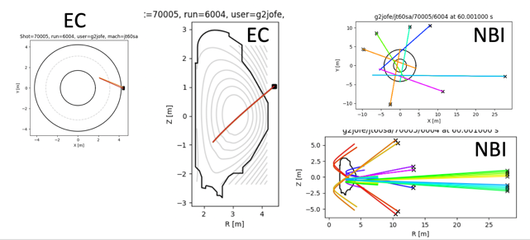
Easy exchange of modules in IMAS
Modelling JT60SA scenarios of the Initial Research Phase I and II
with the European Transport Simulator (version 5.4.0 + CDBM)
The CDBM module provided by M. Honda has been made IMAS compatible and plugged into ETS
This allowed to carry out simulations of JT-60SA Scenario 5
J. Ferreira

Slide 21
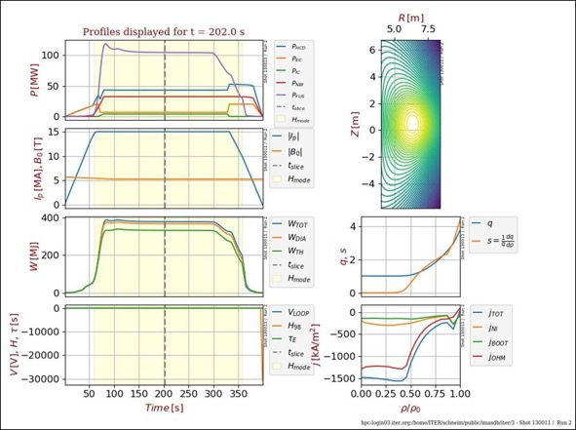
ITER modelling with ETS-6
ITER baseline scenario (thanks to Mireille)
input from METIS
at ITER: public/130011/1
With the ETS
Testing current diffusion
Testing H&CD
These are first results; to be verified!

Slide 22
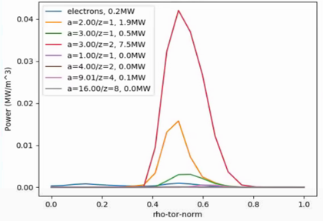
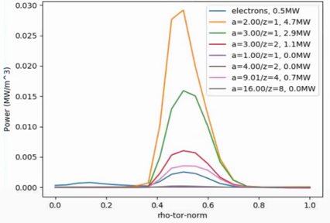
ITER, preliminary results: ICRH
Coupling: ICCoup
Wave solver: Cyrano
Fokker-Planck: StixRedist
Power is absorbed main on the He3.
Collisional redistribution to D and T.
WAVE
DAMPING
D
PLASMA HEATING
He3
T

Slide 23
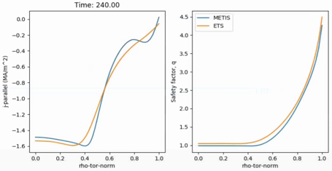
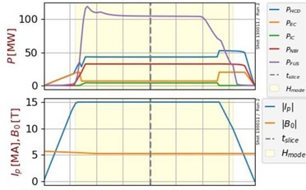
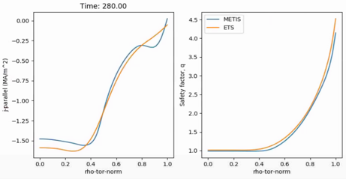
ITER, preliminary results: Current diffusion
Time window 200 - 300 s
Spitzer resistivity with toroidicity
After initial transients we reach a state similar to METIS
METIS REFERENCE

Slide 24
Summary
2019 achievement:
Data mapping of JET/MST in IMAS completed at the level of running ETS and the Equilibrium/MHD stability workflows for all EUROfusion devices
ETS-5 released and validated on experimental data
Nominated ETS TRO in support of the exploitation of ETS
2020 goal:
Release of ETS-6, fully IDS-compatible with pedestal/edge model
Release of the Turbulence and Synthetic Diagnostics (TurbSynD) workflow
Full deployment of the equilibrium and MHD stability workflow (EQMHD)
Consolidate the use of ETS for physics study – ETS-TRO
ETS/ EQMHD collaboration with KSTAR/DIIID/JT-60SA/ITER
“Thanks to theyr wide use in EUROfusion and beyond, ETS / EQMHD will provide Europe with the most advanced and validated workflows for ITER / JT-60-SA predictions and DEMO design” – M. Romanelli

Slide 25
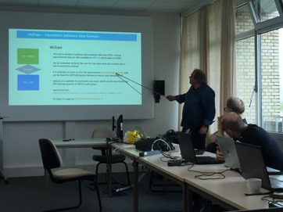
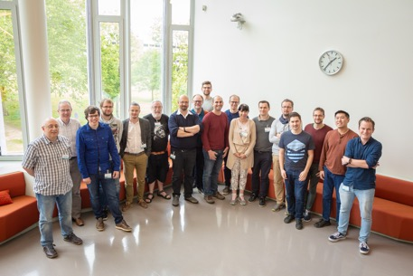
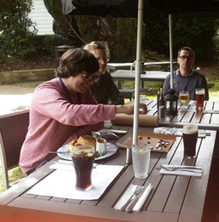
Big thank to the WPCD contributors!

Slide 26
WPCD documentation and media
The WPCD documentation has been organised in two repositories with different functionalities:
Public pages with workflow documentation and project information at
https://wpcd-workflows.github.io
Internal pages on EUROfusion wiki with tasks documentation, presentations, reports, discussions etc. at
https://users.euro-fusion.org/iterphysicswiki/index.php/WPCD:_Code_development_for_Integrated_modelling
Discussion amongst developers and amongst developers and users are taking place in a dedicated Skype Channel and on slack
https://app.slack.com/client/T3QB59XSR/C3QUJV5DL
A YouTube channel has been setup for hosting demonstration-videos as part of the documentation
https://www.youtube.com/channel/UC0rwQ4Wc6in5bInIUVgK8dw?view_as=subscriber
A Tweeter account has been setup for communication with the public on results, achievements, events linked to the WPCD activity
https://twitter.com/WpcdW

Slide 27
Journal Publications in 2019
Code Integration, Data Verification and Models Validation using the ITER Integrated Modelling and Analysis System (IMAS) in EUROfusio, M. Romanelli et al, Fusion Science and Technology, Submitted
Theory of ion matrix sheath dynamics, L. Kos, and D. D. Tskhakaya, AIP Advances, https://doi.org/10.1063/1.5017654
Analytical study of statistical error in coupled finite-volume/Monte Carlo simulations of the plasma edge, M. Baeten et al, Contribution to Plasma Physic, https://doi.org/10.1002/ctpp.201700177
Multiscale modelling for tokamak pedestals, G. Abel et al, Journal of Plasma Physic, https://doi.org/10.1017/S0022377818000326
Energy levels, oscillator strengths, radiative transition probabilities, level lifetimes and electron-impact excitation rate coefficients for Ne-like Mo XXXIII, C. Lorga, and V. Stancalie, Atomic Data and Nuclear Data Tables,https://doi.org/10.1016/j.adt.2019.07.001
Post-Processing for ITER Scrape-Off Layer Plasma Simulations (SOLPS-ITER), D Penko et al, Journal of Fusion Energy, Submitted
2D full-wave simulations of conventional reflectometry using 3D gyro-fluid plasma turbulence, J. Vicente et al, Plasma Physics and Controlled Fusion,https://doi.org/10.1088/1361-6587/ab5fa8

Slide 28
Conference Presentations in 2019
Synthetic conventional reflectometry probing of edge and scrape-off layer plasma turbulence J. Vicente et al, 3rd European Conference on Plasma Diagnostics (ECPD), Lisbon, Portugal, Oral
Modeling ICRH and ICRH-NBI synergy in high power JET scenarios using ETS, P. Huynh et al, 23rd Topical Conference on Radiofrequency Power in Plasmas, Hefei, China, Poster
Full-wave simulations of conventional O-mode fixed frequency probing of plasma turbulence with REFMUL/GEMR codes, J. Vicente et al, 14th International Reflectometry Workshop, Lausanne, Switzerland, Oral
Status of Code Integration, Verification and Validation in EUROfusion, M. Romanelli et al, 3rd IAEA Technical Meeting on Fusion Data Processing, Validation and Analysis, Vienna, Austria, Oral
The study of L-mode filament dynamics using synthetic and experimental BES diagnostics, O. Asztalos et al, 3rd IAEA Technical Meeting on Fusion Data Processing, Validation and Analysis, Vienna, Austria, Oral
Effect of the penalized limiter-shaped heat sink for adiabatic electrons on particle transport in global gyro-kinetic simulations, P. Donnel et al, 46th Conference on Plasma Physics (EPS), Milan, Italy, Oral
Interaction of energetic particles from neutral beam injection with Alfvén Eigenmodes in JT-60SA, R. Coelho et al, 46th Conference on Plasma Physics (EPS), Milan, Italy, Poster
The study of L-mode filament dynamics using synthetic and experimental BES diagnostics, O. Asztalos et al, 46th Conference on Plasma Physics (EPS), Milan, Italy, Poster
First applications of the ICRF modelling code PION in the ITER Integrated Modelling and Analysis Suite, L. Arbina et al, 46th Conference on Plasma Physics (EPS), Milan, Italy, Poster
Multi-machine analysis of EU experiments using the EUROfusion Integrated Modelling (EU-IM) framework, G.L. Falchetto et al, 46th Conference on Plasma Physics (EPS), Milan, Italy , Poster
Full exploitation of the HYMAGYC code for a shaped cross section scenario, G. Fogaccia et al, 46th Conference on Plasma Physics (EPS), Milan, Italy, Poster
Study of Alfvénic modes driven by energetic particles using the code HYMAGYC for the NLED AUG testcase and DTT equilibria, G. Vlad et al, 46th Conference on Plasma Physics (EPS), Milan, Italy, Poster
The initial step towards JOREK integration in IMAS, D. Penko et al, 46th Conference on Plasma Physics (EPS), Milan, Italy, Poster
Application of BES synthetic diagnostics for the study of SOL filament dynamics on the EAST tokamak, O. Asztalos et al, 14th International Symposium on Fusion Nuclear Technology (ISFNT), Budapest, Hungary, Poster
Core-Edge-SOL interplay of turbulence in global and flux-driven gyrokinetic simulations, E. Caschera et al, 18th European Fusion Theory Conference (EFTC), Ghent, Belgium, Oral
Ion cyclotron resonance heating modelling of JET, ITER and DEMO scenarios within the EUROfusion Integrated Modeling (EU-IM) framework, D. Van Eester et al, 18th European Fusion Theory Conference (EFTC), Ghent, Belgium, Oral
Supporting IMAS actors & the European Transport Solver in OMFIT, O. Meneghini et al, 61st Annual Meeting of the APS Division of Plasma Physics, Fort Lauderdale, Florida, USA, Poster
An open-source python/cython library for synthetic tomography diagnostics on tokamaks, Laura S. Mendoza et al, Pyconfr, Bordeaux, France, Oral
ITER data infrastructure and mapping of experimental data and machine description into a shared data format, J. Hollocombe, 24th International Conference on Computing in High Energy and Nuclear Physics (CHEP 2019), Adelaide, Australia, Poster

