Slide 1
EWE - Enabling workflow exploitation - a brief summary
P. Strand (EWE coordinator), F. Imbeaux (EWE-1 task leader),
R. Coelho (EWE-2 task leader), J. Ferreira (EWE-3 task leader), A.H. Nielsen (EWE-4/WIMAS-3 task leader reported in WIMAS)
M. Romanelli (EWE-5 task leader, not reporting here)

Slide 2
EWE-0 Reflections
Useful feedback and requests from Task force Leaders
Mixed bag of requests for new features and general modelling support
Challenge is to extract the gaps in the current (EWE) tools and properly prioritise and resource any needs. Noted requirements
Benchmarking/validation of tools
Some enhancements of existing modules
New features
Manpower for development is scarce and activities need to be selected for impact
General modelling support is a slightly different activity
We do have manpower for support and training
Modellers formally comes from elsewhere
Need to have new structures set in place (á la ETS4JET?)

Slide 3
EWE-0 Reflections
Interesting talk from ITER
Taking on an alternative approach to application implementation
Alleviates some of the rigidness of Kepler, introduces a host of new features/issues
Developer centric (err in the same way as ITM)
Python based
Builds on EUROFusion (kepler( support line but strong decoupling activity ongoing.
WPCD need to reflect and act on this (cmp David Kepler vs Python) discussion
What is the strategic intentions of EUROfusion with the ITER support
Being involved and providing the support is clearly very important!
What is the balance of gain? What is the ROI?
Who, what or where is the prioritizations between ITER and WPCD made?
I think that a strategy that puts WPCD back in focus is needed

Slide 4
EWE-0 Action
Becoming more agile - user stories
We are not always very good at selecting and acting on requests
After an interesting discussion yesterday we agreed to evaluate doing requirements in term of user stories: Rather than a request in the form:
Neo for W modelling (J. Garcia)
An equivalent user story could then be
“I, J. Garcia as the JET TFL responsible for ETS4JET activity, would like to see ETS simulations of tungsten discharges with the NEO code. This is to evaluate the effect of poloidal asymmetries and contrast the result to other codes lacking these features.”
I.e. who, what and why is more easily expressed. We still need to properly break down this into requirements and actionable items (and an assessment criteria!) But the process becomes more structured.
EWE-0 will review and decide on a way to start doing these from a) the current requirement list and b) the JET, MST, SA list of suggested neds.

Slide 5
EWE-0 Action
Becoming more agile - user stories
We are not always very good at selecting and acting on requests
After an interesting discussion yesterday we agreed to evaluate doing requirements in term of user stories: Rather than a request in the form:
Neo for W modelling (J. Garcia)
An equivalent user story could then be
“I, J. Garcia as the JET TFL responsible for ETS4JET activity, would like to see ETS simulations of tungsten discharges with the NEO code. This is to evaluate the effect of poloidal asymmetries and contrast the result to other codes lacking these features.”
I.e. who, what and why is more easily expressed. We still need to properly break down this into requirements and actionable items (and an assessment criteria!) But the process becomes more structured.
EWE-0 will review and decide on a way to start doing these from a) the current requirement list and b) the JET, MST, SA list of suggested needs.

Slide 6
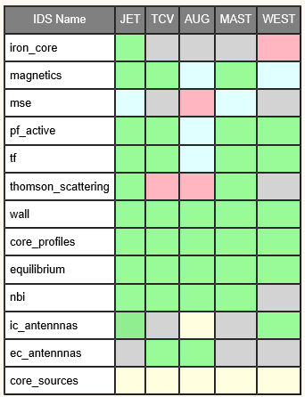
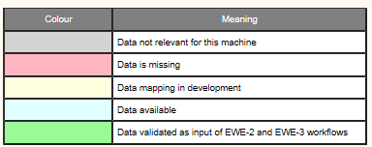
Overall EWE-1 status : data available in IMAS form
Initial experimental input datasets provided for all machines
Iterative process with EWE-2-3 is ongoing to test / extend the datasets as required*
There are some missing information in the IDS access that are filled/hidden by the processing pipeline
WIMAS requirements should be formally submitted (gforge/feature requests?)
Continued work on EWE-4 (now as WIMAS-3)

Slide 7
Present main activities
EWE-3 : core_profiles and equilibrium quantities ok for most machines, validated by ohmic simulations. Simulations with additional heating also available, still in the process of adding H&CD input data.
EWE-2 :
Equilibrium reconstruction from magnetics : validation ongoing, cocos checking, etc …
Addition of HRTS data ongoing for pressure constraint; MSE on the forge (private PPFs…)
Create GIT repos on the Gateway to host data import source code (TRVIEW for AUG, tcv2ids for TCV)
Provide simpler commands and documentation for user’s production
EWE-2 and EWE-3 data don’t always use the same import methods → activity on harmonizing the frontends

Slide 8
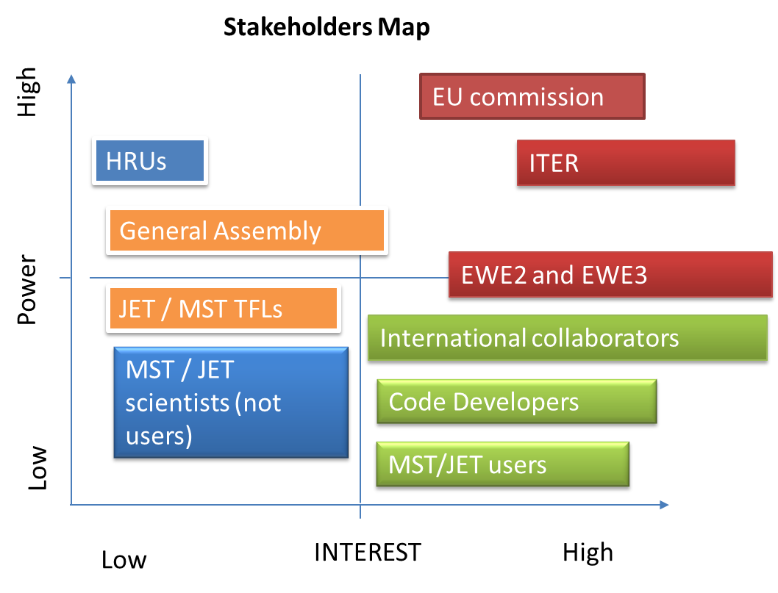
Plans for 2020
Requirements of Key Stakeholders for Task EWE-1
EWE-2 : add pressure and MSE measurements for additional constraints on the equilibrium
EWE-3 : additional H&CD data
Data import tools under GIT
Data import tools documented and easy to use
Developer/User
Data must be verified with EWE-2/EWE-3

Slide 9
Timeline for 2020
 | Jan | Feb | Mar | Apr | May | Jun
Common | Go to Lisbon | … | Agree with EWE-2 & EWE-3 on data import procedure for exploitation | More uniform scripts for executing data import + documentation
AUG | Work to restore communication via UDA plugin for AUG | … | Validated magnetics data for EWE-2. TRVIEW under GIT | NBI/beamlet data in IMAS | Thomson scattering data for EWE-2 | ICRH and ECRH data in IMAS
JET | Validated magnetics data for EWE-2 | … | NBI/beamlet data in IMAS | Validated MSE and Thomson scattering data for W2 | ICRH data in IMAS

Slide 10
Timeline for 2020
 | Jan | Feb | Mar | Apr | May | Jun
MAST | Validated magnetics data for EWE-2 | … | NBI/beamlet data in IMAS | Validated MSE and Thomson scattering data for EWE-2 | ECRH and ICRH data in IMAS | …
TCV | Validated magnetics data for EWE-2 | NBI/(single) beamlet and ECRH data in IMAS. (DONE) | GDAT under GIT | Thomson scattering data and core_sources | … | …
WEST |  | Restored remote data access | Validated magnetics data for EWE-2 (COCOS) | Refined ICRH data in IMAS | Polarimetry data in IMAS | …

Slide 11
Timeline for 2020
 | Jul | Aug | Sep | Oct | Nov | Dec
AUG | New requests from EWE-2 and EWE-3 | Holidays | New requests | New requests | New requests | New requests
JET | New requests from EWE-2 and EWE-3 | Holidays | New requests | New requests | New requests | New requests
MAST | New requests from EWE-2 and EWE-3 | Holidays | New requests | New requests | New requests | New requests
TCV | New requests from EWE-2 and EWE-3 | Holidays | New requests | New requests | New requests | New requests
WEST | New requests from EWE-2 and EWE-3 | Holidays | New requests | New requests | New requests | New requests

Slide 12
EWE-2: why and by whom
Title: Enabling the exploitation of the equilibrium reconstruction and stability workflow 2019
Strongly dependent of EWE-1 (data), WIMAS-1 (workflows) and IMAS-RO (IDSs)
CD.M37 | Enabled use of ETS workflow for interpretative transport analysis in JET (EWE-3) | Dec 2019
CD.M38 | Enabled use of equilibrium and MHD stability workflow for analysis in MST1/JET (EWE-2) | Dec 2019
… | … | …
CD.M41 | Enabled use of ETS workflow for interpretative transport analysis in MST1 and PFC (EWE-1, EWE-3) | Dec 2020

Slide 13
Plans/wish list for 2020
Equilibrium reconstruction
Conclude EFIT++ integration in IMAS.
First trials of mild IMAS version of CLISTE with py3 driver (until an AUG safe plug-in IMAS version is not ready – CLISTEprep less obvious than foreseen…).
Do we have SOL current placeholder in IDSs ? No.
EQUAL/NICE with MSE, polarimetry (Stokes model in NICE) → pending data availability
Kinetic constraint (pressure) on reconstruction
Not obvious for more than on system. JET with HRTS at first.
Include pf_active%circuit (needed by EFIT++, not used – but should – by others)
Not trivial to get right polarities e.g connection matrix, turns with sign, current,…
Include pf_passive currents (missing in %constraints though...)
MHD stability
RHOMASS actor in KEPLER compiled/generated/tested → fill equilibrium mass_density as required from species+density of core_profile.
Sanity check for adherence to experimental scenarios e.g. Ip/Bϕ sign and mode spectra.
Revive complex valued MHD.
J-alpha relies on ascii IDSs (for agile orchestration) – for the moment CPOs and already in use for JET analysis (interpretive scenarios)
Continue exploitation on current “partnerships” (WPJET1, WPSA)
Notes:
Jbs model include and current diffusion – request by H.Meyer

Slide 14
WPCD and the community
Stakeholders Map
High
General Assembly
EU commission
HRUs
ITER
JET / MST TFLs
Power
EWE Task Coordinators
International collaborators
MST / JET scientists (not users)
Code Developers
Low
MST/JET users
INTEREST
Low
High
Notes:
The HRUs have ultimately decisive power since they can rule out the possible contributors to the tasks.

Slide 15
Plans for 2020
Requirements of Key Stakeholders for your Task
JET
Eq. reconstructions with kinetics, MSE, Polarimetry
Codes are ready (April WS)
EFIT++ (by April WS ?)
q-markers (placeholder ?)
MHD stability
Linear MHD on mode analysis
JETTO/ETS to populate CPOs/IDSs
Jalpha
Only CPOs feasible – ASCII CPOs
MST1
CLISTE up and running
SOL currents (magnetics IDS ?)
Py3 driver for now…
ITER
Eq.reconstruction (flyby no storing of device data)
Doable, no put() after read
MHD stability workflow
Showcased already in ITER cluster, want full availability.
WPCD
MHD stability
EQSTABIL in use already (CPOs)

Slide 16
Conclusions
EWE-2
Equilibrium reconstruction and MHD stability workflows released in imasenv 3.25.0
Testers finally available to improve user experience/tuning particularly useful for equilibrium reconstruction.
Staged process dependent on several mods needed in the actors to comply with platform/data changes.
Time now to consolidate/deliver with additional features as available.

Slide 17
Timeline for 2020 – EWE-2
2020 Timeline for your task
 | Jan | Feb | Mar | Apr | May | Jun
R. Coelho | WS - Workflow release, magnetics DD | DD discuss and planning | Test AUG eqconstruction | WS – kinetic recons. | ITER WS
M. Dunne | WS - Workflow test (AUG) + ReadAUG | ReadAUG clean-up | ReadAUG clean-up | WS – kinetic recons. CLISTE |  | CLISTE on AUG - how
O. Sauter | magnetics DD
A. Merle | WS – Workflow test (TCV). Magnetics DD |  |  | WS – kinetic recons.
L. Kogan | WS – Workflow test (MAST) |  | Help EFIT++ | WS – kinetic recons.
E. Giovannozzi | - | CLISTE plan | CLISTE IDS adherence | WS – CLISTE |  | CLISTE on AUG - how
P. McCarthy | - | CLISTE plan |  | WS – CLISTE |  | CLISTE on AUG - how

Slide 18
Timeline for 2020 – EWE-2
2020 Timeline for your task
 | Jul | Aug | Sep | Oct | Nov | Dec
R. Coelho | - | - |  | Test add-on features | Final Releases
M. Dunne | - | - |  | Test add-on features | CLISTE w/o prep. in IDS
O. Sauter | - | -
A. Merle | - | - |  | Test add-on features
L. Kogan | - | - |  | Test add-on features (?). EFIT++ on MAST/JET (?)
E. Giovannozzi | - | - |  |  | CLISTE w/o prep. in IDS
P. McCarthy | - | - |  |  | CLISTE w/o prep. in IDS

Slide 19
EWE-3 Plans for 2020
Exploitation of ETS in support of JET and MST1
JET
In coordination with ETS4JET and JET Task Force leaders
assess the progress of the JET modelling
support the ETS modellers and the ETS TRANSPORT RO
main goals: DT predictive modelling, NTMs, and impurity transport
MST1
In coordination the MST1 Task Force leaders
we should create the ETS4AUG and ETS4TCV groups
assess the progress of the AUG and TCV modelling
continue to support the AUG and TCV data mapping
main goals: a full interpretative flat-top with all H&CD systems for AUG and TCV

Slide 20
EWE-3 Plans for 2020
Development needs
There are a few gaps in the input data
Continue to improve the capability and robustness of our tools.
Bugs in ETS can block users
These have been fixed by developers and CPT, but we don’t have enough human resources to continue to support both the maintenance of ETS v5 (CPOs) and the development of ETS v6 (IMAS).
Lack of essential actors can diminish the exploitation of ETS
Develop actors needed to fulfill the requirements, in coordination with WIMAS-2, and using resources from this task. These actors should be ported to IMAS (within WIMAS-2)

Slide 21
EWE-3 Plans for 2020
EWE-3 Stakeholders Map
High
EU Commission
General Assembly
HRUs
EWE-1 and WIMAS-2/4
JET / MST1 TFLs
Power
ITER
Code Developers
MST / JET Collaborators
JET / MST Modellers
Low
International collaborators
INTEREST
Low
High

Slide 22
EWE-3 Plans for 2020
Stackholders requirements
EU Commission and ITER
Code Developers
Clear development strategy (needs)
A functional gateway
Support from Core Programming Team (CPT) for tools and IMAS suite
MST / JET Modellers and International collaborators
A good set of run examples
Clear documentation
Training sessions
Quick response from WPCD &CPT to trouble tickets (issues found)
General Assembly and JET / MST1 TFLs
Tools for tokamak modelling
Clear reporting of results
Clear document
EWE1 and WIMAS - 2/4
Verification and validation of JET/MST imported data
ETS simulated data for V&V and benchmark of ETS-6 for relevant scenarios of all EUROfusion devices

Slide 23
EWE-3 Timeline for 2020
 | Q1 | Q2 | Q3 | Q4
Jorge Ferreira (0.3 ppy) Rui Coelho (0.1 ppy) |  |  | …
Giovanni Tardini (0.1 ppy) David Coster (0.1 ppy)
Olivier Sauter (0.05 ppy) Antoine Merle (0.05 ppy) (Frida Eriksson) |  | … | … | …
Stuart Henderson (0.1 ppy) (Michele Romanelli) (Nathan Cummings) |  |  |  | …
Philippe Huynh (0.3 ppy) Ludovic Fleury (0.1 ppy)
Silvana Nowak (0.1 ppy)
Irena Ivanova Stanik (0.2 ppy) Michal Poradzinski (0.4 ppy)
Par Strand (0.1 ppy) Emil Fransson (0.1 ppy) Thomas Johnson (0.05 ppy) (Dimitriy Yadykin)
ETS dev
ETS dev & maintance, EWE-3 coordination
Core-edge dev
Support AUG / MST1 modelling when needed - data
Support TCV / MST1 modelling when needed – data
Test of the NTM stabilization/control
TCV modelling
Support JET modelling when needed - data
ETS dev
ETS data translation tools
JET DT + ICRH/NBI synergy
WEST with ICRH + LH simulator
Support WEST modelling when needed - data
NTM modelling
Impurity transport for JET, AUG and TCV
ITBs in JET
Impurity transport for JET&MST
ETS dev
ETS training
ETS training
ETS dev
ETS training
ETS dev
ETS training
Total ppy: 2.15
EWE-3 member
External member to EWE-3

