Slide 1
Fusion Science Department, simulation and Theory in Horizon Europe
By Xavier LITAUDON

Slide 2
Fusion Science Department: Major objectives during Horizon Europe
From ITER Design, Construction to Operation
As a consequence the programme will strengthen
Operational aspects: control for Disruption, Power flux on PFC using MST, JET and JT-60SA including nuclear aspects (DT at JET)
Modelling capability: preparation of operation and extrapolation to ITER /DEMO
→ Maximise EU return for the large EU investment into ITER
ITER scenario to be significantly developed for DEMO and FPPs
integrated approach for the physics studies for ITER and DEMO (similar tools)
focus on aspects beyond ITER (no ELMs, disruption free, radiative scenarios, high beta): benefit ITER phase of operation beyond Q=10
Develop an alternative to conventional exhaust as risk mitigation for DEMO
→ Optimise DEMO schedule once ITER objective fulfilled in the first phase of operation
stellarator as an alternative approach to address tokamak challenges
disruptions and steady state operation
FP9 a decisive period for stellarator M8

Slide 3
Fusion Science Department: High level Objectives in Horizon Europe
Prepare ITER operation with experiments and simulation
Solve tokamak limits and improved control
disruption, ELMs, Exhaust & PFC, long pulse operation
Physics basis for burning plasma
Consolidate DEMO physics basis with experiments and simulation
ELM-free scenarios and divertor compatibility
Integrated real time control under DEMO constrains (disruption free scenario, highly radiating plasmas, detachement control )
PFC qualification under high fluence
Implement an alternative path to conventional exhaust for DEMO
Lay down the physics and engineering basis for stellarator as an alternative approach for DEMO

Slide 4
Fusion Science Department: High level deliverables in Horizon Europe
EU team with experience on JT-60SA operation and return of experience for efficient EU participation in ITER
EU strategy and plans for ITER operation
Control strategy to handle disruptions, transient and heat exhaust
ITER radiative scenarios with metallic wall in D-D & D-T plasmas
Validated simulation tools for ITER and DEMO design
DEMO Integrated conceptual design and validated scenarios
Select alternative divertor concept & Design DTT prototype divertor
Long pulse operation with actively cooled divertor (W7-X, WEST)

Slide 5
Fusion Science Department: Proposed Modifications of the present implementation
New name / grouping | Old name / grouping | Comments
Tokamak and Stellarator Exploitation, Theory, Simulation, Verification & Validation (TSVV)
Tokamak Exploitation & TSVV | JET1, MST1, MST2, WEST | Collegium of TFLs
SA (JT-60SA Exploitation & TSVV) | SA | Since this is differently organised at present (via F4E) for the time being a separate work package is proposed, but in the future this may merge with Tokamak Exploitation
W7X (W7-X Exploitation & TSVV) | S1, part of S2 | Part of S2 activity included in the S1/TSVV tasks under E-TASC and the other part under SPPS
Theory & Simulation | Theory & Simulation E-TASC | E-TASC Scientific Board – also responsible for the selection of ENR proposals in this category
Advanced Computing (AC) | CD, ISA, HLST, CPT | CD, HLST, CPT and stellarator theory will be absorbed in this; the activities towards IMAS should be properly embedded in the Advanced Computing Hubs
Plasma Wall Interaction and Exhaust |  | Bureau-like Project Board (10 persons)
Plasma Wall Interaction and Exhaust (PWIE) & TSVV | PFC, JET2 and ADC - Physics
Support of the ITER Research Plan |  | EUROfusion needs to be in the NBTF Steering and Advisory Committees – no separate Project Board
Support of the ITER Research Plan (SIRP) & TSVV | ITER simulation (CD), JET3, NBTF, ITPA | New WP in FP9

Slide 6
General principles- Theory and Simulation programme
Innovative theory and simulation research is performed when driven by the scientists and engineers themselves
Nevertheless, the production of a new portfolio “EUROfusion standard software” requires a more directed approach
To accommodate both, two inter-linked structures:
Theory-Simulation-Verification-Validation Tasks within the relevant WPs;
Advanced Computing Hubs (~ 5) which provide computer science, scientific computing, data management, code integration, and/or software engineering support for the TSVVs and the entire EUROfusion theory/simulation program → develop a new portfolio of EUROfusion standard software.
Preparation in 2019-2020 and to prepare next Horizon Europe
E-TASC scientific board
Pilot TSVV tasks launched in 2019 and new tasks in May 2020
Call for Hosting Advanced Computing Hubs in 2020

Slide 7
Theory and Simulation programme : Challenges to be addressed in Horizon Europe for ITER and DEMO
Validated predictive capability of the L-H transition and pedestal physics in ITER and DEMO (including ELMs, control and avoidance)
Validated predictive capability for heat exhaust in ITER and DEMO (conventional/alternative divertor configurations)
Integrated modelling of plasma-wall interactions in ITER & DEMO (incl. HELIAS)
Integrated modelling of disruptions in ITER & DEMO (incl. their prediction, mitigation, and avoidance)
Integrated modelling of burning plasmas in ITER & DEMO (incl. HELIAS)
Validated framework for the reliable prediction of plasma performance and operational limits, including stellarator performance limitations
Materials modelling in support to ITER, DONES and DEMO
Multi-fidelity system code for DEMO
[E-TASC GA report Dec. 2018 & Report by TAG sub-group Assessment of PPP&T DEMO modelling needs 2020]

Slide 8
Healthy mix of coordinated de-centralized and centralized efforts in a virtuous cycle
E-TASC Scientific Board
M2, M8 Pedestal-SOL, exhaust, PWI
M3 Materials,neutronics
M1, M8 Core-pedestal
M4-M7 Engineering
TSVV Tasks
Code integration, integrated modelling, and control (IMAS…)
Advanced Computing Hubs
Code development and deployment on HPC platforms
HPC & mid-range facilities
Data analysis (incl. AI) and management
EUROfusion “standard codes” for ITER operation and DEMO design
Validated models for ITER & DEMO

Slide 9
Six ACHs including the JET data center
Optimised codes for HPC:
scalable algorithms, code parallelization & performance optimization, code refactoring, GPU-enabling etc.
Integrated Modelling and Control:
code adaptation to IMAS, IMAS framework development etc.
EUROfusion data including the JET data:
data access, data management, data analysis tools, aspects of AI and VVUQ etc.
The Technical University of Denmark (DTU) will be in charge of the JET Data Centre that will host all JET data

Slide 10
Integrated modelling and control activity within the ACH
Provide integration of modules in the IMAS workflows as they get used for Tokamak modelling and take into account changes in the Data Dictionary and computational environments
Develop and maintain tools for mapping of experimental data
porting of codes in IMAS, and providing Kepler and Python actors,
Integration of Kepler and Python actors in IMAS workflows including the European Transport Solver, the EQSTABIL, fast-ions, core-edge and synthetic diagnostics,
Provide training and support to EUROfusion users of IMAS and workflows for their validation on JET, MST, JT-60SA data and extrapolation towards ITER/DEMO
Provide users support for the exploitation of the EUROfusion workflows via dedicated Technical Responsible Officers
Develop new workflows

Slide 11
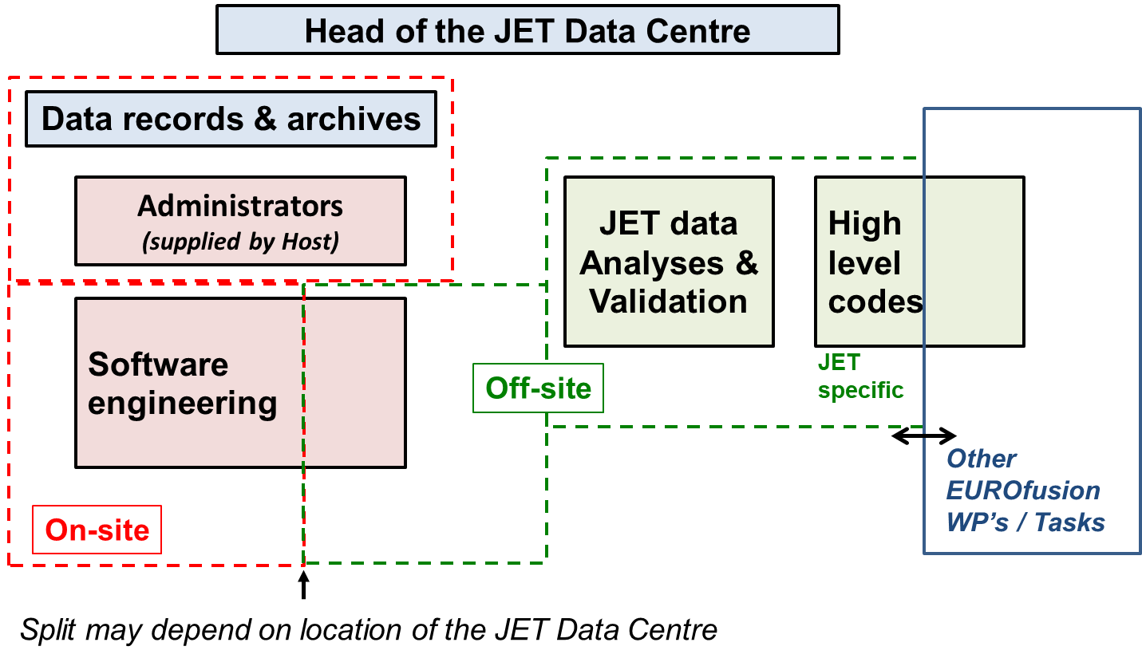
JET data center- Structure

Slide 12
Preparation of ITER operation
To develop the EUROfusion ITER data analysis tools within IMAS for the first phase of ITER operation and design ITER operational scenarios through modelling activities using tools validated on EUROfusion experimental facilities;
To provide direct inputs and contribution to the ITER research plan;
To contribute to the activities of the ITER Neutral Beam Test Facility (NBTF) installed at Padova;
To improve our knowledge on nuclear technology and safety issues relevant to ITER and DEMO, to validate nuclear codes and to reduce the risks of ITER operations and maintenance activities by taking advantage of JET DT operation

Slide 13
Preparation of ITER operation
Exploitation of ETS, and the various IMAS workflows in support of the ITER Research Plan in collaboration with ITER-IO Simulation and Theory group and international community
Develop ITER data analysis tools including breakdown simulation tool and synthetic diagnostic for the initial plasma operation
Design operational scenario for ITER from breakdown to termination while respecting the plan limits (e.g. PF circuits) with free boundary equilibrium and realistic transport, inclusion of validated sources for heating & current drive, fuelling. The activity will include development of tools to enable pre-pulse validation on ITER
The development of theory and computational tools will be coordinated by the E-TASC scientific board and specific TSVV tasks are embedded within the WP.

Slide 14
Conclusion
FP-9 preparation with the full roadmap implementation
strong theory and modelling programme is essential because empirically-based predictions are uncertain in unexplored environments like ITER and particularly DEMO, and this will be a stronger focus than foreseen earlier
Set-up a new initiative within E-TASC to strengthen the theory and simulation programme:
Advanced Computing Hubs, and JET data center TSVV
Your inputs are extremely valuable to prepare this transition
I wish you a successful meeting

