Slide 1
WIMAS-7: Plugins and support for visualization tools in IMAS
L. Kos, D. Penko (University of Ljubljana)
and WIMAS-7 Plugins and support for visualization tools in IMAS Task Force
WPCD Annual Planning Meeting, 24-28 February, Frascati, Italy

Slide 2
IMAS Plugins and Viz support overview
ParaView plugins (in C++ and Python) https://git.iter.org/projects/BND/repos/solps-gui/browse/src/plugins
General Grid Description (GGD) support https://git.iter.org/projects/IMEX/repos/ggd/
IMASViz plugins https://git.iter.org/projects/VIS/repos/viz/
SALOME environment for pre- and post-processing with VirtualGL on NoMachine NX https://git.iter.org/projects/BND/repos/smiter
AppImage support for GUI (SMITER, SOLPS-GUI) including EMC3-Eirene, Cherab, Raysect, Elmer, SMARDDA, ...
Plugins and support for visualization tools in IMAS – service activity
Team (UL) 0.4ppy:
Leon Kos
Dejan Penko (WPISA)
Gregor Simič
Ivona Vasileska
Task page
https://users.euro-fusion.org/iterphysicswiki/index.php/WIMAS-7_Plugins_and_support_for_visualization_tools_in_IMAS

Slide 3
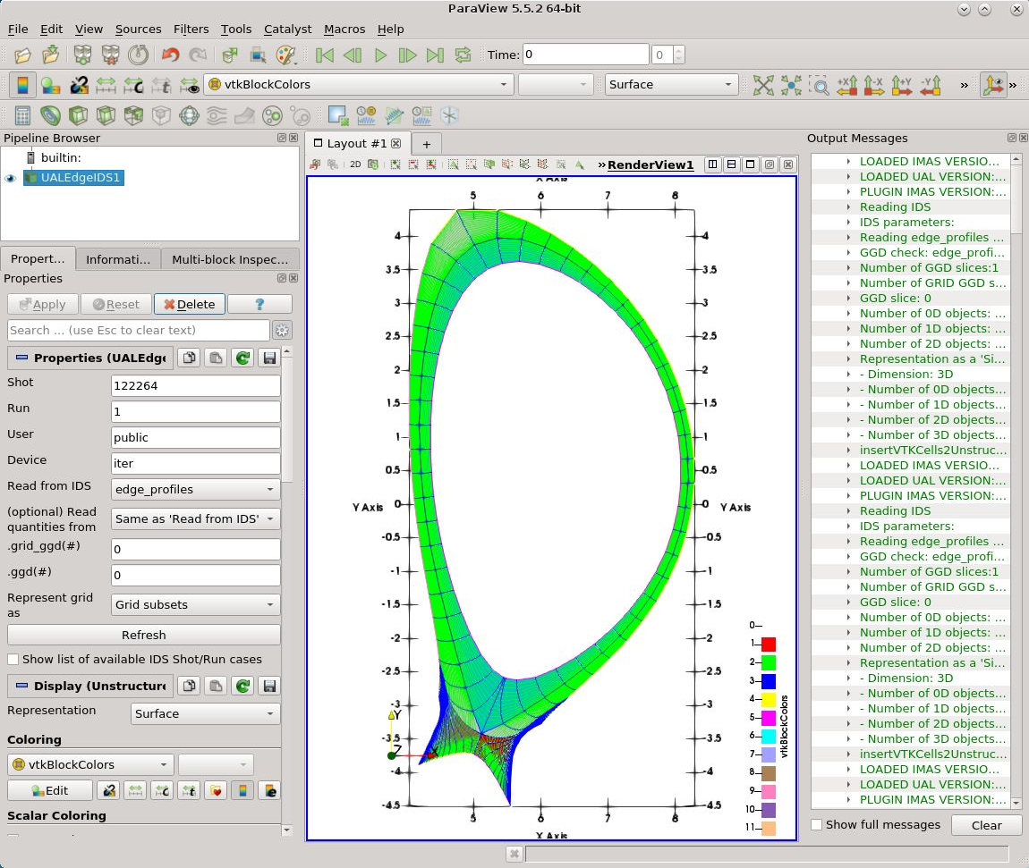
ParaView plugins - Status
ParaView is an open-source, multiplatform application used to visualize data sets
ParaView allows the development and use of user-made plugins (C++ and Python)
One of such plugins (which relates to IMAS and IDSs) is the ReadUALEdge plugin (C++)
Default ReadUALEdge plugin view for opened SOLPS-ITER IDS case (on ITER HPC; Shot: 122264; Run: 1; User: public; Device: iter)

Slide 4
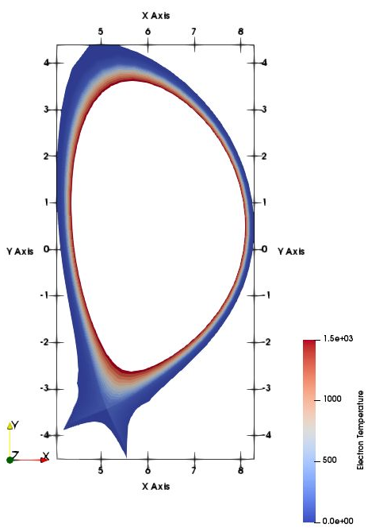
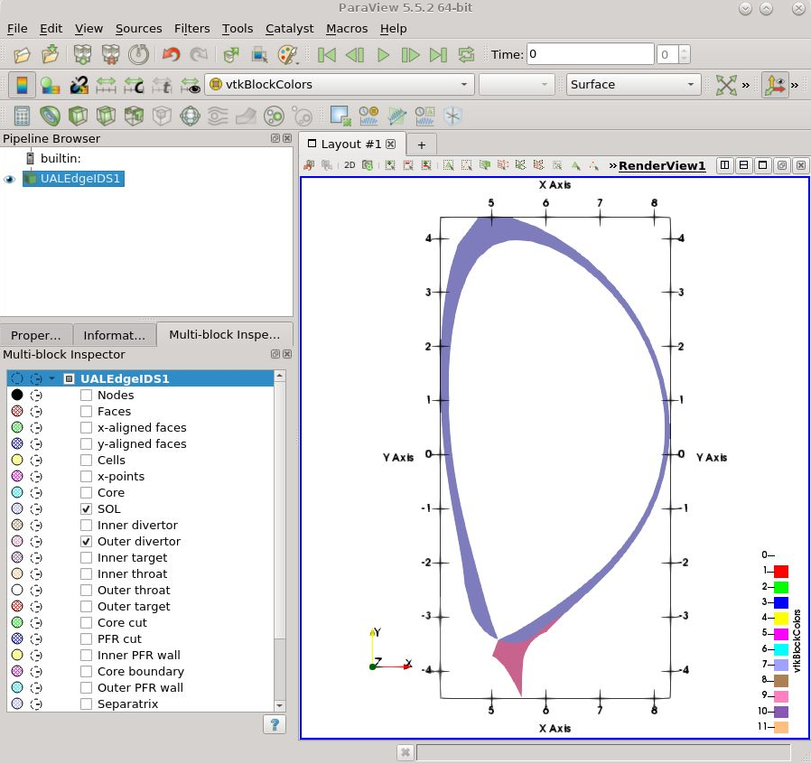
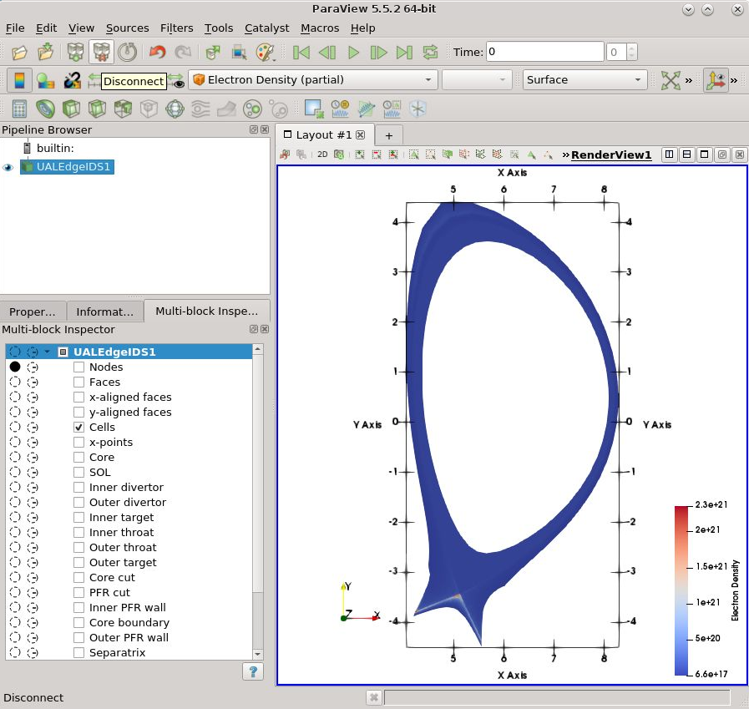
ParaView - ReadUALEdge plugin status
Interactive selection of available grid subsets and physics quantity arrays.
An example displaying all 2D quad elements in the domain and corresponding electron temperature values

Slide 5
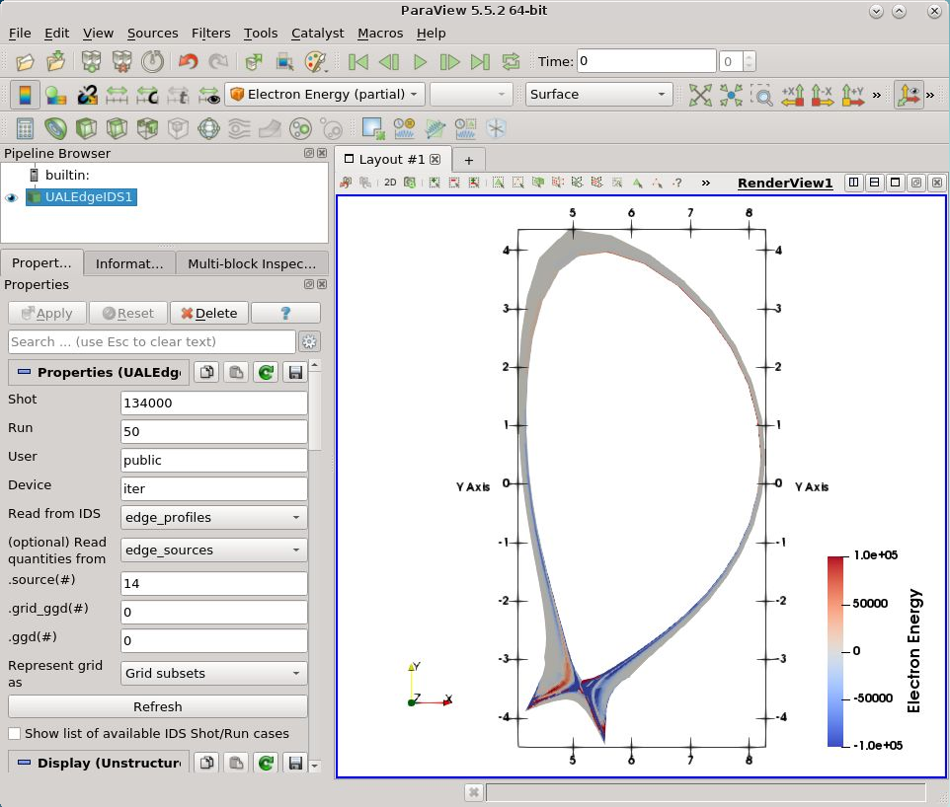
ReadUALEdge plugin status (new)
Support for the latest IMAS versions (IMAS 3.26.0; UAL 4.5.0)
Support for Edge Sources, Edge Transport IDS and (additionally) MHD IDS
Enable reading grid geometry description (GGD) from one IDS, while taking plasma state quantities from other IDS (within the same shot/run case)
Manual available in SOLPS-GUI documentation (link) https://static.iter.org/imas/assets/solps-iter/html/tutorial/edgeualplugin/index.html
JINTRAC EDGE2D case example (on ITER HPC; Shot: 122264; Run: 1; User: public; Device: iter) displaying grid geometry description taken from Edge Profiles IDS while plasma state quantities (electron energy) is taken from Edge Sources IDS.

Slide 6
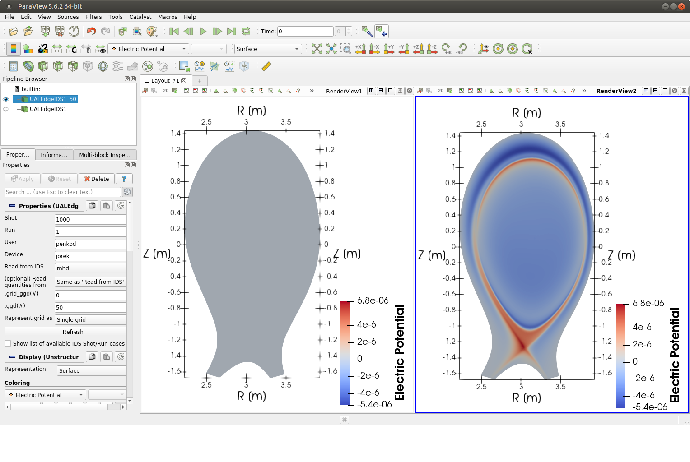
ReadUALEdge plugin status (new)
Improved support for time-dependent data
Enable representing grid as a single unstructured grid (“skipping” GGD grid subsets - required for JOREK)
JOREK (local) case example displaying Electric Potential for first time slice (left) and 51-th time slice (right, note that ParaView uses C++ notation -> indices start with 0)

Slide 7
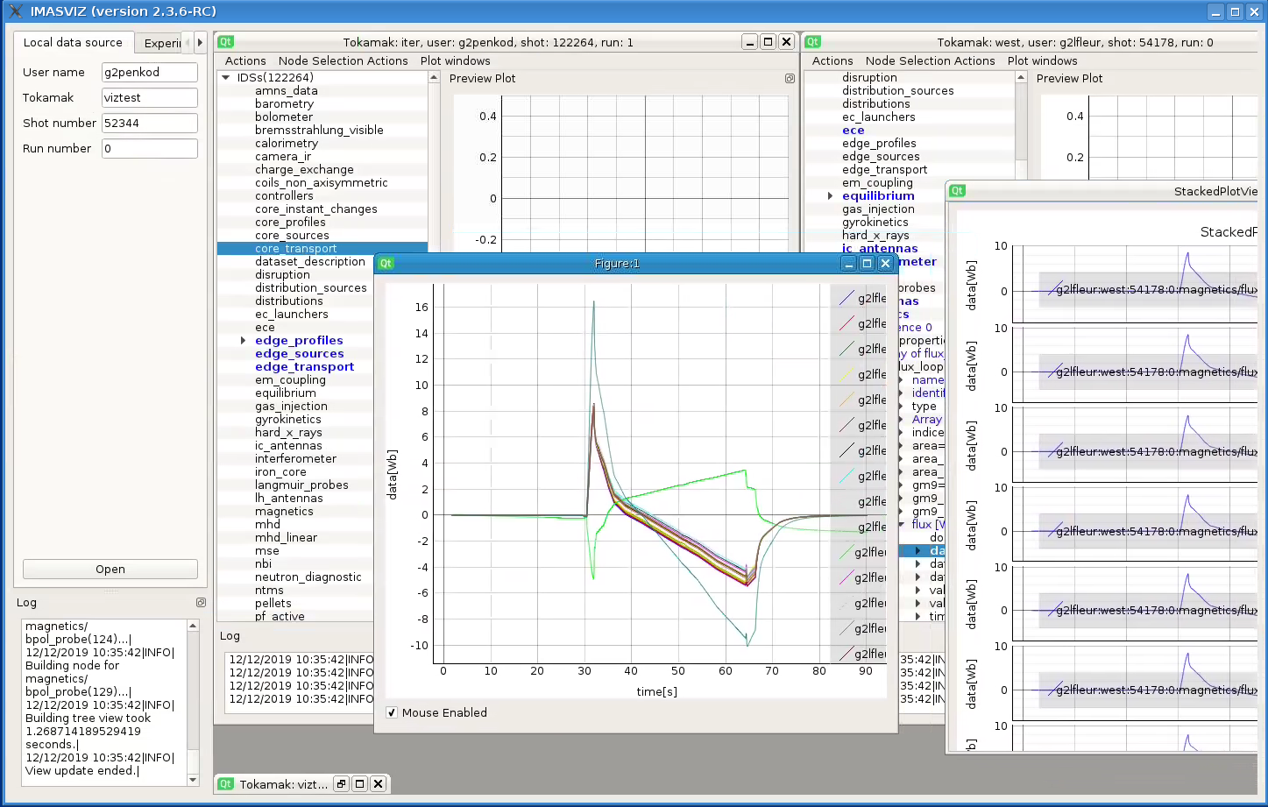
IMASViz - Overview
IMASViz is a visualization tool developed to be used within Integrated Modelling Analysis Suite (IMAS) for the purposes of visualizing static and dynamic IMAS data, stored within IMAS Interface Data Structures (IDSs).

Slide 8
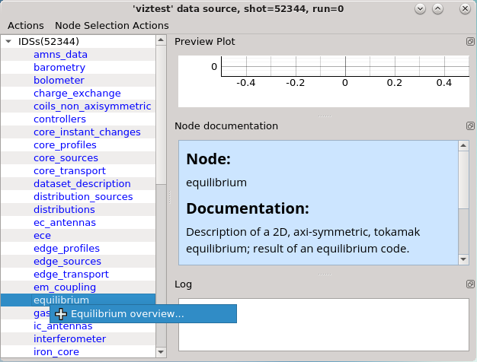
IMASViz plugins - Overview
Python3
PyQt5 GUI
Plotting utilities developed using Pyqtgraph (Python3 package, built on PyQt5, fast) and the latest Matplotlib as legacy interface
Allows the implementation of custom user-made plugins that deal with specific IDSs, extending the tools functionality. A few of such plugins are already available.
Running Equilibrium plugin from IMASViz
Main window of the Equilbrium plugin

Slide 9
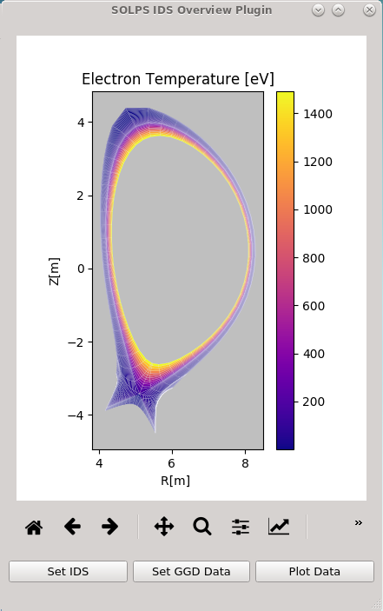
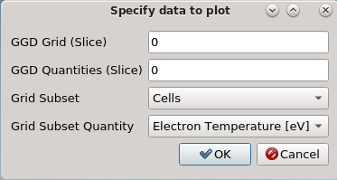
IMASViz - SOLPS Overview plugin
Allows visualization of SOL data stored in the Edge Profiles IDS, including the grid geometry from the GGD structure
Can be used within IMASViz or as a standalone application
The plugin can be used as a widget in Qt Designer
Instructions are available in IMASViz manual (link - WPCD IMASViz documentation) https://wpcd-workflows.github.io/IMASviz/howto/plugin_QTdesigner.html
SOLPS-ITER case example (available on ITER HPC; Shot: 122264; Run: 1; User: public; Device: iter) displaying 2D grid with mapped quantities - Electron Temperature

Slide 10
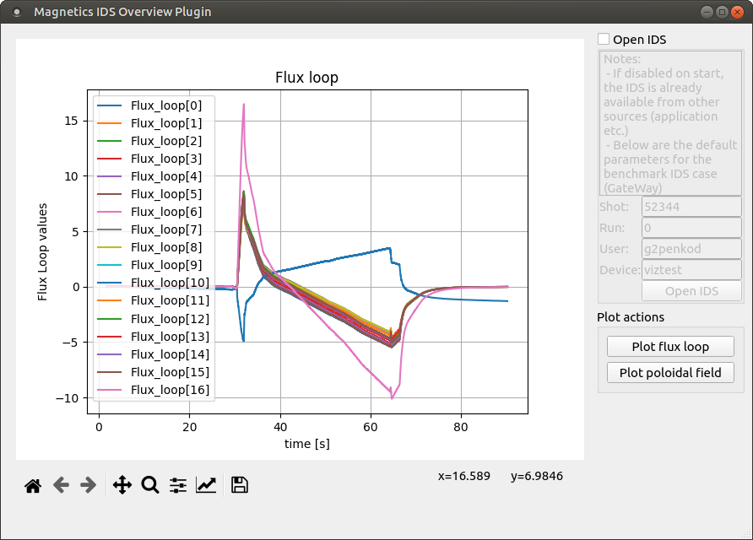
IMASViz - instructions on plugin development (1)
Prepared an extensive instructions (60 pages) on development of (advanced) plugins for IMASViz utilizing Qt Designer together with working example (e.g. Magnetics IDS overview Plugin)
Documentation is available in the HowTo section of the IMASViz documentation (link - WPCD IMASViz documentation)
Such plugins can be also run in standalone mode (without IMASViz required and inside SOLPS-ITER GUI) - interoperability
Demonstration example (available on GateWay; Shot: 52344; Run: 0; User: g2penkod; Device: viztest) plotting 1D flux loop arrays found in Magnetics IDS

Slide 11
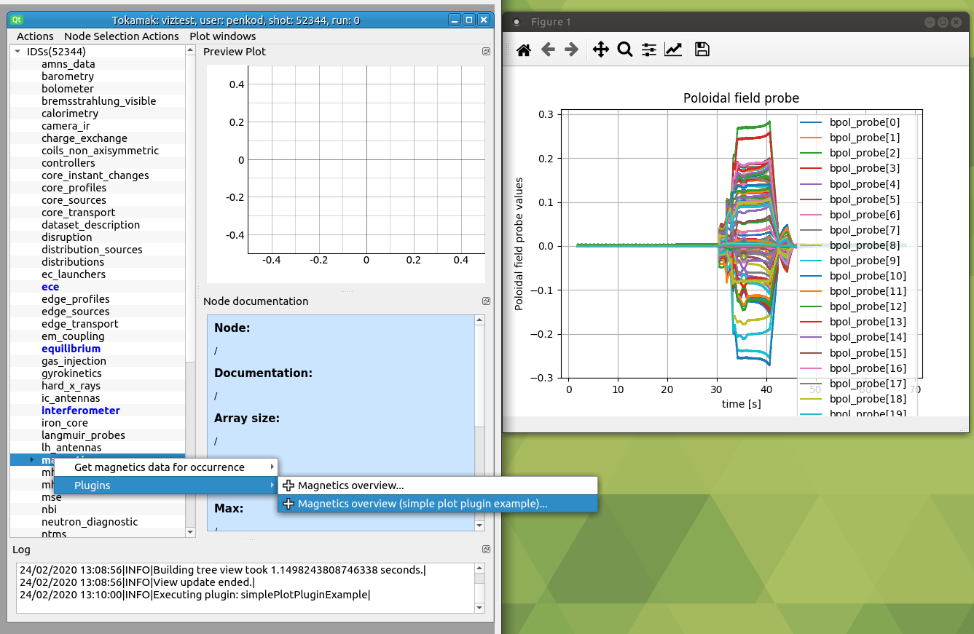
IMASViz - instructions on plugin development (2)
Prepared simpified instructions on development of introductory and simple plugins for IMASViz (~100 lines of code)
Such plugins can be also run in standalone mode (without IMASViz required)
Demonstration example (available on GateWay; Shot: 52344; Run: 0; User: g2penkod; Device: viztest) plotting all available poloidal field probe arrays in Magnetics IDS

Slide 12
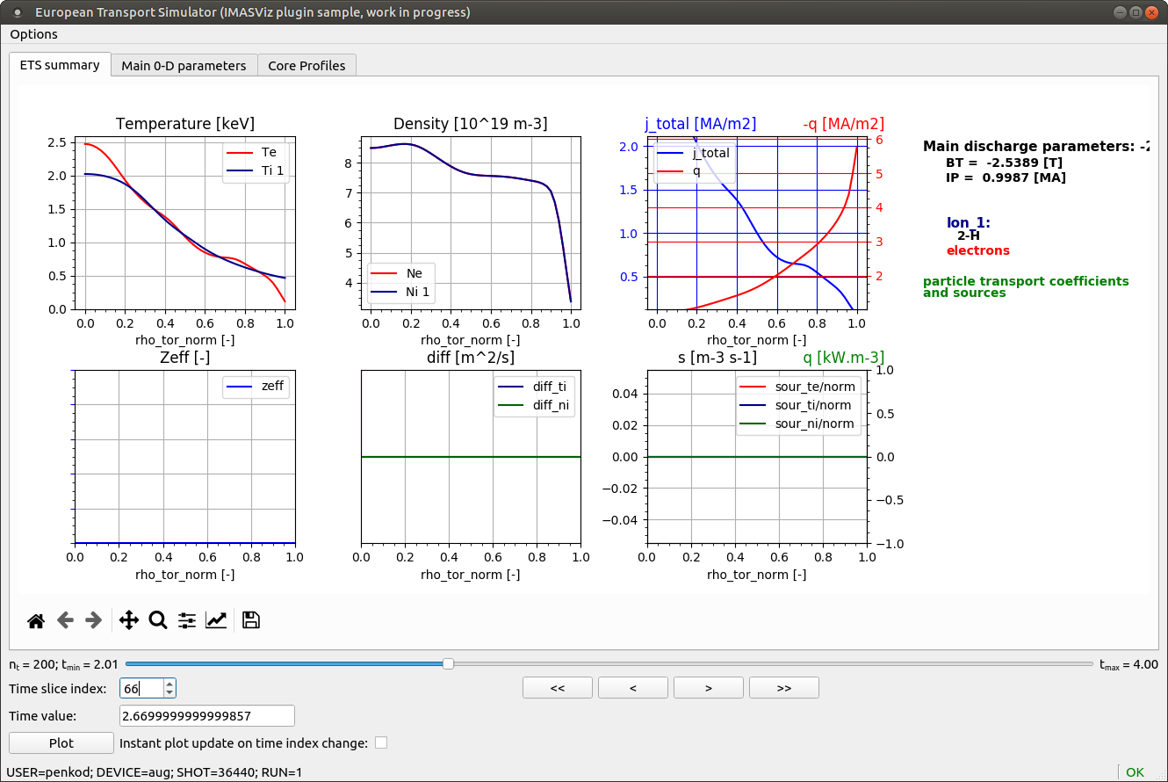
IMASViz- ETSplugin (work in progress)
Intended for IDS cases created with ETS 6.0 (after Barcelona CC)
The main plot and tab design follows the existing ETSviz (CPOs, ETS 5.x) with implementation of a few improvements (time slider, display of t_{min} and t_{max} etc.)
can be also used as independent tool (without IMASViz; code example: python3 ETSplugin.py --shot=36440 --run=1 --user=penkod --device=aug)
Overview of the present ETS plugin.

Slide 13
Plans for 2020
Identification of Key Stakeholders for WIMAS-7
Stakeholders Map
High
EU commission
HRUs
ITER
General assembly
Power
EWE 1-5
MST/JET TFLs
Code developers
MST/JET
scientists (not users)
International collaborators
Low
MST/JET users
INTEREST
Low
High

Slide 14
Plans for 2020
Requirements of Key Stakeholders for WIMAS-7
EU Commission and ITER
• Tools for tokamak modelling
• Clear reporting of results
• Clear documentation
EWE and WIMAS
Verification and validation of JET/MST imported data, and ETS modelling
Provide a set of relevant studies and benchmarks for all EUROfusion devices.
Code Developers
Clear development strategy
A functional gateway
Support from Core Programming Team (CPT) for viualization tools and IMAS suite
MST / JET Modellers and International collaborators
A good set of run examples
Clear documentation
Training sessions
Quick response from WPCD &CPT to trouble tickets (issues found)

Slide 15
Plans for 2020
ParaView plugins:
A more universal plugin (ReadUALEdge successor - ReadUALGGD outside SOLPS-ITER GUI) intended for visualization of 2D data from any IDS/GGD structure, not only the Edge IDSs (this is already partially implemented -> MHD IDS)
Improve support for time-dependant data e.g. reading all time slices at once and use them as frames for the Paraview control features
ETSplugin:
many tabs are yet to be added (“Main 1-D Parameters” etc.)
enable real-time plotting from the IDSs
Support for IMASViz plugins

Slide 16
THANK YOU FOR YOUR ATTENTION

Slide 17
Timeline for 2020
2020 Timeline for your task
 | Jan | Feb | Mar | Apr | May | Jun
Name 1 | Action | … | Action | … | Action | …
Name 2 | Action | … | Action | … | Action | …
…..
….

Slide 18
Timeline for 2020
2020 Timeline for your task
 | Jul | Aug | Sep | Oct | Nov | Dec
Name 1 | Action | … | Action | … | Action | …
Name 2 | Action | … | Action | … | Action | …
…..
….

