Slide 1
WIMAS-3:Turbulence with synthetic diagnostics workflows in IMAS
A.H. Nielsen, O. Asztalos, R. Coelho, G.I.Pokol and A.S. Thrysøe

Slide 2
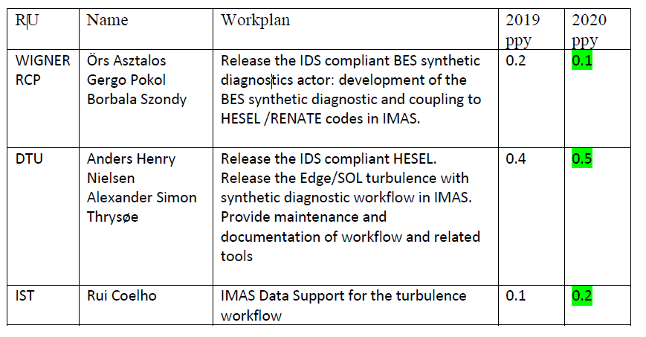
Manpower
----------------
EWE-4 (-0.5 PPY) merged with WIMAS-3 in 2020
Project Management Plan, November 2019

Slide 3
Status
HESEL code is in a Fortran workflow
HESEL output => RENATE (HDF5)
Application of SOL turbulence modeling on MST1:AUG/TCV, JET1:JET, EAST, JT-60SA and ITER
Release of RENATE-OD 1.2.0
Integration of RENATE-OD into CHERAB
Coupling of BES synthetic diagnostic to JOREK
Pedestal synthetic diagnostic modeling on JT-60SA

Slide 4
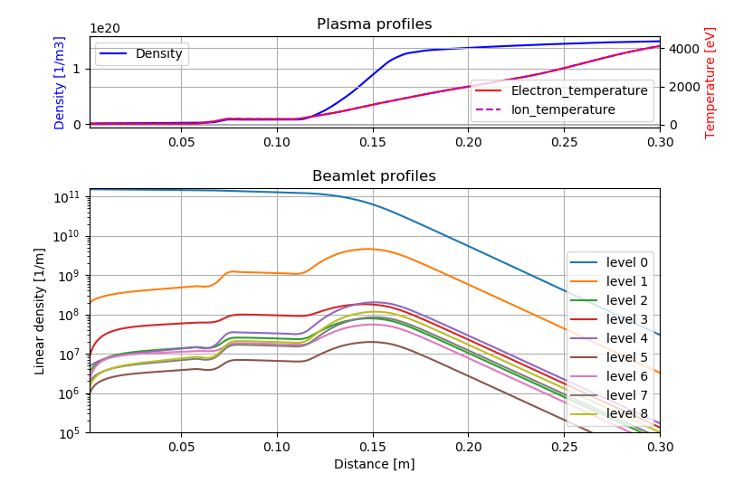
Release RENATE-OD 1.2.0
CRM expanded to handle all plasma components based on: q, Z, A
RK- 4 used to solve electron population evolution.
Direct solver needed for state evolution on density gradients.
Quasi static solver applicable to plasma states where timescale of atomic relaxation << timescale of plasma parameter changes in the frame of reference of the beam atoms
levels in dynamical balance → can apply quasi-static model (attenuation and emissivity coef.)

Slide 5
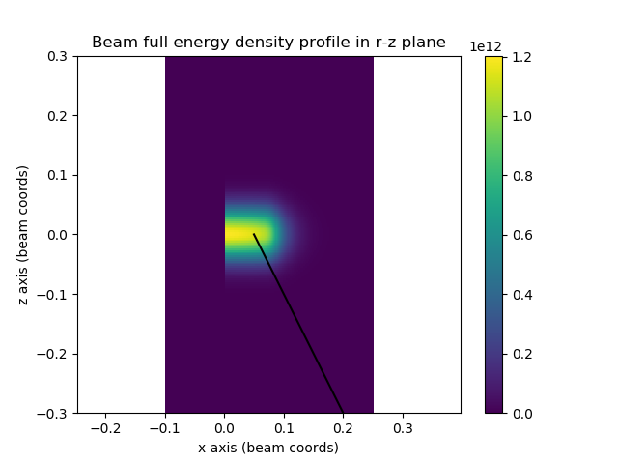
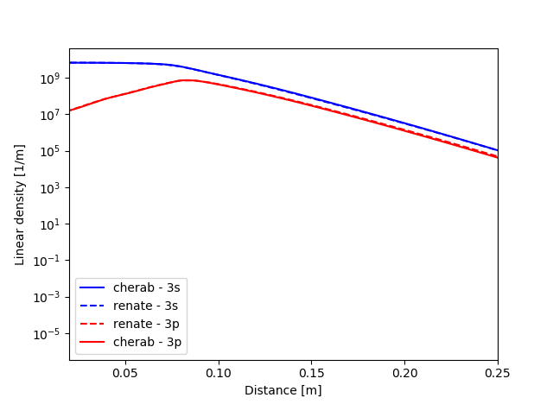
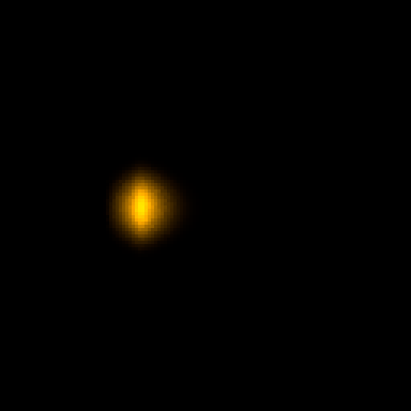
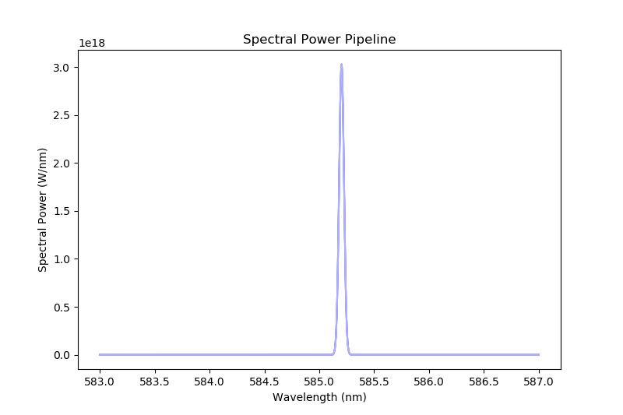
RENATE-OD integration into CHERAB
Implemented some basic test tutorials with standard CHERAB worlds.
Initiated CHERAB –> RENATE-OD calculations with 1D fluctuated profile.
Integration tests are OK.
Cleaning up of ROD wrapper before release and placing into CHERAB family.
Raysect 0.6.0
Cherab 1.2.0
Access to IMAS and IDS
Na emission
Make an actor => Risø WS

Slide 6
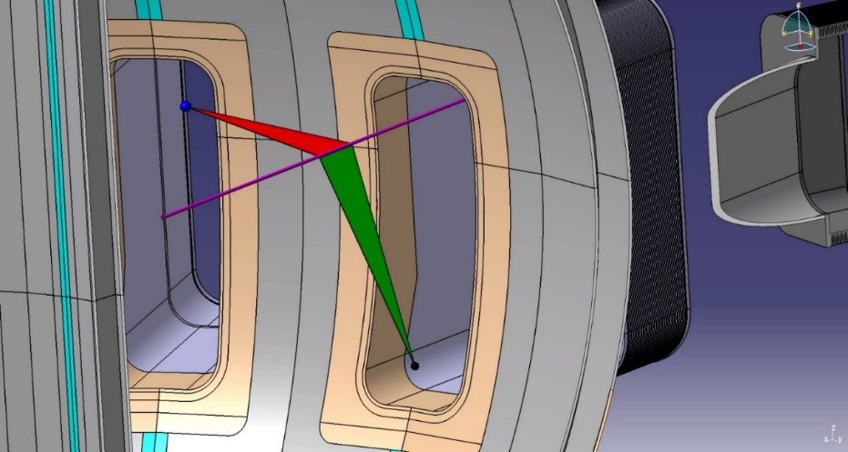
JOREK-RENATE
Application of pedestal synthetic diagnostic modeling on JT-60SA
JT-60SA LiBES observation geometries were used
Radial velocity of ELM filament
Depletion rate of pedestal density
Poloidal mode numbers calculation
JORAK simulation
LiBES

Slide 7
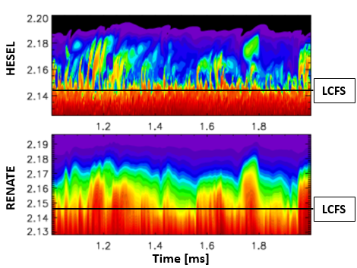
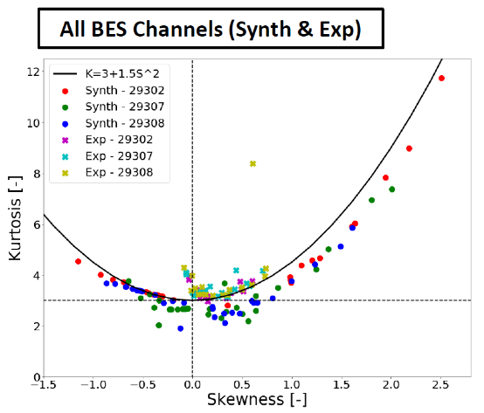
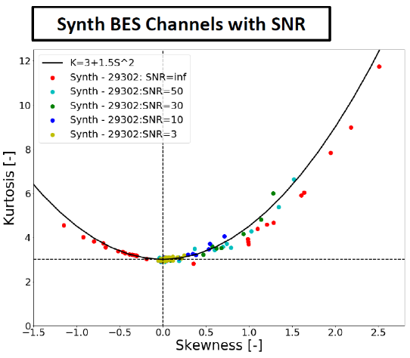
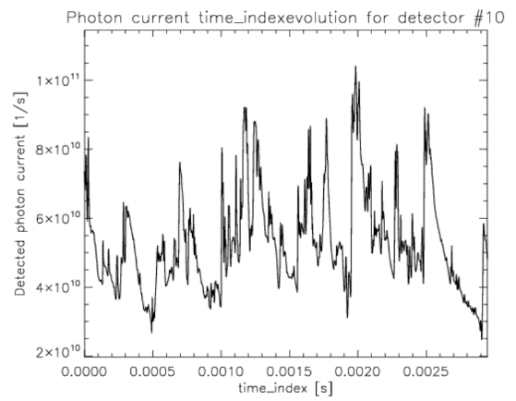
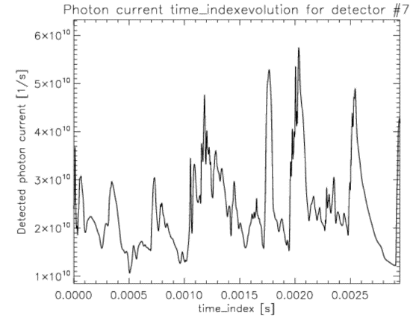
HESEL-RENATE at AUG
Application of SOL turbulence modeling on AUG
HESEL@AUG#2930[2,7,8]
Radial time-evolution plotted of HESEL density and BES signal along dotted arrow.
Filament structures are visible in BES signals.
Spatial artefacts of diagnostic smear filament.
Tilt of structures shows radial propagation of turbulent structures.
Current optical resolution is set at 2 cm.
Noise modelling improved agreement in signal statistics
Asztalos 46th EPS 2019, Nielsen NF 2019, Nielsen IAEA-FEC 2018
IAEA-FEC 2020 and EPS contributions
LCFS
SOL
Gamma distributed

Slide 8
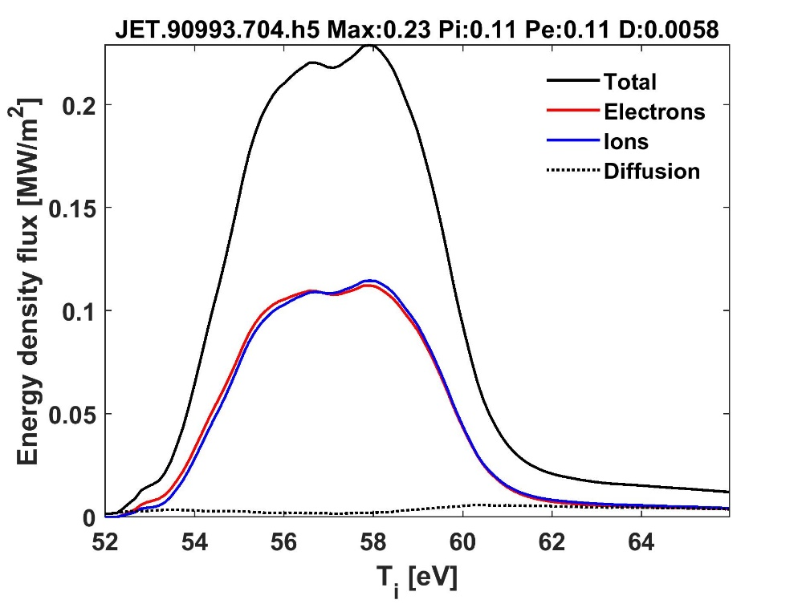
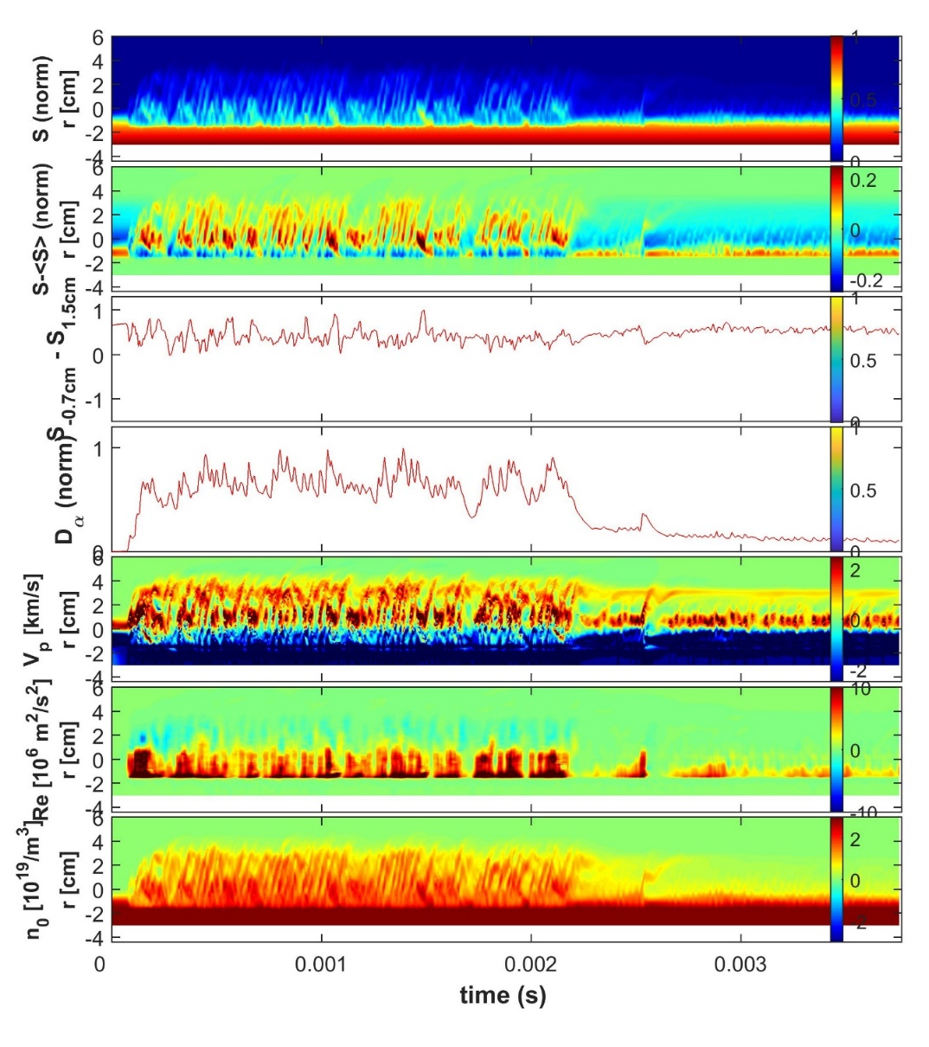
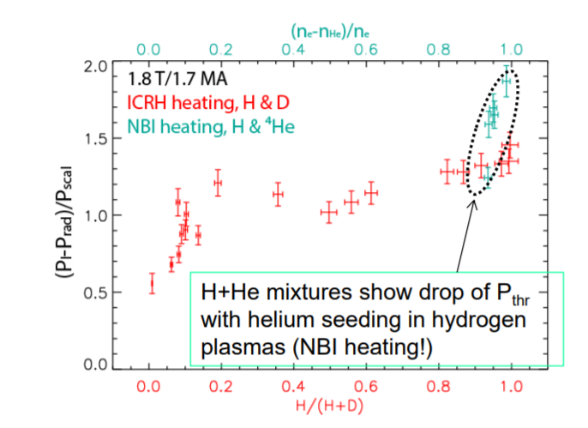
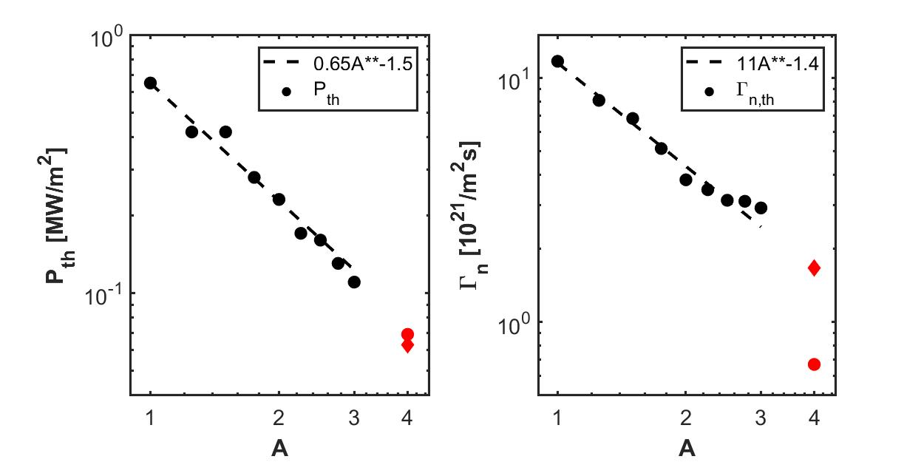
HESEL@JET#90993 – L2H transition
HESEL-RENATE at JET
L H
M18-14 : Isotope effects on L-H transition power threshold
A = 2
P_{L2H} ~2pi(R+a)a
~ 6 MW
T_{i} = α time
Pth~1/A
Temporal evolution of radial profile
JET experimental observations

Slide 9
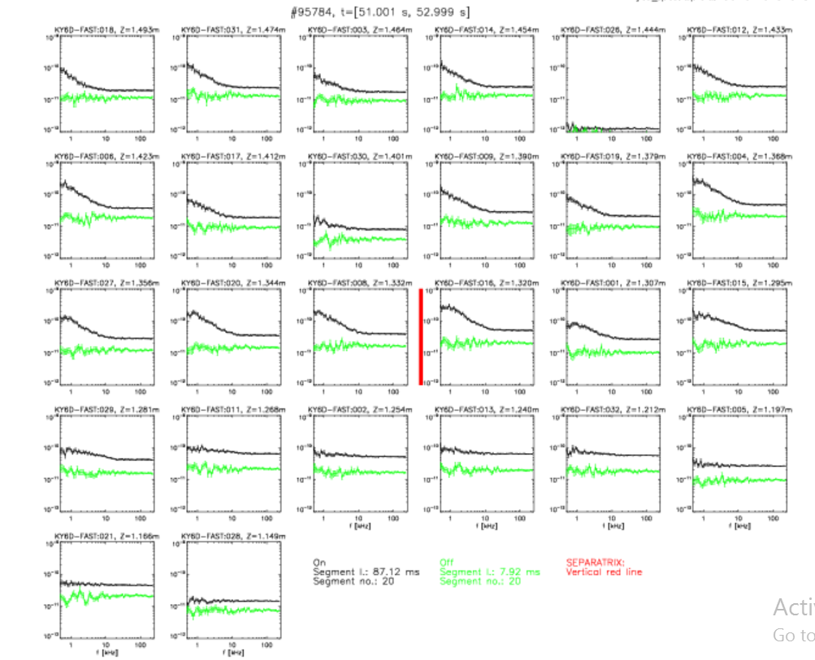
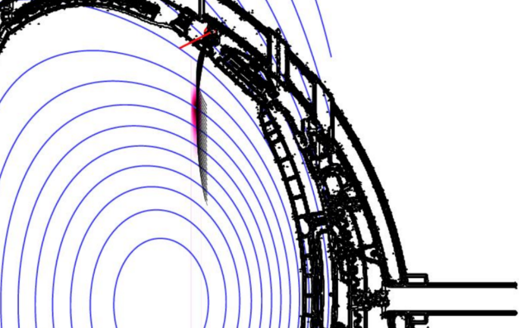
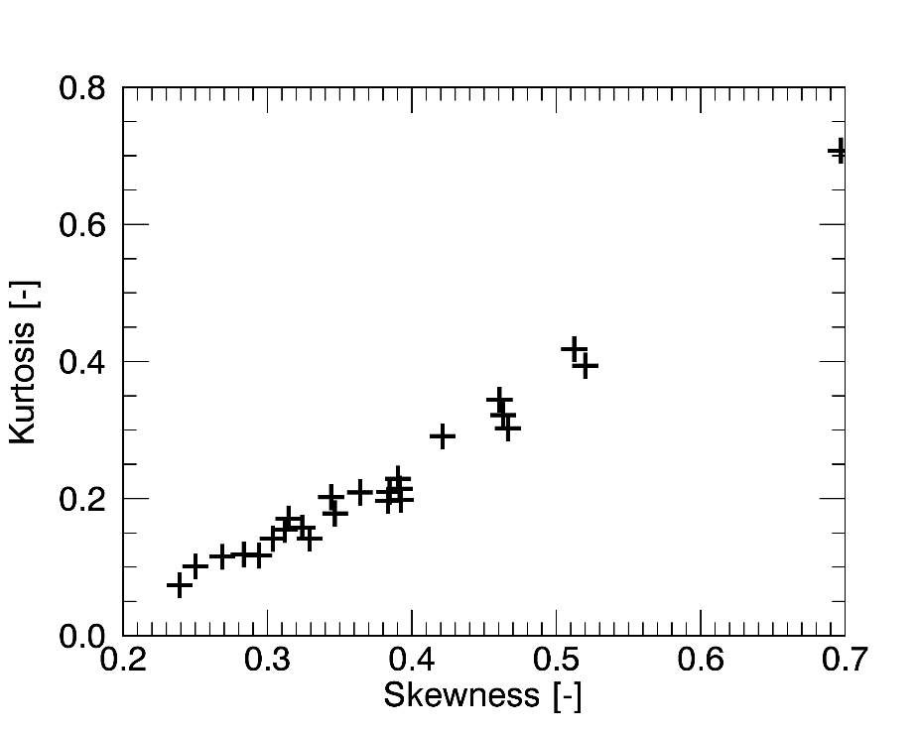
HESEL-RENATE at JET
SOL
Background light
BES light
Edge
Shot #94049 (L – mode plasma):
Power spectra shot clear distinction of BES signal from background signal.
SOL channels show strong broadband spectral activity up to 5kHz.
Skewness of SOL channels increases radially.
Individual filament detection is NOT YET resolved.

Slide 10
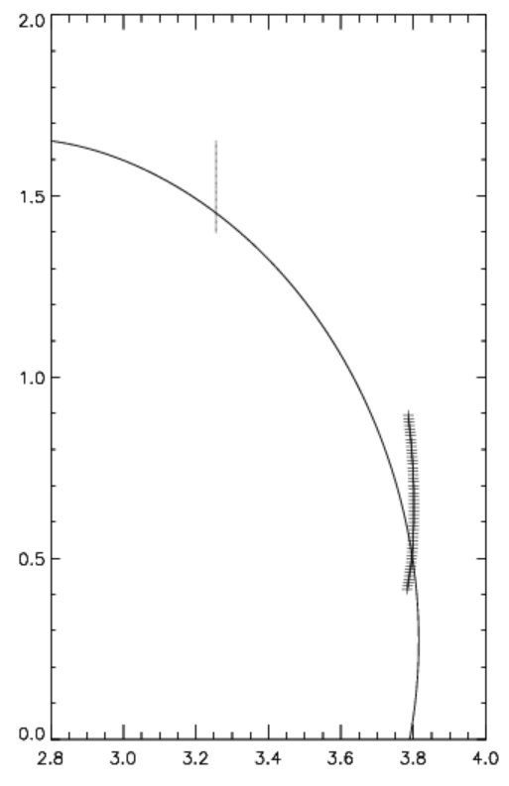
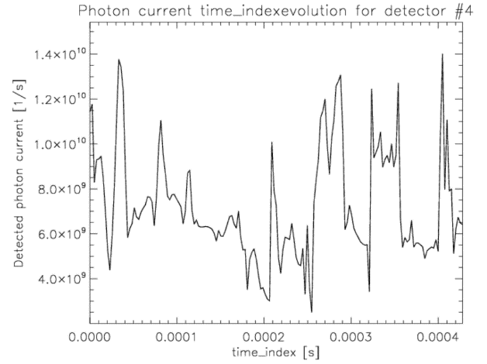
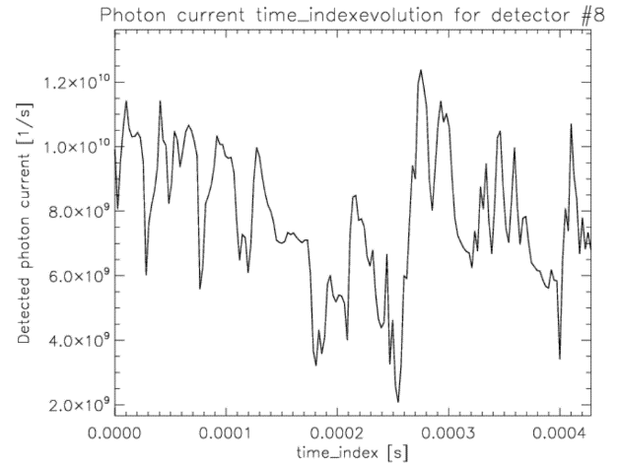
HESEL-RENATE at JET
Field line projection
Beam geometry projection:
HESEL models turbulence in poloidal plane on outer midplane.
Turbulence mapped to beam geometry along field lines.
Vertical range of observed region doubled by field line tracing onto HESEL poloidal plane.
Slab geometry has to extended considerably and curved to fit LCFS
Projection length along field line: 7 – 9m dependent of magnetic geometry.
Interpretation of filament detection and propagation is still underway.
Preliminary synthetic diagnostic runs shot reasonable time-signals (no photon noise was added)
BEAM

Slide 11
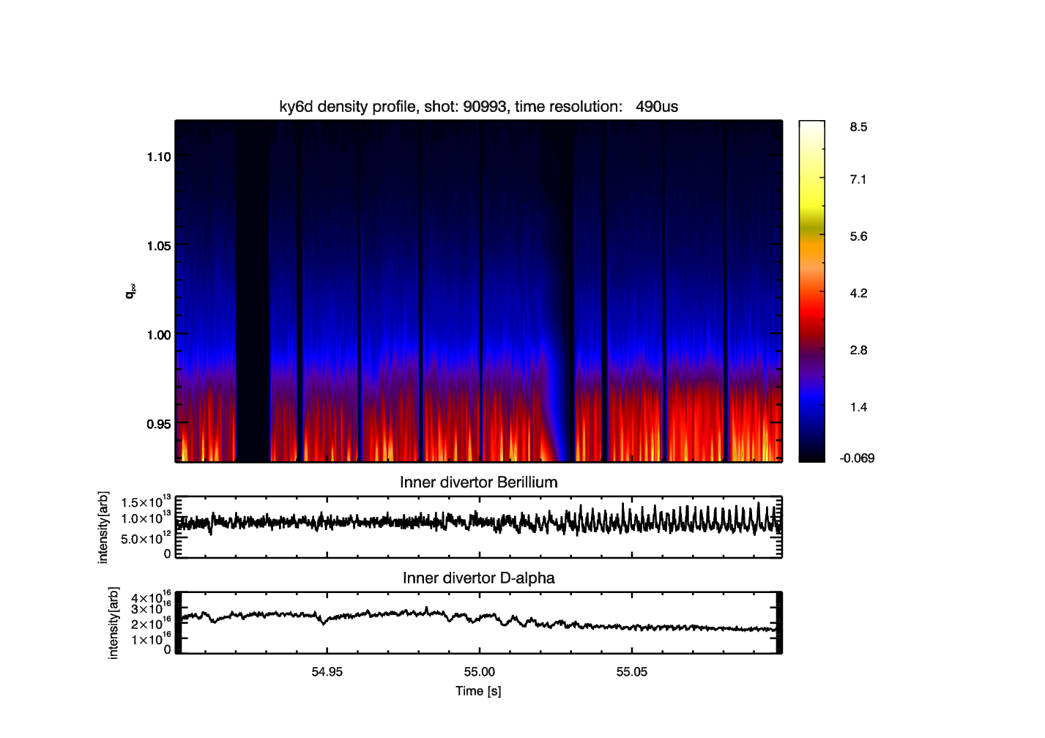
M18-14 : Isotope effects on L-H transition power threshold
HESEL-RENATE at JET
JET Li-BES data analysis during the L-H transition to be compared with HESEL EDGE/SOL simulations – synthetic diagnostics in HESEL
Dániel Imre Réfy, KFKI, Wigner-RCP, HAS
Analyzed 90993 and 90999
BUT terrible SNR
Issues detect fluctuations
Isotope campaign M18-14
90993, 90994, 90995, 90996, 90997, 90998, 90999, 91000, 91015, 91016, 91017, 91018, 91019, 91021, 91022, 91023, 91112, 91114, 91115, 91116, 91117, 91118, 91119, 91120, 91121, 91123, 91125, 91126, 91127, 91253, 91447, 91466, 91468, 91469, 91470
Li-BES data
Very good shot, Good shot, Acceptable shot, Failed shot
RENATE: Gergo Pokol and Örs Asztalos
Budapest University of Technology and
Economics, Hungary

Slide 12
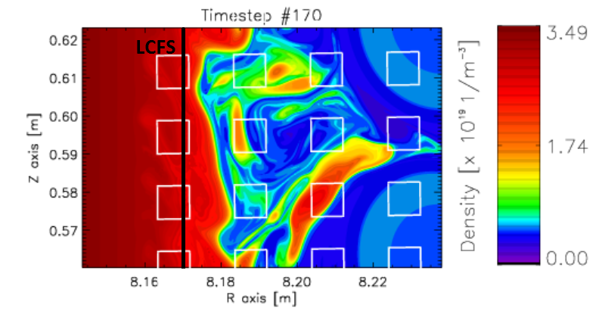
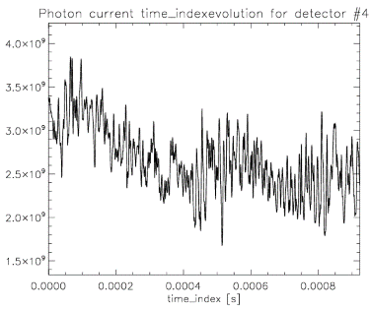
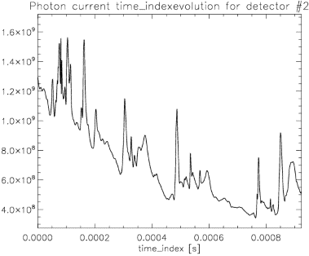
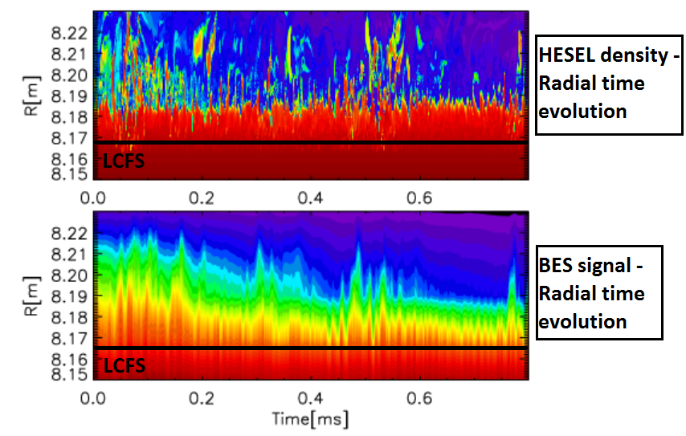
HESEL-RENATE at ITER
SOL turbulence modeling on ITER L-mode (ASTRA profiles)

Slide 13
Plans for 2020
Identification of Key Stakeholders for Task WIMAS-3
Stakeholders Map
Code Developers
High
EU commission
MST/JET users
General Assembly
International collaborators
JET / MST TFLs
HRUs
Power
EWE Task Coordinators
MST / JET scientists (not users)
ITER
Low
INTEREST
Low
High

Slide 14
Plans for 2020
Requirements of Key Stakeholders for your Task
Key Stakeholder 1
Requirement 1
Requirement 2
….
….
….
Key Stakeholder 2
Requirement 1
Requirement 2
…..
…..
…..

Slide 15
Timeline for 2020
 | Jan | Feb | Mar | Apr | May | Jun
O. Asztalos |  | Release Integration test for RENATE-OD-CHERAB | Develop BES actor | Develop BES actor | Release BES Actor | Develop Turbulence workflow
A.H. Nielsen |  | … | Risø WS HESEL AUG (AUGPED => IMAS/IDS) | … | … | Develop Turbulence workflow
G.I. Pokol |  | Release Integration test for RENATE-OD-CHERAB | Develop BES actor | Develop BES actor | Release BES Actor | Develop Turbulence workflow
A.S. Thrysøe |  |  | Risø WS | Code development and documentation | … | …
R. Coelho |  |  | Infrastructure | … | … | …

Slide 16
Timeline for 2020
 | Jul | Aug | Sep | Oct | Nov | Dec
O. Asztalos | Test and use Workflow | Parenting | Test and use Workflow EAST? | Test and use workflow on AUG | Test workflow on JET | Release workflow
A.H. Nielsen | Test and use Workflow | Test Workflow | Test Workflow EAST? | … | … | Release workflow
G.I. Pokol | Test and use Workflow | Parenting | Test Workflow | Test and use workflow on AUG | Test workflow on JET | Release workflow
A.S. Thrysøe | Test and use Workflow | Test and use Workflow | Test and use Workflow | … | .. | Release workflow
R. Coelho | Coordinating infrastructure | … | … | … | … | …

Slide 17
Plans for 2020
Headlines:
Risø WS - Release of BES actor + AUGped
Eindhoven CC - Testing and build of turbulence workflow
Autumn + winter WS/CC – test and release of turbulence workflow
Proposals for the EU-CN to go to EAST but ….
IAEA-FEC 2020 (AUG, EAST, JET) and EPS (AUG,JET) contributions
Requirements:
Support in setting up CHERAB – RENATE-OD on the gateway
Support from EWE for experimental data input from multiple machines

Slide 18
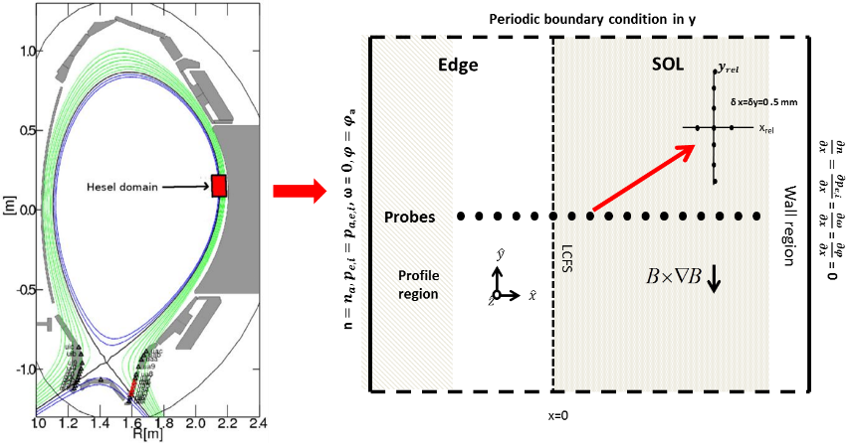
HESEL at AUG (synthetic Langmuir probes)
Radial shift of different diagnostics
LCFS not well defined
Fine tuning of profiles
Need for manual control of the input (EWE)
A.H. Nielsen et al 2019 Nucl. Fusion 59 086059

