Slide 1

EWE-2/WIMAS-1: status, plans, and future prospects
R. Coelho

Slide 2
EWE-2: why and by whom
Title: Enabling the exploitation of the equilibrium reconstruction and stability workflow 2019
Strongly dependent of EWE-1 (data), WIMAS-1 (workflows) and IMAS-RO (IDSs)
CD.M37 | Enabled use of ETS workflow for interpretative transport analysis in JET (EWE-3) | Dec 2019
CD.M38 | Enabled use of equilibrium and MHD stability workflow for analysis in MST1/JET (EWE-2) | Dec 2019
… | … | …
CD.M41 | Enabled use of ETS workflow for interpretative transport analysis in MST1 and PFC (EWE-1, EWE-3) | Dec 2020

Slide 3
WIMAS-1: what and by whom
Title: Equilibrium reconstruction and stability workflow deployment in IMAS 2019
Companion task of EWE-2, strongly dependent on EWE-1 (data) and IMAS-RO (IDSs)
Inevitably a moving target and swift service provider both internally (EWE-2/3) and to WPs in general e.g. JET-IMAS related work both in equilibrium reconstruction and stability, synergy with ETS,...

Slide 4
The Workflows
Equilibrium reconstruction workflow (EQRECONSTRUCT)
  From pure experimental data to full fledged calculated plasma equilibrium.
  Magnetics constrained but adding additional constrains transparently broadcasted in workflow design.
Equilibrium and MHD stability workflow (EQSTABIL)
  From full fledged reconstructed plasma equilibrium to MHD stability.
  Easily pluggable to transport simulator and upgradable to time loop runs.

Slide 5
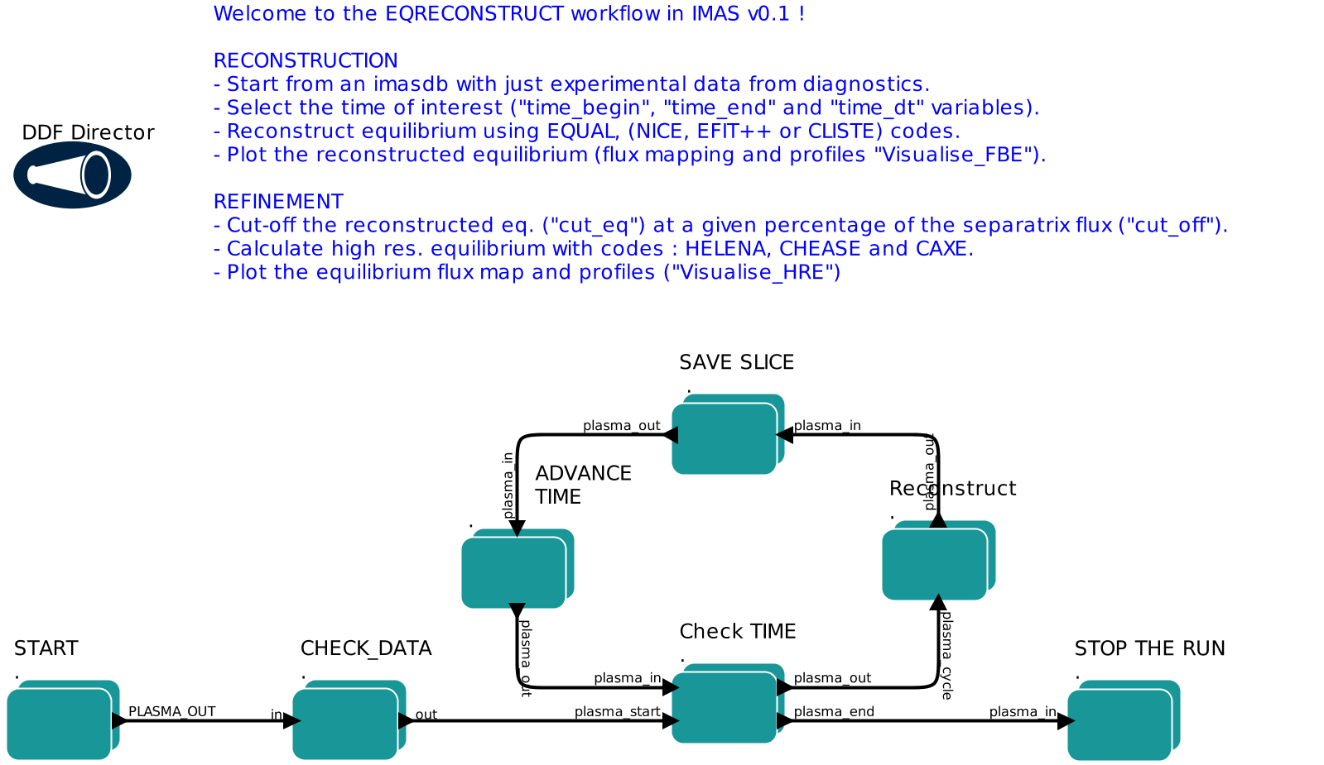
EQRECONSTRUCT
Equilibrium reconstruction
workflow
Latest release: 28/1/2020
Testers: myself, L. Kogan (JET & MAST), A. Merle (TCV), M. Dunne (AUG)

Slide 6
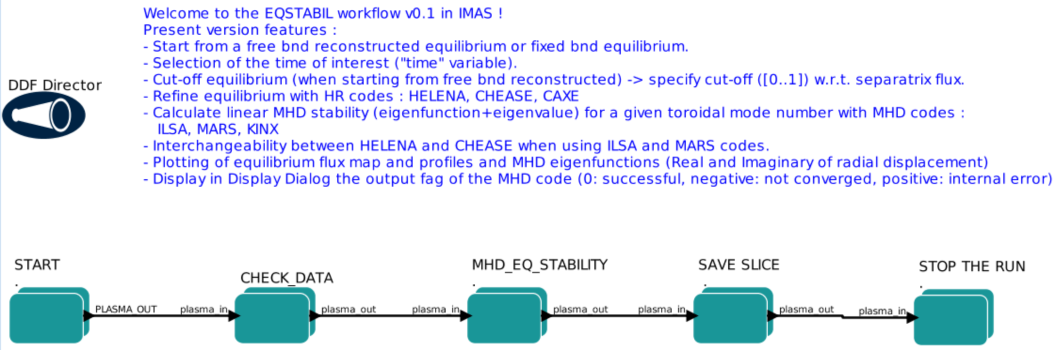
EQSTABIL
Equilibrium and linear MHD
workflow
Last release: 24/01/2020
Testers: myself, A. Merle, M. Dunne

Slide 7
The Cast – current status
Equilibrium reconstruction codes
High resolution equilibrium codes
Linear MHD codes
 | IDS | Remarks
EQUAL | Imasenv/3.25.0/AL4 | Using cocos=11 + abserror
NICE | likewise | Using cocos=11 + abserror ( C++ API plagued… )
CLISTE | IDS compliant (3.25.0/AL4 soon) | Untrivial I/O and data preparation ties with AUG environment
EFIT++ | IDS compliant including driver | Hurdling with environment (software stack Heimdall vs GW)
SDSS | Migrating to 3.25.0/AL4 | E-net builder not trivial (GUI needed)
 | IDS
HELENA | Imasenv/3.25.0/AL4
CHEASE | likewise
CAXE | likewise
😀
😐
🙁
 | IDS
ILSA | Imasenv/3.25.0/AL4
MARS | likewise
KINX | likewise
Occasional plague of batch submission

Slide 8
The Cast – progress monitoring
Equilibrium reconstruction codes
Perfect case study of “low level” bond with platform/DD/data pacing and development.
  Far form strict manpower dependence.
Gaining momentum again since finally building on steady DD+AL
  C++ occasionally plagued environment (EFIT++, NICE). Few users → slower pace.
  Data error convention adherence far from obvious to implement/adhere to.
  Newly adopted cocos=11 (including magnetics) far from obvious to implement/adhere to.
  UDA + TCV2IDS data more consistently available (and correct !), AUG data (finally)
  Testers stepping forward.
Equilibrium and stability codes
Maturely tested and verified → consolidated in imasenv 3.25.0/AL4
  Mass density needs re-integration (link broken till core_profiles matured and data materialised)
  Fully compliant to cocos=11 on input/output
  Driver for DD upgrade/improvement e.g. coordinate_system in mhd_linear (grid)
Integration is inherently faster…
    Less IDSs on input though relying more on data pre-processing (equilibrium provenance)

Slide 9

Result Highlights (1)
JET – magnetics only EQUAL reconstructions #84600 (50-52s)
JET – magnetics only EQUAL/NICE reconstructions #84600 (t=50s)

Slide 10
Result Highlights (2)
TCV: #63540 joint comparison with standalone LIUQE reference

Slide 11
Result Highlights (3)
3.25.0/4.4.0
AUG #33173 @ t=2s
HELENA+ILSA
N=1 internal kink mode
CLISTE equilibrium
Cut-off @ 99.5% of sep.flux
HELENA resolved

Slide 12
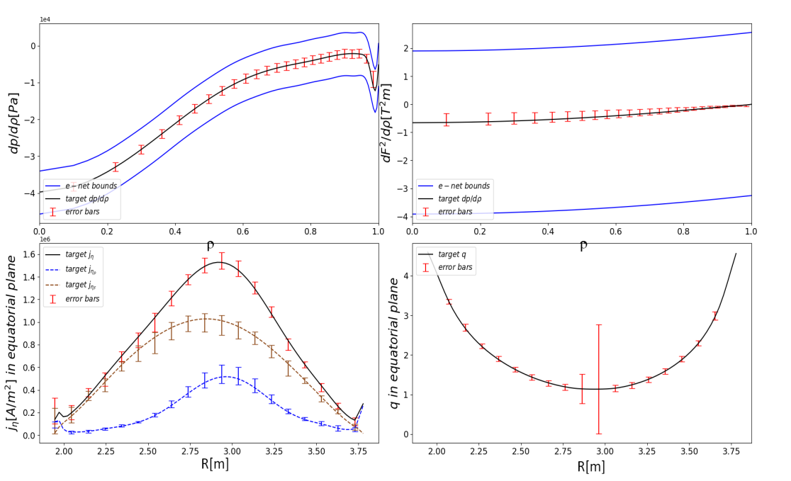
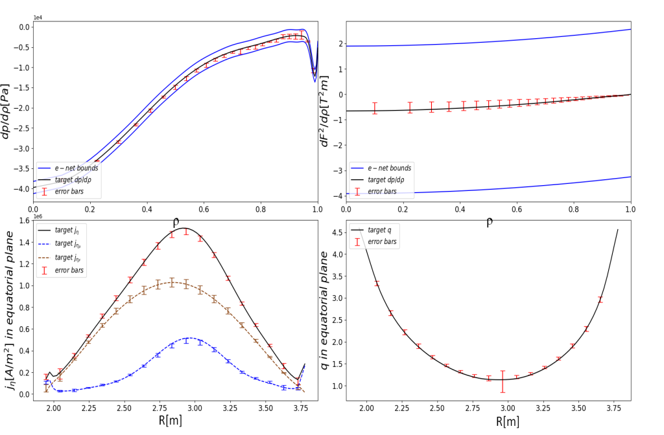
Result Highlights (4)
SDSS: Confidence band on reconstructed equilibria.
Kinetic pressure analysis JET #90198 run 27 (EQUAL, t=47.7, UAL 3.20.0/3.8.9). Error bars without pressure constraint
Kinetic pressure analysis JET #90198 run 27 (EQUAL, t=47.7, UAL 3.20.0/3.8.9). Error bars with pressure constraint

Slide 13
Plans/wish list for 2020
Equilibrium reconstruction
  Conclude EFIT++ integration in IMAS.
  First trials of mild IMAS version of CLISTE with py3 driver (until an AUG safe plug-in IMAS version is not ready – CLISTEprep less obvious than foreseen…).
    Do we have SOL current placeholder in IDSs ? No.
  EQUAL/NICE with MSE, polarimetry (Stokes model in NICE) → pending data availability
  Kinetic constraint (pressure) on reconstruction
    Not obvious for more than on system. JET with HRTS at first.
  Include pf_active%circuit (needed by EFIT++, not used – but should – by others)
    Not trivial to get right polarities e.g connection matrix, turns with sign, current,…
  Include pf_passive currents (missing in %constraints though...)
MHD stability
  RHOMASS actor in KEPLER compiled/generated/tested → fill equilibrium mass_density as required from species+density of core_profile.
  Sanity check for adherence to experimental scenarios e.g. Ip/Bϕ sign and mode spectra.
  Revive complex valued MHD.
  J-alpha relies on ascii IDSs (for agile orchestration) – for the moment CPOs and already in use for JET analysis (interpretive scenarios)
  Continue exploitation on current “partnerships” (WPJET1, WPSA)
Notes:
Jbs model include and current diffusion – request by H.Meyer

Slide 14
WPCD and the community
Stakeholders Map
High
General Assembly
EU commission
HRUs
ITER
JET / MST TFLs
Power
EWE Task Coordinators
International collaborators
MST / JET scientists (not users)
Code Developers
Low
MST/JET users
INTEREST
Low
High
Notes:
The HRUs have ultimately decisive power since they can rule out the possible contributors to the tasks.

Slide 15
Conclusions
EWE-2
  Equilibrium reconstruction and MHD stability workflows released in imasenv 3.25.0
  Testers finally available to improve user experience/tuning particularly useful for equilibrium reconstruction.
  Staged process dependent on several mods needed in the actors to comply with platform/data changes.
  Time now to consolidate/deliver with additional features as available.
WIMAS-1
  Equilibrium reconstruction and MHD stability actors released in imasenv 3.25.0
  Elaborate (natural) process considering multiple changes in DD, AL, cocos, data checking → “No free lunch”
  Meaningful testing of EQSTABIL and EQRECONSTRUCT requires a wider pool of shots to consolidate parameters → only available in TCV (Ip/Bphi signs, ≠ shapes)
  Important note: specific features only available in specific codes → sharing or code integration.

Slide 16
To be completed after this meeting

Slide 17
Plans for 2020
Requirements of Key Stakeholders for your Task
Key Stakeholder 2
Requirement 1
Requirement 2
…..
…..
…..
Key Stakeholder 1
Requirement 1
Requirement 2
….
….
….

Slide 18
Timeline for 2020
2020 Timeline for your task
 | Jan | Feb | Mar | Apr | May | Jun
Name 1 | Action | … | Action | … | Action | …
Name 2 | Action | … | Action | … | Action | …
…..
….

Slide 19
Timeline for 2020
2020 Timeline for your task
 | Jul | Aug | Sep | Oct | Nov | Dec
Name 1 | Action | … | Action | … | Action | …
Name 2 | Action | … | Action | … | Action | …
…..
….

