Slide 1
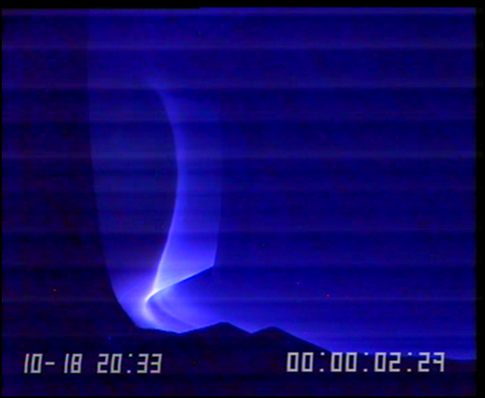
Modelling needs in the WEST programme
G. Giruzzi,
on behalf of the WEST team
http://west.cea.fr/WESTteam

Slide 2
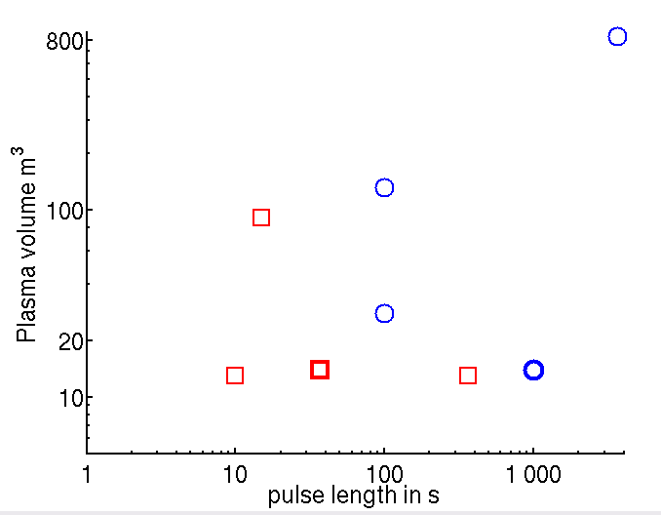
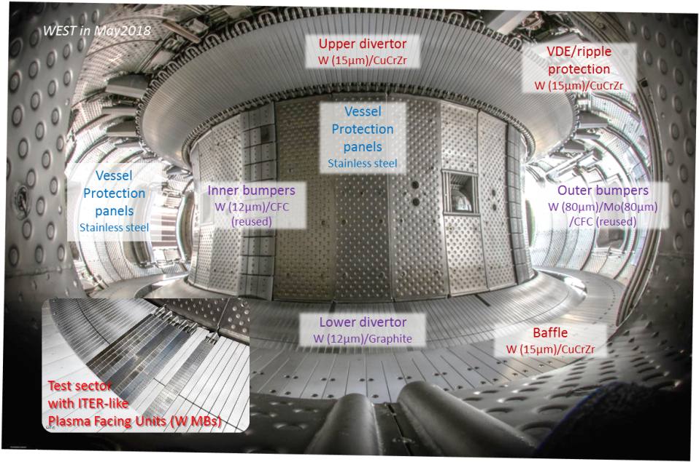
W divertor, superconducting, actively cooled tokamak phase 1 completed, preparing phase 2
W divertor tokamaks
ITER ≥2025
JT60-SA ≥2020+10
JET
IDTT ≥2026
WEST phase 2
≥2020
ASDEX Ugrade
WEST
EAST
Phase 1 (Dec. 2016 – Nov. 2019) | Phase 2 (≥2020 )
actively cooled + W coated inertial divertor elements | completed actively cooled ITER-like divertor

Slide 3
Outline
H mode accessed marginally, due to W core radiation leading to periodic pedestal loss. H mode pedestal maintained up to 4 s
Up to 55 s pulses achieved, good W and density control, no accumulation, in low torque L modes
Deleterious MHD in ohmic phase stabilized thanks to N₂
ICRH absorption leading to increase of energy content but with a weak T_{e}(0 response
Majority of data and analysis codes are in IMAS format
List of pulses for ETS modelling
Getting involved with WEST programme
Find all recent papers/posters/talks on WEST user portal: https://westusers.partenaires.cea.fr

Slide 4
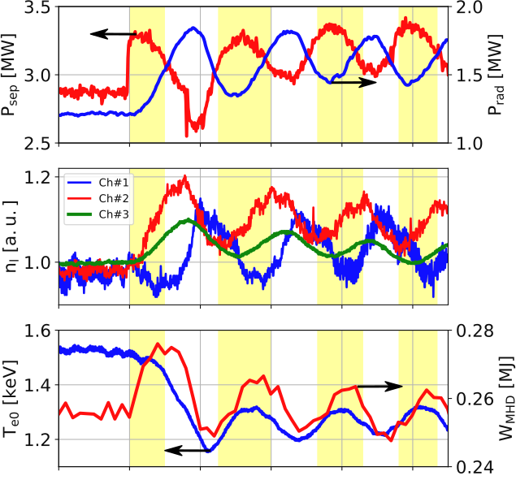
Challenge of H mode access in a W radiating environment
As pedestal forms, W enters and P_{radiation,bulk} increases
P_{separatrix} < P_{threshold}, back to L mode, no pedestal, W out
P_{radiation,bulk} decreases → P_{separatrix} > P_{threshold}, pedestal forms again, etc
Need to model such behavior using W neoclassical+ turbulent transport through pedestal and understand impact of W/other impurity on this dynamics
Note: #55564: 4 s H mode phase
#54719
Pedestal LoS
SOL LoS
Central LoS

Slide 5
Outline
H mode accessed marginally, due to W core radiation leading to periodic pedestal loss. H mode pedestal maintained up to 4 s
Up to 55 s pulses achieved, good W and density control, no accumulation, in low torque L modes
Deleterious MHD in ohmic phase stabilized thanks to N₂
ICRH absorption leading to increase of energy content but with a weak T_{e}(0 response
Majority of data and analysis codes are in IMAS format
List of pulses for ETS modelling
Getting involved with WEST programme
Find all recent papers/posters/talks on WEST user portal: https://westusers.partenaires.cea.fr

Slide 6
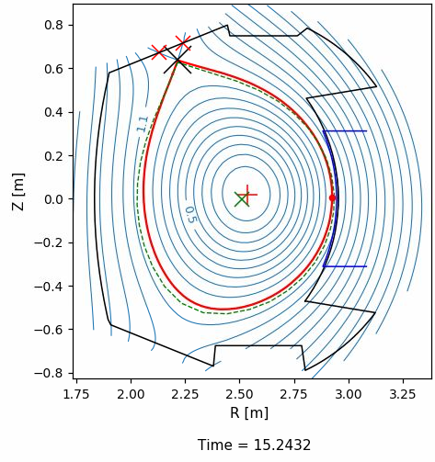
Density control and no W accumulation up to 55s
# 55787
$I_{p}∗10 (MA$)
n (${10}^{19}m^{−3})$
$P_{LH} (MW$)
$P_{rad} (MW$)
Time (s)
[Dittmar Phys. Scr. 2020]
I_{p} = 400kA, B_{T} = 3.7T, P_{LH} = 3.0 MW, f_{rad}~ 55%
V_{loop}~0.1V, LHCD efficiency <1x10¹⁹ A/W/m²
If V_{loop}<0.1V : MHD. W/j(r) interplay under study to prepare → 1000 s
Here modelling need is for LHCD deposition / current drive efficiency

Slide 7
Outline
H mode accessed marginally, due to W core radiation leading to periodic pedestal loss. H mode pedestal maintained up to 4 s
Up to 55 s pulses achieved, good W and density control, no accumulation, in low torque L modes
Deleterious MHD in ohmic phase stabilized thanks to N₂
ICRH absorption leading to increase of energy content but with a weak T_{e}(0 response
Majority of data and analysis codes are in IMAS format
List of pulses for ETS modelling
Getting involved with WEST programme
Find all recent papers/posters/talks on WEST user portal: https://westusers.partenaires.cea.fr

Slide 8
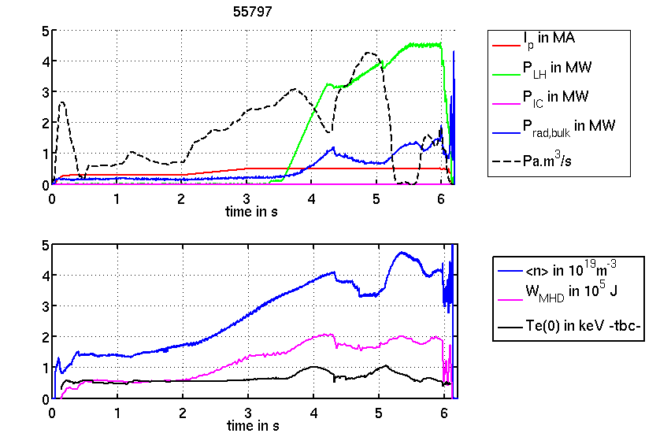
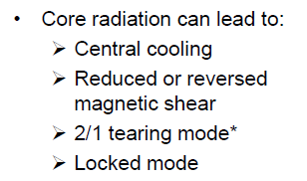
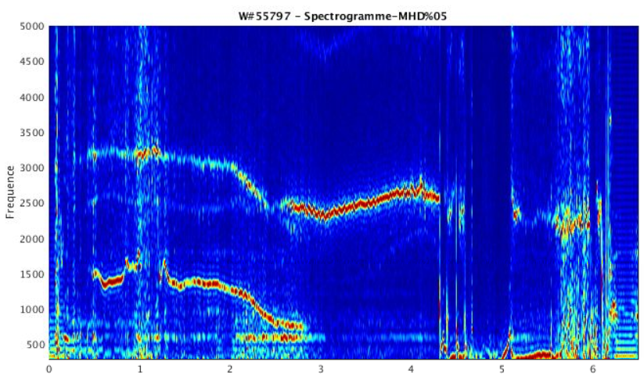
MHD stability : a challenge for scenario development in a full W environment
P_{LH} in MW
W cooling factor max at ~1keV
fueling Pa.m³/s
P_{rad,bulk} in MW
I_{p} in MA
As in JET-ILW [Challis EPS2019, sub. NF2020]
<n> in 10¹⁹m⁻³
flatter j(r)
W_{MHD} in 10⁵J
T_{e}(0) in keV -tbc-
disruption
5
4
3
2/1
F (kHz)
2/1
2
1
0
1
2
3
4
5
6

Slide 9
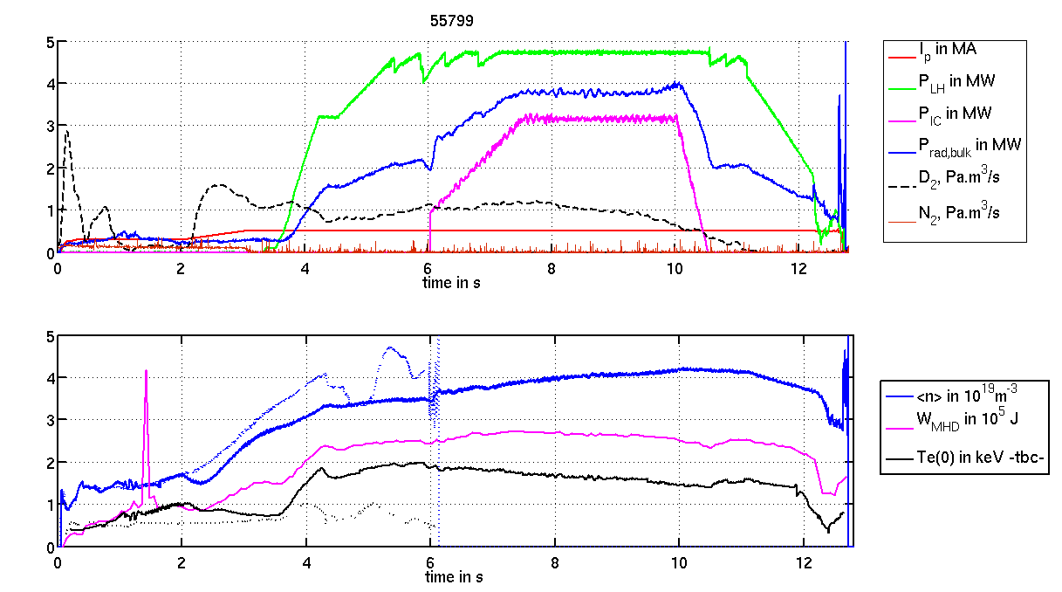
Avoiding (2,1) modes by maximizing T_{e}(0) and j peaking :
early N₂ seeding as an actuator
P_{LH} in MW
P_{rad,bulk} in MW
B_{T}=3.6T
q₉₅=4.5
3 IC antennas: 3.2 MW
2 LH launchers: 4.8 MW
8 MW RF power
f_{rad,bulk}=47%
Max so far 9.2 MW
P_{IC} in MW
N₂ seeding
Pa.m³/s
fueling Pa.m³/s
I_{p} in MA
P_{LH} in MW
P_{rad,bulk} in MW
B_{T}=3.6T
q₉₅=4.5
P_{IC} in MW
N₂ seeding
Pa.m³/s
<n> in 10¹⁹m⁻³
fueling Pa.m³/s
[Helou RF topical 2019]
[Delpech RF topical 2019]
I_{p} in MA
W_{MHD} in 10⁵J
T_{e}(0) in keV -tbc-
early N₂ seeding for larger edge η → peaked j → hotter core
Then permanent trade-off:
Density as low as possible to maximize T_{e}(0)
While maintaining a good LHCD coupling (reflected power < 5%)
2/1
2/1
9

Slide 10
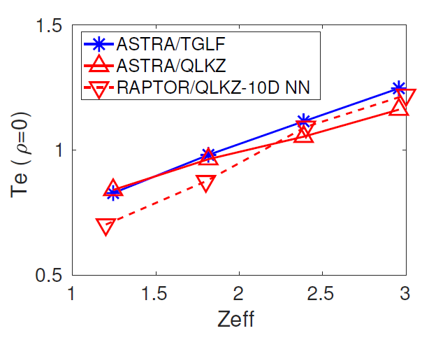
On ohmic phase: Increasing edge Z_{eff} allows to raise T_{e}(0) and avoid MHD
(2,1) mode onset due to nonlinear interplay between heat transport, W transport, radiation, current diffusion, MHD stability
ASTRA or RAPTOR using predictive heat and particle transport by
QuaLiKiz-10D Neural Network [Van de Plassche NF2020]/QuaLiKiz or TGLF
incl. W radiation
Next: explore other actuators to avoid MHD such as core heating by ICRH, …
Need integrated modelling of current diffusion, W transport (turbulent+neoclassical), W radiation, main ions/electrons heat and particle (turbulent) transport
More N₂

Slide 11
Outline
H mode accessed marginally, due to W core radiation leading to periodic pedestal loss. H mode pedestal maintained up to 4 s
Up to 55 s pulses achieved, good W and density control, no accumulation, in low torque L modes
Deleterious MHD in ohmic phase stabilized thanks to N₂
ICRH absorption leading to increase of energy content but with a weak T_{e}(0 response
Majority of data and analysis codes are in IMAS format
List of pulses for ETS modelling
Getting involved with WEST programme
Find all recent papers/posters/talks on WEST user portal: https://westusers.partenaires.cea.fr

Slide 12
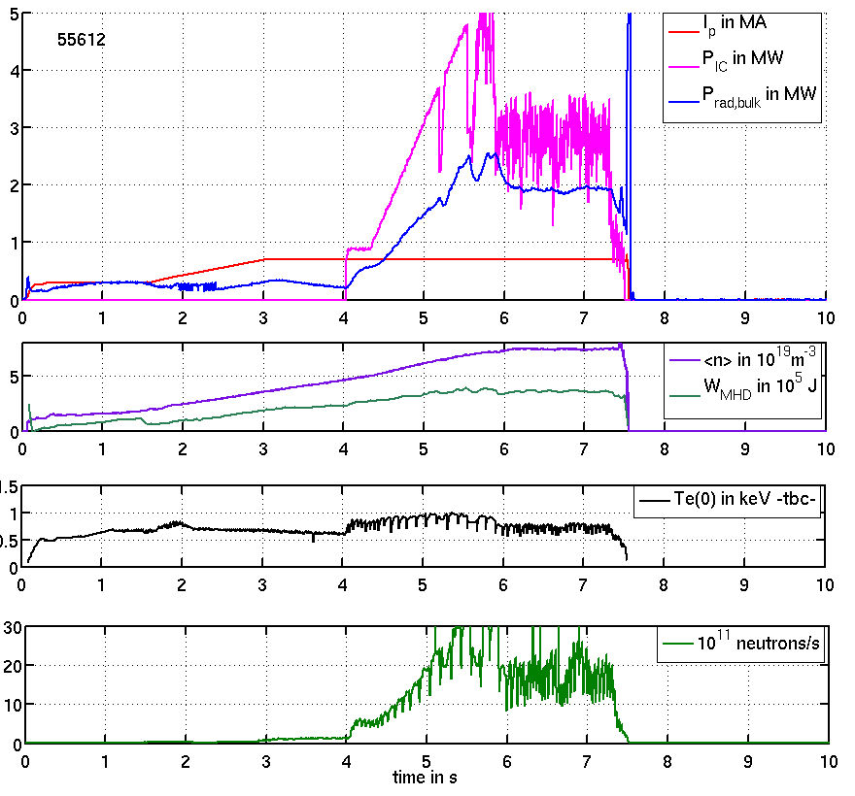
Understand ICRH impact on core plasma: Te(0) vs Ti(0)
As ICRH ramps up:
Te(0) increases very marginally despite expected large ICRH deposition on electrons.
DD neutron rate (signature of Ti(0)) responds more clearly.
Need modelling of ICRH absorption in presence of W radiation

Slide 13
Outline
H mode accessed marginally, due to W core radiation leading to periodic pedestal loss. H mode pedestal maintained up to 4 s
Up to 55 s pulses achieved, good W and density control, no accumulation, in low torque L modes
Deleterious MHD in ohmic phase stabilized thanks to N₂
ICRH absorption leading to increase of energy content but with a weak T_{e}(0 response
Majority of data and analysis codes are in IMAS format
List of pulses for ETS modelling
Getting involved with WEST programme
Find all recent papers/posters/talks on WEST user portal: https://westusers.partenaires.cea.fr

Slide 14
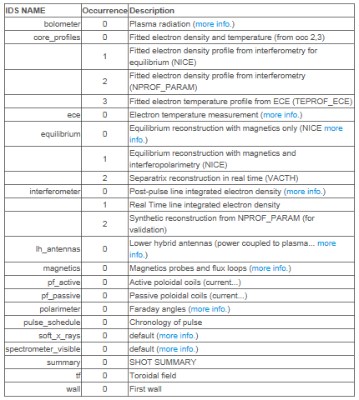
WEST processed data are natively stored in IMAS format
Remotely available via IMAS Access Layer and UDA server (or remote computer access)
Analysis codes in IMAS: METIS, ToFu, SOLEDGE2D, etc

Slide 15
Outline
H mode accessed marginally, due to W core radiation leading to periodic pedestal loss. H mode pedestal maintained up to 4 s
Up to 55 s pulses achieved, good W and density control, no accumulation, in low torque L modes
Deleterious MHD in ohmic phase stabilized thanks to N₂
ICRH absorption leading to increase of energy content but with a weak T_{e}(0 response
Majority of data and analysis codes are in IMAS format
List of pulses for ETS modelling
Getting involved with WEST programme
Find all recent papers/posters/talks on WEST user portal: https://westusers.partenaires.cea.fr

Slide 16
WEST modelling needs
Ohmic phases, study the N₂ seeding impact: with heat/particle prediction and W radiation + current diffusion: #55797 (no N₂) vs #55799 (with N₂)
ICRH absorption: ion vs electron heating, role of W radiation #55612
L-H oscillating transitions: W transport/radiation through the pedestal, with interpretative pedestal, but predictive W transport/radiation, # 54719
Long pulse modelling, explaining why no W accumulation #55787 : need LHCD module.
Easy coupling is expected taking advantage of the fact that WEST data are already in IMAS Data Standard form
Demonstrate coupling output to synthetic diagnostics for soft X-ray, bolometry, Bremsstrahlung, UV spectroscopy (possibility of using ToFu)

Slide 17
Outline
H mode accessed marginally, due to W core radiation leading to periodic pedestal loss. H mode pedestal maintained up to 4 s
Up to 55 s pulses achieved, good W and density control, no accumulation, in low torque L modes
Deleterious MHD in ohmic phase stabilized thanks to N₂
ICRH absorption leading to increase of energy content but with a weak T_{e}(0 response
Majority of data and analysis codes are in IMAS format
List of pulses for ETS modelling
Getting involved with WEST programme
Find all recent papers/posters/talks on WEST user portal: https://westusers.partenaires.cea.fr

Slide 18
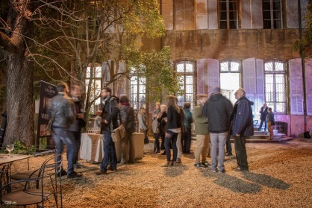
How to get involved in WEST programme preparation?
3rd WEST Experimental Planning Meeting May 5-6, 2020 in Aix-en-Provence
It will address the scientific program for the 2nd phase of WEST operation (campaigns C5 to C8)
Please note also that the next call for experimental and modelling proposals for WEST phase 2 will be issued by end of February 2020.
The output from the call will be used as a basis for discussion during the meeting.
WEST user portal: https://westusers.partenaires.cea.fr
Task Force Leader for scenarios contact:
clarisse.bourdelle@cea.fr

