Slide 1
Modelling needs in the JT-60SA programme
WPCD Annual Planning meeting 24-28/02/2020 ENEA, Frascati, Italy
G. Giruzzi, T. Bolzonella and the WPSA team

Slide 2
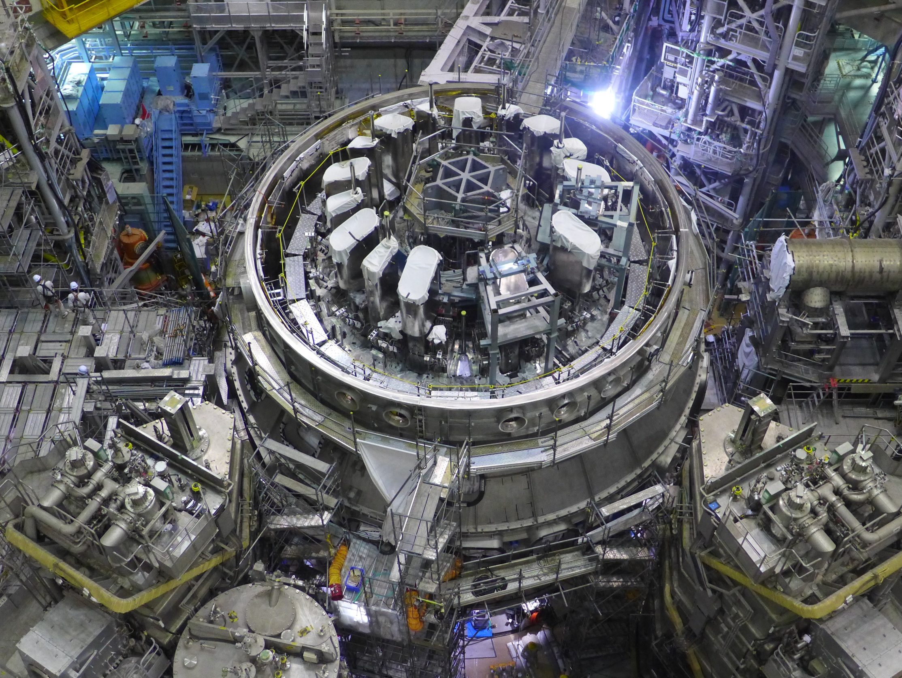













Outline
JT-60SA
What is JT-60SA
JT-60SA timeline
WPSA
WPSA structure and objectives
WPSA 2019-20 modelling activities
Ongoing WPSA-WPCD activities
Future directions and needs

Slide 3
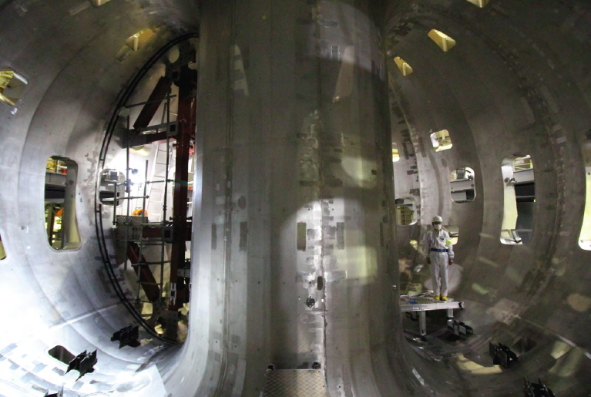
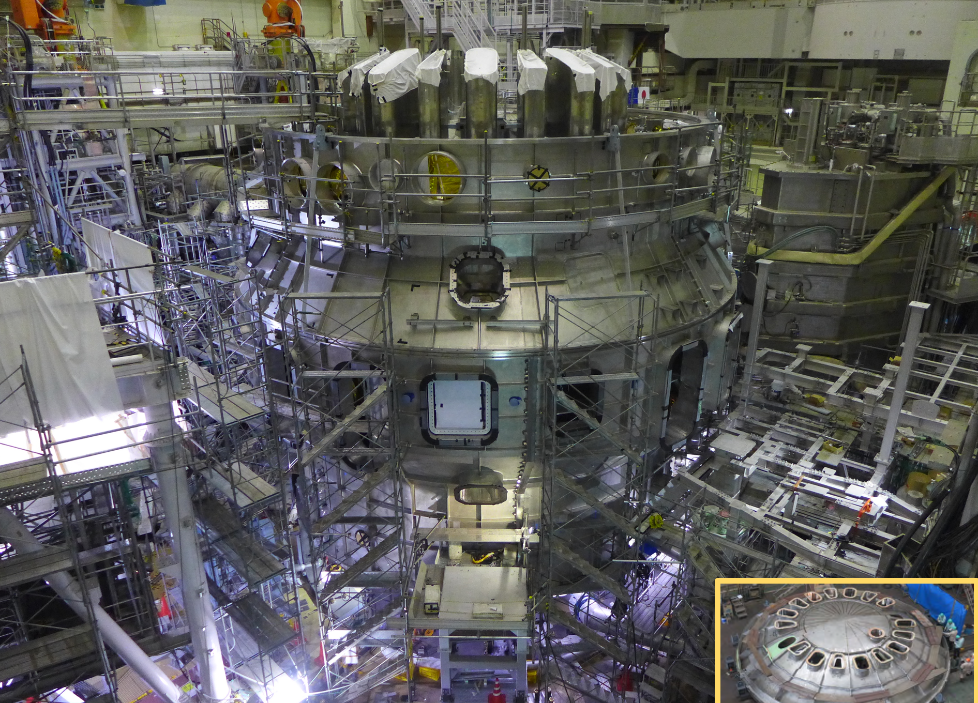
The JT-60SA tokamak
Designed and built jointly by Japan and EU at the Naka site
Largest tokamak before ITER. Fully superconducting, highly shaped
Due to start operation in Sept. 2020
Exploitation by joint EU-Japan team
B_{t} | 2.25 T
I_{p} | 5.5 MA
R / a (A = 2.5) | 2.96 / 1.18 m
κ / δ | 1.93 / 0.5
t (flat-top) | 100 s
N-NBI (500 keV) | 10 MW
P-NBI (85 keV) | 24 MW
ECRH (82, 110, 138 GHz) | 7 MW

Slide 4
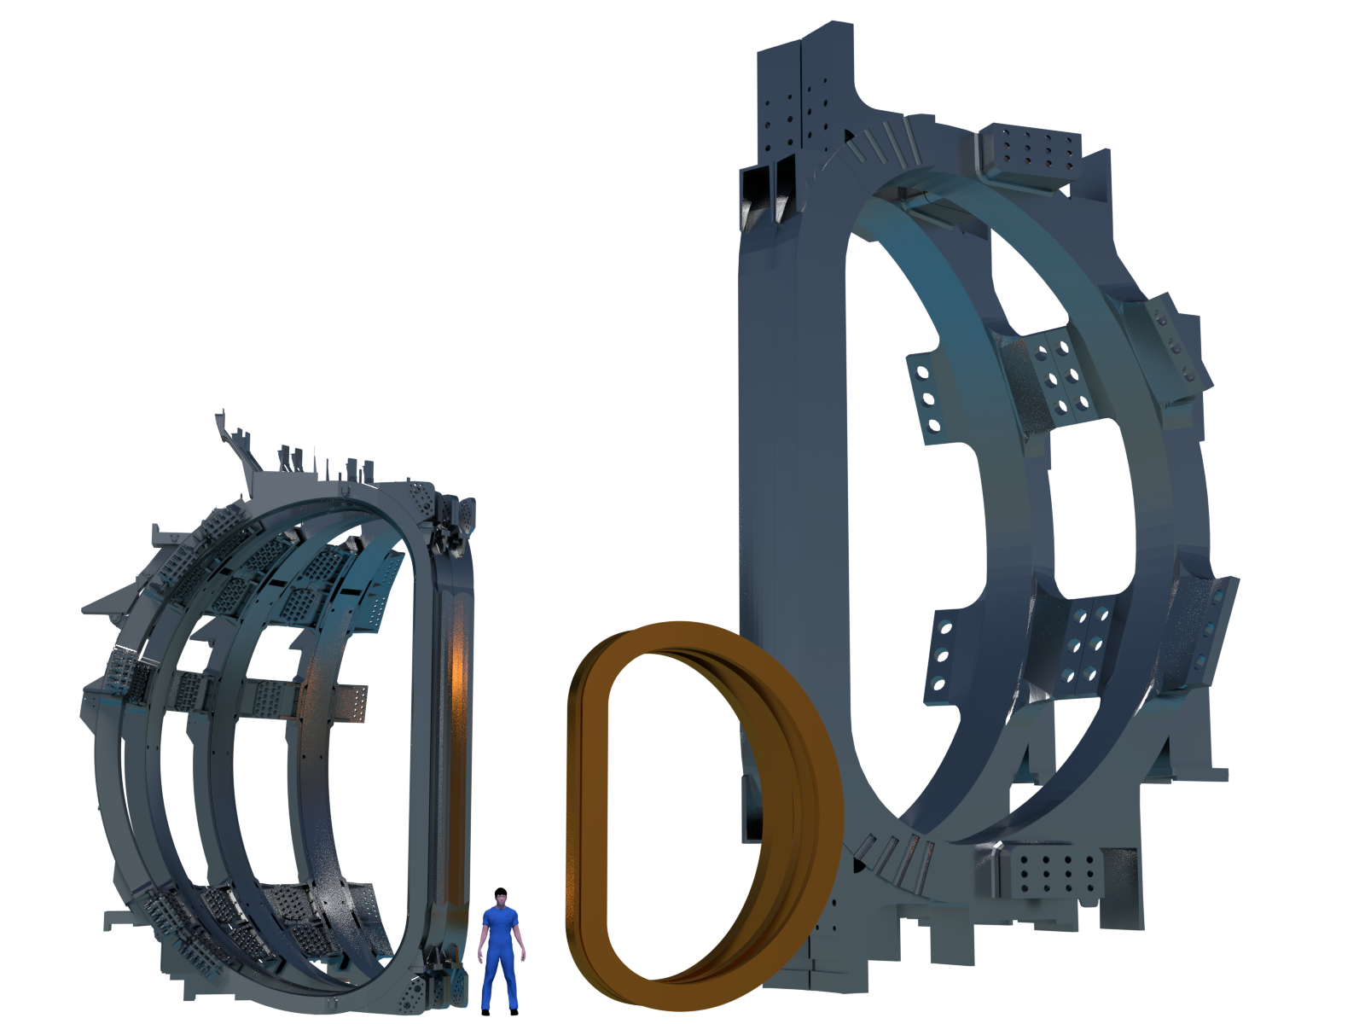
JT-60SA vs JET and ITER toroidal field coils
ITER
JT-60SA
JET

Slide 5
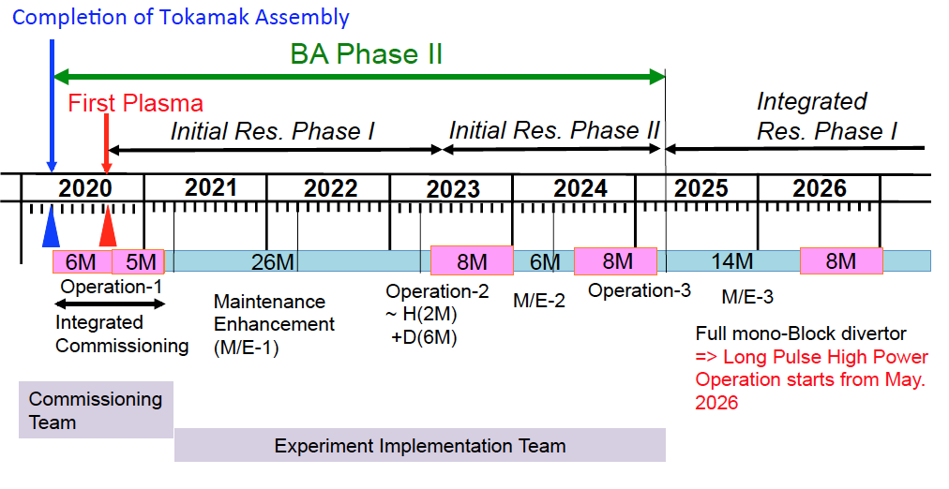
JT-60SA timeline
  Completion of Tokamak Assembly: March 2020
  First Plasma: September 2020
  5 months commissioning with plasma, then 2 years shutdown
  Full scientific exploitation from 2023 (Operation -2)
  Transition to W PFC from 2029
tentative JT-60SA timeline
Note: shutdown for transition to W PFC from 2029

Slide 6
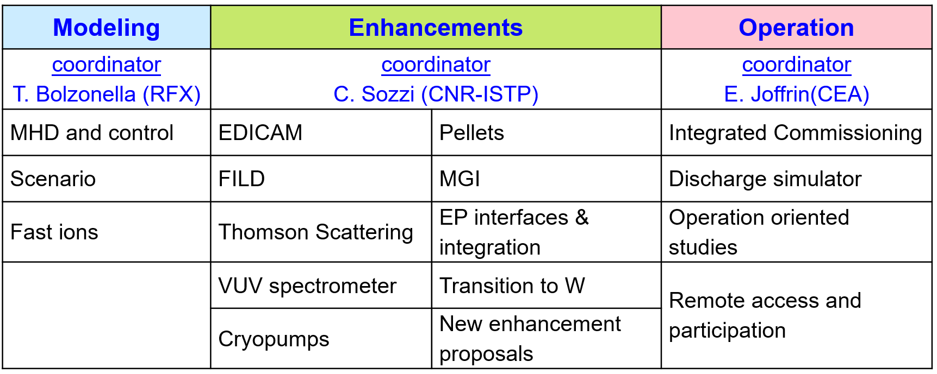
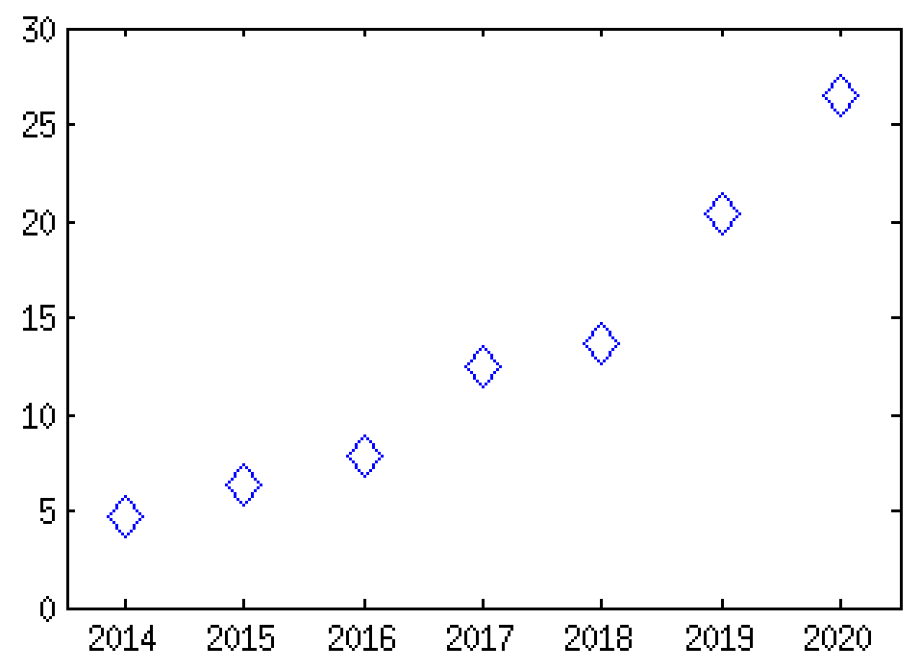
WPSA: structure, activities, resources
Objective: prepare for a high level EU participation in JT-60SA scientific exploitation, fully integrated in the EU fusion programme
manpower (ppy)
  Publications 2014-2019:
  25 articles
  60 conferences & workshops
years

Slide 7
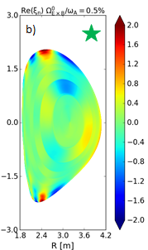
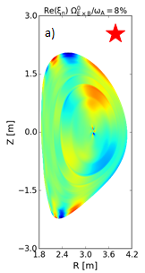
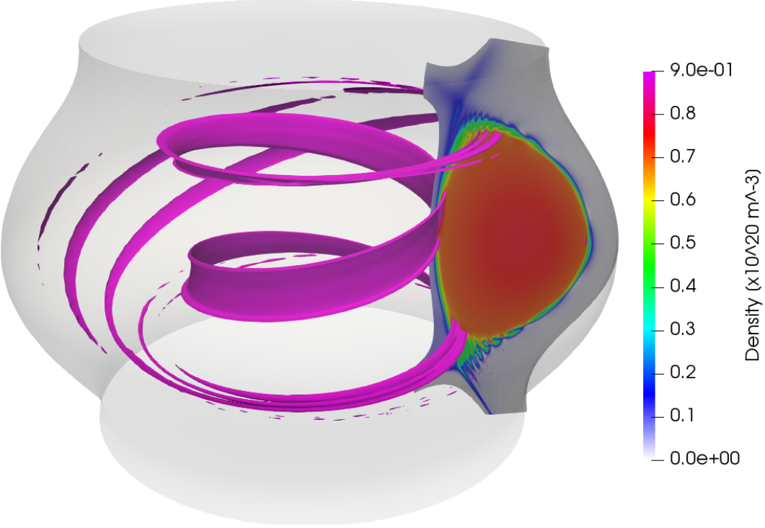
WPSA: MHD and control modelling
Deliverable description | Deliverable owner
MHD analysis of scenarios of Initial Research Phase I and II including WPCD workflows. Modelling of RWM control | R. Coelho (IST)
Non-linear simulations of ELM triggering by pellets (JOREK) | S. Futatani (CIEMAT)
precession drift dominant
bounce resonance dominant
L. Pigatto et al.
S. Futatani et al.

Slide 8
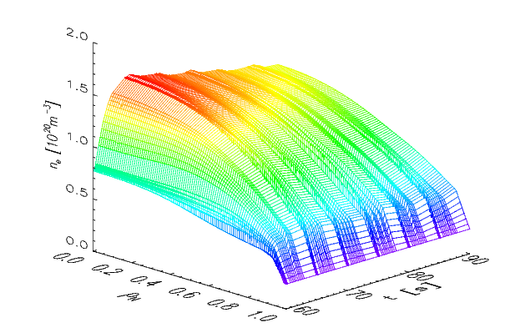
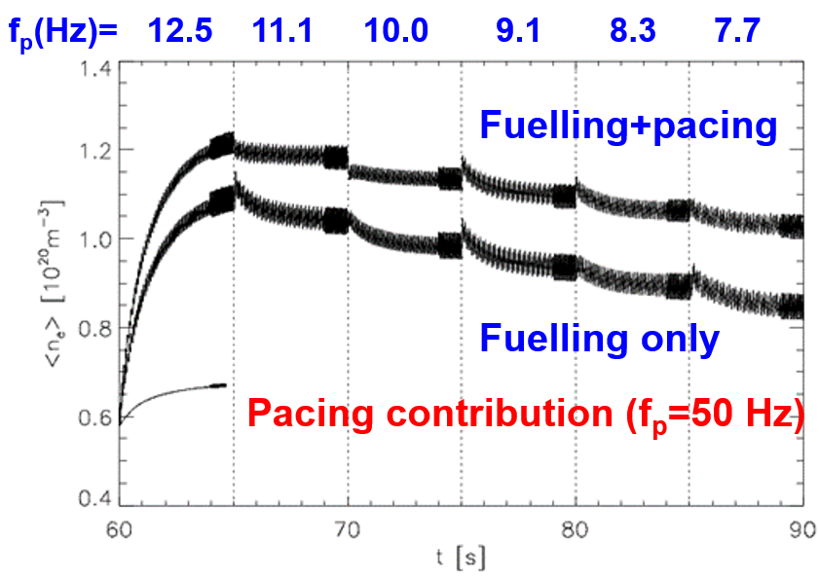
WPSA: Scenario and transport modelling
Deliverable description | Deliverable owner
Modelling of scenarios transient phases (METIS, CRONOS) | J. Morales (CEA)
Modelling of scenarios of Initial Research Phase I and II, including pellet injection (JINTRAC) | L. Garzotti (CCFE)
Effect of shaping on turbulent transport and confinement | M. Romanelli (CCFE)
L. Garzotti et al.

Slide 9
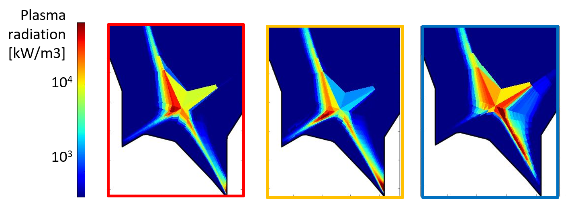
WPSA: Edge modelling
Deliverable description | Deliverable owner
Edge and divertor modelling of JT-60SA scenarios with C wall with SOLEDGE code. | P. Innocente (ENEA-CRFX)
Edge and divertor modelling of JT-60SA scenarios with W wall with SOLPS-ITER code | M. Wischmeier (MPG)
L. Balbinot et al.

Slide 10
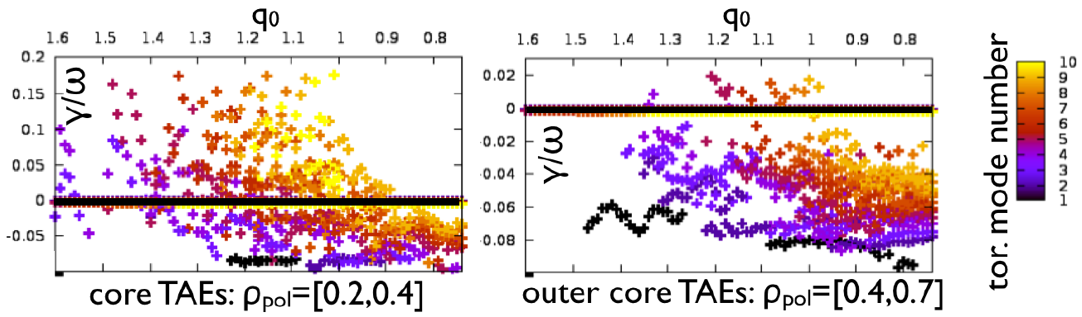
WPSA: Fast ion modelling
Deliverable description | Deliverable owner
Modelling of fast ion distribution (ASCOT code) | T. Kurki-Suonio (VTT)
Analysis of fast ion instabilities during flat-top and current ramp-up phases (LIGKA code) | P. Lauber (IPP)
Analysis of impact of fast ions on turbulence and transport | D. Zarzoso (CEA)
P. Lauber et al.

Slide 11
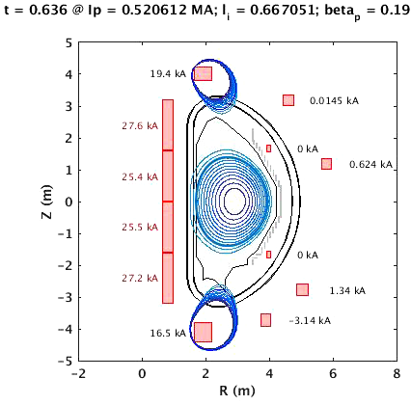
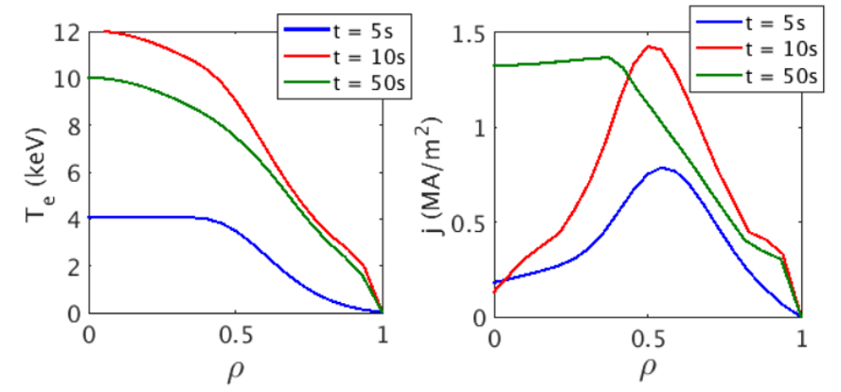
WPSA: other modelling activities 2019-20
Also Enhancements and Operation WPSA areas will benefit from specific modeling activities. In particular:
  Enhancements area relevant deliverables:
New diagnostic systems: EDICAM, Pellets, FILD, MGI, Thomson Scattering, VUV spectrometer;
Transition to W: development of simulations for plasma scenarios with W divertor
  Operation area relevant deliverables:
    Discharge simulator: development of first version, tests and validation;
    Simulation of breakdown scenarios (with and without ECRH) in support to first plasma;
    Studies on plasma controllers and disruptions;
    Wall conditioning modelling in support to first plasma.
J.F. Artaud, V. Ostuni et al.

Slide 12
Modelling JT-60SA scenarios in ETS workflow
Building on previous attempts by J. Ferreira, in 2020 we propose to move towards a systematic exploitation of ETS workflow to model some JT-60SA reference scenarios and compare with previous results by other codes (CRONOS, JINTRAC)
  Proposed procedure:
Follow the ETS-RO expert guidance by submitting a web request form (first contacts ongoing). All the necessary settings for JT-60SA NBI and EC are already present.
Proposal is to start from reference full Ip Single Null inductive scenario (JT-60SA “scenario 2”).
Following step could be the study of hybrid reference scenario (JT-60SA “scenario 4.2”).
CDBM model almost ready in the latest version of ETS-5 → possibility to study scenarios with ITB (JT-60SA “scenario 5”).
Data to be discussed and agreed include: equilibrium configuration, discharge phase to be modelled (current ramp-up, current ramp-down, flat-top), H&CD settings, aim of the simulation (e.g. power balance, calculation of peak ion/electron temperature / density at steady state, estimation of q profile at steady state etc.)

Slide 13
WPSA simulation data storage under IMAS: status and plans
Main JINTRAC and CRONOS data from published papers are already generated and stored under IMAS. Reference papers:
  J. Garcia et al 2014 Nucl. Fusion 54 093010 “Physics comparison and modelling of the JET and JT-60U core and edge: towards JT-60SA predictions”
  L. Garzotti et al 2018 Nucl. Fusion 58 026029 “Analysis of JT-60SA operational scenarios”
Next step is to move part of them to JT-60SA DMS to test sharing with EU and QST colleagues.
First potential “customer” activities: MHD and fast ion analysis (see also final discussion)
Whether this will be the priority is still under discussion, comments from WPCD community are welcome!
Direct link should be established between WPSA (scenario) modelling activities and WPCD/ITER Integrated Modelling Expert Group

Slide 14
Points for discussion
Collaboration between WPCD and WPSA develops upon well established bases and some WPCD experts are already part also of WPSA team.
2020 WPSA modeling needs will/can further enhance the use of WPCD/IMAS tools in the fields of:
  MHD stability → systematic study of realistic plasmas for Initial Research Phases
  Fast ion physics → LIGKA/HAGIS IMAS integration close to completion
  Integrated scenario modelling → systematic ETS runs
  Synthetic diagnostics → longer term (EU diagnostics for JT-60SA)
  Simulation data storage under IMAS → ongoing discussion, including QST (Japan) counterpart
  Support to discharge preparation → WPSA simulator will be provided to EU users via WPCD (which can improve and customize it)
Areas of further/future collaboration could include:
  training activities for WPSA modelling collaborators to be further pushed
  data access and sharing (including requirements from F4E and QST)
  JT-60SA data mapping under IMAS (during scientific exploitation)

Slide 15
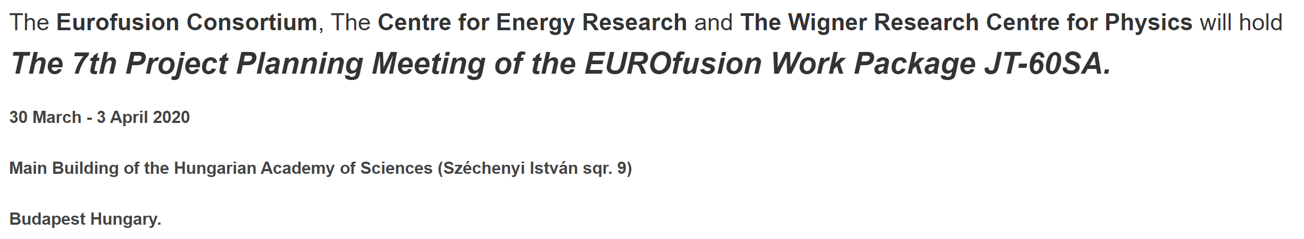
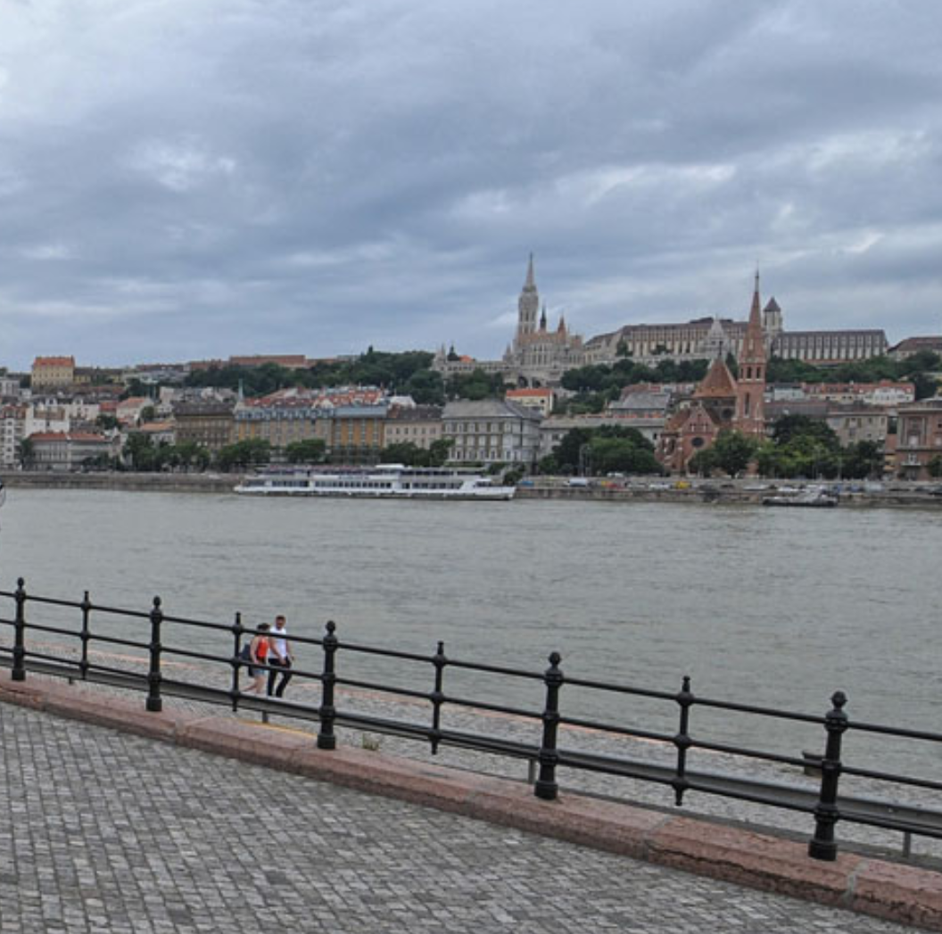
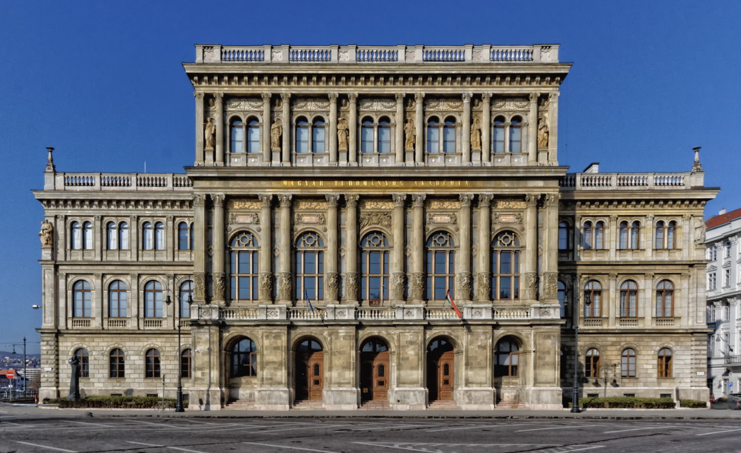
7th WPSA Project Planning Meeting
https://wpsappm2020.wigner.mta.hu/

