Slide 1
Measuring the equation of state of fusion-relevant foams
R.W. Paddock*, M.W. von der Leyen, R. Aboushelbaya, D.J. Chapman, D.E. Eakins,
M. Oliver, R. J. Clarke, M. Notley, C. D. Baird,
N. Booth, C. Spindloe, D. Haddock, S. Irving,
R.H.H. Scott, J. Pasley, M. Cipriani, F. Consoli,
B. Albertazzi, M. Koenig, A. S. Martynenko,
L. Wegert, P. Neumayer, P. Tchórz, P. Raczka,
P. Mabey, W. Garbett, R.M.N. Goshadze,
V.V. Karasiev, S.X. Hu and P.A. Norreys
*robert.paddock@physics.ox.ac.uk
© Crown Owned Copyright/AWE [2022]

Slide 2
References: Paddock, R. W., et al. (2021) Phil Trans R Soc A., 379(2189), 20200224
Paddock, R. W., et al. (2022) J. Plasma Phys, 88, 905880314
Foams and ICF
Foams are of interest for a number of reasons, including: laser beam smoothing and imprint mitigation, adiabat shaping, increasing absorption of Nd-laser light, and increasing conversion from laser light into X-rays.
They are also used in wetted foam ICF capsules, where they can be used to control convergence ratio.
We have performed 1D simulations of such capsules in an expected low-instability regime, achieving gains of 0.2 at 800kJ, and 0.8 at 1.8MJ.

Slide 3
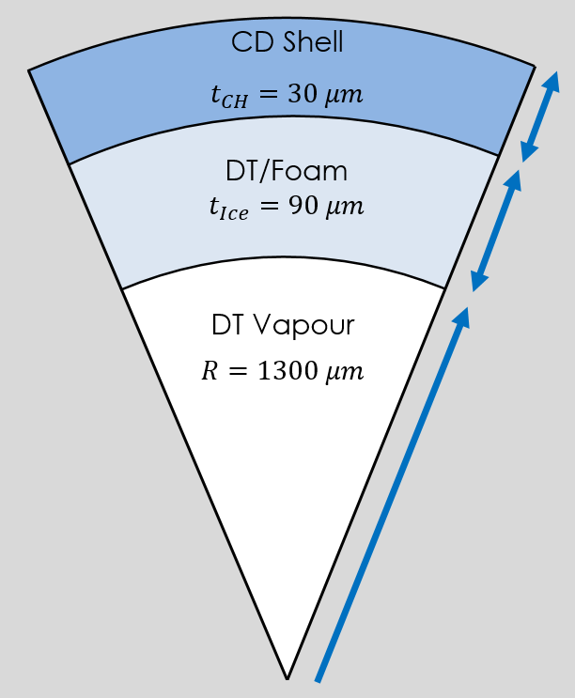
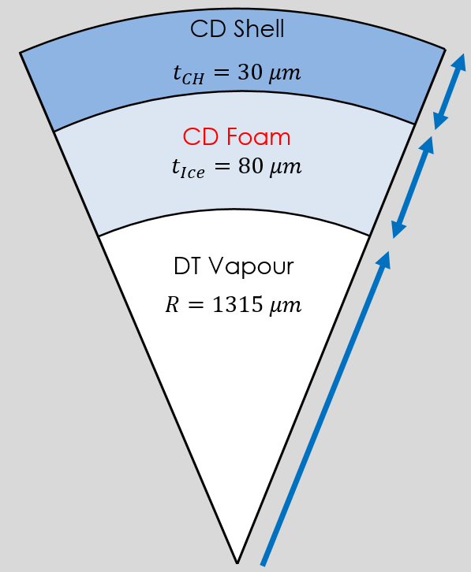
References: Paddock, R. W., et al. (2021) Phil Trans R Soc A., 379(2189), 20200224
Paddock, R. W., et al. (2022) J. Plasma Phys, 88, 905880314
Low instability direct-drive ICF
DT wetted foam
Total density = 253 mg/cm³
Foam only density = ~25 mg/cm³
Dry foam
Total density = Foam density =
253 mg/cm³
Laser Energy = 770 kJ, Gain = 0.2
CR = 16, Implosion Velocity = 400 km/s,
IFAR = 30
Laser Energy = 780 kJ, Gain = 0.02
CR = 16, Implosion Velocity = 390 km/s,
IFAR = 29

Slide 4
Foam equation of state
The equation of state of such foams – both in wetted foam designs, and in our hydrodynamic equivalent design – are not well characterised.
Foams are of major interest for fusion, and this limits the accuracy of simulations including them.
We performed an experiment in Jan/Feb 2022 to measure the EOS of TMPTA plastic foam using the CLF’s Vulcan laser.

Slide 5
Reference: Forbes, J.W. (2012) Shock Wave Compression of Condensed Matter. Heidelberg: Springer International Publishing
EOS theory
The EOS is the phase space of accessible pressure-density points to a material, and is required to close the hydrodynamic equations.
The ‘principle hugoniot’ are the pressure-density states accessible when a material is shocked.
Can consider Pressure-Density, or Shock Velocity-Particle Velocity.
Pressure, P
Density, ρ

Slide 6
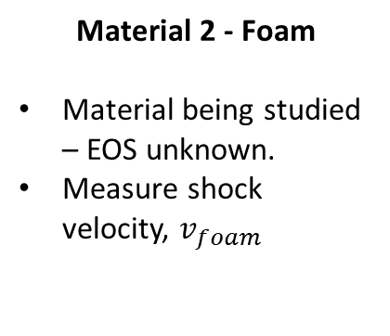
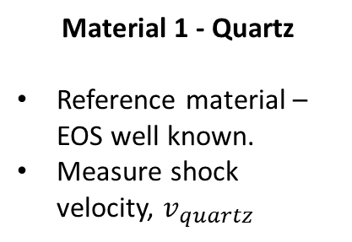
Reference: Forbes, J.W. (2012) Shock Wave Compression of Condensed Matter. Heidelberg: Springer International Publishing
Reference materials and impedance matching
Material 1 - Quartz
Reference material – EOS well known.
Measure shock velocity, $v_{quartz}$
Shock
Shocked quartz
Unshocked quartz
Unshocked foam
Rarefaction wave
Shock
Material 2 - Foam
Material being studied – EOS unknown.
Measure shock velocity, $v_{foam}$
Shocked quartz
Relaxed quartz
Shocked foam
Unshocked foam

Slide 7
Reference: Forbes, J.W. (2012) Shock Wave Compression of Condensed Matter. Heidelberg: Springer International Publishing
Reference materials and impedance matching
Known Quartz EOS
Pressure, P
1
Particle velocity, u

Slide 8
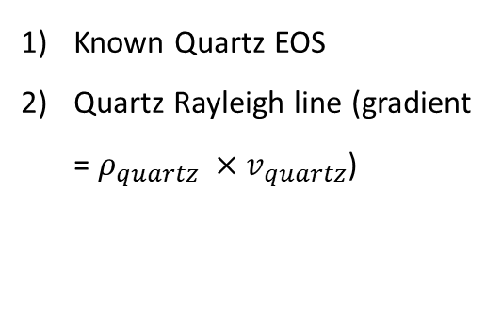
Reference: Forbes, J.W. (2012) Shock Wave Compression of Condensed Matter. Heidelberg: Springer International Publishing
Reference materials and impedance matching
Known Quartz EOS
Quartz Rayleigh line (gradient = $ρ_{quartz} ×v_{quartz}$)
Pressure, P
1
2
Particle velocity, u

Slide 9
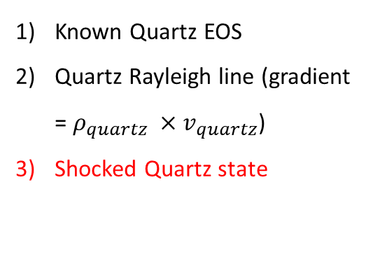
Reference: Forbes, J.W. (2012) Shock Wave Compression of Condensed Matter. Heidelberg: Springer International Publishing
Reference materials and impedance matching
Known Quartz EOS
Quartz Rayleigh line (gradient = $ρ_{quartz} ×v_{quartz}$)
Shocked Quartz state
Pressure, P
1
3
2
Particle velocity, u

Slide 10

Reference: Forbes, J.W. (2012) Shock Wave Compression of Condensed Matter. Heidelberg: Springer International Publishing
Reference materials and impedance matching
Known Quartz EOS
Quartz Rayleigh line (gradient = $ρ_{quartz} ×v_{quartz}$)
Shocked Quartz state
Known Quartz Release curve
Pressure, P
4
1
3
2
Particle velocity, u

Slide 11

Reference: Forbes, J.W. (2012) Shock Wave Compression of Condensed Matter. Heidelberg: Springer International Publishing
Reference materials and impedance matching
Known Quartz EOS
Quartz Rayleigh line (gradient = $ρ_{quartz} ×v_{quartz}$)
Shocked Quartz state
Known Quartz Release curve
Foam Rayleigh curve (gradient = $ρ_{foam} ×v_{foam}$)
Pressure, P
4
1
3
2
5
Particle velocity, u

Slide 12

Reference: Forbes, J.W. (2012) Shock Wave Compression of Condensed Matter. Heidelberg: Springer International Publishing
Reference materials and impedance matching
Known Quartz EOS
Quartz Rayleigh line (gradient = $ρ_{quartz} ×v_{quartz}$)
Shocked Quartz state
Known Quartz Release curve
Foam Rayleigh curve (gradient = $ρ_{foam} ×v_{foam}$)
Shocked Foam state
Pressure, P
4
1
3
2
6
5
Particle velocity, u

Slide 13
Target design
Side view (not to scale)
Top view
1:20 scale (1mm = 2 cm in diagram)
2 mm
Quartz
Foam (40 µm)
Vulcan beam
Imaged region
Foam
(1 mm diameter)
2 mm
400 um
Quartz (40 µm)
400 um
Gold (3 µm)
CH ablator (40 µm thick)
Imaged region
(400 um diameter)

Slide 14
Experiment schematic
Self-emission & reflected 532 nm
Dichroic mirror
400 -500 nm
VULCAN
SOP streak camera
Beam-splitters
Filters
532 nm
VISAR
Streak camera
532 nm laser
532 nm
VISAR
Streak camera

Slide 15
VISAR
Measured velocity
Shock
View 1
View 2
View 2
View 1
Vulcan beam
Time
Quartz is transparent to VISAR
Foam is opaque to VISAR

Slide 16
VISAR
Measured velocity
Shock
View 1
View 2
View 2
View 1
Vulcan beam
Time
Quartz is transparent to VISAR
Foam is opaque to VISAR

Slide 17


VISAR
Measured velocity
Shock
View 1
View 2
View 2
View 1
Vulcan beam
Time
$$t_{1}$$
Shock front in quartz is reflective
Foam is still opaque
$t_{1}$ = shock enters quartz

Slide 18
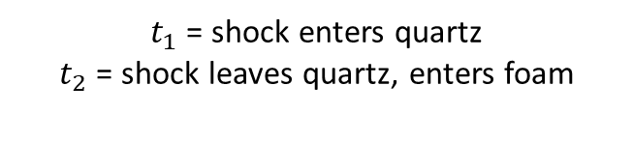

VISAR
Measured velocity
View 1
Shock
View 2
View 2
View 1
Vulcan beam
Time
$$t_{1}$$
$$t_{2}$$
View 2 signal expires when shock leaves quartz
View 1 still cannot see the shock
$t_{1}$ = shock enters quartz
$t_{2}$ = shock leaves quartz, enters foam

Slide 19
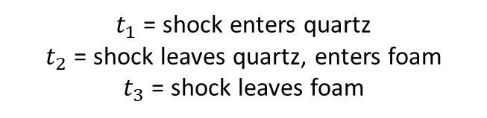

VISAR
Measured velocity
View 1
Shock
View 2
View 2
View 1
Vulcan beam
Time
$$t_{1}$$
$$t_{2}$$
$$t_{3}$$
View 1 also expires when the shock leaves the foam
$t_{1}$ = shock enters quartz
$t_{2}$ = shock leaves quartz, enters foam
$t_{3}$ = shock leaves foam

Slide 20
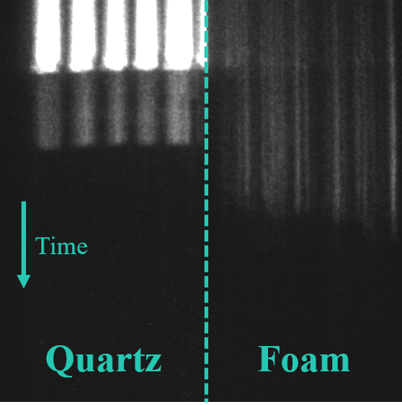
VISAR data (not yet published)

Slide 21
MC analysis for error quantification

Slide 22
Results (not yet published)

Slide 23
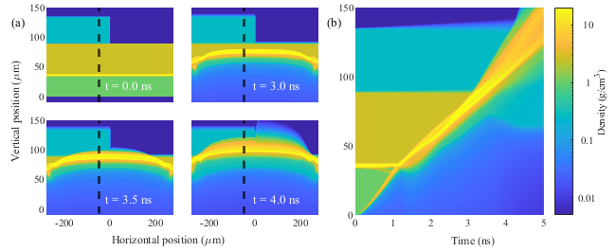
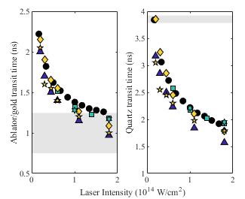
Comparison with simulation
2D flash simulation of the target
Simulated transit times compared to experimental data (Hyades, Helios, Multi, Multi-2d, Flash 1D + 2D)

Slide 24
Summary
We performed an experiment to measure the principle Hugoniot of TMPTA foam relevant to hydrodynamic equivalent ICF capsules, based around the principle of impedance matching.
Our results suggest that this material can be reasonably well described by the equation of state for low-density homogenous plastic.

Slide 25
Acknowledgements
Many thanks to everyone involved in the experiment, including all our collaborators at Oxford, York, LULI, ENEA, IPPLM, GSI, FUB, CLF, AWE.
Thanks to the experimental staff at the CLF for their assistance.
Thanks to UKRI-STFC, UKRI-EPSRC, and AWE for funding.

Slide 26
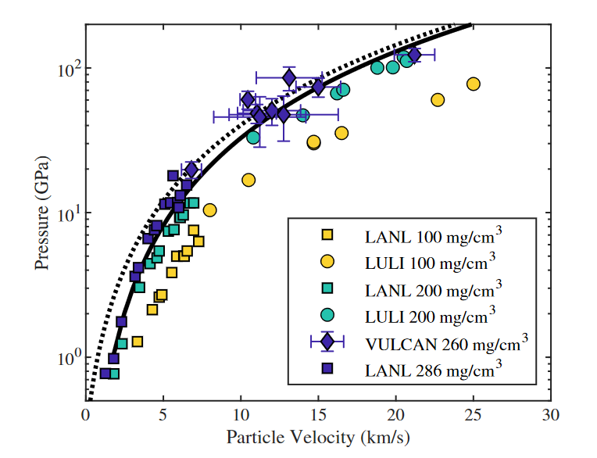
Experimental comparison

