Slide 1
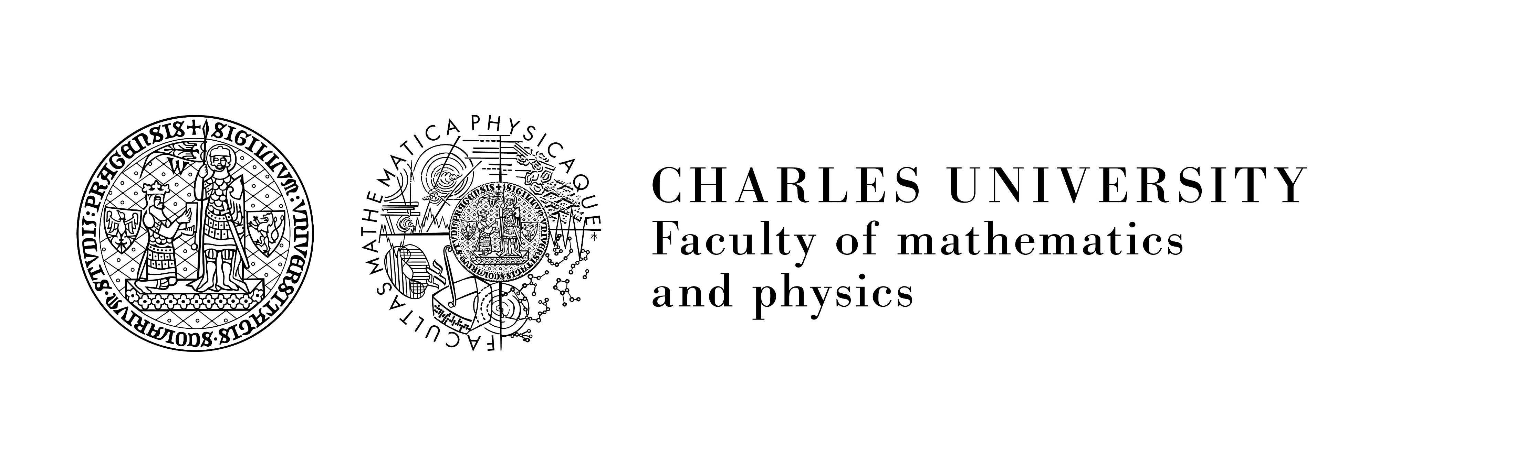

High-order frequency mixing in silicon in vacuum ultraviolet spectral region
Pawan Suthar, Martin Kozák
Faculty of Mathematics and Physics, Charles University, Ke Karlovu 3, 12116 Prague 2, Czech Republic

Slide 2
Outline
Introduction
Interaction of light and matter - high field physics (few TW/cm²)
High harmonic generation (HHG) in atoms and condensed matter
HHG in silicon from mid infrared and near infrared pulses
Dependence of the HHG on the laser polarization direction
Enhancement of VUV light generation from silicon – using high order nonlinear frequency mixing

Slide 3
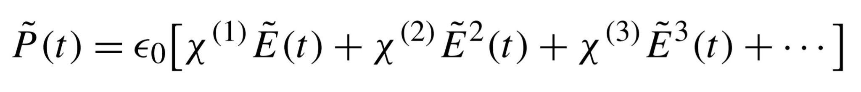
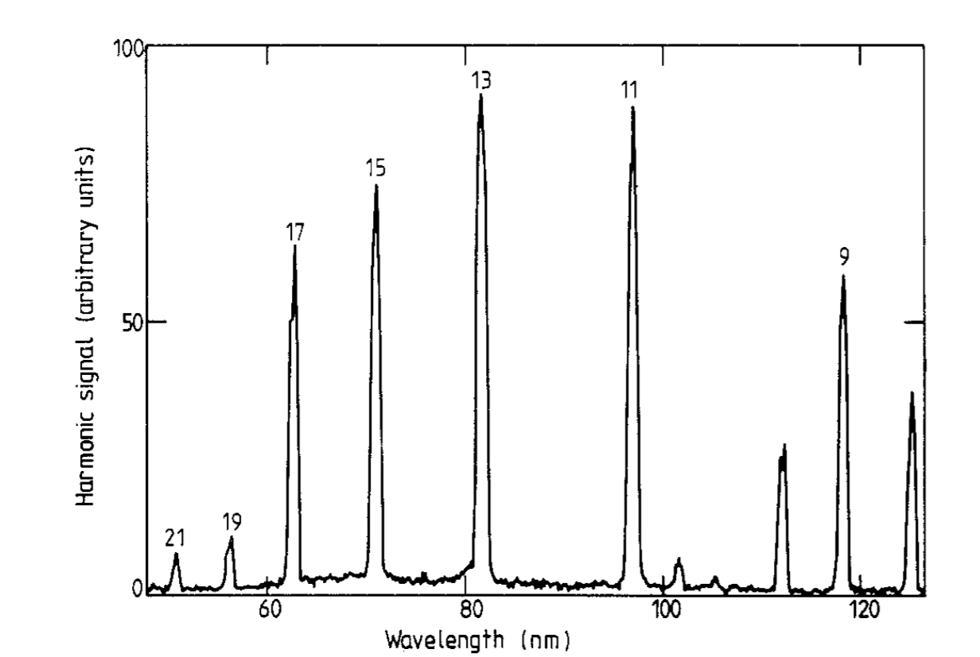
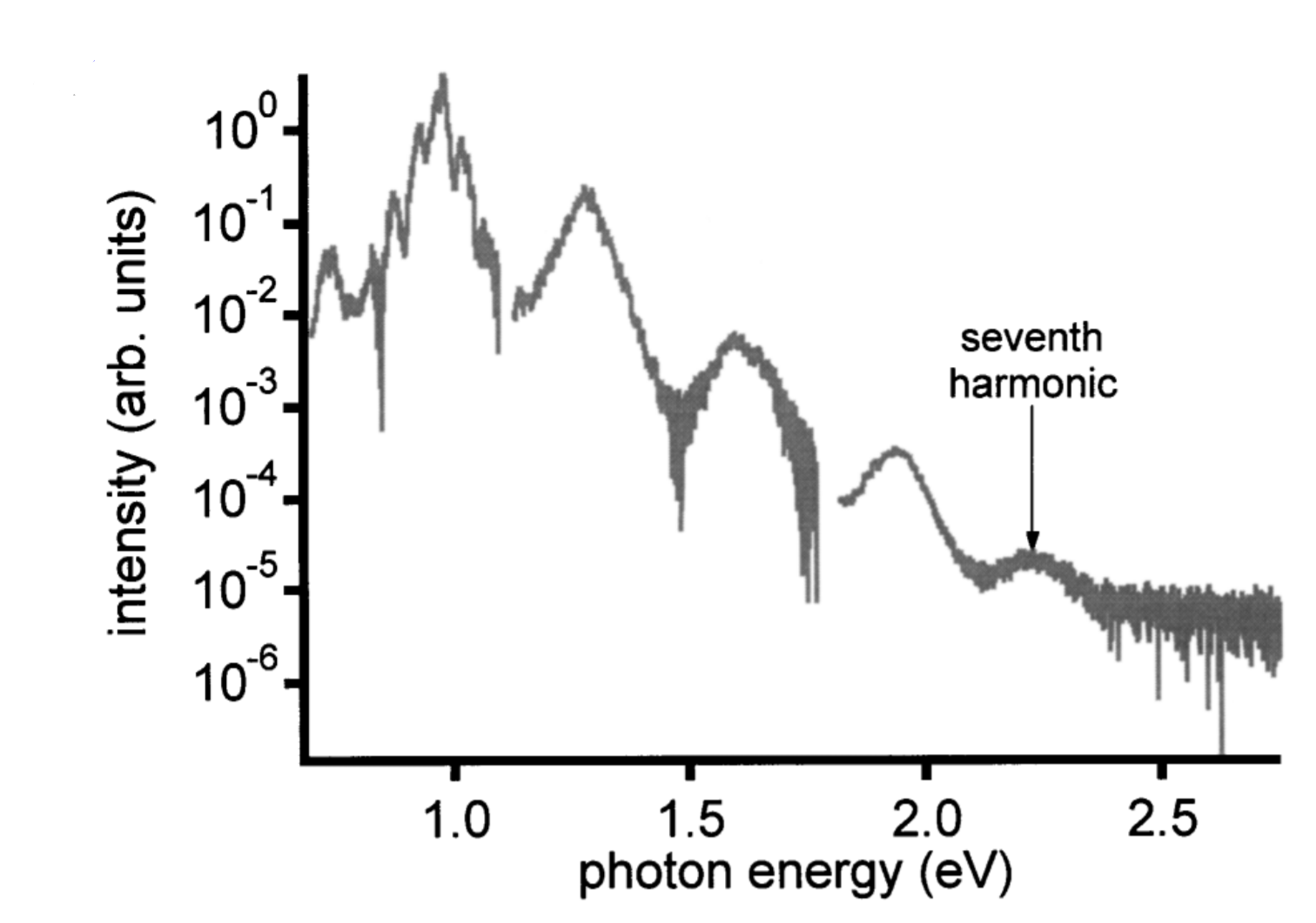
Perturbative regime
Non-perturbative regime
Electric field is small compared to the atomic fields
Polarization response can be expanded as a Taylor series,
Applied laser field is comparable to the atomic fields.
There is a plateau and a sharp cutoff in the harmonic spectra.
M Ferray et al 1988 J. Phys. B: At. Mol. Opt. Phys. 21 L31
Chin et al. J Phys. Rev. Lett. 86, 3292–3295 (2001)

Slide 4
High harmonic generation (HHG) in atoms
HHG – nonlinear generation of frequencies at integer multiples of the driving frequency (>5)
HHG in noble gasses (large binding energy) discovered in 1987
Non-perturbative process
Three step model
Ionization
Acceleration in electric field of laser
Recombination
Coherent source of attosecond pulses and soft x-rays
P. B. Corkum, F. Krausz, Nat. Phys. 3, 381 (2007).
M Ferray et al 1988 J. Phys. B: At. Mol. Opt. Phys. 21 L31

Slide 5
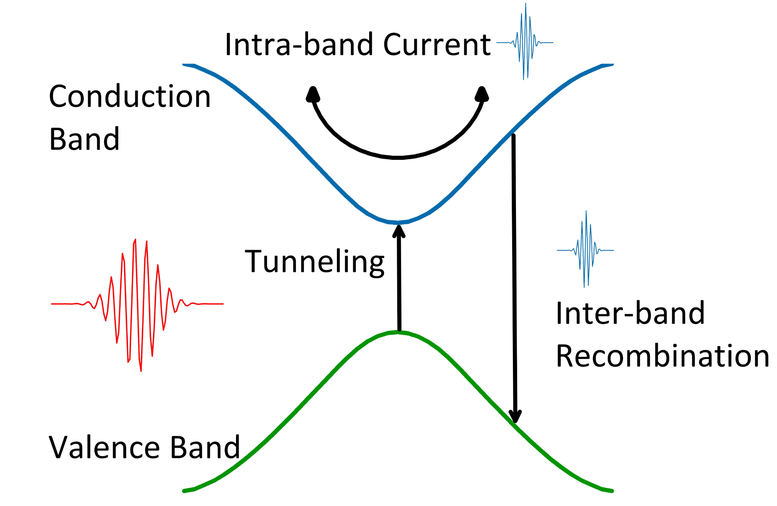
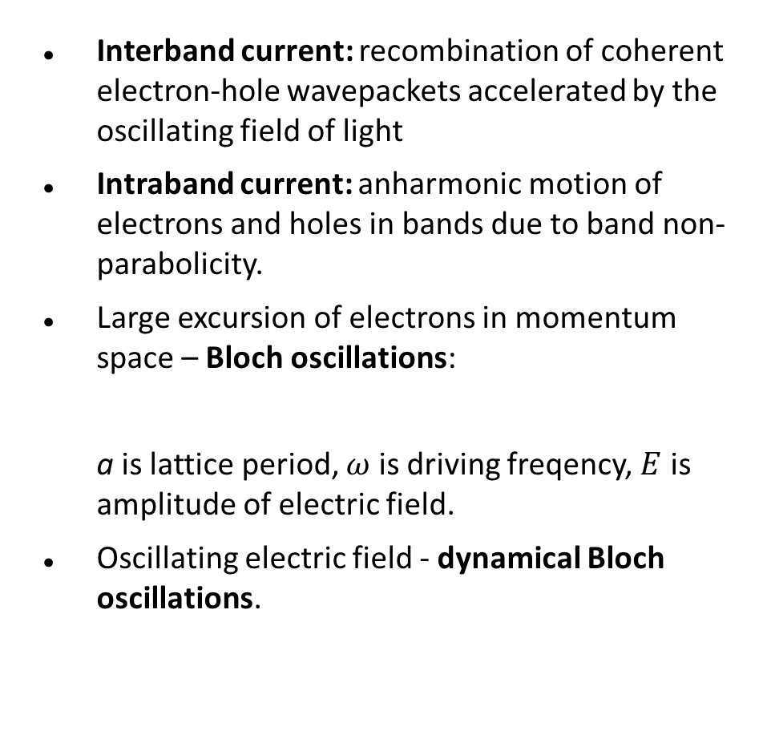
Physical mechanisms behind HHG in solids
Interband current: recombination of coherent electron-hole wavepackets accelerated by the oscillating field of light
Intraband current: anharmonic motion of electrons and holes in bands due to band non-parabolicity.
Large excursion of electrons in momentum space – Bloch oscillations:
a is lattice period, $ω$ is driving freqency, $E$ is amplitude of electric field.
Oscillating electric field - dynamical Bloch oscillations.
$$ℏω=a e |E|$$
Ghimire, S., Reis, D.A., Nature Phys 15, 10–16 (2019)

Slide 6
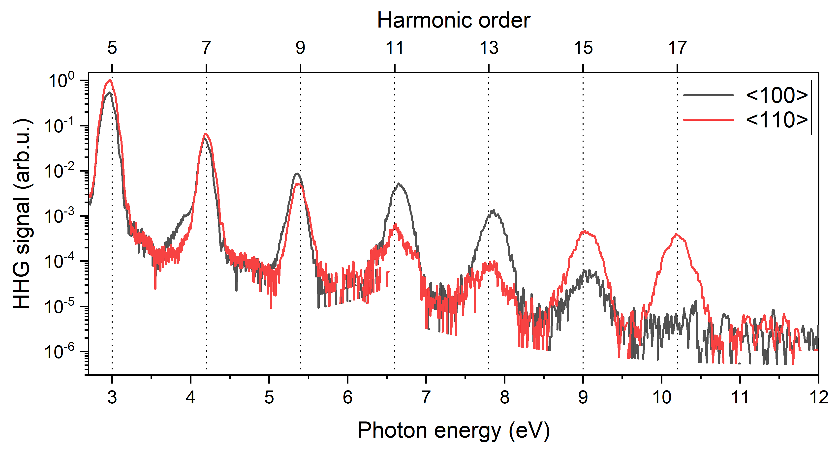
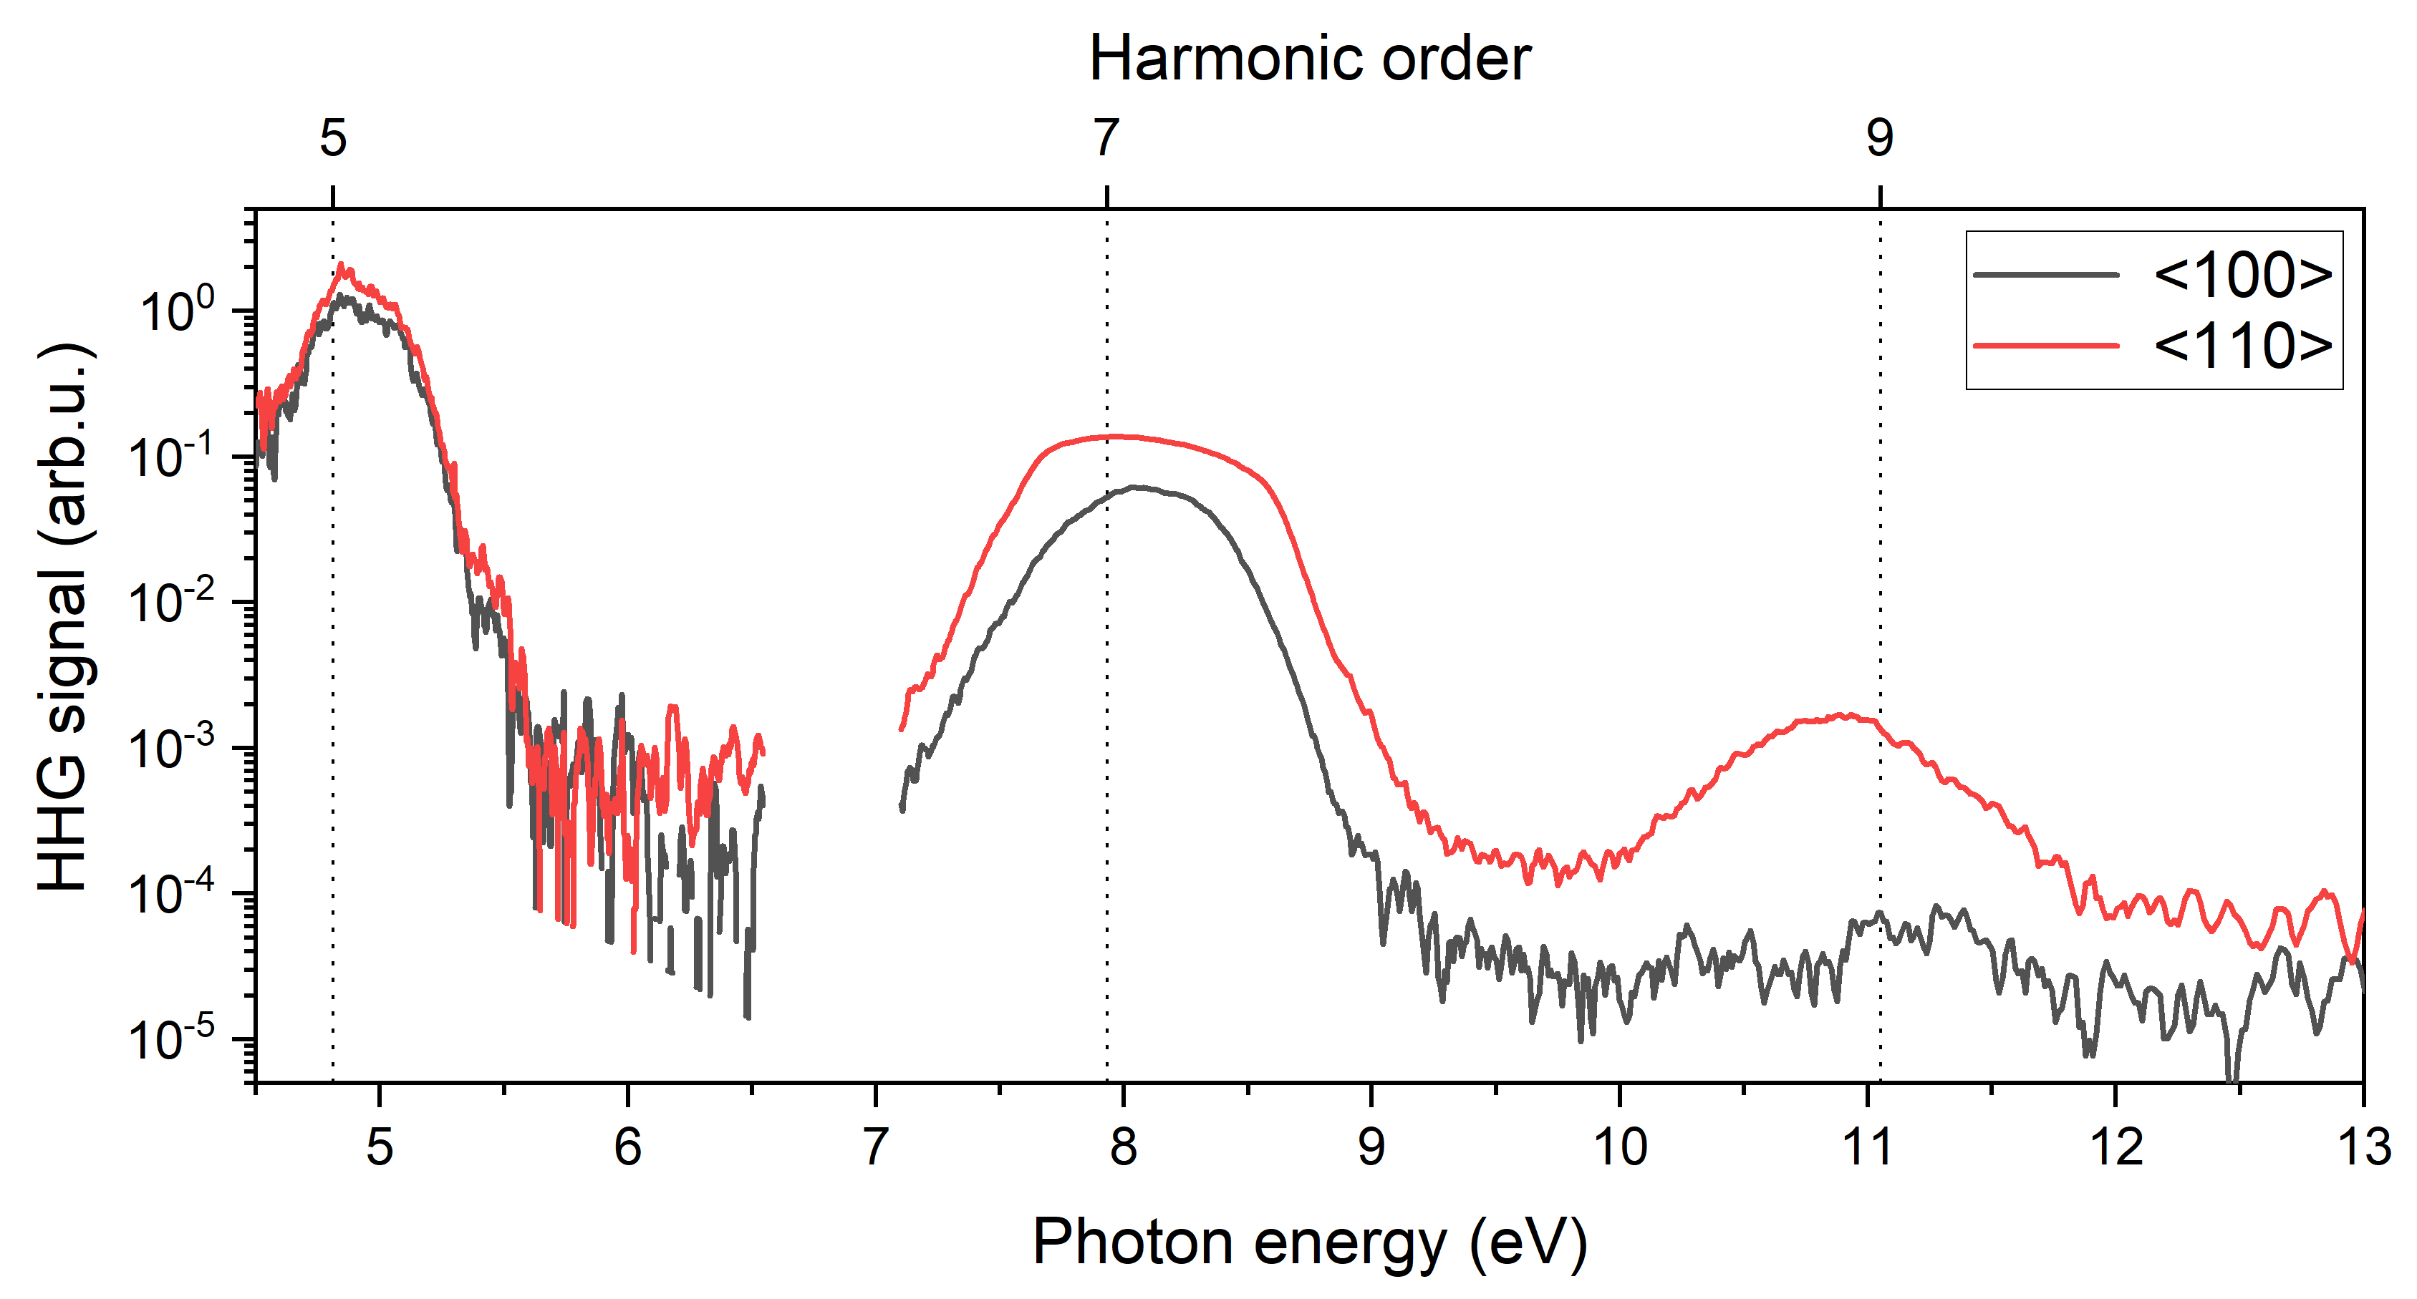
HHG in silicon in reflection geometry
MIR pulses 2000nm (0.6eV), 25 fs pulses produces harmonics in silicon up to 17th order.
NIR pulses 750nm (1.6eV), 6fs pulses used to detect harmonics in silicon up to 9th order.
We measure the dependence of the harmonics on the laser polarization direction with respect to the crystallographic direction of the silicon crystal.
Harmonic spectra from MIR(top) and NIR(bottom) pulses. Black and red lines denote the harmonics when laser polarization is along <100> and <110> crystallographic direction

Slide 7
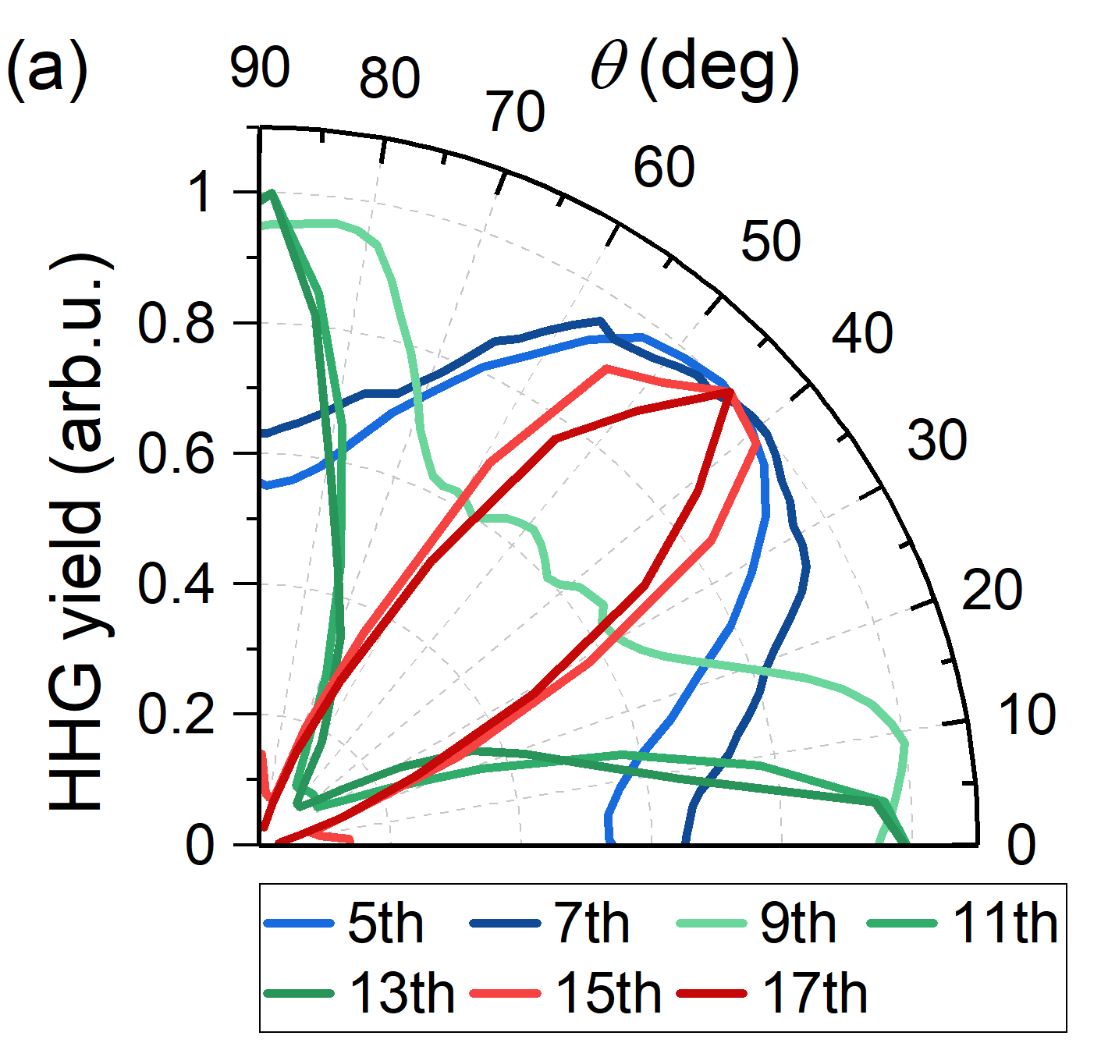
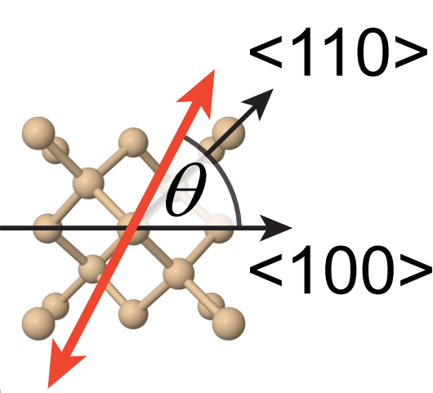
Dependence on the laser polarization direction
The harmonics from MIR pulses (left) show peculiar orientation dependence.
9th, 11th, and 13th harmonics have maximum intensity when laser polarization is along <110> direction while other harmonics have maximum intensity when laser polarization along <100> direction
The dependence of the harmonic generation yield on the polarization of the driving laser with respect to crystallographic orientation of silicon.

Slide 8
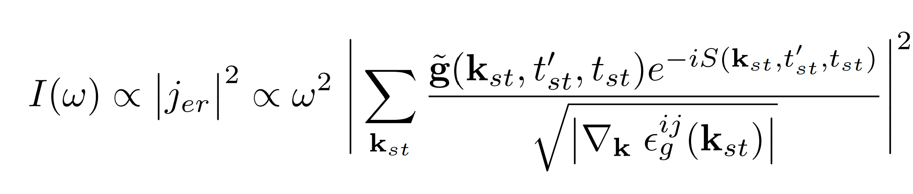
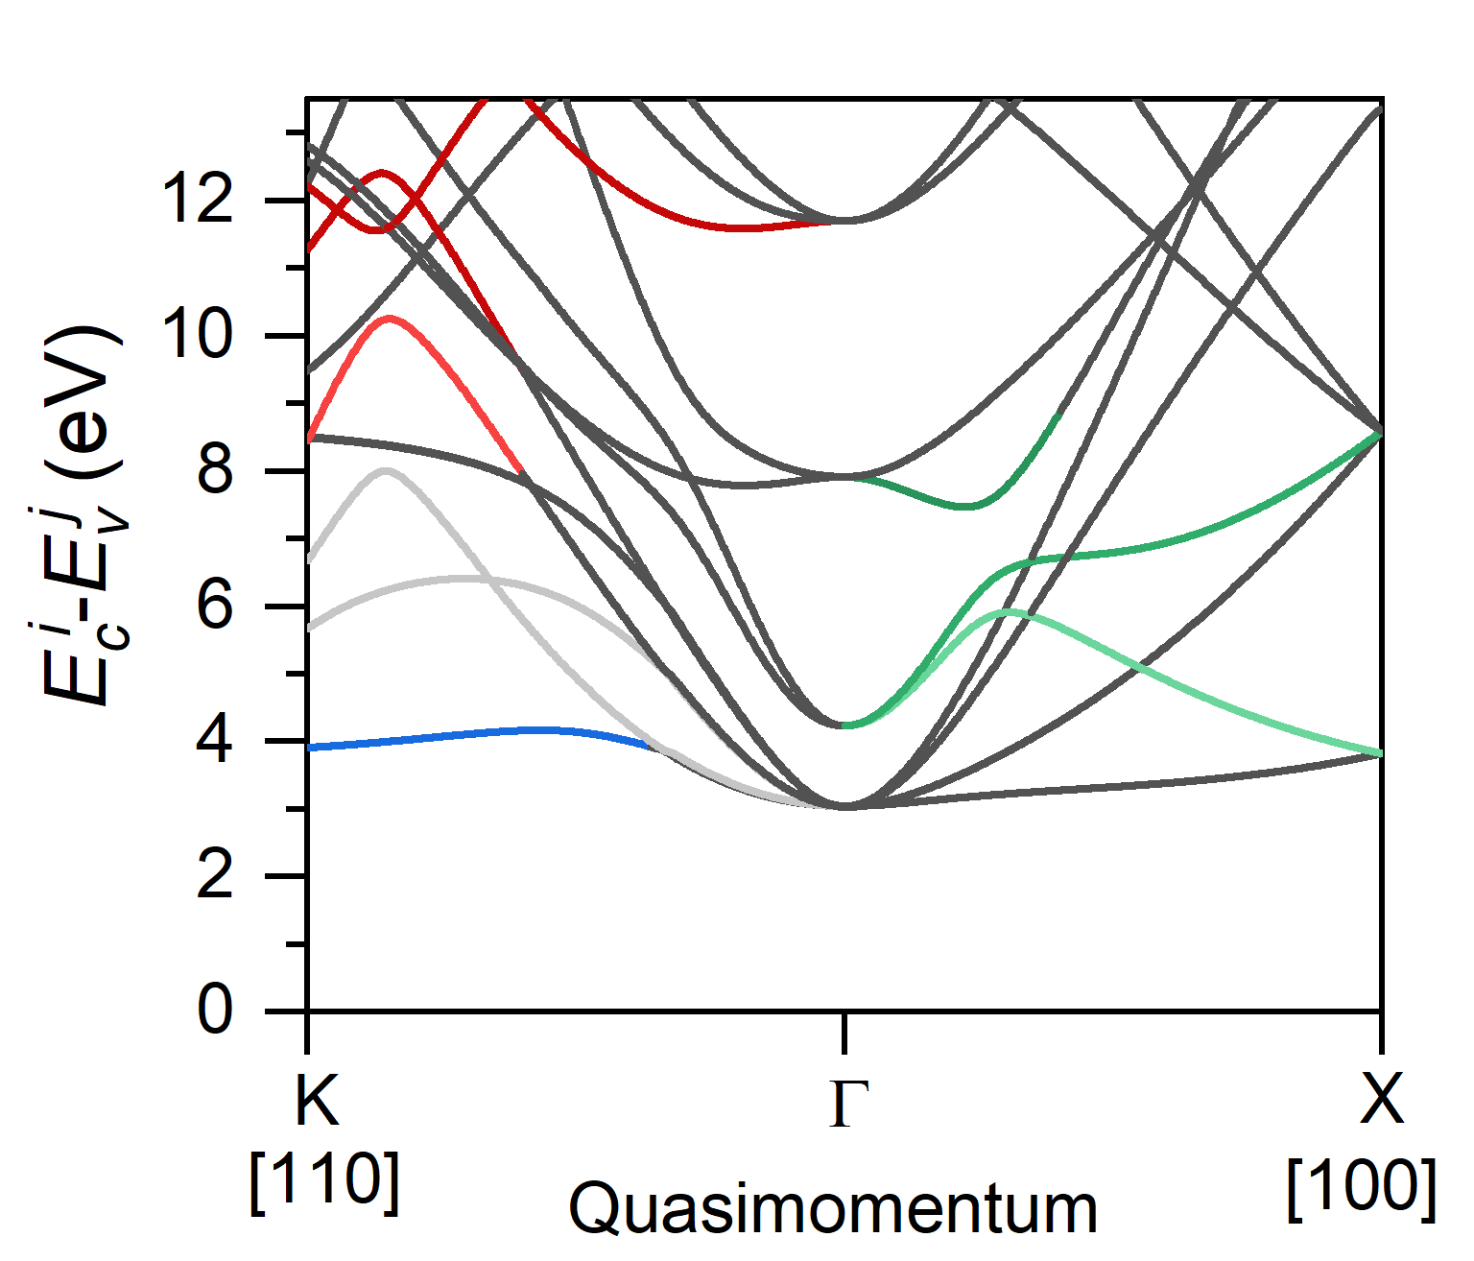
Dependence on the laser polarization direction
Van Hove singularities – where the derivative of the difference between conduction and valence bands become zero leading to enhancement in the recombination probability.
Uzan et al, Nature Photonics (2020) 14 -3,
DOI - 10.1038/s41566-019-0574-4

Slide 9
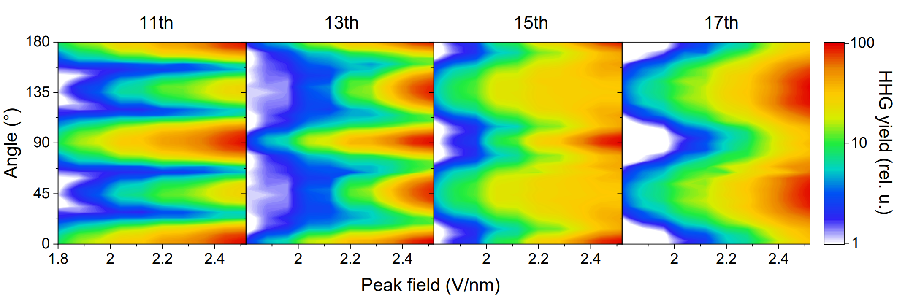
Dependence on the intensity of the driving laser
Increasing the intensity, we can accelerate the electrons further in the conduction band.
This allows to reach new Van Hove singularities farther from the gamma point thus changing the dependence of the harmonics on the polarization direction.
These are the represented by the grey bands in the band structure of silicon.

Slide 10
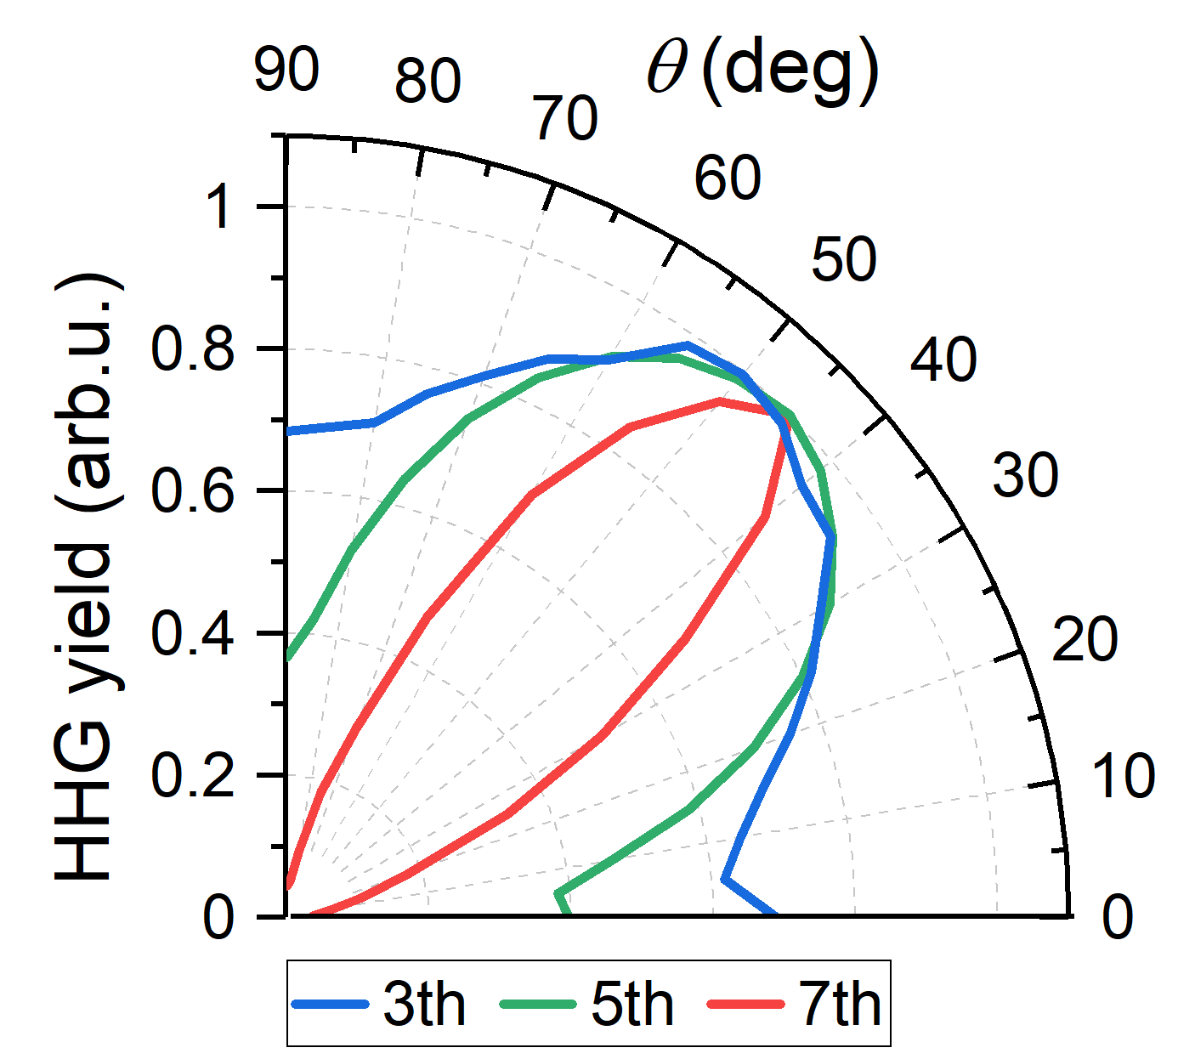
Dependence on the polarization of NIR pulses
Harmonics from NIR pulses show maxima in <110> direction due to increased tunneling probability along this direction.

Slide 11
High order frequency mixing in silicon
22-09-2022
Pawan Suthar
11

Slide 12
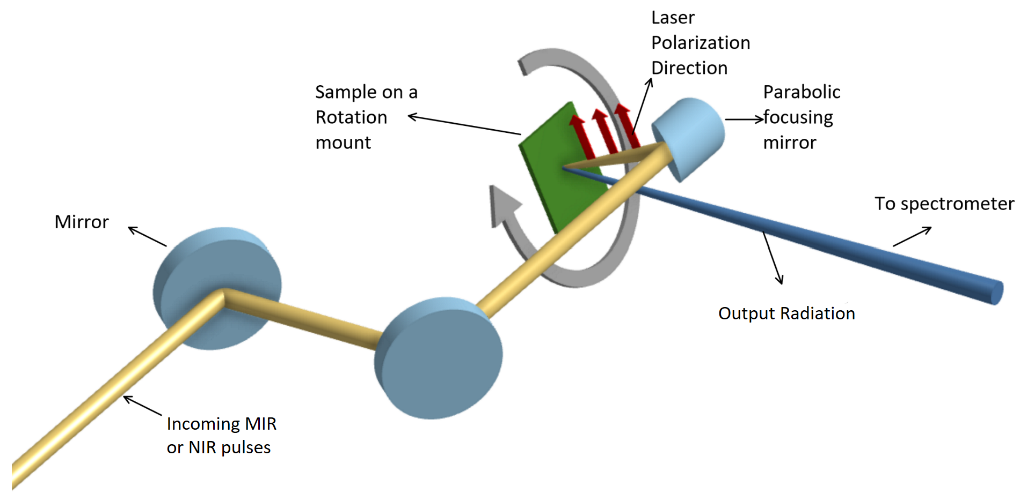
Nonlinear frequency mixing
• Crystalline silicon samples are irradiated by linearly polarized ultrashort broadband pulses MIR pulses (central wavelength of 2000nm and pulse length of 25 fs) and NIR pulses( central wavelength of 750 nm and duration of 7fs) to generate the high order frequency mixing radiation in the VUV spectral region.

Slide 13
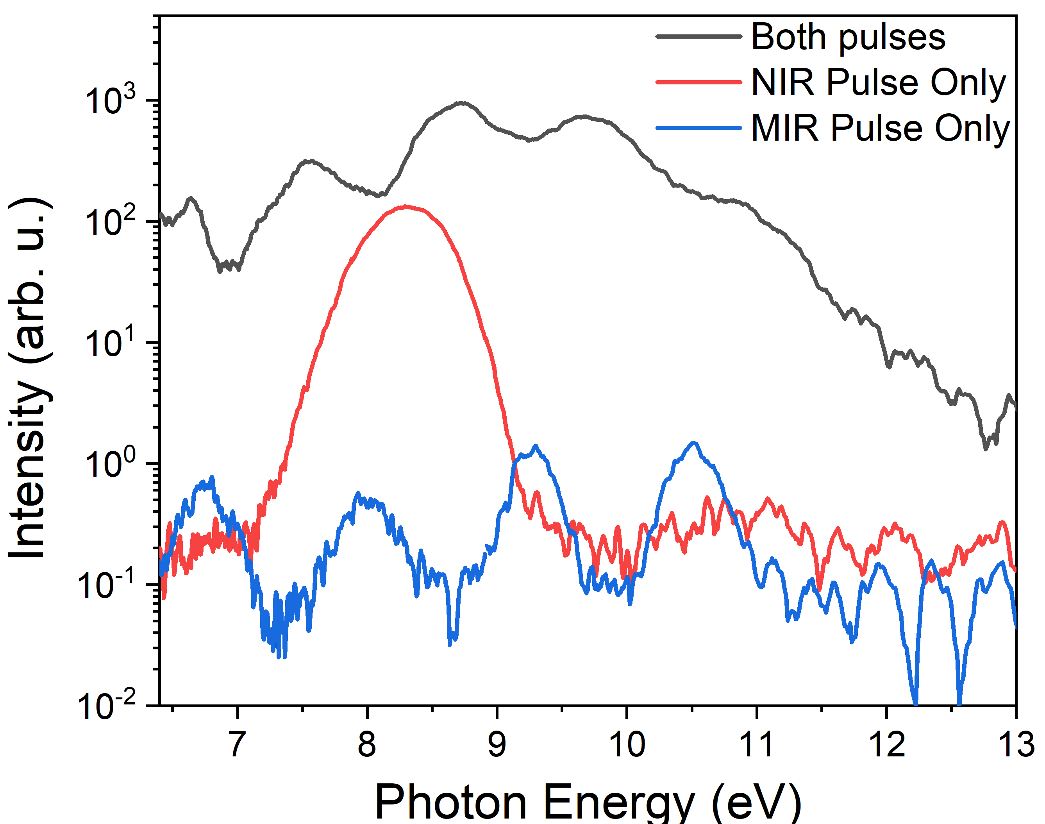
Enhancement of VUV Light compared to high harmonics
High order frequency mixing leads to an enhancement in the VUV optical response in crystalline silicon which might be useful as a source of bright coherent wideband UV radiation.
The yield of the high energy photons is increased by almost 2 orders of magnitude compared to just the HHG signal from the MIR pulses in the same spectral region.

Slide 14
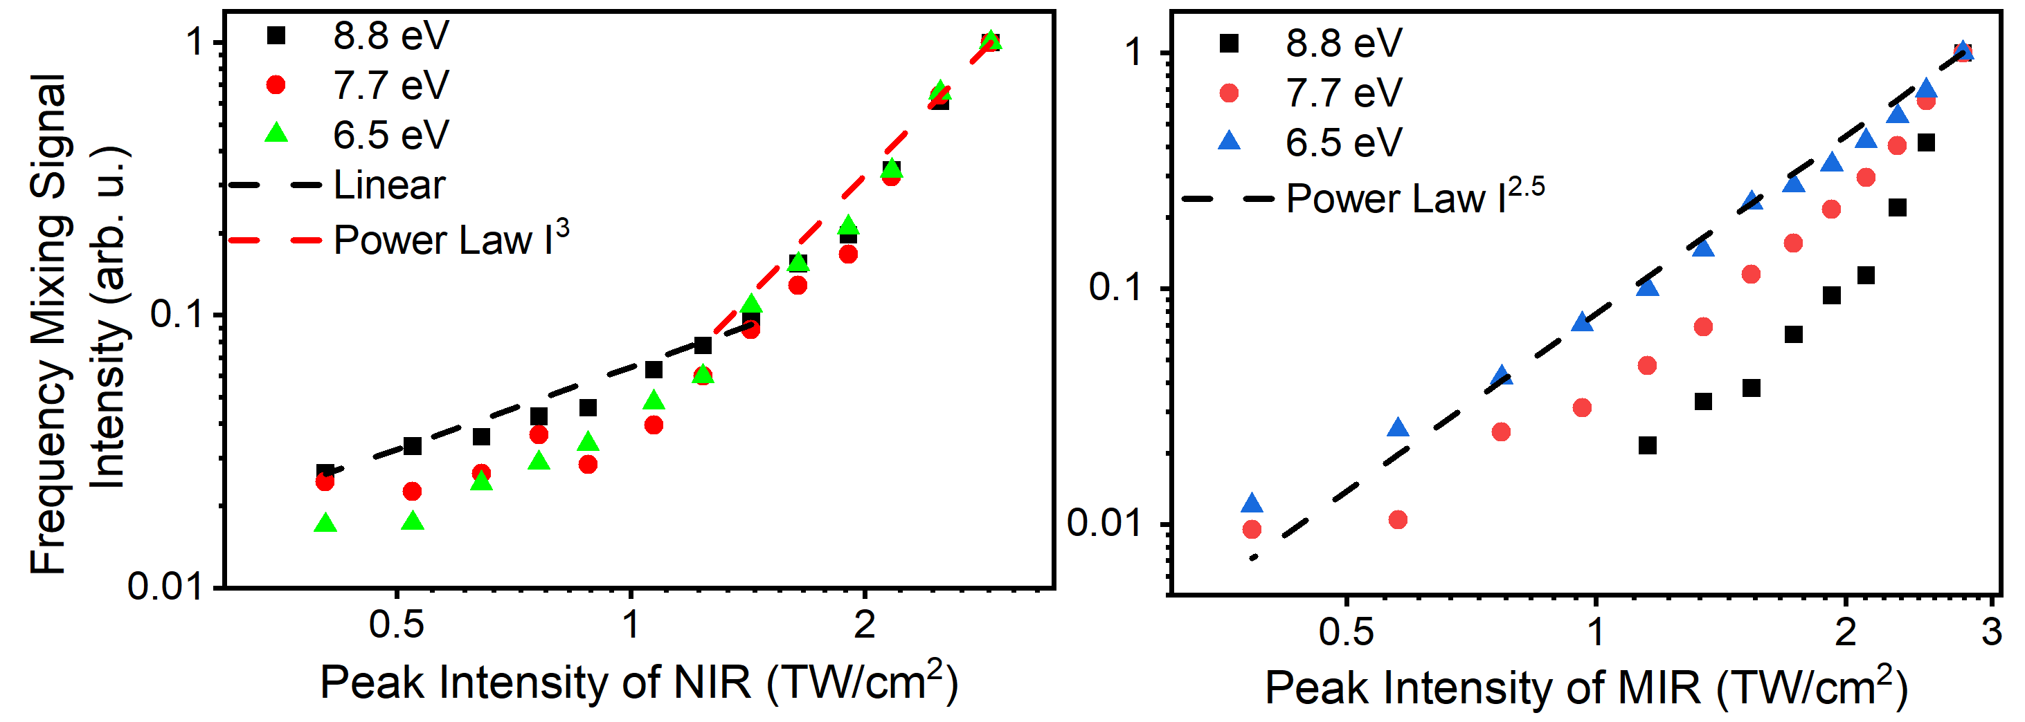
Dependence on the intensity of driving pulses
The intensity dependence of the NIR pulses shows two distinct regimes - linear and nonlinear with power scaling of I³.
At higher intensities of NIR, multiphoton processes start to become important.
The scaling is close I^{2.5} for low energy photons but the dependence is steeper for higher energies in accordance with high order frequency mixing.
The intensity dependence confirm the nonlinear nature of the interaction where we need several photons from both pulses for the high order frequency mixing process.

Slide 15
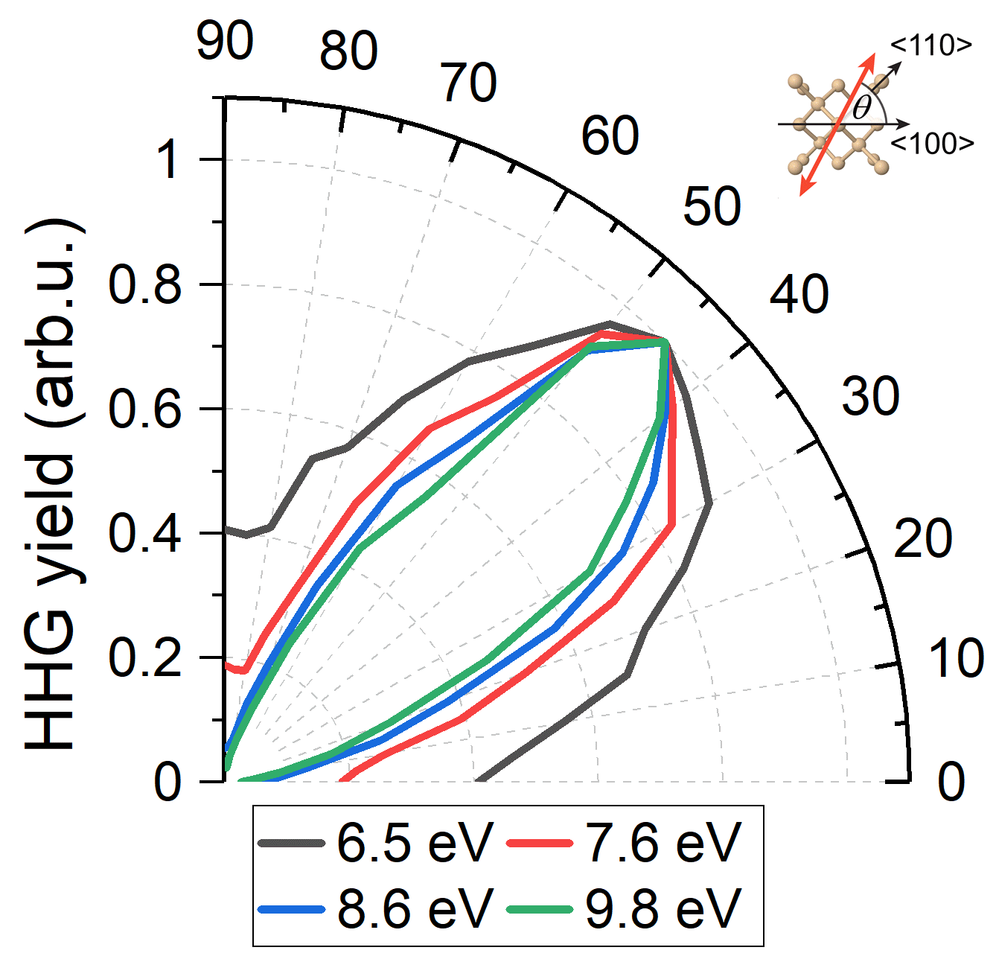
Dependence on the laser polarization direction
The output is maximum when laser polarizations are oriented along <110> crystallographic orientation of silicon.
Higher energies have more pronounced peaks in the direction compared to lower energy part of the spectrum.
This dependence is similar to HHG from the NIR pulses pointing to the role of tunneling probability in different directions as the main reason behind the asymmetries in the signal.
The dependence of different spectral components of the emitted VUV light on the polarization of the laser pulses with respect to the crystallographic axis of silicon crystal.

Slide 16
Conclusions
High harmonic generation in silicon driven by MIR and NIR pulses was studied.
Crystallographic orientation dependence – role of Van Hove singularities in the band structure and tunneling probabilities.
Coherent two-color illumination to enhance the broadband VUV radiation by 2 orders of magnitude using high order frequency mixing.
Intensity and laser polarization of the radiation was also studied to confirm the nature of the interaction.

Slide 17
Thank you.
Financial support from Czech Science Foundation (project GA18-10486Y), Charles University (GAUK 349921, UNCE/SCI/010, SVV2020-260590, PRIMUS/19/SCI/05).

