Slide 1




The superconducting magnet system of the Italian Divertor Tokamak Test (DTT) Facility
Luigi Muzzi
on behalf of the DTT Magnet System design team:
A. Di Zenobio, S. Turtù, L. Affinito, A. Anemona, V. Corato, C. Fiamozzi Zignani, L. Giannini, G. Messina, L. Morici, R. Righetti, G. Romanelli, L. Zoboli and A. della Corte – ENEA
R. Bonifetto, A. Zappatore and R. Zanino – Politecnico di Torino (NEMO Group)
and DTT design contributors:
see Divertor Tokamak Test facility – Interim Design Report; ed. by R. Martone, R. Albanese, F. Crisanti, P. Martin and A. Pizzuto; ISBN: 978-88-8286-378-4

Slide 2

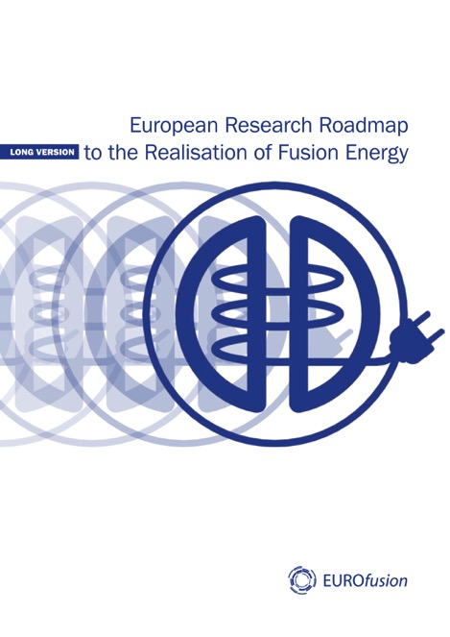
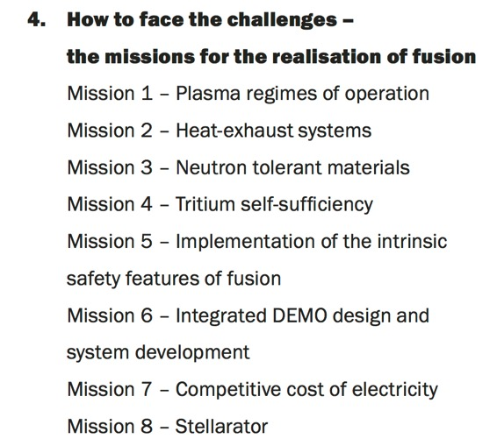
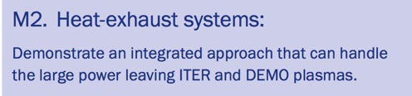
EU Research Roadmap to Fusion Energy
(Sept. 2018)
L. Muzzi - The DTT Magnet System

Slide 3
DTT: Divertor Tokamak Test Facility project
General objective: create a research infrastructure addressed to the solution of the power exhaust issues in view of DEMO.
Test Divertor alternative solutions & improve experimental knowledge in the PEX scientific area
Replace Divertor by Remote Handling
High Magnetic System flexibility to Implement Various Plasma configurations
L. Muzzi - The DTT Magnet System

Slide 4
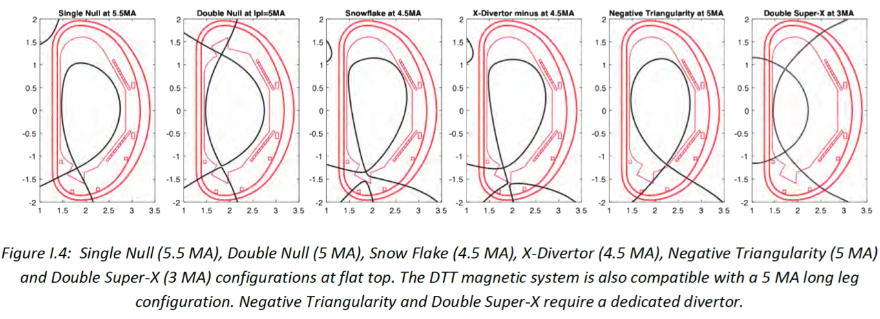
DTT Facility Overview
The facility will offer high flexibility to test the candidate divertor concepts and to probe different magnetic (i.e. plasma) topologies
Magnetic configurations and e.m. analysis by R. Ambrosino
L. Muzzi - The DTT Magnet System

Slide 5
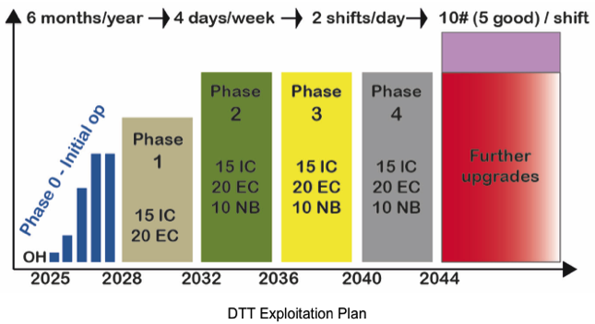
Reference machine parameters
Max. plasma current: 5.5 MA. Inductive operation with a max. high β flat top up to 50 s.
Heating system providing 45 MW (target) (20-30 MW ECRH, 3-9 MW ICRH, 7-15 MW NNBI).
R (m) / a(m) | 2.14/0.65 SN – 2.14/0.65 DN
A | 3.3 SN/DN
Vol (m³) | ≈28
I_{p} (MA) | 5.5
B_{T} (T) | 6 @ R₀
Neutron production rate, Sn (n/s) | 1.2-1.5 10^17 DD + 1% DT
Maximum dwell time for high performance | 3600
Nominal repetition time after disruption (s) | 3600
Number of shots per day | 5-10
Days of operation per year | 100
Years of operation | 25
L. Muzzi - The DTT Magnet System

Slide 6
DTT s.c. Magnet System Overview
  18 TF coils:
  Nb₃Sn CICC: 42.5 kA – 11.9 T
  providing 6.0 T over plasma major radius (2.14 m)
  6 CS modules (indipendently fed)
  Nb₃Sn CICC: 30 kA – 13.4 T
  providing 16.3 Weber magnetic flux for plasma initiation at breakdown
2.14 m
5.3 m
  6 PF coils
  Nb₃Sn (PF1 & PF6) CICC: 28.3 kA – 8.5 T
  NbTi (PF2 to PF5) CICC: 28.6 kA – 5.4 T
  Identical in pairs to guarantee full top/down symmetry
L. Muzzi - The DTT Magnet System

Slide 7
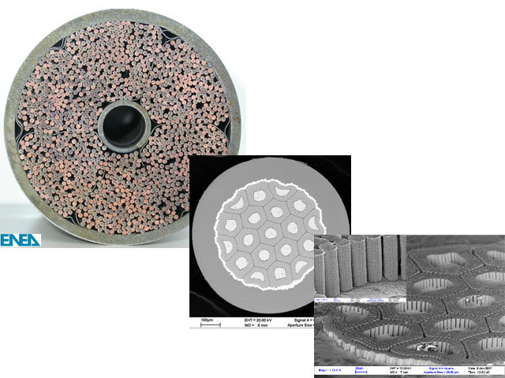

S.C. components design rationale
ITER TF CICC
Empty fraction for forced He circulation
DTT superconducting coils (in terms of strands, conductor, coil winding technology) design is based on the assumption of:
Pressure relief channel
strand
1000 ÷ 5000
filaments
tight time and budget constrains: state-of-art magnet technology choices (or close to), in order to minimize R&D.
Steel
jacket
Strand bundle
L. Muzzi - The DTT Magnet System

Slide 8
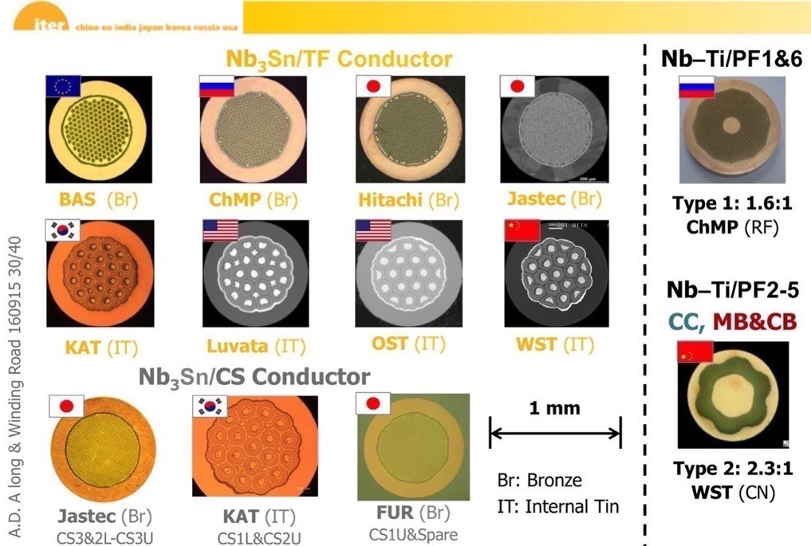
S.C. components design rationale: STRANDS
Ic achieved: 190 A – 315 A
on 0.82 mm wire
(Vostner - SUST 2017)
Ic achieved: 325 A
on 0.73 mm wire @ 6.4 T
(Karasev – IEEE TAS 16)
all 0.82 mm wires | Min. Critical Current
DTT TF specs (Nb₃Sn) | 285 A (4.2 K; 12 T; 0% strain)
DTT CS & PF1/6 specs (Nb₃Sn) | 260 A (4.2 K; 12 T; 0% strain)
DTT PF2-5 specs (NbTi) | 500 A (4.2 K; 5 T)
Courtesy A. Devred
Ic achieved > 260 A
on 0.82 mm wire
(Devred - SUST 2014)
L. Muzzi - The DTT Magnet System

Slide 9




S.C. components design rationale: STRANDS
55 tons
all 0.82 mm wires | Min. Critical Current
DTT TF specs (Nb₃Sn) | 285 A (4.2 K; 12 T; 0% strain)
DTT CS & PF1/6 specs (Nb₃Sn) | 260 A (4.2 K; 12 T; 0% strain)
DTT PF2-5 specs (NbTi) | 500 A (4.2 K; 5 T)
22 tons
L. Muzzi - The DTT Magnet System

Slide 10
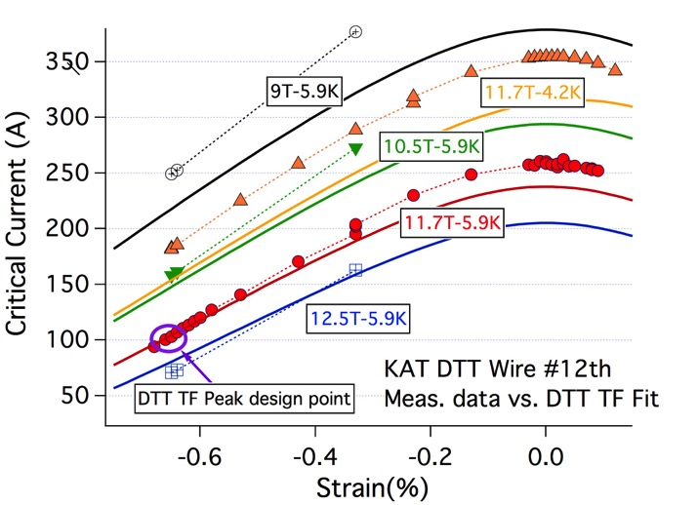
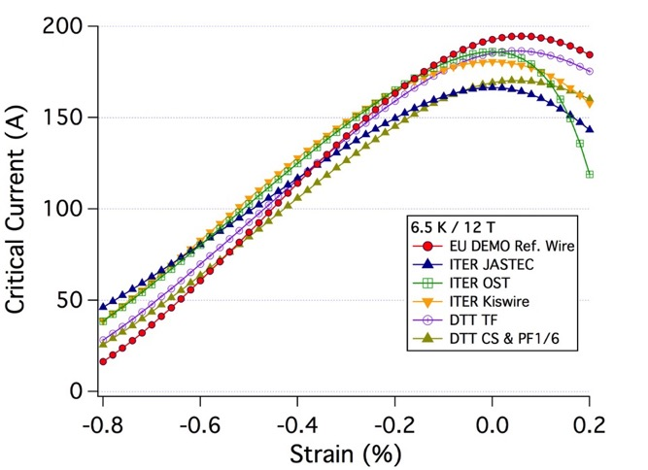
S.C. components design rationale: STRANDS
- Nb₃Sn performance depends (strongly) on strain state and sensitivity is hard to predict;
- Nb₃Sn wire inside Cable-in-Conduit conductors (CICC) is subject to strain:
Breschi_SUST 2017
Typical operating range
L. Muzzi - The DTT Magnet System

Slide 11
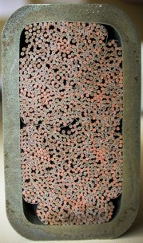
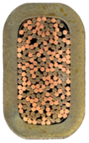
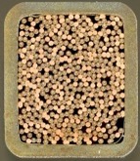
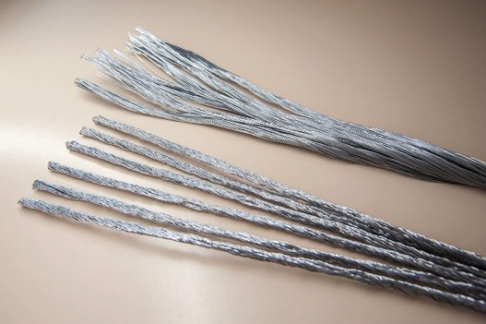
S.C. components design rationale: CICC
DTT CICC design is based on the results collected within a number of programs:
Present reference CICC solution based on:
rectangular geometry, with constant thickness steel jacket;
EITHER very short twist pitch cable configuration (ITER CS-like) OR long twist pitch & low Void Fraction (HFML / NHMFL-like)
Assumption: ε_{eff} = - 0.65%
JT-60SA
HFML
EU-Alt TF
NAFASSY
Design verification with dedicated experimental tests (DC properties with e.m. and thermal cycling + AC losses) is necessary, in order to assess the actual performance.
L. Muzzi - The DTT Magnet System

Slide 12
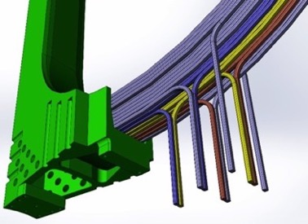
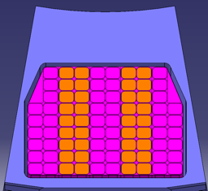
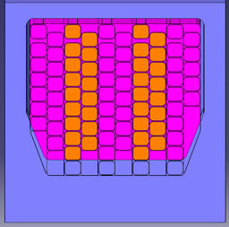
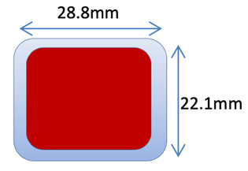
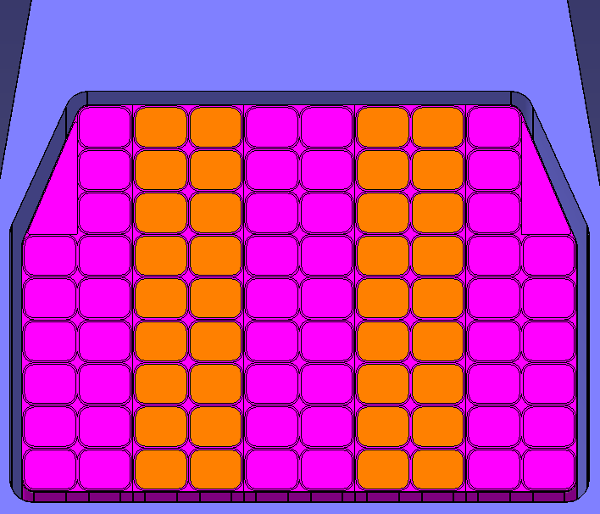
Toroidal Field Coils
- CICC operating current: 42.5 KA
- B_{peak}: 11.9 T
- Double pancake-winding: 3 rDP; 2 sDP; 84 turns
- Max. hydraulic length: 110 m
- Cable: 420 / 180 S.c./Cu wires
- ΔT_{margin} > 1.4 K
- Jacket: 1.9 mm 316 LN
- Turn insulation: Fiber-glass + resin
- Wind → React → Insulation → Impregnation
Overall TF energy: 2 GJ
L (1 TF coil): 48 mH
Max. Volt. at discharge < 1 kV (terminal to terminal)
TF coil height ≈ 6 m
TF coil width ≈ 3.2 m
L. Muzzi - The DTT Magnet System

Slide 13
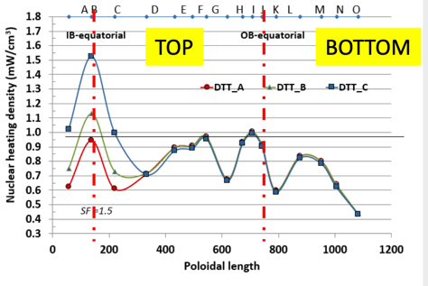
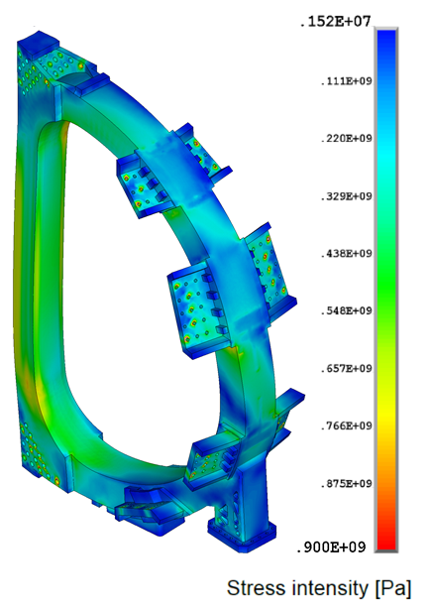
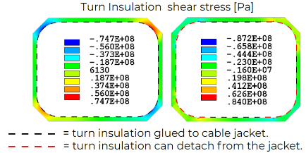
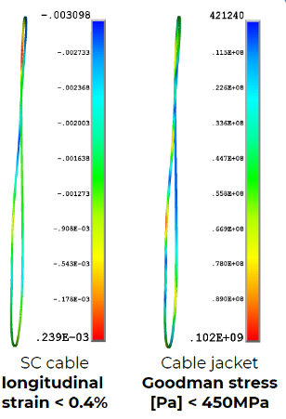
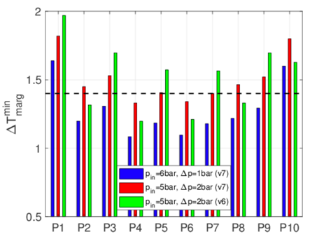
Toroidal Field Coils: analyses
Thermal-Hydraulics
3D global
2D detailed
3D submodeling

Slide 14
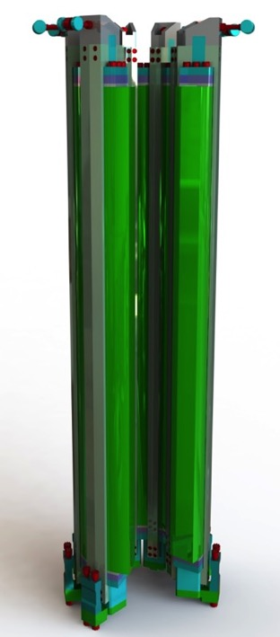
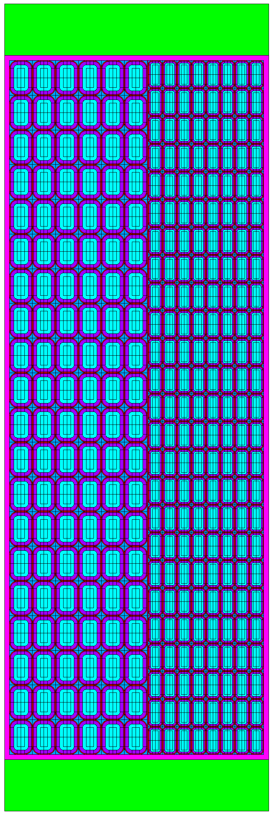
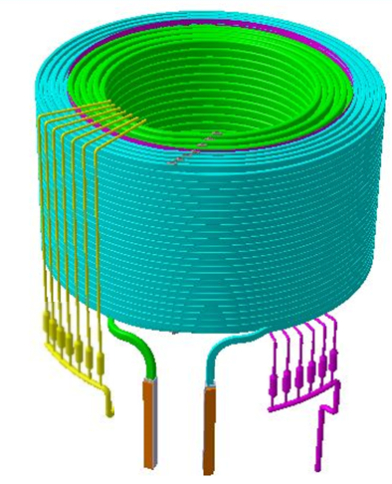
Central Solenoid modules
Design choices:
6 identical but independent modules
Layer wound (optimized J_{E} --> Flux > 16.3 W
Optimized concepts for inter-grade joints and terminations
G-10 inter-module spacer (60 mm)
5.3 m
High Field Section
648 s.c. wires
4.1mm jacket
Low Field Section
180 s.c. wires
2.0mm jacket
1,5 m
L. Muzzi - The DTT Magnet System

Slide 15
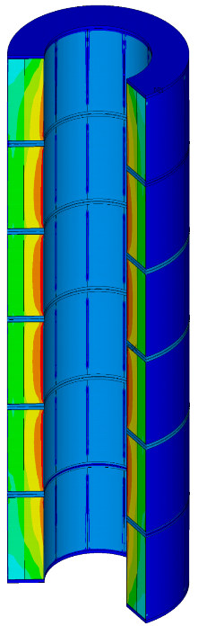
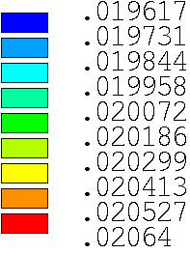
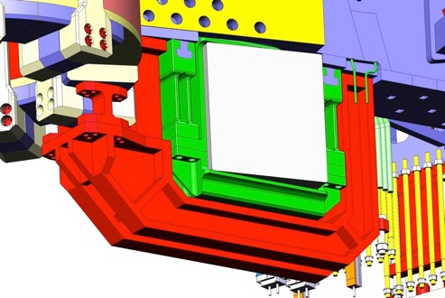
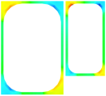
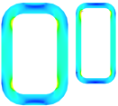
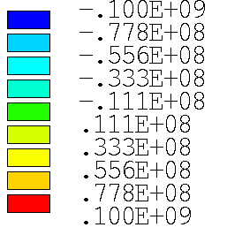
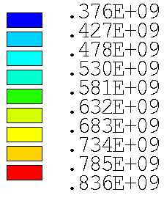

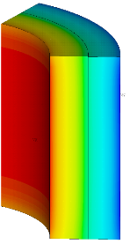
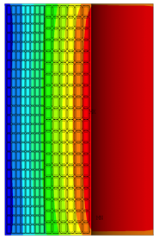
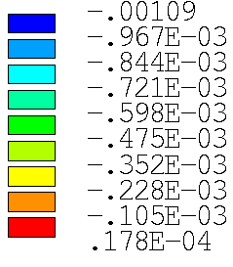
Central Solenoid - analyses
3D global
2D detailed
Stress level in SS is below the allowable limits for both components: membrane (667 MPa) and membrane + bending (867 MPa)
«Deformed shape x100»
[ Pa ]
SINT
3D submodeling
Shear XY
CS Gravity support
(only on lower side; attached to TF casing)
[ m ]
CSU1(Ur)

Slide 16
CS and PF support structures
CS Gravity support
(only on lower side; attached to TF casing)
L. Muzzi - The DTT Magnet System

Slide 17
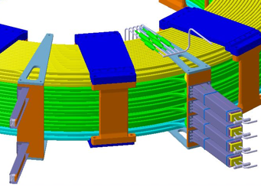
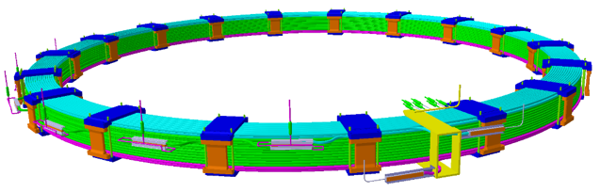


Poloidal Field Coils
COIL | PF1/6 | PF2/5 | PF3/4
Bmax (T) | 8.5 | 4.4 | 5.4
# turns (radial x vertical) | 20 x 18 | 10 x 16 | 14 x 14
I_{op} max (kA) | 28.3 | 27.1 | 28.6
ΔT_{margin} (T_{op}: 4.5K) | 1.8 | 1.8 | 1.7
Hydraulic length (m) | 178 | 193 | 381
L (H) | 0.454 | 0.298 | 0.690
V_{max} (V) | 2150 | 1350 | 3290
Weight (ton) | 15 | 16 | 28
Delay / discharge const. | 1.5 s / 6 s
CICC dimensions (mm) | 23.4 x 28.3 | 26.4 x 27.7 | 26.4 x 27.7
Jacket thickness (mm) | 3.0 | 3.0 | 3.0
Central channel (in/out) | 5 / 7 mm | 5 / 7 mm | 5 / 7 mm
# SC / Cu strands; 0.82 mm | 180 (Nb₃Sn) / 216 | 162 (NbTi) / 324 | 324 (NbTi) / 162
PF1
PF2
PF3
PF Double or Quadri-pancake winding and joint (praying or shaking hands) boxes
PF4
DP winding for PF2 to 5
PF6
PF5
L. Muzzi - The DTT Magnet System

Slide 18
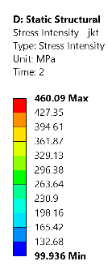
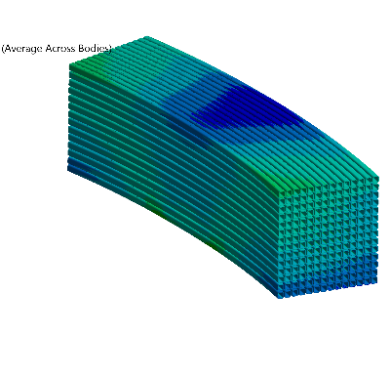
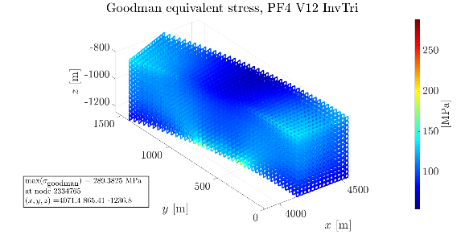
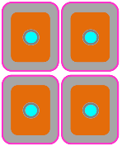
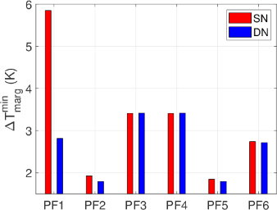
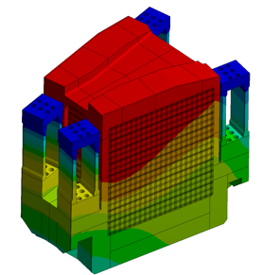
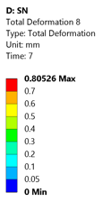
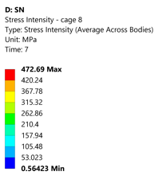
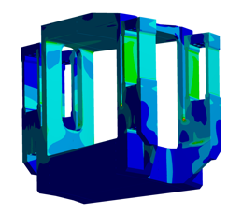
Poloidal Field Coils - analyses
Thermal-Hydraulics
3D global
Fatigue assessment
common He inlet for each DP at coil bore
Inter-turn
Inter-pancake
counter-current He flow in adjacent pancakes
Target ∆T_{margin} > 1.7K
is reached in each coil (AC losses values still to be experimentally verified)
L. Muzzi - The DTT Magnet System

Slide 19
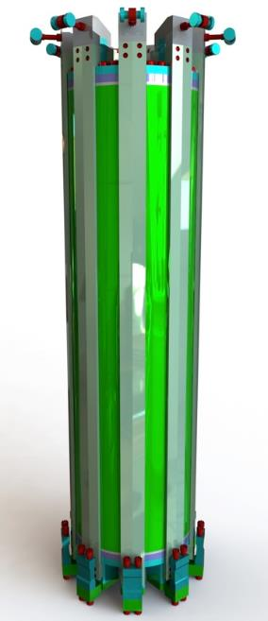
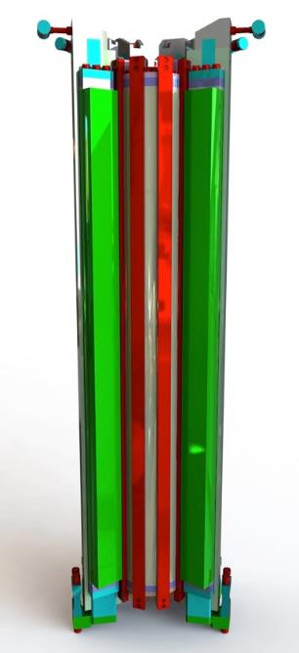
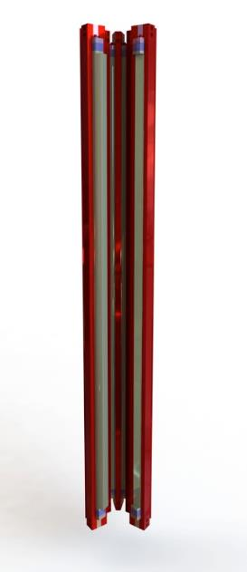

CS HTS Insert Coil
DTT as a test-bed for next generation fusion magnets
Design of a HTS insert
(presently outside of the DTT scope)
Pre-compression structures
Coil centering systems
Technical merits:
Higher Magnetic Flux (16.4 Volt sec → 17.3 Volt sec)
Higher Magnetic Field (14 T → 17.5 T)
Fundamental technology demonstration toward high-magnetic field fusion.
HTS
LTS

Slide 20


CS HTS Insert Coil
ENEA-TRATOS Aluminum slotted Core HTS CICC
Most recent concept
External high-strength Aluminum-alloy jacket.
L = 36 mm
6 slots for twisted stack of s.c. tapes
30 – 35 kA current in 18 T – 20 T field (to be tested)
L. Muzzi - The DTT Magnet System

Slide 21

Summary and perspective
  The DTT – Divertor Tokamak Test Facility is going to be built in Frascati (Italy), aimed to the study of power exhaust solutions in view of DEMO.
  The project has undergone a number of Design Review milestones, and the superconducting magnet design is being finalized. Its design was based as much as possible on already assessed technologies. All coils will be cold tested.
  First procurement milestone was the Tender for the strand supply, to be followed within the next few months by conductor and TF coil procurement tenders.
  Currently outside the scope of the project, a feasibility study is on-going, of a HTS coil to be inserted (at a later stage!) into the Central Solenoid to increase the available flux and to use DTT also as a test-bed for the development of the next generation fusion magnets.
Interim Design Report
April 2019
Ed. by R. Martone (CREATE), R. Albanese (CREATE), F. Crisanti (ENEA), P. Martin (RFX) and A. Pizzuto (ENEA)
L. Muzzi - The DTT Magnet System

