Slide 1
ENEA 2019 R&D Activities
DEMO WPMAG 2019 Final Meeting
11-13 February 2020; ENEA Frascati (Italy)
L. Muzzi (on behalf of: ENEA FSN – Superconductivity Division)
R. Righetti - ICAS
Notes:
Good morning to everybody,
I'm very pleased to be here, and to provide my EXTERNAL point of view for an hopefully fruitful discussion. Although in a different environment, I'm fully involved in the R&D on high current Nb3Sn conductors and coils. I'm in fact currently working on the procurement of Nb3Sn wires for a fairly big fusion project, named DTT (Divertor Tokamak Test Facility), and of the related conductors. A large fraction of what I'm going to show you, especially concerning ITER, represents review material. I participated to the development of ITER Conductors, but mostly from the point of view of a supplier, manufacturing conductors and working on the qualification tests during the their prototyping phase. On the other hand, I'm fully involved in the European magnet development programme for the DEMO project, following ITER in the roadmap toward the development of fusion energy.
With this introduction, let me briefly summarize the content of my talk:

Slide 2
ENEA 2019 R&D Activities
Pending from 2017:
Manufacture of two “low-grade” Nb₃Sn CICC lengths
Manufacture of the interlayer joint sample.
Pending from 2018:
Manufacture of spiral sample for thermo-hydraulic tests.
2019 Task specs:
Test and analysis of LF-grade Nb₃Sn CICC.
Test and analysis of the interlayer joint sample.

Slide 3
LF CICC manufacture

Slide 4
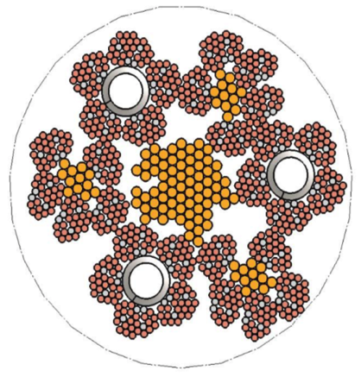
LF1 and LF2 cables
General layout of cables (as the 2015 H.F. CICC WR1):
S.c. and 1.0 mm Cu wires (Cr-coated) from WST
1.5 mm Cu wires (Cr-coated) from Luvata, leftover from 2014 samples
Parameter | LF1 | LF2
# S.C. strands (1 mm) | 120 | 180
# Cu strands (1.0/1.5 mm) | 690 / 120 | 630 / 120
Cable Layout | [(2x(2x(1sc+2Cu)+3Cu)+3x3Cu)]x(5+C1)x(6+C2) | (2x(1sc+2Cu)+3Cu)x3x(5+C1)x(6+C2)
Twist Pitch Sequence | 110 / 125 / 145 / 175 / 500 mm
Target V.F. in cable bundle | 26%

Slide 5
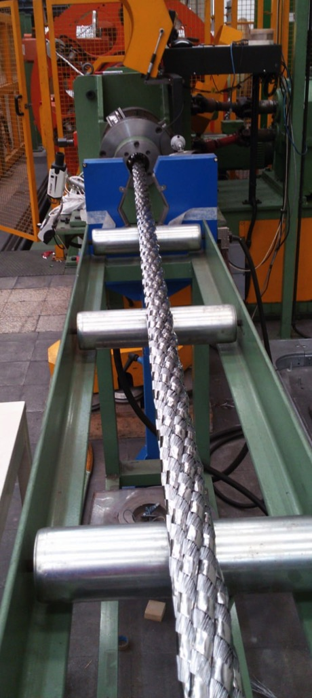
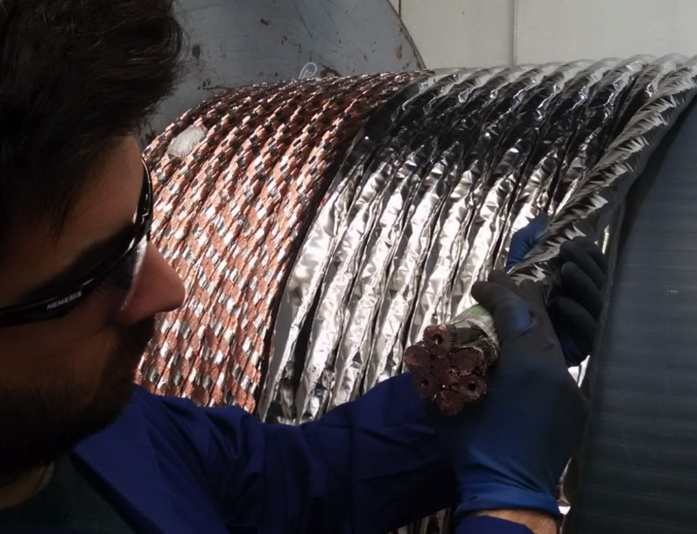
LF1 and LF2 cables
40 m Cu dummy
20 m LF1 s.c. cable
20 m LF2 s.c. cable
have been manufactured

Slide 6
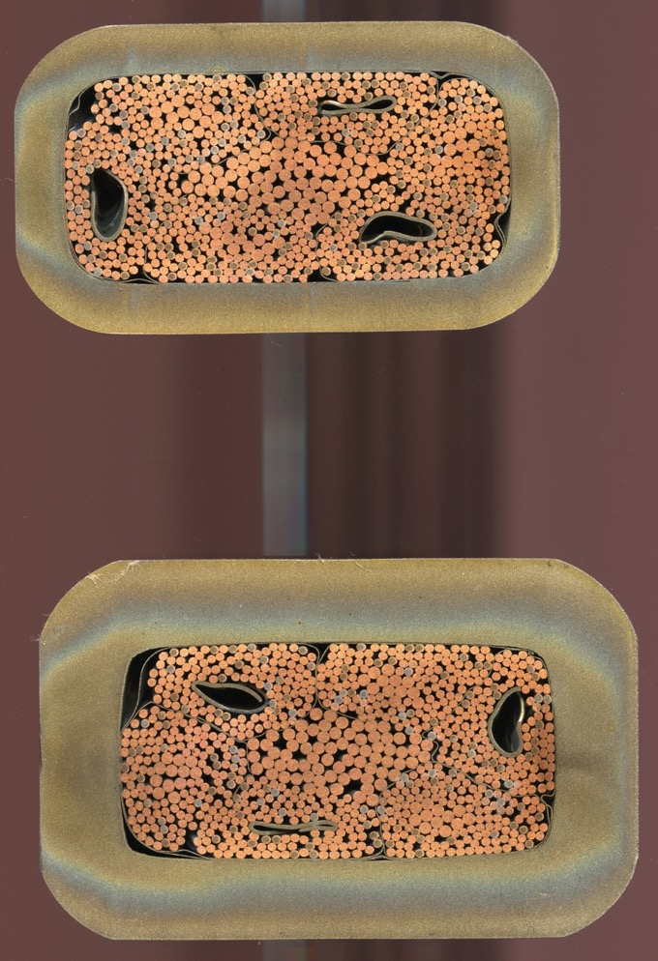
LF1 and LF2 conductors
LF2
In spite of the spiral issue, it was decided to proceed anyhow to CICC compaction of the lengths required to manufacture the interlayer joint sample.
5.5 mm
9.5 mm
LF1

Slide 7
LF1 and LF2 conductors
Feed-back on design:
Use thick spirals OR place them not at the center of petals;
The central large copper core could be reduced. And some copper be distributed at the interstices between petals.
The Round-to-Rectangular compaction with thick steel jacket doesn’t seem to present critical issues.

Slide 8
Inter-layer joint manufacture

Slide 9
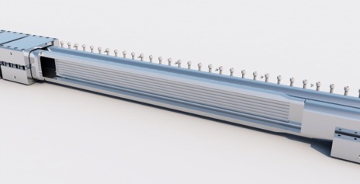
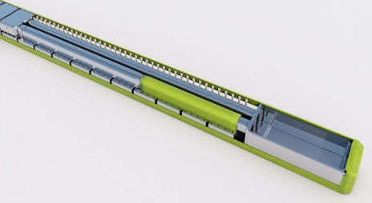
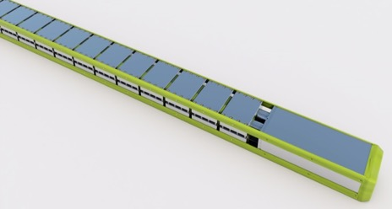
Inter-layer joint manufacture
Design of a joint assembly, between two different LF conductors with rectangular cross-section, thick steel jacket, and a low number of superconducting wires in cross-section.
Target was to demonstrate an “invisible” joint (room occupancy not exceeding the dimensions of the larger of the two CICC).
A SULTAN sample has been, in the “hairpin-type” configuration. The joint is placed in the position corresponding the high field region of the SULTAN facility.

Slide 10
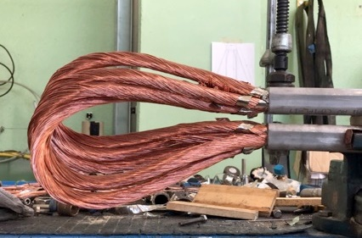
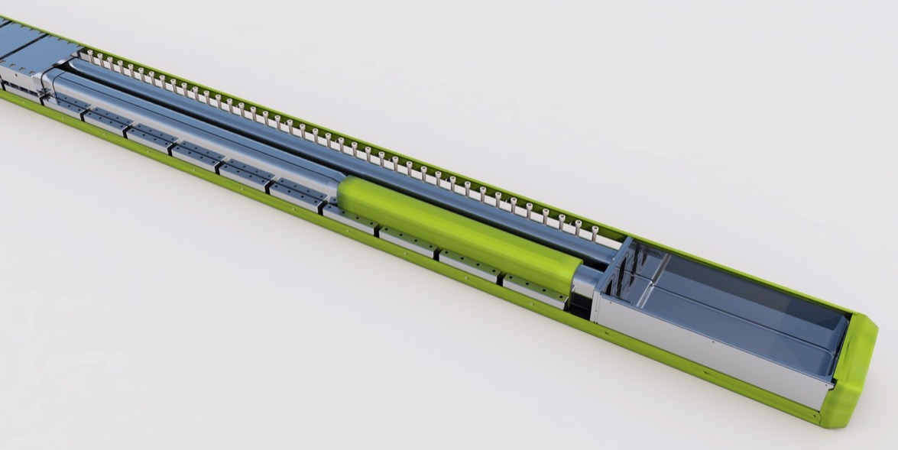
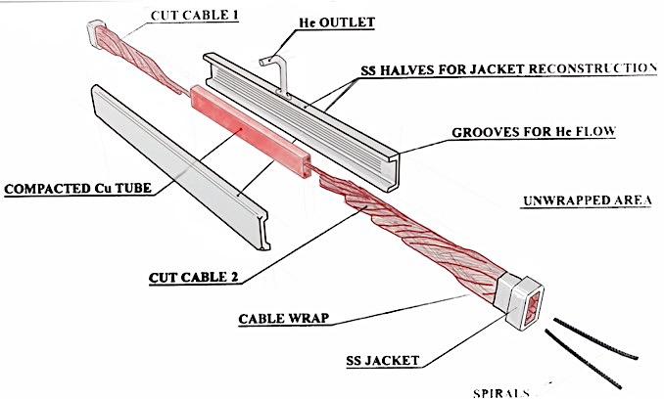
Inter-layer joint manufacture
Hairpin
LF1-LF2 Joint
The sample containing the joint between LF1 and LF2 and a bottom hairpin box junction has been assembled: one leg is represented by the conductor LF1 while the adjacent leg contains the joint LF1-LF2 to be tested

Slide 11
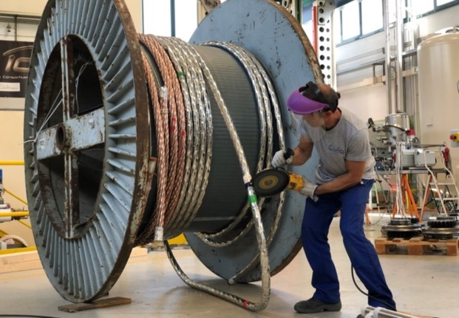
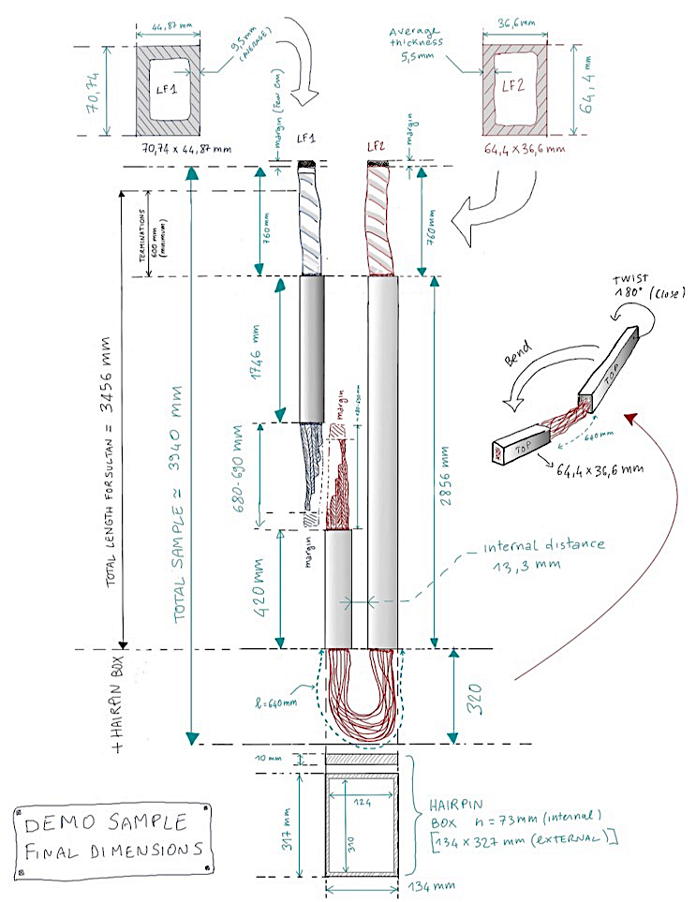
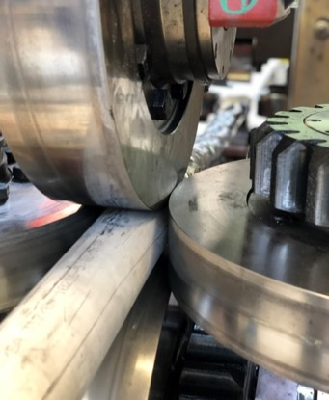
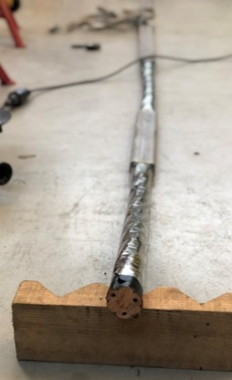
Inter-layer joint manufacture
Joint
Hairpin

Slide 12
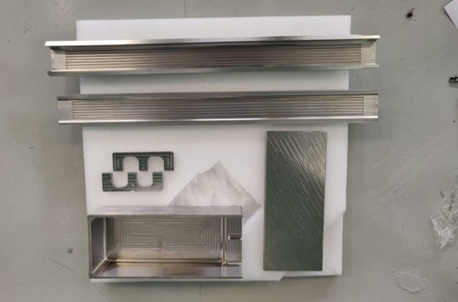
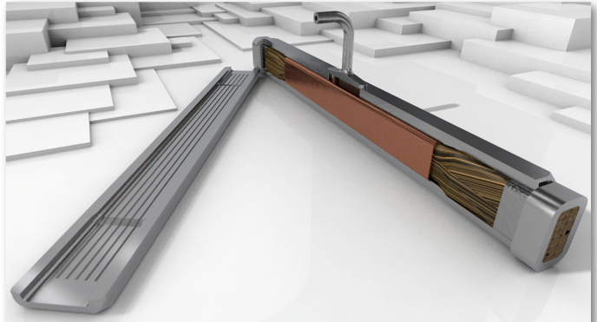
Inter-layer joint manufacture
A copper shell encloses the scaled and paired petals (in order to optimize the transport of the current) while two stainless steel halves close and connect the joint to the conductor jacket.
The helium flow is ensured by the internal grooves in the covering stainless steel halves of the joint.

Slide 13
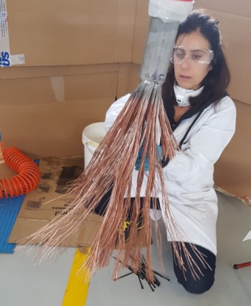
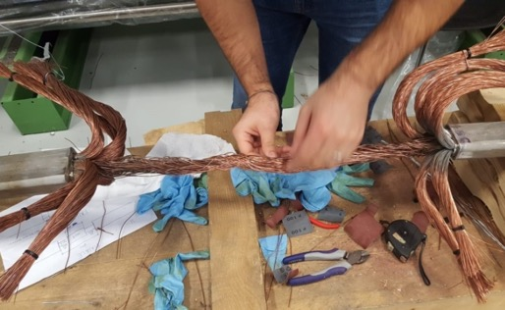
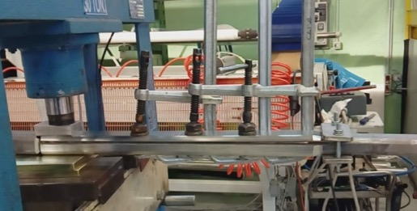
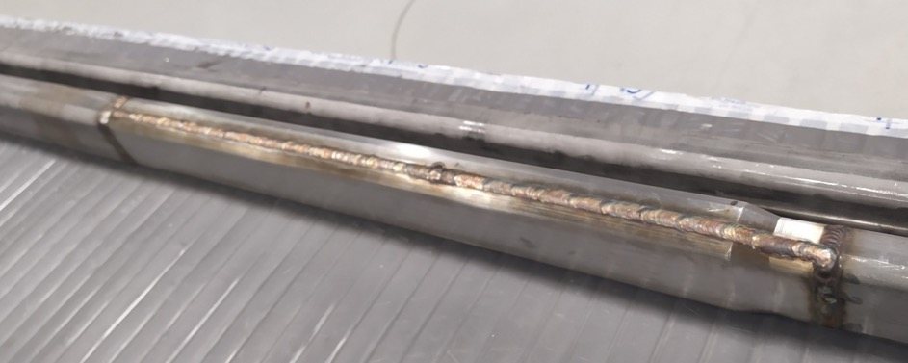
Inter-layer joint manufacture
After removal of Cr plating from the strands, the two conductors were prepared in order to couple the petals
The two cables, at the facing ends, has been scaled along the entire length of the joint and the copper covering has been fixed to maintain compact the junction under the jacket.

Slide 14
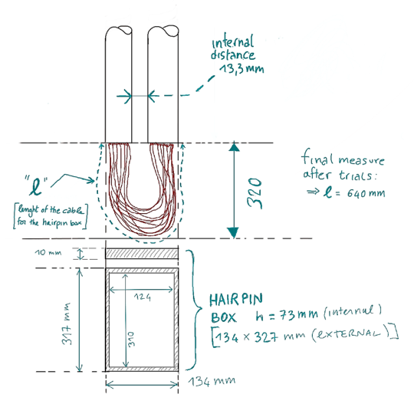
Inter-layer joint manufacture
To finally assemble the SULTAN Sample, the two legs of conductors has been set parallel by bending the “l” portion and housing it into the bottom hairpin box.
During production of the hairpin box the following steps have been respected:
1. Preparation of the central unjacketed cable
2. Welding the connection part (front interface) between the two legs and the box.
3. Hairpin box final assembly and He leak test.
A dedicated verification test of the length “l ” of cable needed for the hairpin box

Slide 15
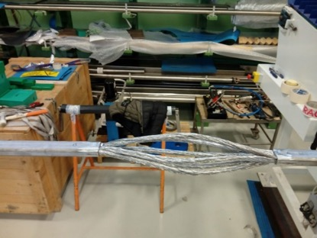
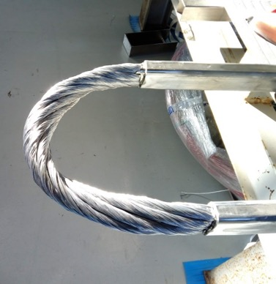
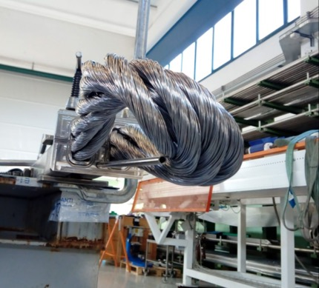
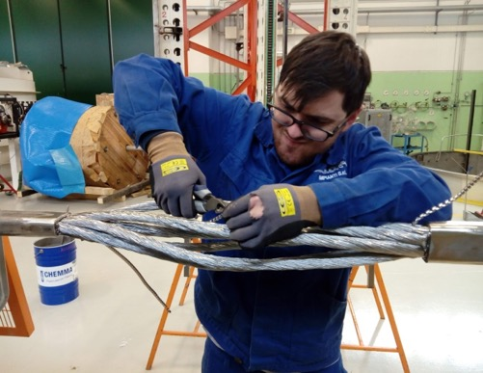
Inter-layer joint manufacture
During production, the following steps have been respected:
1. Preparation of the central unjacketed cable
2. Welding the connection part (front interface) between the two legs and the box.
3. Hairpin box final assembly and He leak test.
Included:
removal of cable wrapping from central unjacketed cable
removal of the petal sub-wrapping tape
removal of central spiral leaving at least 40-50mm from jacket edge at each side.

Slide 16
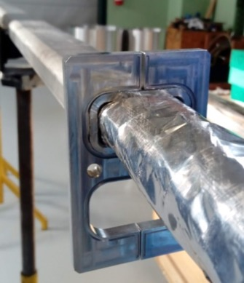
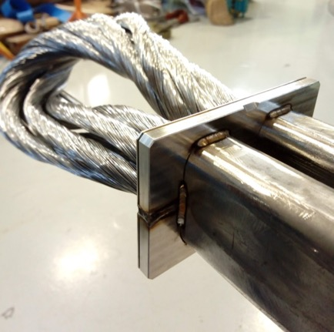
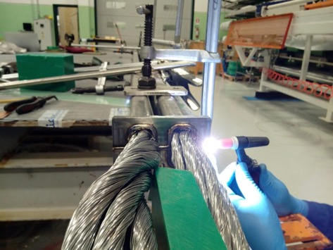
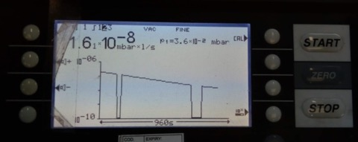
Inter-layer joint manufacture
During production, the following steps have been respected:
1. Preparation of the central unjacketed cable
2. Welding the connection part (front interface) between the two legs and the box.
3. Hairpin box final assembly and He leak test.
The two halves of the front interface have been welded to the conductor legs. Interface and conductors are joined by spot weld on the external side (mechanical resistance) while full welds on the internal side of the box has been performed (and checked*) for tightness.
* leak test, after a temporary box assembly

Slide 17
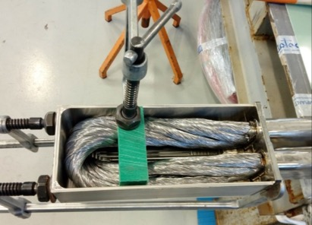
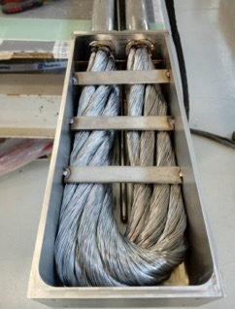
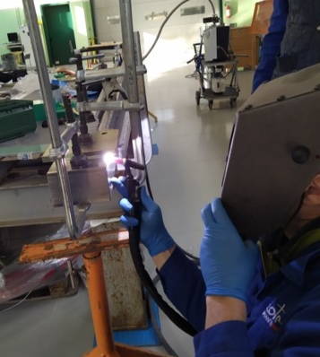
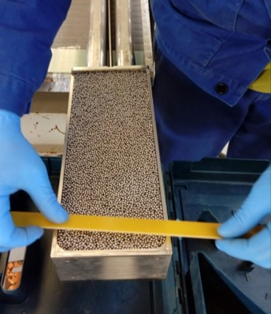
Inter-layer joint manufacture
During production, the following steps have been respected:
1. Preparation of the central unjacketed cable
2. Welding the connection part (front interface) between the two legs and the box.
3. Hairpin box final assembly and He leak test.
The unjacketed conductor has been fixed into the box by pressing the cable with clamps and welding few steel slabs prepared on purpose.
Final closing welding has been performed by pilgrim step technique in order to minimize the welding distortion with final leak test check.
Empty spaces in the box left by the cable after bending have been filled up by small stainless-steel spheres to keep the cable fixed inside the box.

Slide 18
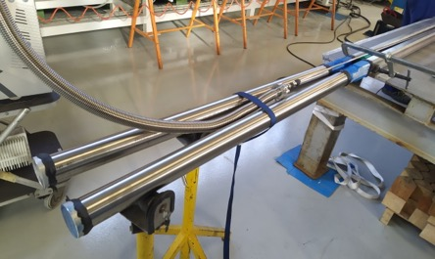
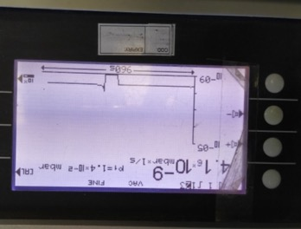
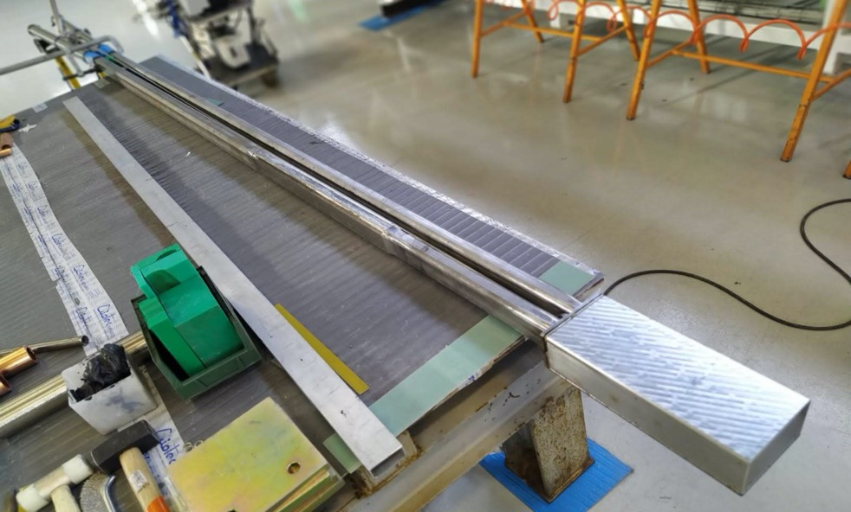
Inter-layer joint manufacture
Final global leak test has been performed successfully.
In order to be characterized experimentally at the SULTAN facility, the following steps will need to be carried out at the SPC Institute (Switzerland):
manufacture of the terminations for connection of the two sample legs to the power supply;
sample reaction heat treatment;
instrumentation installation;
final overall sample assembly.

Slide 19
Test of the WST Nb3Sn wires

Slide 20
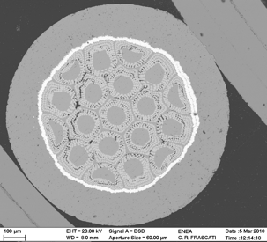
Test of the WST Nb3Sn wires
Wires supplied by WST for sample manufacture:
S.C. | Billet number | Length
1 | 2013-14013B-1 | 332 m
2 | 2013-14013B-2 | 605 m
3 | 2013-14004 | 526 m
4 | 2013-14007 | 218 m
5 | 2013-14013A | 281 m
6 | 2013-14008A-1 | 590 m
7 | 2013-13278B | 457 m
8 | 2013-13294A-2-1 | 555 m
9 | 2013-13292A | 496 m
10 | 2013-14014B | 604 m
11 | 2013-14013B-3 | 692 m
12 | 2013-13294A-1 | 761 m
13 | 2013-13289A | 530 m
14 | 2013-13291B-1 | 258 m
15 | 2013-13291A | 472 m
16 | 2013-13281A | 181 m
17 | 2013-13278A | 197 m
Item | Expected Performance
Strand type | ITER Nb₃Sn
Strand Diameter (mm) | 1.0±0.01
Piece length (m) | 150~600
Twist direction | right
Twist pitch (mm) | 15±2
Thickness of Cr plating (µm) | 2~3
Cu/non-Cu | 1±0.1
RRR (273/20K) | > 100
I_{C} (A) @4.2K, 12T | > 370
J_{C} (A/mm²) @4.2K, 12T | > 950
n value @4.2 K, 12 T | >20
Q_{h} (mJ/cm³) @4.2K, ±3T | < 800
Cr-coated Cu | Piece id. number | Quantity (kg) | Quantity (m) | RRR_{273K/20K}
1 | 40253259-17-01B | 69.4 | 9983 | 307
2 | 40253259-17-01A | 62.5 | 9000 | 313
3 | 40364556-13-13B-2 | 90.5 | 12985 | 260

Slide 21
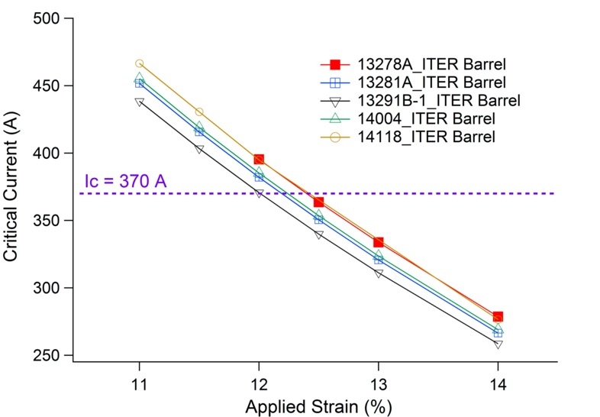
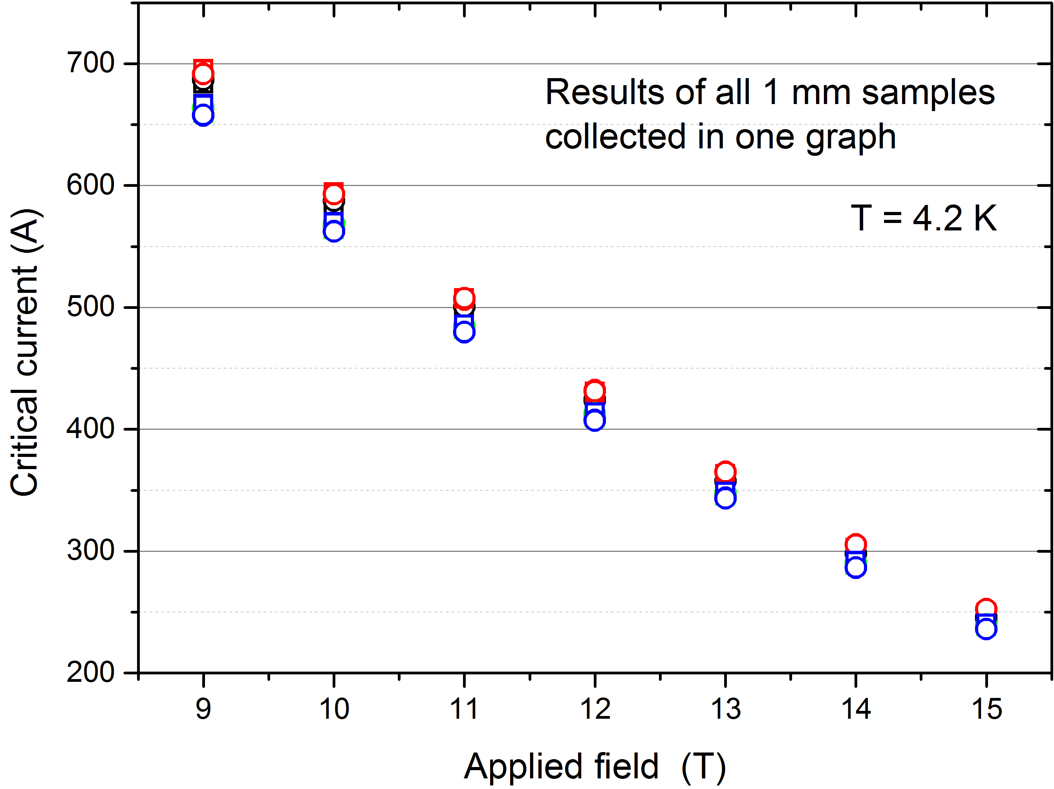
Test of the WST Nb3Sn wires
Meas. on ITER barrel at 4.2K
Bruzzone; EFDA _D_2MDFPU, May 2015
Recommended H.T. schedule
200 h. at 650 °C
Recommended H.T. schedule
250 h. at 650 °C

Slide 22
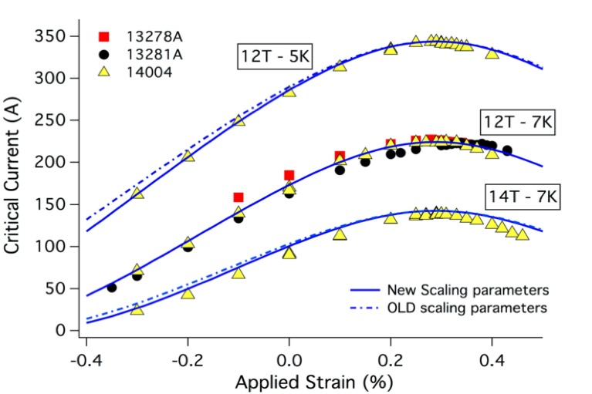
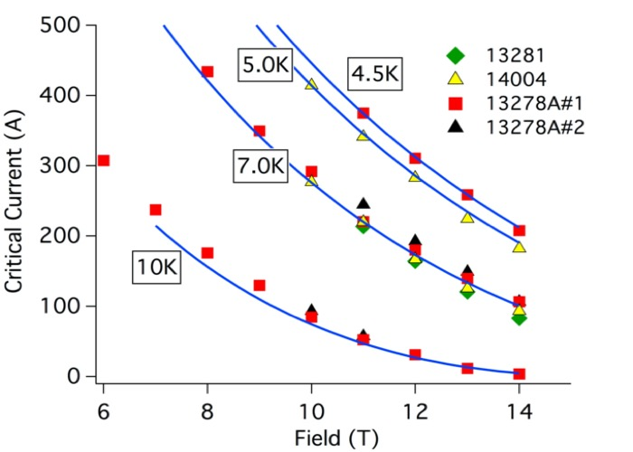
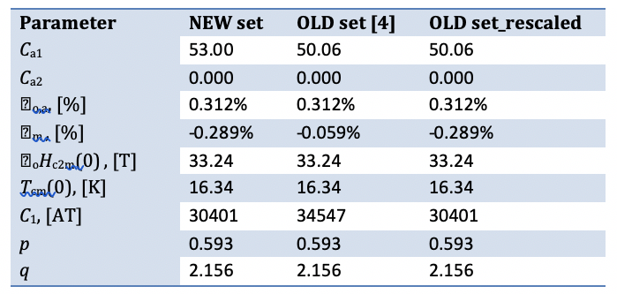
Test of the WST Nb3Sn wires
Meas. on ENEA WASP barrel vs. strain, field, temperature

Slide 23
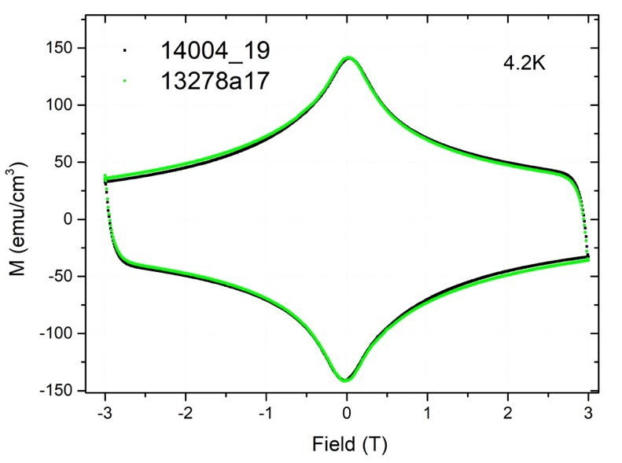
Test of the WST Nb3Sn wires
AC losses measurements by VSM:
Hyst. Losses: 790 mJ/cm³
d_{eff} = 34 μm for both samples

Slide 24
Proposals for 2020
- involvement in test and analysis of the joint sample.

