Slide 1
MAG – 4.2- T011- D001 RW2 with cabled stabilizer
P. Bruzzone
February 13th, 2020

Slide 2
Summary of SPC Task MAG – 4.2 – T011
D001. A new, “cabled” stabilizer will be developed and procured under industrial contract. It will be assembled into the new RW2rutstab conductor (recycling of a RW2brass) using pre-compression. The DC performance change will be monitored. The AC loss will be measured, sinus and trapezoidal, parallel and perpendicular field, 4.5 K and 20 K.
D002. An inter-layer joint sample for React&Wind technology based on RW2 cable with diffusion bonding method will be assembled and tested in SULTAN.
D003. One or two ENEA conductor/joint samples will be tested in SULTAN.
D004. A new Nb₃Sn strand procurement (to be used in 2020 for RW3 conductor) will be launched.
Delayed

Slide 3
Outline of Report on D001
Background and rationale for RW2 stabilizer
Manufacture of the new, cabled stabilizer
New RW2 assembly with cabled stabilizer
DC performance and reversibility
AC loss results
Outlook

Slide 4
Rationale and Requirement for copper in R&W
In R&W large conductors, the Nb₃Sn superconductor must stay close to the neutral bending axis to limit the bending strain during handling -> Nb₃Sn flat cable
The fusion conductors, mostly the TF, needs a large amount of copper for quench protection (let’s call it “stabilizer”) -> the segregated copper forms a sandwich with the flat cable
To allow transverse compression of the flat cable at assembly and properly support the cable -> the segregated copper must be compact.
To prevent very large eddy currents loss -> the segregated copper must have highly anisotropic resistance.
A - 1

Slide 5
Critical review of former attempts
In RW1, the layer of copper wires wrapped around the flat cable had imperfections and did not support properly the cable
Replacing the copper wires in RW1 with a solid copper profile improved the performance but led to very high eddy currents
The mixed matrix stabilizer in RW2 had only small resistance anisotropy (factor of 3) and was difficult to manufacture in exact shape.
The wide cooling channel in the RW2 mixed matrix was not compatible with transverse pre-compression.
A - 2

Slide 6
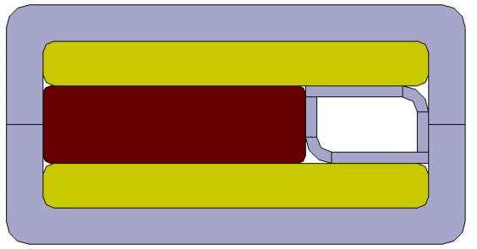
Guidelines toward the best stabilizer
Avoid a monolithic composite
Difficult to shape to exact shape
Difficult to get high anisotropy with bonded metallic contact
Expensive, little interest from industry to develop it
Aim to a flexible, but compact assembly
Suitable to transfer transverse load at assembly
Suitable to unwound at a conductor assembly line
Prefer frictional resistance barrier to break eddy currents loops
-> Move the pressure release channel to the side of the flat cable
A - 3

Slide 7
Manufacture of the cabled stabilizer
Specified to fit in the same cable space of former RW2 prototypes
Use CuNi clad on high RRR copper wire, rather than electroplating
Limit the CuNi cross section to <10% of the solid cross section
Limit to ≤ 10% the void fraction
Assemble 30 CuNi clad wires into a flat cable with rounded edge
B - 1

Slide 8
Procurement of the CuNi clad copper wires
The wire is procured at WST, where the mixed matrix composite was procured in 2018.
Two copper billets, each ≈ 90kg, are extruded with a CuNi can.
Initially, the CuNi is ≈13% and decreases to ≈ 9% after extrusion and drawing.
The coiled wire at ø = 6mm was delivered in May 2019. Delivery time ≈ 3 months, price ≈ 75 $/kg.
B - 2

Slide 9
Cabling
The wire was sent to Tratos and draw down to ø = 3.35mm.
No annealing could be done at Tratos, the wire was very hard.
Special rollers with rounded edges were procured at Tratos.
The cabling trials with cu dummy was ok. The rounded edges were obtained in a second pass.
The second pass failed with the hard CuNi clad wires.
About 10m of cabled stabilizer (no rounded edge) was delivered to SPC in September 2019.
CuNi clad cable (no rounded edges)
Copper cable (with rounded edges)
B - 3

Slide 10
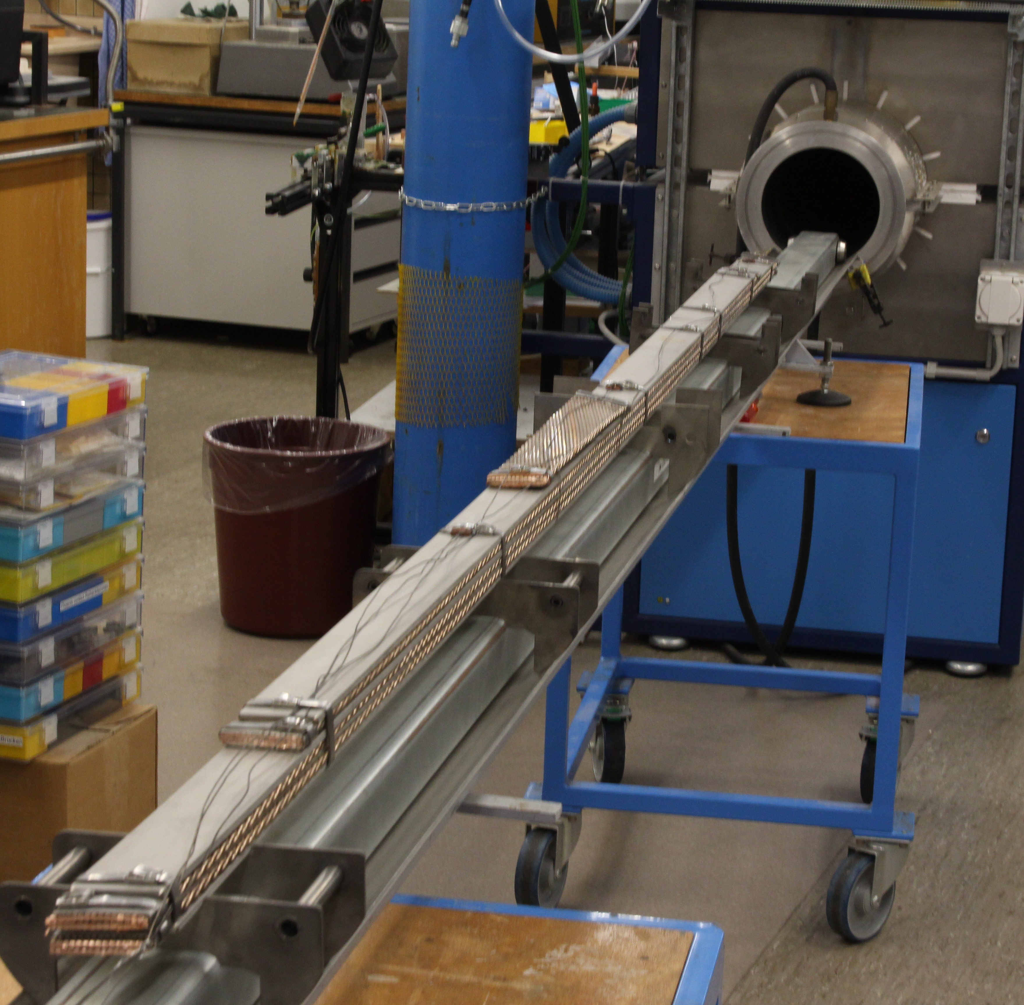
Cable at SPC
The cable was cut in three units and annealed in the SPC furnace.
The cable dimension was ok, but the lack of rounded edges called for new machined steel jacket.
The RRR measurement of the cable (transverse direction) turned out to be difficult. A suitable holder is being prepared, test expected in March 2020
B - 4

Slide 11
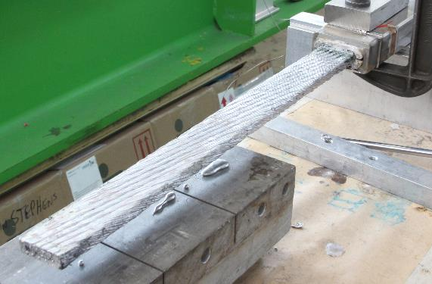
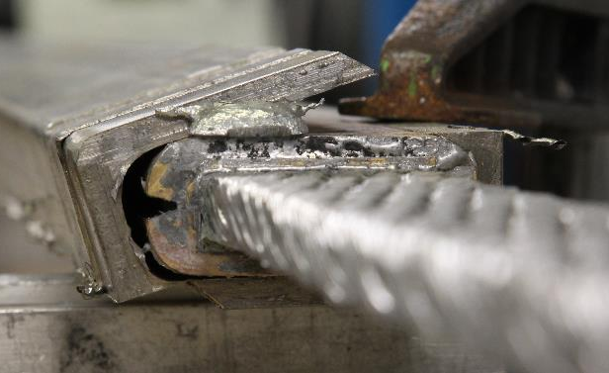
New RW2 assembly with cabled stabilizer
A new sample of RW2 conductor (baseline 2015) is assembled in October 2019, RW2rutstab.
The flat cable is recovered from a former RW2 assembly, RW2brass, tested in 2017, which used a brass profile as stabilizer.
The termination of RW2brass are unsoldered and the jacket is milled at the corners to extract the cable.
C - 1

Slide 12
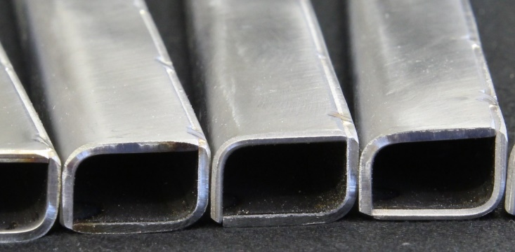
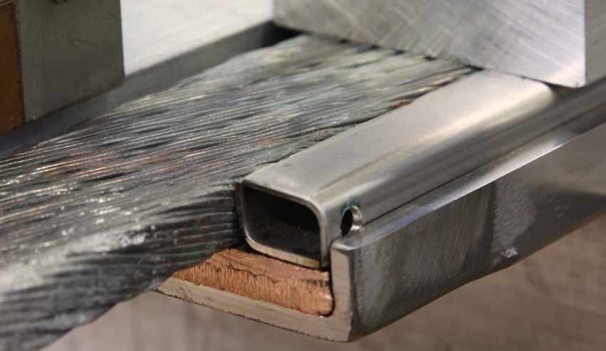
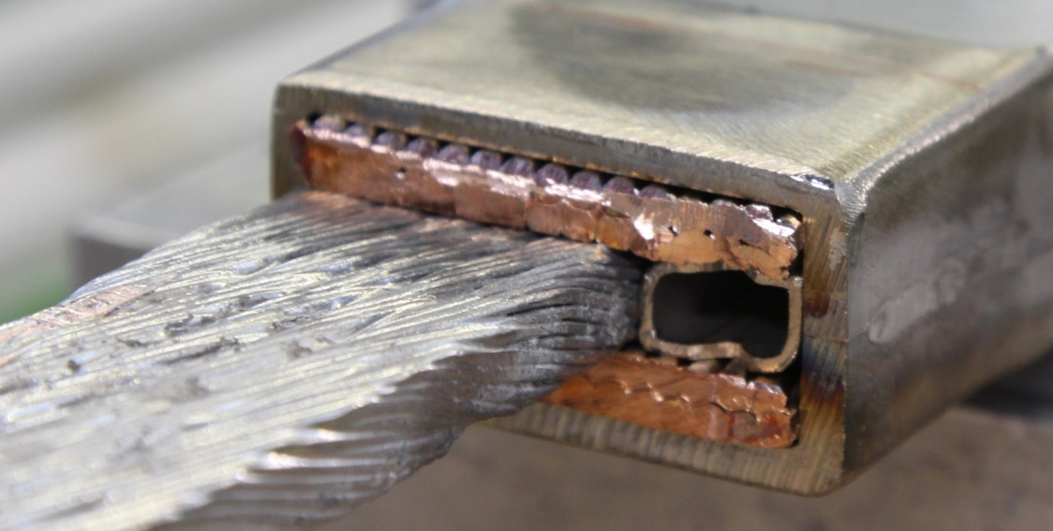
The RW2rutstab assembly with cabled stabilizer
C - 2

Slide 13
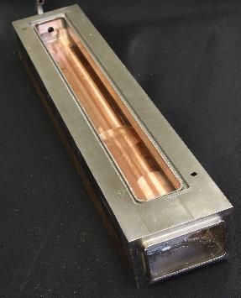
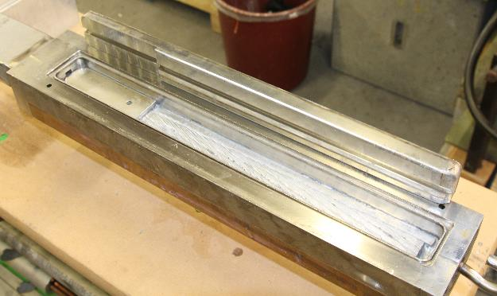
The RW2rutstab assembly with cabled stabilizer
The cooling channel is obtained by spot welding two sheets of perforated steel, bent at 90°.
The flat cable is now out-of-center. The shoes at the termination are machined for the new position of the flat cable.
The jacket halves are welded under pressure, to provide transverse pre-compression at the cable.
The RW2rutstab is paired with RW2fullMM into a SULTAN sample.
C - 3

Slide 14
SULTAN Results: Evolution of DC performance
The flat cable of RW2rutstab was tested and cycled in 2017 as RW2brass with poor performance.
The DC performance of RW2rutstab shows now a recovery by 0.2 K in terms of T_{cs}, but still 0.5 K lower than the “RW2 fullMM”, which was assembled since the beginning with transverse pre-load.
The results suggest that only a fraction of the observed degradation, say 20-30%, is reversible.
The performance of RW2fullMM remains stable.
D - 1

Slide 15
Evolution of DC performance
D - 2

Slide 16
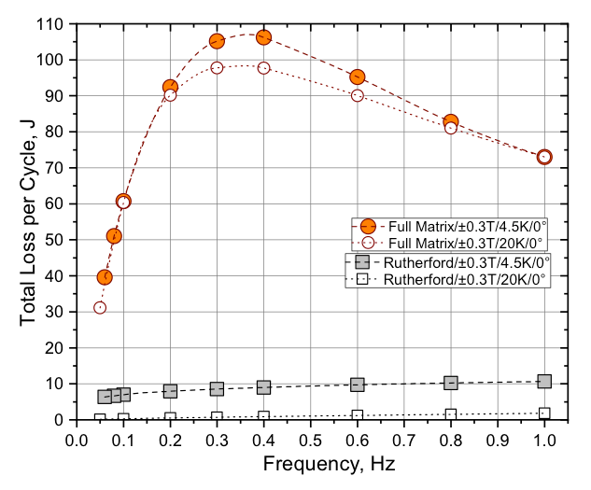
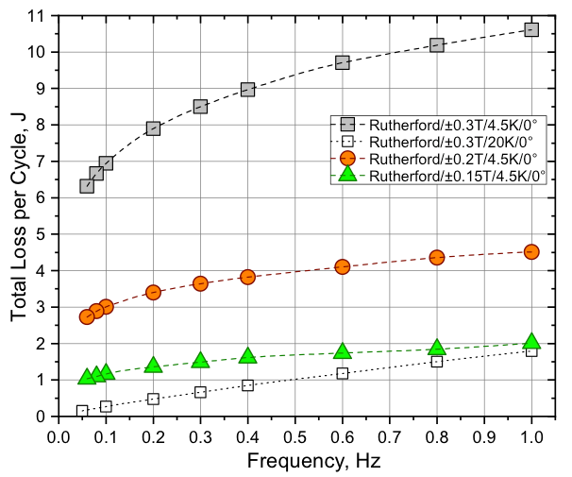
SULTAN Results: AC loss at 4 K and 20 K, 0°
Comparison AC loss RW2 with Mixed Matrix vs. Rutherford cable
AC loss RW2 with Rutherford cable,
4 / 20 K, various ∆B
E - 1

Slide 17
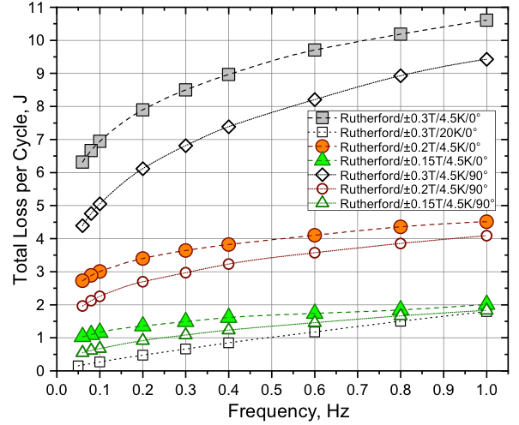
SULTAN Results: AC loss RW2rutstab, 90°
E - 2

Slide 18
SULTAN Results: Eddy currents loss at 4 K and 20 K
The AC loss is drastically lower than with the full mixed matrix, over one order of magnitude.
The eddy currents loss in the stabilizer is only 10% of the overall loss.
At 90° orientation, the overall loss decreases only 20% compared to 0°, proving the effectiveness of the steel strip in the median plane to reduce the coupling currents loops.
The target is achieved, with transverse resistivity >> than the longitudinal resistivity.
The cabled stabilizer is now the baseline for the DEMO RW generation of conductors.
E - 3

Slide 19
Trapezoidal pulse field
Sinus sweep AC field with extrapolation to low frequency (steady state AC loss) is inadequate to assess the most critical loss, i.e. the plasma initiation loss in the CS, where the transient duration, 0.6s, is of the same order of magnitude as the “steady state” coupling time constant.
A trapezoidal field pulse, with ramp time from 0.3s to 3s allows direct assessment of the loss in relevant time scale.
The coupling time constant to be used for the computation of the plasma initiation AC loss is experimentally assessed as a function of the ramp time.
E - 4

Slide 20
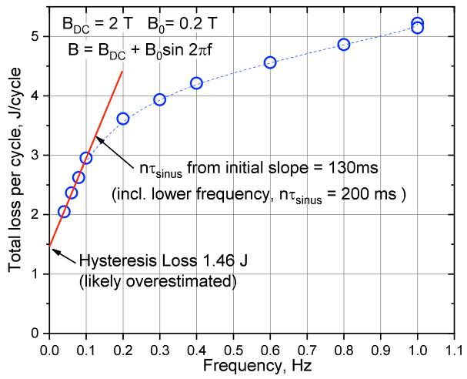
Trapezoidal pulse field (example of ITER TF)
Instead of extracting a single nτ from the slope of the sinusoidal loss curve, we can extract nτ from individual linear pulse (trapezoidal) with given ramp time T. So we obtain nτ = f (T)
E - 5

Slide 21
Trapezoidal pulse field, RW2rutstab and RW2fullMM
At the actual plasma initiation, with T = 0.6s, the correct nτ for AC loss calculation is….
The assessment of nτ by pulse field allows reducing the present over-conservatism in the AC loss calculation.
In the preliminary evaluation, the hysteresis loss is not subtracted. The real plot (coming soon) will have normalized units and a bigger difference between the two conductors.
E - 6

Slide 22
Outlook of RW samples in 2020 and beyond
All the available RW2 cable is now used and recycled. Nb₃Sn strand for next RW3 prototype cable is procured at LUVATA, delivery ≈ June 2020.
The remainder of CuNi clad copper wire, now at ø=6mm, will be annealed, drawn and cabled as a stabilizer for RW3.
More CuNi clad wire has been ordered at WST to be used in future RW conductors. Delivery May 2020.
In summer 2020, ≈ 35m of RW3 flat cable (baseline 2018) will be cabled to feed the R&D needs, including
Assessment of bending limits for RW conductors
More RW diffusion bonded joints
F - 1

Slide 23
Additional R&D for RW conductors
According to the suggestions of the panel, more R&D should be started
Very high current conductor, > 100 kA, to reduce TF voltage (requires a new strand procurement)
Separation of hydraulic/mechanical function for CS conductors (could be done using RW3 cable)
Long length manufacture on industrial scale, to be coupled with the project of an insert CS coil in Naka.
F - 2

