Slide 1
MAG-4.2-T011-D002
Test of R&W Prototype Joint
WPMAG Final Meeting 2019
V. D’Auria, B. Stepanov, K. Sedlak, P. Bruzzone

Slide 2
Outline
Background of RW2 joint
RW2 joint using diffusion-bonding technique (RW2J2)
  Assembly
    Cables preparation before bonding
    Diffusion bonding
    SULTAN sample
  Test results
    Electrical resistance
    AC losses ꓕ and ‖ to the broad side
  Conclusions and perspectives

Slide 3
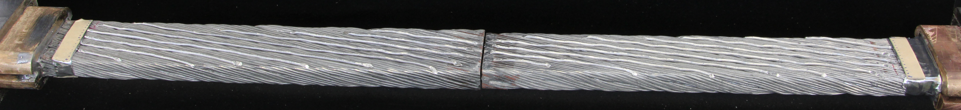
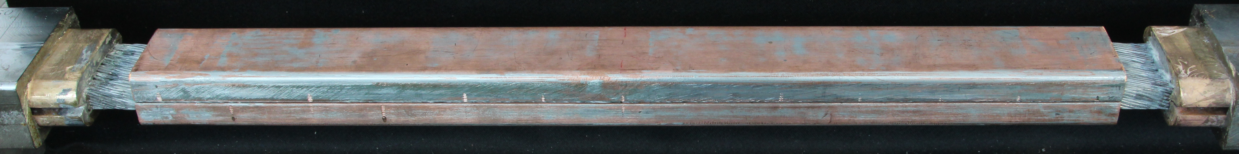
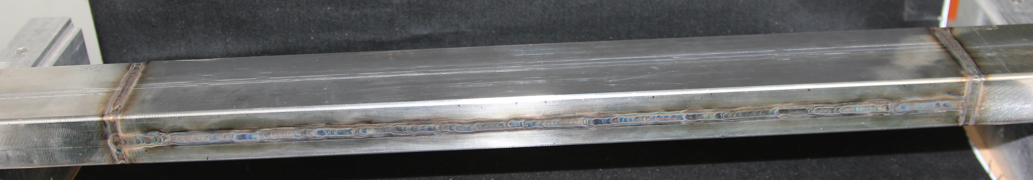
Background of RW2 Joint
In 2017 failed test of a butt-joint with superconducting bridges (RW2J1). Resistance 3-13 nΩ at 0-11 T

Slide 4
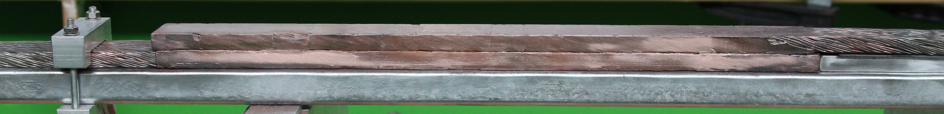
RW2J2
Inter-layer joint for React&Wind cables → joint during winding
Overlap geometry
Target R≤1 nΩ at operating conditions, B=8 T and I=63.3 kA
Diffusion bonding joint (N.B. cables already heat treated) → no solder, no flux agents, no indium wires.
Techniques/tools compatible with in situ assembly, including:
  Copper spraying method to flatten the surfaces
  Clamp to keep pressure, ≈30 MPa
  Oven to keep temperature, ≈650 °C

Slide 5
Outline
Background of RW2 joint
RW2 joint using diffusion-bonding technique (RW2J2)
  Assembly
    Cables preparation before bonding
    Diffusion bonding
    SULTAN sample
  Test results
    Electrical resistance
    AC losses ꓕ and ‖ to the broad side
  Conclusions and perspectives

Slide 6
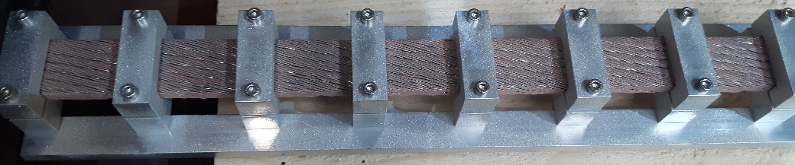
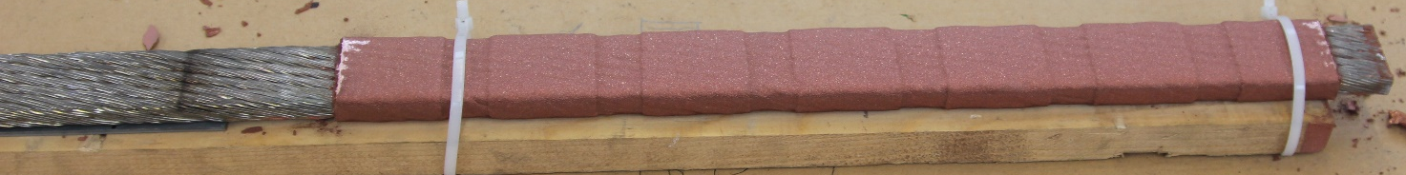
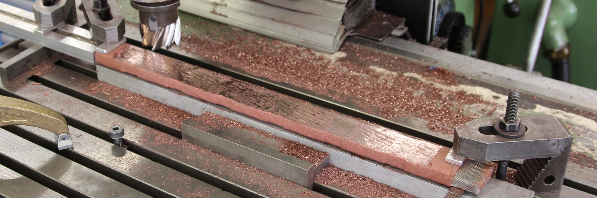
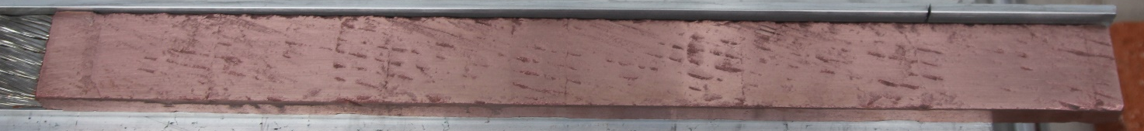
RW2J2 – 1. Thermal copper spray
Aluminum clamps & bars as support
Sandblasting & copper-spray in multistage
Surfaces milled flat

Slide 7
Outline
Background of RW2 joint
RW2 joint using diffusion-bonding technique (RW2J2)
  Assembly
    Cables preparation before bonding
    Diffusion bonding
    SULTAN sample
  Test results
    Electrical resistance
    AC losses ꓕ and ‖ to the broad side
  Conclusions and perspectives

Slide 8
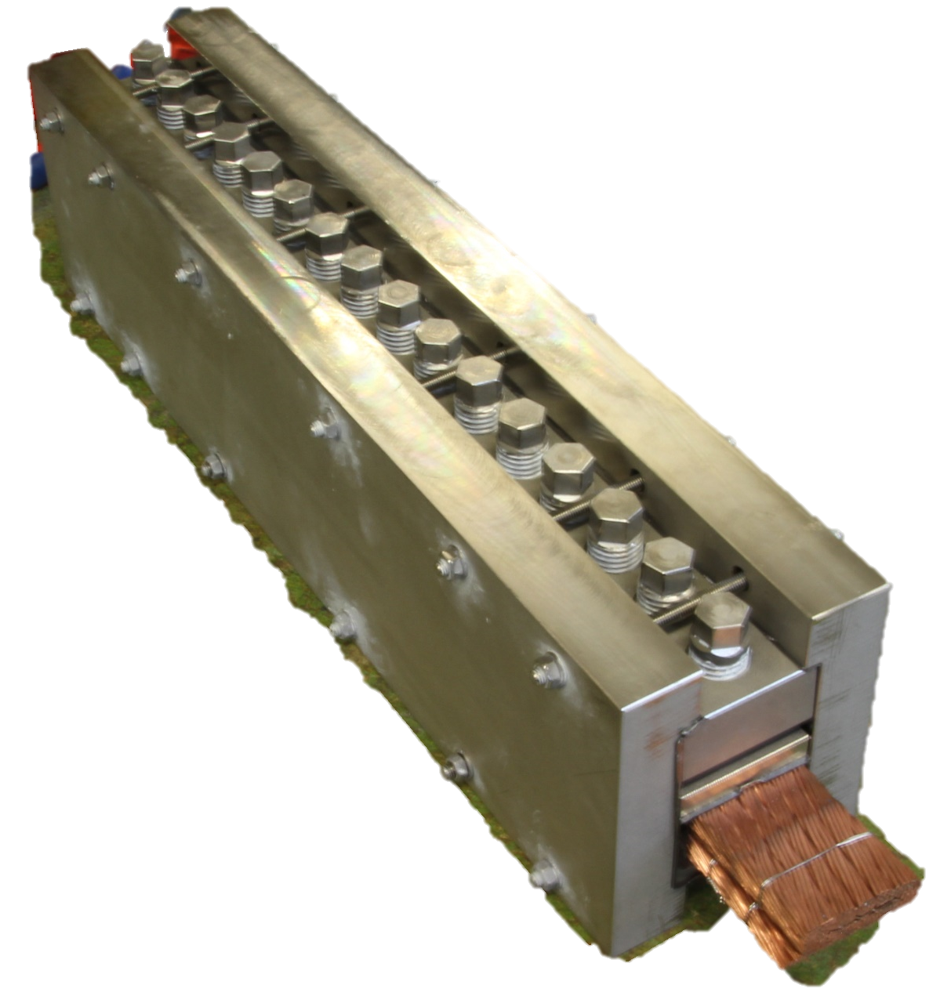
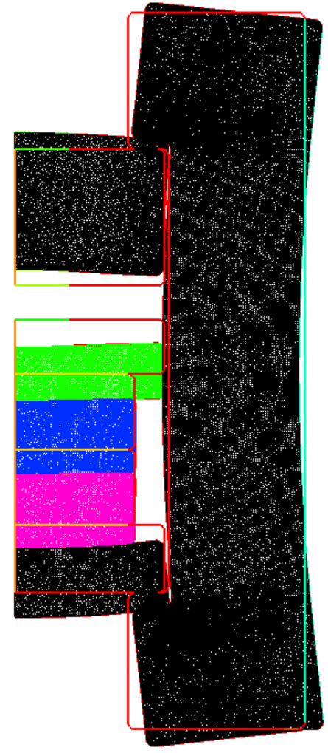
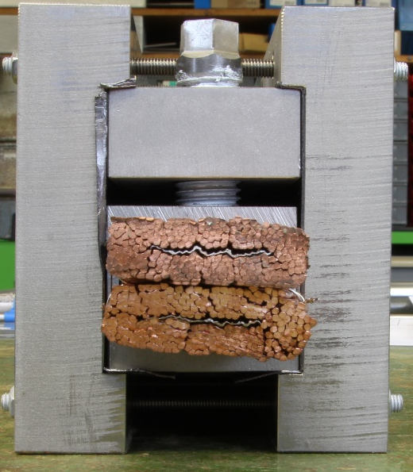
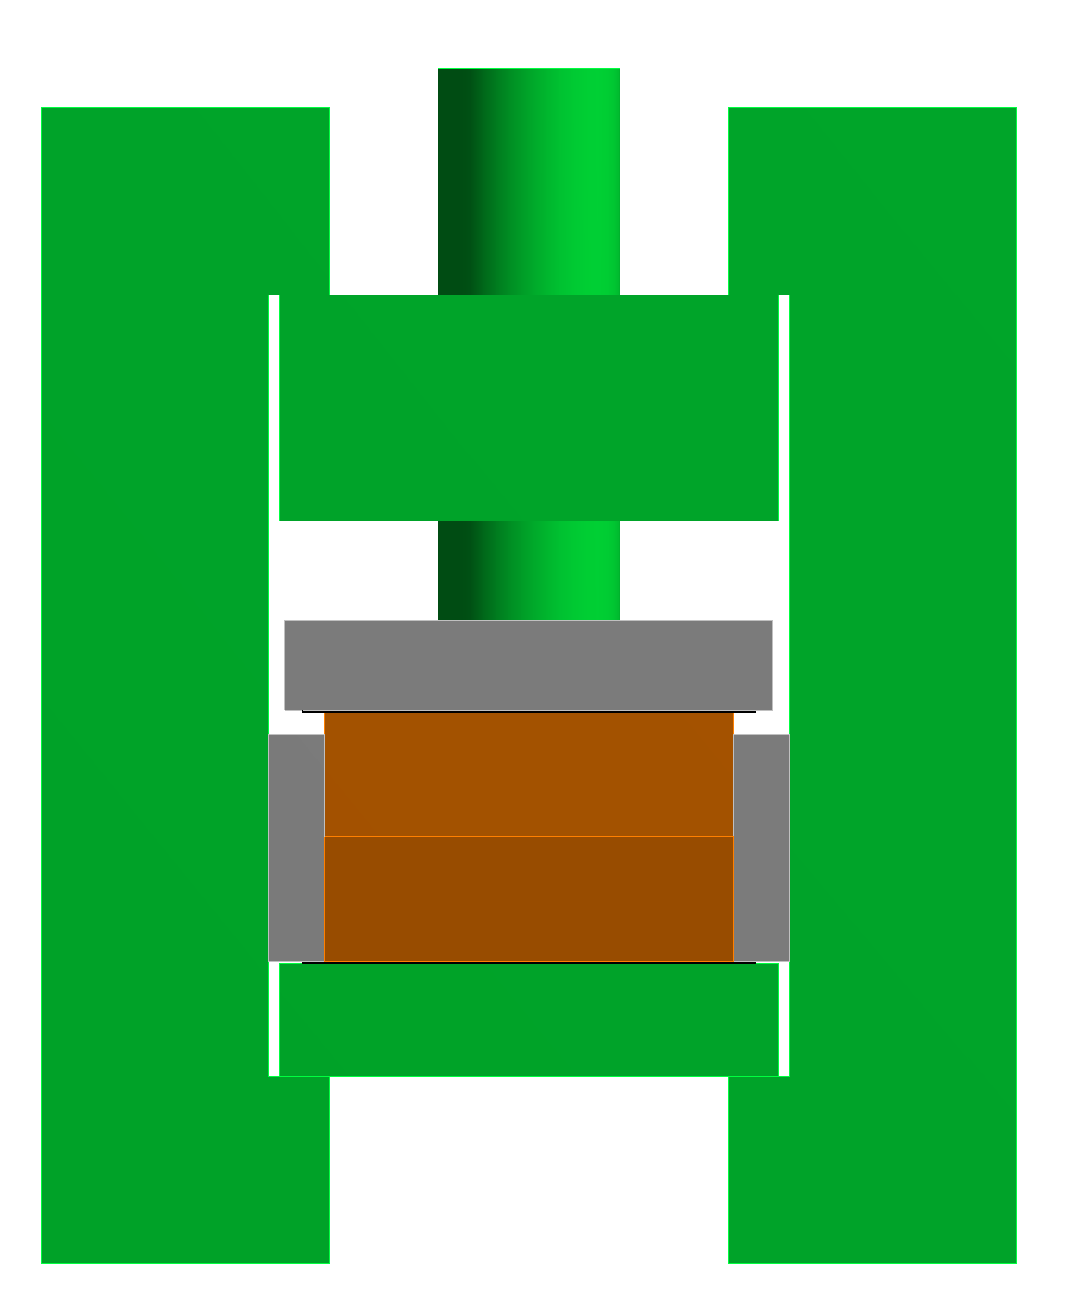
RW2J2 – 2. Clamp
Target joint pressure @ 650 °C is 30 MPa
Clamp design criteria:
  Disassembly after diffusion-bonding
  Joint pressure homogeneity
  Choice of materials such that p=24 MPa @ 20 °C → p=30 MPa @ 650 °C
Displacement amplification factor=50
Materials:
Inconel 600
Stainless steel
Glass-fiber
Cable
Notes:
α_Inconel600=15.5e-6 K⁻¹ average between 20 and 650 degrees
α_AISI304=17.5e-6 K⁻¹ average between 20 and 650 degrees
α_AISI316=18.5e-6 K⁻¹ average between 20 and 650 degrees
α_cable=16.5e-6 K⁻¹ average between 20 and 650 degrees

Slide 9
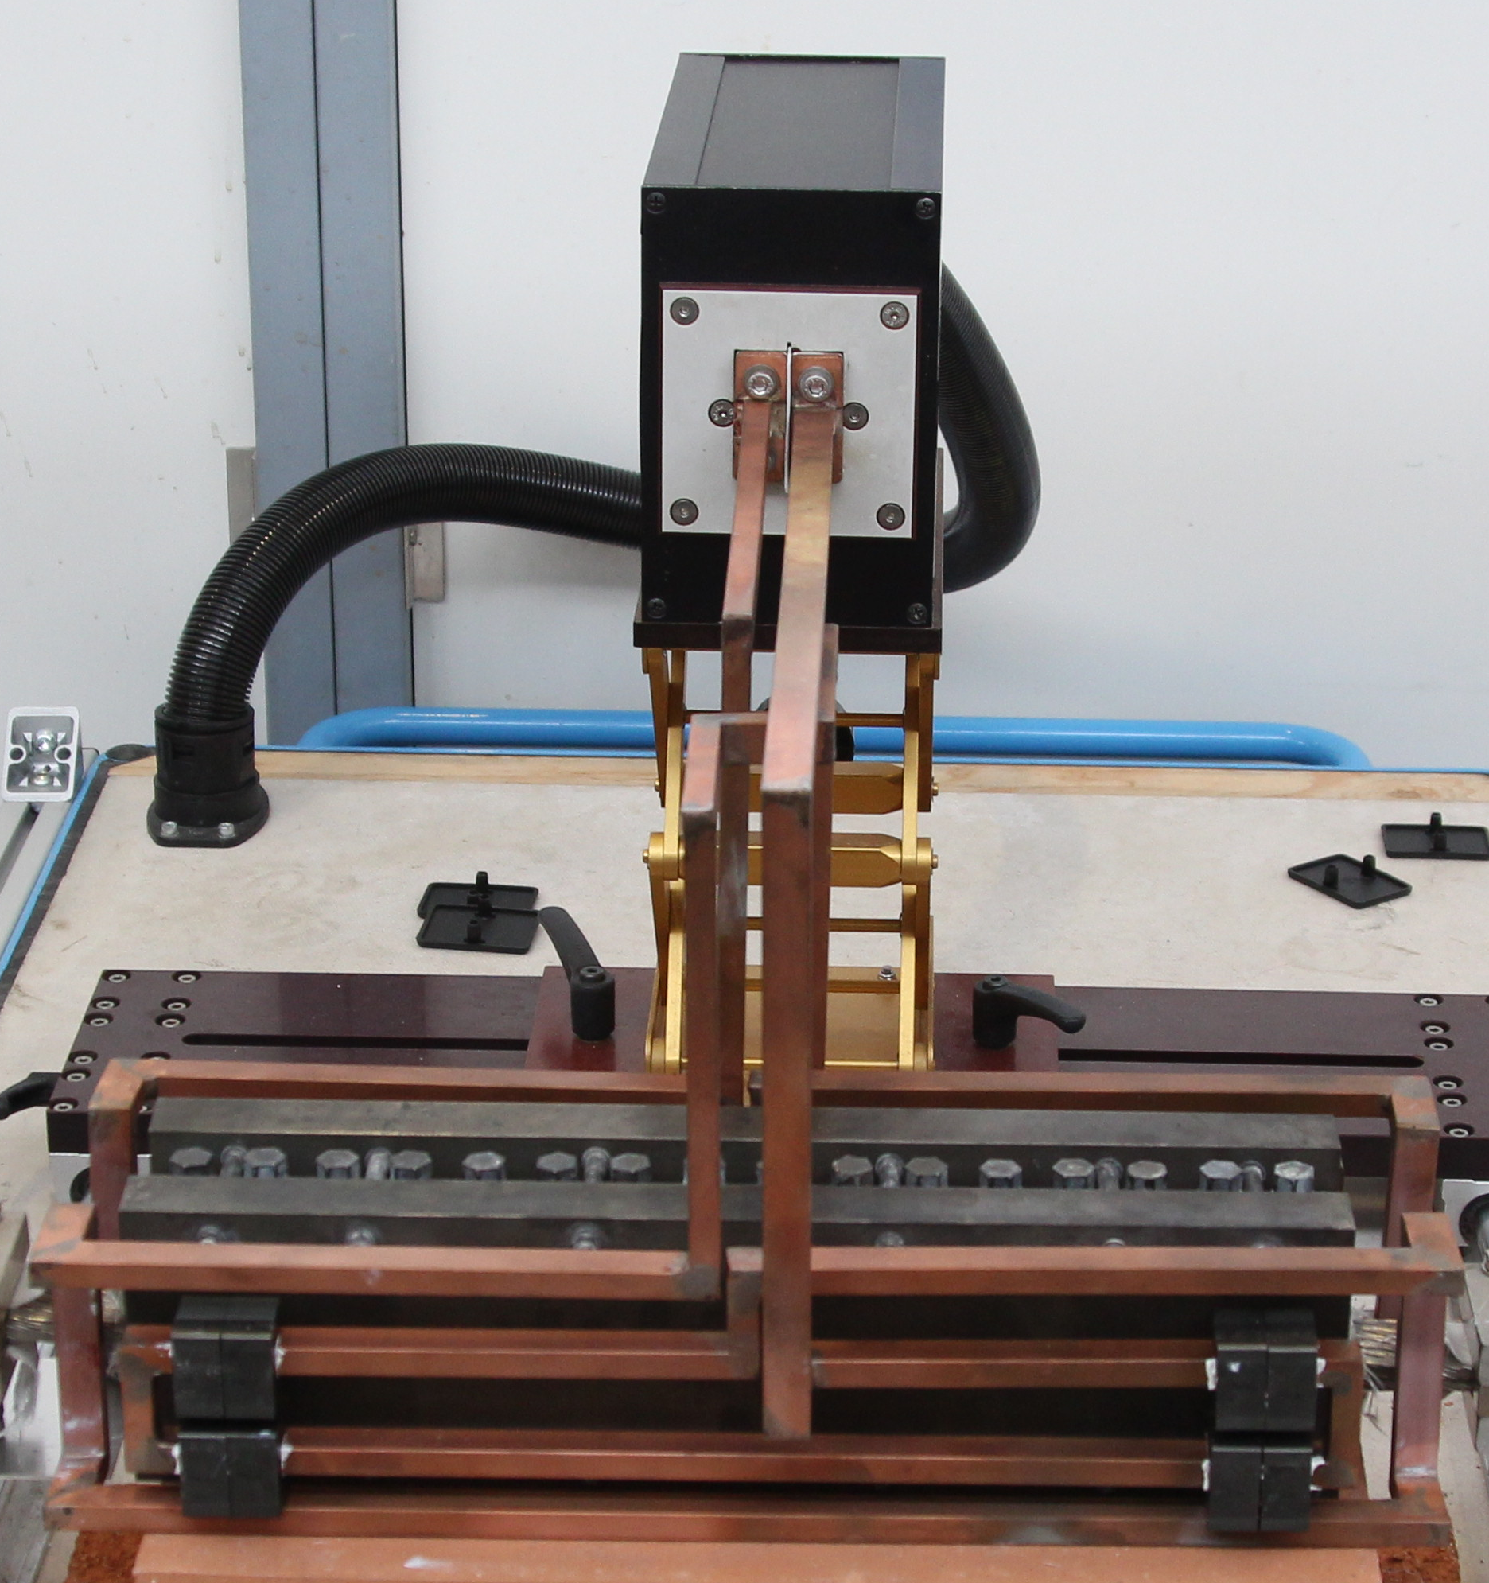
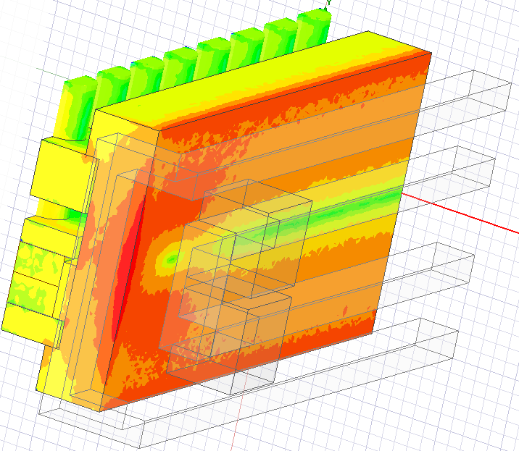
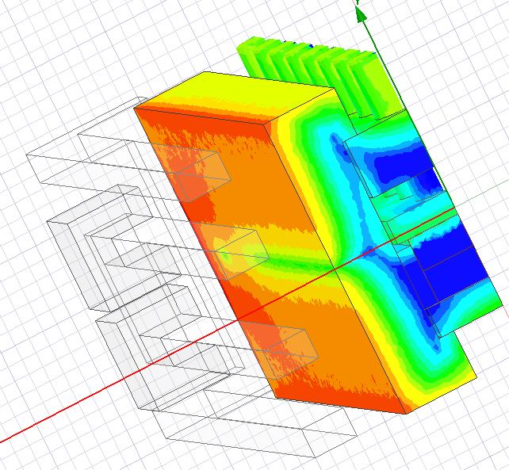
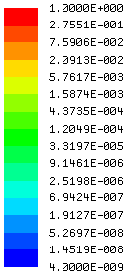
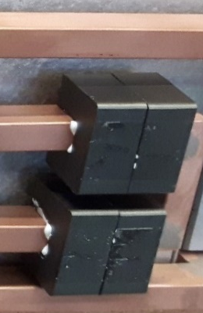
RW2J2 – 3. Oven to keep temperature (I)
Portable inductive copper oven
Inductors optimized → cable temperature as homogeneous as possible
f=52.3 kHz
P=4.6 kW
Clamp end
Clamp center
Normalized
Ohmic Losses
Ferrite blocks focus field lines
Notes:
$$δ=\sqrt{\frac{ρ}{π∙μ∙f}}$$
δ: penetration depth [m]
ρ: resistivity [Ωm]
μ: magnetic permeability [H/m]
f: frequency [Hz}
It shouldn’t be higher than 1/8 diameter of work piece. δ=2.2 mm for Inconel 600

Slide 10

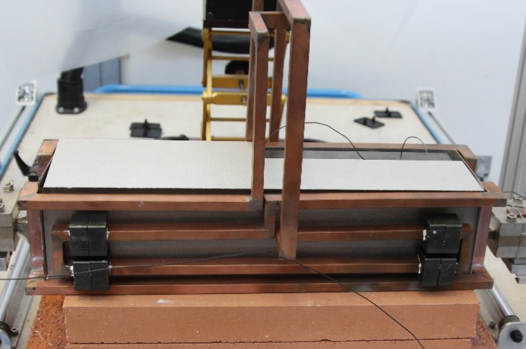
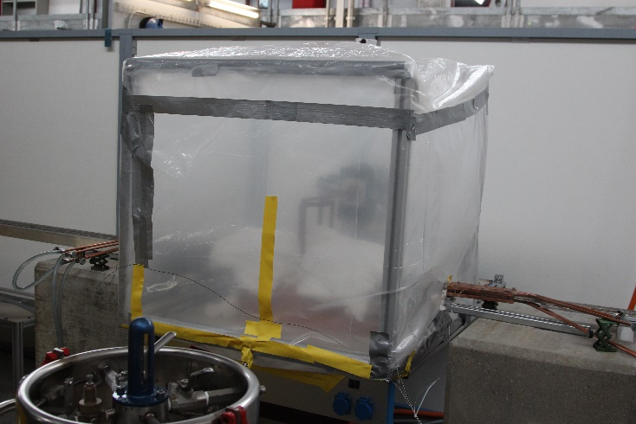
RW2J2 – 3. Oven to keep temperature (II)
(a)
Oven and cable ends active cooling
Mica plates shield from thermal radiation.
Inert atmosphere with N₂
Cable T @ steady-state (P=4.6 kW, f=52.3 kHz):
  690 °C @ cable center
  620 °C @ cable ends
  20 °C @ Cu plates
Times:
  1.5 h to get steady-state
  2 h of diffusion-bonding
  6 h cool-down
Pressure clamp
Cu Inductors
Cu cooling plates
N₂ inlet
(b)
(c)
Mica plates
Ceramic wool
N₂ dewar
f=52.3 kHz, P=4.6 kW

Slide 11
Outline
Background of RW2 joint
RW2 joint using diffusion-bonding technique (RW2J2)
  Assembly
    Cables preparation before bonding
    Diffusion bonding
    SULTAN sample
  Test results
    Electrical resistance
    AC losses ꓕ and ‖ to the broad side
  Conclusions and perspectives

Slide 12
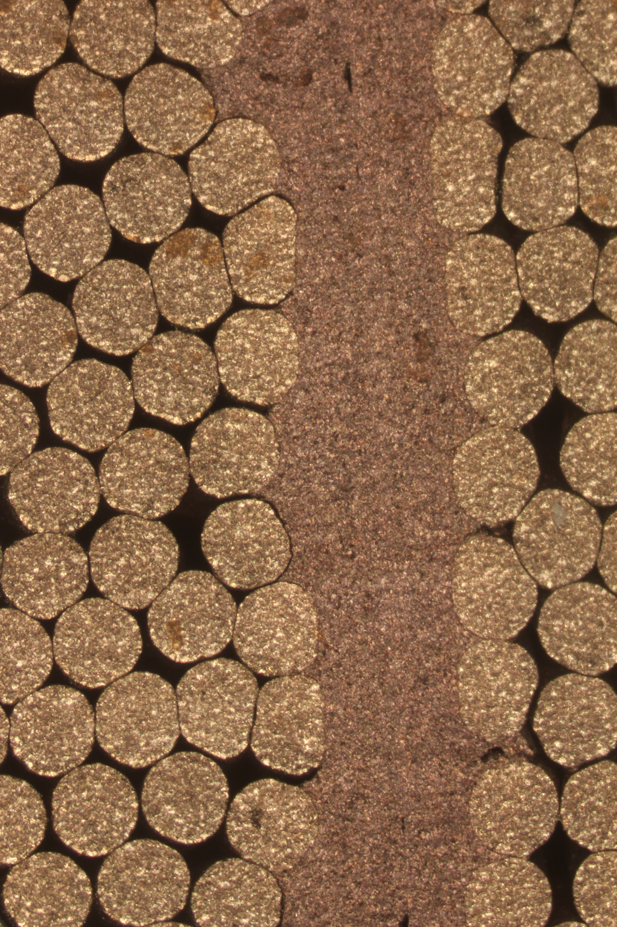
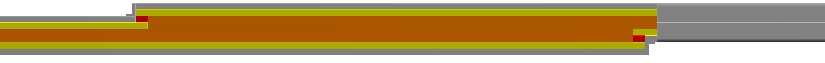
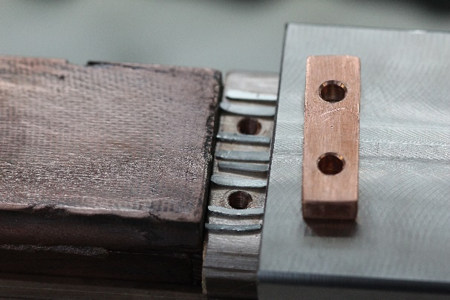
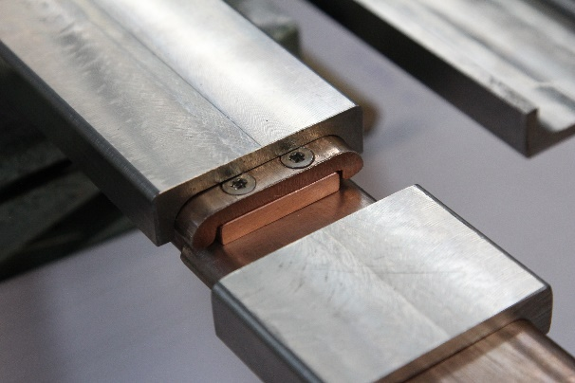
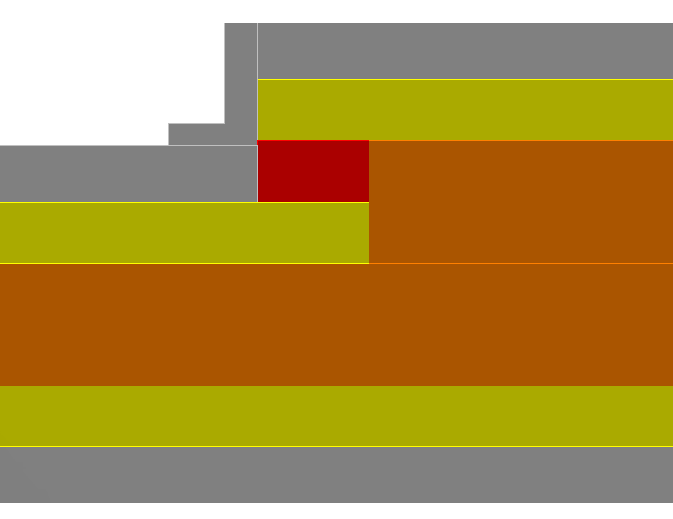
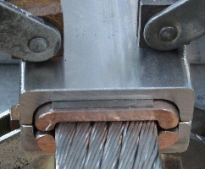
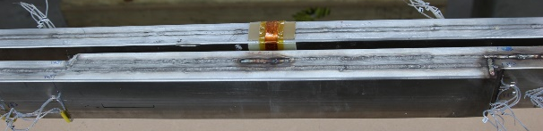
RW2J2 – SULTAN sample
  Stabilizer is machined according to joint dimensions
  Copper bridge with indium ensures full matrix stabilizer electrical continuity
Dummy
joint
RRR=70
Cu bridge
Jacket
joint
Stabilizer
  Cable preload with thin steel foil between jacket and stabilizer
  Steel end caps and bars are welded to the jacket

Slide 13
Outline
Background of RW2 joint
RW2 joint using diffusion-bonding technique (RW2J2)
  Assembly
    Cables preparation before bonding
    Diffusion bonding
    SULTAN sample
  Test results
    Electrical resistance
    AC losses ꓕ and ‖ to the broad side
  Conclusions and perspectives

Slide 14
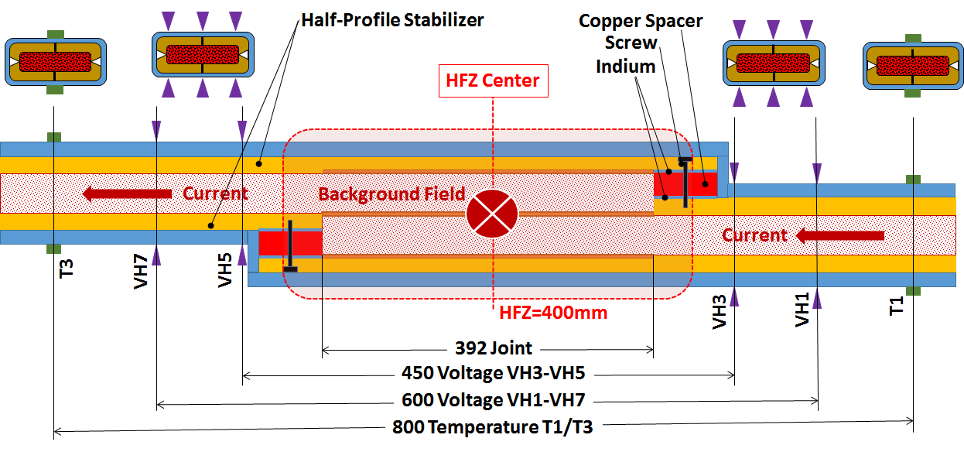
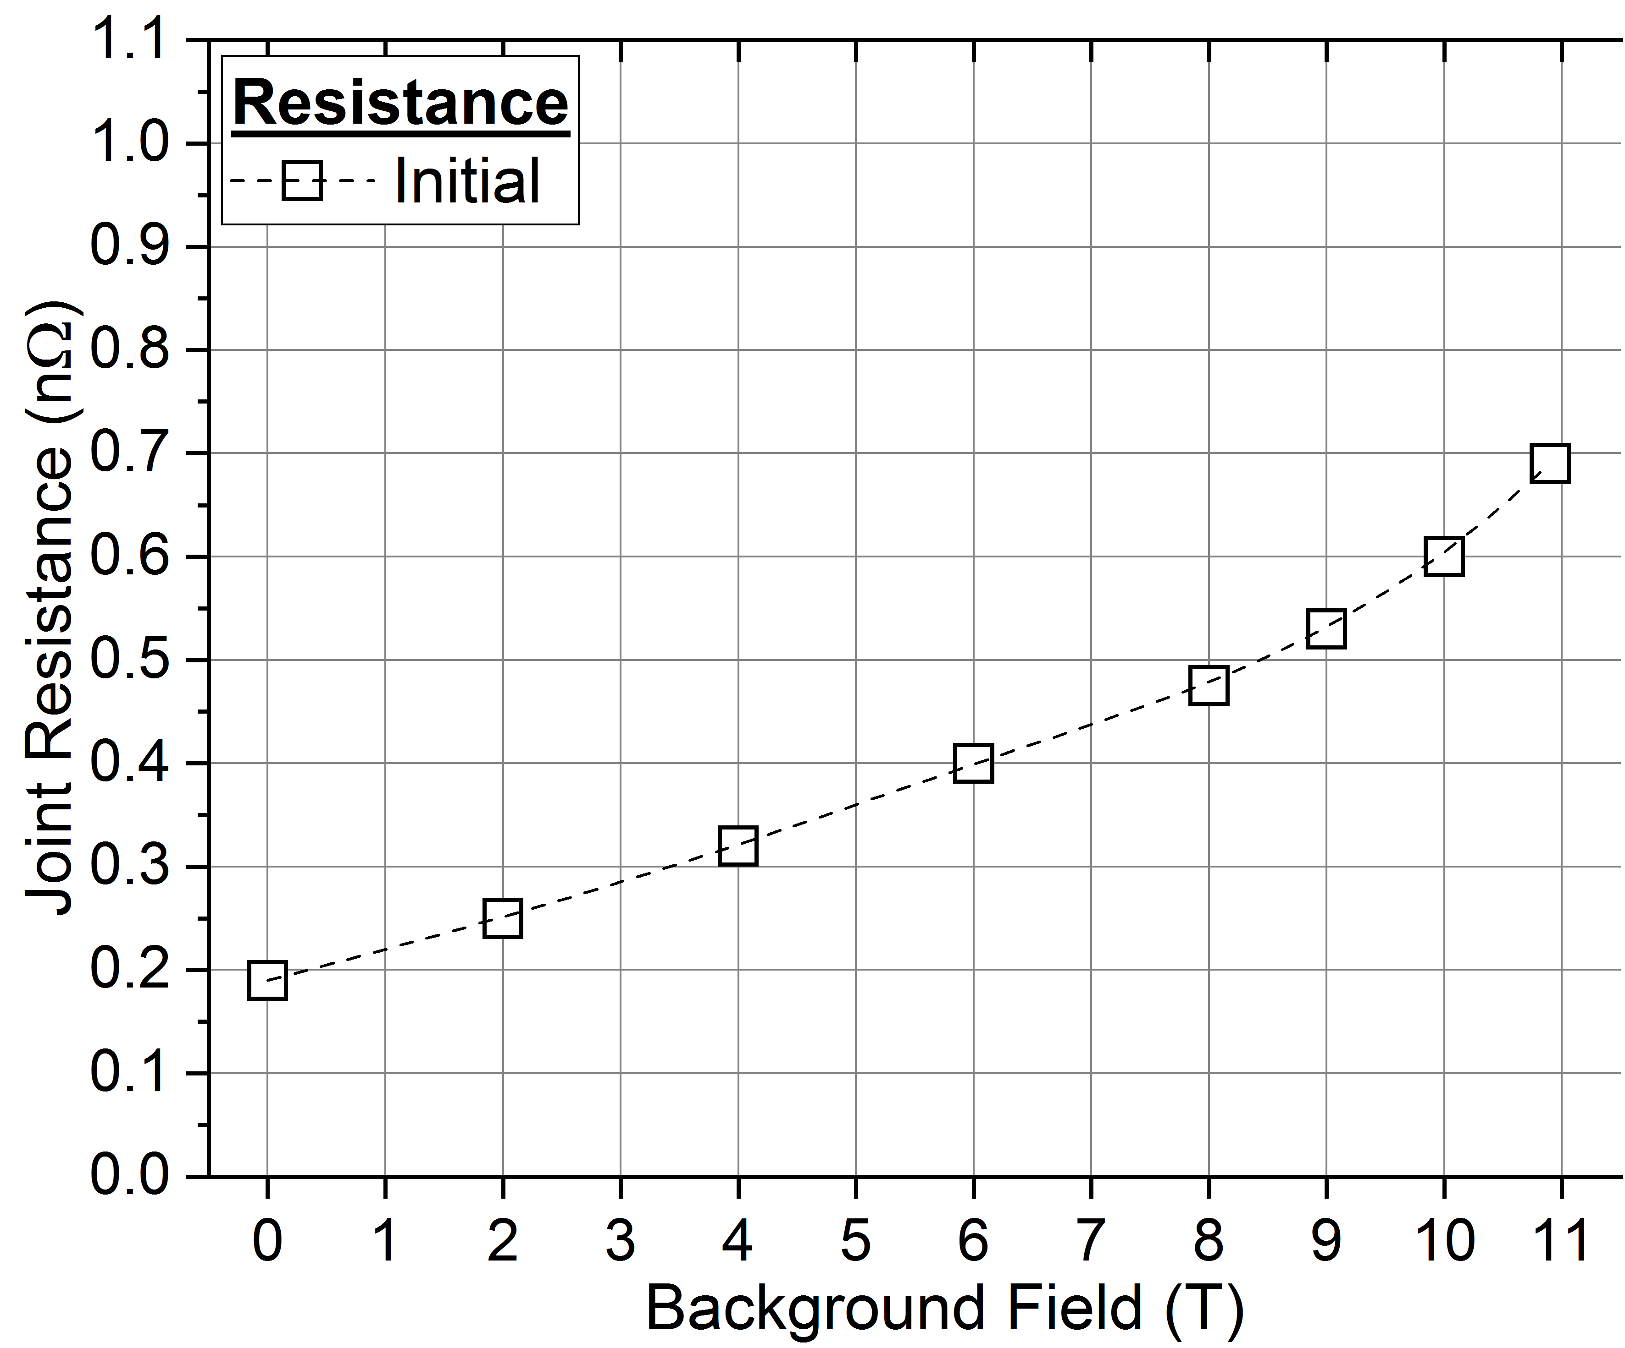
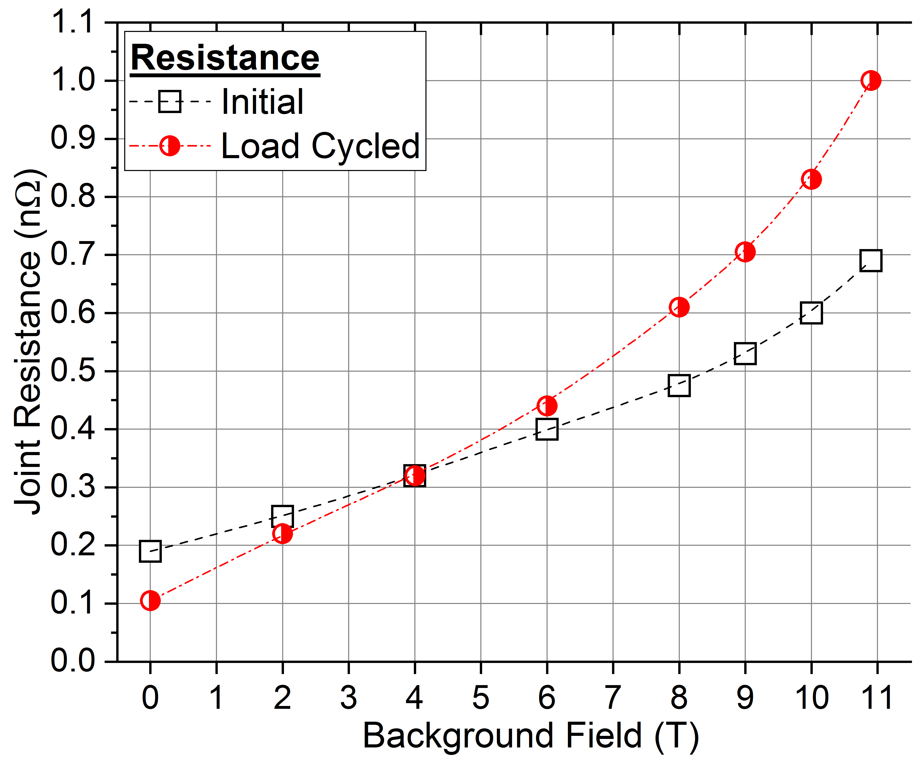
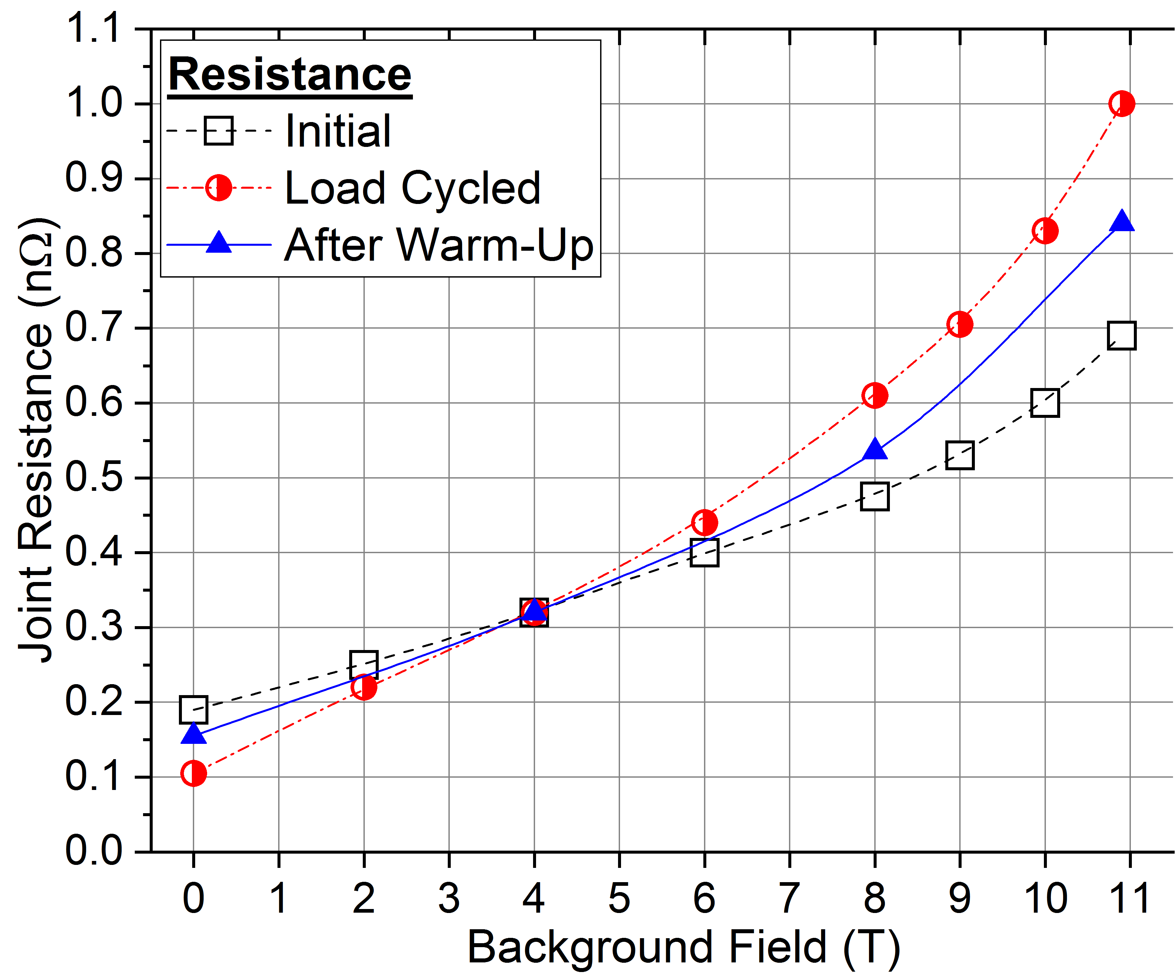
Test results – Electrical Resistance
Stabilizer
V-taps arrays at 450 mm and 600 mm. R @ different I-flat-top and B
I=63.3 kA
R(B) behavior according to Cu magneto-resistance for the “initial” curve
Higher difference between R_{450mm} and R_{600mm} after cycling (8Tx63.3kA=506 kN/m). We suspect damage @ joint sides
Joint in TF
Notes:
Joint works at 8 T, but it is important also test at 10.9 T because we use two high-grade
We suspect damage because of difference between R450 and R600 (not shown). Also because @ low fields, far from strands saturation, the average R after cycling is lower than the “initial” curve

Slide 15
Outline
Background of RW2 joint
RW2 joint using diffusion-bonding technique (RW2J2)
  Assembly
    Cables preparation before bonding
    Diffusion bonding
    SULTAN sample
  Test results
    Electrical resistance
    AC losses ꓕ and ‖ to the broad side
  Conclusions and perspectives

Slide 16
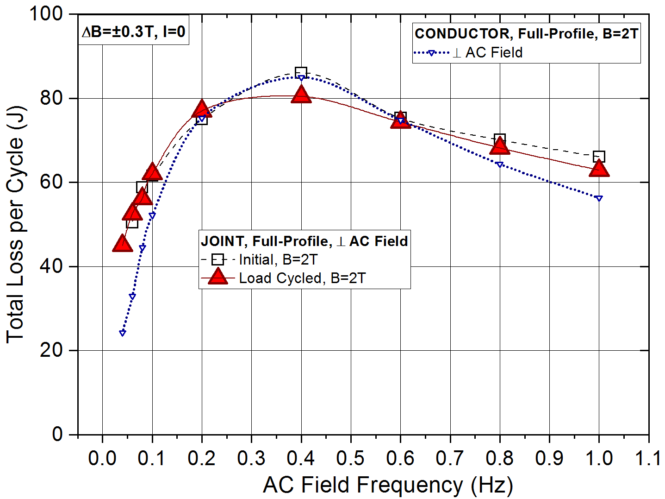
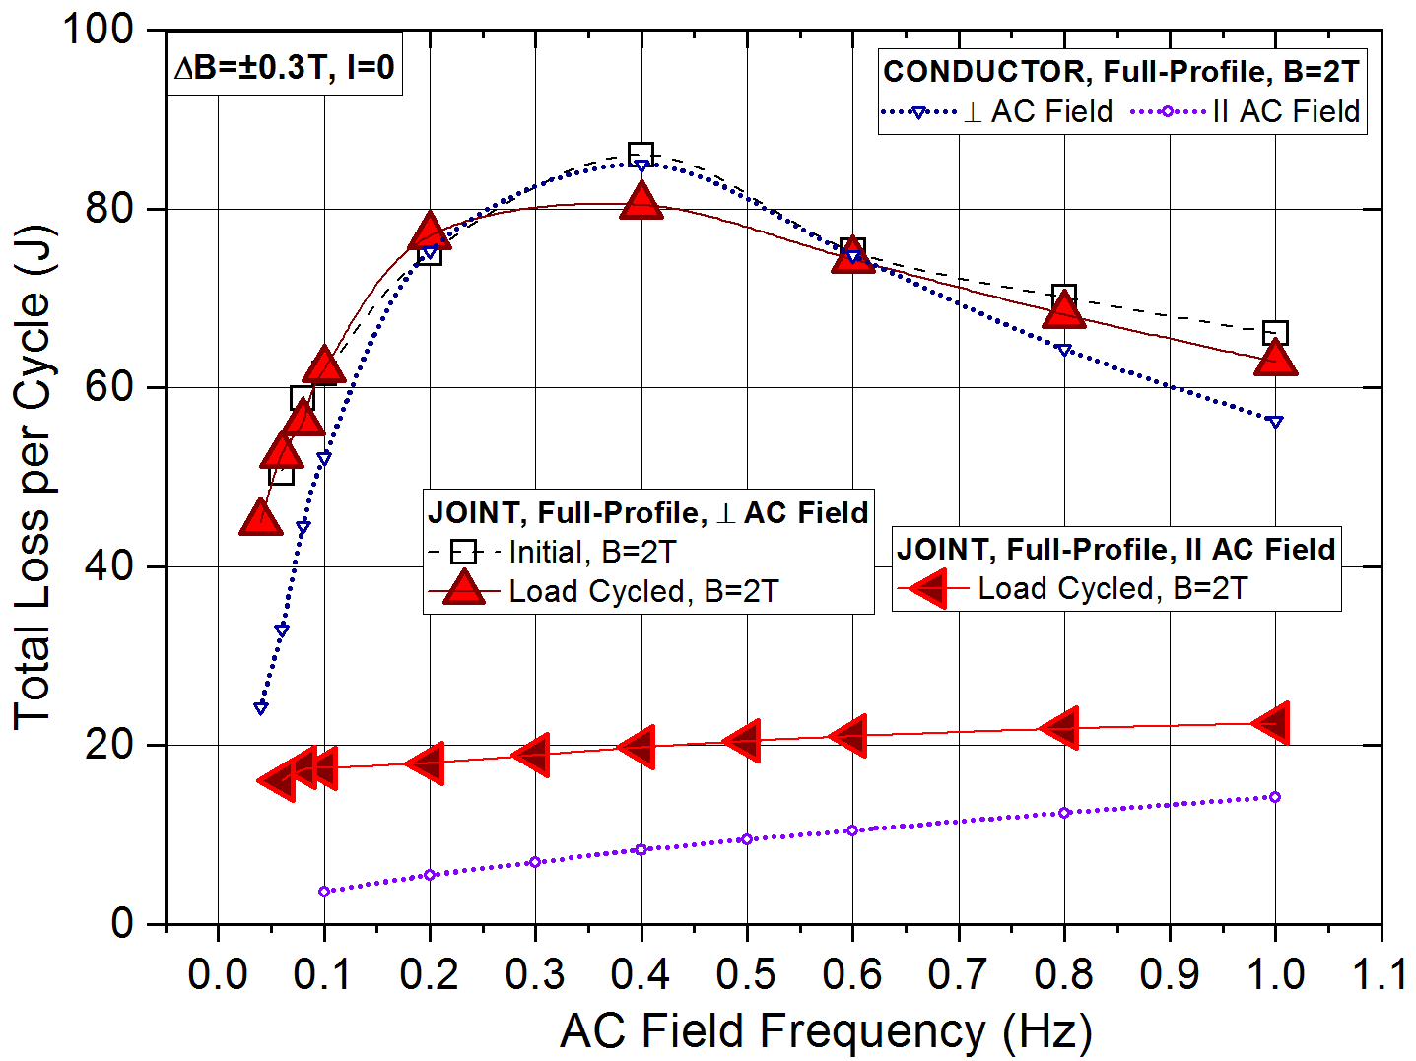
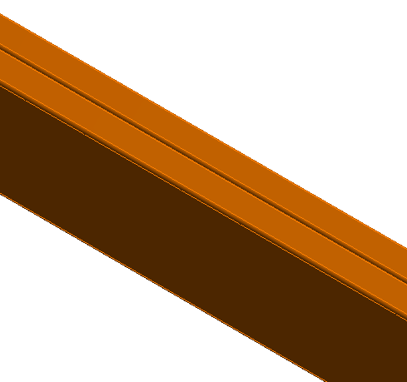
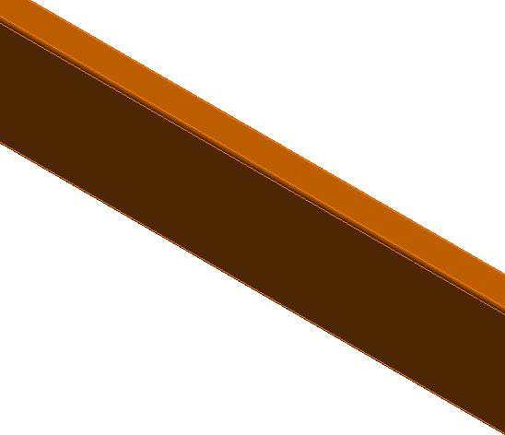
Test results – AC losses and Transient Stability Test
Comparison between joint and conductor at B=2 ± 0.3 T sinusoidal pulse
AC field ꓕ broad face
  No screening @ lower f → joint AC losses ≈ twice as conductor ones
  Screening @ higher f → joint and conductor losses are similar
AC field ‖ broad face: new current loops make comparison with conductor not scalable
Transient stability test at B=8 T, I=63.3 kA → quench in conductor leg if dB/dt>17.6 T/s in 128 ms. Deposited energy in joint 65 J
ΔB_{ꓕ}
ΔB_{ꓕ}
ΔB‖
ΔB‖
ΔB‖
ΔB_{ꓕ}

Slide 17
Conclusions and perspectives
MAG-4.2-T011-D002 completed
We have a joint reference for layer-wound DEMO RW magnets
Further R&D
Further characterization of the joint
  Mechanical tests with KIT (TS for KIT)
  Micrographs to study joint uniformity
The mechanical design of the joint (jacket, stabilizer, fillers) can be improved
A new joint may be prepared using RW3 late next year
Notes:
Joint costs:
Spray ≈350 CHF/cable
Inductors ≈1500 CHF
AC power supply rent ≈1200 CHF/week

Slide 18
Backup

Slide 19
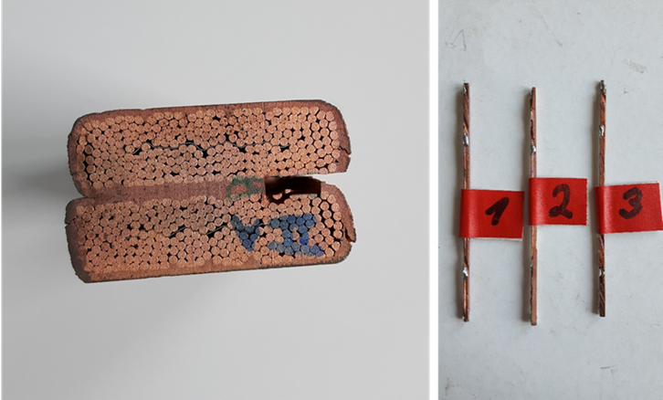
Measuring RRR sprayed copper

Slide 20
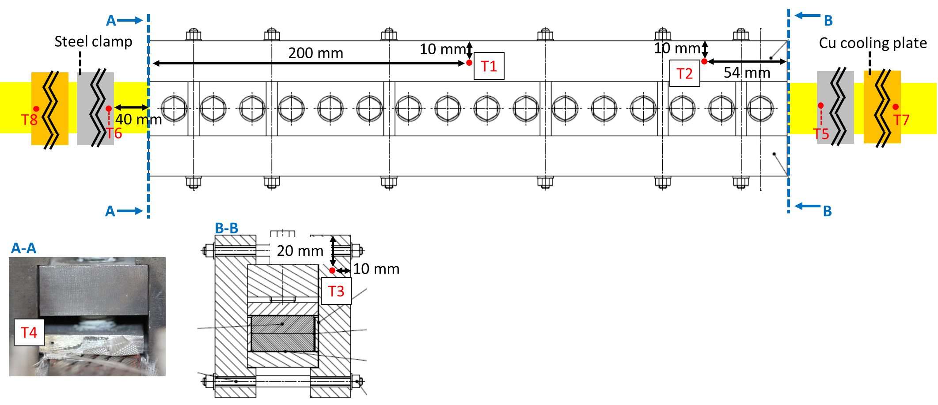
Diffusion bonding temperature distribution

