Slide 1
MAG-2.1-T023-D001: CEA R&D
L. ZANI & CEA team
WPMAG Final Meeting, 12th Feb. 2020, Frascati

Slide 2
CEA R&D on TFCNSS-1
Update on TFCNSS-1 fabrication
Nb₃Sn strand production & QA checks
  125 kg ordered for both Nb₃Sn & Cu material
  Fabrication started in May, completion of production by WST in September 2019
  Material received by cabling company (Changtong) in December
  Production inventory received (49 unit lengths between 100 m & 700 m)
  Samples chosen (29 unit lengths of 4 meter each)
  2 samples tested for I_{C}
Superdummy strand purchase
Objective = provide strand for cabling trials before using the Nb₃Sn
  Material ordered by CEA, 208 kg produced by Luvata (stiffness adapted for cabling)
  Delivery at CEA early December 2019
  Sent to Changtong company ~ received end december 2019

Slide 3
WST strands tests
WST production strand tests
Actions
  November 2019: first tests in BERENICE facility: R&D WST samples
  January 2020: tests of 2 production strands
⇨ I_{C} ~ 330 A
Less than declared WST values
→ to be checked
10 mandrels ordered to extend the measurements
He filling lines to be ordered

Slide 4
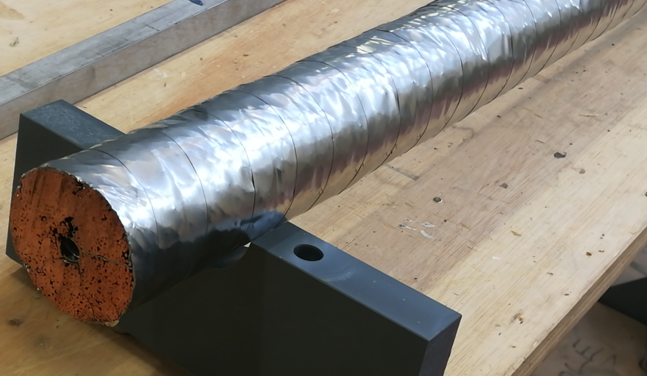
CEA R&D on TFCNSS-1
Compaction trial
Objective = simulate the jacket compaction before acting on the definitive material
  Definitive cable dimensions set
  A short dummy length produced by ASIPP in August (some meters) > sent to INFLPR for tomography
Void fraction | 31.3 %
r₁ | 2 mm
a₁ | 45 mm
Jacket thickness | 5 mm
Void fraction | 40.0 %
Gap | 0.8 mm
Spiral ext. diam. | 10 mm
D₂ (mm) | 66.18 mm
  Issues to procure a EU jacket at nominal dimensions (non standard)
    Will be produced in CN ➔ OK
  Discussions with ICAS to arrange the compaction trial
    Ongoing

Slide 5
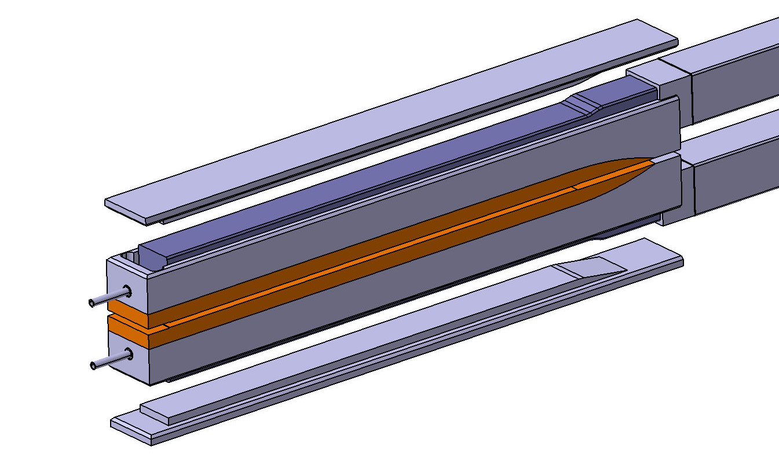
CEA R&D on TFCNSS-1
TFCNSS-1 pieces
  Bottom Joint + Terminals
    Drawing completed
    Manufacture started (completion ~ April)
    Cable insertion tests to be conducted at CEA
  Leftover to procure
    heat treatment support
      ⇨ drawing ongoing

Slide 6
CEA R&D on TFCNSS-1
Schedule
  Compaction trials by ICAS ~ March
    ➔ To be stabilized
  Cabling trials ~ Feb - March
  ➔ To be agreed with ASIPP
  Conductor fabrication ~ April
  ➔ To be agreed with ASIPP
  TFCNSS-1 assembly at CEA ~ [May to September]
  ➔ To be consolidated
  TFCNSS-1 tests at SPC ~ October-November
  ➔ 3 weeks tests targeted, to be consolidated

Slide 7
Conclusions - perspectives
Conclusions
  TFCNSS-1 manufacture is ongoing
  Tests in SULTAN are targeted for end 2020
Perspectives TS 2020
  Extend the I_{C}-strain tests on WST strands (check possiblities with Univ. Twente)
NB: this proposal should be adjusted according to the volume of work (when identified) which is needed for addressing Gate Review documentation

Slide 8
Thank you for your attention
Questions ?

