Slide 1
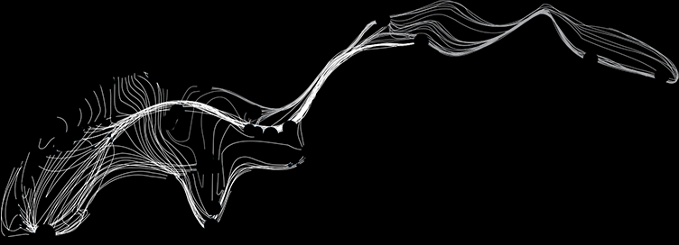
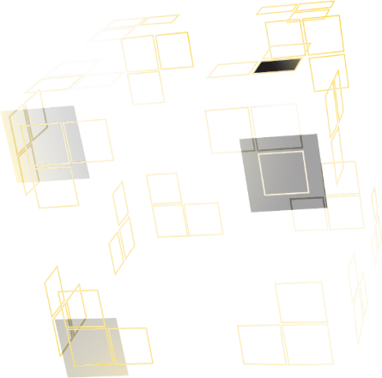
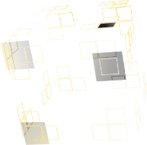
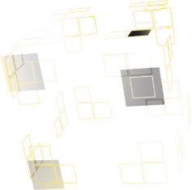
MAG-4.3-T0021, AC Loss in CICCs with different cable patterns, measurement and modeling
UNIVERSITY OF TWENTE.
A. Nijhuis¹, V.A. Anvar^{1,2}, T.E.W. Hamer¹, J. Qin³, Y. Wu³, A. Devred⁴, T.J. Haugan⁵, R. J. Thomas³, M.S.A. Hossain^{2,7}
¹ University of Twente, Faculty of Science & Technology, 7522 NB Enschede, the Netherlands
² University of Wollongong, Institute for Superconducting and Electronic Materials, Wollongong, Australia
³ Institute of Plasma Physics, Chinese Academy of Sciences, China
⁴ CERN, Technology Department, CH-1211 Geneva 23, Switzerland
⁵ US Air Force Research Laboratory, Wright Patterson AFB, OH 45433, USA
⁶ Department of Mechanical Engineering, T.K.M.C.E, Kerala, India
⁷ University of Queensland, School of Mechanical and Mining Engineering, Brisbane, QLD 4072, Australia
EUROfusion, WPMAG19, Final Meeting, ENEA, February 2020

Slide 2
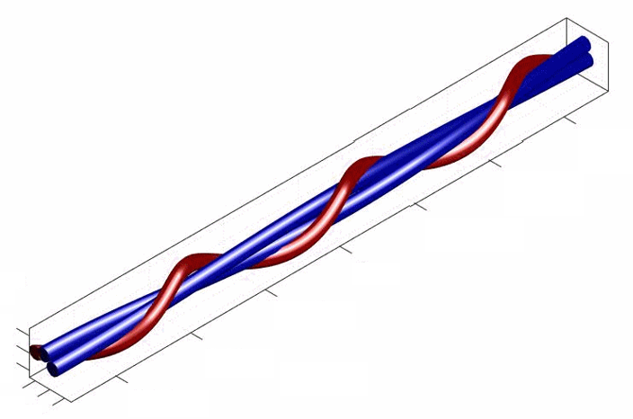
Introduction; three CICC cable patterns
CWS design aims for more lateral strand support and less Nb₃Sn strand indentation. The Twente design aims for reduction of coupling loss and maximizing strand mechanical lateral support (TP ratio close-to-one). The CSMC-CEFTR cable pattern (close to ITER CS is taken as a reference.
Three cabling twist patterns have been selected for further studies with full-size and sub-size CICCs.
CICCs manufactured at ASIPP, Hefei, China and tested at Twente.
Soft copper strand around Nb₃Sn strands in short twist pitch
Twente design with twist pitch ratio close to one
Short twist pitch version
ITER Baseline for comparison
UNIVERSITY OF TWENTE.

Slide 3
New set sub-size CICCs with cabling variations
Strand diameter, d_{s} = 0.82 ± 0.005 mm, Layout = (2 Sc+1 Cu) × 3 × 4 × 4, tube wall thickness 1.5 mm
# | Design | Void fraction [%] | Twist pitch lengths [mm] | cosθ | Jacket inner diameter [mm]
1 | Twente | 27.9 ± 1 | 50×58×66×76 | 0.941 | 11.95
2 | Twente | 28.0 ± 1 | 110×118×126×140 | 0.983 | 11.70
3 | Twente | 23.2 ± 1 | 50×58×66×76 | 0.945 | 11.55
4 | Twente | 32.3 ± 1 | 50×58×66×76 | 0.938 | 12.35
5 | CSMC | 32.6 ± 1 | 25×50×90×160 | 0.966 | 12.20
6 | CWS-I | 32.5 ± 1 | (40+10)×60×90×160 | 0.925 | 12.45

Slide 4
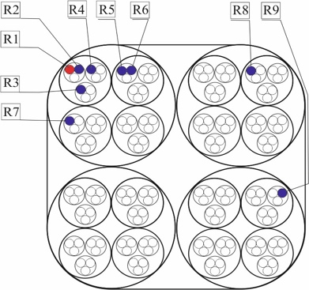
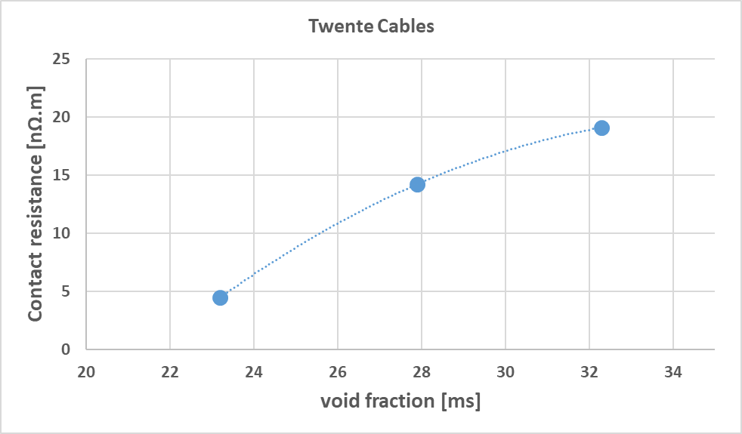
Interstrand contact resistance sub-size CICCs
Selected strand set from each cable
Cables 3, 4 and 5 similar R_{c} range.

Slide 5
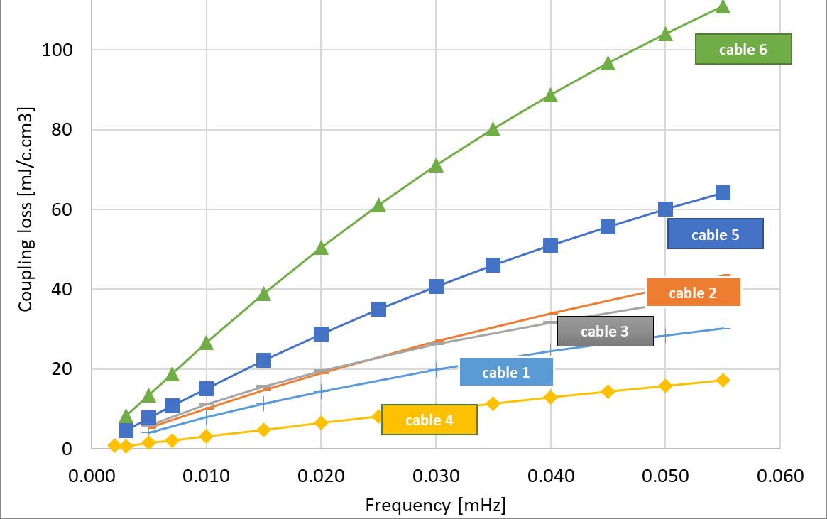
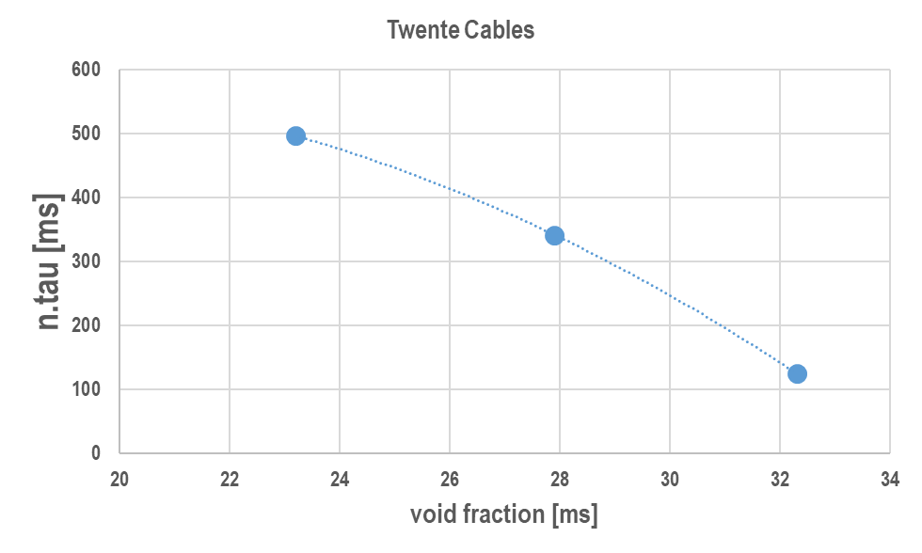
AC Loss results sub-size CICCs
# | Design | VF [%] | L_{p}’s [mm]
1 | Twente | 27.9 | 50×58×66×76
2 | Twente | 28.0 | 110×118×126×140
3 | Twente | 23.2 | 50×58×66×76
4 | Twente | 32.3 | 50×58×66×76
5 | CSMC | 32.6 | 25×50×90×160
6 | CWS-I | 32.5 | (40+10)×60×90×160
Irrespective of cable parametric variations or low void fraction, all 4 Twente cables show lowest coupling loss.
CWS-I highest coupling loss, CSMC is in between.

Slide 6
Strand indentation in Full-Size CICCs
CWS – I
Twente
CSMC
Strands are highly deformed and disordered
Damage Cr coating
No visible strand indentation and strands are well ordered
Visible strand indentation and disorder but less compared to CWS-I, but more compared to Twente
UNIVERSITY OF TWENTE.

Slide 7
I_{c}(B) ITER barrel
4 strands extracted from each CICC, before heat treatment, heat treated and tested on ITER barrel.
Un-cabled similar strands measured as reference.
Ic(B) results show that strands have good performance, except for cable 6 (CWS), 10% at 13 T.
# | Design | VF [%] | TP lengths [mm]
1 | Twente | 27.9 ± 1 | 50×58×66×76
2 | Twente | 28.0 ± 1 | 110×118×126×140
3 | Twente | 23.2 ± 1 | 50×58×66×76
4 | Twente | 32.3 ± 1 | 50×58×66×76
5 | CSMC | 32.6 ± 1 | 25×50×90×160
6 | CWS-I | 32.5 ± 1 | (40+10)×60×90×160
UNIVERSITY OF TWENTE.
7

Slide 8
Conclusion
Twente cable design lowest coupling loss for both full and sub-size CICCs; with CSMC 4 and CWS 8 X higher coupling loss (same void fraction).
For low void fraction (23%), coupling loss still 2X lower than ITER CS STP.
No strand deformation observed for Twente design, strong deformation in CWS, intermediate in CSMC.
Extracted strands show degraded performance for CWS design (10%), other samples perform like non-cabled reference.
UNIVERSITY OF TWENTE.

Slide 9
Single nτ for simple coupling loss calculation
Coupling loss for sinusoidal and trapezoidal applied magnetic field.
Magnetic field pulse comparison with JackPot-ACDC for sinus and trapezoidal runs with different ΔB and dB/dt, Q_{hyst}=zero.
Values of nτ-pulse from energy measured on trapezoidal runs, after subtracting Q_{hyst}.
P. Bruzzone, A new test method of AC loss assessment for fusion conductors, Fus Eng Des 146 (2019) 928–931.

Slide 10
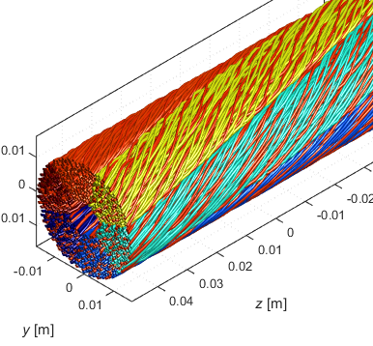
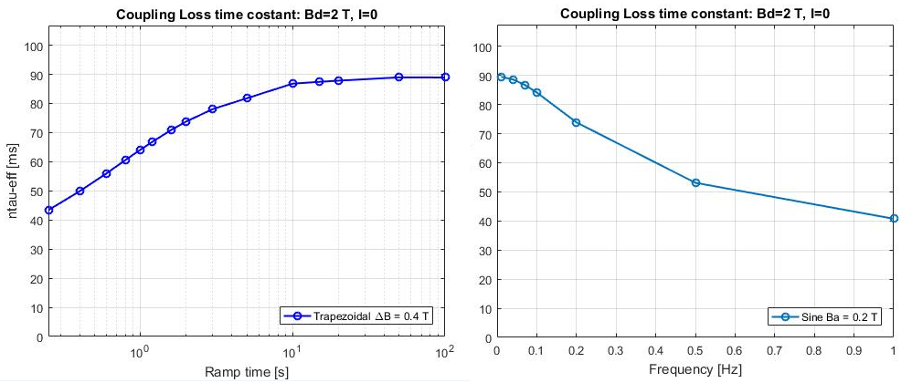
JackPot coupling loss ITER CSJA8, sinus & trapezium
Effective single nτ from JackPot coupling loss generation sinusoidal and trapezoidal applied magnetic field.
CS conductor at plasma initiation, ΔB 1.2 T (ITER) and 0.9 T (DEMO) over 0.8 s
dB/dt = 1 T/s
Single nτ−eff derived for very low dB/dt (trapezoidal) equals nτ−eff from sinusoidal initial slope value.

Slide 11
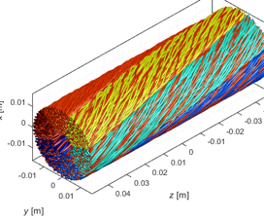
JackPot scaling single nτ for ITER CSJA8, ΔB varied
Effective single nτ from coupling loss generation sinusoidal and trapezoidal applied magnetic field.
CS conductor at plasma initiation, ΔB 1.2 T (ITER) and 0.9 T (DEMO) over 0.8 s
Loss scales with B_{a}² for a sinewave, and ΔB² for trapezoidal shape.

Slide 12
JackPot scaling single nτ for ITER CSJA8 & R_{c} varied
Unified nτ scales with unified ramp time (shape curvature depends on cable pattern/design?, TBD).
➜ general scaling for dB/dt and nτ.

Slide 13
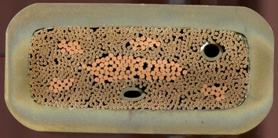
JackPot scaling single nτ for DEMO WP2 & R_{c} varied
Unified nτ scales with unified ramp time (shape curvature depends on cable pattern/design?, TBD).
➜ general scaling for dB/dt and nτ.

Slide 14
0.05 s ramp time
Trapezoidal pulse, effect dwell time
0.05 s ramp time
0.05 s ramp time
Δt = 300 s
dwell time = 1000 s
Effective single nτ from coupling loss generation trapezoidal applied field depends on dwell time (example is from full-size CICC with large nτ (9,000 ms).
0s Dwell
0.02s Dwell

Slide 15
JackPot-THEA: E_{ave} field threshold ITER CS conductor
Average electric field versus perturbation period (magnetic filed pulse) and the temperature margin of the CS conductor simulated with JackPot-THEA and compared to the quench electric field measured in SULTAN during T_{cs} tests.

Slide 16
Proposal 2020
D001
Identify a scaling law for use of single time constant (from sinewave pulsed field) for linear ramped magnetic fields exploring influence of conductor geometry, B, shielding, ramp and dwell time with JackPot.
Validate single time constant scaling law against experimental data.
D002
Comparison between peak / average electric field threshold (as identified and reported previously) and MQE (analytical vs numerical).
D003
Transport current test of a SS CICC with Twente cable pattern, TPR-1, L_{p}1=100 mm, and 27% void fraction.
Alternatively with MgB₂ as innovation for DEMO Feeder and low field PF sections. Manufacture and testing of MgB₂ sub-size CICC to validate the optimized cable pattern evaluated with JackPot.

Slide 17
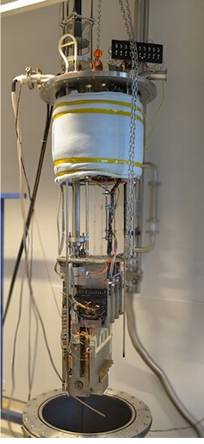
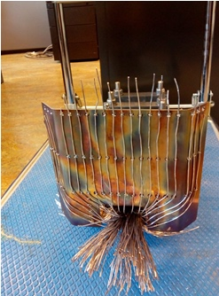
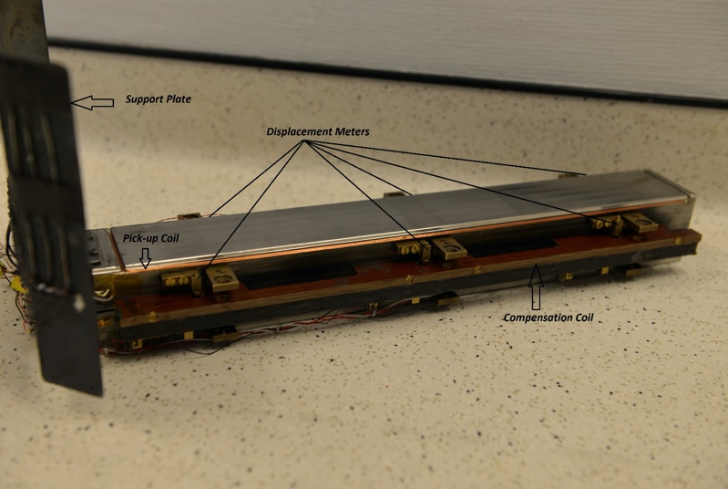
DEMO TF – RW2: Twente Press test WP1 TF conductor (1)
Press sample section with slits, bolts, PU-coils, extensometers & ISCR contacts
Support plate
Displacement meters
Pick-up coil
Compensation coil

Slide 18
WORK DELAYED
MAG2018: WP2 DEMO TF (ENEA) sample AC loss cyclic load test in Press for 2018: sample received and work started December 2019. Test completion March2020.
MAG 2019: WP3 DEMO TF (CEA) sample; TFCNSS-1 conductor delivery March-April 2020. Press test completion August 2020.
(The sample tested and reported during MAG18, was also delayed and actually belonged to MAG17).

