Slide 1
MAG – 3.4- T007- T009 – T010 Industrial Feasibiliy Studies
P. Bruzzone
February 13th, 2020

Slide 2
Summary of SPC Tasks MAG – 3.4
T006. The contracts placed in 2018 with SIMIC (TF case), BNG (Logistic) and SEA-ALP (Logistic) have been completed in Spring 2019. The three final reports have been approved after minor iteration in early May 2019 and are uploaded in IDM. In general, the reports are rich of valuable information.
T007. Awarded in Spring 2019. Studies on manufacturing process for conductor and winding of the DEMO hybrid CS coil
T009. Awarded in January 2020. Industrial feasibility study on the TF radial plates of the EUROfusion DEMO.
T010. Awarded in January 2020. Insulation procedure for the DEMO TF Nb3Sn conductor – option WP#2.
Completed

Slide 3
Highlights from MAG – 3.4 – T006
TF case. The projection of SIMIC on the feasibility of TF case and casing is alerting.
The thickness of the case prevent a closure weld as in ITER. An alternative casing procedure is proposed.
The time scale is scaring. Without duplication of key equipment, the casing of 16 TF coils last over 20 years, or 29 years including the case manufacture.
The cost of case and casing, without equipment duplication, is estimated at 1.5 B€.
In situ coil manufacture. Despite the huge logistic challenges, there is a strong resistance against in situ manufacture.
Single Impregnation. Opposite to ITER, both companies (BNG and SEA-ALP) prefer single impregnation of windings.
React & Wind. Both companies recognize the simplification in the manufacture and propose winding from a long, straight conductor section.

Slide 4
MAG – 3.4 – T007 Studies on manufacturing process for conductor and winding of the DEMO hybrid CS coil
The task is part of the 2019 additional industrial involvement.
The object of the industrial study is to discuss Conductor assembly procedure, tooling, handling, accuracy, logistic requirement and CS module winding and stacking with pre-compression structure.
Based on the good experience in the former “Logistic” studies, BNG and SEA-ALP were inquired in May. The budget of the task, 150 k€, is split in two. Two contracts were awarded July to BNG and SEA-ALP.
The kick-off meetings were held on August 1st (SEA-ALP) and September 10th (BNG).
Both contracts are on track. Reports are expected in March 2020 (SEA-ALP) and April 2020 (BNG).

Slide 5
MAG – 3.4 – T009 Industrial feasibility study on the TF radial plates of the EUROfusion DEMO.
The task is triggered by the panel report on the Progress Review Meeting (December 2019).
The object of the industrial study is to discuss how to extrapolate the manufacturing process of the TF radial plates from ITER to DEMO (WP#4).
With “express procedure” the task, for a value of 37.5 k€, was awarded to SPC on January 14th.
The call for tender was sent to SIMIC, CNIM and WalterTosto. Two companies replied (SIMIC and WalterTosto). The task was awarded to SIMIC.
The procurement order was signed on January 28th. The kick-off meeting by videoconference was held on February 7th (technical input from L. Zani).

Slide 6
MAG – 3.4 – T010 Insulation procedure for the DEMO TF Nb₃Sn conductor – option WP#2.
The task is triggered by the panel report on the Progress Review Meeting (December 2019).
The object of the industrial study is to discuss the wind-react-transfer procedure for the double-layer wound WP#2.
With “express procedure” the task, for a value of 37.5 k€, was awarded to SPC on January 14th.
The call for tender was sent to ASG, BNG and SEA-ALP. Two companies replied (ASG and BNG), SEA-ALP declined. The task was awarded to ASG.
The procurement order was signed on January 28th. The kick-off meeting by videoconference was held on February 6th (L. Muzzi also attended).

Slide 7
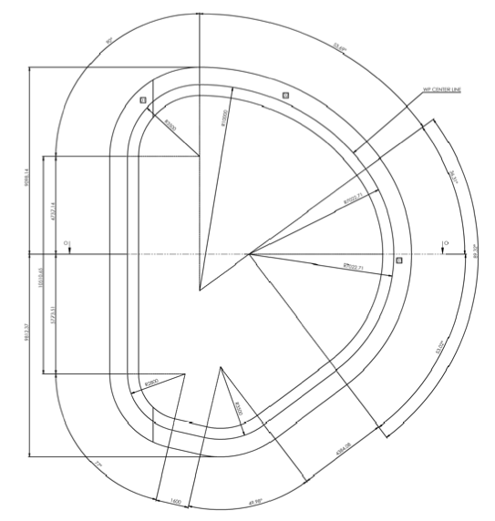
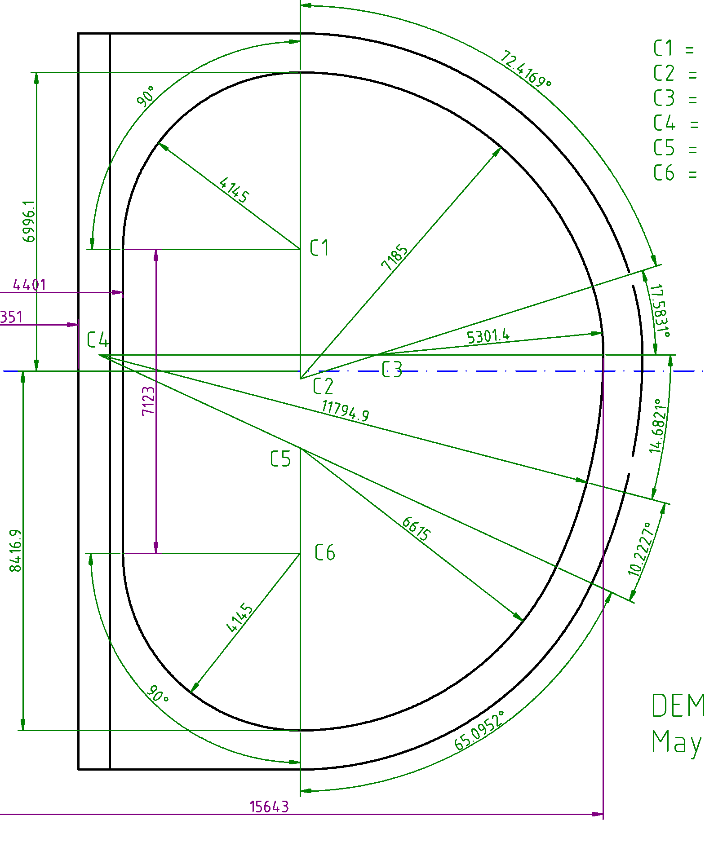
TF Shape
In the Logistic studies, radial plates and WP#2 insulation, the companies criticize the “ear shape” of the TF since baseline 2017, with sharp corners. We wish to route this message to those who invented the ear shape. Reverting to smoother corner radius is strongly recommended . This is the only way for larger conductor, e.g. high I_{op} and/or longer τ.

Slide 8
Conclusion
Four industrial studies with four companies are on going under supervision of SPC:
SEA-ALP (CS conductor and winding)
BNG (CS conductor and winding)
SIMIC (Radial Plates)
ASG (Insulation WP#2)
The four reports are expected between March and May 2020, in time for the gate review.
The content of the studies is interesting and valuable for the MAG Team. A clear feedback in the design choices is desirable -> “Industrial meeting”?

