Slide 1
MAG-3.4-T008-D001: Industrial feasibility studies
L. ZANI & CEA team
WPMAG Final Meeting, 12th Feb. 2020, Frascati

Slide 2
Introduction
Task order
PF system (~ 0.75 ppy)
An extensive descriptive list of the different stations used for the PF WPs fabrication of the two PF systems sets.
A detailed description of workstations including their scope with their manufacturing technical procedures detailed,.
Description of the tooling needed for the transformations carried out in the manufacture objective and if applicable the differences between the two PF sets requirements will be highlighted.
A technical analysis of the manufacture workflow of two sets of PFs with rationales of the chosen organization of the overall production including space occupancy and considering if possible schedule options (fast track / slow track).
For each PF and each set of PF will be provided a list including:
Breakdown of the fabrication flow detailing the working effort at each station. Effort total in units that can be convertible into costs.
Risks attached to each manufacturing stage in relation to the coils concept themselves or to the chosen fabrication methodology.
(if applicable) the R&D needed at each stage to ensure a safe manufacture path. This R&D should be somehow quantified in terms of working effort and global schedule.
QA approach considerations would also be mentioned, roughly exposing the weight of controls and reports in the global cost.
An overall time schedule should be provided, with a detail on the different stages of manufacture considered. A reasonable detailing (at minimum the workstation level) should be considered and agreed.
when possible illustrative sketches should be included.
➔ the study was applied to both SPC and CEA PF system designs on DEMO 2018 configuration

Slide 3
PF study elements
First outcomes
Considerations on transport (french regulation)
Category | Length [m] | Width [m] | Mass [kg]
1st category | L ≤ 20 | L ≤ 3 | M ≤ 48 000
2nd category | 20 < L ≤ 25 | 3 < l ≤ 4 | 48 000 < M ≤ 72 000
3rd category | L > 25 | L > 4 | M > 72 000
Diameter > 4 m > 3rd category
Calculations of jacket deformation
Decrease of spool diameter to < 4 m
➔ Switch to 2nd category

Slide 4
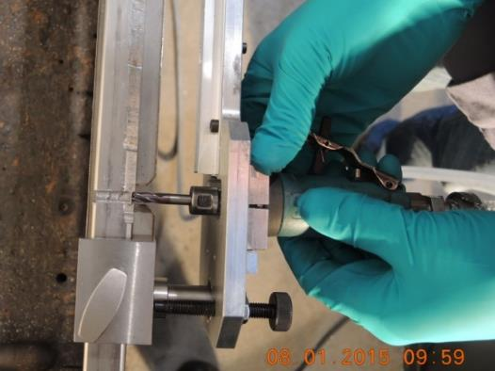
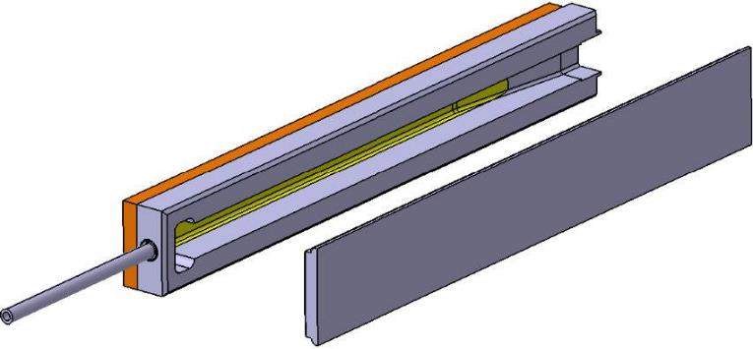
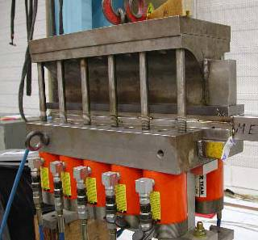
PF study elements
Description of the joint fabrication

Slide 5
PF study elements
Manufacture flow
Surface of the manufacture areas

Slide 6
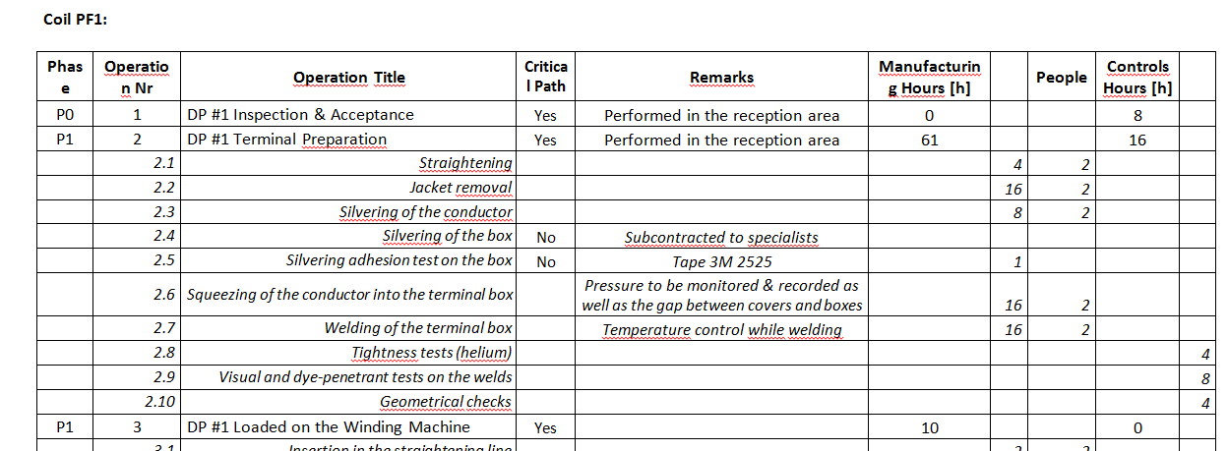
PF study elements
Overall operation breakdown
[…]
ongoing

Slide 7
Conclusions - perspectives
Conclusions
The feasibility study on PF system was addressed by GE on both CEA and SPC approaches
Work is quite advanced (80% on CEA option / 30% on SPC option) optimization still ongoing.
Comparative part still to be done
Completion schedule depending on overlap with TS 2020
Perspectives TS 2020
Conduct the feasibility study on WP#2
CEA-GE agreement amendement started
Assess the objectives / reference documents for coordination with same SPC-driven study, then GE can start

Slide 8
Thank you for your attention Questions ?

