Slide 1
3D mechanical analysis of TF WP#2 ENEA-UNITUS
F. Giorgetti, G. Calabrò, P. Fanelli,
G. Tomassetti, V. Corato, L. Muzzi
WPMAG Final Meeting 11-13 February 2020

Slide 2
Outline
Geometry
Homogenization
3D EM analsyis
3D Mechanical analysis
Conclusions
2020 TS

Slide 3
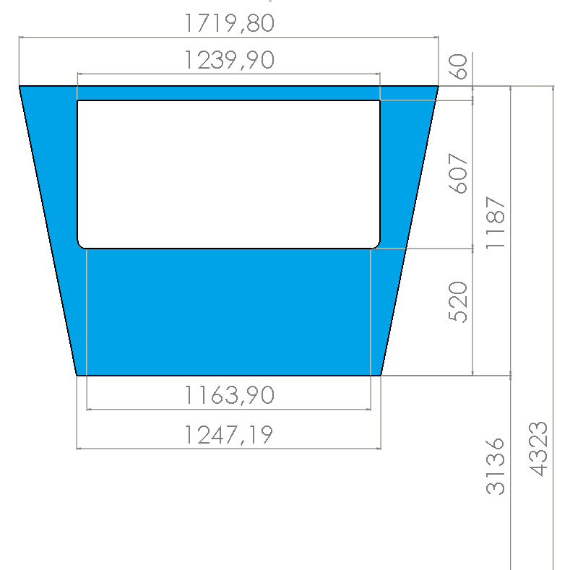
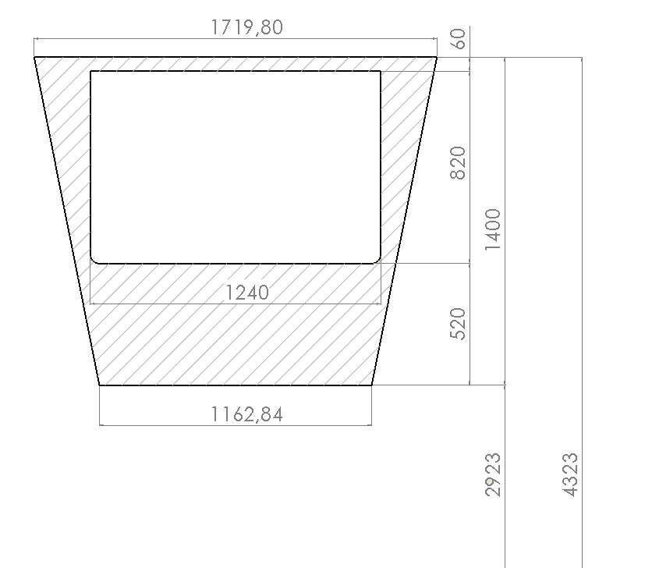
Geometry
The WP#2 layer-wound configuration is composed of 6 graded Double Layers (DL) [1].
Baseline vs WP#2 configurations:
Reduced radial space (from 820 mm to 607 mm), maintaining the same 12 T maximum field.
Same inner TF coil (plasma facing) radius (i.e. 4323 mm).
Same 520 mm casing nose thickness.
[1] L. Muzzi et al., ENEA TF Winding Pack Design and Analysis (2NGZ2G_v1_1)

Slide 4
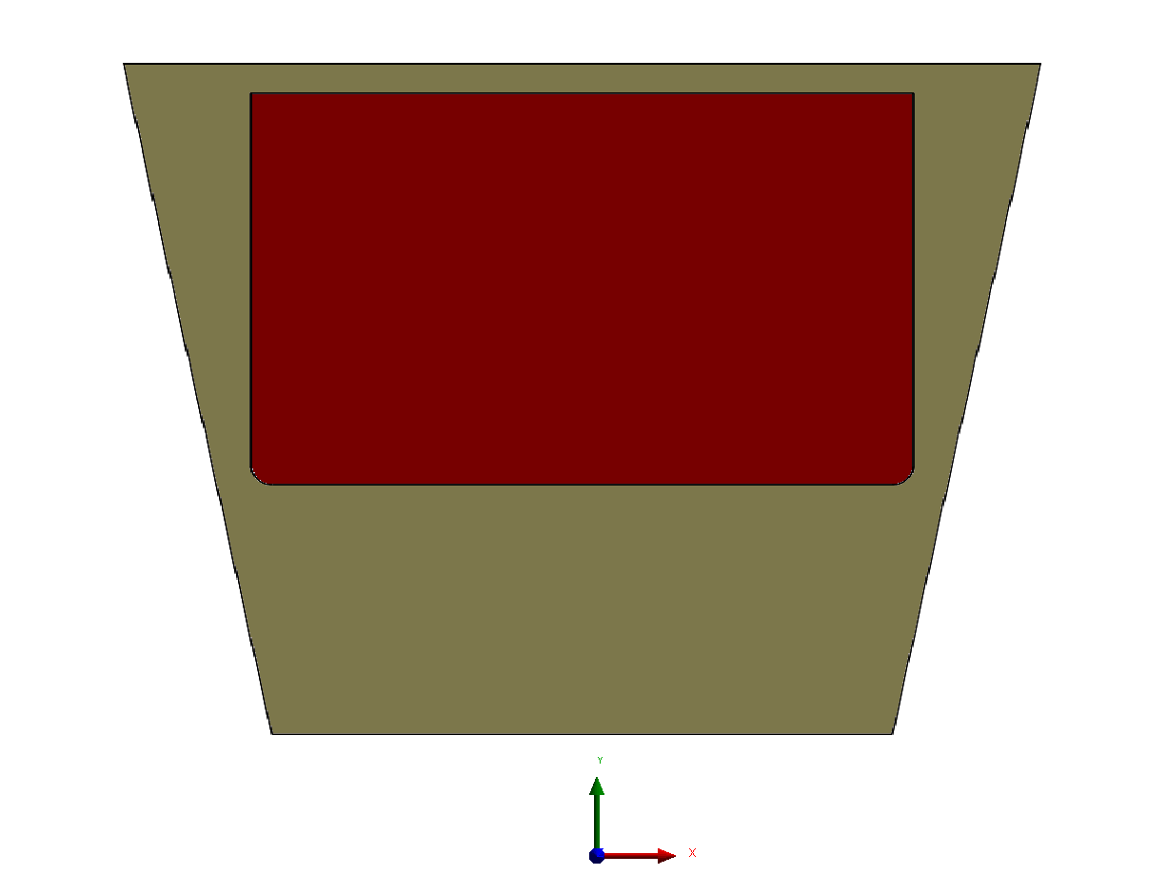
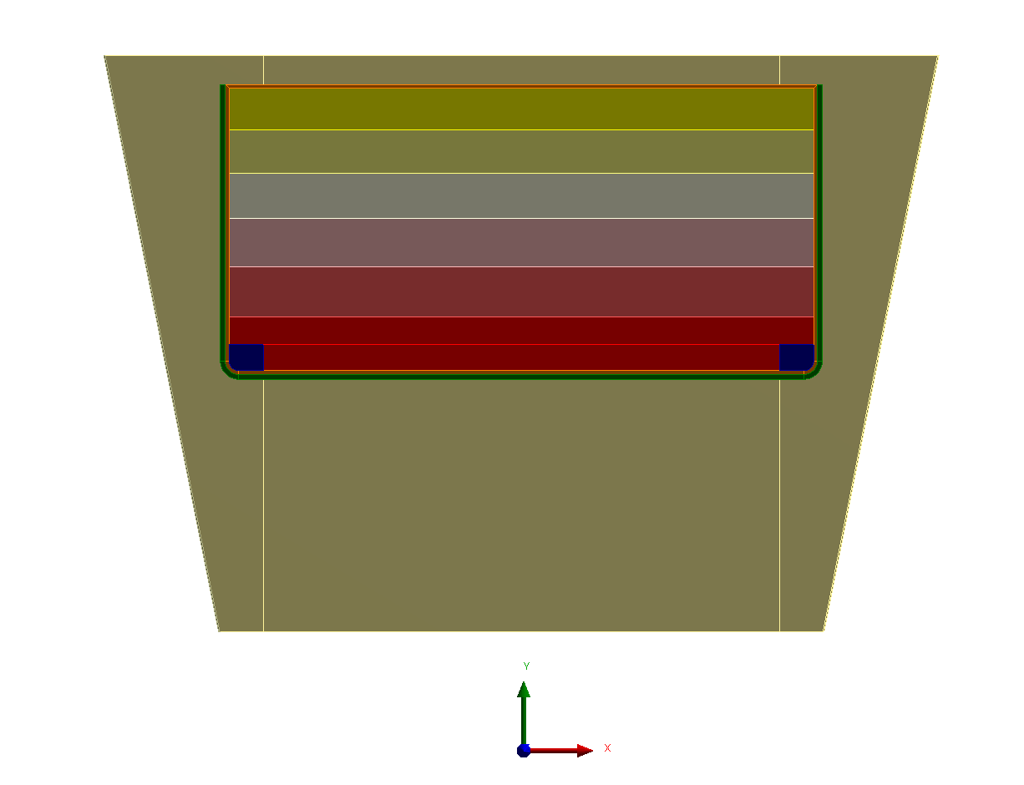
Geometry
The geometry domains of the TF coils and the WP as well were properly divided in sub-regions in order to obtain a mapped mesh in almost all TF parts.
Gravity support and Outer Inter Coil Structures not included in the simulations
BASELINE
CONFIGURATION
ENEA CONFIGURATION

Slide 5
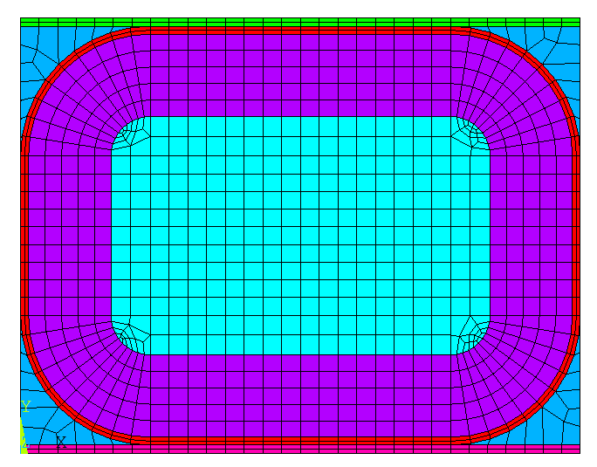
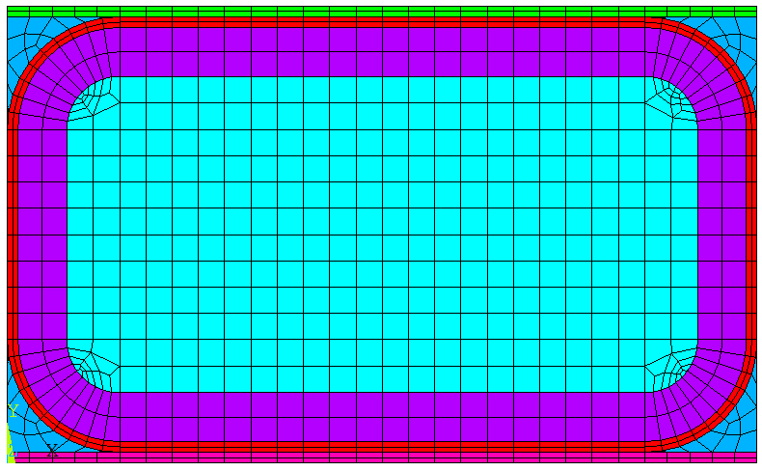
Homogenization
DLs equivalent orthotropic properties obtained with the procedure exposed in [2].
Steel Jacket thickness = 10.4 mm
Aspect Ratio 1.35
Layers 17+15
DL6
DL6
DL1
Steel Jacket thickness 4.6 mm
Aspect Ratio 1.76
Layers 17+17
DL1
[2] M.E. Biancolini et al., Mechanical analysis of PF4 and TF systems (2MZKNX_v1_0)

Slide 6
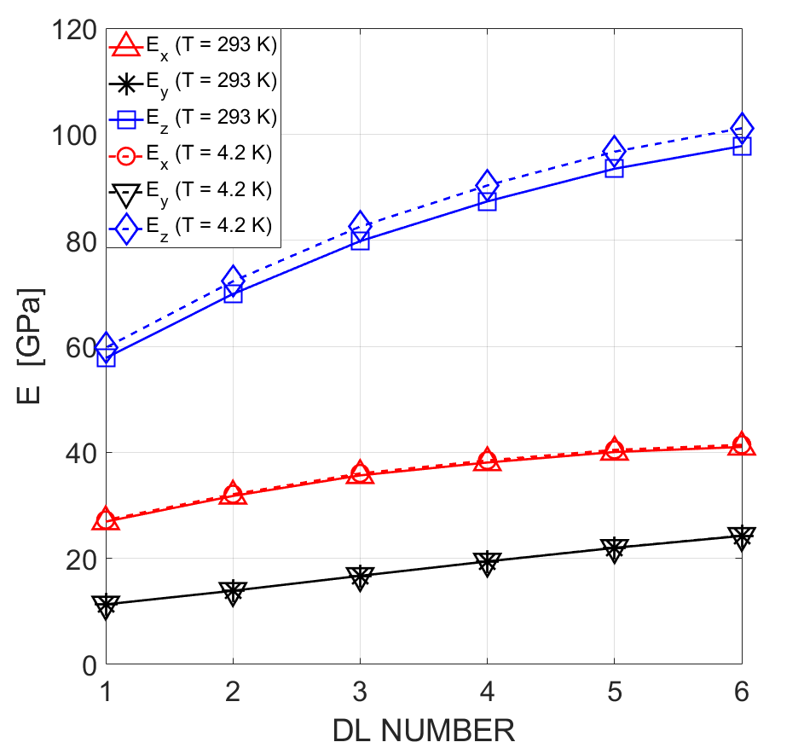
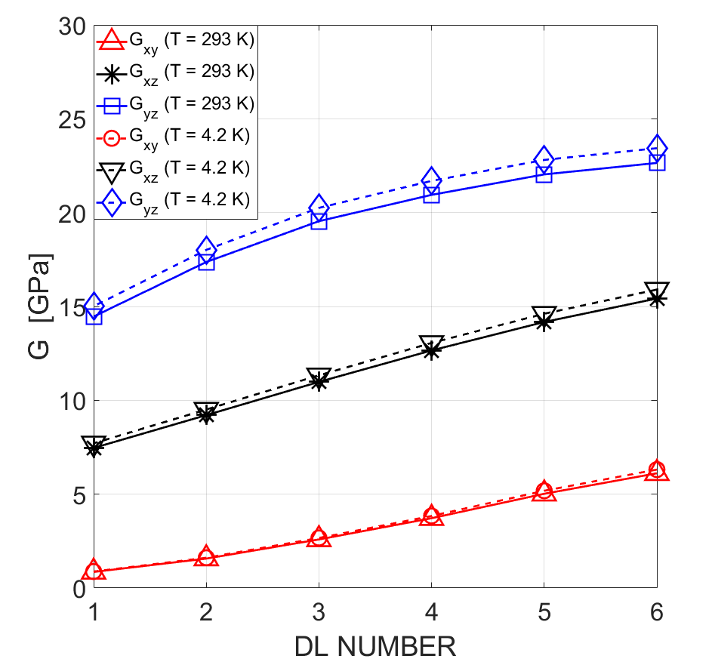
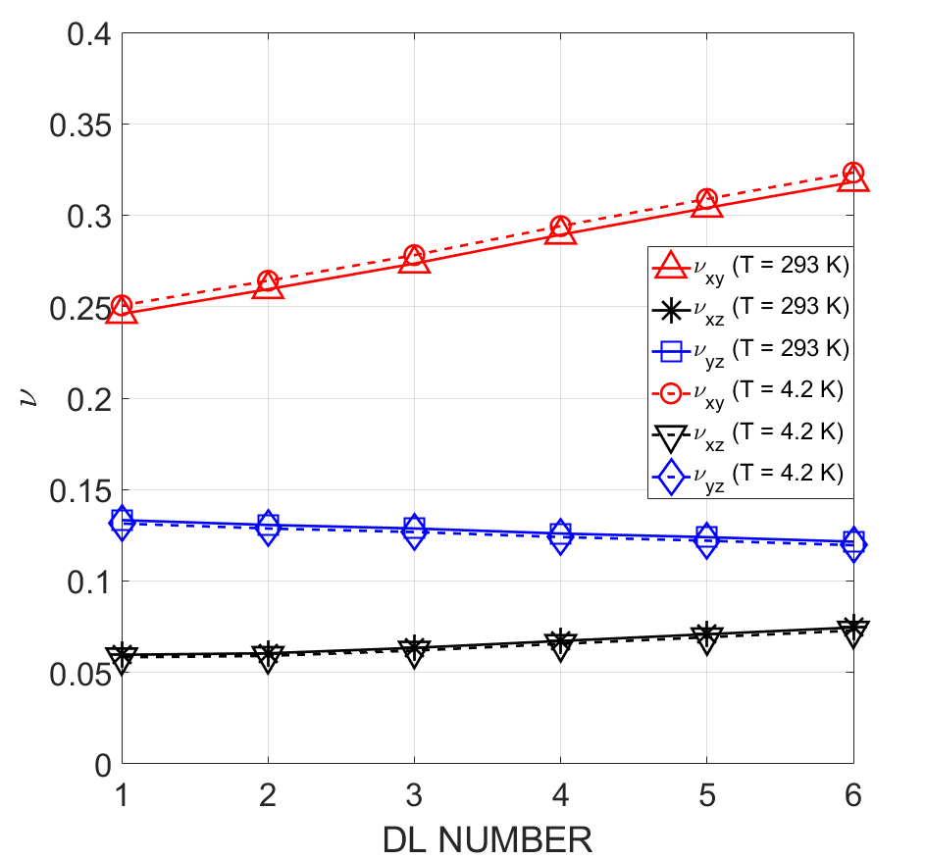
Homogenization
Homogenization results.
Young and shear moduli increase from DL1 to DL6 (increasing amount of steel passing from DL1 to DL6).
Higher values obtained at 4.2K, due to stiffer behviour of steel at lower temperatures.

Slide 7
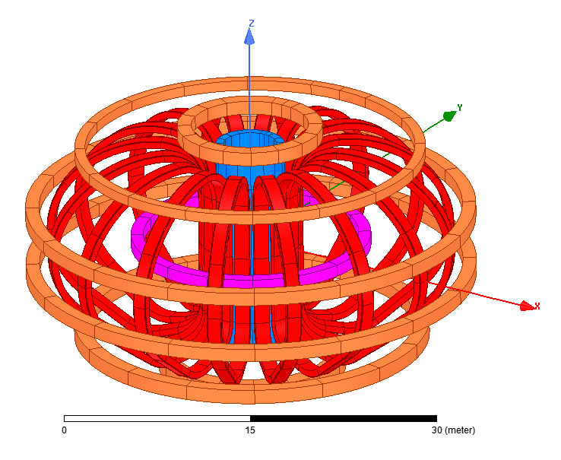
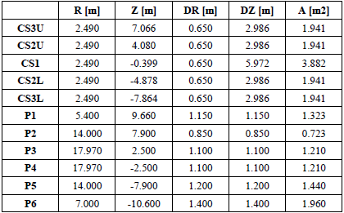
3D EM Analysis
The EM analysis is based on reference scenario of 8th of July [3].
Total current flowing in the 202 TF conductors is 14.8MAt
Coils treated as a homogeneous media
EM analysis performed with ANSYS Maxwell
[3] Reference Equilibrium for 2018 WPMAG DEMO Single Null (8th July 2019)

Slide 8
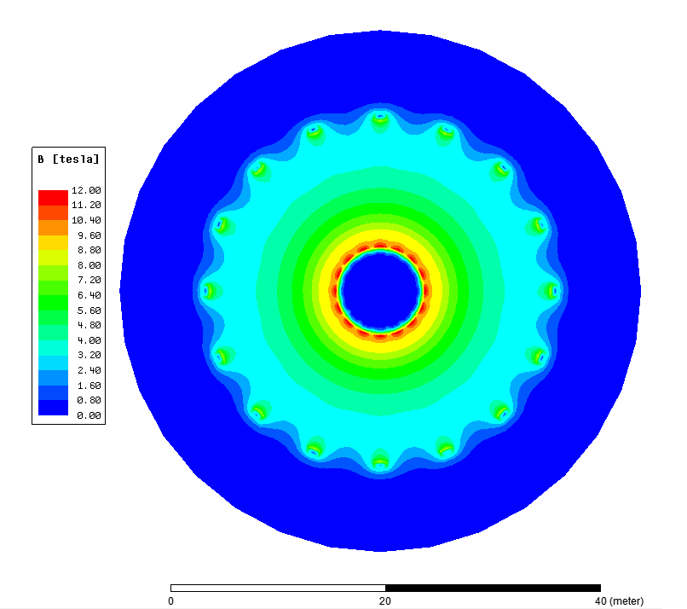
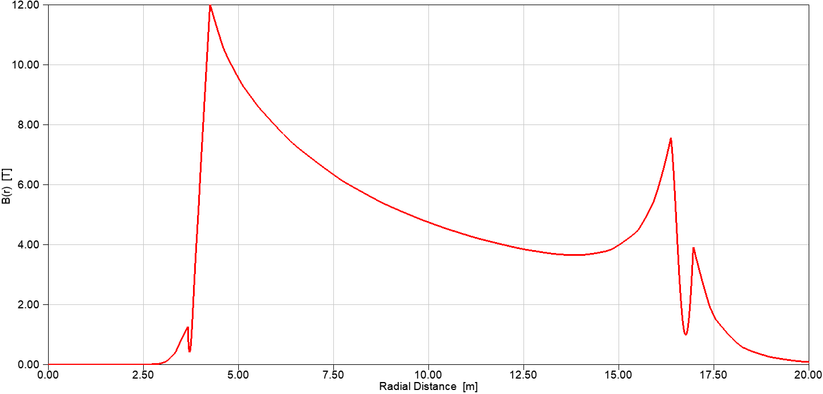
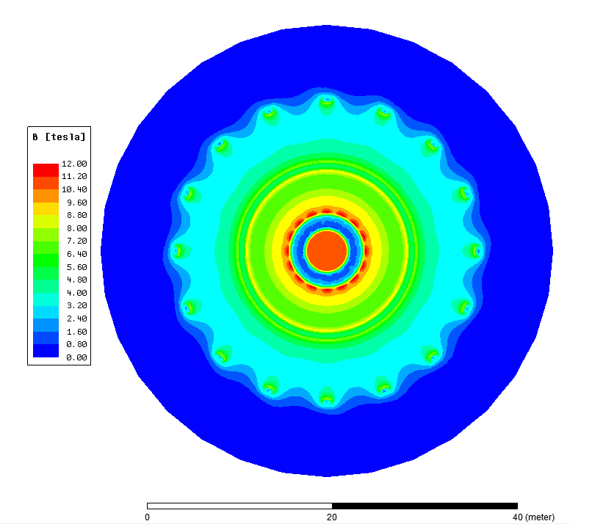
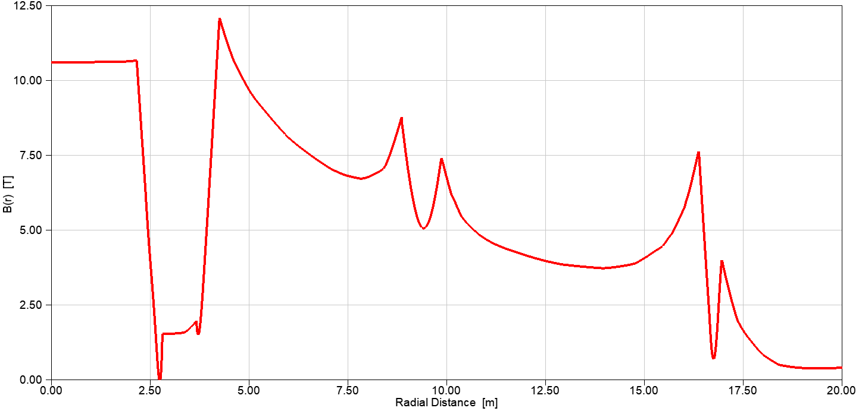
3D EM Analysis
B field contour @Equatorial plane
EM calculation results
@Energization
@EoF
Energization
|B| = 12 T
EoF
|B| = 12 T

Slide 9
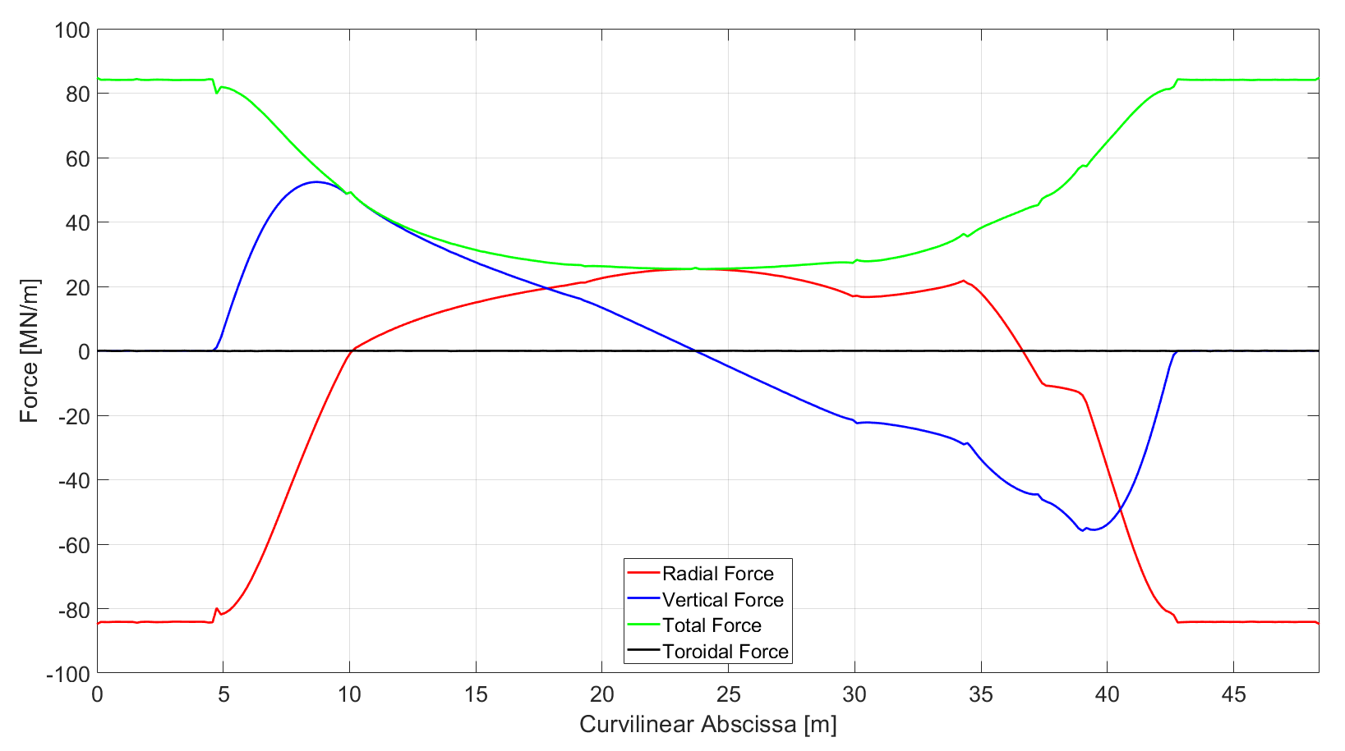
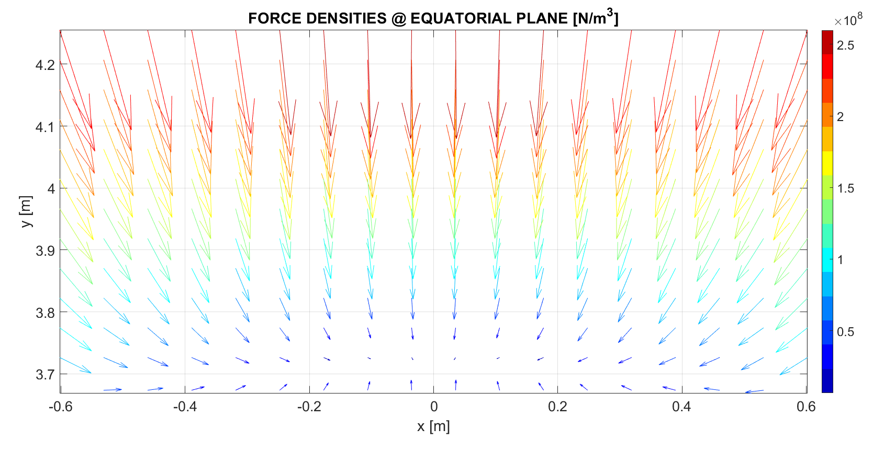
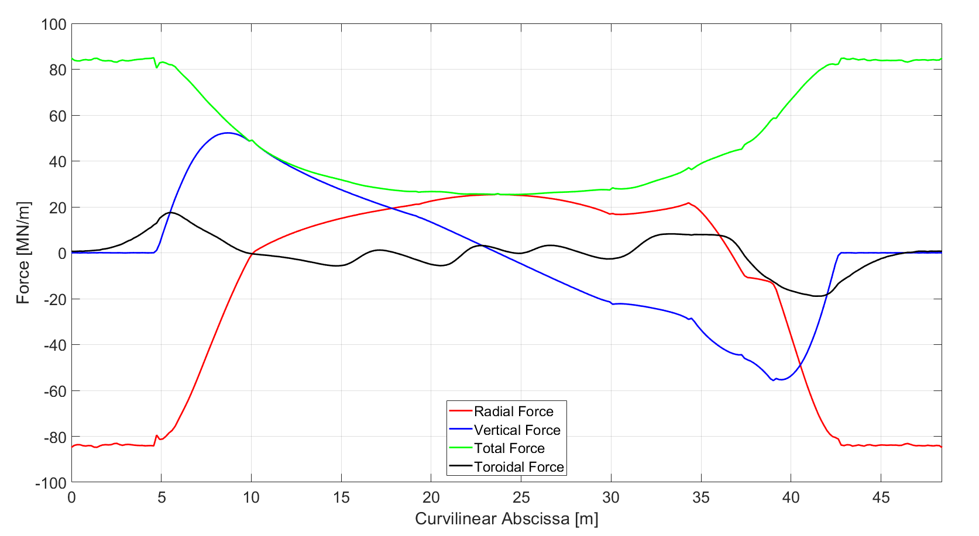
3D EM Analysis
EM forces vs. TF curvilinear abscissa
@Energization (no out of plane forces)
@EoF
TF - EM force densities @Equatorial plane

Slide 10
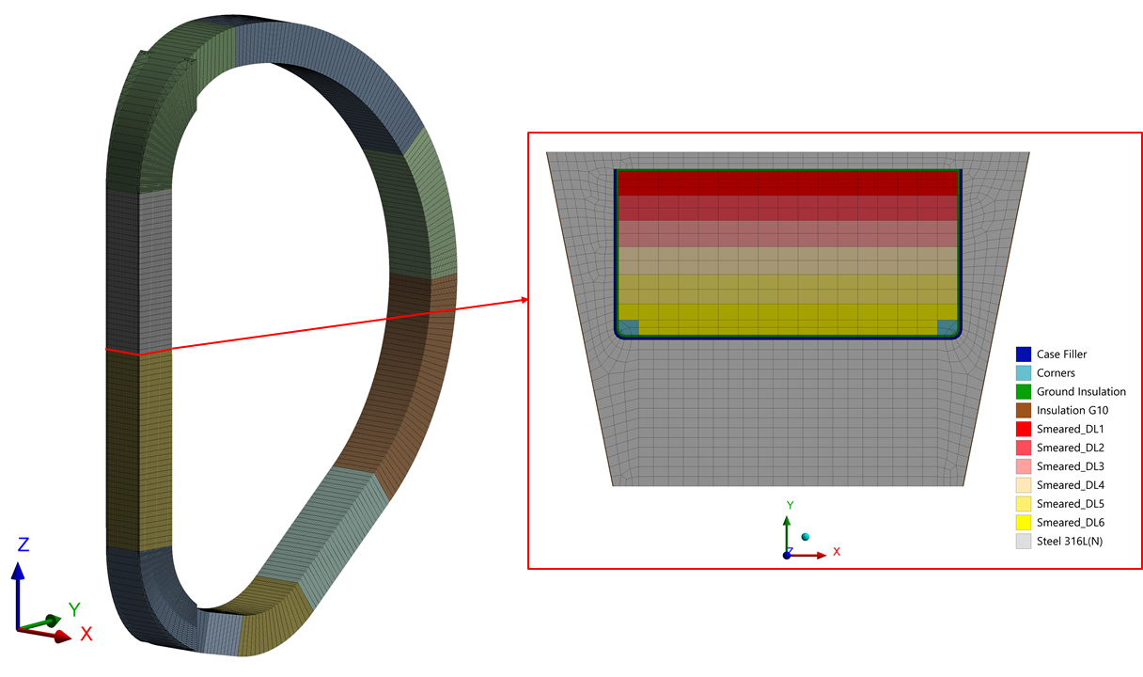
3D Mechanical Analysis
Analysis performed inside ANSYS Workbench environment.
The EM loads are interpolated inside ANSYS Maxwell on the structural mesh nodes (68904 points).
Material properties are extracted from [4]
[4] F. Nunio et al., Reference basis for mechanical & thermal analysis of TFC (EFDA_D_2MC8T4)

Slide 11
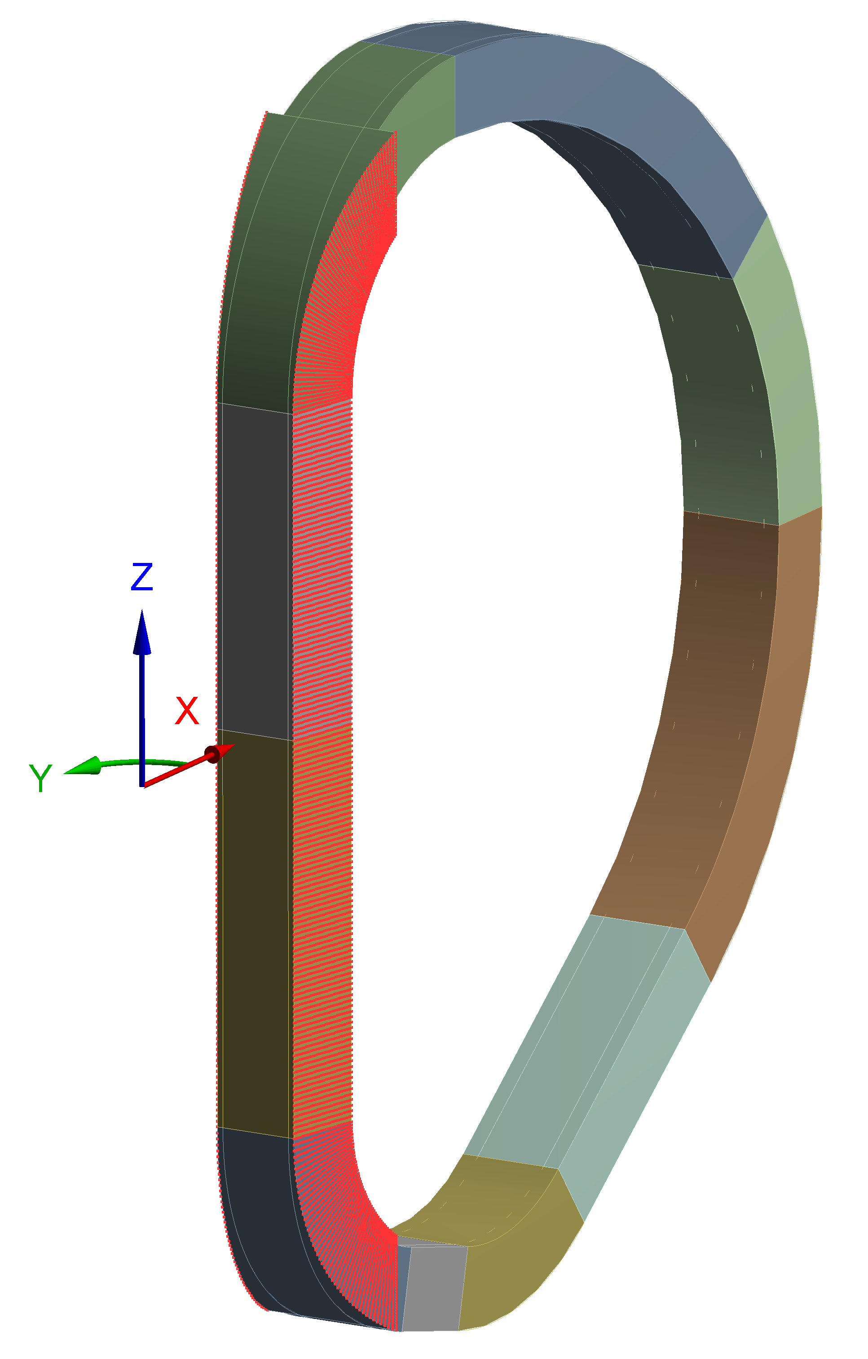
3D Mechanical Analysis
Mesh stats
Number of elements: 356k
Number of nodes: 393k
Boundary conditions
Cyclic symmetry (16 sectors) applied through CEs
Friction (μ=0.2) between casing and WP
Casing-wedge insulation (left -12.5°): friction (μ=0.2)
Casing-wedge insulation (right +12.5°): bonded [1]
Vertical support
Load steps:
Cooling Down
EM loads (@Energization)
EM loads (@EoF)
[1] L. Muzzi et al., ENEA TF Winding Pack Design and Analysis (2NGZ2G_v1_1)

Slide 12
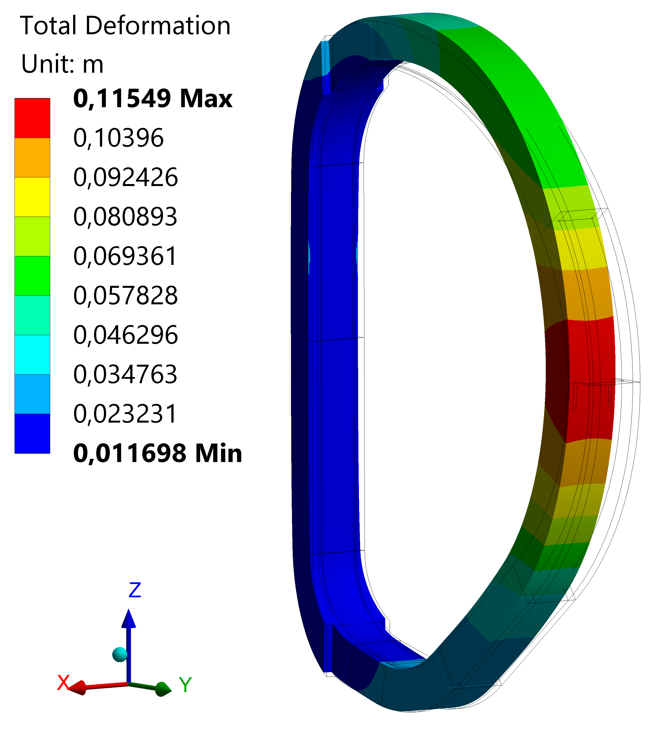
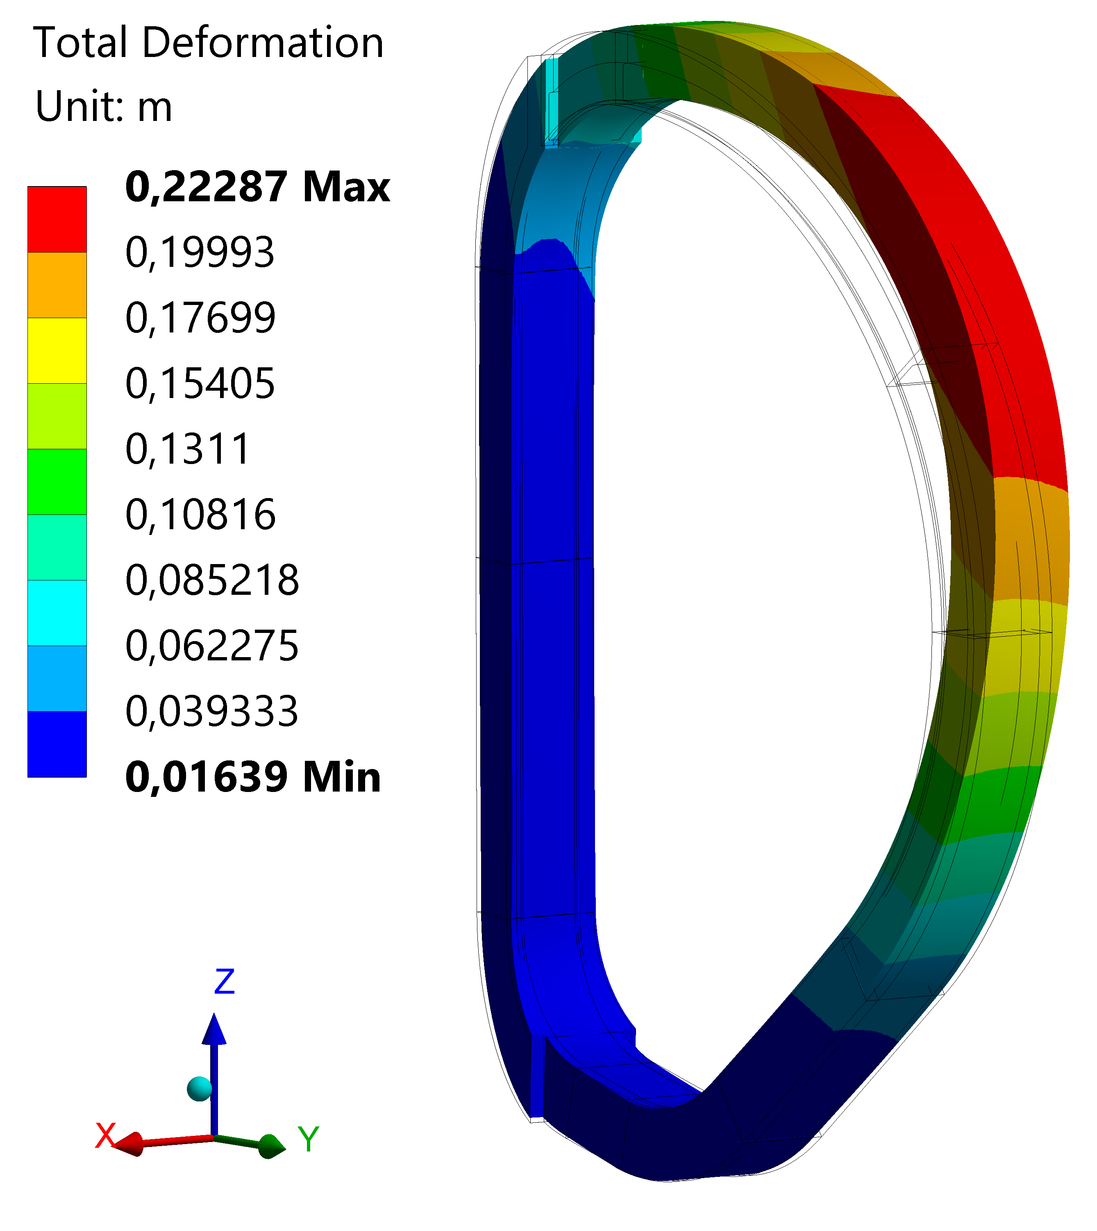
3D Mechanical Analysis
Casing results: deformation
Maximum Casing deformation is 0.223 m @EoF instat of scenario (almost double with respet to @Energization)
 | CD+EM loads @Energization | CD+EM Loads @EoF
Total Deformation [m] | 0.115 | 0.223
0.05 m
0.21 m
CD+EM loads @Energization
CD+EM loads @EoF

Slide 13
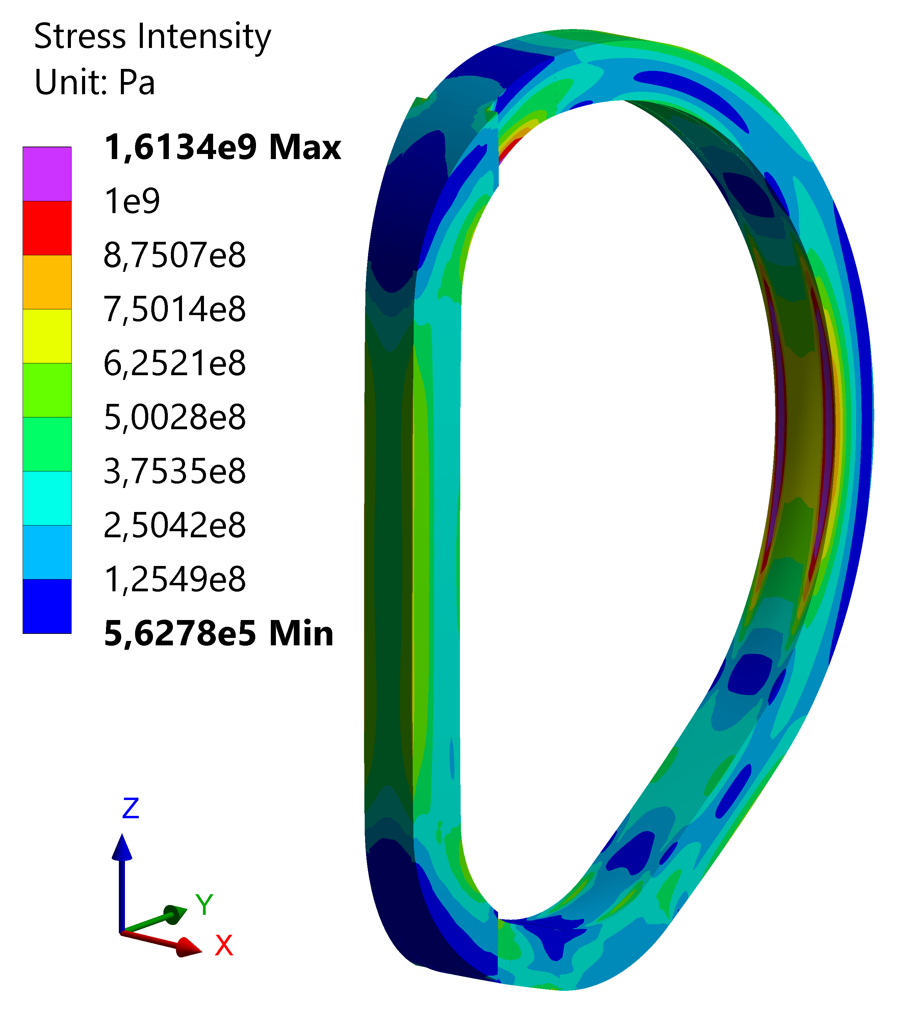
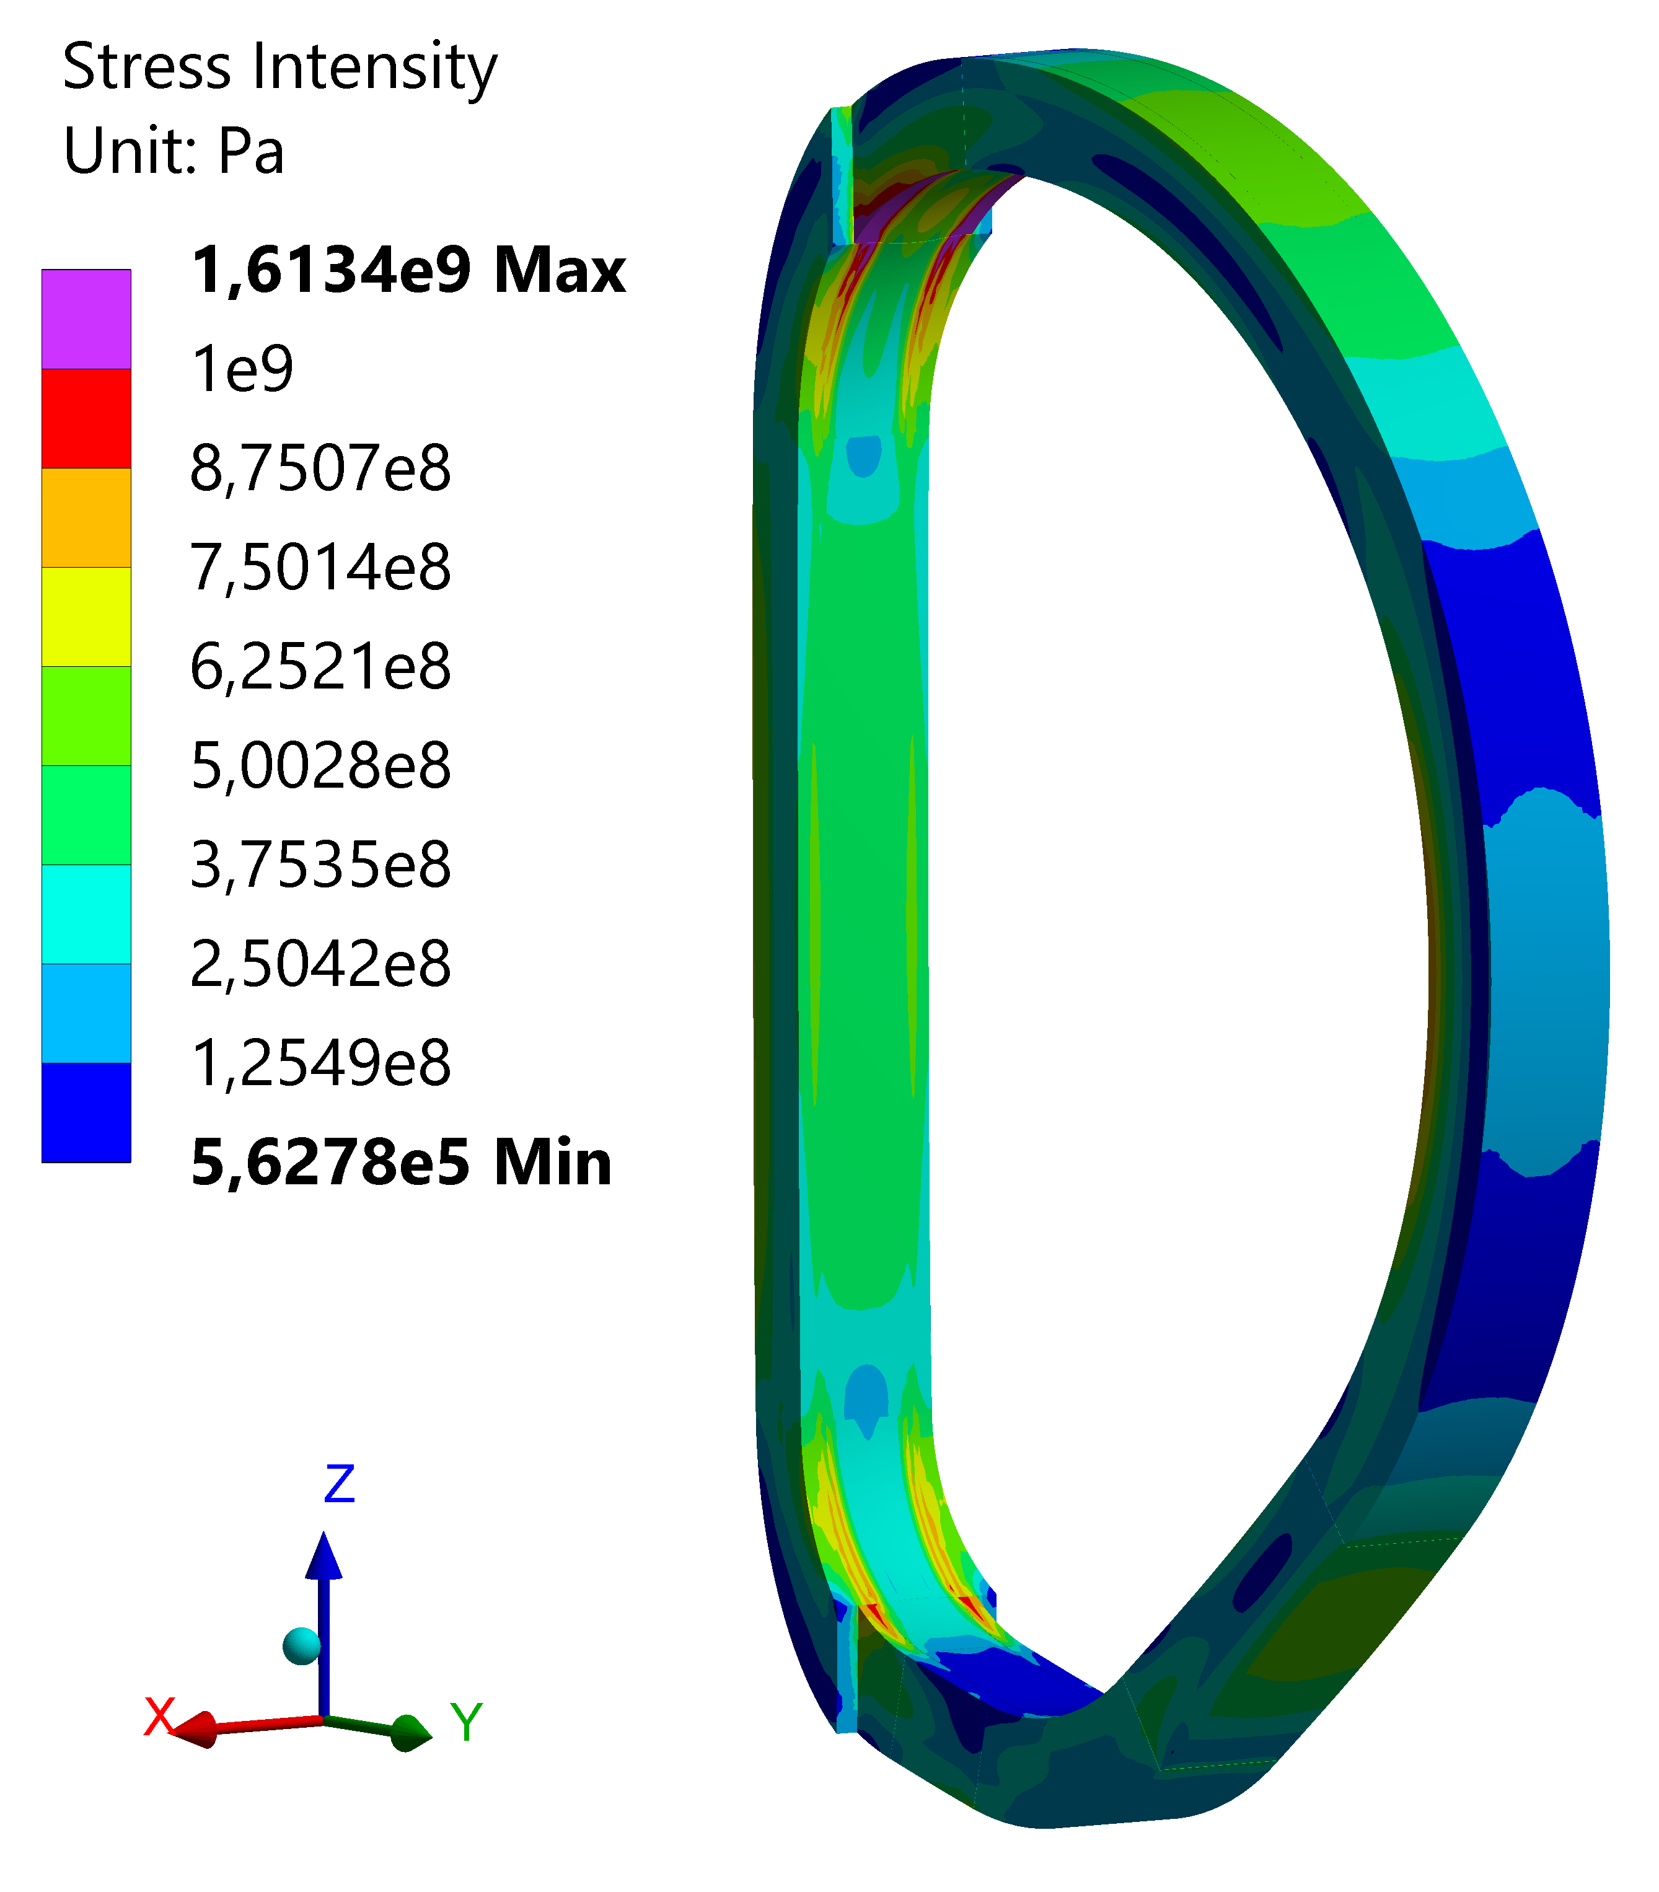
3D Mechanical Analysis
Casing results: Stress (SINT)
The critical locations are in the upper and lower curved portion of the casing above and below the inner straight leg.
Another critical location is in the outer leg near the equatorial plane.
The presence of OIS could be helpful to mitigate the stresses and to reduce the structure deformation.

Slide 14
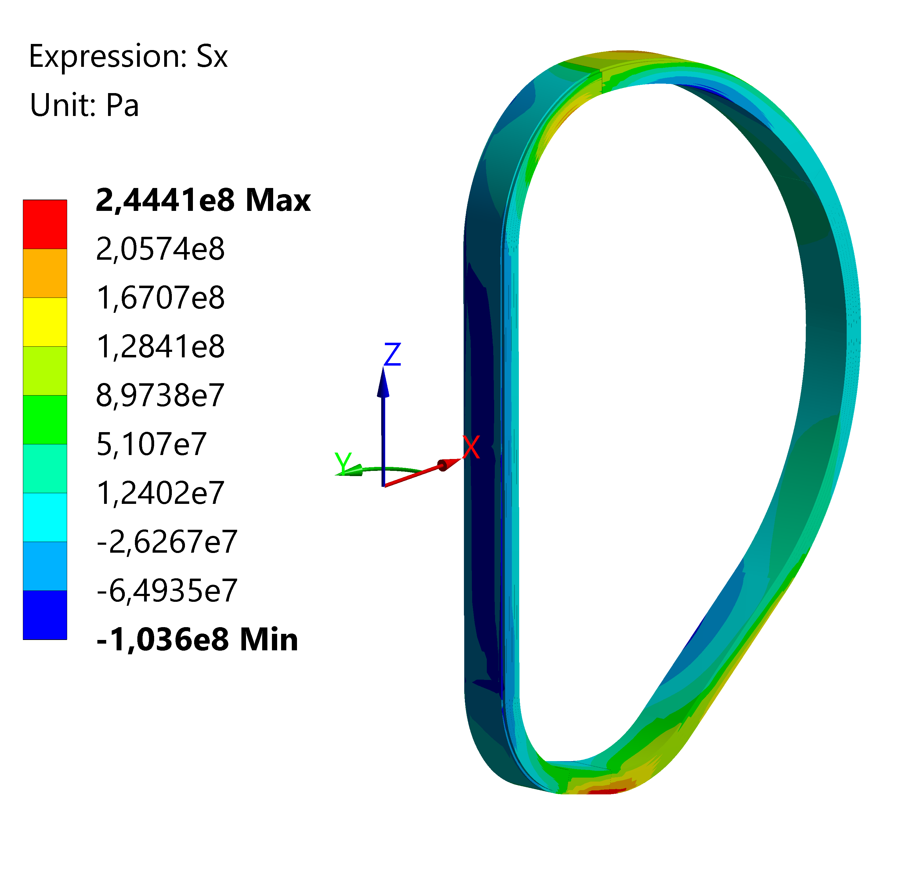
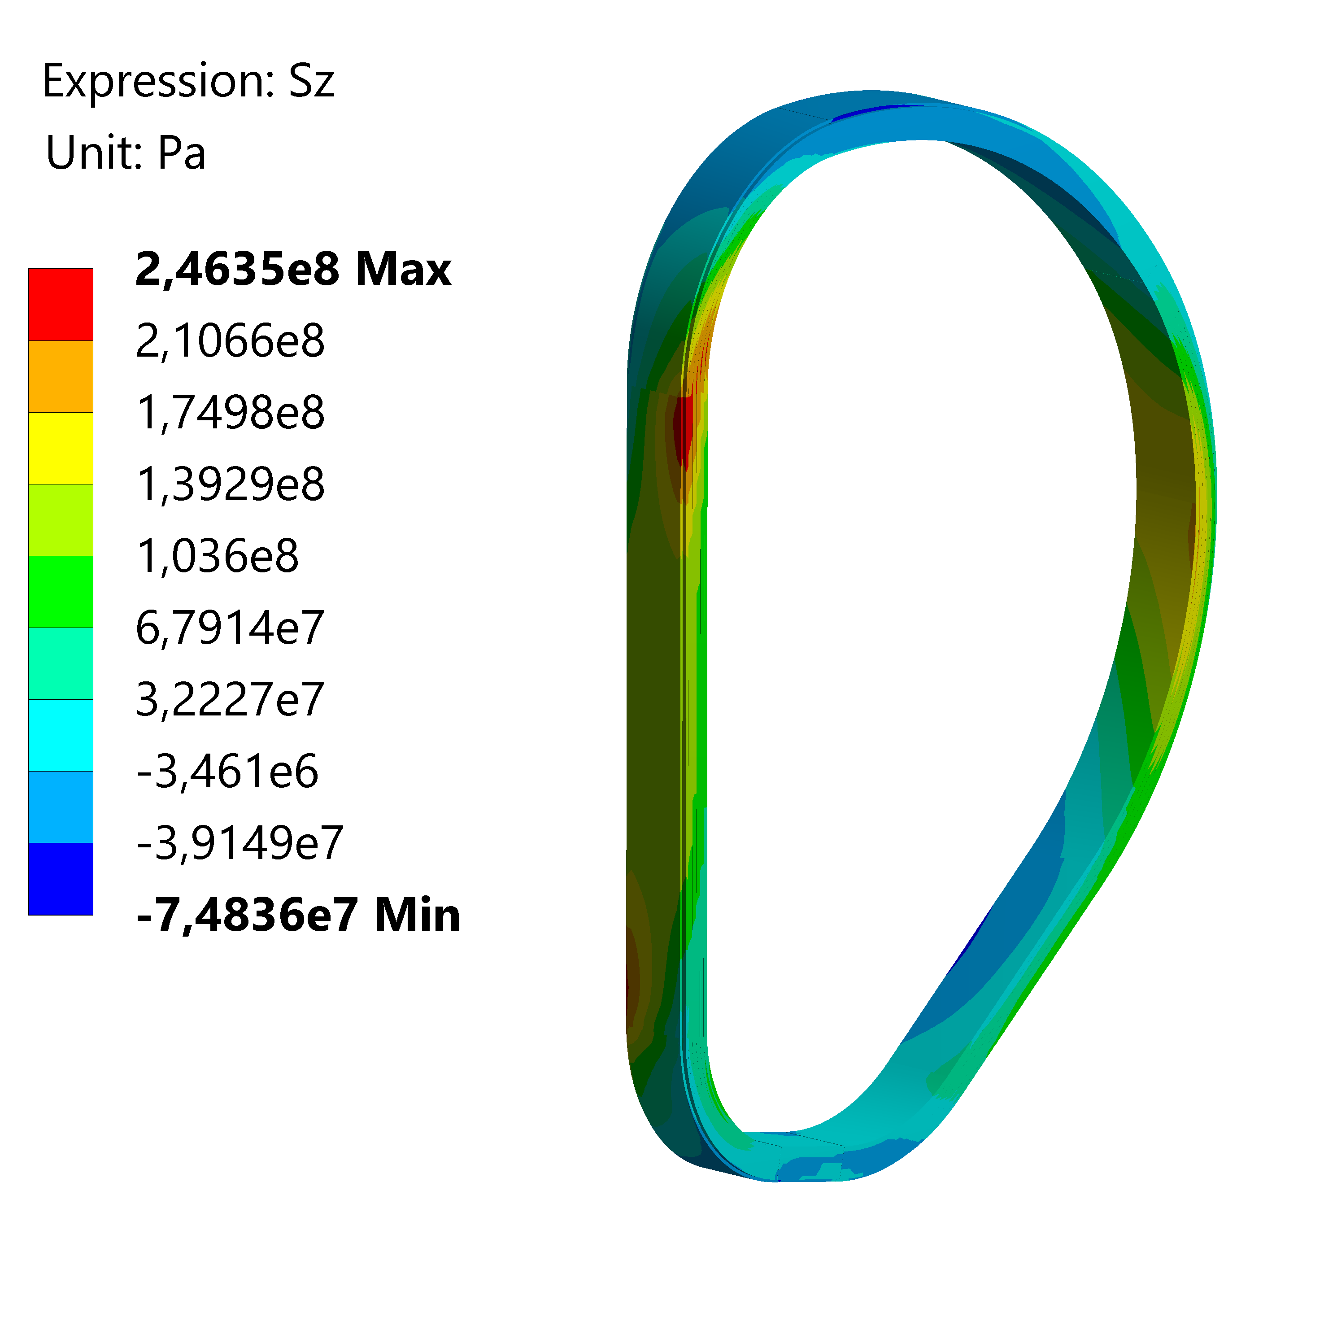
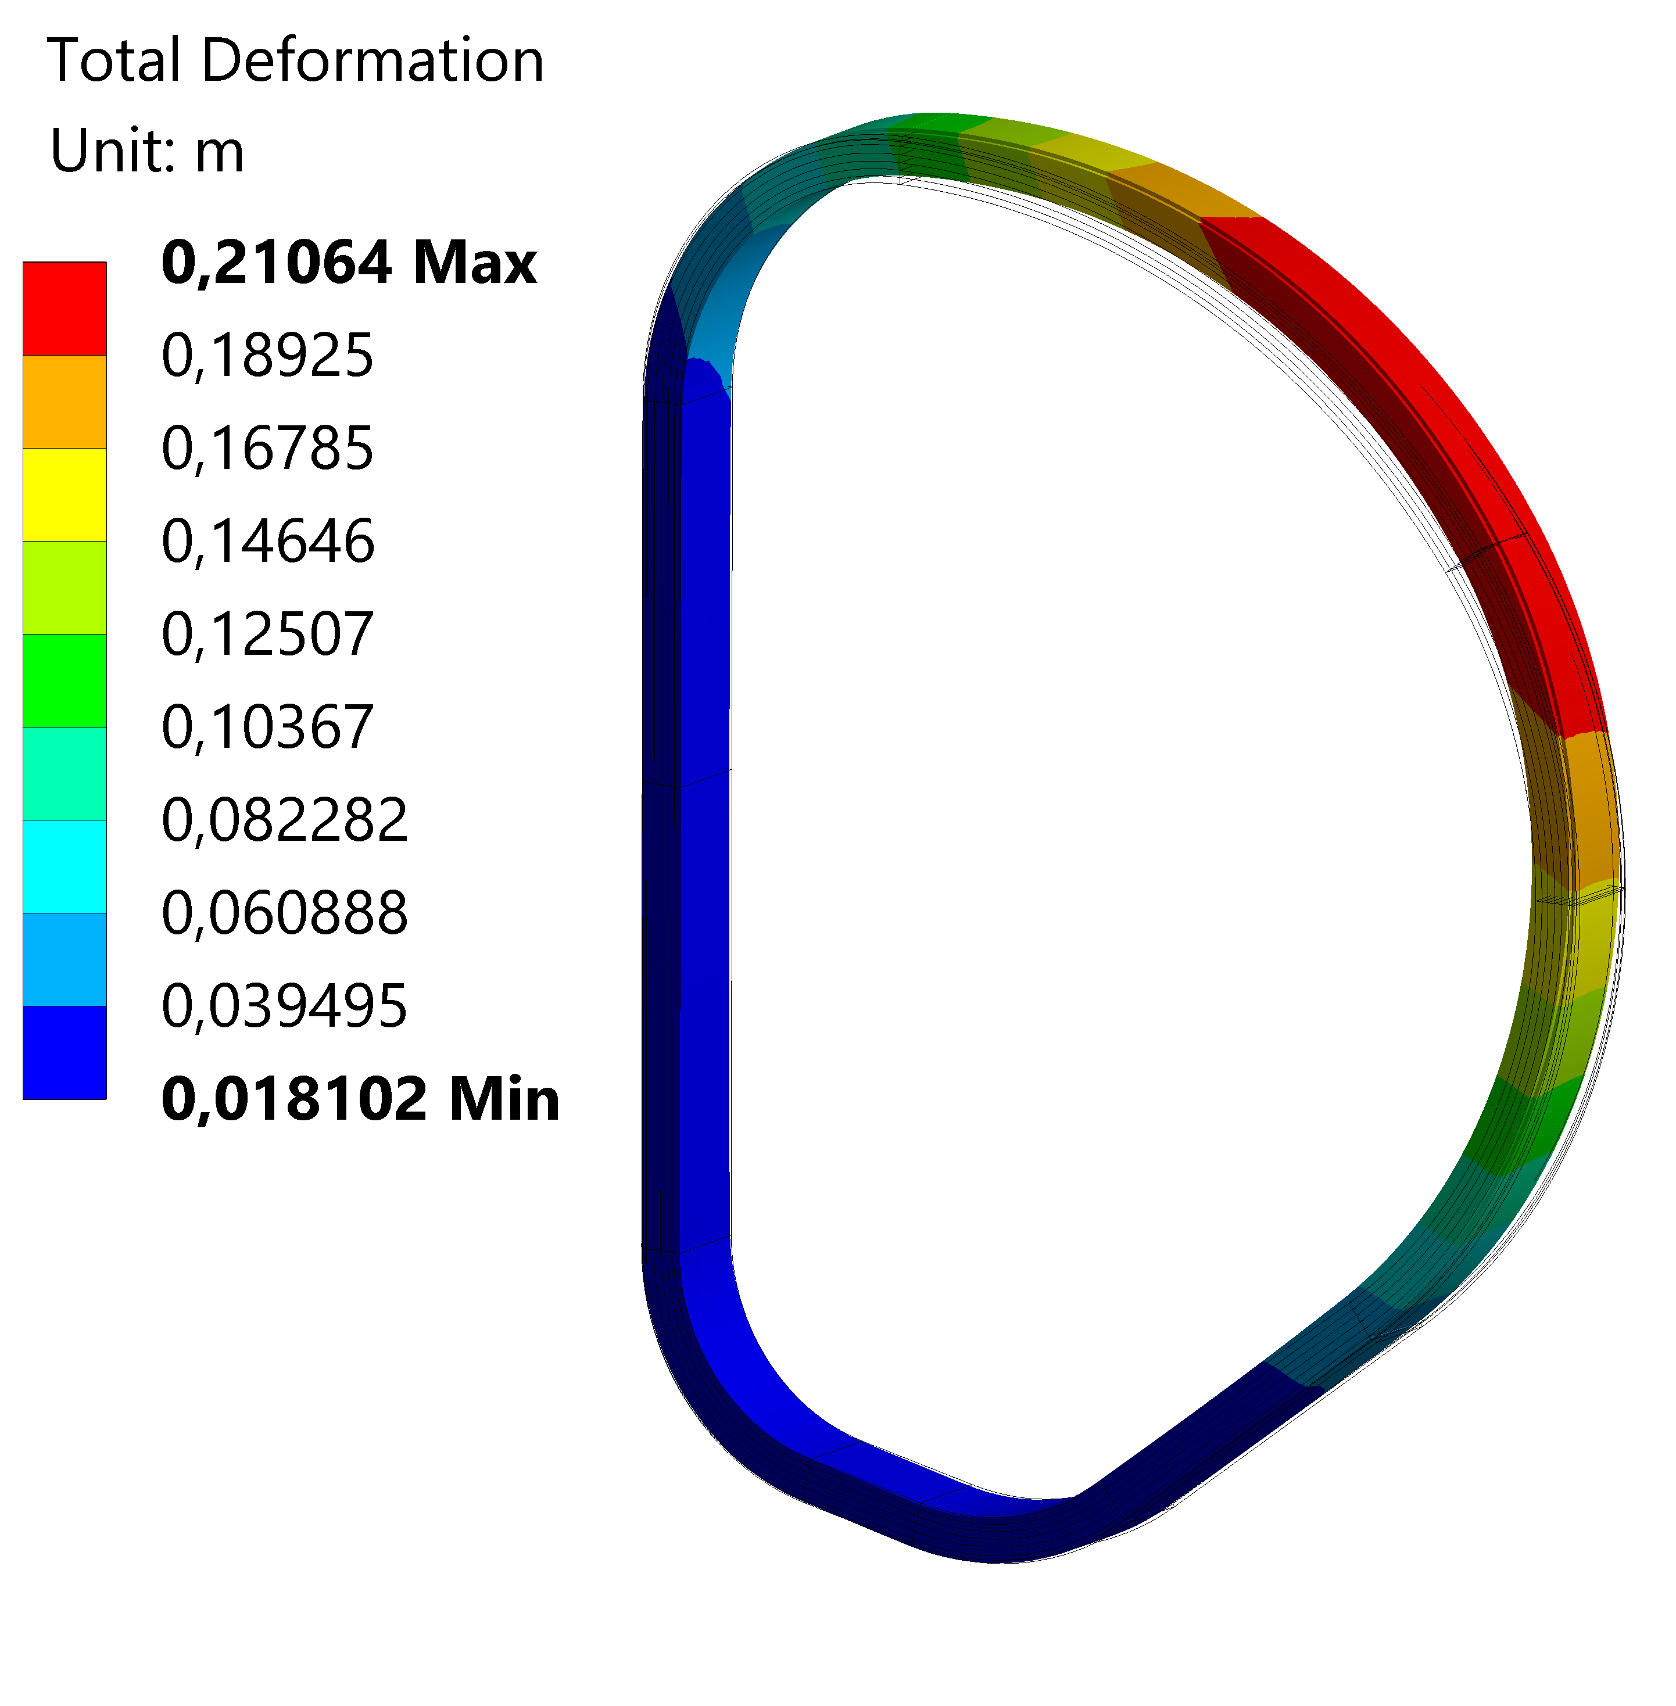
3D Mechanical Analysis
Smeared WP results: deformations and Stresses
Maximum WP deformation is 0.21 m @EoF instant of scenario (almost double with respet to @Energization)
In the inner leg straight portion an almost constant compression of 103 MPa is observed
Another critical location can be found in the lower part, but is influenced by roughly representation of the GS
In the vertical direction a critical location could be found in the upper portion of straight leg
 | CD+EM loads @Energization | CD+EM Loads @EoF
Total Deformation [m] | 0.108 | 0.211

Slide 15
Conlusions and future work
The TFC WP#2 configuration of 2018 DEMO has been analyzed.
Homogenization procedure allowed to extrapolate for each DL the equivalent elastic properties.
Both EM and structural analyses have been performed within ANSYS Workbech.
EM loads evaluated @Energization and @EoF instants of scenario.
Critical location were highlighted on steel casing and on smeared WP.
The availability of geometrical entities (i.e. gravity support, OIS) could be helpful to mitigate the stress state and to reduce the total deformations.

Slide 16
2020 TS
3D Mechanical and electro-magnetic analysis of the optimized solution proposed by Giordano Tomassetti [5].
The analysis presented will be repeated considering the optimized WP#2 layout. The effects of the increased EM field peak (from 12T to 12.5T) will be evaluated highlighting the differences with the baseline solution.
Work to be addressed:
Geometry, considering the increased WP radial dimension
Homogenization, because of the variation of the steel jacket thicknesses
EM analysis, to reach the required 12.5T peak field
Structural analysis, with the same BCs but the updated EM forces
GS and OIS will be considered (if available) to make a more reliable comparison.
[5] G. Tomassetti et al., 2D optimization to maximize the magnetic field (2P8X5E)

Slide 17
3D mechanical analysis of TF WP#2 ENEA-UNITUS
F. Giorgetti, G. Calabrò, P. Fanelli,
G. Tomassetti, V. Corato, L. Muzzi
WPMAG Final Meeting 11-13 February 2020

