Slide 1
Coordination of the Mechanical Analysis
Design of the mechanical structures
and supports of the magnetic system
Daniela P. Boso
WPMAG Final meeting
Frascati 11-13/02/2020

Slide 2
Coordination of the Mechanical Analysis
Design of the mechanical structures
and supports of the magnetic system
Daniela P. Boso
WPMAG Final meeting
Frascati 11-13/02/2020

Slide 3
2019 TASKS - Status as last Friday
MAG-3 - Magnet Conceptual Design - Structures & Fabrication
MAG-3.1 > Mechanics
MAG-3.1-T017-D001 - Mechanical analysis of the CS coil
Xabier Sarasola (signed)
MAG-3.1-T017-D002 - Mechanical analysis of the PF coils
Mithlesh Kumar (in work)
MAG-3.1-T018-D001 – Mech. evaluation of 2018 TF WP#4 and PF system
Christophe Portafaix - Francois Nunio (in work)
MAG-3.1-T018-D002 - Mechanical evaluation of PF system
Christophe Portafaix - Francois Nunio (in work)
MAG-3.1-T019-D001 - 2D optimization to maximize the magnetic field
Giordano Tomassetti (recommended)
MAG-3.1-T019-D002 - 3D mechanical analysis of TF WP#2
Francesco Giorgetti (recommended)

Slide 4
2019 TASKS - Status as last Friday
MAG-3 - Magnet Conceptual Design - Structures & Fabrication
MAG-3.4 > Industry interface
MAG-3.4-T007-D001 - Report on Studies on manufacturing process for conductor and winding of the DEMO hybrid CS coil
Pier Luigi Bruzzone (In work)
MAG-3.4-T008-D001 - CEA industry feasibility studies
Louis Zani (In work)

Slide 5
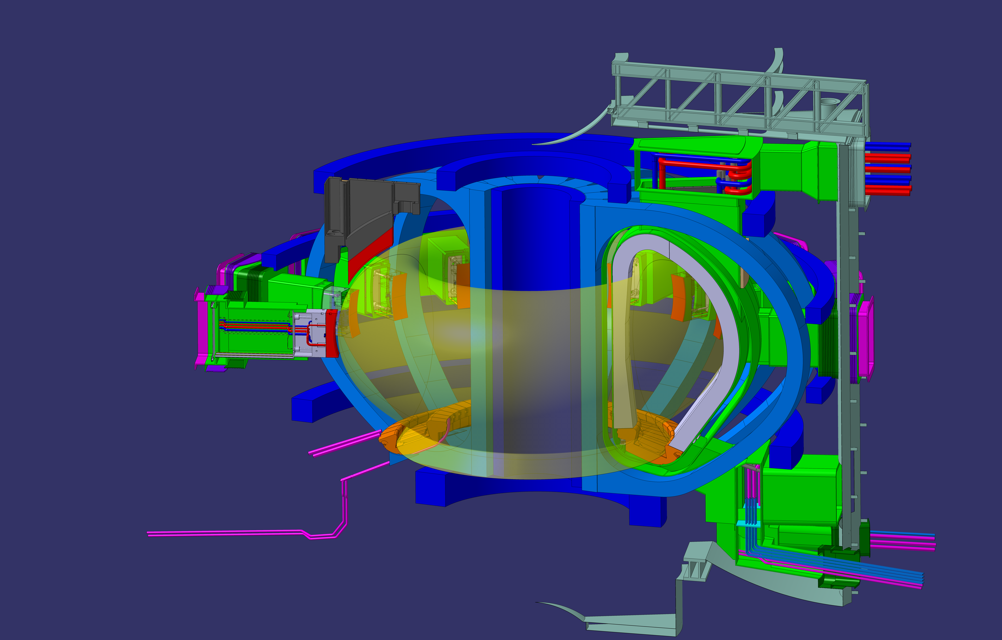
Baseline machine 31-07-2019 (2NNCRK v1.0)

Slide 6
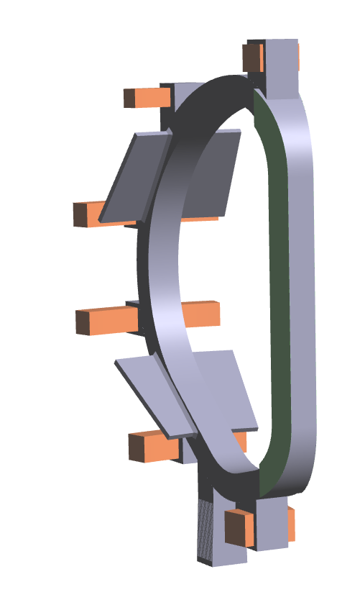
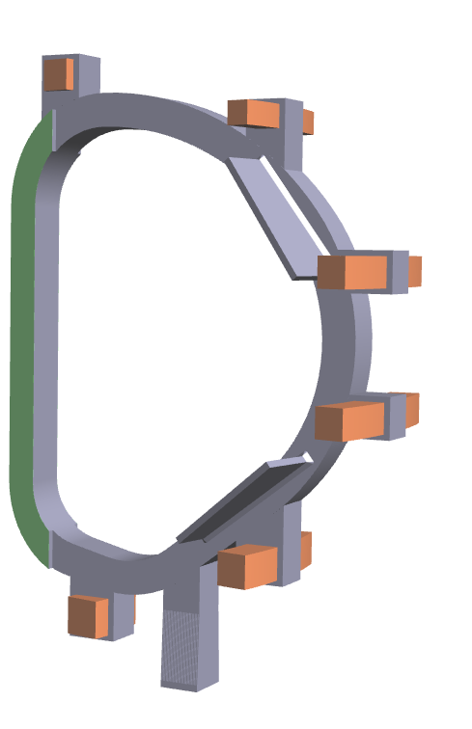
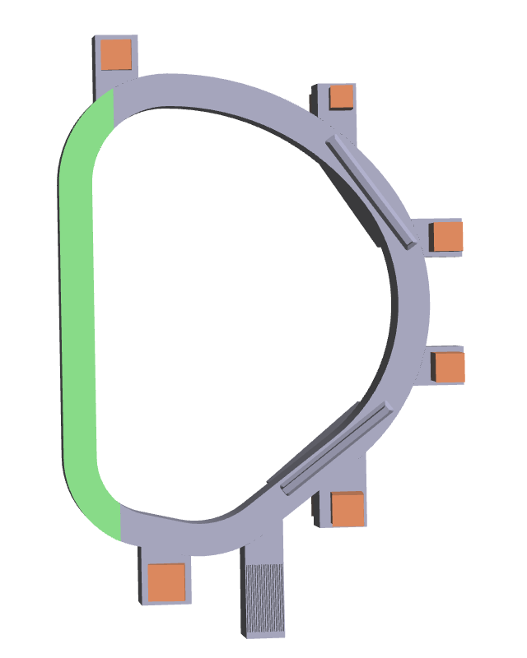
Phys_mag_PROCESS_baseline_July_18 (2N622S v1.1)
It had been decided earlier already that this MAG-baseline configuration will be used to do CAD work on the coils etc. (analysis…) within WPMAG, but not outside (2nd_August_2018_discussion_minutes_2MZ5ZY_v1_0)

Slide 7
Phys_mag_PROCESS_baseline_July_18 (2N622S v1.1)
In autumn 2018 a substantial change in DEMO magnetic system became official: the number of toroidal field coils was decreased from 18 to 16.
Basing on the PROCESS run “Phys_mag_PROCESS_baseline_July_18_2N622S_v1_1”, and after the initial iterations and adjustments, in November 2018 it was decided to fix the following parameters for the mechanical design:
Minimum steel thickness = 50 mm;
Toroidal width of the WP (including the insertion gap) = 1240mm (corresponding to 152.5 mm thickness of the casing on the lateral side of the outboard coil);
Thickness of the case lid = 60 mm;
External edge (R out, including lid) of the inboard leg = 4323 mm;
Decrease the WP corner from 80 mm (original PROCESS value) to R=38mm;
Increase the discharge time from 24 s (original PROCESS value) to 35 s;
Increase the value of the nose thickness from 382 mm (original PROCESS value) to 520 mm.

Slide 8
Phys_mag_PROCESS_baseline_July_18 (2N622S v1.1)
In this new baseline the space for the TF winding pack is bigger, therefore the thickness of the proposed designs is likely to be lower than the allocated volume. As a consequence, it was decided to split the activities in two different steps:
The first step consists in producing a reference design by starting from the PROCESS run having a peak field = 12T. The thickness of the proposed configurations shall be optimized.
The second step consists in trying to maximize the magnetic field by keeping the same allocated space (total TF thickness = 1400 mm, including case) for all winding packs. Obviously, the stress limits must be satisfied in the whole structure for the maximum magnetic field obtained. In this way a single overall radial build is obtained, with different fields as a function of winding pack. In maximizing the WP performance, the amount of stainless steel of the case can be increased: a complete flexibility on the thickness of the WP vs case structure is allowed.
For further details, readers are referred to the enclosed documents:
Phys_mag_PROCESS_baseline_July_18_2N622S_v1_1.dat
DEMO-2018-0000-REV04.pdf

Slide 9
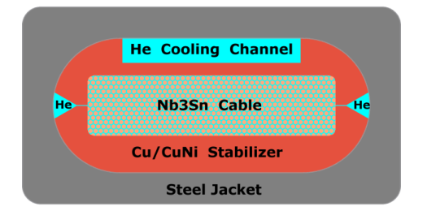
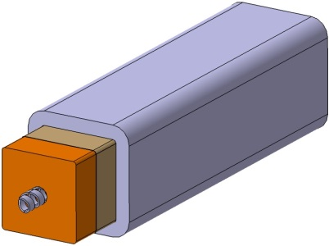
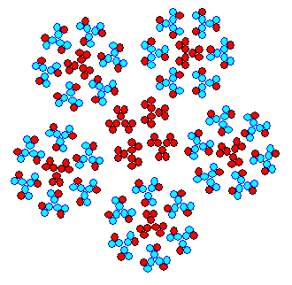
TOROIDAL FIELD COIL: ALLOCATED SPACE
WP#1
WP#2
WP#3
WP#4
radial plate
jacket
  Nominal-field TF coil (minimizing the radial build).
  Maximum-field TF coil (using all available radial build allocated)

Slide 10
Phys_mag_PROCESS_baseline_July_18 (2N622S v1.1)

Slide 11
Phys_mag_PROCESS_baseline_July_18 (2N622S v1.1)

Slide 12
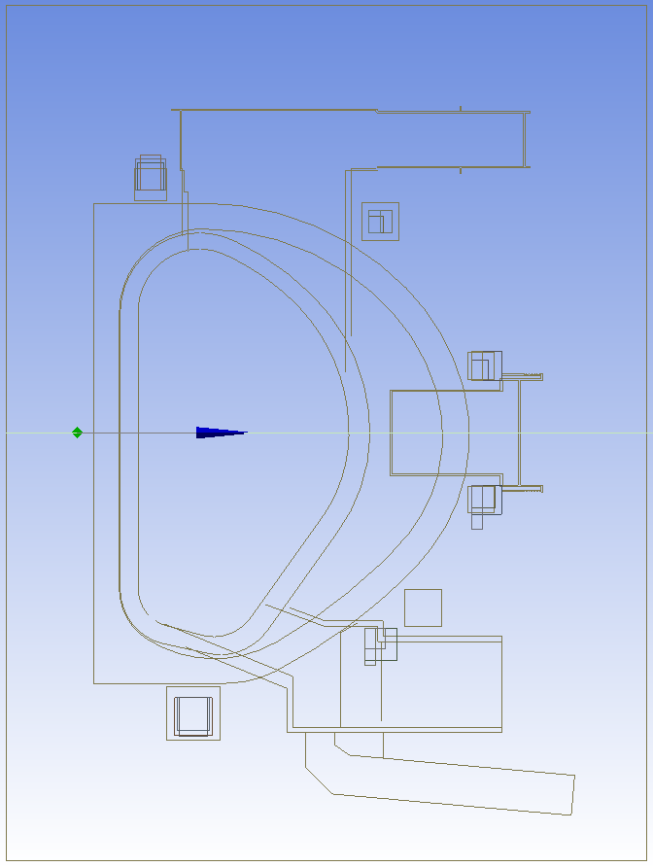
PF Coils
Latest CAD from IDM dated April 2019 based on DEMO baseline 2017: Reference flat-top equilibria, Ambrosino et al.
Design given in DEMO baseline 2017: Reference flat-top equilibria, Ambrosino et al.
Design given in Reference equilibrium for 2018 WPMAG DEMO Single Null July 2019 and EU DEMO 2018 Equilibrium Description March 2019
Design proposed at MT conference Vancouver based on Reference equilibrium for 2018 WPMAG DEMO Single Null July 2019.
New Proposal based on Reference equilibrium for 2018 WPMAG DEMO Single Null July 2019.
The aspect ratio differing from 1 can:
Reduce the peak field.
Reduce the conductor hydraulic length.
Reduce the size of the cryostat.

Slide 13
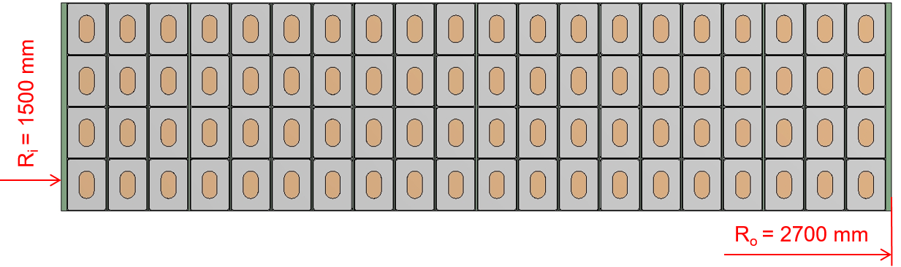
CS Coils
Two design variants:
ITER-like Nb₃Sn design. Differences to ITER:
  Overall size of the coil
  Square-in-square CICC (unlike round-in-square in ITER)
Hybrid, layer wound CS coil: HTS, (R&W) Nb₃Sn, Nb-Ti

Slide 14
Coordination of the Mechanical Analysis
Design of the mechanical structures
and supports of the magnetic system
Daniela P. Boso
WPMAG Final meeting
Frascati 11-13/02/2020

Slide 15
OUTLINE
Finite element global model of the magnet system and its mechanical structures
  Motivation
  Analysis results
  Comparison with CEA model of one TF with continuum elements
Pre-Compression Ring Stiffness
  Sensitivity analysis
Contact of the inner straight leg of the TF coils
  Influence of the spring stiffness
  Structural Design Path
  Focus on the Outer Inter-coil Structures
  From the global model to a two-leg model with continuum elements
  Two proposals

Slide 16
3D global model of the magnet system
A finite element mechanical model of the whole magnet system is developed.
The global model is composed of beam elements with smeared properties and spring elements connecting the inner leg of the TF coils.
This model allows evaluating:
  - the mechanical behavior of the magnet system on its whole;
  - the torsional effects on the TF coils;
  - the in-plane and out-of-plane bending of the TF coils;
  - the role played by the relative stiffness of the Inner Inter-coil Structures (IIS), the Outer Inter-coil Structure (OIS) and the Pre-Compression Rings (PCR);
  - the influence of the position of the Gravity Supports (GS) on the system.

Slide 17
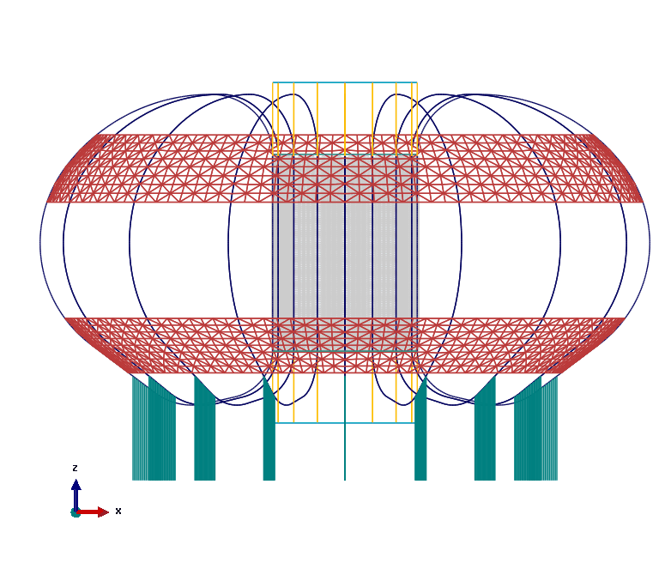
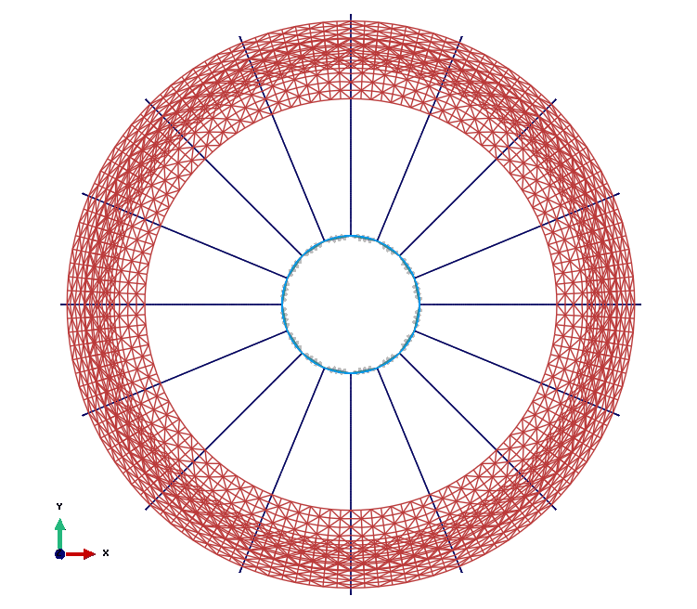
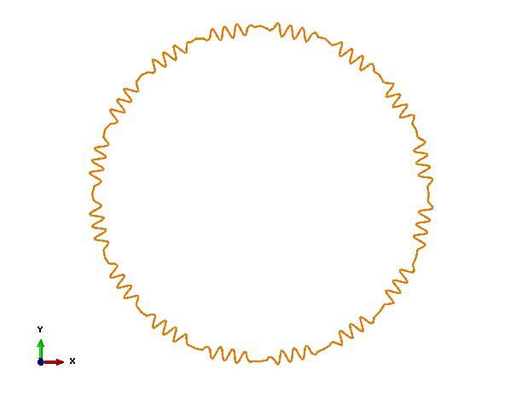
3D global model of the magnet system
Computational model with beam finite elements (structural elements).
Front view and top view

Slide 18
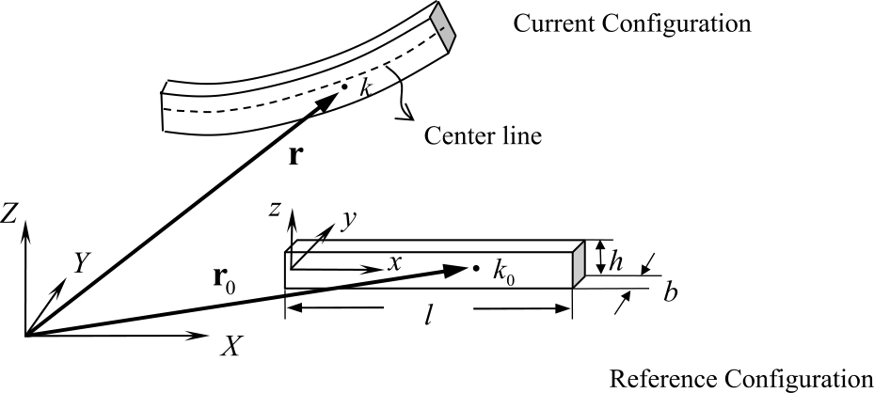
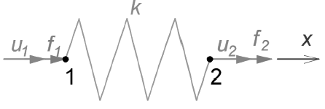
Finite elements of the 3D global model
Details of the global model
Without spring elements
number of elements: 14416
number of nodes: 38992
total number of variables: 61344
(degrees of freedom)
With spring elements
number of elements: 16096
number of nodes: 38992
total number of variables: 61344
(degrees of freedom)
The chosen beam element is a 3-node linear beam, with 6 dof per node (three translations and three rotations)
The chosen spring element introduces a stiffness between two degrees of freedom. It acts between two nodes, with its line of action being the line joining the two nodes.

Slide 19
FE model characteristics, applied forces and prescribed boundary conditions
All beams are fully connected each other (no pins)
The straight portion of each TF inner leg is connected with the adjacent ones by means of the spring elements
All lower nodes of the gravity supports are fixed to the ground
Poloidal Field coils are not taken into account for the moment (already present as FE)
EM forces are applied to the TF coils, EOF scenario
Smeared properties are considered for TF coils

Slide 20
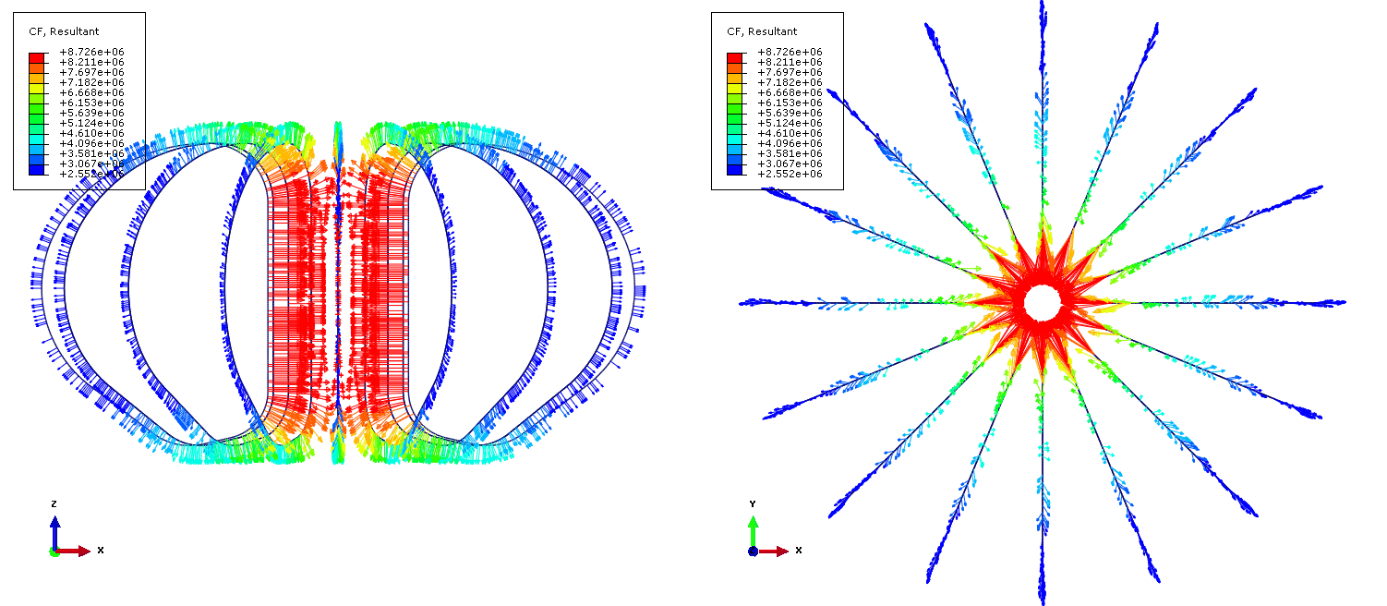
EM resultant forces per unit length [N/m]
EOF Scenario – WP#3 (Provided by F. Nunio – CEA)

Slide 21
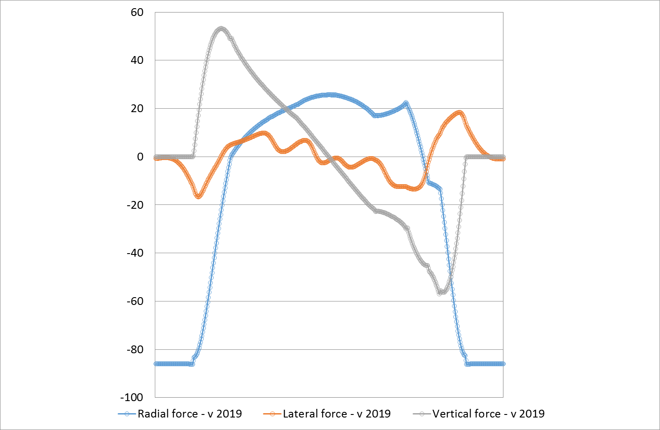
EM resultant forces per unit length[MN/m]
EOF Scenario – WP#3 (Provided by F. Nunio – CEA)
Distribution of EM components along coils axis [MN/m]

Slide 22
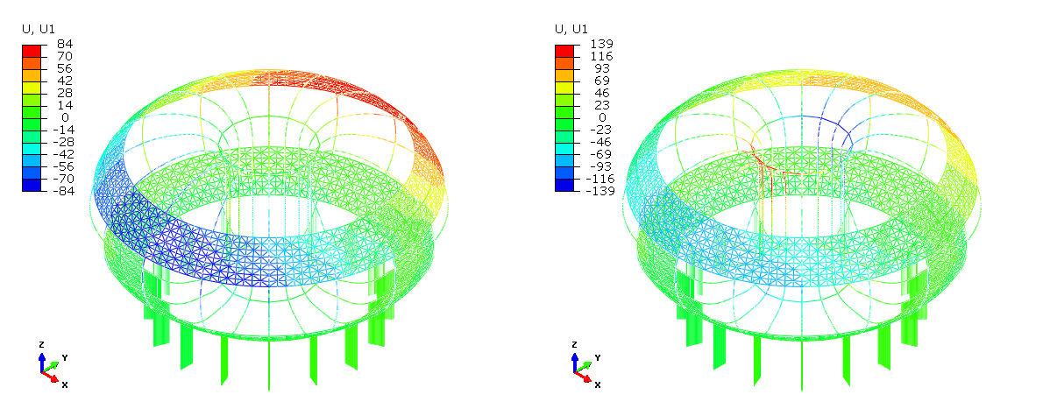
Ux displacement – Two IIS connections
Displacement along x axis with IIS fully connected (left) and pinned (right) to the vertical legs of the toroidal field coils

Slide 23
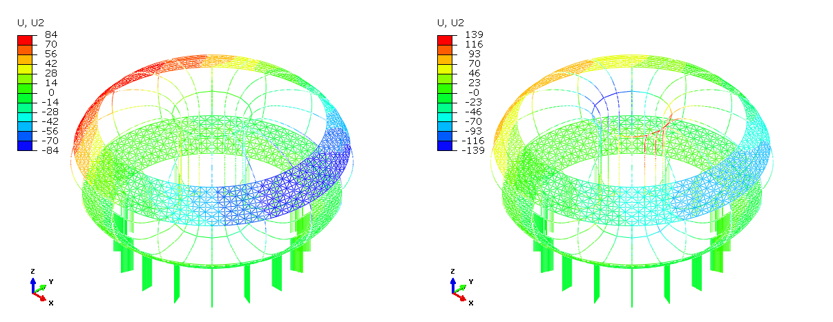
Uy displacement – Two IIS connections
Displacement along y axis with IIS fully connected (left) and pinned (right) to the vertical legs of the toroidal field coils

Slide 24
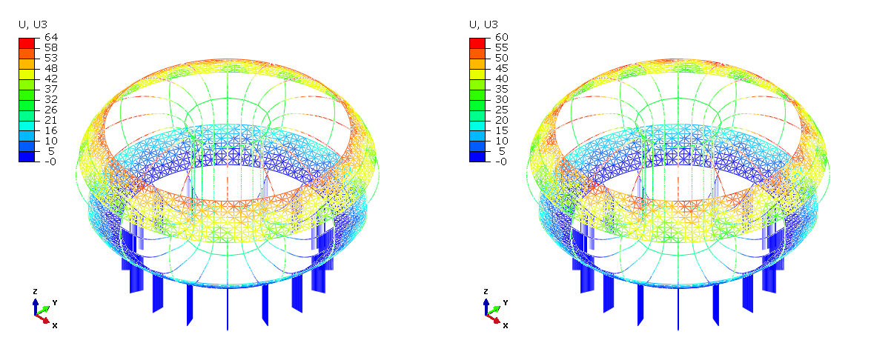
Vertical displacement – Two IIS connections
Displacement along z axis with IIS fully connected (left) and pinned (right) to the vertical legs of the toroidal field coils

Slide 25
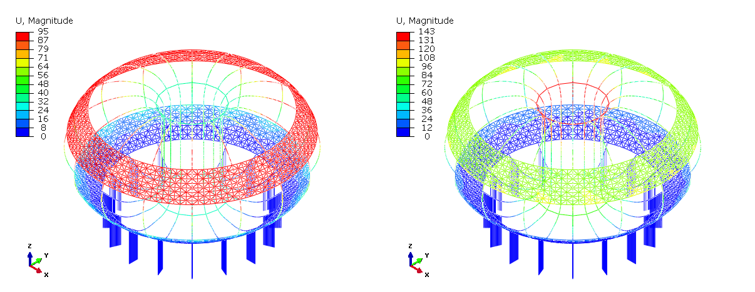
Total displacement – Two IIS connections
Total displacement with IIS fully connected (left) and pinned (right) to the vertical legs of the toroidal field coils

Slide 26
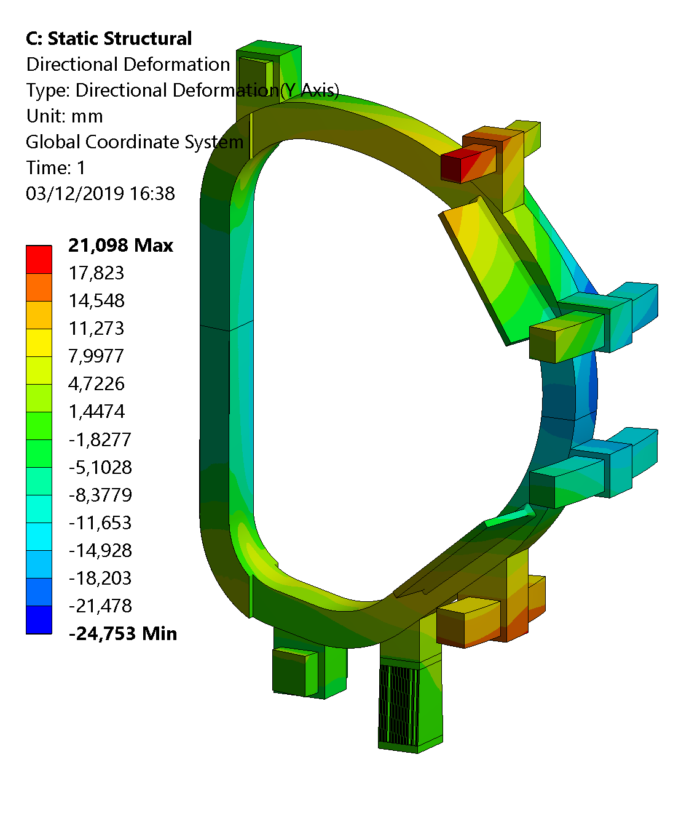
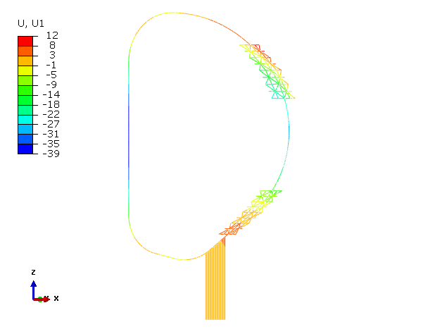
Radial displacement – comparison with CEA model

Slide 27
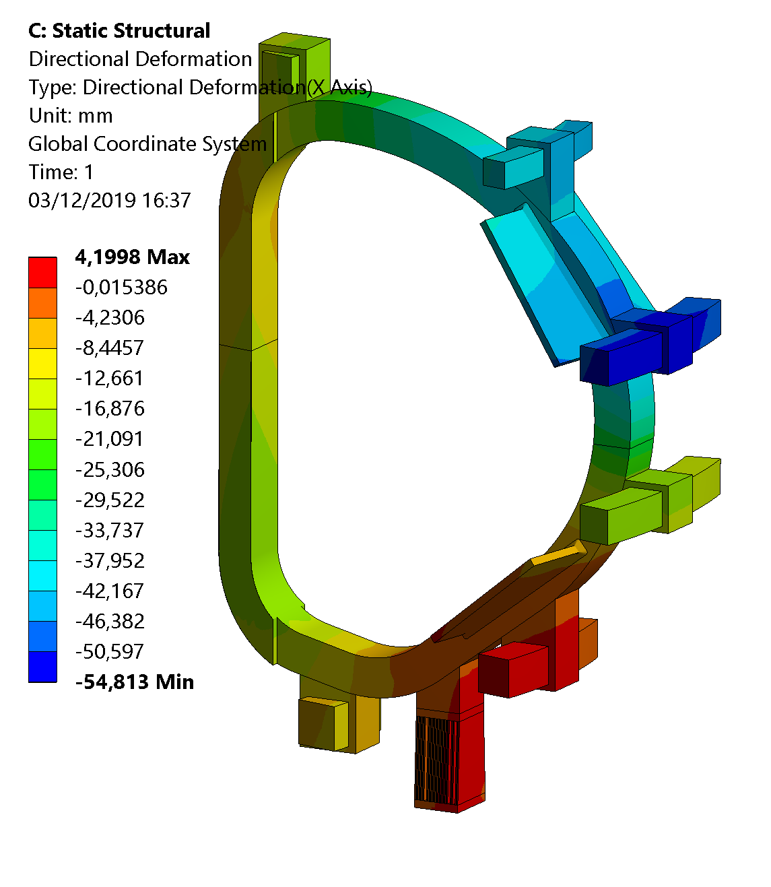
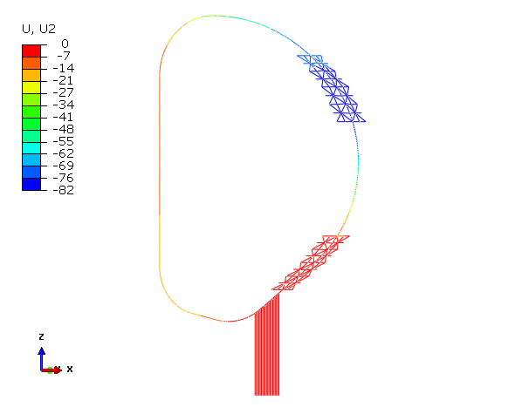
Lateral displacement – comparison with CEA model

Slide 28
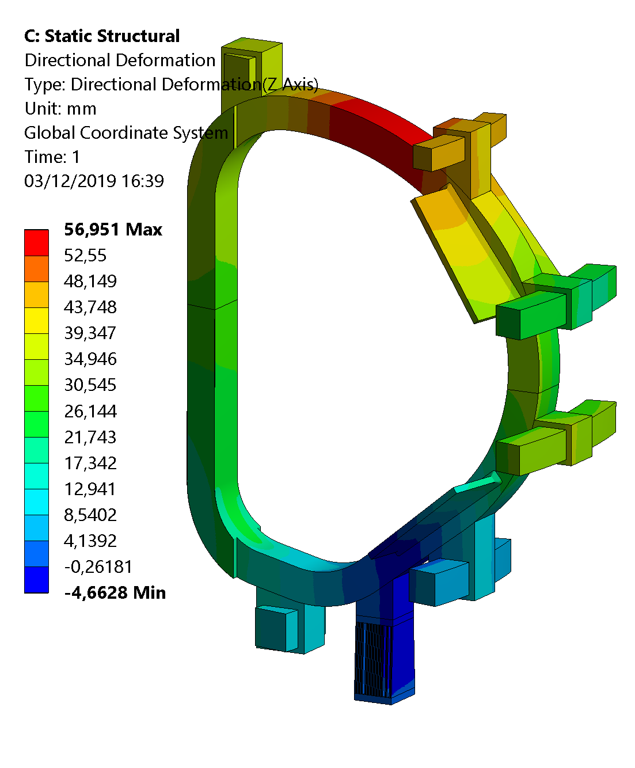
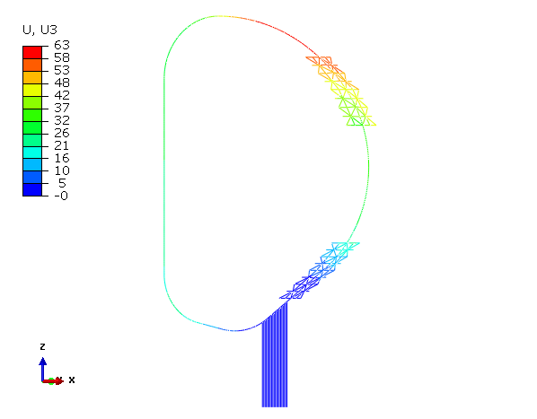
Vertical displacement – comparison with CEA model

Slide 29
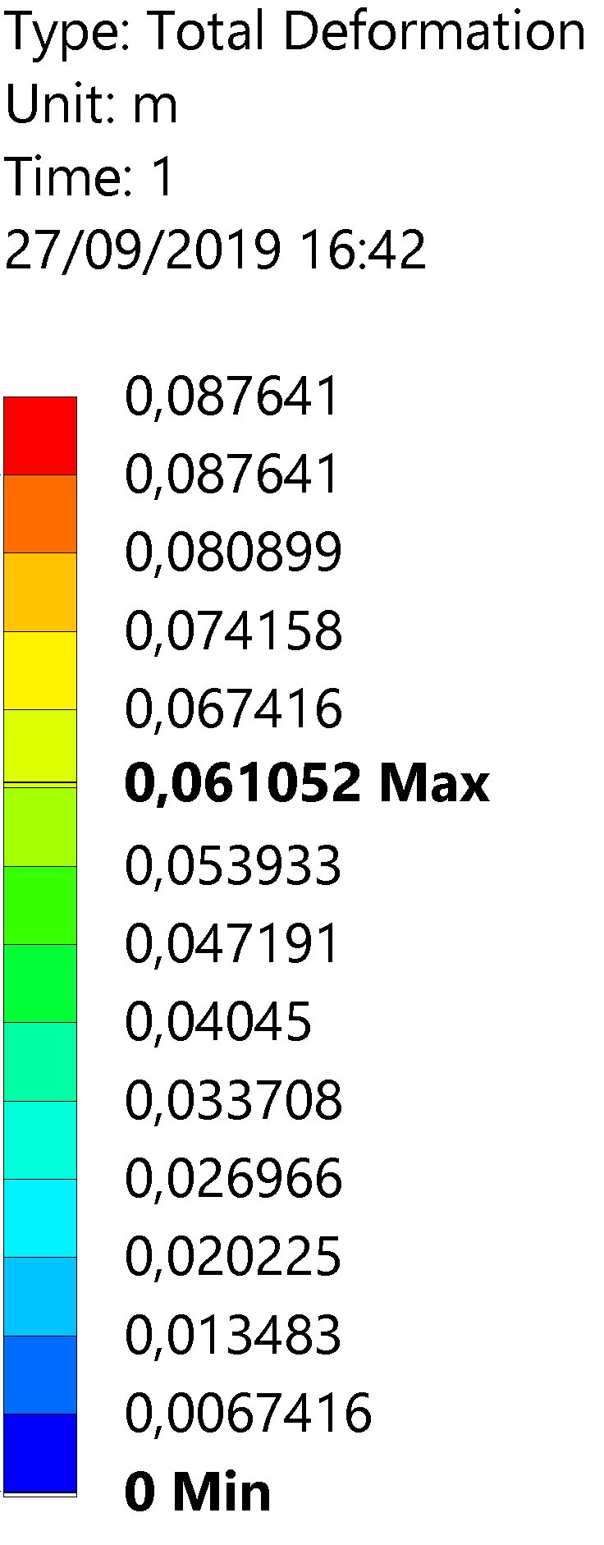
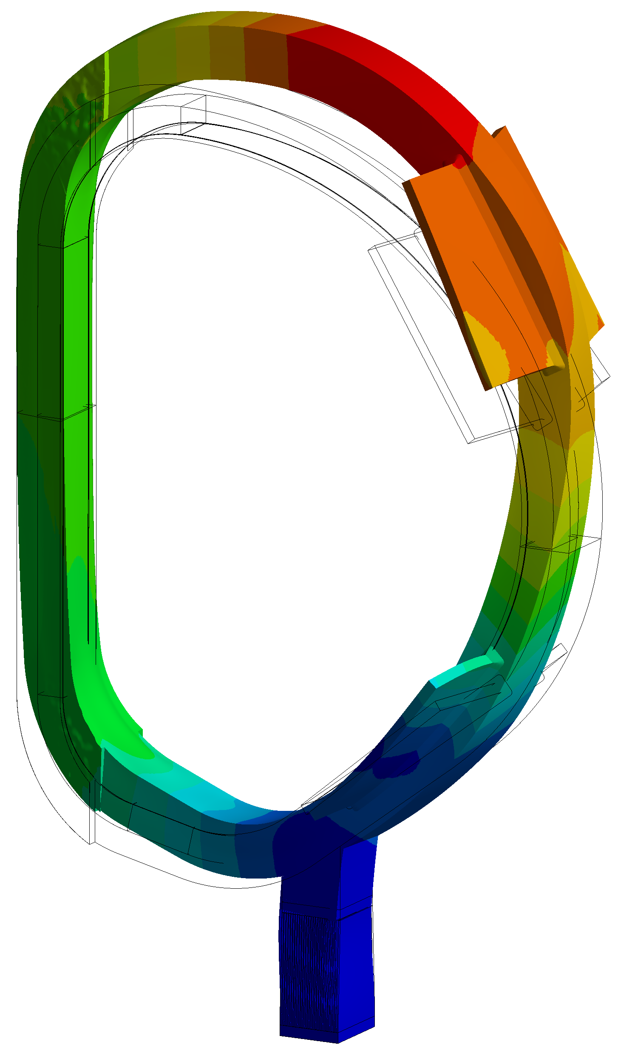
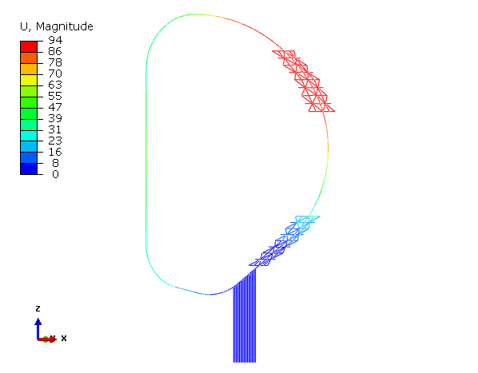
Total displacement – comparison with CEA model

Slide 30
Pre-Compression Ring stiffness: sensitivity analysis
A sensitivity analysis is performed to investigate the influence of the stiffness of the pre-compression ring (PCR) on the structural behavior of the magnet system.
The study is performed by varying the PCR stiffness and keeping constant all the other structures, namely the inner inter-coil structures and the gravity supports.
With respect to the reference case, ten different configurations where tested.

Slide 31
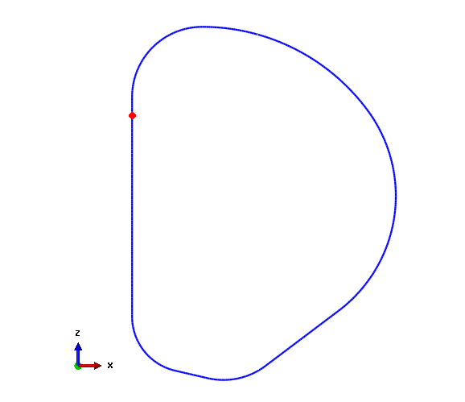
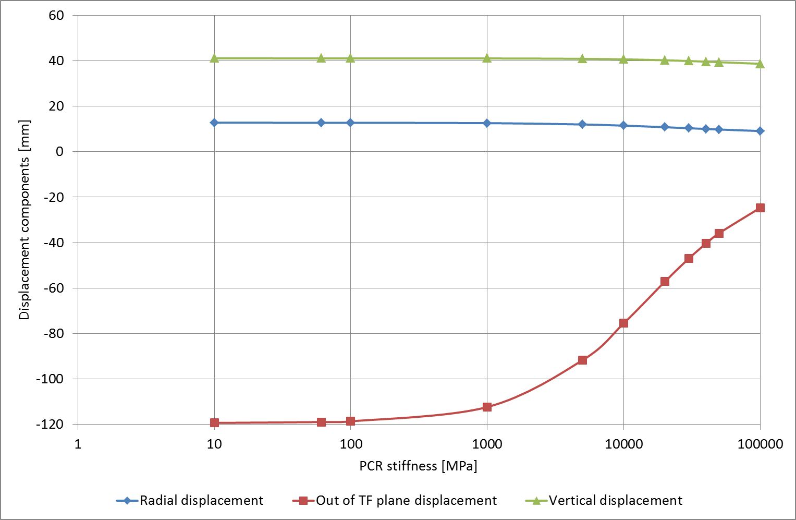
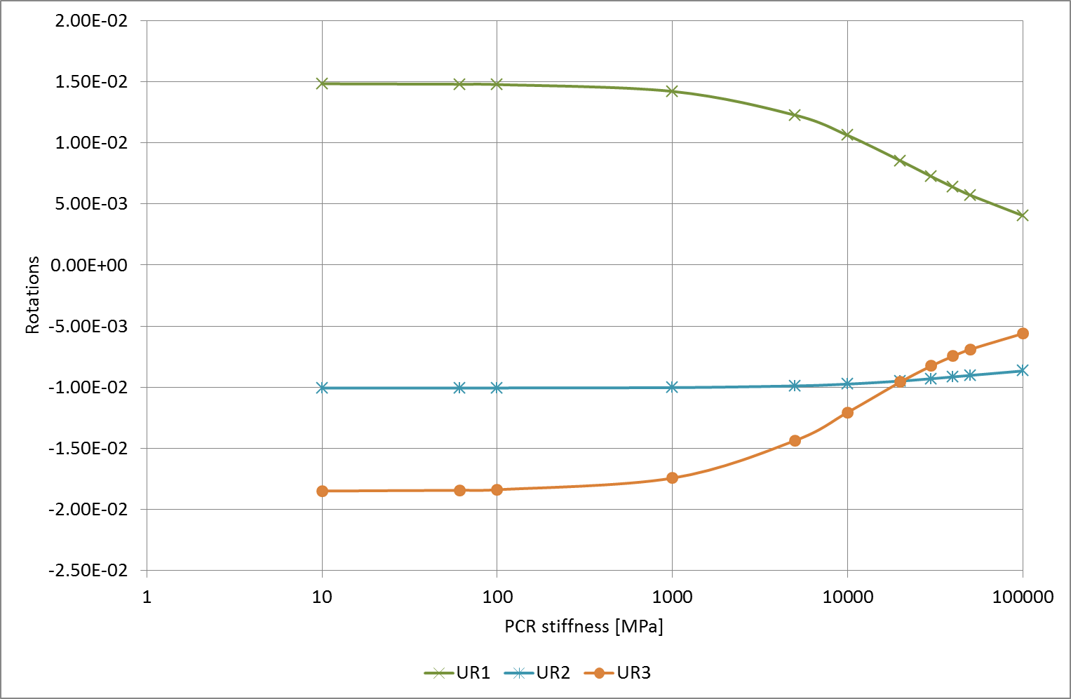
Pre-Compression Ring stiffness: sensitivity analysis
Pre-Compression Ring stiffness: sensitivity analysis
Displacement components and rotations components as a function of the PCR stiffness

Slide 32
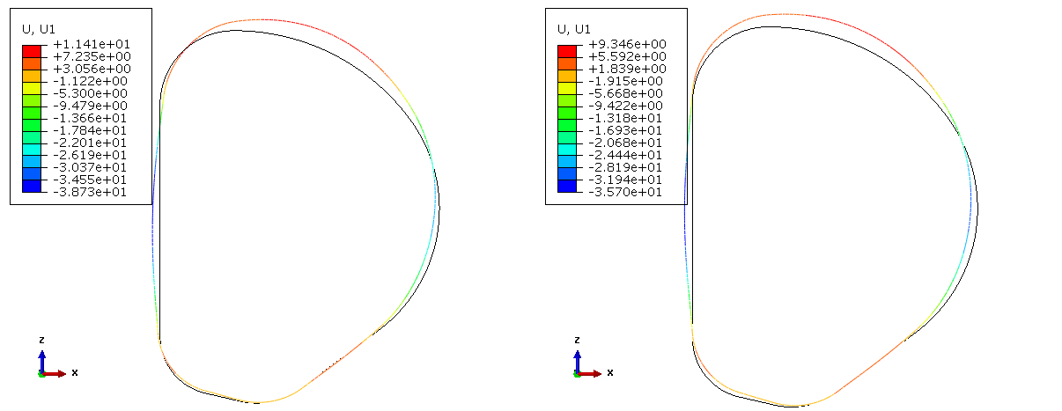
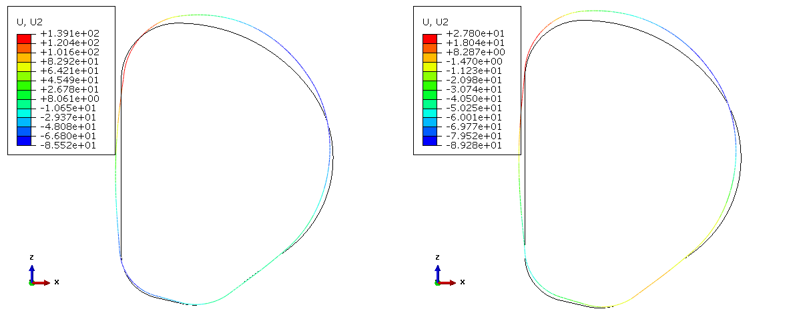
Pre-Compression Ring stiffness: sensitivity analysis
Soft
Hard
Soft
Hard
Radial displacements and UR1 rotation with “soft” (on the left) and “hard” (on the right) pre-compression rings

Slide 33
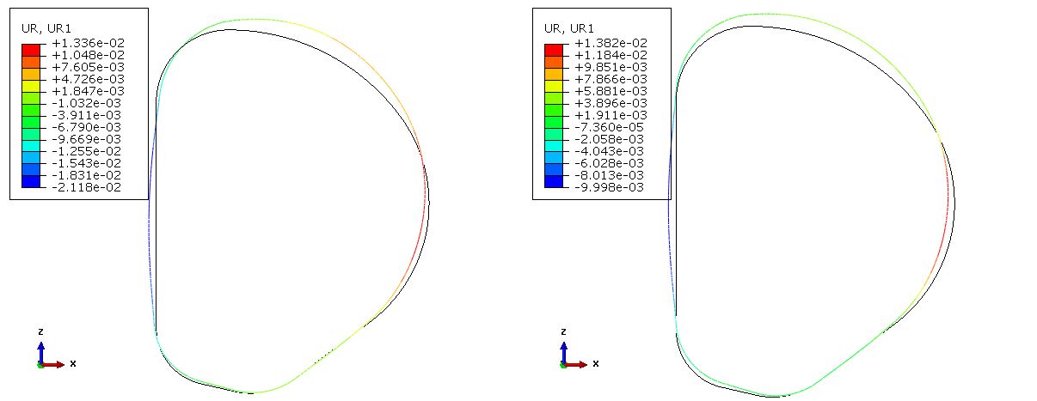
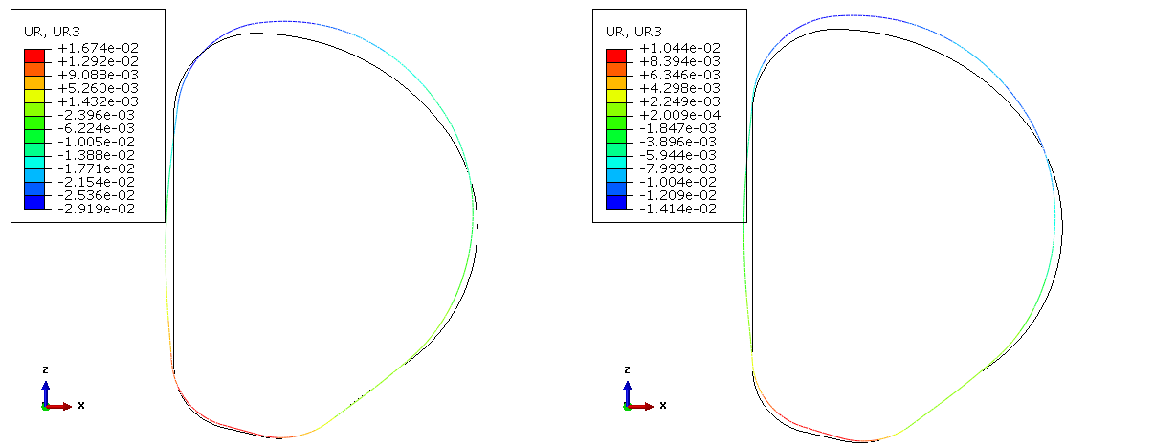
Pre-Compression Ring stiffness: sensitivity analysis
Soft
Hard
Soft
Hard
Radial displacements and UR1 rotation with “soft” (on the left) and “hard” (on the right) pre-compression rings

Slide 34
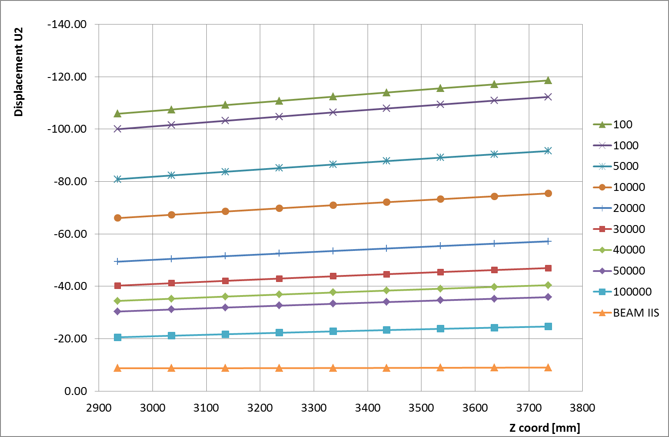
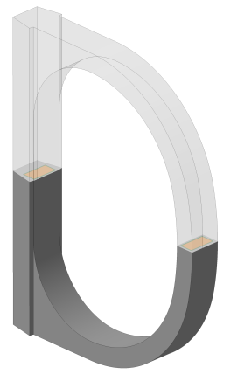
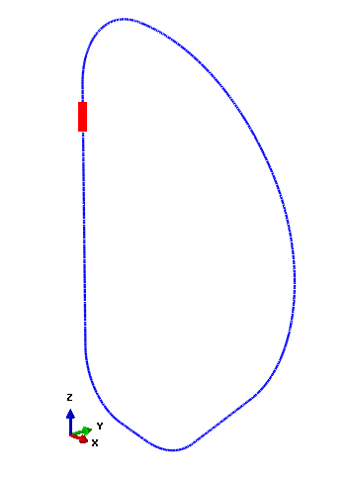
Pre-Compression Ring stiffness: sensitivity analysis
Pre-Compression Ring stiffness: sensitivity analysis
Out of TF plane rotation as a function of the position along the TF coil for different PCR stiffnesses

Slide 35
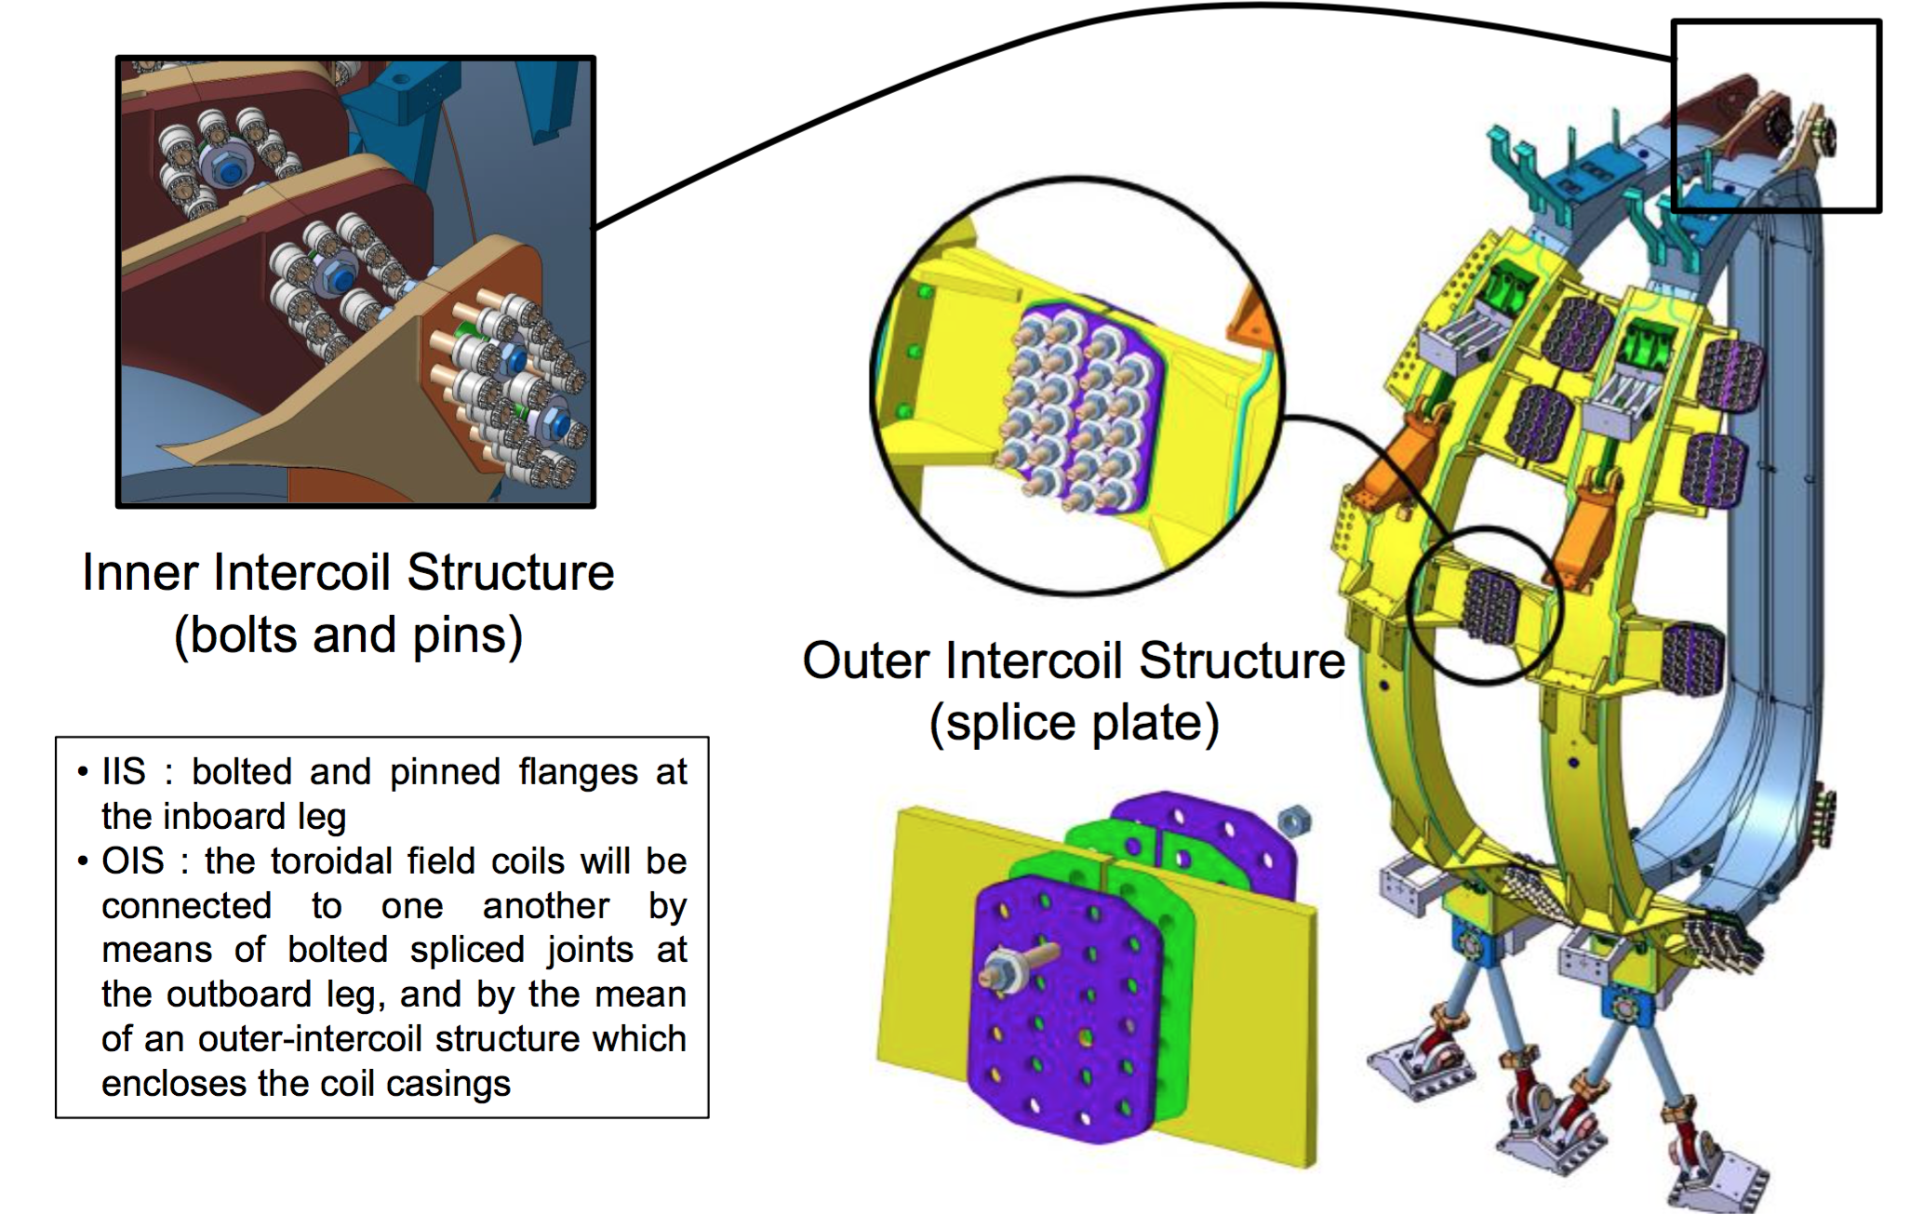
Pre-Compression Ring stiffness: sensitivity analysis
Pre-Compression Ring stiffness: sensitivity analysis
JT-60SA
IIS: bolted and pinned flanges at the inboard leg

Slide 36
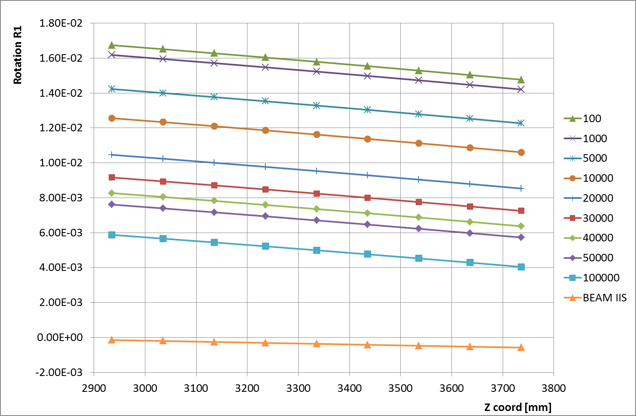
Pre-Compression Ring stiffness: sensitivity analysis
Pre-Compression Ring stiffness: sensitivity analysis
Out of TF plane rotation as a function of the position along the TF coil for different PCR stiffnesses

Slide 37
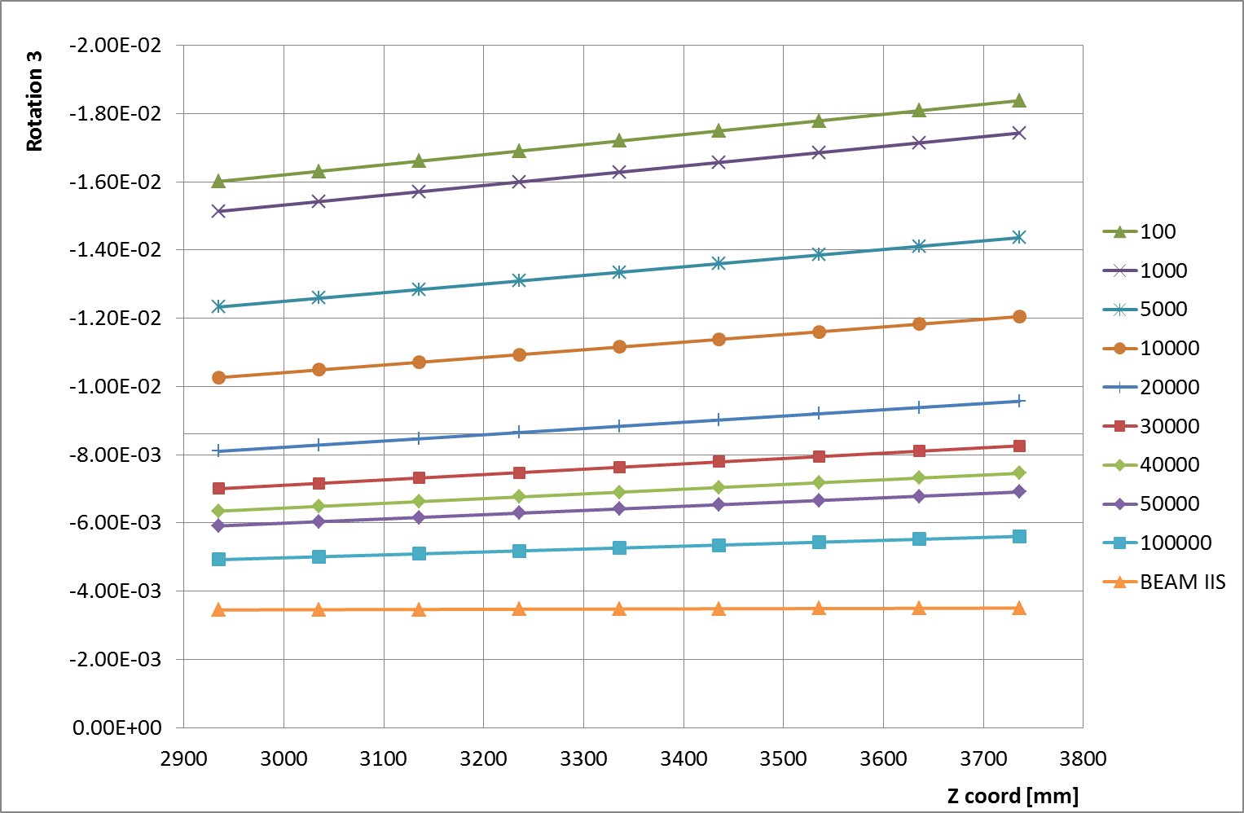
Pre-Compression Ring stiffness: sensitivity analysis
Pre-Compression Ring stiffness: sensitivity analysis
Out of TF plane rotation as a function of the position along the TF coil for different PCR stiffnesses

Slide 38
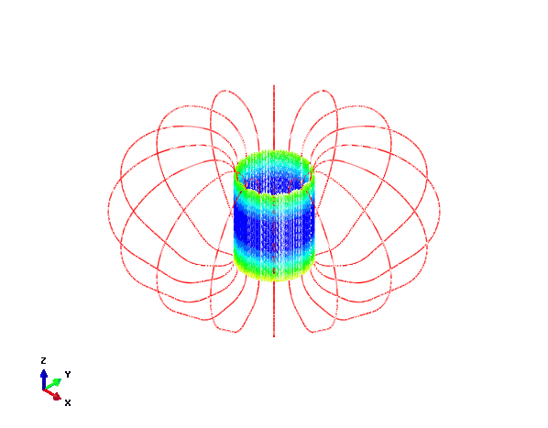
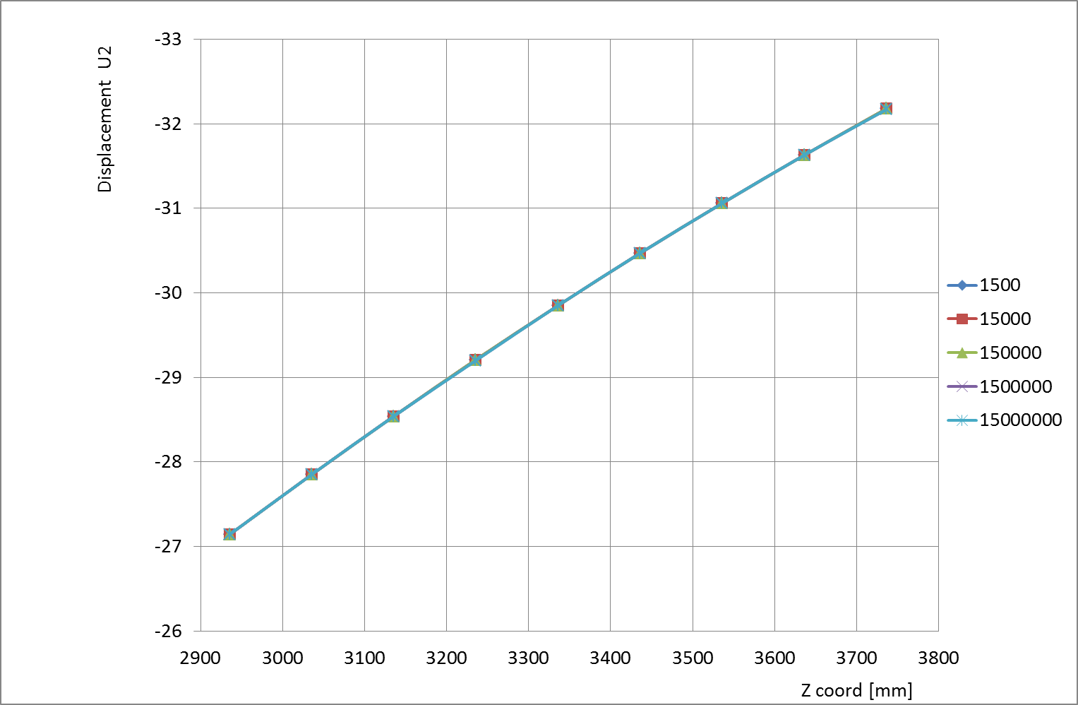
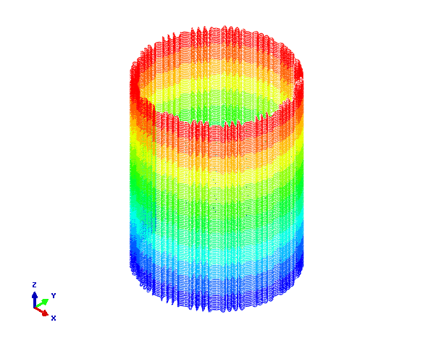
Influence of the spring stiffness
To investigate the influence of the stiffness of the springs on the structural behavior of the magnet system, a sensitivity analysis is performed. With respect to the reference case, five different configurations where tested. The image reports the out of TF plane displacement as a function of the position along the coil axis.

Slide 39
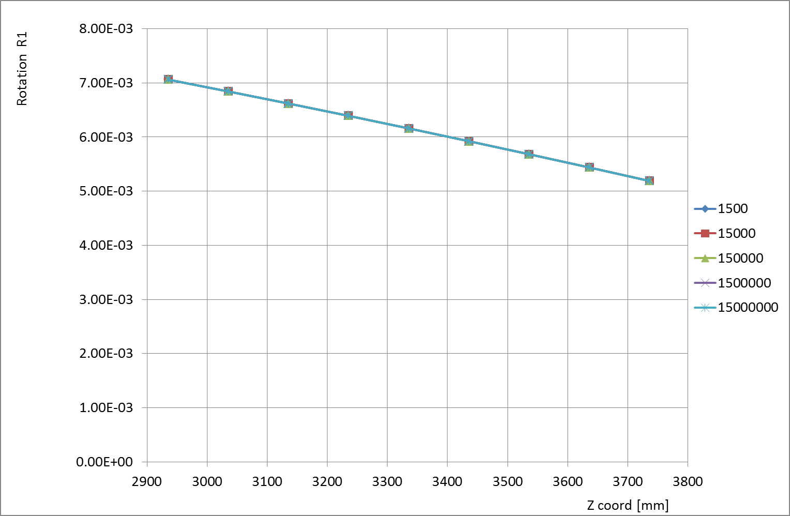
Influence of the spring stiffness
To investigate the influence of the stiffness of the springs on the structural behavior of the magnet system, a sensitivity analysis is performed. With respect to the reference case, five different configurations where tested. The image reports the rotation around the first axis as a function of the position along the coil axis.

Slide 40
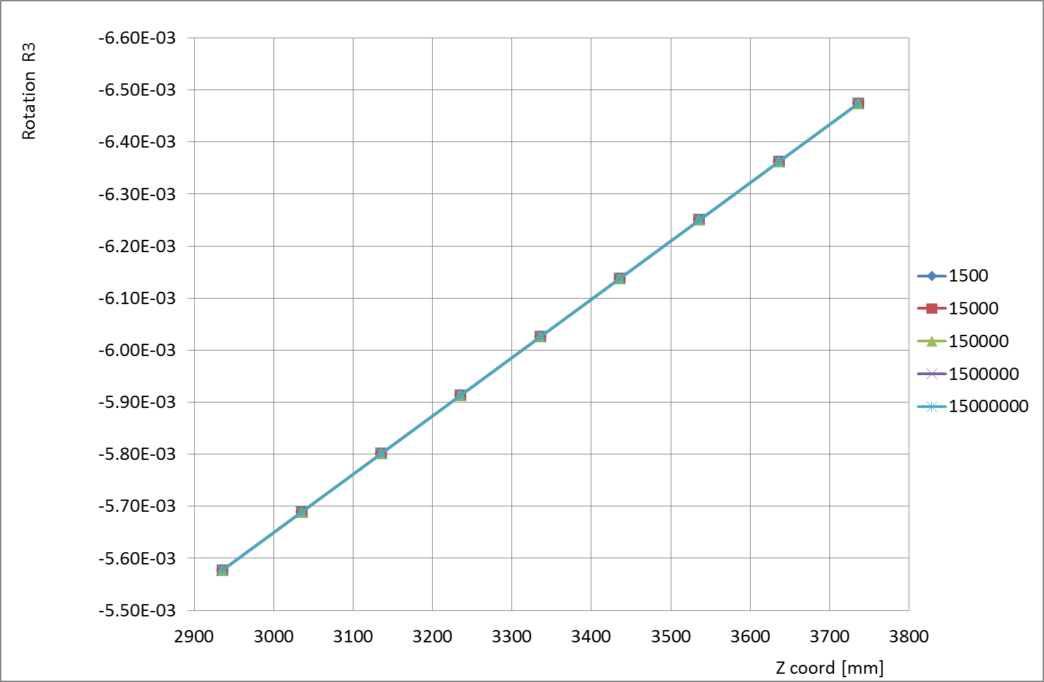
Influence of the spring stiffness
To investigate the influence of the stiffness of the springs on the structural behavior of the magnet system, a sensitivity analysis is performed. With respect to the reference case, five different configurations where tested. The image reports the rotation around the third axis as a function of the position along the coil axis.

Slide 41
Pre-Compression Ring stiffness: sensitivity analysis
Structural Design Path
The finite element model made of structural beam elements allows identifying the most solicited areas as well as obtaining the related forces.
As a second step, a finite element model made of continuum elements is developed to analyze the stress and strain fields in details.
As a final step, the structural design can be performed.
In the following the Outer Inter-coil Structures are considered.

Slide 42
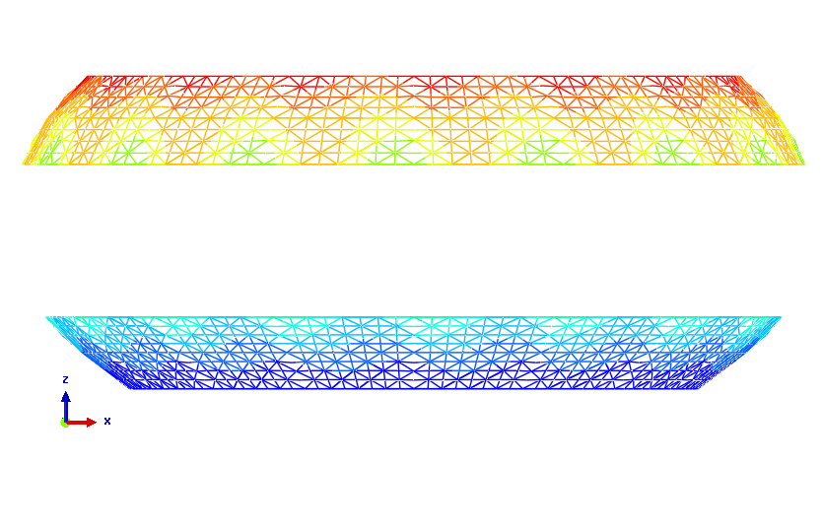
Pre-Compression Ring stiffness: sensitivity analysis
Structural Design Path - OIS
Global 3D beam model: detail of the Outer Inter-coil Structures

Slide 43
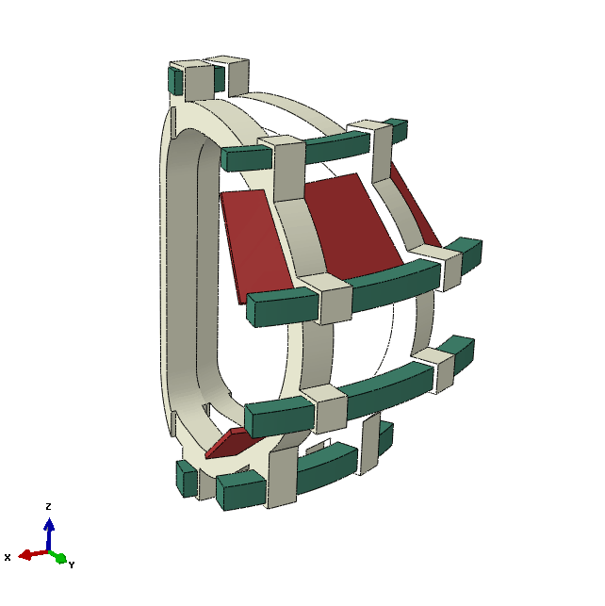
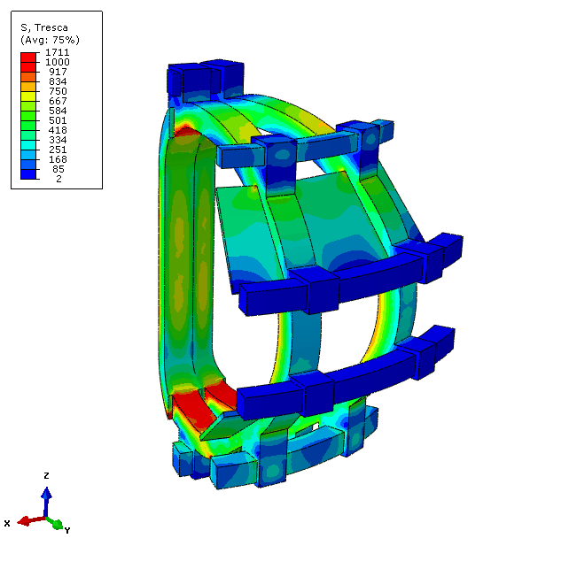
Pre-Compression Ring stiffness: sensitivity analysis
Structural Design Path - OIS
Finite element model of 1/8 of the magnet system and related structures. 3D continuum elements are used

Slide 44

Pre-Compression Ring stiffness: sensitivity analysis
Structural Design Path - OIS
Tresca stress distribution on the upper OIS

Slide 45

Pre-Compression Ring stiffness: sensitivity analysis
Structural Design Path - OIS
σ_{zz} stress distribution on the upper OIS

Slide 46

Pre-Compression Ring stiffness: sensitivity analysis
Structural Design Path - OIS
Tresca stress distribution on the lower OIS

Slide 47

Pre-Compression Ring stiffness: sensitivity analysis
Structural Design Path - OIS
σ_{zz} stress distribution on the lower OIS

Slide 48


Slide 49


Slide 50


Slide 51


Slide 52


Slide 53
CONCLUDING REMARKS
Finite element global model of the magnet system and its mechanical structures: very flexible and suitable for sensitivity and parametric analyses
Pre-Compression Ring Stiffness
Contact of the inner straight leg of the TF coils
  Structural Design Path
  Bottleneck: applied loads (EM forces)
  WP #?

Slide 54
2020 ACTIVITY PROPOSAL
Coordination of the Mechanical Analysis
preparation of a catalogue of FEM Reference Data
review of the documentation produced by the analysts
Preparation of the documents for the gate-review
Design of the mechanical structures and supports of the magnetic system
Refinement of finite element global model:WP #? EM loads?
  Parametric analyses (Review panel suggestion)
  GS position
Outer Inter-coil Structures
Inner Inter-coil Structures
Tie-plates

Slide 55
Thank you for your attention
DEMO Magnets review
2019 WPMAG DPRM#3
Garching bei München 12.12-13.12.2019

