Slide 1
Presentation on EEG activities
Wide-Range Studies on Insulation (2019-2020)
Bennet Jose
CEA Paris-Saclay

Slide 2
EEG work program
Current
MOCK UPS
tests on small scale models
RT and cryogenic
standard and alternate insulation
FE models and criteria
❷
STUDY
existing insulation techniques, mechanical behavior, failure etc.
❸
❶
Large scale WP model
design and
feasibility study
ALTERNATE TECHNIQUES
hybridization, ceramics, …
coatings /surface treatment
❷
May 2019
Fev
2020

Slide 3
Progress of the EEG work program
Phase 1
  Studies on insulation and literature survey
  Training on FE modelling by participating in WPMAG activities
  Kick start of activities with CEA Cadarache and ITER (MIFI Facility)
  Start of experimental activities
  Training on Grid Method
  Training on Fusion and Plasma physics at IPP (Summer university, Garching 2019)
Phase 2
  Preparation of test specimen
    Procurement of materials (Ribbon, Resin, design of mould etc)
    Resin Impregnation of test sample
    Machining of the test sample
    Placement of grids
    Tests in ENSTA Brest (IRDL)
    Image processing and FE Modelling

Slide 4
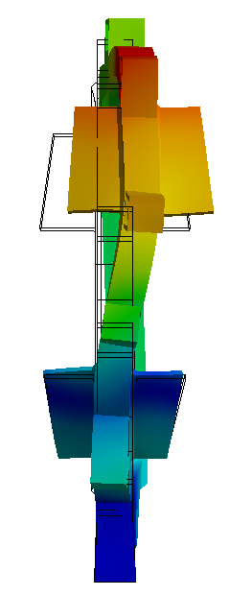
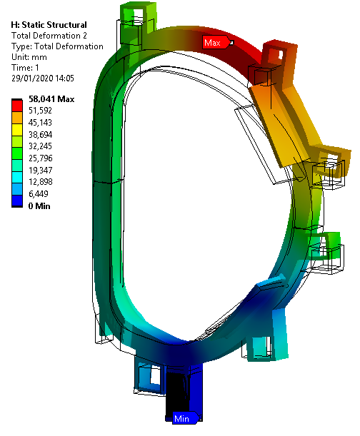
Training on FE modelling
Global Analysis of TF coil with WP4
  Mechanical Modelling of the global TF structure
  Homogenization of coil properties
  Post processing

Slide 5
Activities with CEA Cadarache, ITER
  Discussion on activities at IRFM
    Overview on mechanical analysis and criteria used for ITER and JT60sa Coils
    Overview on thermo-hydraulics
  Visit to MIFI Facility (ITER)
    Discussion on various tests performed on magnets
    Discussion on tooling and preparation of small test specimens
    Procurement of resin

Slide 6
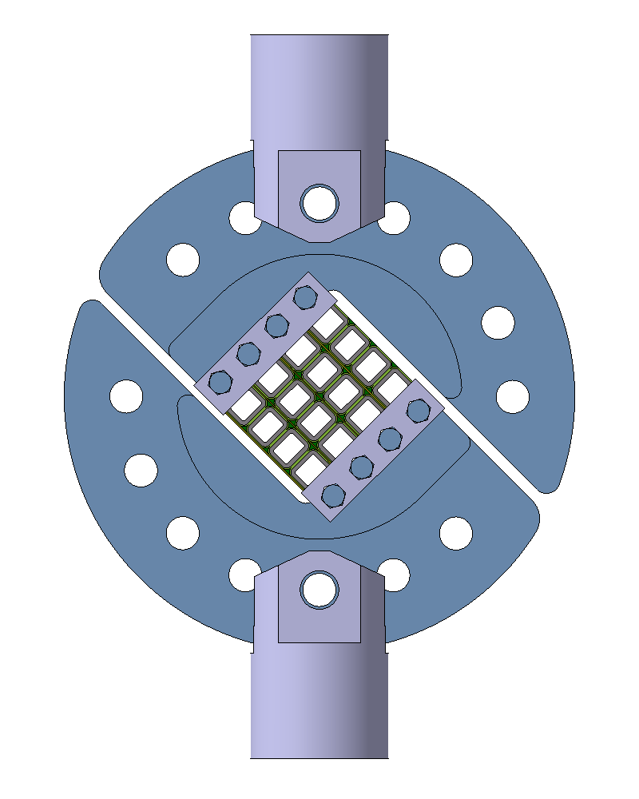
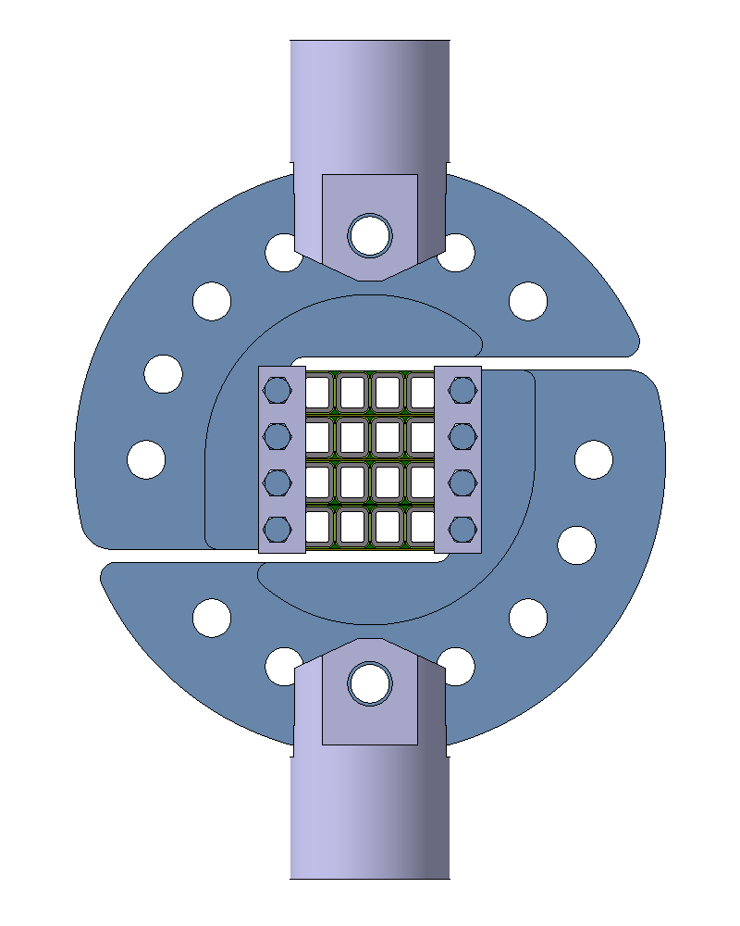
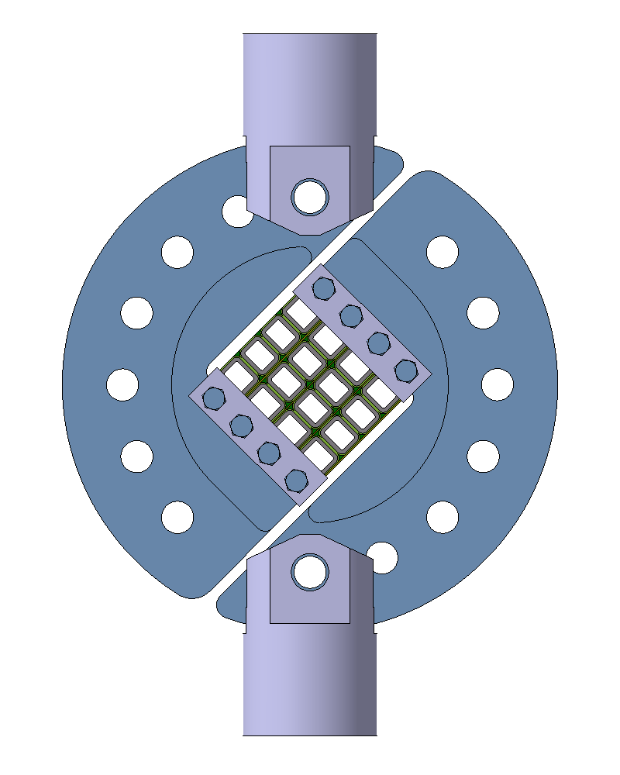
Experimental Activities
ARCAN test fixture
  Contract in place with ENSTA Brest(IRDL) for testing small scale samples
  Full field measurement using grid method
shear + tension
shear
shear + compression

Slide 7
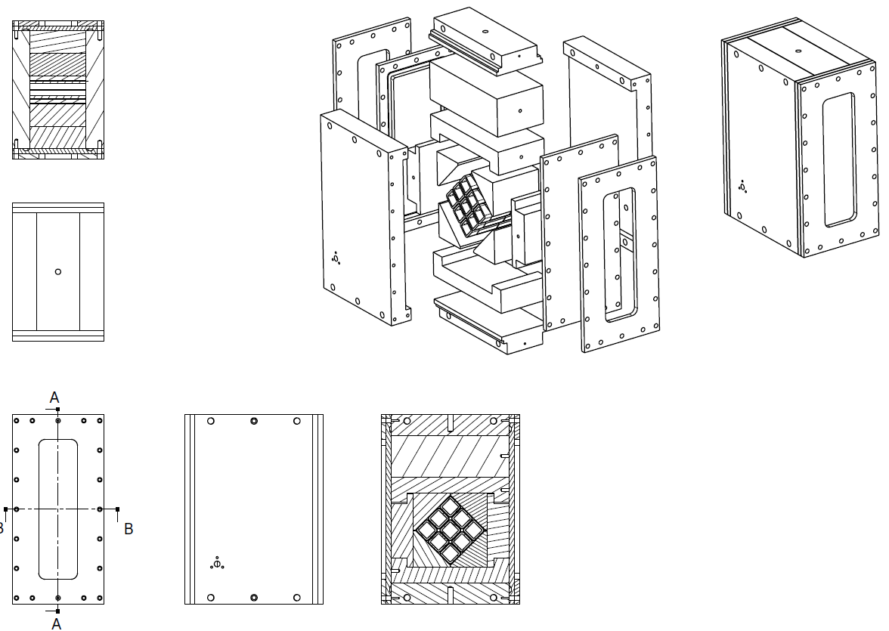
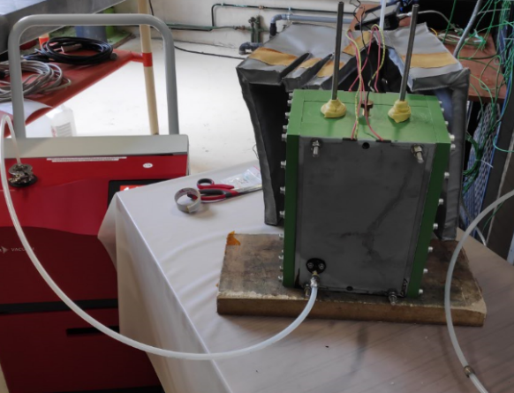
Experimental Activities – Phase 2
Preparation of test specimen
  Initial tests will be performed on 3x3 CICC type specimens
  Mould to be used for the impregnation of a specimen of 88 mm
Procurement ongoing
  Existing mould to be used in CEA Saclay

Slide 8
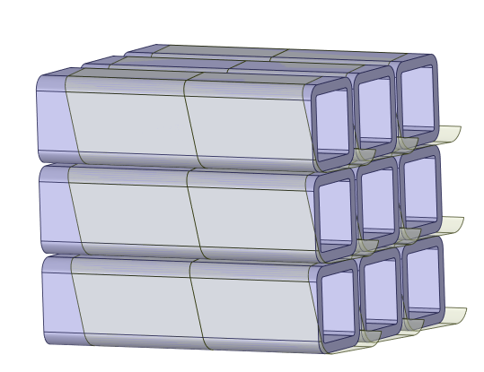
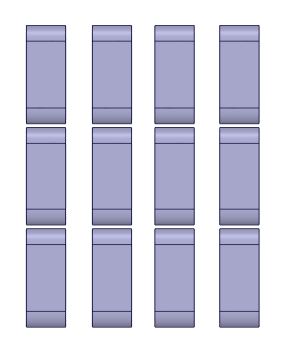
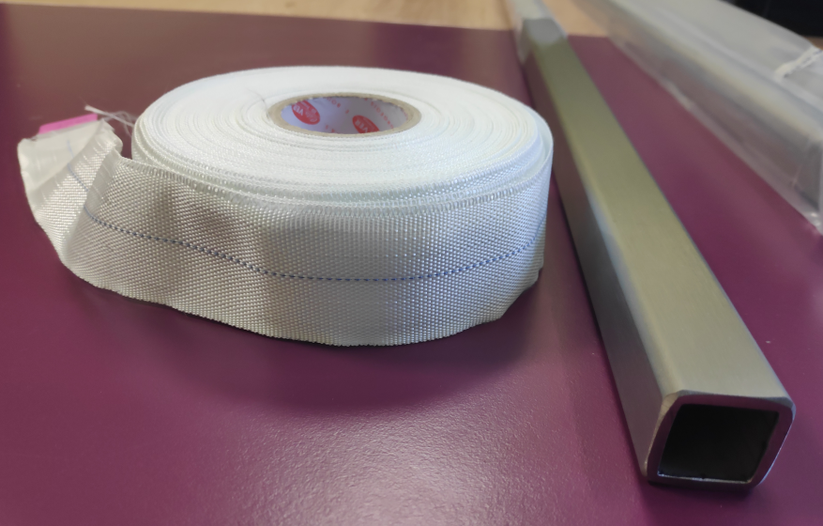
Experimental Activities
Preparation of test specimen
  Preparation and Machining of test specimen
(25x25x3)x3 + (0,5x6) mm
(Square tube) (Ribbon)
88 mm
10~12 mm x 4 Specimens
Glass fibre ribbon and 25x25x3 mm tube procured
  Resin: CTD 435A/B from MIFI (ITER) Epoxy resin used in ground insulation
  Procurement of new resin for future studies - in progress from CTD

Slide 9
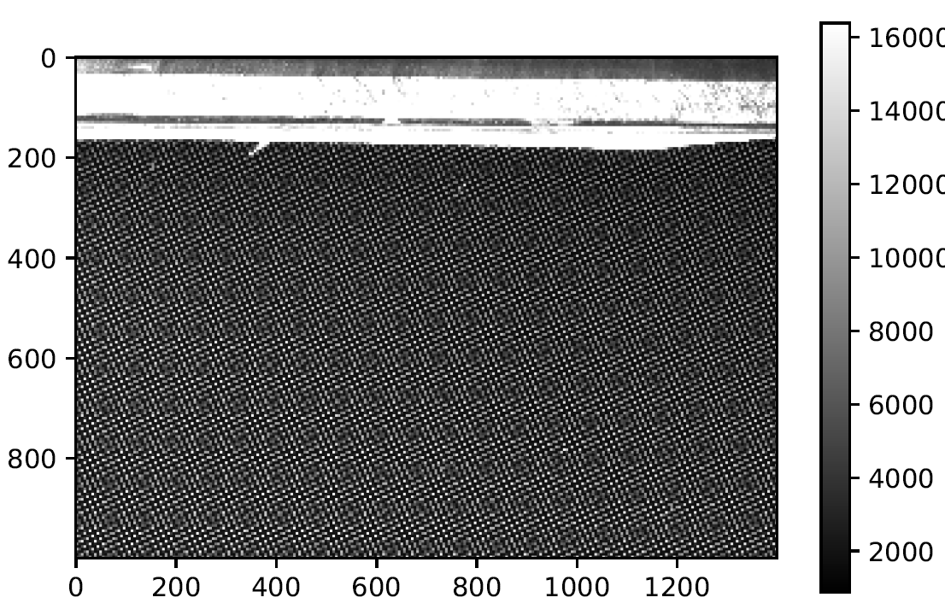
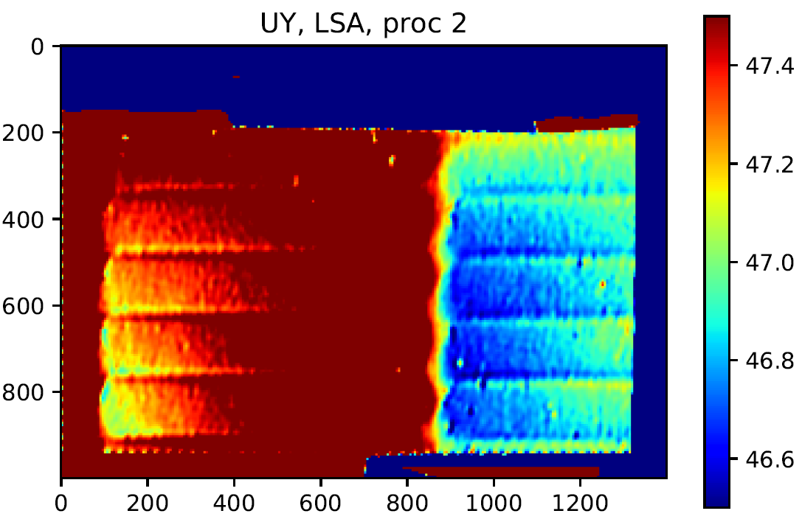
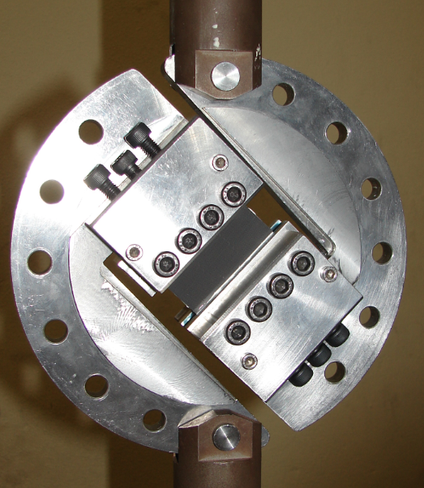
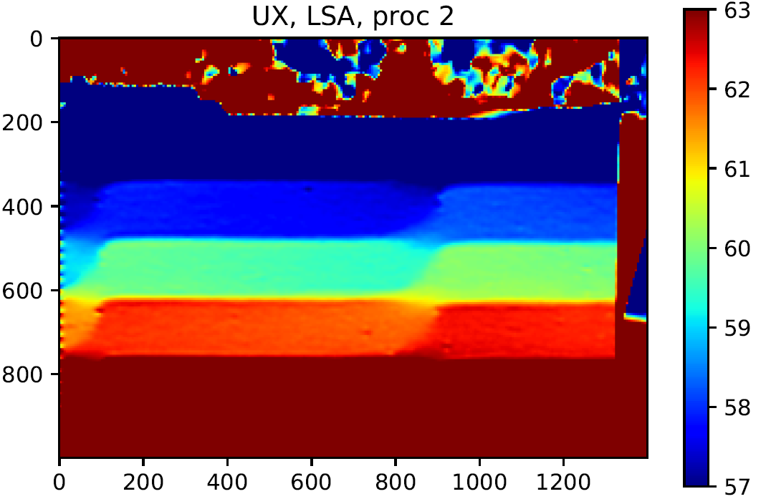
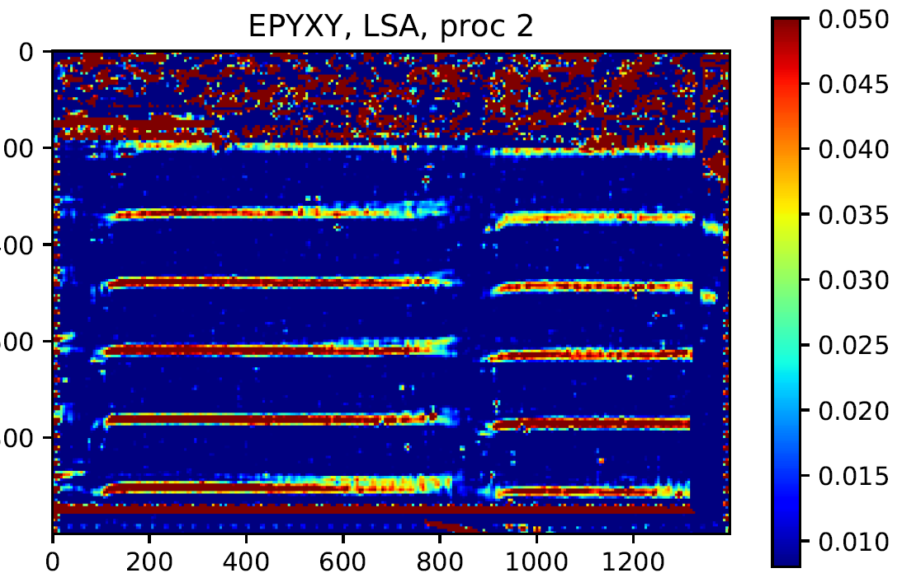
Activities performed
Study on grid method
  Training on grid method by using the script in Python by processing images of existing samples
Sample tested*
  It was decided to use the script in MATLAB for better resolution of the results
  *courtesy: F.NUNIO, C. BADULESCU

Slide 10
Timeline Phase 2 >Nov 2019
Quotation for testing of 4 samples in place between CEA and ENSTA
Design of Mould and procurement of tubes and tape
Nov - Dec 2019
Procurement of resin and Mould
Dec- Jan 2020
Impregnation and cutting of samples
Jan – Feb 2020
Testing of samples
ENSTA Brest
March 2020
Preparation of grid
Image processing and FEM Validation
March –June 2020

Slide 11
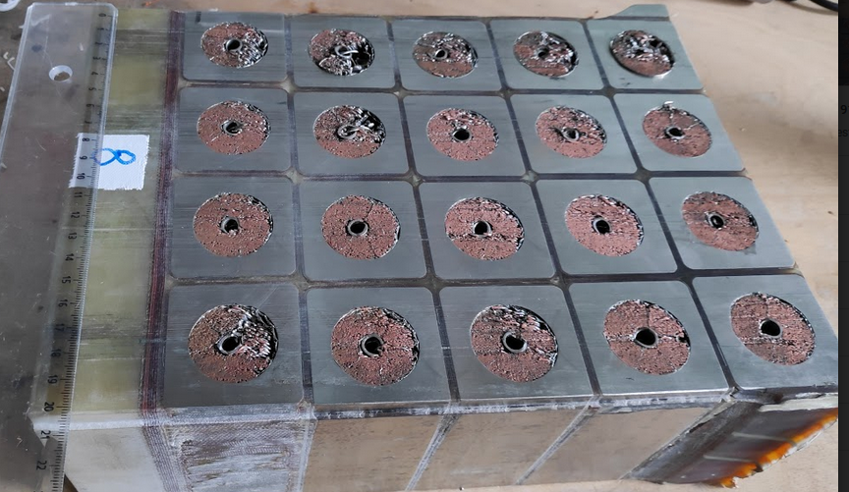
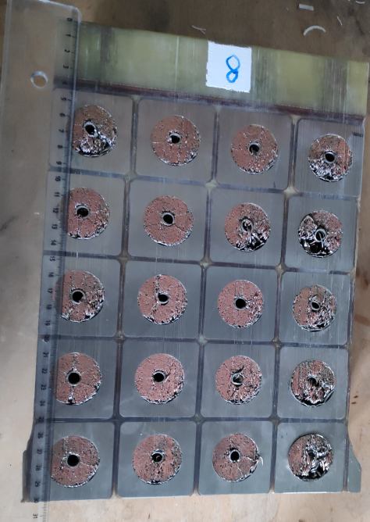
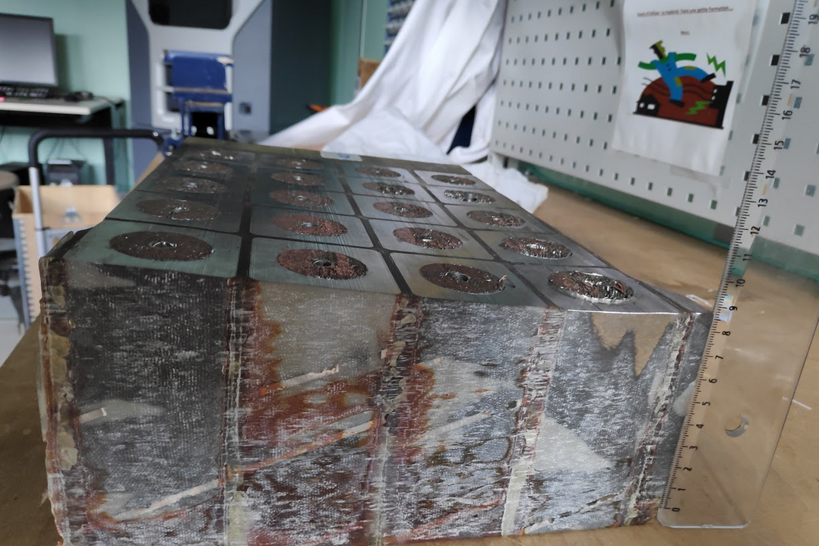
Future tasks and New collaborations
Testing of ITER CS module - 8 (4x5)
Thanks to the collaboration of CEA with ITER, the cut sample of Full scale ITER CS is at CEA Saclay!!
Compression test with full field measurement
21cm
30 x 21 x 9 cm
~46 Kg
30 cm
9 cm
Test planned for end of 2020 or 2021
(discussion ongoing)

Slide 12
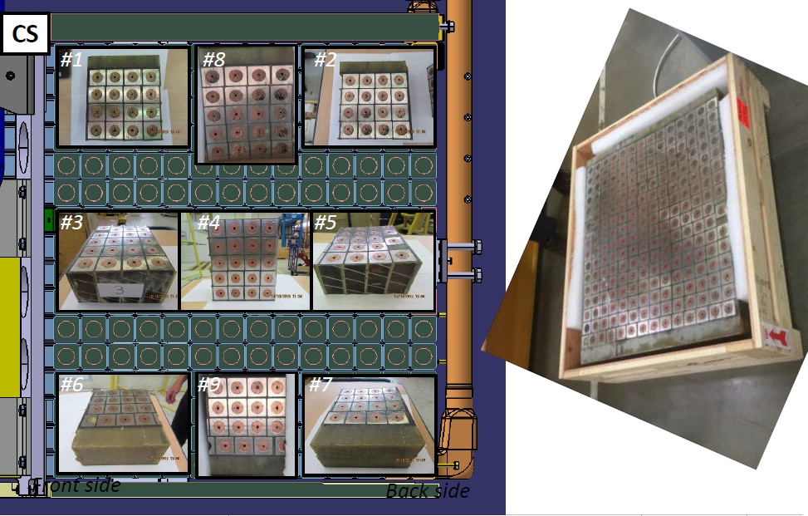
Future tasks and New collaborations
Participation in ITER CS module qualification activities
Sample 2,6 and 7 to CERN
Participation in Pushout tests at CERN (Feb 2020)
Participation in CTE testing at CEA Saclay
Collaboration on insulation studies for accelerator magnets
A new collaboration with accelerator magnet team at CEA Saclay for studies on insulation
  *Image courtesy: T.SCHILD, ITER

Slide 13
Conclusion
  Phase 1 activities as per the work program is completed
  Phase 2 activities are ongoing as planned
  Two new collaborations in place

Slide 14
Thank you …

Slide 15
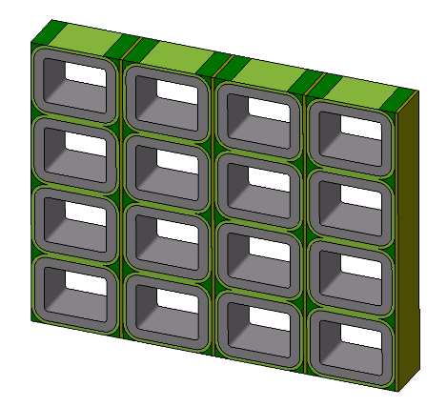
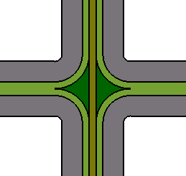
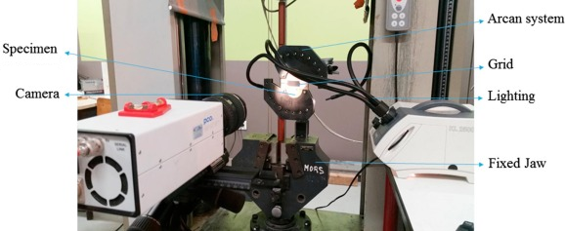
Small scale WP samples to test insulation*
  Motivation: improve the understanding of the structural strength of the insulation, refine the strength criteria and validate FE analyses.
  Full strain field measurement technique : see http://www.thegridmethod.net/
4x4 conductor pattern (≈ 10 cm²)
(2D plane stress → ≈ 1 cm thickness)
ARCAN test fixture allowing different stress state :
shear + tension
shear
shear + compression
Test setup
Output : strain field
over the entire surface
of the 4x4 sample
ε_{xy}
Fine pitch grid glued onto sample
(grid method)
*F.NUNIO, WPMAG Final Meeting 2018

Slide 16
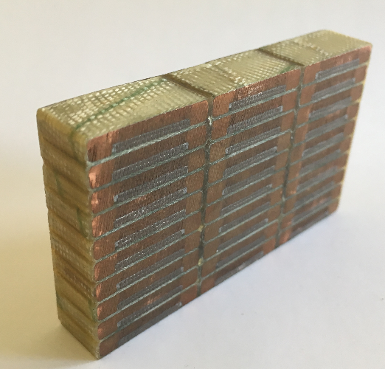
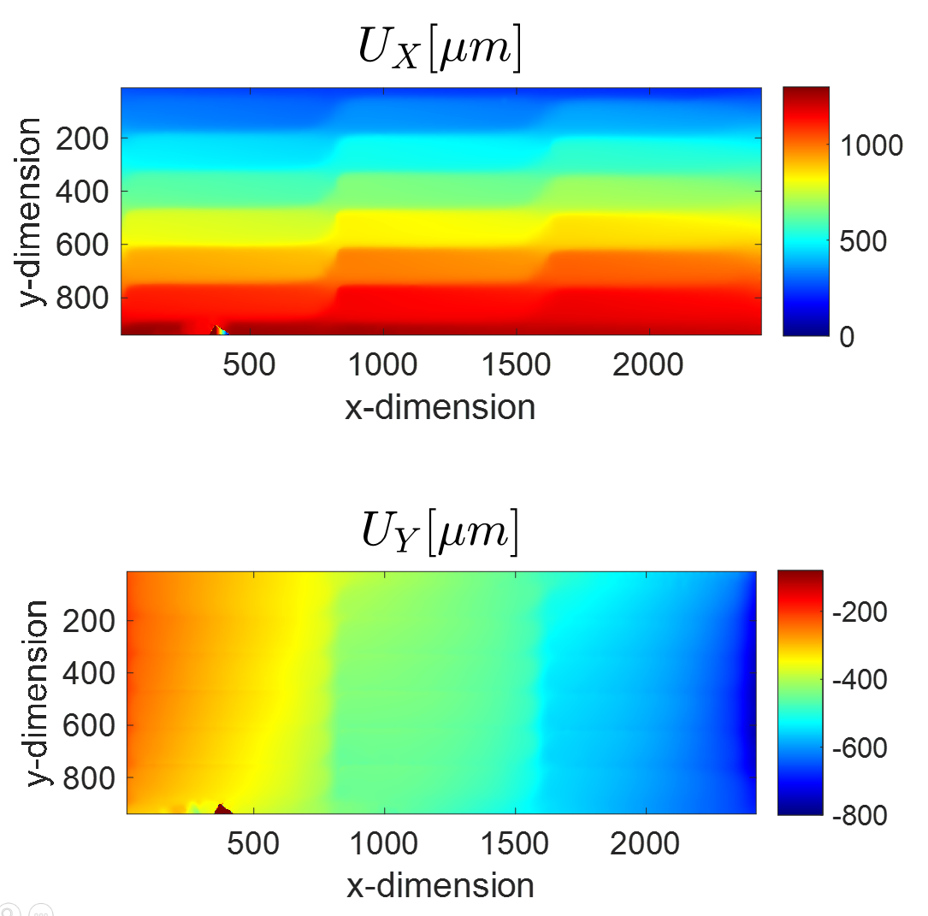

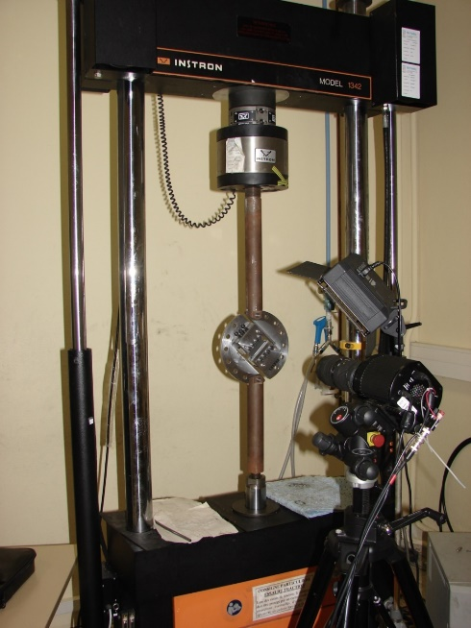
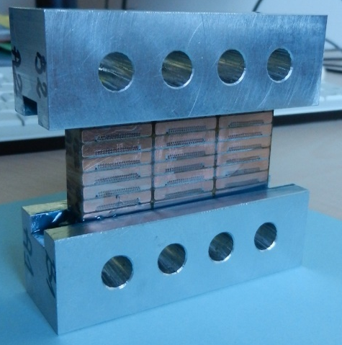
Feasibility study of "full-field" measurement on SC stacks
“Measuring in-plane displacement and strain fields with the grid method. A feasibility study on superconducting magnet”
Workshop #2 on Nb3Sn technology for accelerator magnets, session 2 on “Material aspect / characterization”
C. Badulescu, B. Blaysat and M. Grédiac
Specimen in an Arcan fixture
Shear/Compression setup
Results for shear/compression setup
Specimen (NbTi-Cu / G11)
Y
X
Specimen with clamps
*F.NUNIO, WPMAG Final Meeting 2018

Slide 17
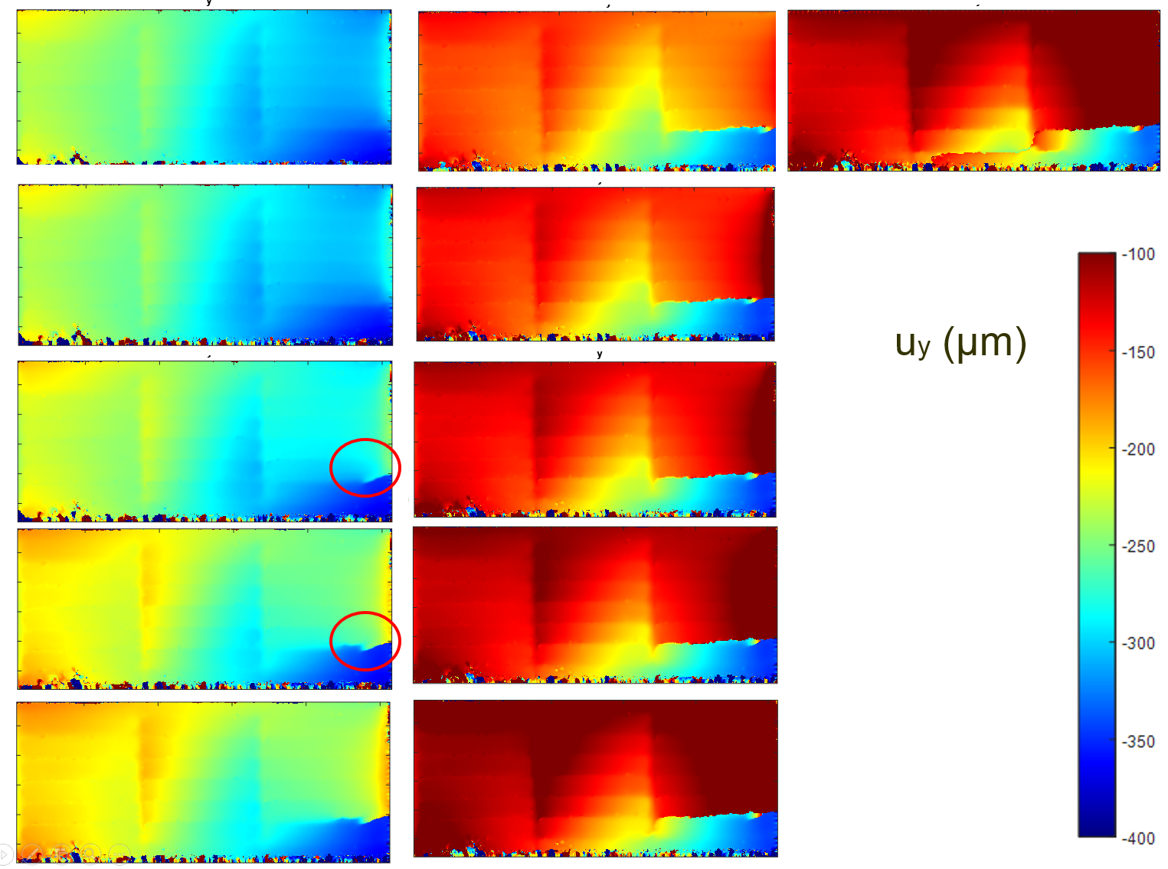
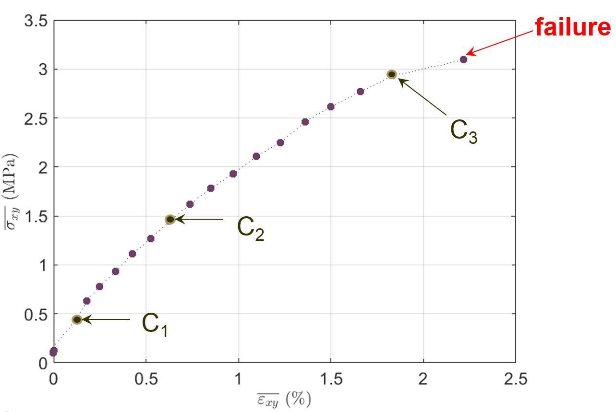
Feasibility study of "full-field" measurement on SC stacks
“Measuring in-plane displacement and strain fields with the grid method. A feasibility study on superconducting magnet”
Workshop #2 on Nb3Sn technology for accelerator magnets, session 2 on “Material aspect / characterization”
C. Badulescu, B. Blaysat and M. Grédiac
Pure Shear setup
Crack initiation + propagation
C1
C3
Y
X
C2
*F.NUNIO, WPMAG Final Meeting 2018

