Slide 1
Sizing and Preliminary Design of Feeders
R. Guarino
R. Wesche
WPMAG
Final Meeting
11-13 Feb 2020

Slide 2
Introduction
WPMAG Task “EXTRA – Sizing and Preliminary Design of Feeders” (MAG-2.4-T007) :
  EPFL SPC works on sizing of the bus bars and HTS current leads
  POLITO studies heat loads and cooling
Work done at EPFL SPC:
  preliminary 3D arrangement of the feeders within DEMO tokamak
  preliminary sizing of the bus bars
  preliminary evaluation of the mechanical loads and support structure
  outline design of the HTS current leads

Slide 3
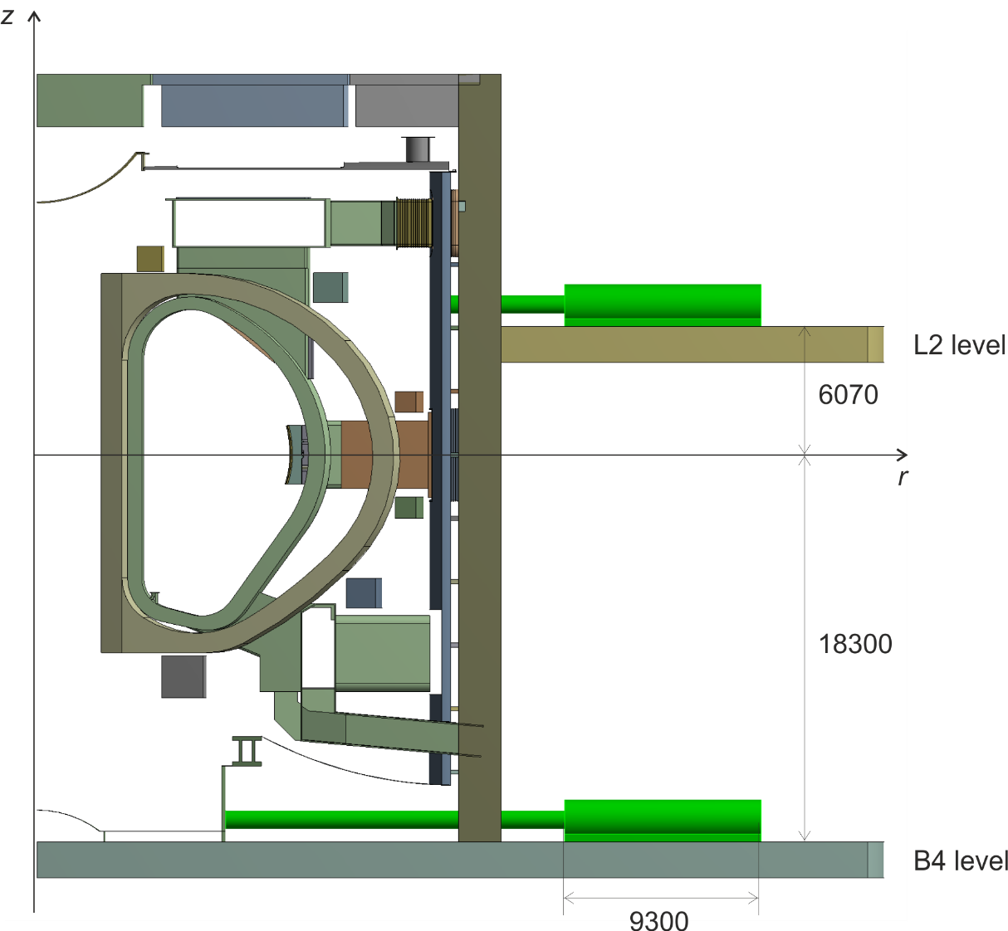
Feeder Integration Studies
First iteration based on scaling up linearly the ITER design
Feeders positioned at the B4 and L2 levels of the tokamak building
Fixing the coil terminal joint positions and preliminary bus bar routing
Our proposal based on current cryostat design:
  16 TF feeders, 6 CS feeders, PF6 feeder @ B4 level
  PF1 to PF5 feeder @ L2 level
CFT
SBB/CTB/DB assembly

Slide 4
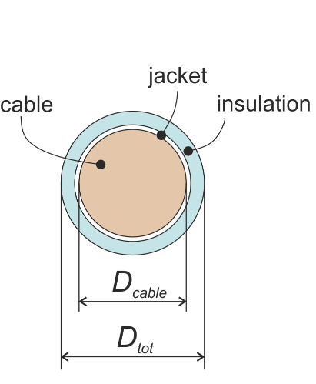
Bus Bar Design
3D electromagnetic FE simulations for magnetic field along bus bars
3 bus bar designs based on worst-case operational conditions
(ITER design is based on 1 main bus bar and 1 correction coil bus bar)
NbTi-Cu bus bars:
  maximum adiabatic hot spot temperature 250 K, temperature margin 2.5 K
  current discharge time 2τ
  2 mm stainless steel jacket + 6 mm 30 kV insulation
 | TF | CS | PF
I_{op} | 66.0 kA | 46.3 kA | 59.0 kA
B_{tot} (background + self) | 2.7 T | 4.5 T | 3.1 T
τ | 35 s | 15 s | 15 s
D_{tot} | 62.4 mm | 52.7 mm | 52.6 mm

Slide 5
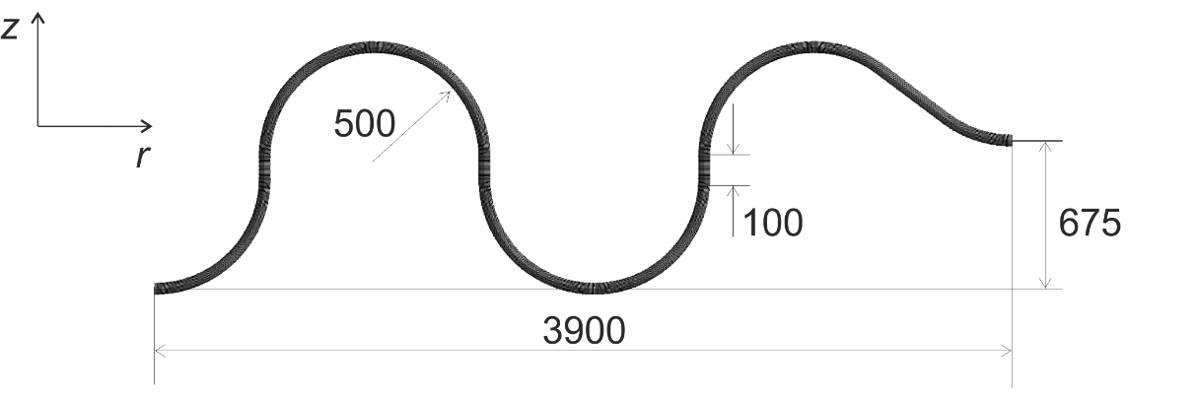
Bus Bar Mechanics
S-bend bus bar (from ITER) for reducing cool-down loads on HTS CLs
S-bend geometry suitable for the proposed 3 DEMO bus bars:
Overall mechanical loads on the HTS current leads:
  cool-down load 1.5÷3.1 kN (≈79 mm displacement)
  Lorentz forces due to background magnetic field 1.4÷5.5 kN/m
  Lorentz forces due to self magnetic field 1.2÷2.2 kN/m
  negligible bus bar weight (< 0.2 kN/m)
  total load on HTS current leads 2÷4 kN (< 5 kN as prescribed in ITER)
Verification of the jacket and insulation (according to ITER SDC)

Slide 6
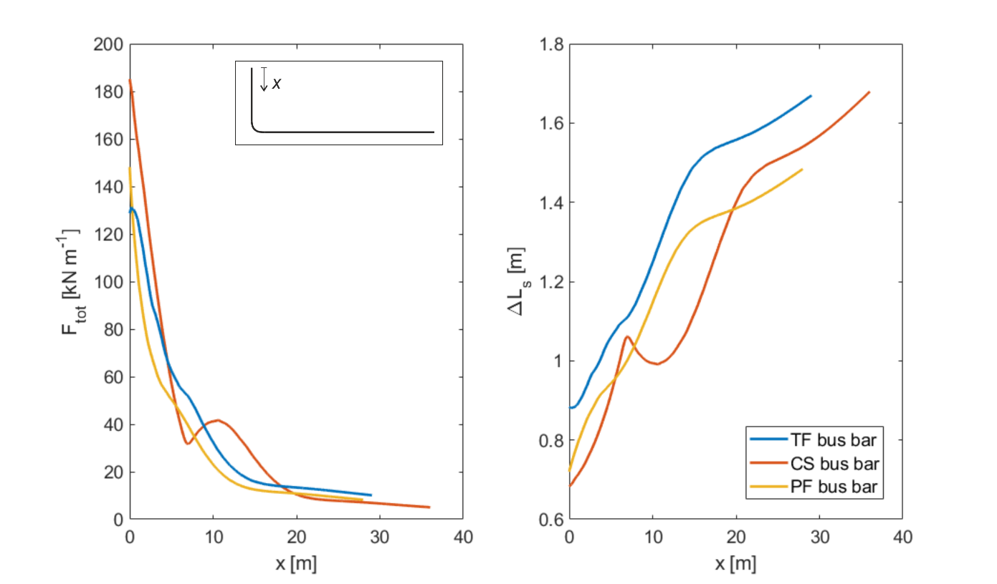
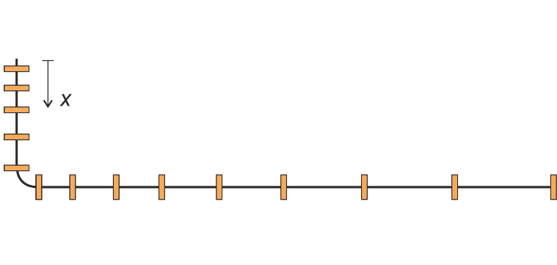
Bus Bar Support Structure
Total load on the bus bars is function of the distance x
PREMAG scenario represents the worst case (from 3D FE simulations)
Linearly increasing arrangement of the bus bar supports (as in ITER)
Proposed support inter-distance:
  (x = 0 m at the coil terminal joint in cryostat)
  TF bus bars from 0.8 to 1.6 m
  CS bus bars from 0.6 to 1.6 m
  PF bus bars from 0.6 to 1.4 m
  maximum lateral displacement < 5.0 mm
distribution of
the total load

Slide 7
Outline Design of HTS Current Leads
TF coils (8 or 16 sectors): 66 kA HTS current leads (16 or 32 CLs)
CS coils: 47 kA HTS current leads (12 CLs)
PF coils: 59 kA HTS current leads (6 CLs)
sketch of the proposed
66 kA TF current lead

Slide 8
Simulation of a Loss of Flow Accident
384 s after loss of flow
T_{max}(HEX) < 433 K √
T_{max}(HTSM) < 160 K √
J_{Cu}(HEX) needs to be limited to 16 A/mm²

Slide 9
Outline Design of HTS Current Leads
 | 66 kA CL (TF) | 47 kA CL (CS) | 59 kA CL (PF)
T_{cold} (K) / T_{warm} (K) / dQ/dt (W) | 5 / 65 / 14.14 | 5 / 65 / 7.23 | 5 / 65 / 8.74
T_{He,in} (K) / dm/dt (g/s) | 50 / 4.34 | 50 / 3.09 | 50 / 3.90
N_{stacks} / N_{RE-123} / N_{brass} | 30 / 210 / 210 | 28 / 140 / 140 | 30 / 180 / 180
RE-123 / brass tapes (w x t) (mm²) | 12 x 0.07 / 0.8 | 12 x 0.07 / 0.5 | 12 x 0.07 / 0.5
D_{i} / D_{o} steel support (mm) | 150 / 170 | 140 / 155 | 150.9 / 165.1
L_{eff} HTS module (mm) | 400 | 400 | 400
D_{i} / D_{o} steel tube HX (mm) | 190 / 200 | 160 / 170 | 180 / 190
A_{Cu} (mm²) / L_{eff} Cu wires (mm) | 4125 / 626 | 2938 / 628 | 3688 / 634
N_{wires} (D = 0.1 mm) / RRR Cu | 525210 / 90 | 374014 / 90 | 469506 / 90

Slide 10
Summary
A preliminary integration study of the feeders has been presented
The design of 3 bus bars has been performed
An S-bend bus bar geometry suitable for DEMO has been proposed
A structural verification of the bus bar (including maximum load on HTS current leads) has been performed
An outline of the bus bar support structure has been proposed
The outline designs of the HTS current leads have been prepared (also based on the simulation of a loss of flow accident)

Slide 11
Future Work (2020 Task)
Conceptual design of the bus bar cable
Conceptual study of alternative in-cryostat bus bar designs (e.g. HTS)
Preliminary design of HTS bus bars to the power supply (Al bus bars used in ITER)
Considerations on bus bar joints and terminations (including review of ITER solutions)

