Slide 1




Status of the 2019 tasks
Task 1a: Exploratory study on EU DEMO cryoplant & cryodistribution
Task 1b: Cryo-magnetic optimization with SIMCRYOGENICS
Task 2 : Contribution to the design philosophy manual
Proposals for 2020
MAG-2.5-T008 Cryogenics studies for EU DEMO
10th-13th February 2020
C. Hoa, V. Lamaison, F. Bonne, S. Varin, L. Zani, Q. Le Coz, M. Lewandowska

Slide 2
STATUS of 2019 TASKS
Tasks | Deliverable | Status | Task owner | 2020 proposals
1a- Engineering Studies on DEMO | D001 | Optimization study on capital and operation costs related to the refrigeration power, for one given architecture of cryoplant, and one given TF design. CAPEX/OPEX: CAPEX is the capital expenditures (turbine, heat exchanger, cryomachines capacities …) OPEX is the operating expenditures (electricity, cryogenic fluids: nitrogen,…) Replaced by: Summary of WPPMI task Phase 1 (parametric study and review of the technical requirements) – summary report under finalization | Christine Hoa | 2021-2027 proposal 2020: WPPMI final results (April 2021) with Baseline concept, general layout, cost estimations
1b- Refrigeration cooling optimization with SIMCRYOGENICS on 3 TF winding pack designs | D001 | Modelling work already performed (presented at the Intermediate meeting in Oct. 2019)- Report under finalization Contribution from M. Lewandowska | Christine Hoa | → 2020 publication
2- Preparation of design philosophy manual and the Gate review G1 | D002 | On going with outputs from D001 | Christine Hoa | 2020 further contribution for Gate review G1

Slide 3
STATUS of 2019 TASKS
Tasks | Deliverable | Status | Task owner | 2020 proposals
EXTRA 2019 3- Impact of the cryogenic studies on the TF conductors towards an optimal cryo-magnetic system | D003 | First encouraging results in 2019 with modelling tools under development (Multi-physic platform): SIMCRYOGENICS, THEA, CAST3M, MADMACS | Sandra Varin, François Bonne | 2020 final deliverable in July 2020 Communication in SOFT in Sept 2020 2021-2027 proposals optimization methodology to apply on the pre-selected magnet designs ( TF, CS, PF winding packs)

Slide 4
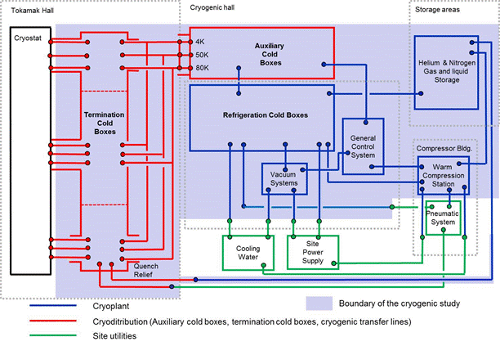
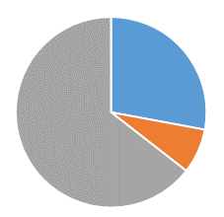
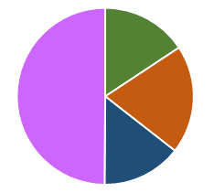
D001: Engineering study on EU DEMO
WPPMI Exploratory study with Industry ( Contract with Air Liquide signed in March 2019 → April 2020)
Phase 1: review of the cooling requirements (June –Sept 2019)
TF
4 %
4.4 K loads
28%
Structures
14%
CS
6 %
80 K loads
64 %
PF
4 %
50 K loads
8%
  Total equivalent load @4.5 K
  → 103 kW (32,6 MW electrical power)

Slide 5
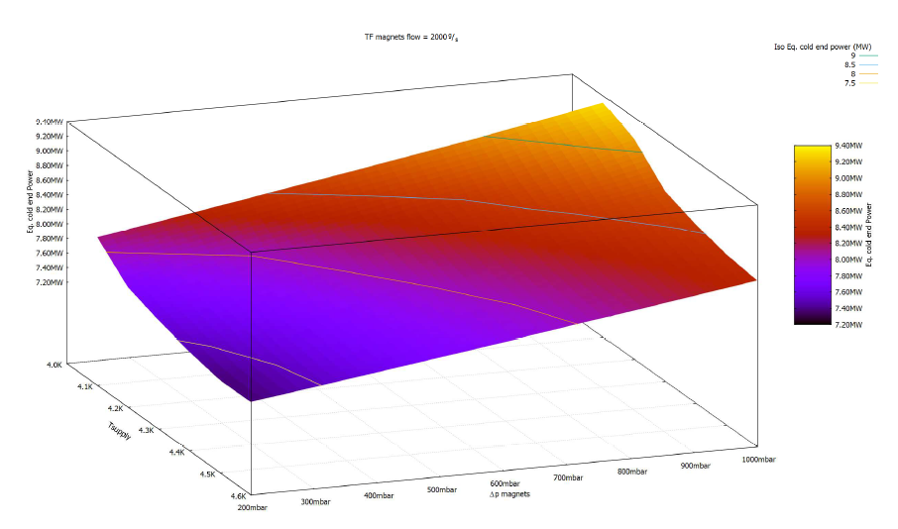
D001: Engineering study on EU DEMO
WPPMI Exploratory study with Industry ( Contract with Air Liquide signed in March 2019 → April 2020)
Phase 1: review of the cooling requirements (June –Sept 2019)
TF magnets 2000 g/s
Isoline estimated electrical power (MW)
Tin=4,1 K
DP= 0,2 bar
2000 g/s
7,3 MW (-13%)
Estimated electrical power (MW)
Estimated electrical power (MW)
Tin=4,5 K
DP= 1 bar
2000 g/s
8,2 MW
Tsupply(K)
DP magnet (mbar)
| PAGE 5

Slide 6
D001: Cryo-magnetic optimization with SIMCRYOGENICS
Pout=
1,3 bar
Pin=
10 bar
Optimization model → (Tin, ∆P)
for minimum Prefrigeration (W) at 300 K
DT=0,2 K
Prefrigeration at 300 K
Cold compressor
1D CICC model
Saturated helium bath
Tcicc < Tcs-1,5K
Pbath / Tin
∆P / ṁ
Cold circulator
BUNDLE
CICC MASS
CENTRAL CHANNEL
Immersed heat exchangers
Nuclear load Q(x)/ joints

Slide 7
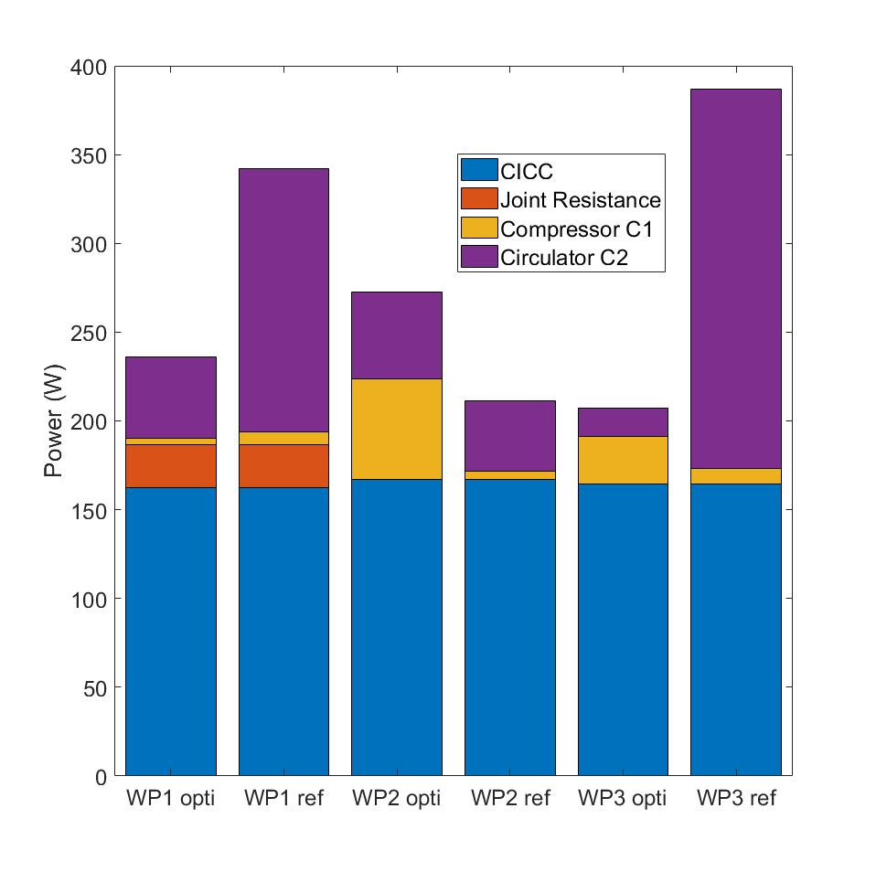
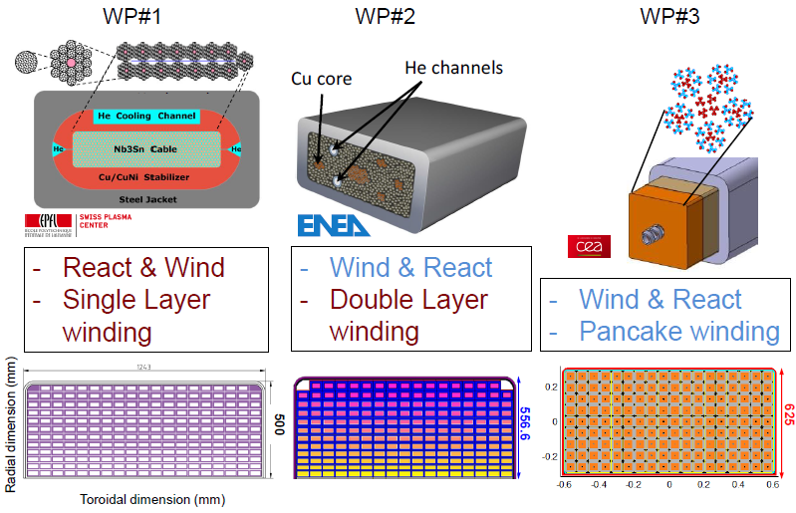
D001: Cryo-magnetic optimization with SIMCRYOGENICS
Summary comparison results on 3 TF designs (2015)
Heat load repartition Pideal refrigeration at 300 K
Constraint : Tcicc (x) < Tcs (x)-1,5K
Reference: Tin=4.5 K, DP=1bar
Optimization results
  WP#1 → (4.58 K, 0.48 bar)
  WP#2 → (4.05K, 0.89 bar)
  WP#3 → (4.26K, 0.20 bar)

Slide 8
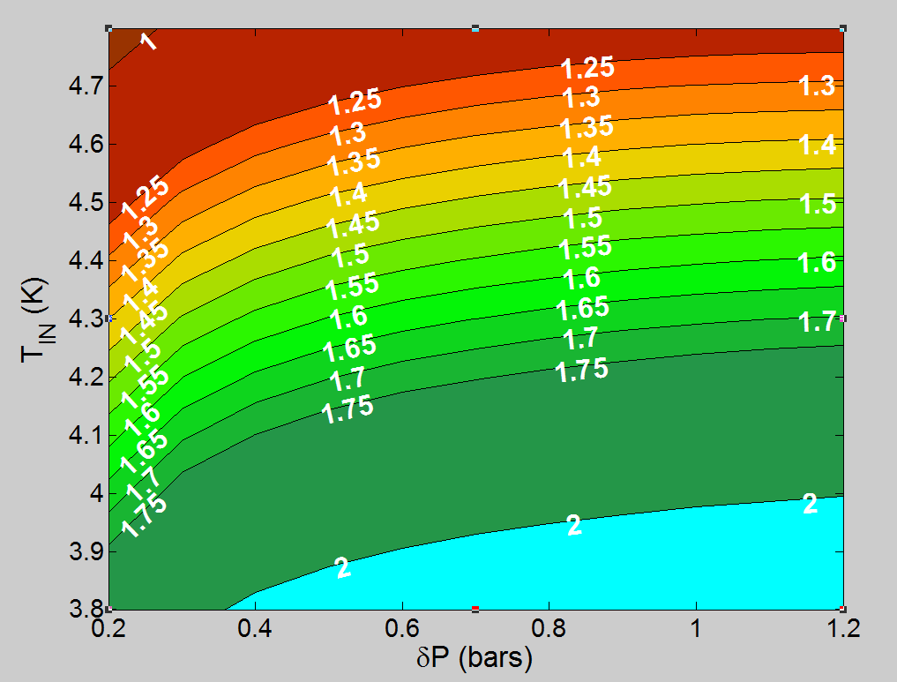
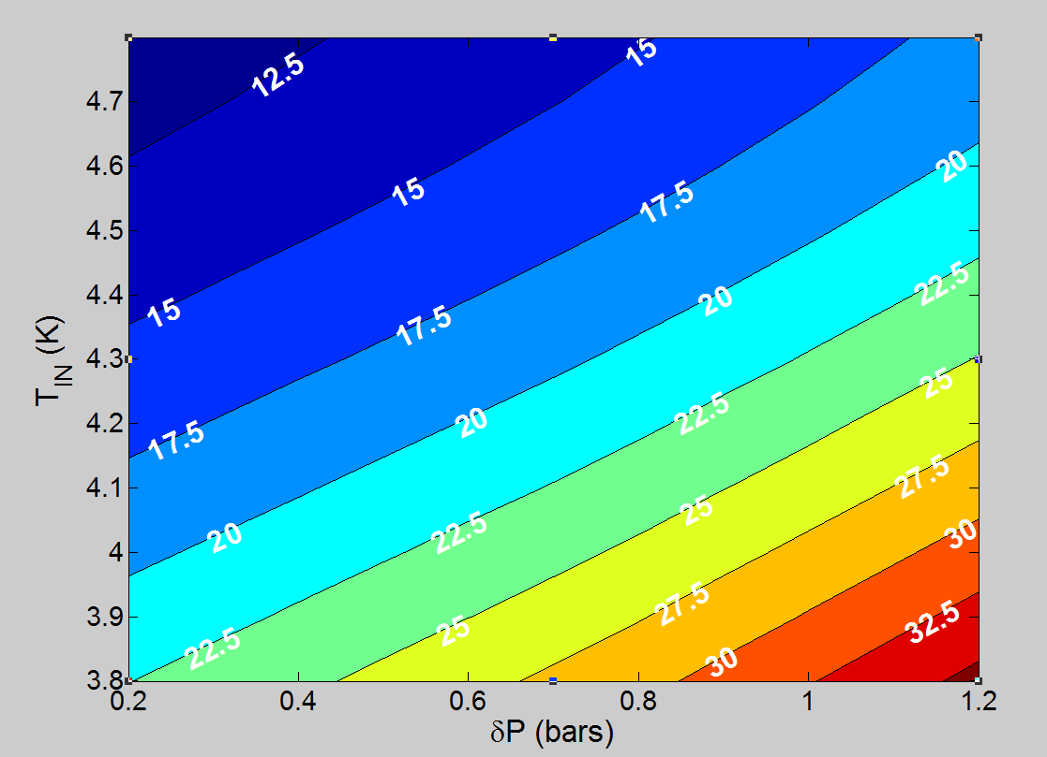
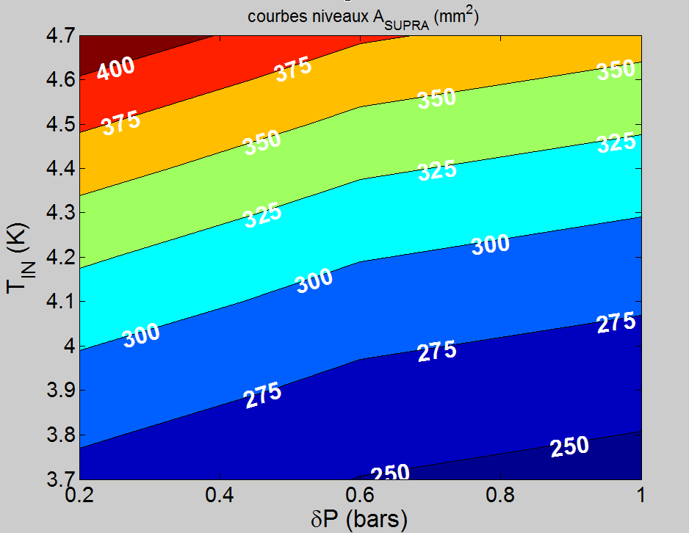
D002: Contributions to the design philosophy manual
ΔT_{ma} min [K]
Φ_{cryoplant} [W]
  WPMAG and WPPMI tasks (D001)
4 K loads:
  Potential reduction of about 20% on the electrical power consumption
    with reduction of mass flows/pressure drop
    [0,2-1 bar]
    with decrease of the inlet temperature to comply with the temperature margin
    [4,1-4,7 K]
    with increase of the inlet pressure
    → 5 to 10 bar
Figures (THEA +SIMCRYOGENICS) for optimization of P refrigeration for one given TF design
A_{SUPRA}[mm²]
  Optimization on the superconducting cable mass
50 K loads
  With reduction of pressure drop (< 1bar)
  Pin (5 to 3 bar)
80 K loads
  Baking requirements 473 K vs 373 K
Preliminary results
Figure (MADMACS +THEA) for optimisation of TF designs

Slide 9
Proposals for 2020
EXTRA TASK: 3- Impact of the cryogenic studies on the TF conductors towards an optimal cryo-magnetic system
  2019: First encouraging results with Cryogenics & Thermal hydraulics (SIMCRYOGENICS,THEA) on given TF design WP#3
  2020: Methodology assessment with optimization tools (SIMCRYOGENICS, THEA, MADMACS) for the minimization of both the magnet and cryogenic costs
  Applications on several TF designs (WP#3 and WP#4)
  Participations: CEA MAG 2.1 (TF design), 2.2 (Thermal hydraulics) and 2.5 (Cryogenics), 3.1 (Mechanics)
  TOTAL : (9+9) PM to be confirmed, deliverable MAG 2.5-T008 -D003 → shift to July 2020
Gate review documentation
  WPMAG outputs from TASK 1
  WPPMI summary results (phases 2 & 3, general layout and cost estimations)
  Review of RAMI analysis on Cryogenic system
  Total: 4.8 PM
NB: this proposal should be adjusted according to the volume of work (when identified)
which is needed for addressing Gate Review documentation

Slide 10
Thank you for your attention

