Slide 1
Studies on TF circuit and transient voltages in case of coil fast discharge and transient conditions
Mattia Dan and Alberto Maistrello
for Consorzio RFX team
12/02/2020 WPMAG final meeting 2020

Slide 2
New developments on of the TF FDU analysis
The 2018 DEMO baseline with 16 toroidal coils assumed as reference
The analyses performed on the TF FDU in the 2018 were based on a discharge time constant of 23s. As a results 16 TF coils sectors were necessary to comply with the voltage limits;
New analyses performed in 2019 with the 35s* assumed as discharge time constant for evaluating the possibility of moving from the 16 sectors to the 8 sectors option;
The effect of temperature dependent resistors has been considered;
The fault condition determining the worst situation has been analyzed;
The effect of the stray impedances of the connections on the voltage peaks generating on the TF coils at the FDU intervention has been studied.
*PDD - Plant Description Document (2KVWQZ v1.5)

Slide 3
Input data for the analysis
Input data set for the analyses
*Considering 1.1 s of the delay in the intervention of the protection
The present constraints on the voltage for the design of the systems are:
Nominal and maximum coil terminal to terminal voltage at current dump (FDU intervention, no fault) is below 10 kV;
Nominal and maximum coil terminal to ground voltage at current dump (FDU intervention, no fault) is below 5 kV;
The voltage to ground applicable for acceptance test by the coil manufacturer (the maximum of twice the normal operation ground voltage plus 1kV or fault ground voltage plus 1kV) will not exceed 29 kV
 | Data set 1 | Data set 2
Discharge time constant | 35 s | 35 s
Nominal TF coils current | 90 kA | 74.61 kA
Inductance value of one TF coil | 2.25 H | 3.61 H
Maximum ∫i²(t) dt during fast discharge | 150 GA²s* | 103.7 GA²s*
1
1
2
3
2
3
2
3
4
1-PDD - Plant Description Document (2KVWQZ v1.5)
2-PROCESS 2017 (EU_2ML9ZC_v1_0)
3-PROCESS 2018 (EFDA_D_2MKZUL v1.0)
4-Common operating values for DEMO magnets design (EFDA_D_2MMDTG)

Slide 4
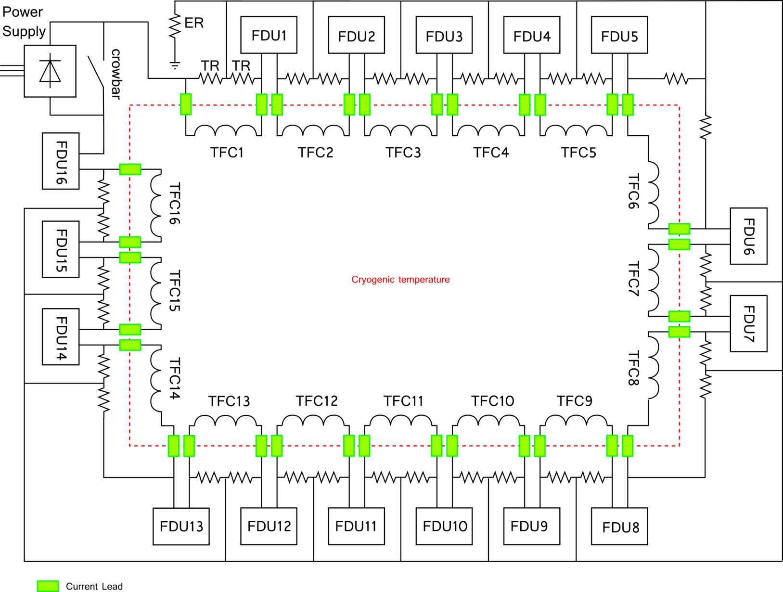
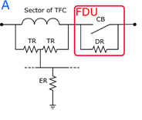
TF circuit configuration presently assumed: ITER-like

Slide 5
Data set 1 – FDU nominal operation constant DR
$$V_{tt}=\frac{DR∙I_{op}}{N_{coil}}=\frac{{ L}_{coil}}{τ} {∙ I}_{op}$$
Terminal to terminal
Coil voltage
$$V_{coil sector}=DR∙I_{op}∙e^{− \frac{DR}{L_{coil}∙N_{coil}}t}$$
$$V_{tg}=\frac{DR∙I_{op}}{2}=\frac{{ L}_{coil}}{2τ} {∙ I}_{op}$$
Terminal to ground
Coil voltage
$I_{op}$: operative current
$DR$: discharge resistor
${ L}_{coil}$: inductance of 1 TF coil
$N_{coil}$= number of TF coils for each sector
 | 16 sectors | 8 sectors
Discharge Resistor value | 64.3 mΩ | 128.6 mΩ
Terminal to terminal maximum voltage (of one coil) | 5.8 kV | 5.8 kV
Terminal to ground maximum voltage | 2.9 kV | 5.8 kV
The use of temperature dependent resistors reduces the initial voltage peak thanks to a lower initial resistance value, keeping the I²t value as constraint.
The resistor modules used in ITER have been considered for a first design of the resistor.

Slide 6
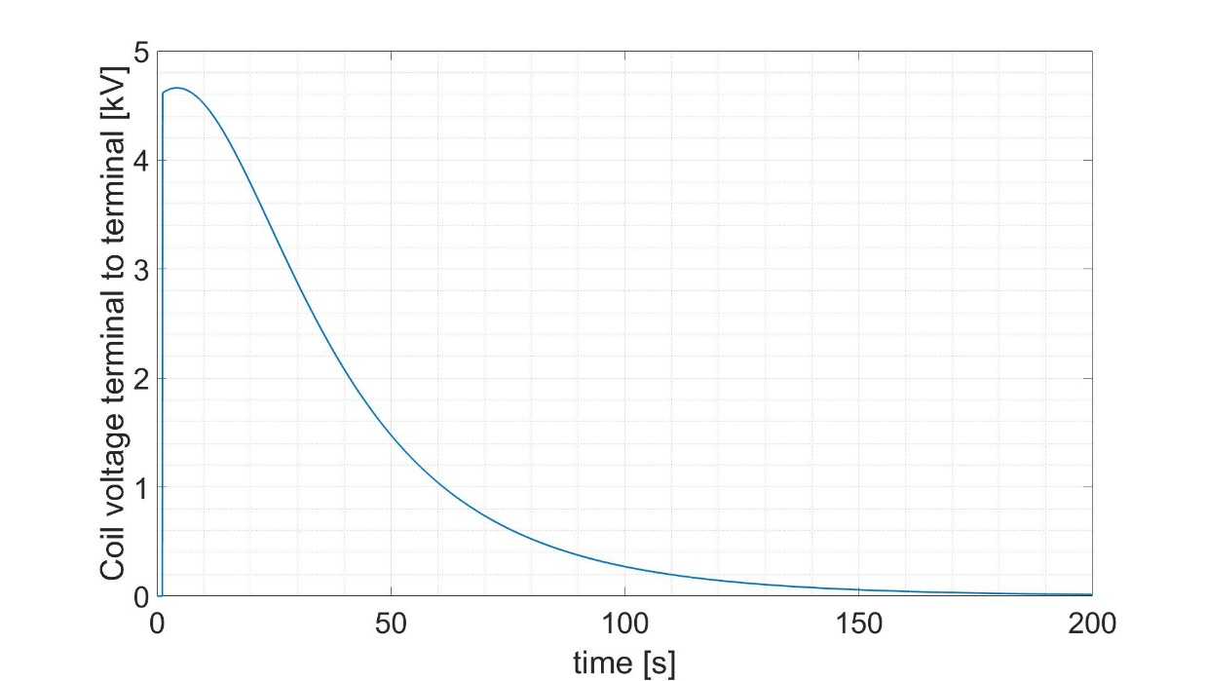
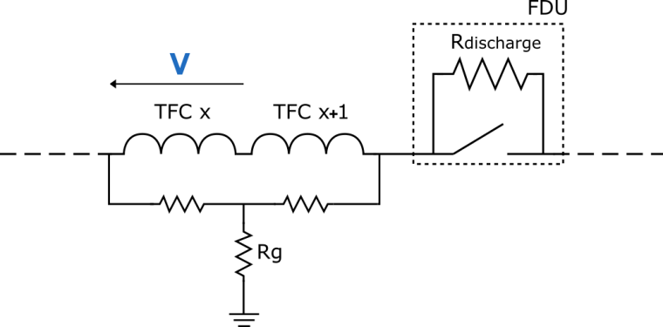
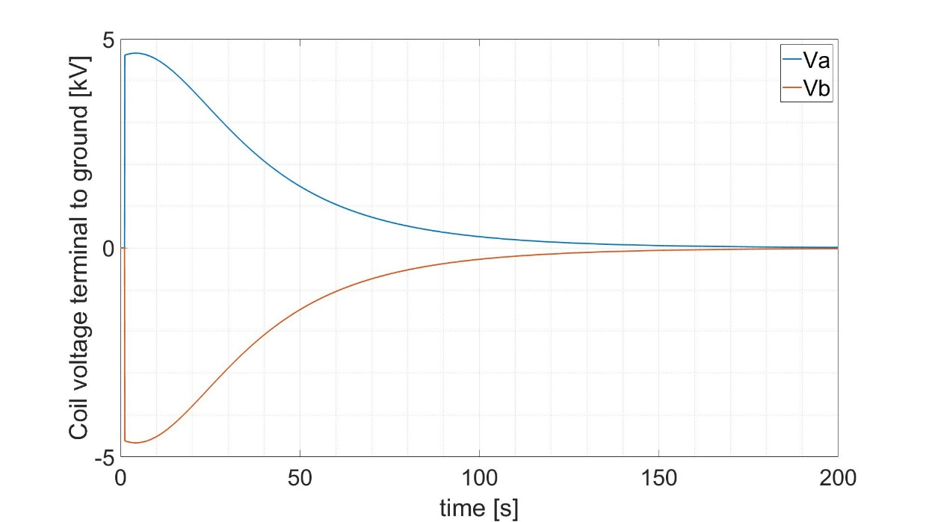
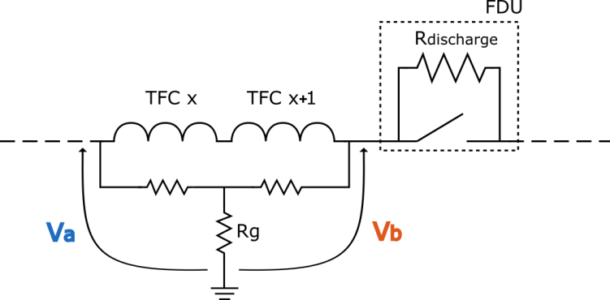
Data set 1 – FDU nominal operation temperature dependent DR
Maximum voltage 4.7 kV < 10 kV, limit value
8 sectors option is acceptable
LIMIT
Maximum voltage 4.7 kV < 5 kV, limit value
LIMIT

Slide 7
ITER-like TF circuit configuration with 8 sectors

Slide 8
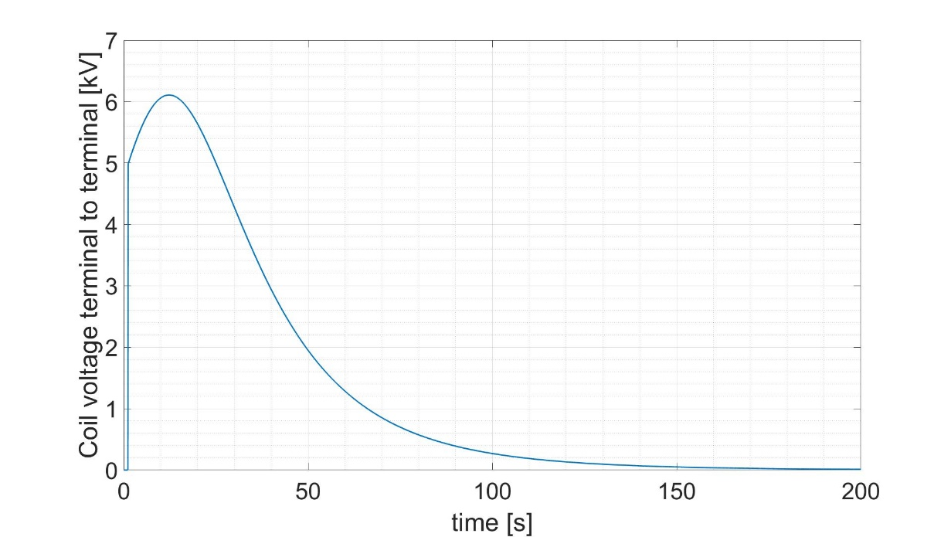
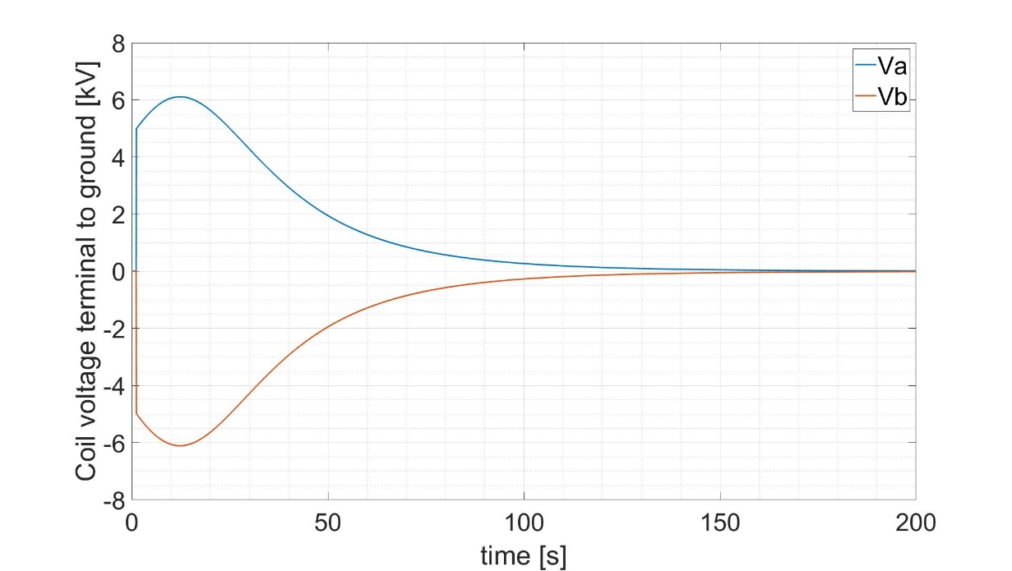
Data set 2 – FDU nominal operation temperature dependent DR
Maximum voltage 6.1 kV < 10 kV, limit value
8 sectors option does not comply
with the insulation limits
LIMIT
Maximum voltage 6.1 kV >5 kV, limit exceeded
LIMIT

Slide 9
Factors in support to the feasibility of 8 TF sectors option
Considering the energy dissipation in the passive structures of the TOKAMAK, the DR value could be further reduced with a consequent reduction of the voltage peaks;
Since the 8 sectors option is close the acceptability limit, it seems more interesting to perform the analyses of the overvoltages due the effect of the stray impedances of the connections and in fault condition with the 8 sectors option of DEMO 2018 reference scenario (data set 2).

Slide 10
Operational conditions of the FDU
For DEMO 2016 and 2017 baseline scenarios an analysis on the operational conditions of the FDU was performed* and the conditions considered were:
FDU intervention
FDU intervention + ground fault at one FDU terminals
FDU intervention + 1 FDU does not operate
FDU intervention + 1 FDU opens with a delay of 10 ms
FDU intervention + 1 FDU does not operate + ground fault near faulted FDU
FDU intervention + 1 FDU does not operate + ground fault opposite to faulted FDU
FDU intervention + 1 FDU does not operate +ground fault next to the not operating FDU
Untimed intervention of 1 FDU
The analyses pointed out that for the ITER-like topology the worst (double) fault condition is the number 7, both for the voltage peaks applied to the coils and for the I²t increment.
Then the analysis on the fault event for the FDU is focused in this condition.
* MAG-2.4-T005-D001

Slide 11
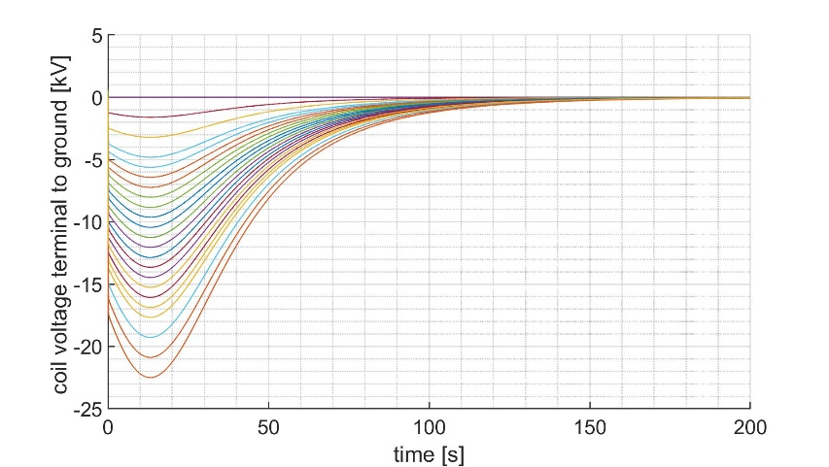
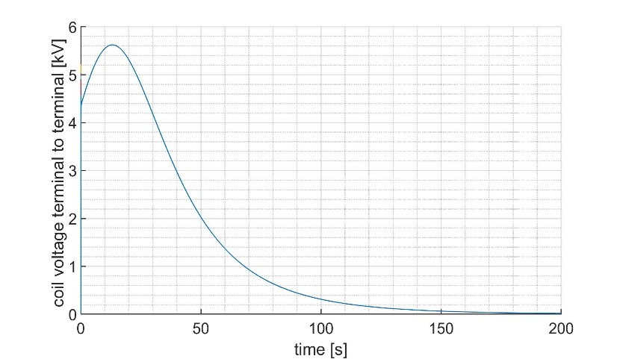
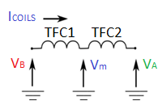
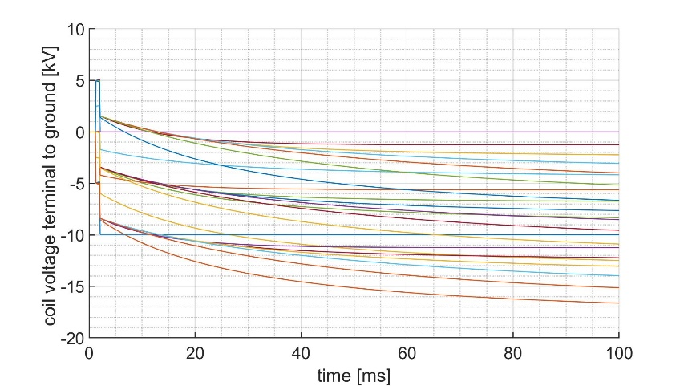
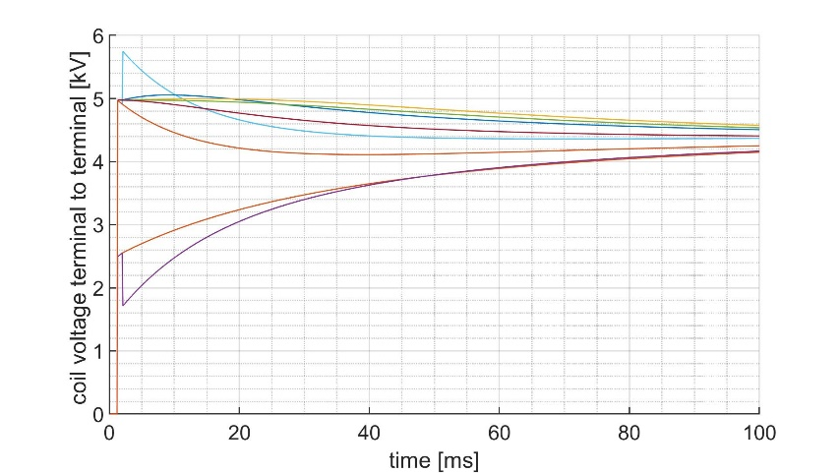
Voltage peaks and I²t on the coils with the worst fault condition
V_{A}, V_{B} and V_{m}
V_{Am} and V_{mB}
The maximum fault voltage is 22.5 kV, well lower than the limit of 28 kV for the fault condition.
The I²t is 109.1 GA²s, while the value determined by the coil discharge with τ=35 s with a constant value of DR is 103.7 GA²s.

Slide 12
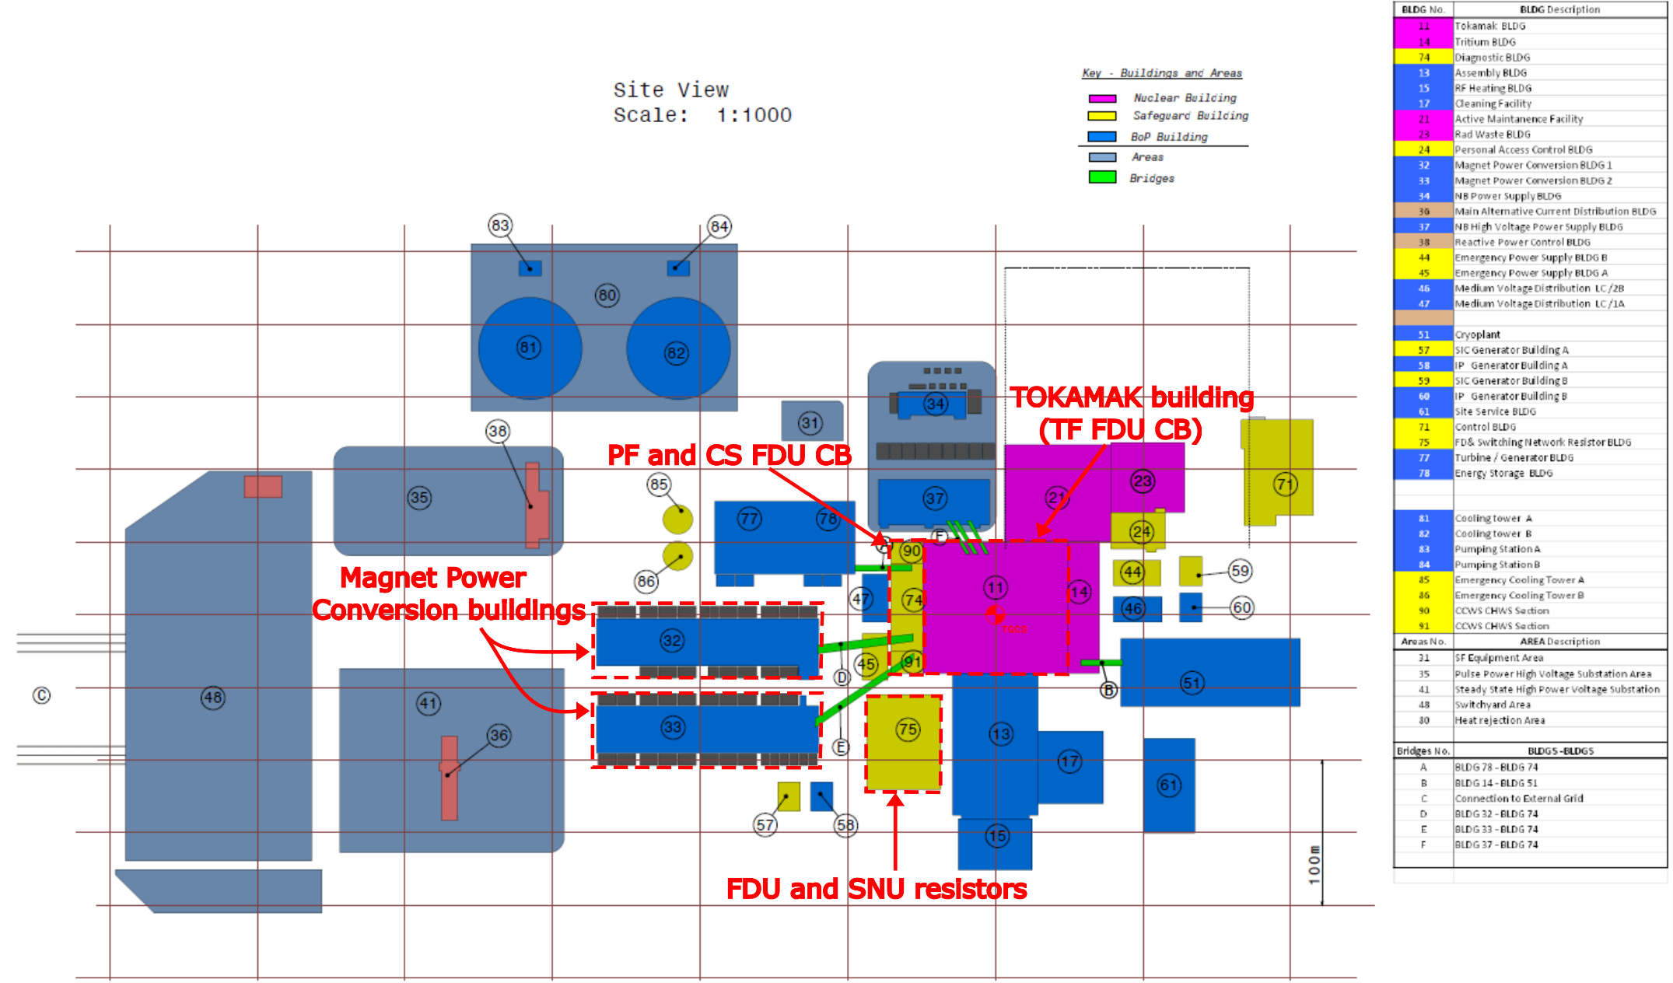
DEMO layout – connection between the TF FDU components
Long cable connection
between TF CB and DR
up to 250m

Slide 13
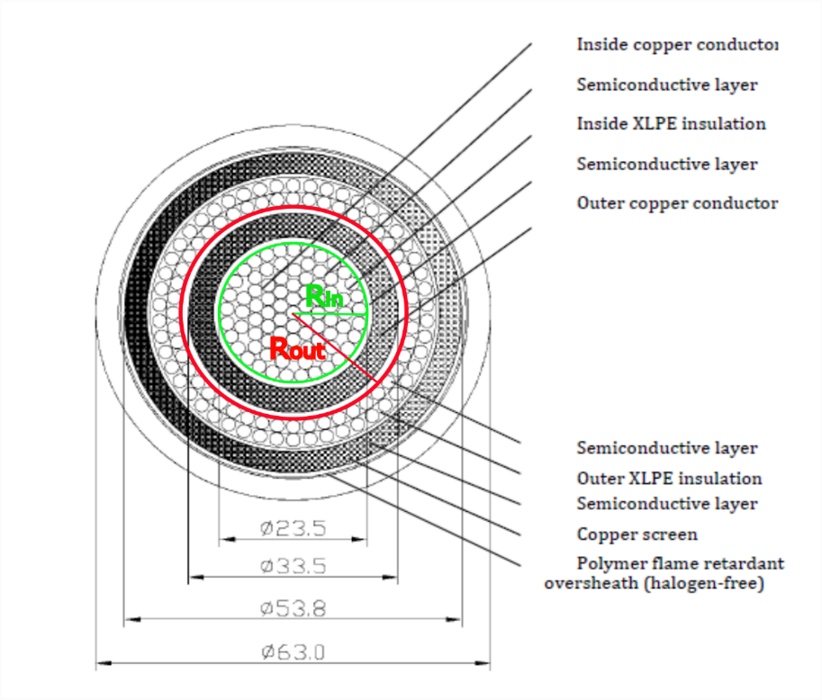
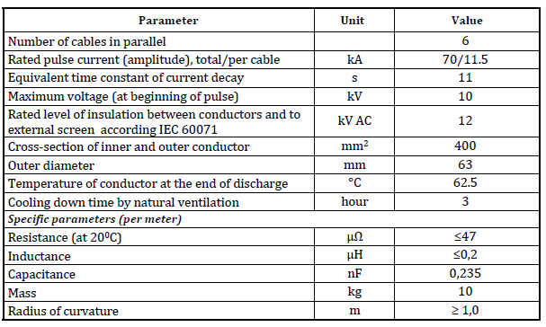
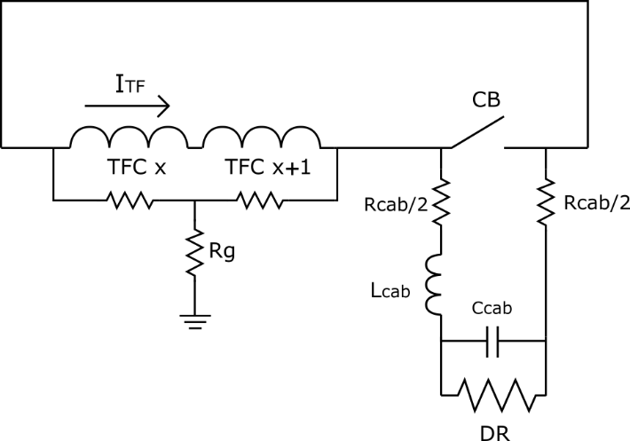
Impedance of the cable connection between CB and DR
The coaxial cable used in ITER for the connections has been considered for this analysis:
7 cables of 250m length (maximum estimated distance) in parallel have been considered:
Parameters | Values
Inductance of the cable | 7.14 µH
Capacitance of the cable | 411.3 ηF
Resistance of the cable (splitted between inner and outer conductors) | 1.68 mΩ

Slide 14
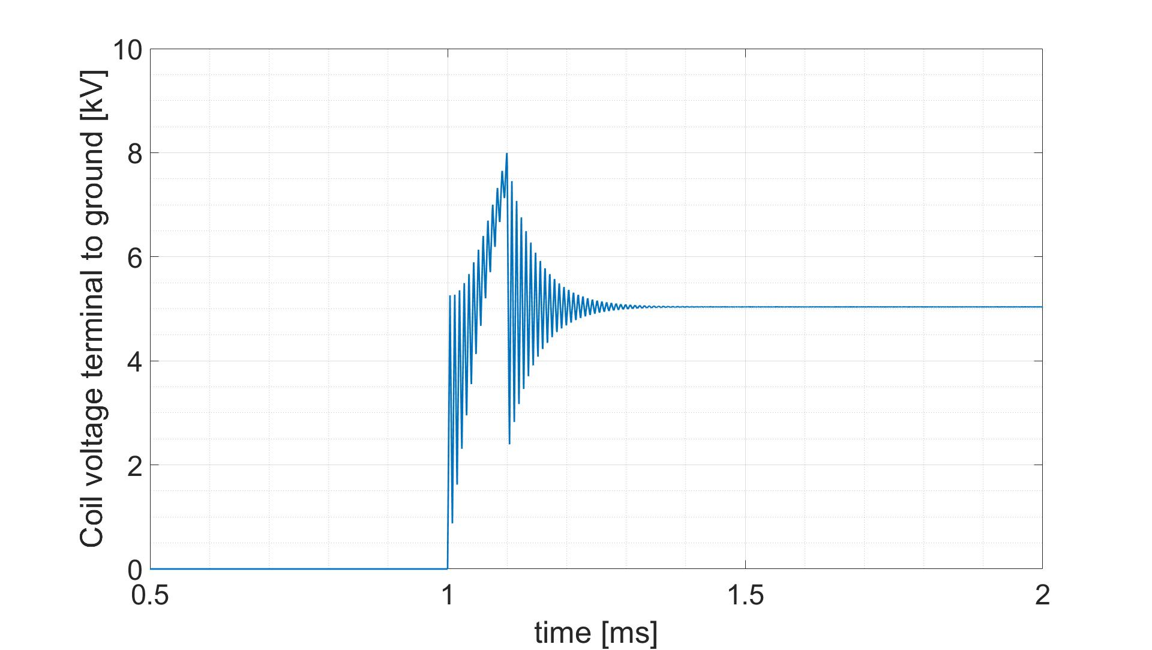
Effect of the cables on the terminal to ground voltage
A high frequency oscillation is generated at the beginning of the transient of the LR discharge, when the CB is opening (less than 1ms).
CB simulated as a linear decay of the current with constant derivative: the oscillation amplitude depends on the derivative; the turn-off time of 100μs is considered, for simulating the pyrobreaker intervention*
LIMIT
*The 70 kA pyrobreaker for ITER magnet back-up protection,
M. Manzuk et al., Fusion Engineering and design, 2013

Slide 15
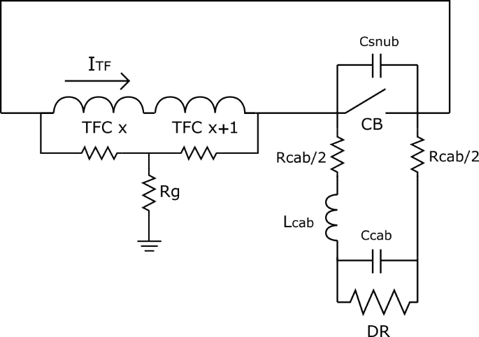
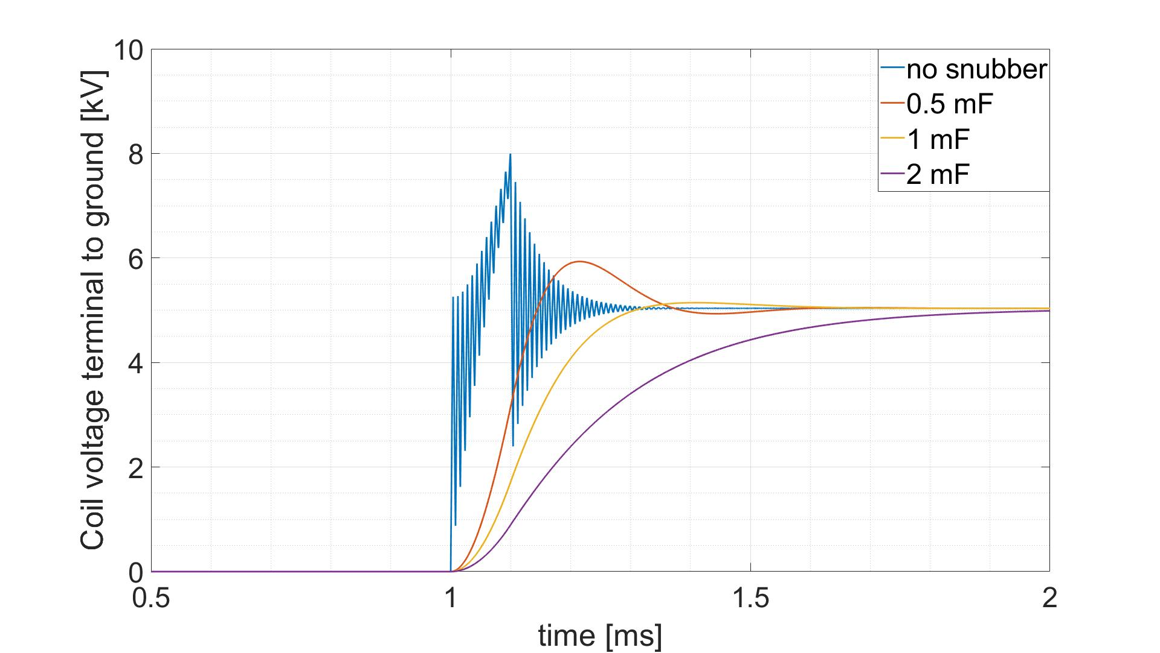
Effect of a voltage clamping circuit in parallel to the CB
The adoption of a voltage clamping circuit can dump the oscillations without affecting the evolution of the transient
LIMIT

Slide 16
Conclusions
The analyses have demonstrated that the peak voltage value at the coil discharge is strongly dependent on the values of the discharge time constant, coil current and inductance.
With the data set 1: 35 s, 90 kA, 2.25 H and the adoption of temperature dependent resistors, the limits both of coil terminal to terminal and terminal to ground voltages are respected.
With the data set 2 : 35 s, 75 kA, 3.6 H (DEMO 2018 reference scenario) the limit of the coil terminal to ground voltages is not exceeded too much.
The fault analysis of the FDU topology with 8 sectors in the worst condition considered indicates that the overvoltages values remain within the limits.
The analysis on the effect of the stray impedance of cables connecting the CBs to the DRs points out a high frequency oscillation occurring during the opening of the CB, dangerous for the coil insulation; it can be damped by a properly designed clamping circuit.

Slide 17
Future work in 2020– Collection of interface data
TF coils options
 | WP1 (EPFL) [1] | WP2 (ENEA) [2] | WP3 (CEA) [3] | HTC (KIT) [4]
 |  |  |  | opt 1 | opt2 | opt3 | opt4
Iop [kA] | 63.3 | 90 | 88.1 | 68.0 | 63.4 | 55.8 | 46.4
number of coils | 16 | 16 | 16 | 16 | 16 | 16 | 16
TF energy [GJ] | 160.70 | 160.70 | 160.70 | 160.70 | 160.70 | 160.70 | 160.70
discharge time constant [s] | 35 | 35 | 35 | 30 | 30 | 30 | 30
inductance [H] |  |  |  | 2.97 | 3.41 | 4.41 | 6.39
[1] Report on TF Winding Pack Design and Analysis MAG-2.1-T004-D002
[2] Report on TF peak field evaluation MAG-2.1-T017-D001
[3] CEA TF and CS winding pack optimization MAG-2.1-T006-D001
[4] Overall compilation of previous deliverables of MAG-2.1-T007-2016

Slide 18
Future work in 2020 – Collection of interface data
PF coils options
EPFL-baseline 2018/2019
 | PF1 | PF2 | PF3 | PF4 | PF5 | PF6
I total max [MA] | 16.53 | 5.89 | 8.47 | 12.03 | 9.91 | 24.03
nturns per layer | 14.00 | 10 | 12 | 12 | 12 | 18
nlayers | 20.00 | 10 | 12 | 17 | 15 | 23
n turns | 280 | 100 | 144 | 204 | 180 | 414
Icoil [kA] | 59.04 | 58.90 | 58.82 | 58.97 | 55.06 | 58.04
Inductance [H] | 1.37 | 0.71 | 1.94 | 3.71 | 2.13 | 4
discharge time constant [s] | 15 | 15 | 15 | 15 | 15 | 15
values from the meeting of 02/10/2019
ENEA
 | PF1 | PF2 | PF3 | PF4 | PF5 | PF6
I total max [MA]
nturns per layer
nlayers
n turns | 370 | 202 | 309 | 309 | 403 | 549
Icoil [kA] | 45 | 45 | 45 | 45 | 45 | 45
Inductance [H] | 2.6 | 2.63 | 6.22 | 6.22 | 17.3 | 22.9
discharge time constant [s]
Preliminary DEMO CS and PF circuits current and voltage ratings based on a first set of control requirements - Draft v1.1 (IDM 2NEVTT)
Annex A to PMI-5.2.1-T030-D001 Final Report

Slide 19
Future work in 2020 – Collection of interface data
CS coils options
EPFL-SPC
 | CS3U | CS2U | CS1 | CS2L | CS3L
I total max [MA] | 36.117 | 36.117 | 72.235 | 36.117 | 34.893
nturns per layer | 39 | 39 | 78 | 39 | 39
nlayers | 20 | 20 | 20 | 20 | 20
Icoil [kA] | 46.304 | 46.304 | 46.305 | 46.304 | 44.735
Inductance [H] | 2.19 | 2.19 | 5.98 | 2.19 | 2.19
discharge time constant [s] | 7.5 | 7.5 | 15 | 7.5 | 7.5
Values from the meeting of 02/10/2019
ENEA
 | CS3U | CS2U | CS1U | CS1L | CS2L
I max [MA]
nturns per layer
nlayers
Icoil [kA] | 45 | 45 | 45 | 45 | 45
Inductance [H] | 2.07 | 2.07 | 5.57 | 5.57 | 2.07
discharge time constant [s]
Preliminary DEMO CS and PF circuits current and voltage ratings based on a first set of control requirements - Draft v1.1 (IDM 2NEVTT)
Annex A to PMI-5.2.1-T030-D001 Final Report

Slide 20
Future work in 2020 – voltage limits on the coils
1
The present constraints on the voltage for the design of the systems are :
TF coils:
Nominal and maximum coil terminal to terminal voltage at current dump (FDU intervention, no fault) is below 10 kV;
Nominal and maximum coil terminal to ground voltage at current dump (FDU intervention, no fault) is below 5 kV;
PF and CS coils:
Nominal and maximum coil terminal to terminal voltage at current dump (FDU intervention, no fault) is below 10 kV;
Nominal and maximum coil terminal to ground voltage at current dump (FDU intervention, no fault) is below 5 kV;
In fault conditions for both TF,PF and CS coils:
The maximum voltage to ground is 28 kV;
1- Common operating values for DEMO magnets design (EFDA_D_2MMDTG)

Slide 21
Thank you for the attention

Slide 22
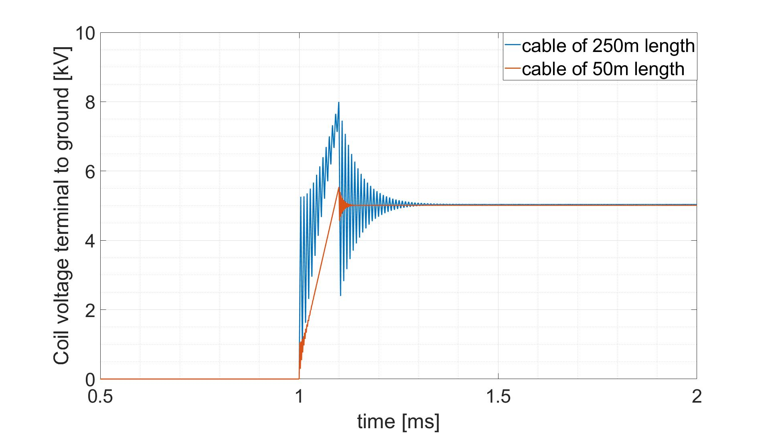
Dependence of the voltage peak on the lenght of the cables
Reducing the lenght of the cable, the voltage peak is reduced and the oscillation time is shorter, but still the voltage limits are overcome also with 50m cables.
LIMIT

Slide 23
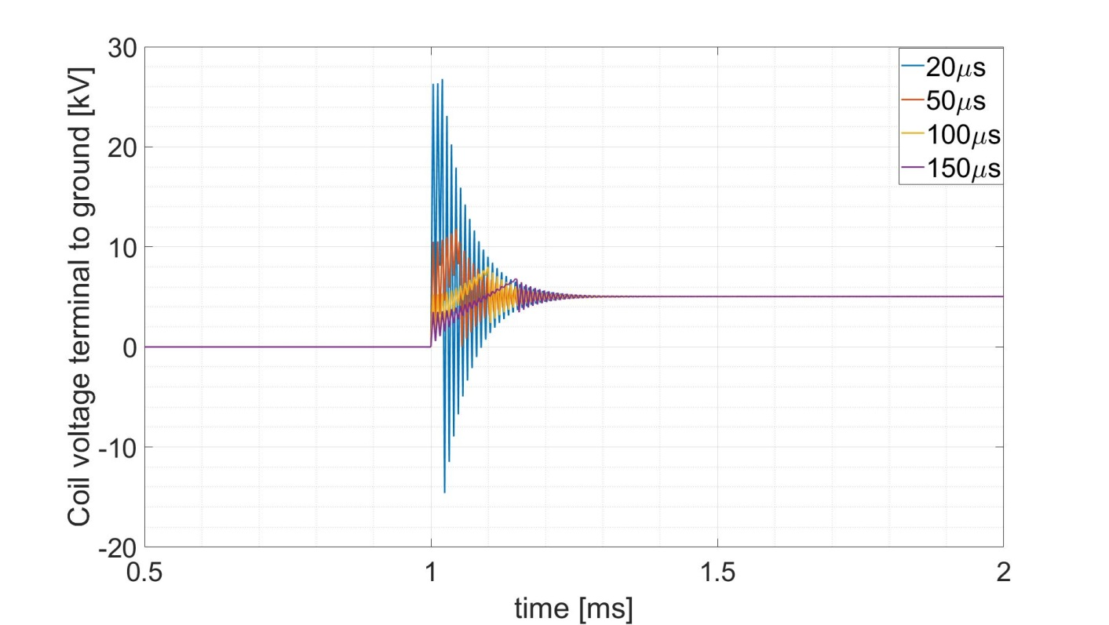
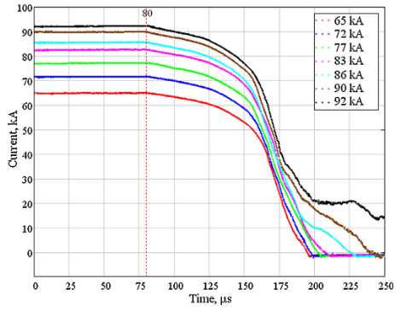
Analyses with different turn-off times
The turn-off time of the PB is about 100μs for 75 kA, but during the intervention there is a high current derivative in the final part*
Different turn-off time with constant current derivative are simulated:
20μs, precautionary condition, higher than PB current derviative
50μs, condition simulating the maxium derivative of PB
100μs, considering the PB turn-off time
150μs, lower current derivative
Higher oscillations
Tests on ITER PB
LIMIT
*The 70 kA pyrobreaker for ITER magnet back-up protection,
M. Manzuk et al., Fusion Engineering and design, 2013

