Slide 1

Assessment of thermo-hydraulic properties of Winding Packs for DEMO
Monika Lewandowska, Aleksandra Dembkowska Leszek Malinowski, Pawel Herbin
West Pomeranian University of Technology, Szczecin
Poland
WPMAG Final Meeting, Frascati, 12 February 2020

Slide 2
Outline
2019 Task description
Summary of the modeling activities
  Completion of the quech analysis of the DEMO CS1 coil (SPC design)
  Comparative parametric thermal-hydraulic study of different design of DEMO TF coils using simplified models (WP#1-3 based on 2015 reference) aimed at the assessment of temperature margin at various values of T_{in} and Δp.
  Preliminary thermal-hydraulic analysis of the DEMO CS1 coil (CEA design) at normal operating conditions
Summary of the experimental activities
  Completion of the analysis of the results of measurements of the heat transfer coefficient between the fluid flowing in a CICC bundle region and a jacket wall performed in 2018
  Hydraulic test of the WD8 and WD6 dummy conductors similar to HTS conductors and of the spiral sample.
2020 Task proposal

Slide 3
2019 task description
The task is focused on the thermal-hydraulic analysis of the DEMO coils, in continuation of the effort of 2018.
Thermal-hydraulic analyses using simplified models or the THEA code of the available designs of the DEMO coils in burn or in quench conditions will be performed. In particular we foresee:
  Completion of the 2018 quench analysis of the CS1 module (SPC design)
  Contribution to thermal-hydraulic analysis of the new CEA design of the DEMO CS or PF conductors
  Comparative parametric thermal-hydraulic study of different design of DEMO TF coils using simplified models (WP#1-3 based on 2015 reference) aimed at the assessment of temperature margin at various values of T_{in} and Δp
Experimental verification of the heat transfer and friction factor correlations used in thermal-hydraulic simulations. In particular we foresee:
  Completion of the analysis of the results of measurements of the heat transfer coefficient between the fluid flowing in a CICC bundle region and a jacket wall performed in 2018
  Performing hydraulic tests of available short samples (e.g. dummy conductors similar to HTS conductors designed for DEMO or WD, or a spiral sample) using water and analysis of the results

Slide 4
  Summary of the modeling activities
Completion of the 2018 quench analysis of the DEMO CS1 module (SPC design)

Slide 5
Maximum hot spot temperatures obtained in 2018
Case A with both AC losses during the fast discharge and IT heat transfer taken into account
Case B with AC losses and no IT
Case C with no AC losses and no IT
(W/m)
t_{dump} (s)
T_{jacket max} (K)
T_{strands max} (K)
L2 Case A | L2 Case B | L2 Case C | L6 Case A | L6 Case B | L6 Case C | L16 Case A | L16 Case B | L16 Case C
27.4 | 27.4 | - | 13.2 | 13.2 | - | 1.5 | 1.5 | -
6.21 | 6.28 | 6.28 | 2.67 | 2.68 | 2.68 | 6.20 | 6.28 | 6.28
62.7 | 67.2 | 70.8 | 75.6 | 79.5 | 77.0 | 61.2 | 67.8 | 66.1
105.5 | 102.1 | 113.4 | 177.4 | 175.1 | 167.6 | 99.7 | 103.0 | 99.1
Different layers exhibit quite different behaviour – taking into account IT heat transfer or AC losses during the current dump may lead either to decreasing or increasing of the maximum hot spot temperature.

Slide 6
Outcomes: thermal-hydraulic phenomena affecting the value of the hot spot temperature
After studying evolution of the temperature, pressure and mass flow rate profiles during quench we identified several thermal-hydraulic phenomena affecting the value of the hot spot temperature:
IT heat transfer results in a small reduction of ΔT_{marg} in turns adjacent to the location of heat disturbance => increased speed of quench propagation => slightly shorter quench detection time => small reduction of T_{hot spot}
IT heat transfer allows transverse heat removal from the disturbance region to adjacent turns => lowering T_{hot spot} , particularly in the jacket
IT heat transfer results in formation of side maxima of temperature in turns adjacent to the heat disturbance => pressure rise in these turns, which may lead in some layers (e.g. L6) to formation of two pressure maxima on both sides of the central hot spot, which slow down expulsion of heated helium and impede longitudinal heat removal from the disturbance region => increase of T_{hot spot}
AC losses during the current dump => small temperature rise along the whole conductor. In a normal zone temperature rise due to AC losses may slightly increase copper resistivity and thus enhance Joule heat generation => increase of T_{hot spot .} However, in layers with large AC losses, the observed trend is just the opposite. This is due to significant pressure rise in conductor with the maximum in the hot-spot region => acceleration of helium outflow from the hot-spot region in both directions => strongly enhanced heat removal => reduction of T_{hot spot}

Slide 7
  Summary of the modeling activities
Comparative parametric thermal-hydraulic study of different design of DEMO TF coils using simplified models (WP#1-3 based on 2015 reference) aimed at the assessment of temperature margin at various values of T_{in} and Δp.

Slide 8
Goal of the study
Preliminary parametric comparative study of WP#1-WP#3 TF designs was performed, using the simplified model, aimed at finding the values of helium T_{in} and Δp which could allow for minimization of the refrigerator power necessary to cool the EU-DEMO TF coils

Slide 9
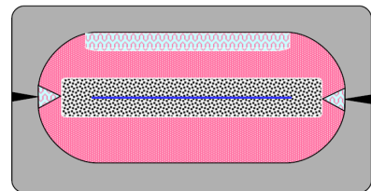
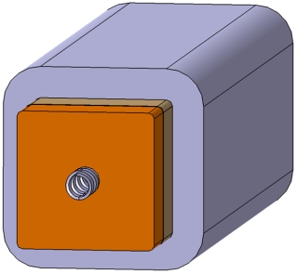
WP#1 – 12 SL
Basic assumptions
Analysis based on the 2016 WP#1-WP#3 designs of the DEMO TF coils
Forced flow cooling with supercritical helium at:
T_{in} = 4.5, 4.35, 4.20, 4.05 K, p_{in} = 6 bar, Δp = 1, 0.75, 0.5, 0.25 bar
Friction factor correlations:
  Bundle region – DF correlation based on a porous media analogy
  Cooling channels of WP#1 conductors - Bhatti-Shah correlation for turbulent flow in smooth, circular or non-circular ducts
  Experimental friction factor correlations for the spiral cooling channels of WP#2 and WP#3
Tool: simplified steady heat removal model (NH load at the EoB conditions calculated with the „older” formula proposed by LZ and MF profiles along a conductor were taken into account, whereas the interturn, interlayer and WP-casing heat transfer were not included in the model)
WP#2 - 6 DL
WP#3 – 9 DP
9
9

Slide 10
Outcomes
For a given conductor and each pair of values (T_{in}, Δp) we calculated the mass flow rate in each channel of flow, as well as the temperature, pressure, T_{cs} and ΔT_{marg} profile along the conductor.
Minimum of ΔT_{marg} was found
Power of the ideal (Carnot) refrigerator necessary to cool the conductor was calculated as:
As requested by the CEA team, the analysis was performed:
  for all conductors in the SL wound WP#1
  for the odd conductors in the DL wound WP#2
  for the single central pancake in the DP wound WP#3
10
10

Slide 11
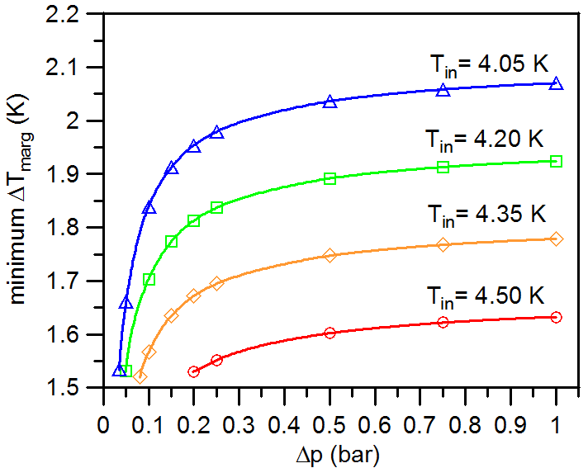
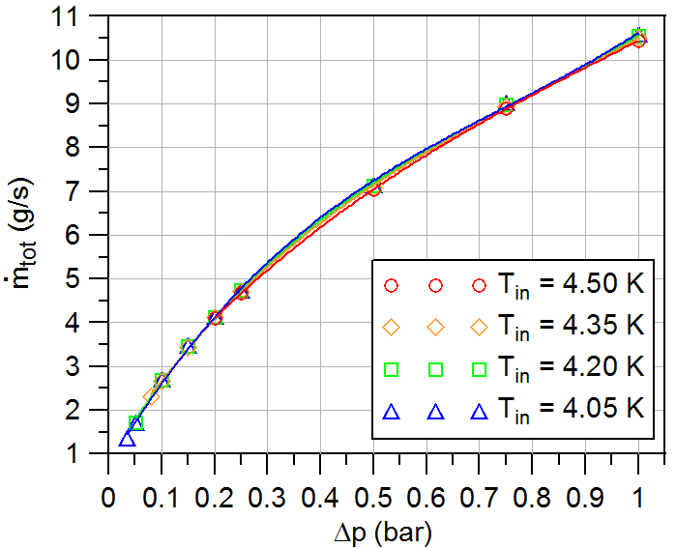
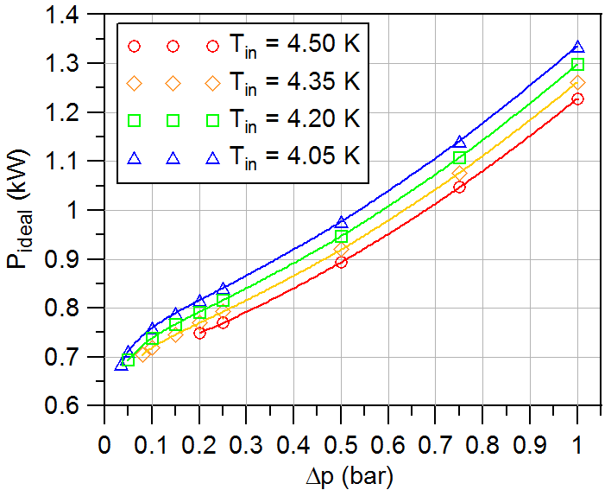
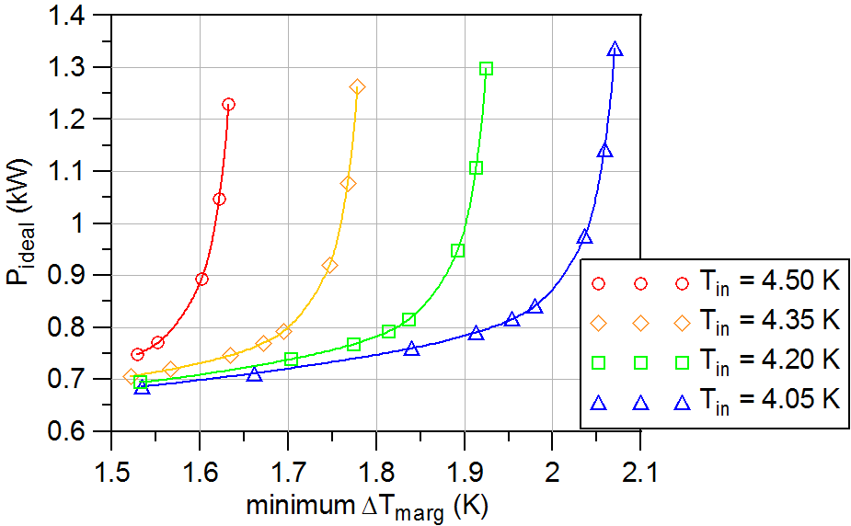
Results: WP#3 (single central pancake)
Total mass flow rate in the whole WP and the ideal refrigerator power necessary to cool the whole WP can be conservatively estimated as: ṁ_{tot} x 18 and P_{ideal} x 18
11

Slide 12
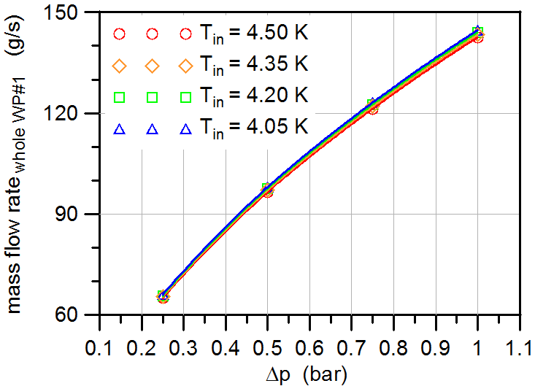
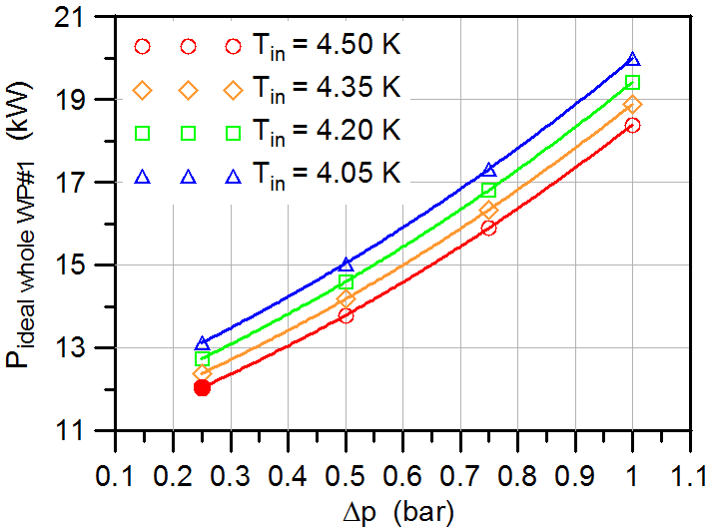
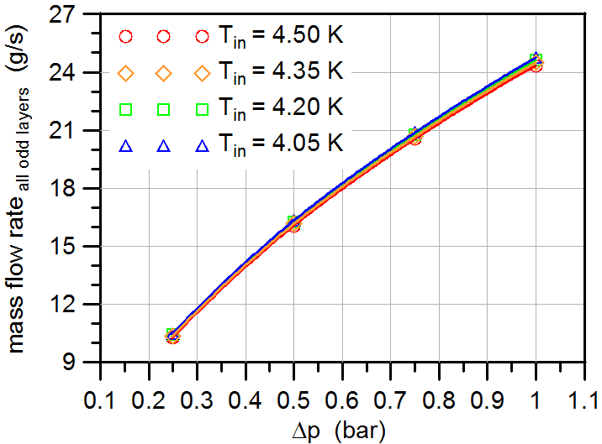
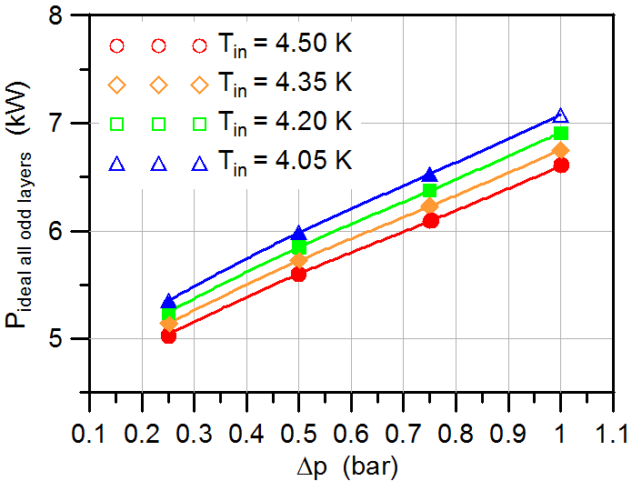
Results: WP#1 (all layers) and WP#2 (odd layers)
WP#1
WP#1
Solid symbol denote the points, for which the minimum ΔT_{marg} in some layers was below 1.5 K
WP#2
WP#2
Total mass flow rate in the whole WP#2 and the ideal refrigerator power necessary to cool the whole WP#2 can be conservatively estimated as: ṁ_{tot} x 2 and P_{ideal} x 2
12
12

Slide 13
Summary and conclusions
Preliminary investigations of the impact of the cooling parameters beyond the reference values (T_{in}=4.5 K, Δp=1 bar) on the ideal refrigeration power necessary to cool the whole DEMO TF WP (WP#1-WP#3 designs based on 2015 DEMO reference) were performed
Promising possibility of significant reduction of the refrigeration power for WP#1 and WP#3 was observed
The obtained results served as a reference point for the more detailed simulations, taking into account the pumping powers of the cold circulator and cold compressor, and optimization carried out by the CEA Grenoble team using the Simcryogenic code

Slide 14
  Summary of the modeling activities
Contribution to the thermal-hydraulic analysis of the new CEA design of the DEMO CS conductor

Slide 15
Input data provided by the CEA team „4 points scenario”
I_{max} = 106 kA
As requested by the CEA team, P_{coupling} was computed using the cross section of superconducting strands as a reference dimension S (different approach than that used in analysis of the SPC design of CS1 performed in 2017-18).

Slide 16
THEA model of the conductor
THEA model was validated by comparison of mass flow rate, temperature, pressure, and ΔT_{marg} profiles at Premag and at the end of burn, for the case without inter-turn heat transfer (no IT), with the respective predictions of the steady state simplified model.

Slide 17
Outcomes – parametric study of the minimum ΔT_{marg}
Min ΔT_{marg} was typically located at the end of the 1st turn
In the simulations of a single current cycle the global min ΔT_{marg} was reached at the end of the cycle, in simulations of several cycles global min ΔT_{marg} was typically about 1 mK lower and was observed at the very beginning of Premag
At EOF steady state is reached, so there is no difference between the min ΔT_{marg} obtained for two or more cycles.
Taking into account IT heat transfer => small reduction of min ΔT_{marg}
min ΔT_{marg} > 1.5 K even for nτ = 400 ms
Typical minimum ΔT_{marg} evolution during a single current cycle

Slide 18
Summary of experimental activities
Completion of the analysis of the results of measurements of the heat transfer coefficient (HTC) between the fluid flowing in a CICC bundle region and a jacket wall performed in 2018

Slide 19
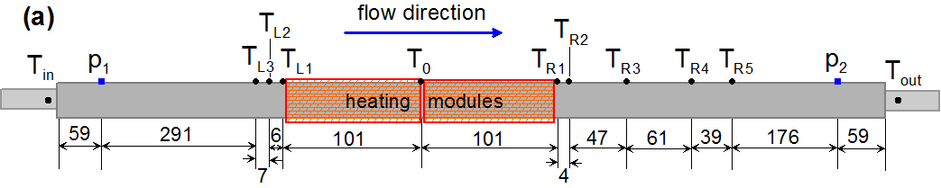
Measurements of the transverse HTC between the wall and the fluid in a smooth tube and in a CICC sample (JTF091)
Instrumentation scheme of the (a) 2017 configuration (b) 2018 configuration (not in scale). Dimensions in mm
Encountered problem:
Observed large discrepancy between the readings of sensors T_{Mx} and T_{Gx} ,
particularly in CICC, confirmed by observation with a thermovision camera =>
problems with reliable estimation of the jacket wall temperature

Slide 20
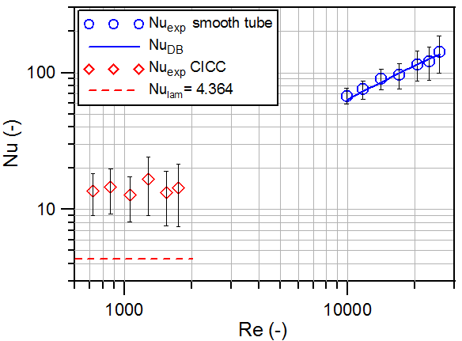
Measurements of the transverse HTC in a smooth tube and in a CICC sample - results
Results obtained in (a) 2017 (wall temperature estimated using T_{M0}, T_{L1} and T_{R1} eadings) and in (b) 2018 (wall temperature estimated based on T_{Mx} readings corrected by taking into account temperature drop due to transverse heat conduction in copper modules and temperature drop in the gaps)
Discrepancy of the results obtained in experiments performed in 2018 and in 2017 was noticed, probably due to the underestimation of the wall temperature in 2017.
THEA simulation of the experiment was performed to clarify the problem of wall temperature and verify the results obtained in 2018.
20

Slide 21
THEA model of the conductor (I)
We prepared a dedicated userFluids.f file with the routines which allow compute the values of the water thermo-physical properties as of p and T
To account for the transverse drop of the jacket temperature due to heat conduction, jacket was modeled as consisting of three thermal components: the inner layer (of thickness 0.15 mm), the middle layer (of thickness 1.8 mm), and the outer layer (of thickness 0.15 mm).
Thermal components are linked via thermal resistances R = 1/(h∙P_{c}), where P_{c} is the contact perimeter and h is the HTC. The jacket-strands contact perimeter P_{js} =15% P_{ji} where P_{ji} is the inner jacket perimeter, and the contact HTC between the strands, and the jacket is h_{js} = 500 W/(m²K).

Slide 22
THEA model of the conductor (II)
We considered 3 cases, which featured different values of the convective HTC h_{conv} between the flowing water and the wetted solid components (strands and jacket inner layer):
A. with h_{conv exp} extracted from the experimental value h_{exp}, by solving the
equation:
obtained under the assumption that the thermal resistance 1/(h_{exp}∙P_{ji}) is
equivalent to thermal resistances 1/(h_{js} ∙P_{js}) and 1/(h_{conv} ∙P_{jf}) connected in
parallel, where P_{jf} = 85% P_{ji} is the jacket-fluid contact perimeter.
B. with h_{conv lam} obtained with the smooth tube expression for the laminar flow
Nu_{lam} = 4.01
C. with h_{conv DB} obtained with the classical smooth tube Dittus – Boelter
expression for the turbulent flow in a smooth duct:
Nu_{DB} = 0.023∙Re^{0.8}∙Pr^{0.4}.

Slide 23
Typical comparison of the results of THEA simulations with the experimental data
Temperature of the jacket outer layer and temperature drop in gaps between the heating modules calculated with THEA agree reasonably well with the experimental data in Case A.
The temperature of the jacket outer layer was significantly too high or too low as compared to experimental data in Case B and in Case C, respectively.

Slide 24
Summary and conclusions
It is recommended to use in thermal-hydraulic simulations of EU-DEMO conductors the HTC He - strands, and He - jacket based on the overall Nusselt number calculated as: Nu = max (Nu_{lam}, Nu_{DB}). This was assumed to be a conservative approach. Our results indicate that this may lead to overestimation of the He – jacket HTC in the Re range 1500-3500 and underestimation for Re < 1500.
Temperature profiles of the outer layer of the jacket calculated with THEA , using the HTC values derived from the experiment, agreed reasonably well with the readings of the temperature sensors located at the outer surface of the jacket and the heating modules.
The h_{exp} obtained from our experiment are the effective values in which direct heat transfer from jacket to fluid and indirect heat transfer from jacket to the bundle strands, and then from the strands to the fluid are lumped together.
It can be expected that the values of h_{exp} are limited by the additional thermal resistance due to wrappings. Thus, the HTC obtained in our experiment cannot be interpreted as the convective HTC between the fluid and solid cable components. To clarify the role of wrappings in the jacket – fluid heat transfer it would be interesting to perform a similar experiment using a CICC (or a dummy conductor) without wrapping.

Slide 25
Summary of experimental activities
Hydraulic test of the WD8 and WD6 dummy conductors similar to HTS conductors and of the spiral sample

Slide 26
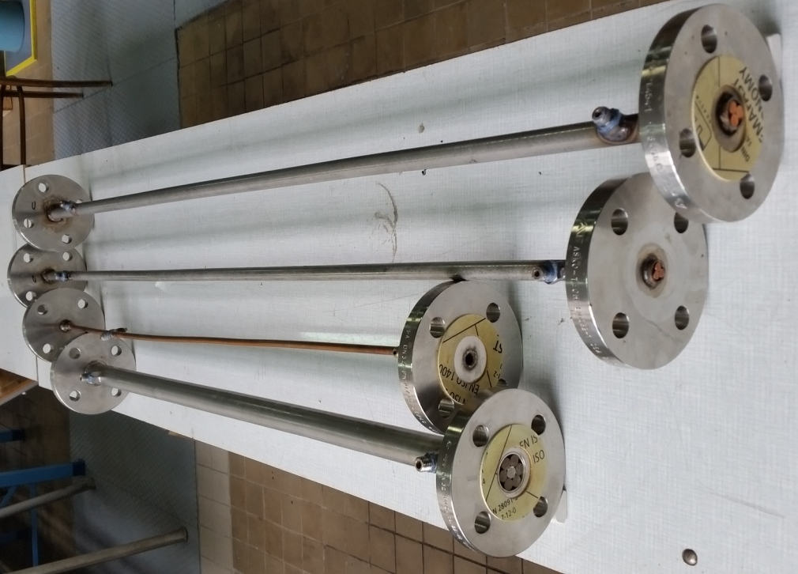
Goal of the work
Four dedicated short samples, namely: 3 dummy conductors with the layout similar to the DEMO HTS or WD conductors (Option 1 and 2) and a small spiral-walled pipe, have been prepared and tested for pressure drop using demineralized water at different temperatures.
The results of the performed hydraulic tests were used to develop experimental friction factor correlations for the considered ducts in the EU DEMO relevant Re range, which could be utilized in future thermal-hydraulic studies of the DEMO coils or WD.

Slide 27
Fanning friction factor correlations (I)
The experimental friction factors of the dummy conductors were compared with predictions of correlations available in the literature:
classical correlation for laminar flow in a smooth equilateral-triangle duct
classical Bhatti-Shah correlation for the transition and turbulent flow in smooth circular and non-circular ducts
correlation developed for the EURATOM LCT conductor, which is currently used in thermal-hydraulic analyses of the HTS conductors designed for the EU DEMO TF and CS coils
27

Slide 28
Fanning friction factor correlations (II)
The experimental friction factors of the spiral sample were compared with predictions of correlations available in the literature:
correlation recently developed by CFD simulations for the spiral duct with D_{in} = 5 mm and spiral thickness of 1 mm:
predictive friction factor expression in the following implicit form:
with two sets of parameters:
α ₁ = 11.88, β₁ = 0.039 and γ₁ = −0.299 valid in the range 5∙10⁴ < Re < 10⁶
resulting from pressure drop measurements on a pipe with different spiral inserts with t_{sp} = 1 mm, D_{in} of about 10 mm, and g_{sp} /t_{sp} in the range 2.4-5.3
α₂ = 6.4, β₂ = 0.1717 and γ ₂ = −0.3428 valid in the range 2∙10⁴<Re<2∙10⁵
obtained by CFD simulations of flow in the spiral duct of D_{in}/D_{out} = 7/9 mm and g_{sp} / t_{sp} in the range 2.4-5.3

Slide 29
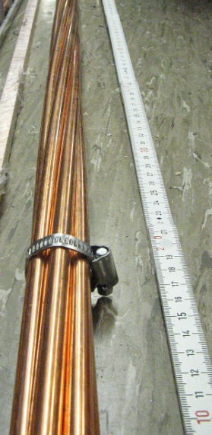
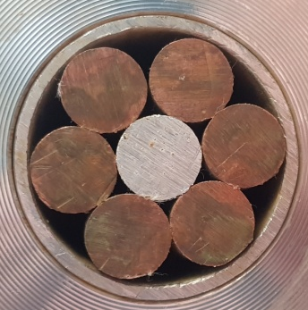
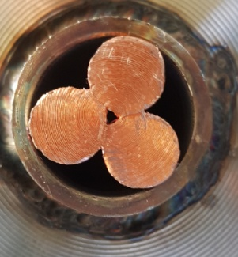
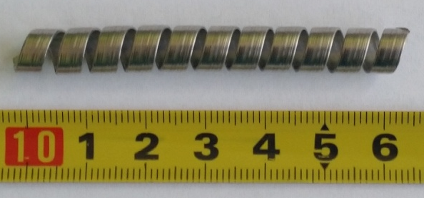
Preparation of the samples
The “6 around 1” dummy cable, consisting of six copper rods of 10 mm diameter twisted around the central aluminum rod with the same diameter, was prepared by the EPFL-SPC team. We cooled the 1 m long piece of the cable in the LN₂ bath and inserted it into a stainless steel pipe with the nominal diameter D_{out}/D_{in} = 33.7/29.7 mm
(this sample was prepared and tested in February 2019 and we included the results in our 2018 final report)
The WD8 and WD6 samples were prepared by the KIT team. Each of them is made from a twisted triplet of Cu rods of 8 mm and 6 mm diameter, respectively. The triplets were inserted into the pipes with D_{out}/D_{in} = 21.3/17.3 mm or 17.2/13.2 mm, respectively, and compacted by ~ 0.2 mm.
The spiral made of the steel strip 4.1 mm x 0.5 mm, with the gap fraction of ~26%, and the D_{out} of ~7.25 mm was inserted into a copper pipe with the nominal dimensions D_{out}/D_{in} = 9.5/7.5 mm, which was subjected to drawing until its D_{out} was reduced down to ~9.3 mm. This sample was provided by the ENEA Frascati team.
29

Slide 30
Characteristics of the samples
Parameters of dummy conductors relevant for the present study. Assumed uncertainties are given in parentheses.
Description | Symbol | Unit | Value
 |  |  | 6 around 1 | WD6 | WD8
Number of strands | N_{str} | - | 7 | 3 | 3
Strand diameter | D_{str} | mm | 10 (0.05) | 6 (0.05) | 8 (0.05)
Tube inner diameter | D_{in} | mm | 30.0 (0.3) | 12.9 (0.2) | 17.1 (0.2)
Cable space area | A_{cs} | mm² | 706.9 (14.1) | 130.7 (4.1) | 229.7 (5.4)
Flow area | A_{f} | mm² | 157.1 (14.9) | 45.9 (4.3) | 78.9 (5.7)
Wetted perimeter | P_{wet} | mm | 236.2 (18.6) | 73.1 (5.8) | 95.9 (8.4)
Hydraulic diameter | D_{h} | mm | 2.66 (0.33) | 2.51 (0.25) | 3.29 (0.39)
Distance between the pressure taps | L | mm | 820 (4) | 1083 (5) | 1083 (5)
Accurate estimation of P_{wet} is problematic - it depends on the unknown length of the strand-strand and strand-jacket contact perimeters ☹
The values of P_{wet} in Table 1 were obtained by image analysis.
Spiral sample: Flow area and Re are based on D_{in} = 6.25 (0.25) mm, L = 700 (2) mm
30

Slide 31
Instrumentation used in hydraulic tests at THETIS
Measuring instrument | Measured quantity | Measuring range | Basic measurement uncertainty
Flow meter | ṁ | 20 – 3000 kg/h | ± 0.15% of measured value
Temperature sensor 1 and 2 | T₁ , T₂ | -200 – 400 ºC | ± 0.15 ºC ± 0.2% of |measured value|
Pressure sensor 1 | p₁ | 0 – 2.5 MPa | ± 0.2% of measuring range
Pressure sensor 2 | p₂ | 0 -1 MPa | ± 0.2% of measuring range
Differential pressure sensor 1 | Δp₁ | 0 – 0.25 MPa | ± 0.1% of measuring range
Differential pressure sensor 2 | Δp₂ | 0 – 1.6 MPa | ± 0.1% of measuring range
DAS | - | - | ± 0.1% of measuring range
water density (ρ) and dynamic viscosity (μ) were calculated at the reference conditions: p_{ref}= p_{ambient}+ (p₁+ p₂)/2 and T_{ref}= (T₁+ T₂)/2.

Slide 32
Results – WD8 and WD6 dummy conductors
Data measured at different temperatures, transformed into the dimensionless form, are grouped at the single trend lines, as expected ☺
In both WD dummy conductors, the laminar regime has not been reached
Friction factor in the turbulent range is very small, close to predictions of the smooth tube correlation
The results in dimensionless form are sensitive to the value of P_{wet} ☹
The results are well fitted by the following power laws:
f_{WD8}
f_{WD6}
32

Slide 33
Results – spiral
The experimental friction factor values of the spiral sample are close to predictions of the f_{Zan1} correlation, probably because the ratio (t_{sp}/D_{in}) for our sample and for conductors used in to fit the values of parameters α₁, β₁ and γ₁ were similar.
Also the fit obtained from recent CFD simulations in (f_{sp Bon}) is within the experimental error bar, in spite of the different geometry of the spiral used to develop it.

Slide 34
Summary and conclusions
Four dedicated short samples (three dummy conductors with the layout similar to HTS conductors designed for the DEMO TF and CS coils or for the WD experiment, and one spiral sample with a small diameter similar to those used in the LTS conductors designed by ENEA for the DEMO TF coil) have been prepared and tested for pressure drop using water at different temperatures in the range 12-53 ºC.
We obtained the friction factor data in the Re range typical for normal operation of the DEMO coils.
The results obtained for dummy conductors indicate that the f_{LCT} correlation, currently used in thermal-hydraulic studies of the DEMO HTS conductors, is over-conservative, and the use of standard smooth tube correlations in future thermal-hydraulic studies of HTS and DEMO and WD conductors could be considered.
It would also be desirable to perform further CFD simulations or pressure drop tests or of the WD conductors using water at lower temperature or other fluids, to obtain f vs. Re data in the wider Re range, particularly in the laminar regime.
The ENEA team has just completed the manufacture of a DEMO conductor sample with the spiral used in our test and they observed that 0.5 mm thickness of the steel strip used to wind the spiral is too small to prevent spiral deformation and closure of cooling channels during the conductor compaction. Thus, further hydraulic tests of spiral samples with D_{in} of about 5-6 mm and larger thickness should be performed to obtained the friction factor data for spirals with the layout fully relevant for the future DEMO conductor.

Slide 35
2020 proposal
Contribution to the thermal-hydraulic analysis of the new CEA design of the DEMO CS1 conductor (in particular: assessment of the minimum ΔT_{marg} for the most conservative case based on B_{max})
Thermal-hydraulic analysis of the new CEA design of the DEMO PF conductors
Additional serie of hydraulic tests of the spiral, WD6 and WD8 samples at possibly low ambient temperature (to achieve data at low Re, in the laminar regime if possible)
Hydraulic test of the Option 3 conductor provided by KIT at three different water temperatures and analysis of the results

